Slide 1

If you build it, they will come: the case for creating DDI metadata and the advanced search and discovery tools that will follow
William C. Block
Cornell Institute for Social and Economic Research (CISER)

Slide 2


The Idea for this presentation grew out of two separate meetings:
  1st Annual EDDI Meeting (Bonn, December 2009)
    Kevin Schurer (opening plenary speaker): Benefits of DDI to various stakeholders:
      Data users
      Owners or creators of data
      Funding agencies
      Curators of data
  Wolfram Alpha Data Summit (Washington D.C., September 2010)

Slide 3
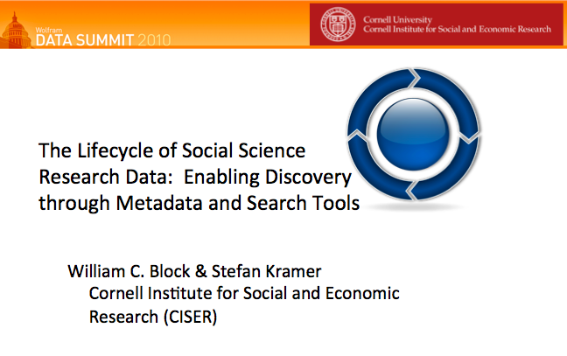

Slide 4
Select List of Wolfram Data Summit Participants:
Health and Medical Data (Accenture, NCHS)
Large Scale Textual Data (Internet Archive)
Crowdsourcing and Collaborative Data Sites Protein Data Bank, OpenStreetMap, Worknik)
Biological data (DataOne, Encyclopedia of Life)
Geographic data (National Snow and Ice Data Center)
Data and the Media (NRP, BBC, USN&WR, NYT)

Slide 5
Select List of Wolfram Data Summit Participants (Continued):
Government data (Statistics Italy, World Bank, UN Population Fund)
Data Aggregation (Space Telescope Science Institute)
Scientific and Technical Data (NIH, NIST)
Economics and Financial Data (IMF, Thomson Reuters, FRB, BLS, Dun and Bradstreet)

Slide 6
  Wolfram Data Summit: Incredibly Diverse List of Participants…might call them Stakeholders
  Benefits of DDI to Various Stakeholders
  (Kevin Schurer, EDDI 2009)
  Data users
  Owners or creators of data
  Funding agencies
  Curators of data

Slide 7
  Wolfram Data Summit: Incredibly Diverse List of Participants…might call them Stakeholders
  Benefits of DDI to Various Stakeholders
  (Kevin Schurer, EDDI 2009)
  Data users (disseminators)
  Owners or creators of data
  Funding agencies
  Curators of data

Slide 8
  Wolfram Data Summit: Incredibly Diverse List of Participants…might call them Stakeholders
  Benefits of DDI to Various Stakeholders
  (Kevin Schurer, EDDI 2009)
  Data users (disseminators)
  Owners or creators of data
  Funding agencies
  Curators of data (not disseminators)

Slide 9


Lifecycle of social science research data
Research study is conceived and planned, methodologies selected, funding sources explored
Idea
Existing data sources are sought and explored – also happens for basic research needs
Search & Discovery
Data management
Research instruments are designed; data are collected through surveys, interviews, etc. – and from existing data sources
Collection
Archiving
Final datasets are deposited for long-term preservation – e.g., into institutional or domain repository
Collected data are merged, cleaned, analyzed, subsetted, coded, harmonized, linked, etc.
Analysis & Processing
Publication
Final datasets are made publicly accessible – e.g. via researcher’s and/or department’s and/or journal publisher’s web site
Notes:
Creation, (re)use and discovery of research data often follows a predictable flow, suggesting a “lifecycle” of research data. This slide describes an ideal situation - a current problem is that much data never makes it to the publication and archiving stages, but remains on the computers of the researchers and is eventually lost, forgotten, or unusable. Solid red lines represent flow of data, dashed green lines actions for data creation (first) and preservation (later).

Slide 10

Researchers and metadata creation/maintenance
Researchers will tend to describe their data only as much as necessary for their own use, for current project
But: no one knows their data better than they do
Needed: easy-to-use tools, and outreach to researchers, for sustainable metadata production – some actions may be performed by researchers, others by their institution’s data service providers
Collection
Analysis & Processing
Publication
Archiving

Slide 11
Researcher buy-in is essential for data archiving
“Archives that preserve and disseminate social and behavioral data perform a critical service to the scholarly community and to society at large, ensuring that these culturally significant materials are accessible in perpetuity. The success of the archiving endeavor, however, ultimately depends on researchers’ willingness to deposit their data and documentation for others to use.”
--ICPSR Guide to Social Science Data Preparation and Archiving: 4th Edition, p. 3
Data management
Archiving
Ideally, the archiving endeavor achieves researcher buy-in in all lifecycle stages involving data management activities – not just at the final point of archival deposit.
Collection
Archiving
Analysis & Processing
Publication

Slide 12
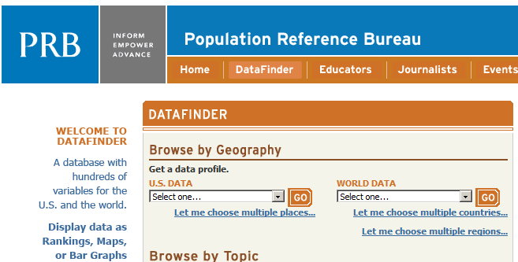
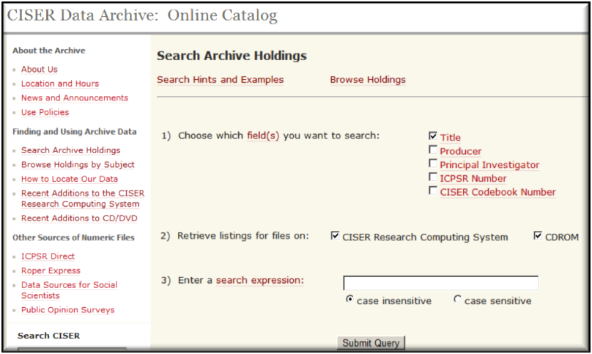
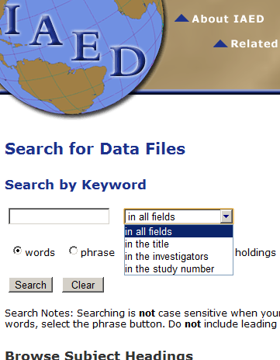
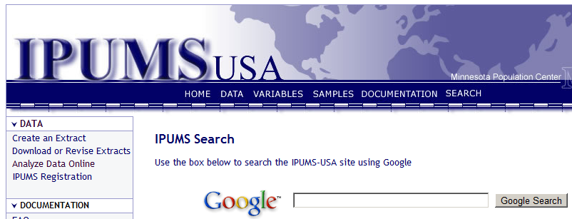
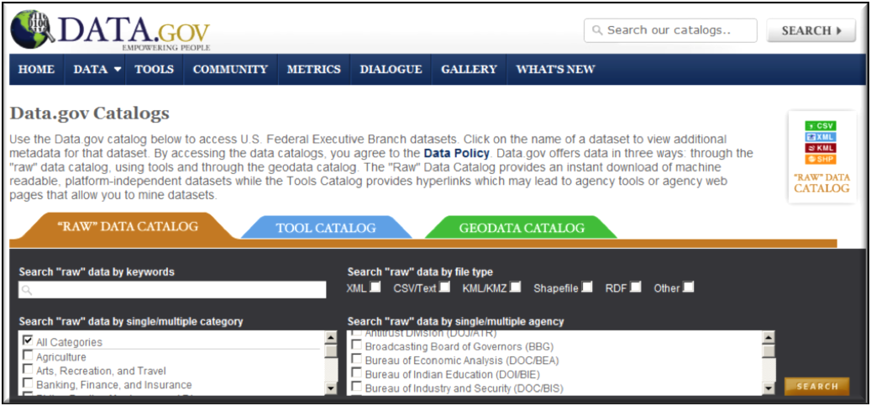
Challenge of finding data: there are many data-focused archive catalogs … but often as “information silos”
Different search inputs, different search outputs, no easy way to search all at once, and not in “data-targeting” ways

Slide 13
Desirable search or browse functions for numeric data in social sciences
Not (easily) offered by most data catalogs, but often needed by data searchers, in addition to topic … such as:
Time span (example: 1970 – present)
Time frequency (example: annually)
Geographic extent (example: all of United States)
Geographic granularity (example: county level)
Methodology, sample (example: survey of adults aged 18-24)

Slide 14
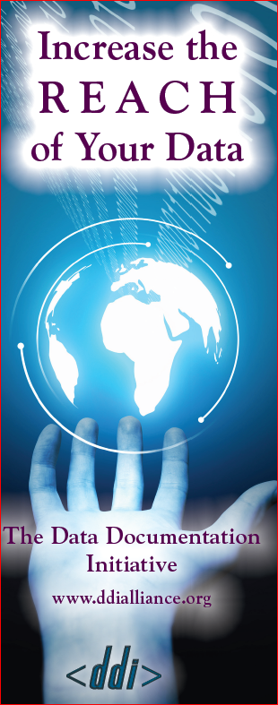
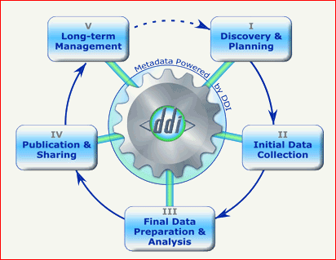
Data Documentation Initiative (DDI)
DDI 3 designed to support the social science data lifecycle with metadata
Powerful – but also complex! Used by national statistical agencies, data archives, etc.
Tools for using DDI being developed – choosing the right ones for specific institutional needs is key
Has the elements to capture information targeted in social science data searches
Source: http://www.ddialliance.org/

Slide 15
Lifecycle of social science research data
Research study is conceived and planned, methodologies selected, funding sources explored
Idea
By search tools utilizing metadata from data stores, new research data becomes available for finding and exploring by researchers
Metadata
Existing data sources are sought and explored – also happens for basic research needs
Search & Discovery
Ideally begins early in data lifecycle to assure long-term preservation and access of data. One activity is metadata preparation and its exposure to external search tools
Data management
Research instruments are designed; data are collected through surveys, interviews, etc. – and from existing data sources
Collection
Archiving
Final datasets are deposited for long-term preservation – e.g., into institutional or domain repository
Collected data are merged, cleaned, analyzed, subsetted, coded, harmonized, linked, etc.
Analysis & Processing
Publication
Final datasets are made publicly accessible – e.g. via researcher’s and/or department’s and/or journal publisher’s web site
Notes:
Creation, (re)use and discovery of research data often follows a predictable flow, suggesting a “lifecycle” of research data. This slide describes an ideal situation - a current problem is that much data never makes it to the publication and archiving stages, but remains on the computers of the researchers and is eventually lost, forgotten, or unusable. Solid red lines represent flow of data, dashed green lines actions for data creation (first) and preservation (later).

Slide 16
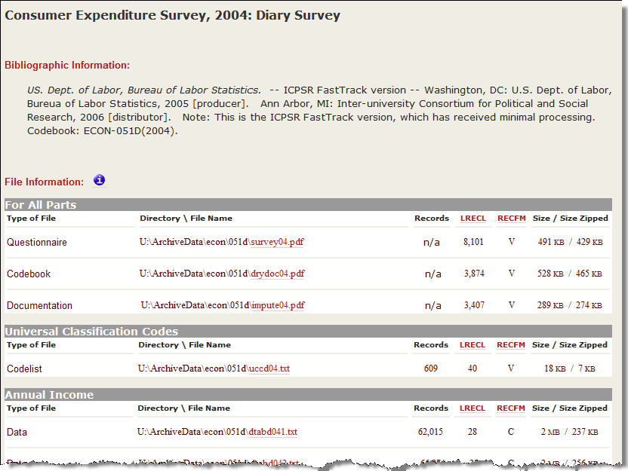


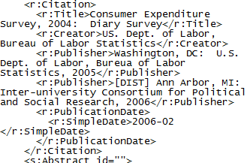
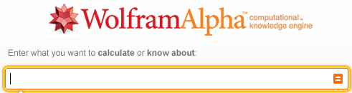
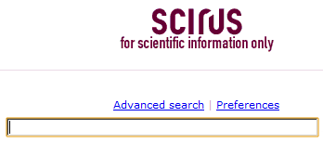
Exposing and indexing the holdings of data archives and publications in standardized metadata formats could enable web-scale discovery through new cross-collection search engine functions built to exploit that metadata
Better
Search & Discovery
Metadata
Search for data
about: ___
From (year): ___
To (year): ___
In (geography):___
at the level of: ___
Collected via: ___
etc., etc.: ___

Slide 17
1st Annual EDDI Meeting (Bonn, December 2009)
  Kevin Schurer (opening plenary speaker): Benefits of DDI to various stakeholders:
    Data users (disseminators)
    Owners or creators of data
    Funding agencies
    Curators of data (not disseminators)

Slide 18
1st Annual EDDI Meeting (Bonn, December 2009)
  Kevin Schurer (opening plenary speaker): Benefits of DDI to various stakeholders:
    Data users (disseminators)
    Owners or creators of data
    Funding agencies
    Curators of data (not disseminators)
If you build it (metadata), they will come…

Slide 19
1st Annual EDDI Meeting (Bonn, December 2009)
  Kevin Schurer (opening plenary speaker): Benefits of DDI to various stakeholders:
    MetaData users (disseminators)
    Owners or creators of data
    Funding agencies
    Curators of data (not disseminators)
If you build it (metadata), they will come…

Slide 20


Thank you! Any questions?
William C. Block
block@cornell.edu

