Slide 1
Acronym Engineering:
DIS = Data Intensive Science?
No!
DIS = DDI Into SDMX!

Slide 2
Beyond Dissemination: Query-based Access
2nd European DDI Users Conference, Utrecht
December 2010

Slide 3
Background of DDI Initiative
Context:
    Open government dissemination initiatives
    Interest in social sciences study dissemination
    Support lifecycle management for census/survey data
  Challenges for Dissemination Approaches
    Reduction in production resource and cost
    Not stuffing it up (maintain trust)
    Ensure Disclosure Control
    Increase output and reuse from studies
    Interoperability and data integration (mash-up)
Space-Time Research view:
  Query-based access can service broader information demands with fewer resources than traditional dissemination methods
  DDI is the path to successful query-based access

Slide 4
Limitations of Dissemination-Based Access
Typical example: census with 50 questions
  Output has 50 five-dimensional cubes, covering a range of topics and filtered for populations of interest
  Proportion of total possible five-dimensional cubes built = 100 / C(50, 5) = 0.005%
The Provider’s Burden:
  Choose which small fraction of all possible outputs are made available
  Choose which stories to tell
  Effort devoted to ad hoc information requests for queries not addressed by automated systems
  Quality and consistency in servicing ad hoc requests
The Customer’s burden:
  Cannot use provider as a source of information when timelines are tight
  Spend significant resources extracting the right information
  Builders must download and manage their own data, monitoring provider for updates

Slide 5
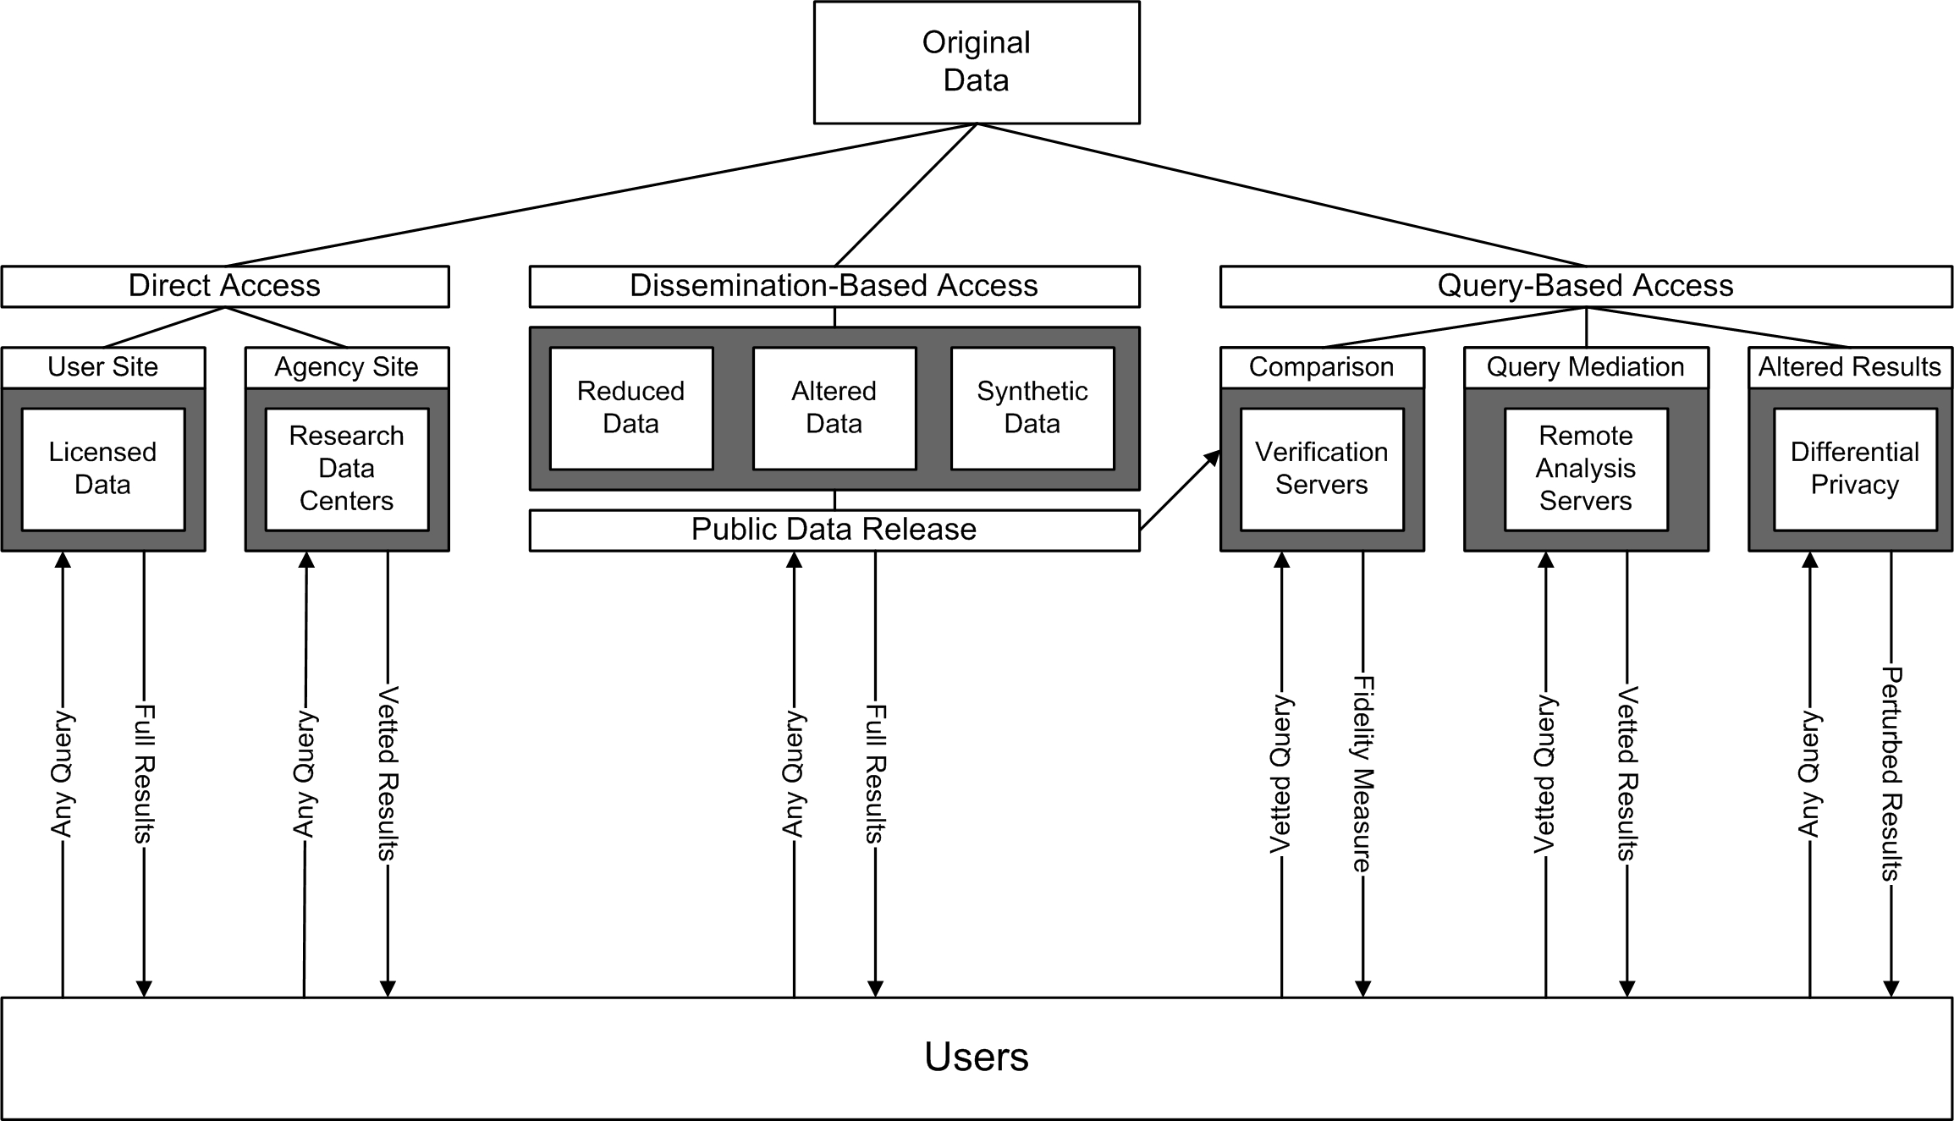
Different Access Models
Servers run against original data
Reduced error through automation
Large % of possible results accessible
☹ Provider dictates analytic tools
☺ Existing processes, tools
Small % of possible results accessible
Not original data
☹ Inconsistent results across products
☺ Original data
☹ Costly for provider
☹ Many access constraints
Notes:
Direct Access: Typical arrangement requires users to sign forms in triplicate to get access, and provider to maintain analytic environment with a range of software installed (SAS, SPSS, R, etc)
Dissemination-based access: Provider choses a set of outputs and users can either accept these or contact provider for further custom output that wasn’t included in dissemination datasets.
Query-based Access: Server(s) work against microdata. Query results are automatically vetted against disclosure risk and/or adjusted to reduce disclosure risk to acceptable level.
[1] “Data Confidentiality: The Next Five Years. Summary and Guide to Papers” - Journal of Privacy and Confidentiality (2009)

Slide 6
Dissemination-Based vs. Query-Based Access Approach
Dissemination-Based | Query-based
Generate specific output data such as cubes | Work directly from microdata and create output as required
Disclosure control before data released | Disclosure control on-the-fly
Limit number of cube dimensions to aid usability and disclosure control | Unlimited dimensions: cubes created on-demand through UI
Make output datasets available for download | Customisable output available for download or access through API

Slide 7
Notes on Query-Based Access
Reduces up-front processing that is mandatory for dissemination-based access
Reduces/eliminates need to store and manage large numbers of cubes
Zero waste. Only create statistics that people actually want to use.
Remaining challenges
Inconsistency in results if a combination of both approaches is used (eg: aggregation via QBA, microdata analytics via 5% sample CURF)
Privacy-preserving analytics for microdata (eg: regression)

Slide 8

Architecture
3rd party apps, internal processes
SuperVIEW
Easy to use, visualization and interactive reports
Output Format Layer – CSV, XLS, XLSX, KML, SDMX
SuperWEB
Ad hoc table/cube creation, charts, thematic maps
SDMX
Web Services
SuperSTAR Server
Schema discovery, tabulation, confidentiality and metadata services
Provider’s user management system
Administrative Services
Data Control API
Confidentiality
Existing confidentiality routines
SuperSTAR Data Repository
New routines
New routines
All types of data accessible
through SDMX API, including
ad hoc tabulations of unit record
databases and tables
created in SuperWEB
RDBMS
JDBC driver
DDI
JDBC Driver
Text file
JDBC Driver

Slide 9
DDI Use in SuperSTAR: loading data from DDI
  Support for loading DDI3.1 XML to SXV4
  Implemented as a JDBC driver
  Browse source like any other dataset
  Feature support:
    Connect via HTTP basic authentication or file URL
    Multiple logical records
    Hierarchical code schemes
    Multiple response variables
    Weighted survey data, including replicate weights
    Detection of variable types (additive, non-additive, classified, text only, etc)
  Future:
    Links to DDI descriptive metadata
    Multiple versions
    Multilingual labels

Slide 10
DDI 3 JDBC Driver
  DDI version 3.1
  For loading DDI data for use in clients that support JDBC (eg: ETL tools, RDBMS imports)
  Tested with Colectica DDI output
  Logical products map to database schema
  Connects to data sources referenced in DDI using HTTP or file protocols
  HTTP authentication
  Maps key elements to a standard relational elements (some details on next slide)
  Further detail mapped to simple relational schema used to augment basic relational view with more descriptive DDI structures. Eg: Identification of fact and classification tables, labels

Slide 11
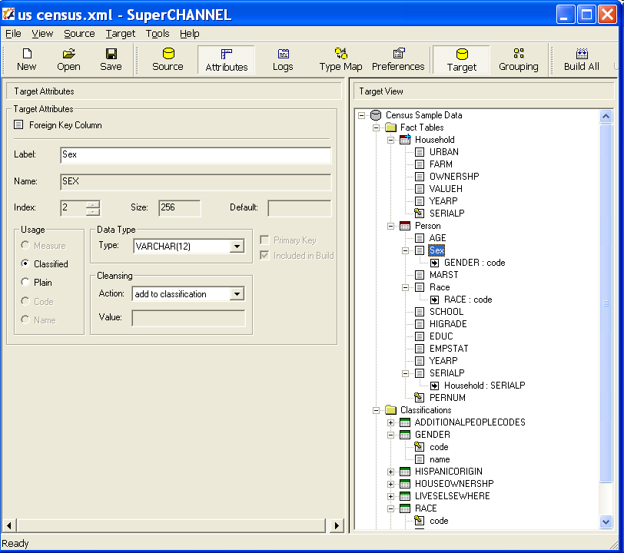
Loading DDI3.1 to SuperSTAR
Rich metadata in DDI allows for automated loading
Logical records
Variable with code scheme
Logical Record Relationship
Case Identification
Code schemes
Code scheme ID
Category label

Slide 12
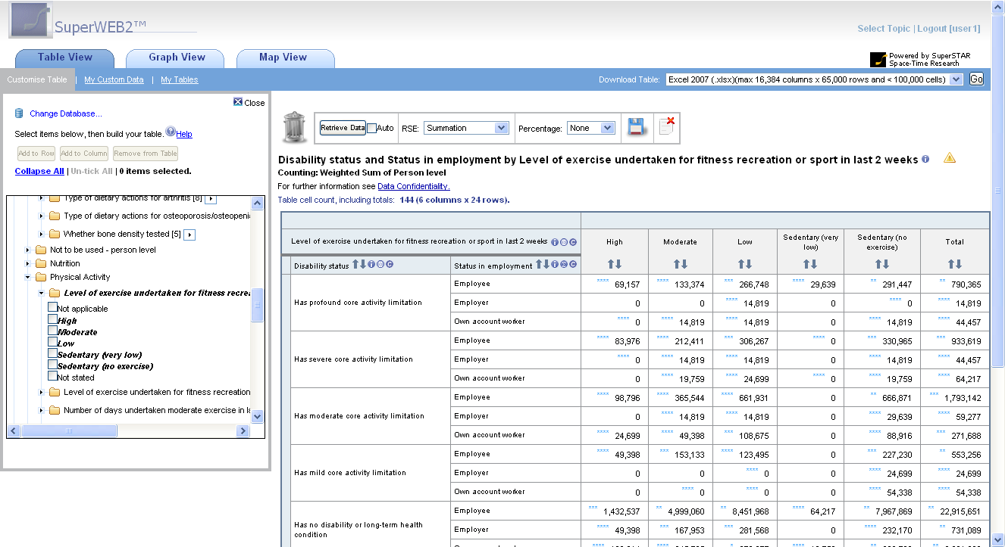
Accessing the statistics: ad hoc tabulation in SuperWEB
  DDI input, including survey specific weighting attributes
  Calculate the RSE values for all tabulated results
Build cubes interactively,
then download or save
results
Data quality
annotations (RSE)
Visualise
Choose any variable

Slide 13
Accessing the statistics: SDMX RESTful API
  RESTful API conforming to SDMX v2.1 draft proposal
  Examples of the following three scenarios shown on subsequent slides
  Explore database metadata using HTTP GET:
    http://localhost:8080/sdmxservices/DataStructure/NHS1
    http://localhost:8080/sdmxservices/Codelist/NHS1_NHS_DWELLSTRUC_1284260valueset
  Similarly, access tables created in SuperWEB (custom datasets) by browsing metadata or retrieving data:
    http://localhost:8080/sdmxservices/Data/EducationByMaritalStatus/USER-user1
    Also includes Relative Standard Error (RSE) values for survey data as annotations
  Define new tables:
    POST SDMX query to URL for the dataset
    URL for data returned in response header
  Also retrieve DSD definition for any ad hoc query

Slide 14
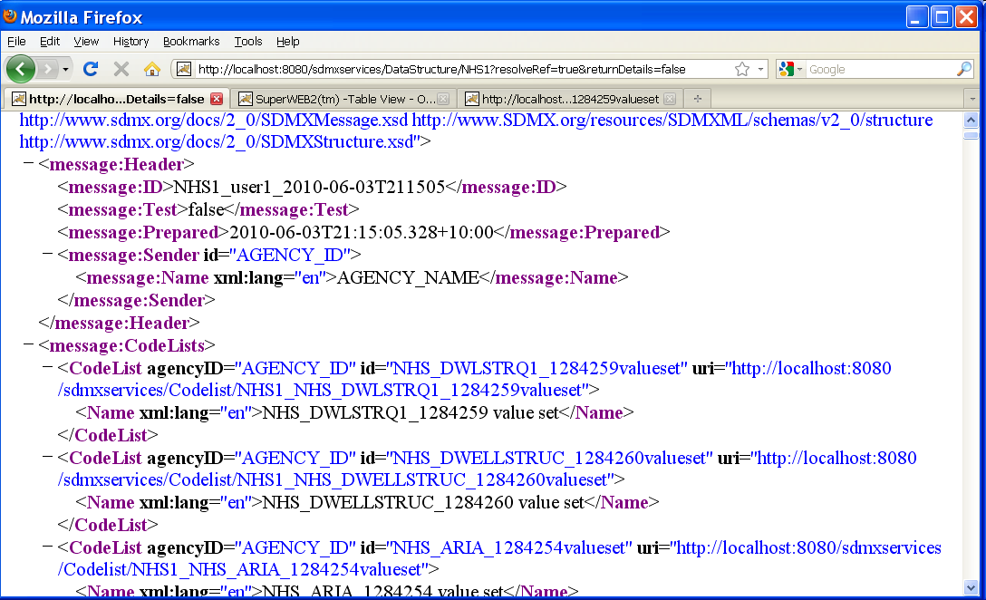
Explore Metadata – Retrieve a Data Structure Definition
Choose level of
detail required
Use these URIs to drill
further into metadata

Slide 15
Notes on DDI Experience
Rich metadata makes automated loading easy
Working with Algenta helped keep things real
  DDI conformance issues in our implementation
  adherence to the standard
  Consensus on workarounds
Excellent support from Wendy and others on complex issues (thank you!!)
Profiles not very machine actionable.
  Chose to use schematron instead for more rigorous validation
Welcome more tools in DDI 3 space - conversions between statistical formats
More examples in DDI format would be very useful
  Clarify best practices for features such as multiple response variables
Difficult (and silly!) to hand-craft DDI,
  GUI tools are essential for productive development
Looking forward to the record relationship fix in DDI 3.2!

Slide 16
Thank you!
Further Information:
  www.spacetimeresearch.com
  SDMX/DDI blog posts: http://www.spacetimeresearch.com/archives/category/sdmxddi.html
  Will add these slides and respond to unanswered questions via blog after conference
  For more complete set of slides or more info, please contact don.mcintosh@spacetimeresearch.com

Slide 17
The Demo
http://strmt.dyndns.org/webapi/jsf/login.xhtml

