Slide 1
SERPent:Secure Epidemiology Research Platform
The Use of DDI Tools and Standards in
Epidemiology and Public Health Research
Tito Castillo, Anthony Thomas, Rich Hutchinson, Pat Tookey, Janet Masters, Rachel Knowles*
MRC Centre of Epidemiology for Child Health, ICH and *British Paediatric Surveillance Unit
Andy Ryan, Robert Liston Aida Sanchez, Spiros Denaxas
Institute for Women’s Health Epidemiology & Public Health
Pascal Heus
Metadata Technology Ltd.

Slide 2
Context
MRC Centre of Epidemiology for Child Health, ICH
  provides a secure computing service (epiLab)
  65 members of staff
  Wide range of projects involving analysis of
    1958, 1970, 2000 UK Birth Cohorts
    Disease Surveillance
    Public health policy
    Record linkage
    Genetic epidemiology
UCL
  Platform Technologies supports research infrastructure across the School of Life and Medical Sciences.
  Computational Life and Medical Sciences (CLMS) encourage and support collaboration, communication and co-operation across basic and clinical sciences.
  Data Managers Group network across the Biomedical faculty to promotes and share best practice in data management and curation. Peer discussion forum.

Slide 3
Primary motivation
Creation of a secure environment designed for epidemiological research
  Information asset register
  Standardise data management procedures
  Support effective record linkage
  Transparent information governance for data access and sharing procedures
  Develop common archival process

Slide 4
Relevant Information Standards & Initiatives
Health Level 7 (HL7)
  To create the best and most widely used standards in healthcare.
Clinical Data Interchange Standards Consortium (CDISC)
  To develop and support global, platform-independent data standards that enable information system interoperability to improve medical research and related areas of healthcare.
Public Population Project in Genomics (P3G)
  Encourage collaboration between researchers and biobankers
  Promote harmonization of information
  Optimize the design, set-up and research activities of population-based biobanks
  Facilitate the transfer of knowledge and provide training to those working in the field

Slide 5
Scenario – Public Health research
Multiple Secure Research ‘Enclaves’
Distributed databases
Heterogeneous technologies
Independent information governance requirements
Common requirements
Highly sensitive data
Study design & documentation
Record linkage
Multiple controlled vocabularies
Questionnaire management
Data exchange & sharing
Research transparency

Slide 6
Project Plan
JISC Virtual Research Environment
  9 months (Jan - Sep 2010)
  6 representative use cases
Training in DDI 2.1& 3
Annotate existing surveys in DDI 2.1
  IHSN Microdata Management Toolkit
  Bespoke software utilities
Generate Catalogue
  NADA web catalogue
Retrospective
  Lessons learned
Collaboration
  MRC Data Support Service
  UK Data Archive
  UK Digital Curation Centre

Slide 7
Use cases
Title | Initiated | Details
Whitehall II Study | 1985 | 10, 308 non-industrial civil servants (age 35-55 years) Medical examinations + questionnaires
National Study of HIV in Pregnancy in Childhood (NSHPC) | 1990 | Prospective surveillance of 11,500 HIV positive pregnancies in the UK
UK Collaborative Trial of Ovarian Cancer Screening (UKCTOCS) | 2000 | 202,00 women recruited and followed up to assess ovarian cancer screening services
UK Collaborative Study of Congenital Heart Defects (UKCSCHD) | 2004 | 4000 births in UK between 1992-96 with serious congenital heart defects. Questionnaire-based survey of health, development, social activity, school and exercise.
Optimising Management of Angina (OMA) | 2009 | Examination of quality of care given to patients with angina Patients >40 years of age with recent onset stable angina Face-to-face assessments
Cardiovascular disease research Linking Bespoke studies and Electronic Records (CALIBER) | 2009 | Linked electronic patient records to investigate cardiovascular disease General practice database Myocardial Ischemia National Audit Project Hospital Episode Statistics Mortality data from the Office of National Statistics

Slide 8
Data manager – current practice
 | UKCSCHD | CALIBRE OMA | Whitehall II | UKCTOCS | NSHPC
e-Docs | • | • | • | •
Paper | • |  | • | • | •
Survey database | STATA | MySQL | SAS | SQL Server | MS Access
Separate admin db | MSAccess | MySQL | MSAccess
Microdata docs |  |  | • | •
Sensitive field flag | • | • | • |  | •
Derived data | • | • | • | •
Data sharing plan |  | • | •
Citation standards |  | •
Open access db | •
Public website | • | • | • |  | •
Microdata submission
Limited exclusive access to primary researchers
Controlled public access
Collaborative access among scientists

Slide 9
Data manager intentions
What aspects of DDI do you intend to use in the future?
 | UKCSCHD | CALIBRE OMA | Whitehall II | UKCTOCS | NSHPC
Data sharing | • | probably | • | • | •
Archival | • | probably | • | • | •
Questionnaire design | probably |  |  | •
Instrument registration | unlikely |  |  | • | •

Slide 10
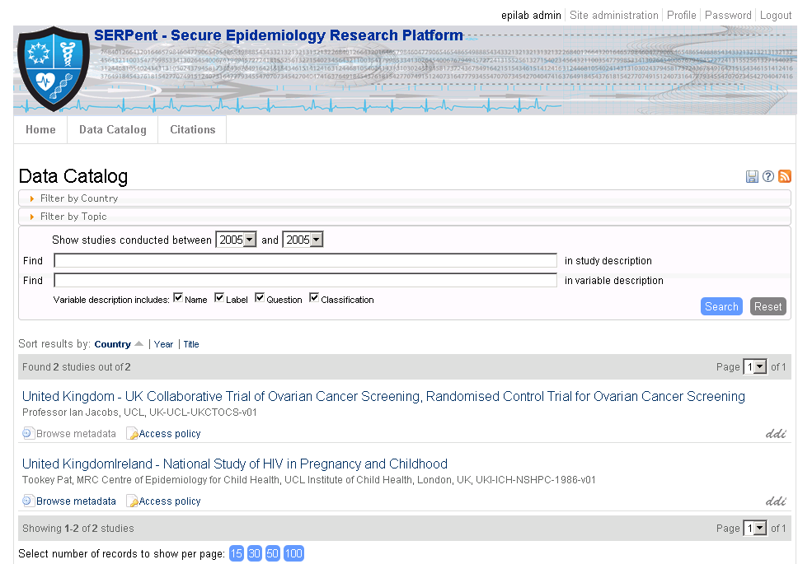
NADA Catalogue
http://epilab.ich.ucl.ac.uk/nada/index.php/catalog

Slide 11
NADA catalogue
Positive
  6 studies catalogued
  Standard representation
  Searchable portal
  Simple publication process
Negative
  Poor support for questionnaire design
    Order & branching logic
  No sensitive variable flags
  No information about derived data
  Poor support for large controlled vocabularies (clinical terminologies)
  Limited support for variable types

Slide 12
Migration path to DDI 3
No need to tackle the whole standard in one go
Go via DDI 2.5 (release date 2011)
Questionnaire / Instrument Design
  Resource Packages
    Identifiable, Versionable, maintainable
    Reusable
    Extensible
Integrate with existing survey tools
Extend to allow for:
  Research funding / financial profiling
  Consent process
  Information Governance / Security
  Research e-Val process

Slide 13
Existing options for integration of survey tools with DDI
Option 1: Design in DDI 3 export to Survey tool
  Use Colectica Designer (DDI 3 compliant editor)
  Commission export utility to preferred survey tool
  Disadvantage: Commercial product (not free)
  Advantage: Design based on DDI 3 semantics
Option 2: Design in survey tool then export to DDI
  REDCap (REDCap Consortium)
  Rich data collection tool designed for clinical research
  Integration with Statistical tools
  Audit trail / security management
  wide consortium of users (over 150 partner institutions)
  Disadvantage: Not DDI aware, simplistic metadata model
  Advantage: Easy to design, export to DDI v2

Slide 14

Specifications
Developed in Vanderbilt University
Apache / MySQL / PHP application
Not open source, requires consortium membership
Metadata-driven design
Rapidly evolving platform

Slide 15
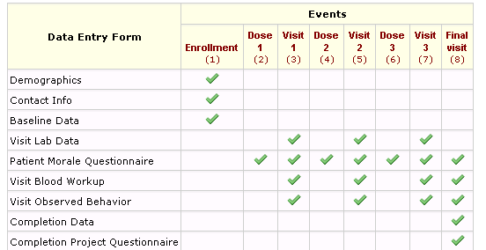
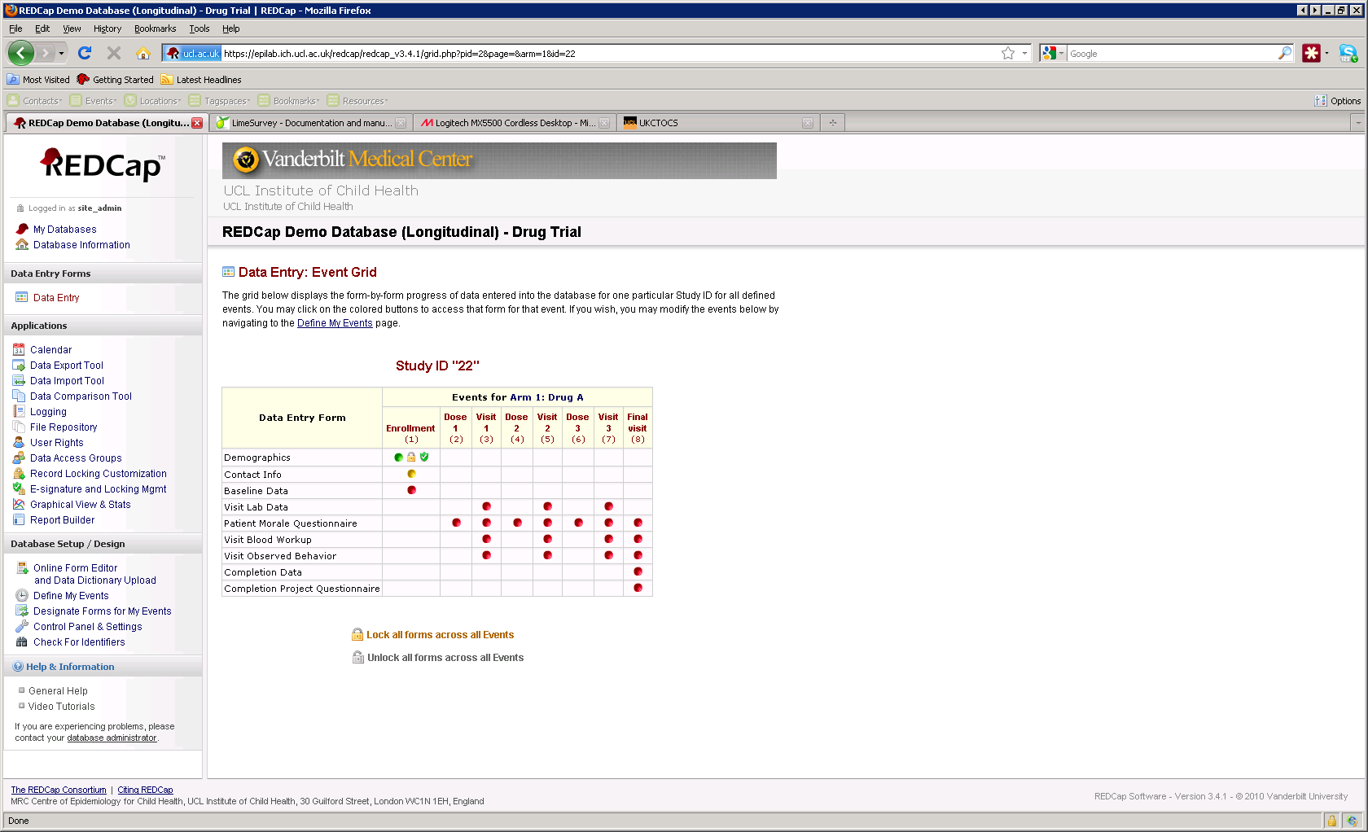
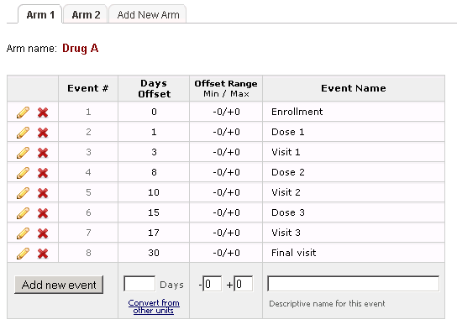
Longitudinal design with REDCap
Reuse forms for multiple data entry
Define multiple arms & events for each arm
Associate events to specific data entry forms
Traffic-light progress dashboard

Slide 16
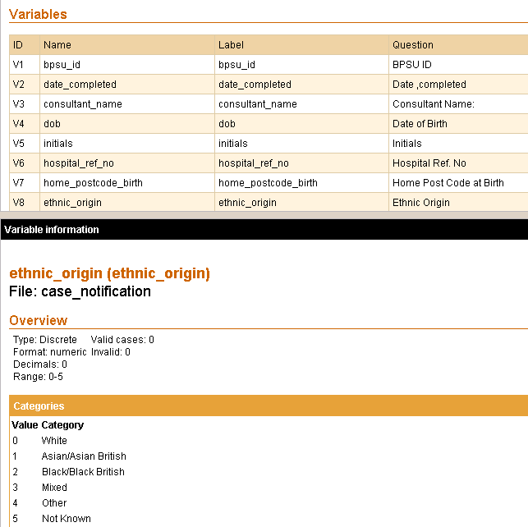
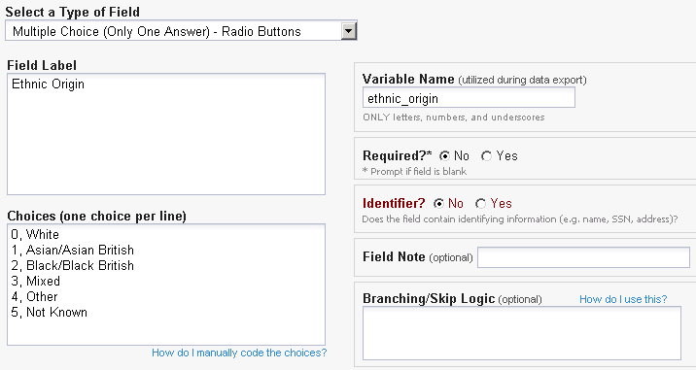
Export questionnaire design (REDCap to DDI)
REDCap Variable

Slide 17






Acknowledgements
UCL
Prof Ian Jacobs
  Dean Health Sciences Research UCL and NHS Partners
Prof Carol Dezateux
  Director, MRC Centre of Epidemiology for Child Health, ICH
Prof Sir Michael Marmot
  Head of Epidemiology and Public Health Department
External
Chris Rusbridge
  Director, Digital Curation Centre
Neil Geddes
  e-Science Director, Science & Technology Facilities Council
Melanie Wright
  Director, ESRC Secure Data Service, UK Data Archive
Andrew Westlake
Retired Statistician
Department of
Epidemiology & Public Health

