Slide 1
Converting General Microsoft Word Questionnaires to DDI

Slide 2
Content
QDDS
Context
Concept
Implementation
Prospects

Slide 3
QDDS
QDDS: Questionnaire Development Documentation System
Directed by Max Stempfhuber, Jürgen Krause, Rainer Schnell
Technical solution by Oliver Hopt
Funded January 2008 - August 2009 by German Research Foundation (DFG)

Slide 4
QDDS – Core functions
version control
change documentation
structural questionnaire analysis
support for further questionnaire development

Slide 5
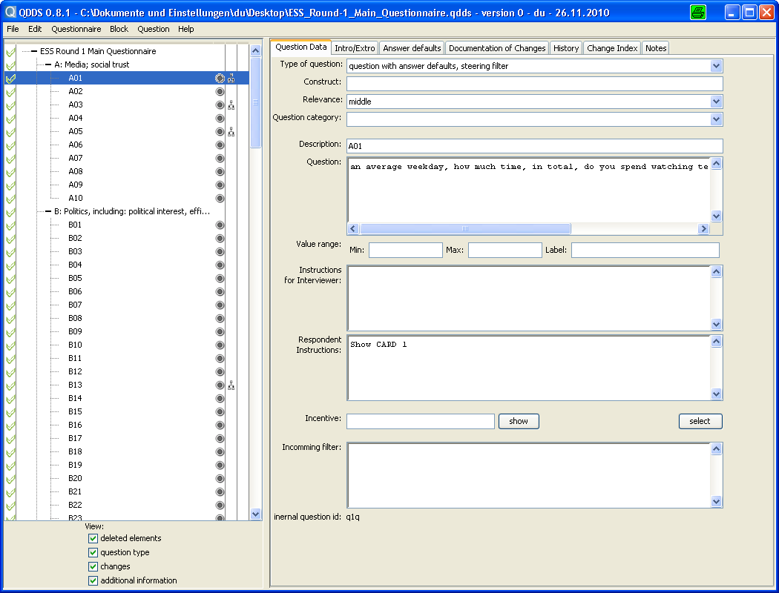
QDDS

Slide 6
Application context
usage of word processing programs for creation of questionnaires (Microsoft Word)
questionnaires are rarely sufficiently documented
  reason:
    frequent revisions
    e.g.: 20 versions of a 15-page questionnaire
    => 300 pages + documentation
no solution for import into a questionnaire application - until now

Slide 7
Structuring of questionnaires
formal structuring of visually structured data for storage in XML-files (manually by the user)
structuring through text formatting
2 approaches to identify individual questionnaire elements:
  style sheets
  „hard“ formatting

Slide 8
Questionnaires with style sheet layout
preparation needed
often already used for consistent design of questionnaires
assignment of style sheet to questionnaire element
more flexible visual design, because changes of formatting are possible
import of the questionnaire paragraph by
paragraph

Slide 9
Questionnaires with “hard” formatting
very time consuming / labour intensive for the user (with large questionnaires)
restrictive/limiting with visual design
error-prone
worthwhile/reasonable only with small questionnaires
requires complex revision to identify
elements within import

Slide 10
Apache POI 3.6.
POI = Poor Obfuscation Implementation
reading and writing of various Microsoft Office formats, based on:
  Office Open XML-Standard (OOXML)
  Microsoft OLE 2 Compound Document Format (OLE2)
Microsoft Word 97 (-2007), „doc“, Word-API HWPF (Horrible Word Processor Format)
Microsoft Word 2007 and above, „docx“, Word-API XWPF
Jar-Files

Slide 11
Oracle OpenOffice.org API
advantages:
  access to all information stored in odt-files
  every format supported by Open Office (doc, rtf, etc)
  one solution for every format
  access to Open Office Files via XML possible
disadvantages:
  Open Office has to be installed
  Microsoft Word is mainly used, Open Office on the contrary only rarely

Slide 12
QDDS Architecture
.
.
.
interface
Manipulator
load(node)
get(field)
set(field, value)
.
.
.
UI class a
DDI2XyMan
UI class b
DDI2XzMan
Manager
--------------
Window
UI class c
DDI2YxMan
UI class d
DDI2YzMan

Slide 13
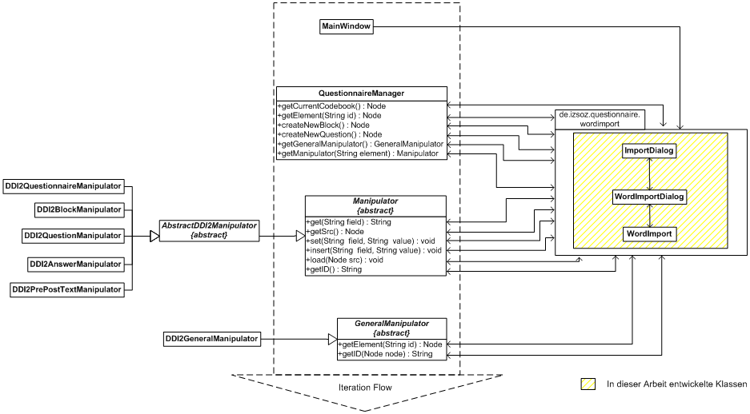
Import filter integration into QDDS

Slide 14
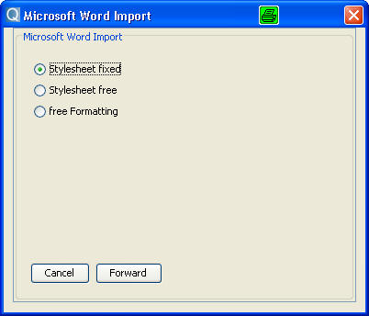
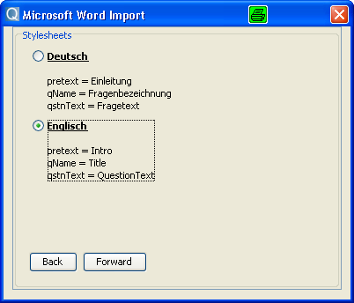
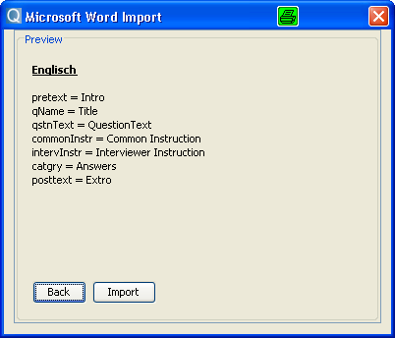
Example fixed stylesheet

Slide 15
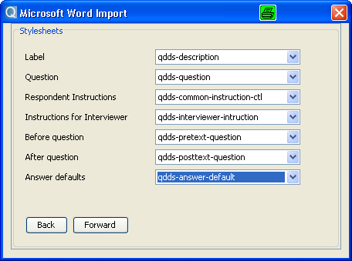
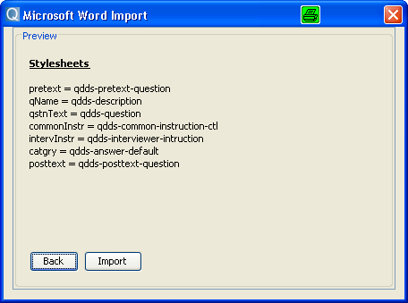
Example free stylesheet

Slide 16
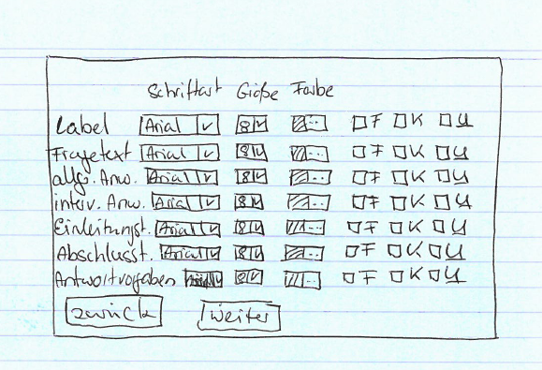
Example hard formatting

Slide 17
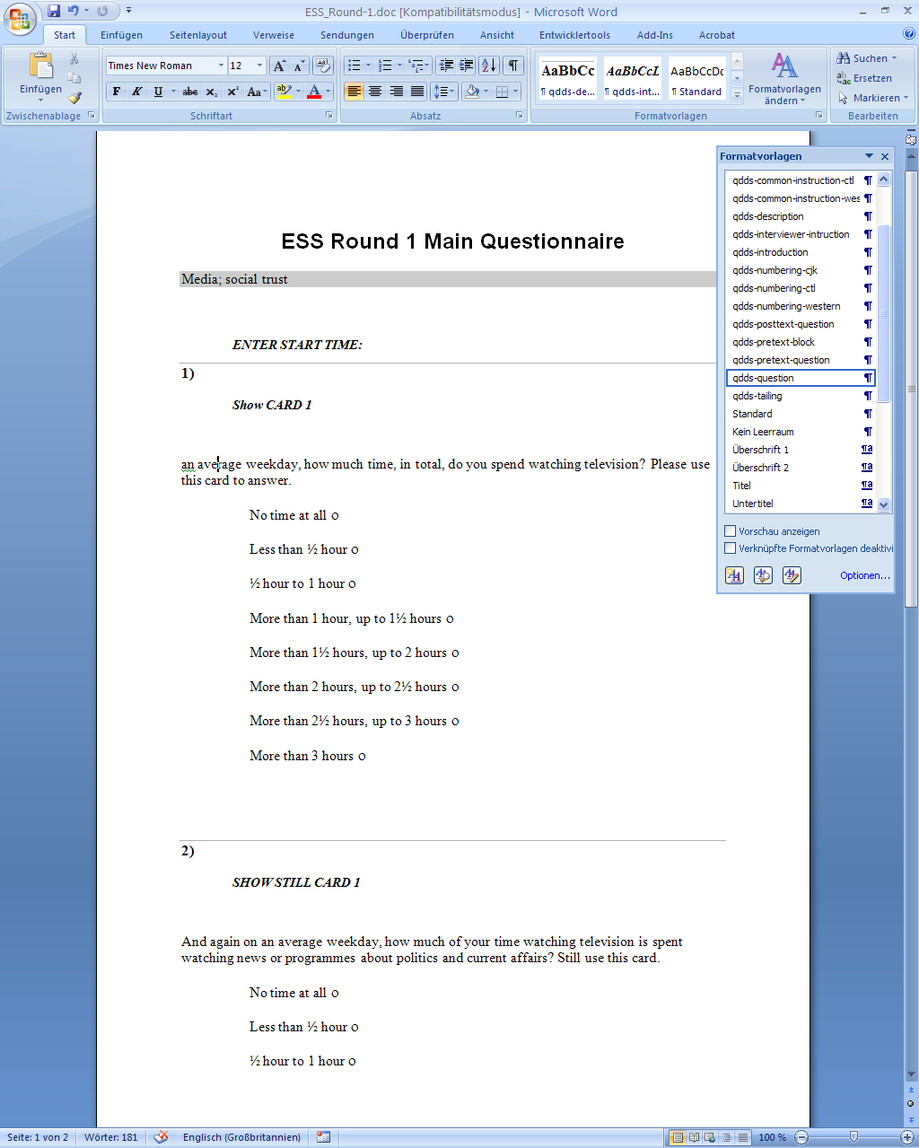
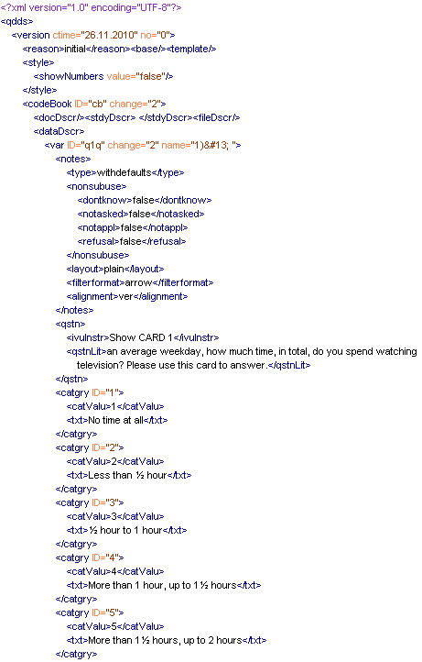
Example Word to DDI

Slide 18
Prospects
Further development:
  import with free (“hard”) formatting
  import of docx-files
  import of odt-files
  word importer as a standalone application
  extended concept for additional DDI entities for further Metadata extractions

Slide 19
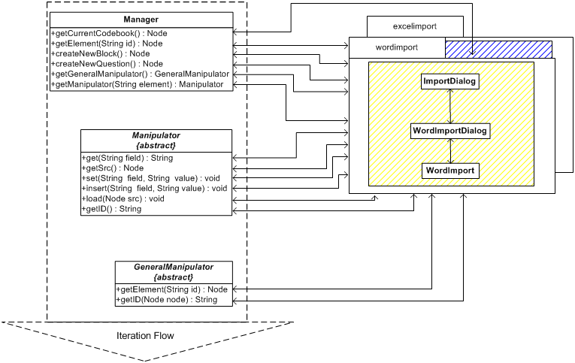
Importer as standalone application

Slide 20
Feel free to ask questions!
Contact
Nadine.Dulisch@gesis.org

