Slide 1
Challenges for Data Intensive Science
- from the Humanities perspective -
Peter Wittenburg

Slide 2
Content
DIS - a new buzzword for what we are doing already?
Data Management and Curation
  increasing data volumes and complexity
  recommendations of HLEG
  some typical data management operations
  the trust issue
Computational Methods
  an example at the MPI
  promises of DIS
  interoperability dream
  quality problem
an antagonism at the end

Slide 3
a new Buzzword on the market
Data Intensive Science/Research - what could it be?
  Tony Hey, Jim Gray, etc. (MS) define it as a new paradigm
    Paradigm: empirical science
    Paradigm: theoretical science
    Paradigm: simulation based science
    Paradigm: Data Intensive Science (DIS)
  DIS has to do with much and complex data
    allow to tackle the Grand Challenges
    seamless and secure access to data, analysis tools and compute resources - not only by humans but also by machines
    new distributed, scalable analysis methods
    possibility to combine all technology across disciplines
    effective, distributed collaboration environment (large scale)
    need first class infrastructure as basis
sounds very much like eScience

Slide 4
Data Intensive Science
the 3 pillars of data intensive science (G. Bell)
  the data creation/capture challenge
    driven mainly by increasing technological innovation
  the data management and curation challenge
    how can we store our data
    how can we organize our data
    how can we preserve and migrate our data
  the data exploitation challenge
    how can we access our data
    how can we extract scientific evidence from our data
    how can we enrich our data
not today
focus
some words

Slide 5
well-known goals
ESFRI research infrastructures are tackling these challenges except for looking for new analysis methods and tools and new communication technologies
analytics and communication
research infrastructure
e-Infrastructures
physical resources
of course: scale and complexity is an issue for us
  stepwise more data
  stepwise tackling the complexity of our data landscape

Slide 6
Pillar 2
Data Management and Curation is in the Focus of many initiatives - thus it seems an issue not to be “solved”
let’s look at some aspects

Slide 7
Data Management is in focus
quite some initiatives dealt with this problem
  ESFRI Groups and Task Forces
    ESFRI Task Force on Repositories
  e-Infrastructure Reflection Group
    Data Management Task Force (joint report with ESFRI)
  Alliance for Permanent Access
    interesting conferences (cost aspect, etc.)
  Blue Ribbon Task Force
    ensuring that valued digital information will be accessible not just today, but in future
  High Level Expert Group On Scientific Data
    Policy Report for Strategy 2030 on data preservation and access
  ASIS&T Summit on Scientific Data Management
  very interesting interdisciplinary meeting on data management
  4th Paradigm Research (-> Data Intensive Sience)
    book about change in research by Tony Hey et al (Microsoft)
  numerous national initiatives in EU

Slide 8
Underlying Mission
what is the underlying mission of all these initiatives
  creating awareness about an unsolved problem
  creating awareness about our responsibility for data
  creating awareness about changing research methods
  start changing cultures of all participants
  start thinking about novel solutions
  start reserving the required funds
  etc.

Slide 9

expert group vision 2030
Riding the wave
How Europe can gain from the rising tide of scientific data
a vision for 2030
Final Report of the High Level Expert
Group on Scientific Data launched 6 Oct 2010

Slide 10
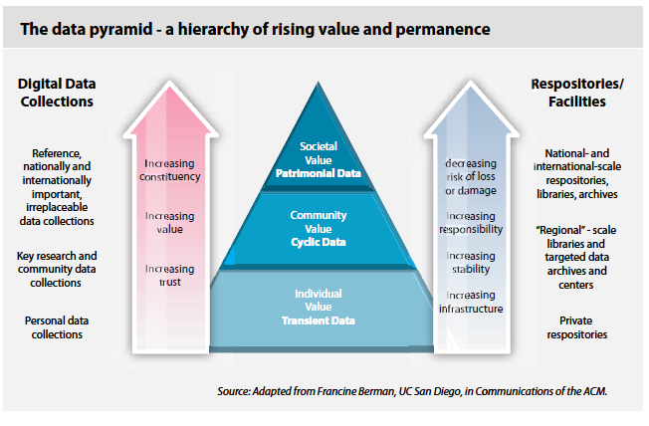
research data - relevance

Slide 11
research data - time dimension
routine experimental data
  medium life time (~10 y) - relevant to proof quality of work
  subject of technological innovation
exceptional experimental data
  (per accident) measurement of special phenomena
  long-life time - relevant as reference for longitudinal studies
data observing the state of ...
  people (minds, health), society, environment, climate, etc.
  long-life time - relevant as reference
data generated by simulations
  MPG: cheaper to store the program code than to store the data

Slide 12
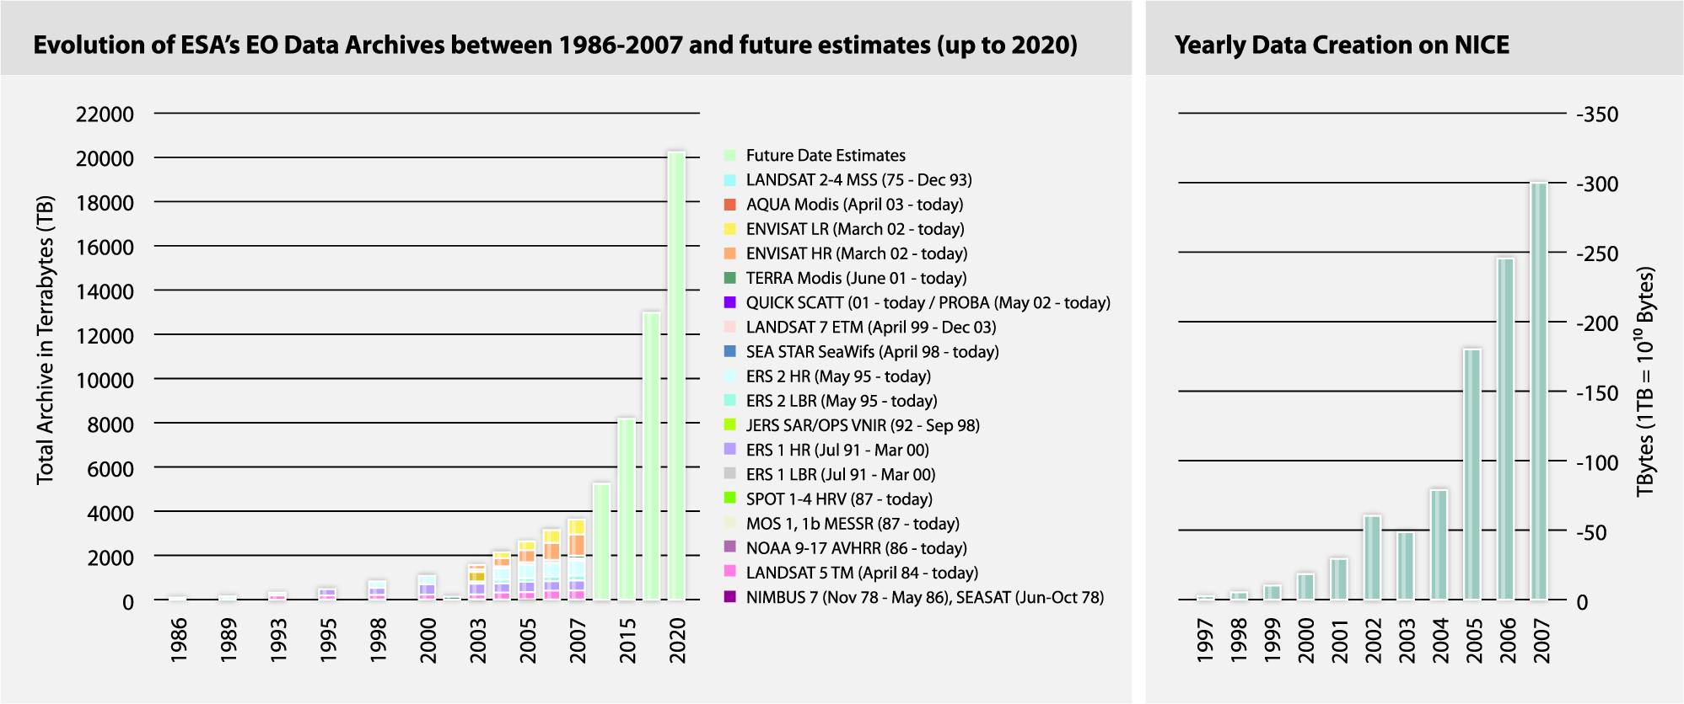
Scale Dimension

Slide 13
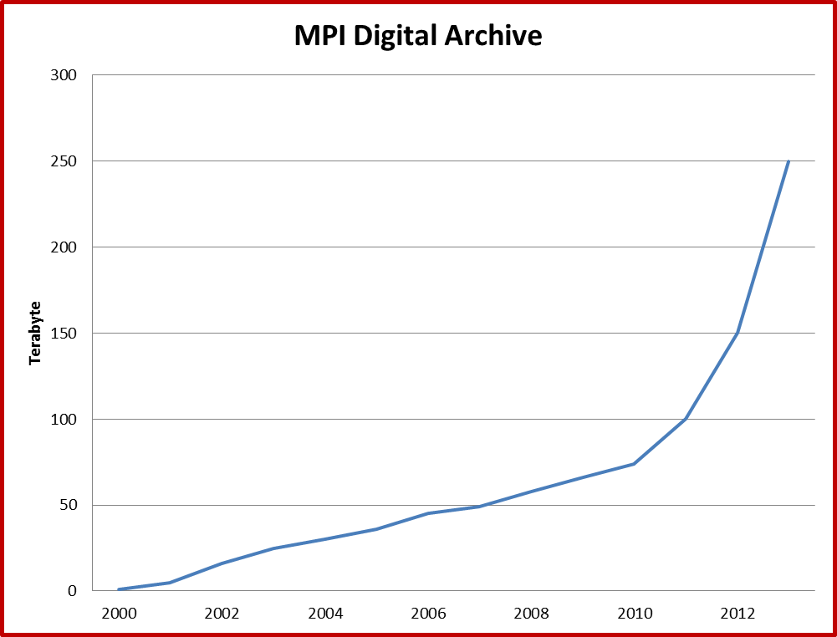
Scale also in Humanities
switch to lossless
mJPEG2000, HD Video and Brain-Imaging

Slide 14
Scale the only dimension?
natural science and IT experts often only look at scale dimension - the amount of data
  without doubt: offers many special problems for storage, organization, access and support
  but often time series have regular organization and structure
however in many disciplines (in particular the humanities) it’s complexity which makes us suffer
  complex external relationships
  context relevant for understanding
  provenance relevant for processing
  non-regular structure and complex semantics
  etc.

Slide 15
Complexity Dimension
PID
metadata
description
metadata
description
collections
the Object
Object Instance
Object Version
metadata
description
Derived Object

Slide 16
Problem without Scale and Complexity?
not really
can export singular tapes of 1.5 Terabytes and put them
into safes at different locations
  there are no complex relations to be considered
  manual effort is manageable
in case of scale manual operations cannot not be paid, they are not efficient and form a danger for long-term preservation
in case of complexity simple packaging for preservation is not feasible anymore
research objects are part of a variety of virtual collections dependent on the research question in focus

Slide 17
HLEG recommendations
Riding the wave
How Europe can gain from the rising tide of scientific data
a vision for 2030
do we have recommendations?
Final Report of the High Level Expert
Group on Scientific Data launched 6 Oct 2010

Slide 18
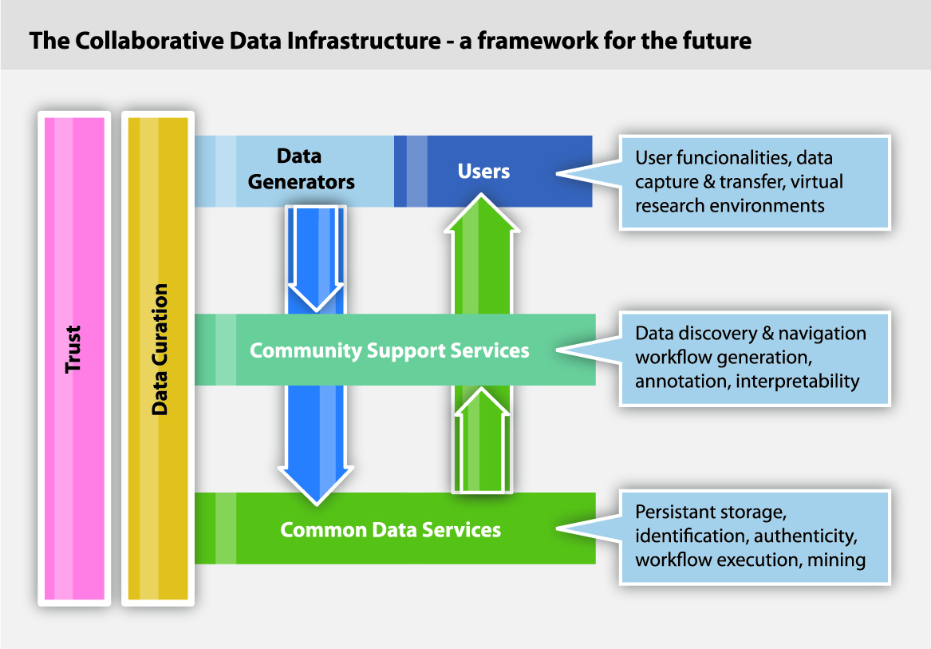
CDI as Target
Workbenches
Portals
Web Apps
etc.
A collaborative Data Infrastructure –
a framework for the future
CLARIN
DARIAH
CESSDA
LifeWatch
ENES
etc.
EUDAT
D4Science
etc.
complex landscape due to grown solutions
need new type of architecture and interfaces

Slide 19
Vision 2030 & Recommendations
All stakeholders, from scientists to national authorities to general public are aware of the critical importance of preserving and sharing reliable data produced during the scientific process.
Researchers and practitioners from any discipline are able to find, access and process the data they need. They can be confident in their ability to use and understand data and they can evaluate the degree to which the data can be trusted.
Producers of data benefit from opening it to broad access and prefer to deposit their data with confidence in reliable repositories. A framework of repositories work to international standards, to ensure they are trustworthy.
Public funding rises, because funding bodies have confidence that their investments in research are paying back extra dividends to society, through increased use and re-use of publicly generated data.

Slide 20
Vision 2030 & Recommendations
The innovative power of industry and enterprise is harnessed by clear and efficient arrangements for exchange of data between private and public sectors allowing appropriate returns for both.
The public has access and can make creative use of the huge amount of data available; it can also contribute to the data store and enrich it. All can be adequately educated and prepared to benefit from this abundance of information.
Policy makers can make decisions based on solid evidence, and can monitor the impacts of these decisions. Government becomes more trustworthy.
Global governance promotes international trust and interoperability.

Slide 21
Life-cycle management solved?
UNESCO (Dietrich Schüller)
  80% of our recordings about cultures and languages are
  highly endangered
  for logistic reasons much of this data will be lost
  what about all data on our notebooks or in some databases?
do we lose our cultural and scientific memory?
J. Gray (DIS) is an optimist:
soon there is a time when data will live forever as archival media - just like paper based storage - and be publically accessible in the CLOUD to humans and machines - thus similar to national libraries and museums

Slide 22
Life-cycle management solved?
life-cycle management means regular migration & curation
  new carriers - new formats - new structural encodings
  relevant contexts may change over time
  transformations may question authenticity
  there will be semantic shifts over time
obvious is: uncurated data is guaranteed to be lost
obvious is: there is a lot of collected data that is not curated in any systematic way
let’s have a look at some operations which we should apply in the digital domain

Slide 23


Creation and Upload
Repository
do we have
it in place?
Metadata
PID
Primary data
Some checks + calculations
accepted formats
correct semantics
consistency
size and checksum
etc.
PID
PID
Registration
Service
URL
MD5
etc.
speak about
millions of PIDs
Metadata
Primary data

Slide 24
Safe Replication
safe channel
trusted partners
Repository A
Repository B
Metadata
PID
Metadata
PID
Primary data
Primary data
Internet
modify
record
check MD5
do we have
it in place?
PID
Resolution
Information

Slide 25
New Version Upload
Repository
new Metadata
PID
new version
Primary data
Some checks + calculations
accepted formats
correct semantics
consistency
size and checksum
etc.
PID
PID
Registration
Service
URL
MD5
etc.
speak about
millions of PIDs
new Metadata
do we have
it in place?
new version

Slide 26
Transformation/Curation
Repository A
Metadata
Transformation
Algorithm
Primary data
Transformed
data
PID
URL
MD5
etc.
PID
Resolution
Information
do we have
it in place?

Slide 27
Annotation/Enrichment
Repository A
Annotation
Algorithm
Metadata
Primary data
Annotation
URL
MD5
etc.
Annotation
PID
do we have
it in place?
PID
Resolution
Information
new Metadata

Slide 28
Obstacles for LCM
let’s assume we have done a good job in building a
preservation/curation infrastructure
are there obstacles to preserve our data?
technical innovation and organizational
instabilities
there is the trust problem with its
many facets

Slide 29
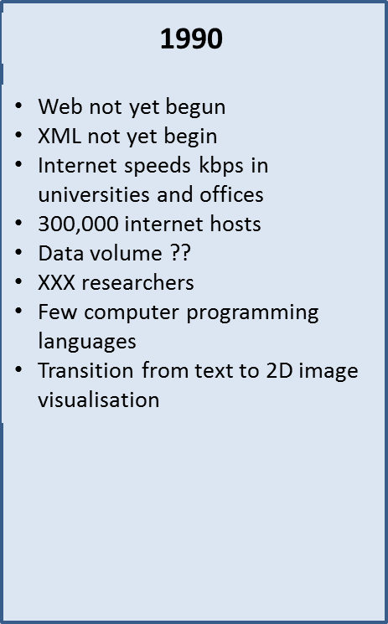
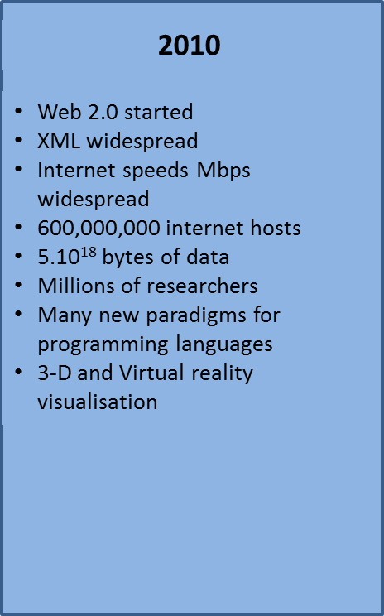
innovation rate is so high
2030
Semantic Web
XML forgotten
Internet speeds Pbps widespread
2,000,000,000,000 hosts
5.10²⁴ bytes of data
Billions of citizen researchers
Natural language programming for computers
Virtual worlds
there is a problem with integrity and authenticity due to
technological innovation
how stable is our digital world?
which are the islands we can build on?

Slide 30
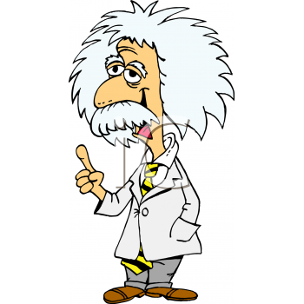



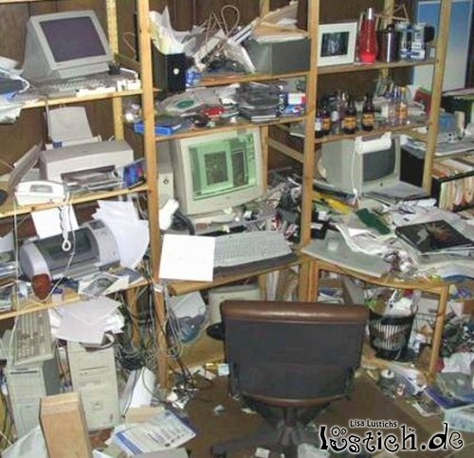
trust only yourself
only my theory is
relevant and papers count
my creative
data backyard
Wall of Silence
illusion of accessibility, protection, scientific advantage, etc.
but many are excluded from data intensive research
although data creation is publically funded

Slide 31
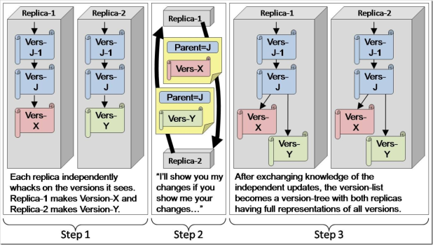

can we trust others?
why should I change?
can I trust the repositories?
Linked Data Universe
based on Stable Repositories
should I really look?
can I trust the
data?
Change in culture and trust relationship required
who is owner of the data (Microsoft, a data repository, the researcher)?
trust in quality and attitude of data curators
trust in acknowledging creators’ efforts (yet no machinery in place)

Slide 32
Pillar 3
new computational methods for the analysis of the large data amounts
let’s look at one concrete example from the
humanities first

Slide 33
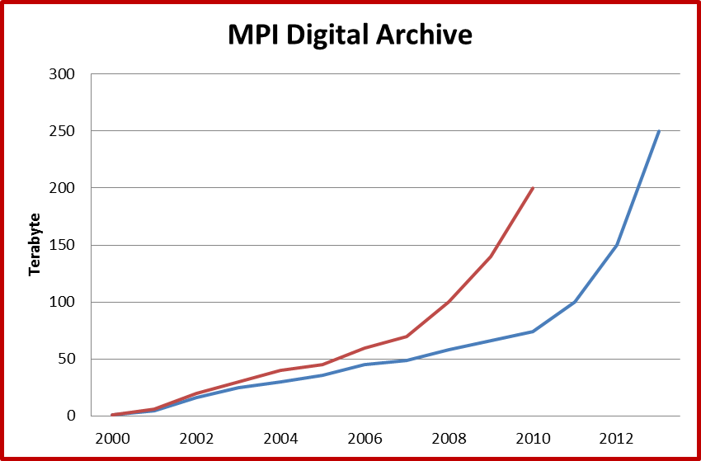
MPI in need of computational methods
untouched
data
organized/
annotated
data
huge amount of data cannot be manually annotated anymore
i.e. increasing amount of data is left untouched
MPI is in urgent need for new computational paradigms
is speech/image recognition technology available?

Slide 34
more data yes or no?
short history of speech recognition
  until 70-ties knowledge based systems
    relied on phonetic knowledge
  radical shift to stochastic techniques (HMM, ANN, etc.)
    rely only on mathematics on big data sets
    training sets got bigger and bigger
    quite some progress in specific scenarios
    but nothing available for our type of resources
  now back to the roots (not only at MPI)
    combination of both
    black box approach only for “simple” patterns
    need to interact with data
    do not need so much data - exemplar based training

Slide 35

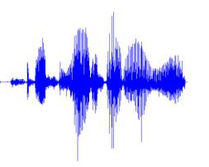
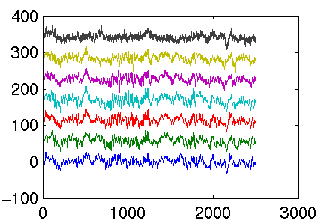
back to the roots at MPI
annotation lattice
recogniser
recogniser
recogniser
recogniser
recogniser
many simple recognizers
certainly cascaded recognizers
thus back to the roots
smart pattern analyzer
immediate interaction

Slide 36
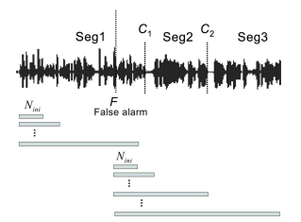
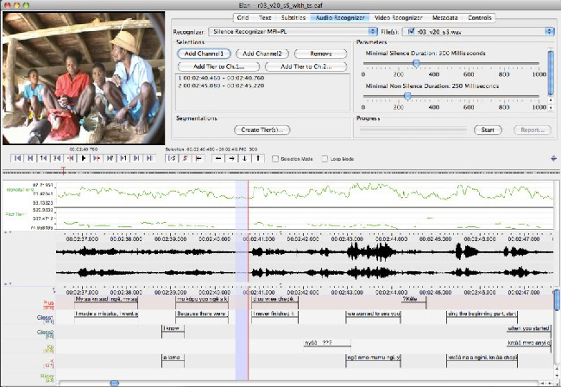
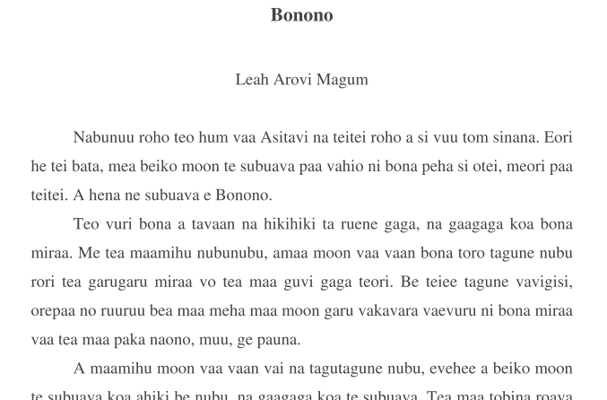
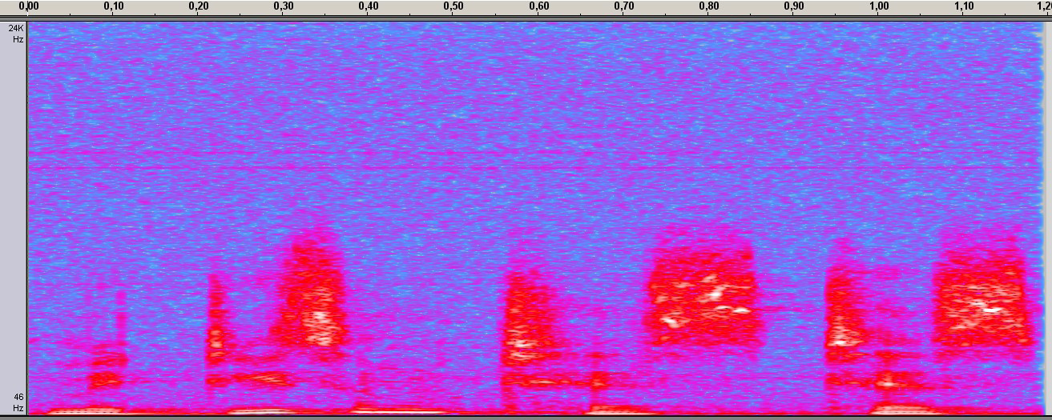

“simple detectors” and usability

Slide 37
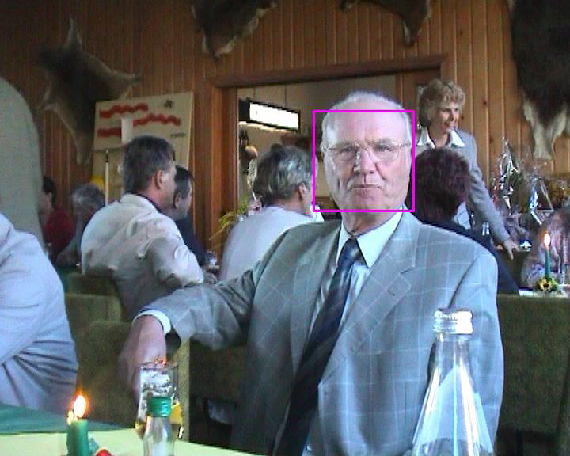
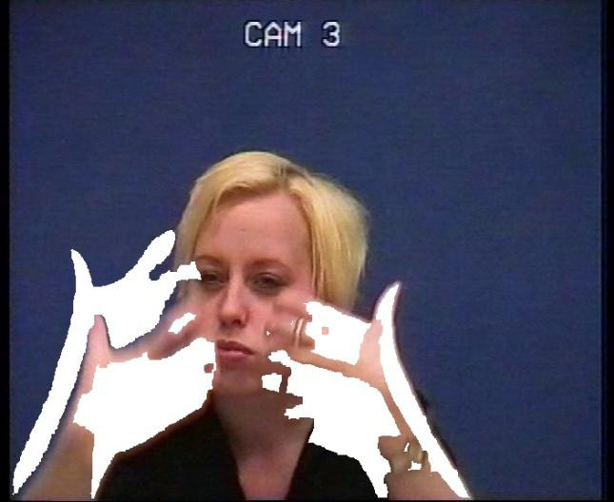
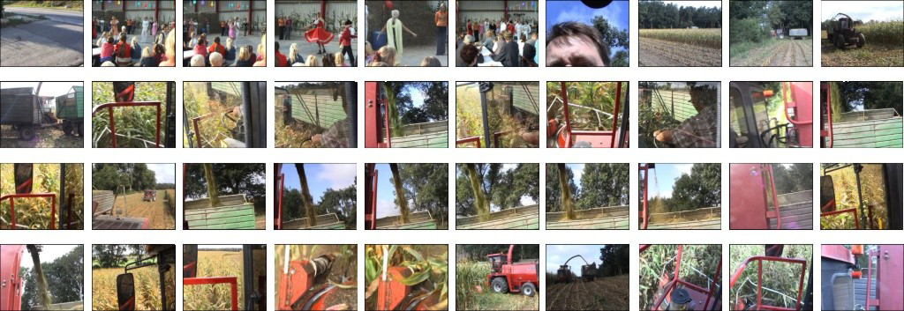
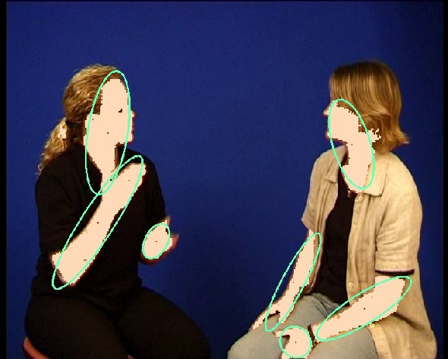
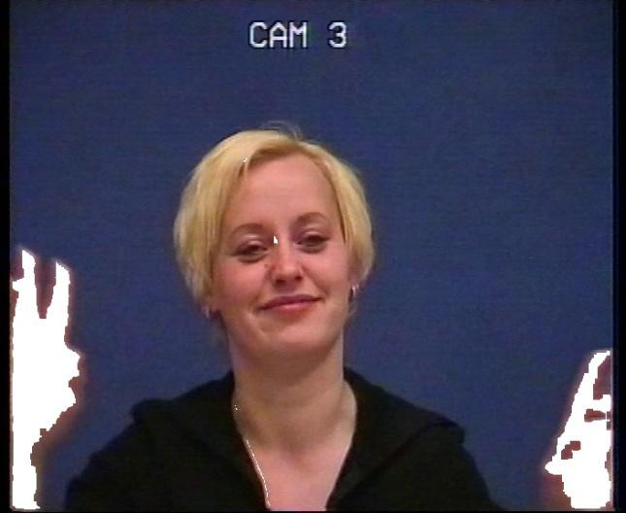
back to the roots at MPI

Slide 38
Promises of Data Intensive Science
yes - we desperately need new algorithms obviously in
almost all disciplines that cope with data Tsunami
what is Data Intensive Science promising here?
  a focused strategy for data sharing is pivotal
  all researchers deposit data in CLOUDs to make
  them available for all kinds of of processing
  seamless access to data across disciplines
  care must be taken that community differences do
  not impede seamless interoperability
  data is often organized to answer a few questions,
  DIS will make data available for broader questions

Slide 39
Promises of Data Intensive Science
what is Data Intensive Science promising II
  all technology should be available not only to humans
  but also for processing by computational analytics
  need scientists collaboratively experimenting with
  the available data across scales, across techniques
  and across disciplines
  etc etc
lots of good dreams - let’s look at some issues

Slide 40
the interoperability dream
what does interoperability really mean?
do we have interoperability when we adhere to a
limited number of schemas or when we know the
underlying schemas?
well - it would already be a gigantic step ahead since
everyone could write wrappers of some sort
  for natural sciences this could already be the goal
  since then they know how to extract numbers
  but could I interpret the content and re-purpose or
  re-combine data in the humanities?
world in SSH is more difficult though - I need to know
the semantics of the units

Slide 41
layers of semantics
in the area of linguistics we are talking about
  semantics of annotation tiers or lexical attributes
  semantics of annotation tags or attribute values
    annotations can be about part of speech,
    morphology, syntax, semantics of gestures,
    etc
    it is already a major multi-year challenge to find
  agreements on these limited categories
    don’t believe: look at ISOcat (www.isocat.org)
  semantics of “words/expressions/etc” in texts
    well there are general ontologies (SUMO, CYC, etc)
    and there are Wordnets
    thus some help for some specific tasks but ...

Slide 42
general interoperability does not exist
did you ever look what the e-IRG/ESFRI Task Force on
Data Management wrote about interoperability?
there is no such general interoperability!
but ...
  we can adhere to some basic principles
    register your schema - thus make it explicit
    register your categories - thus make them explicit
    allow users to easily create exploitable relations
    perhaps offer reference registries to reduce the
    size and management of the mapping problem
    (such as ISOcat or codebook for surveys)
but what about meaning of categories in contexts?

Slide 43
lack of quality impedes processing
we can forget about all dreams when quality remains
a problem
Virtual Language Observatory
  > 270.000 metadata of resources/collections in there
  no problem for human observer to understand
  granularity level
  quality of metadata is lousy
    any search is problematic
    some people call for Google, social tagging etc
      an interview does not say how old a person is
      social tagging only works if many are tagging
  how to dream about automatic procedures if essential
  information is missing or wrong

Slide 44
broad quality campaign
obviously we need a broad quality campaign
  make schemas and categories explicit
  refer to reference categories
  be more complete in metadata descriptions
  be standards compliant
  do debugging
improve awareness about these needs
  how: can we show benefits?

Slide 45
the Frege antagonism
Frege’s magnifying glass antagonism
if you magnify on details you are losing the overview
if you focus on the overview you don’t see the details
fundamental problem when turning to lots of data:
  you need to apply statistics to understand the trends
  but you are in danger to easily loose the grounding
is there a way out?
  have a proper model and take care of the exceptions
  how do we come to such model?

Slide 46
Conclusions
do I have conclusions?
so what is DIS - just a new branding pushed forward by MS
wrt. curation and preservation (pillar 2)
  working on relevant aspects in infrastructures
  still many problems to be solved
wrt. new analytics (pillar 3)
  lots of good dreams
  but no clear answer to interoperability issue
  ignorance of the huge quality issue
but of course it is very good that so many initiatives
point to the urgent tasks ahead of us

Slide 47
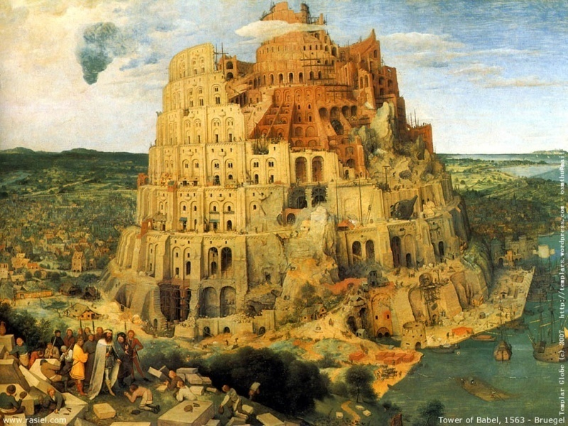
Falls nicht to end in Babylonish scenario nous avons still algo time om sistemas te improve.
Thanks for your attention!

