Slide 1

Course on DDI 3:
Putting DDI to Work for You
8 December 2010
Wendy Thomas, Minnesota Population Center
2nd Annual European DDI Users Group Meeting
Learning DDI: Pack S01
Copyright © GESIS – Leibniz Institute for the Social Sciences, 2010
Published under Creative Commons Attribute-ShareAlike 3.0 Unported
S01

Slide 2



Credits
The slides were developed for several DDI workshops at IASSIST conferences and at GESIS training in Dagstuhl/Germany
Major contributors
  Wendy Thomas, Minnesota Population Center
  Arofan Gregory, Open Data Foundation
Further contributors
  Joachim Wackerow, GESIS – Leibniz Institute for the Social Sciences
  Pascal Heus, Open Data Foundation
S01

Slide 3
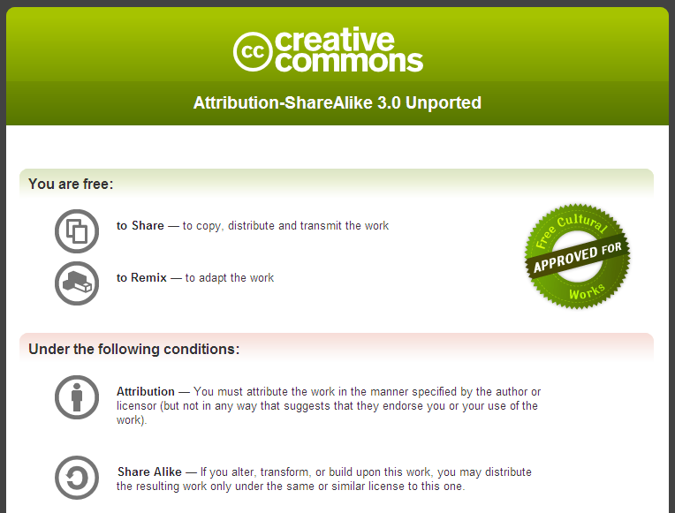
License
S01
Details on next slide.

Slide 4
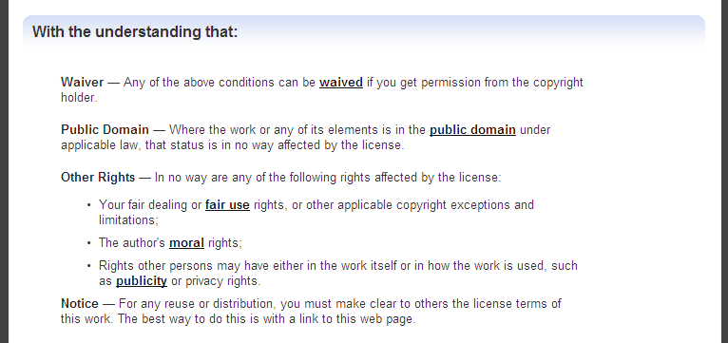
License (cont.)
On-line available at: http://creativecommons.org/licenses/by-sa/3.0/
This is a human-readable summary of the Legal Code at: http://creativecommons.org/licenses/by-sa/3.0/legalcode
S01
Notes:
Ask about doing the XML tutorial at this point and then fit into today’s schedule if needed

Slide 5
Overview of DDI 3
Learning DDI: Pack S03
Copyright © GESIS – Leibniz Institute for the Social Sciences, 2010
Published under Creative Commons Attribute-ShareAlike 3.0 Unported
S03

Slide 6
DDI 3.0 and 3.1
DDI 3.1 was published 2009-10-18
REMEMBER when we refer to DDI 3 we mean both 3.0 and 3.1
When we talk about DDI 3.1 the feature we are talking about is not available in DDI 3.0
We are teaching the latest version which is DDI 3.1
We will note upcoming DDI 3.2 changes you will want to be aware of
S03

Slide 7
Origins of the DDI Alliance
DDI 1/2 were developed by an informal network of individuals from the social science community and official statistics
  Funding was through grants
It was decided that a more formal organization would help to drive the development of the standard forward
  Many new features were requested
  The DDI Alliance was born to facilitate the development in a consistent and on-going fashion
S03

Slide 8
DDI Alliance Structure
DDI 3 specifications are created by committees drawn from among the member organizations
  Some outside experts are invited to attend
The Steering Committee governs the organization
The Expert Committee votes to approve all published work
  One representative per member organization
The Technical Implementation Committee (TIC) creates the technical work products (XML schemas, UML models, documentation, etc.)
Working Groups are short term groups working on future DDI topical content (i.e., Survey Design & Implementation)
Tools Catalog Group describing tools and software to work with DDI
Web Site Maintenance Group
S03

Slide 9
Moving from DDI 1/2 to DDI 3
DDI Alliance members wished to support current DDI 1/2 users and will continue to support this specification
The limitations of DDI 1/2 needed to be addressed in order to move the standard forward to a broader audience and user base
Requirements for DDI 3 came out of the original committee as well as the broader data archive community
The development of the first waves of software for DDI 1/2 raised additional requirements
S03

Slide 10
Requirements for 3.0
Improve and expand the machine-actionable aspects of the DDI to support programming and software systems
Support CAI instruments through expanded description of the questionnaire (content and question flow)
Support the description of data series (longitudinal surveys, panel studies, recurring waves, etc.)
Support comparison, in particular comparison by design but also comparison-after-the fact (harmonization)
Improve support for describing complex data files (record and file linkages)
Provide improved support for geographic content to facilitate linking to geographic files (shape files, boundary files, etc.)
S03

Slide 11
DDI 1 / 2
S03
Document Description
Citation of the codebook document
Guide to the codebook
Document status
Source for the document
Study Description
Citation for the study
Study Information
Methodology
Data Accessibility
Other Study Material
File Description
File Text (record and relationship information)
Location Map (required for nCubes optional for microdata)
Data Description
Variable Group and nCube Group
Variable (variable specification, physical location, question, & statistics)
nCube
Other Material

Slide 12
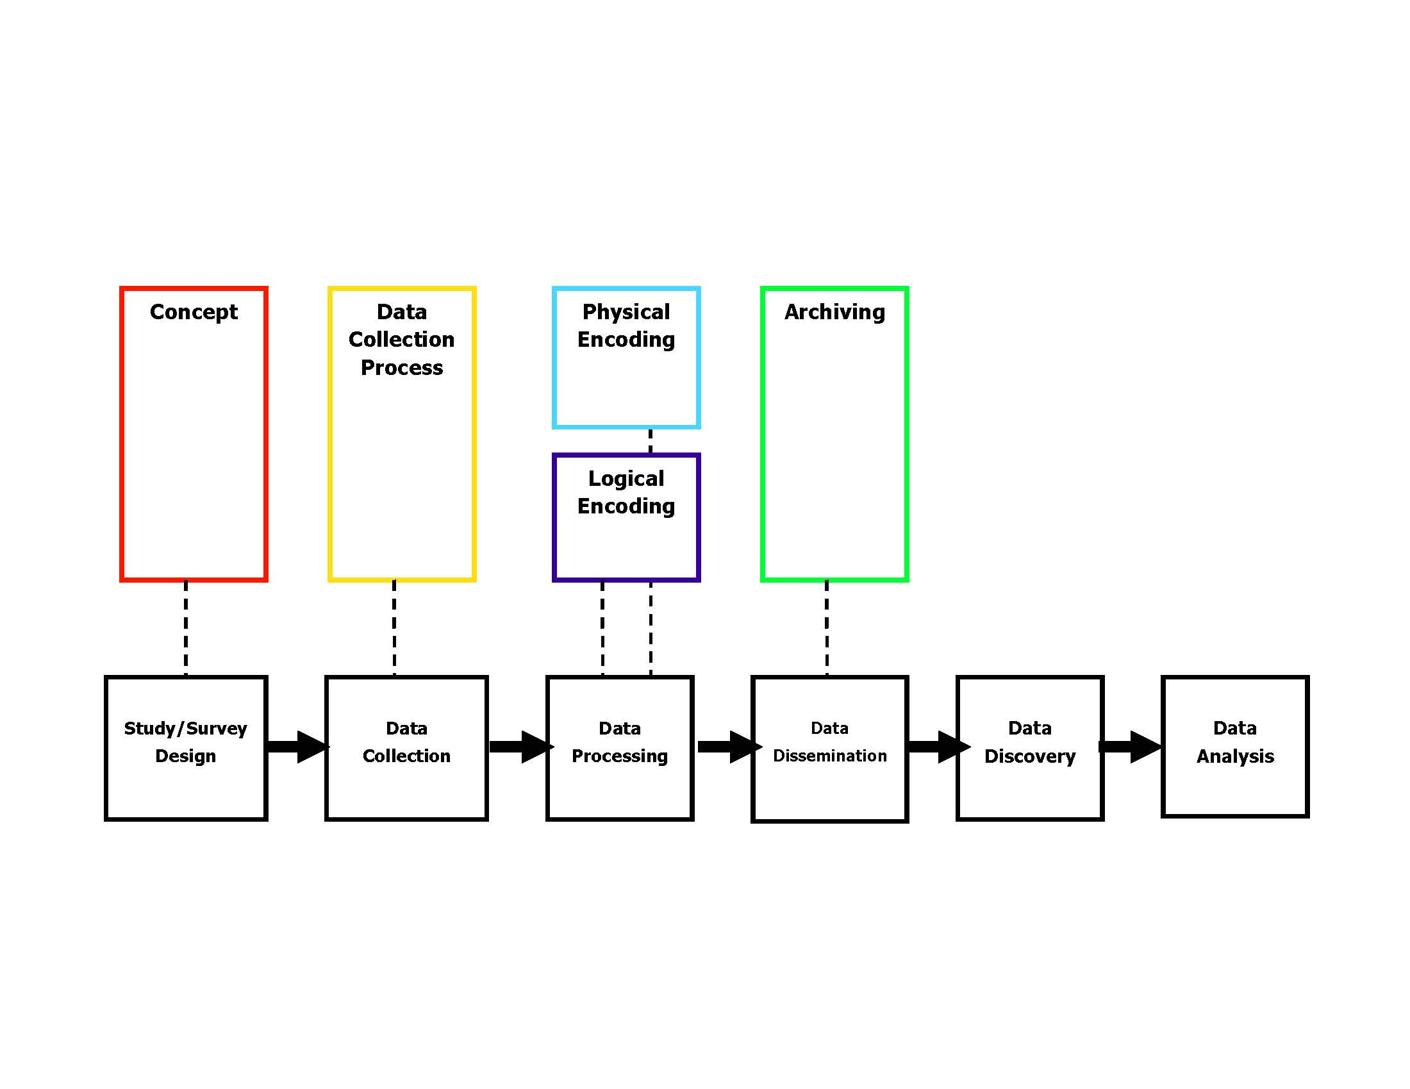
Our Initial Thinking…
The metadata payload from DDI 1/2 was re-organized to cover these areas.
S03
Notes:
We are starting to break these out based on a Data Life Cycle Model, keeping in mind not only those sections that are highly related to each other, but also looking at those sections that stay consistent even when the data itself is moved to a different physical storage structure, or when it moves from one archive to another, or even when it encounters various methods of obtaining access to the data. There is obviously a lot more detail behind this, but what we are trying to provide with this model is a base for discussion within the Expert Committee and DDI community. All of this is a prelude to the creation of Version 3.0.

Slide 13
File Text
Location Map
Physical Location
Statistics
Study Citation
Document Source
Study Information
Data Accessibility
Study Methodology
Questions
Variable specification
nCubes
Variable & nCube Groups
S03
Other Material
Notes:
We are starting to break these out based on a Data Life Cycle Model, keeping in mind not only those sections that are highly related to each other, but also looking at those sections that stay consistent even when the data itself is moved to a different physical storage structure, or when it moves from one archive to another, or even when it encounters various methods of obtaining access to the data. There is obviously a lot more detail behind this, but what we are trying to provide with this model is a base for discussion within the Expert Committee and DDI community. All of this is a prelude to the creation of Version 3.0.

Slide 14
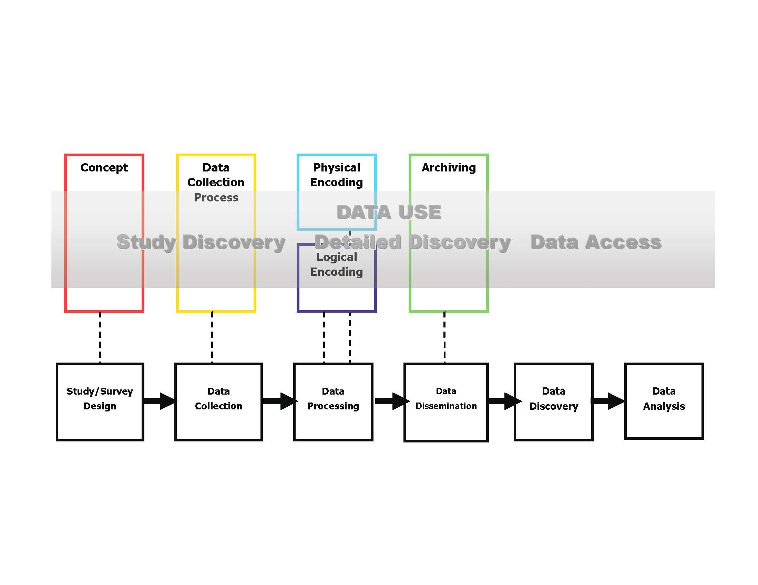
For later parts of the lifecycle, metadata is reused heavily from earlier
Modules.
Wrapper
The discovery and analysis itself creates data and metadata, re-used in future cycles.
S03
Notes:
We are starting to break these out based on a Data Life Cycle Model, keeping in mind not only those sections that are highly related to each other, but also looking at those sections that stay consistent even when the data itself is moved to a different physical storage structure, or when it moves from one archive to another, or even when it encounters various methods of obtaining access to the data. There is obviously a lot more detail behind this, but what we are trying to provide with this model is a base for discussion within the Expert Committee and DDI community. All of this is a prelude to the creation of Version 3.0.

Slide 15
Realizations
Many different organizations and individuals are involved throughout this process
  This places an emphasis on versioning and exchange between different systems
There is potentially a huge amount of metadata reuse throughout an iterative cycle
  We needed to make the metadata as reusable as possible
Every organization acts as an “archive” (that is, a maintainer and disseminator) at some point in the lifecycle
  When we say “archive” in DDI 3, it refers to this function
S03

Slide 16
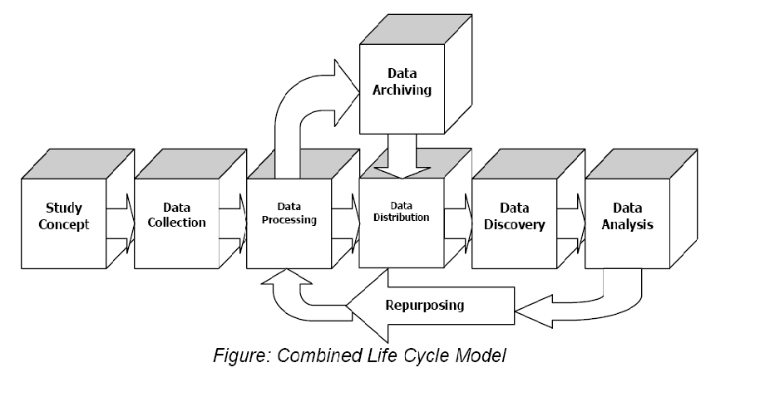
DDI 3 Lifecycle Model
Metadata Reuse
S03

Slide 17
Approach
Shift from the codebook centric model of early versions of DDI to a lifecycle model, providing metadata support from data study conception through analysis and repurposing of data
Shift from an XML Data Type Definition (DTD) to an XML Schema model to support the lifecycle model, reuse of content and increased controls to support programming needs
Redefine a “single DDI instance” to include a “simple instance” similar to DDI 1/2 which covered a single study and “complex instances” covering groups of related studies. Allow a single study description to contain multiple data products (for example, a microdata file and aggregate products created from the same data collection).
Incorporate the requested functionality in the first published edition
S03

Slide 18
Development of DDI 3
2004 – Acceptance of a new DDI paradigm
  Lifecycle model
  Shift from the codebook centric / variable centric model to capturing the lifecycle of data
  Agreement on expanded areas of coverage
2005
  Presentation of schema structure
  Focus on points of metadata creation and reuse
2006
  Presentation of first complete 3.0 model
  Internal and public review
2007
  Vote to move to Candidate Version
  Establishment of a set of use cases to test application and implementation
2008
  April: DDI 3.0 published
2009
  DDI 3.1 approved for publication in May 2009
  Published October 2009
  bugs and feature corrections identified during the first year of use, some were backward incompatible
S03

Slide 19
DDI Version Numbers
With publication of DDI 3.1 a version number system was established for DDI going forward
Structure of the DDI version number: X.Y.Z where:
  X major new features or changes
  Y minor incompatible changes
  Z minor compatible changes
The XML namespace declaration includes only the X and Y levels. For example 3_1
This means minor (Z) updates do not require a change in the XML namespace for use.
S03

Slide 20
Changes in DDI and Implications for Metadata and Data Management
Learning DDI: Pack S05
Copyright © GESIS – Leibniz Institute for the Social Sciences, 2010
Published under Creative Commons Attribute-ShareAlike 3.0 Unported
S05

Slide 21
DDI 1/2 Applications
Simple survey capture
High level study description with variable information for stand alone studies
Descriptions of basic nCubes (individual statistical tables)
Replicating the contents of a codebook including the data dictionary
Collection management beyond bibliographic records
S05

Slide 22
DDI 3 Applications
Describing a series of studies such as a longitudinal survey or cross-cultural survey
Capturing comparative information between studies
Sharing and reusing metadata outside the context of a specific study
Capturing data in the XML
Capturing process steps from conception of study through data capture to data dissemination and use
Capturing lifecycle information as it occurs, and in a way that can inform and drive production
Management of data and metadata within an organization for internal use or external access
S05

Slide 23
Why can DDI 3 do more?
It is machine-actionable – not just documentary
It’s more complex with a tighter structure
It manages metadata objects through a structured identification and reference system that allows sharing between organizations
It has greater support for related standards
Reuse of metadata within the lifecycle of a study and between studies
S05

Slide 24
Reuse Across the Lifecycle
This basic metadata is reused across the lifecycle
  Responses may use the same categories and codes which the variables use
  Multiple waves of a study may re-use concepts, questions, responses, variables, categories, codes, survey instruments, etc. from earlier waves
S05

Slide 25
Reuse by Reference
When a piece of metadata is re-used, a reference can be made to the original
In order to reference the original, you must be able to identify it
You also must be able to publish it, so it is visible (and can be referenced)
  It is published to the user community – those users who are allowed access
S05

Slide 26
Change over Time
Metadata items change over time, as they move through the data lifecycle
  This is especially true of longitudinal/repeat cross-sectional studies
This produces different versions of the metadata
The metadata versions have to be maintained as they change over time
  If you reference an item, it should not change: you reference a specific version of the metadata item
S05

Slide 27
DDI Support for Metadata Reuse
DDI allows for metadata items to be identifiable
  They have unique IDs
  They can be re-used by referencing those IDs
DDI allows for metadata items to be published
  The items are published in resource packages
Metadata items are maintainable
  They live in “schemes” (lists of items of a single type) or in “modules” (metadata for a specific purpose or stage of the lifecycle)
  All maintainable metadata has a known owner or agency
Maintainable metadata can be versionable
  This reflects changes over time
  The versionable metadata has a version number
S05

Slide 28
Management of Information, Data, and Metadata
An organization can manage its organizational information, metadata, and data within repositories using DDI 3 to transfer information into and out of the system to support:
  Controlled development and use of concepts, questions, variables, and other core metadata
  Development of data collection and capture processes
  Support quality control operations
  Develop data access and analysis systems
S05

Slide 29
Upstream Metadata Capture
Because there is support throughout the lifecycle, you can capture the metadata as it occurs
It is re-useable throughout the lifecycle
  It is versionable as it is modified across the lifecycle
It supports production at each stage of the lifecycle
  It moves into and out of the software tools used at each stage
S05

Slide 30
Metadata Driven Data Capture
Questions can be organized into survey instruments documenting flow logic and dynamic wording
  This metadata can be used to create control programs for Blaise, CASES, CSPro and other CAI systems
Generation Instructions can drive data capture from registry sources and/or inform data processing post capture
S05

Slide 31
Reuse of Metadata
You can reuse many types of metadata, benefitting from the work of others
  Concepts
  Variables
  Categories and codes
  Geography
  Questions
Promotes interoperability and standardization across organizations
Can capture (and re-use) common cross-walks
S05

Slide 32
Virtual Data
When researchers use data, they often combine variables from several sources
  This can be viewed as a “virtual” data set
  The re-coding and processing can be captured as useful metadata
  The researcher’s data set can be re-created from this metadata
  Comparability of data from several sources can be expressed
S05

Slide 33
Mining the Archive
With metadata about relationships and structural similarities
  You can automatically identify potentially comparable data sets
  You can navigate the archive’s contents at a high level
  You have much better detail at a low level across divergent data sets
S05

Slide 34
Technical Features
Learning DDI: Pack S08
Copyright © GESIS – Leibniz Institute for the Social Sciences, 2010
Published under Creative Commons Attribute-ShareAlike 3.0 Unported
S08

Slide 35
Core Features of DDI 3
This section looks at some of the core features of DDI 3 taken as a whole:
  Identifiables, Versionables, Maintainables
  Referencing
  Notes
  Other materials
  Citations
  Coverage
  Genericode (controlled vocabularies)
These features occur throughout DDI 3 modules, and are very frequently used
S08

Slide 36
Versioning and Maintenance
There are four classes of elements:
  Unidentified
    contained by one of the following elements
  Identifiable (has ID)
  Versionable (has version and ID)
  Maintainable (has agency, version, and ID)
Very often, identifiable items such as Codes and Variables are maintained in parent schemes
S08

Slide 37
Rationale
Because several organizations are involved in the creation of a set of metadata throughout the lifecycle flow:
  Rules for maintenance, versioning, and identification must be universal
  Reference to other organization’s metadata is necessary for re-use – and very common
S08

Slide 38
Maintenance Rules
A maintenance agency is identified by a reserved code based on its domain name (similar to it’s website and e-mail)
  There is a register of DDI agency identifiers which we will look at later in the course
Maintenance agencies own the objects they maintain
  Only they are allowed to change or version the objects
Other organizations may reference external items in their own schemes, but may not change those items
  You can make a copy which you change and maintain, but once you do that, you own it!
S08

Slide 39
Publication in DDI
There is a concept of “publication” in DDI which is important for maintenance, versioning, and re-use
Metadata is “published” when it is exposed outside the agency which produced it, for potential re-use by other organizations or individuals
  Once published, agencies must follow the versioning rules
  Internally, organizations can do whatever they want before publication
Note that an “agency” can be an organization, a department, a project, or even an individual for DDI purposes
  It must be described in an Organization Scheme, however!
There is an attribute on maintainable objects called “isPublished” which must be set to “true” when an object is published (it defaults to “false”)
S08

Slide 40
Versioning Rules
If a “published” object changes in any way, its version changes
This will change the version of any containing maintainable object
Typically, objects grow and are versioned as they move through the lifecycle
Versions inherit their agency from the maintainable scheme they live in
S08

Slide 41
Versioning Across the DDI 3 Lifecycle Model
S08
Version
3.0.0
Version
1.0.0
Version
1.1.0
Version
2.0.0

Slide 42
Versioning: Changes
ConceptScheme X
V 1.0.0
Concept A v 1.0.0
Concept B v 1.0.0
Concept C v 1.0.0
ConceptScheme X
V 1.1.0
Concept A v 1.1.0
Concept B v 1.0.0
Concept C v 1.1.0
Add:
Concept D v 1.0.0
ConceptScheme X
V 2.0.0
Concept A v 1.2.0
Concept B v 1.0.0
Concept C v 1.2.0
Concept D v 1.1.0
Add:
Concept E v 1.0.0
references
references
references
Note: You can also reference entire
schemes and make additions
ConceptScheme X
V 3.0.0
Concept D v 1.1.0
Concept E v 1.0.0
references
S08

Slide 43
Identifiable Rules
Identifiers are assigned to each identifiable object, and are unique within their maintained parent scheme
Identifiable objects inherit their version from their containing versionable parent (if any)
Identifiable objects inherit their maintaining agency from the maintainable object they live in
S08

Slide 44
Inheriting Identifying Fields
VariableScheme=“X”, Agency=“us.mpc” Version=“2.4.0”
Inherited agency for all variables is “us.mpc”
ID=“var4” Version=“2.0.0”
ID=“var3” Version=“1.0.0”
ID=“var2” Version=“1.2.0”
ID=“var1” Version=“1.0.0”
Variables
Identifiables inside the variables would inherit both their
Agency (from the scheme) and their versions (from the
Versionable variables).
S08

Slide 45
Referencing
When referencing an object, you must provide:
  The maintenance agency
  The identifier
  The version
Often, these are inherited from a maintained scheme
  This is part of their identification
S08

Slide 46
Maintainable, Versionable, and Identifiable
DDI 3 places and emphasis on re-use
  This creates lots of inclusion by reference!
  This raises the issue of managing change over time
The Maintainable, Versionable, and Identifiable scheme in DDI was created to help deal with these issues
An identifiable object is something which can be referenced, because it has an ID
A versionable object is something which can be referenced, and which can change over time – it is assigned a version number
A maintainable object is something which is maintained by a specified agency, and which is versionable and can be referenced – it is given a maintenance agency
S08

Slide 47
Basic Element Types
Maintainable
Versionable
Identifiable
All ELEMENTS
Differences from DDI 1/2
--Every element is NOT identifiable
--Many individual elements or
complex elements may be
versioned
--A number of complex elements
can be separately maintained
S08

Slide 48
Inheritance of Agency and Version
In DDI 3 XML instances, identifiables and versionables live in maintainable schemes or modules
  All of the children of the scheme inherit that scheme’s agency
  If identifiables live inside of a versionable, the identifiables inherit the version number of the versionable
All of these objects always implicitly have an agency, a version, and an ID
This becomes clear in the way DDI 3 identifiers are structured
S08

Slide 49
In the DDI Instance
Maintainable
Object
Provides agency
Provides version,
passes agency from
maintainable
Versionable
Object
Identifiable
Object
S08

Slide 50
What Does This Mean?
As different pieces of metadata move through the lifecycle, they will change.
  At a high level, “maintainable” objects represent packages of re-usable metadata passing from one organization to another
  Versionable objects represent things which change as they are reviewed within an organization or along the lifecycle
  Identifiable things represent metadata which is reused at a granular level, typically within maintainable packages
The high-level documentation lists out all maintainables, versionables, and identifiables in a table
S08

Slide 51
DDI 3.1 Identifiers
There are two ways to provide identification for a DDI 3 object:
  Using a set of XML fields
  Using a specially-structured URN
The structured URN approach is preferred
  URNs are a very common way of assigning a universal, public identifier to information on the Internet
  However, they require explicit statement of agency, version, and ID information in DDI 3
Providing element fields in DDI 3 allows for much information to be defaulted
  Agency can be inherited from parent element
  Version can be inherited or defaulted to “1.0.0”
S08

Slide 52
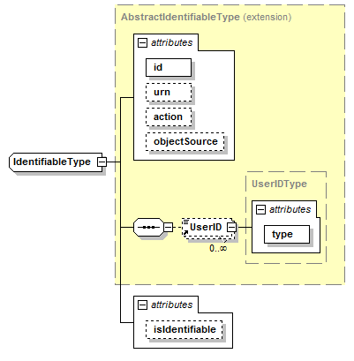
Identification Types - Identifiable
S08

Slide 53
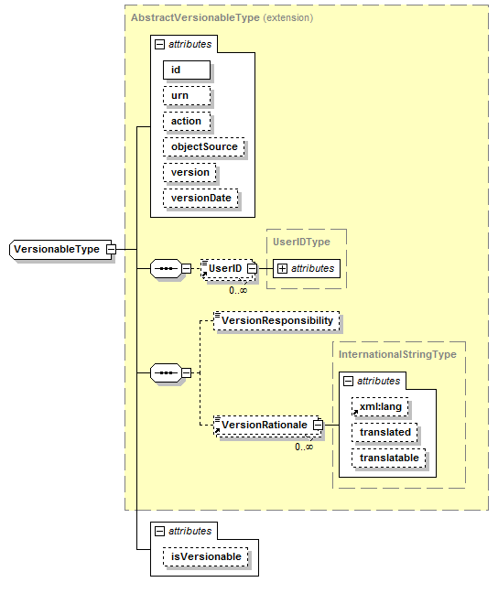
Identification Types: Versionable
S08

Slide 54
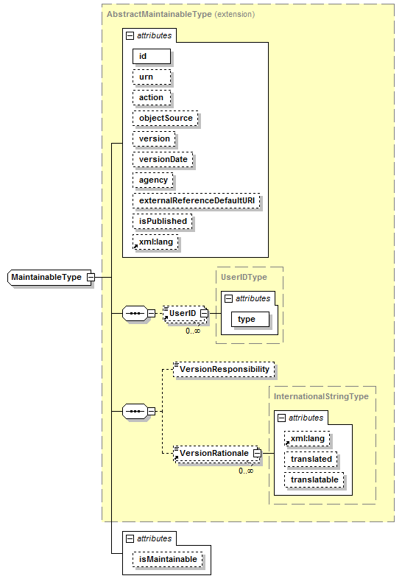
Identification Types: Maintainable
S08

Slide 55
Parts of the Identification Series
Identifiable Element
  Identifier:
    ID
    Identifying Agency
    Version
    Version Date
    Version Responsibility
    Version Rationale
    UserID
    Object Source
Variable
  Identifier:
    V1
    us.mpc
    1.1.0 [default is 1.0.0]
    2007-02-10
    Wendy Thomas
    Spelling correction
S08

Slide 56
DDI Identifiers: Elements
S08
Typical appearance (identifiable):
<p:DataItem id=“AB347” isIdentifiable=“true”>
…
</p:DataItem>
Typical appearance (versionable):
<l:Variable id=“V1” version=“1.1.0” versionDate=“2007-02-12” isVersionable=“true”>
<r:VersionResponsibility>Wendy Thomas</r:VersionResponsibility>
<r:VersionRationale>Spelling Correction</r:VersionRationale>
…
</l:Variable >

Slide 57
DDI Identifiers: Elements (cont.)
Typical appearance (maintainable):
<l:VariableScheme id=“VarSch01” agency =“us.mpc” version=“1.4.0” versionDate=“2009-02-12” isMaintainable=“true”>
…
</l:VariableScheme>
Note that version and agency may be defaulted/inherited, which means they do not need to be supplied in the local element
  In a simple example, they are given once for the whole study
  The object type is determined by the containing element
S08

Slide 58
The URN
urn=“urn:ddi:us.mpc:VariableScheme. VarSch01.1.4.0:Variable.V1.1.1.0”
Declares that its a ddi element
Gives the identifying agency
Tells the type of the element that is the parent maintainable including ID and version number
Tells the type of the element itself including ID and version number
  Note that the element ID must be unique within its maintainable object rather than within the agency
There are generic tools for resolving URNs
  They are mapped to local URLs
S08

Slide 59
URN Detailed Example
This is a URN
From DDI
In a variable scheme
The scheme agency is us.mpc
urn=“urn:ddi:us.mpc:VariableScheme. VarSch01.1.4.0:Variable.V1.1.1.0”
With identifier
VarSch01
For a variable
Version 1.1.0
Version 1.4.0
Variable ID is V1
S08

Slide 60
Changes to URN Syntax
Due to implementation experiences with DDI 3.0, the URN syntax was heavily revised for version 3.1
What we present here is the 3.1 version of the URN syntax
NOTE that with the publication of 3.2 a number of the constraints on the ID, Version, and Agency structures will be relaxed
S08

Slide 61
The Proposed URN in DDI 3.2
urn=“urn:ddi:us.mpc:VariableScheme: VarSch01:1.4.0:Variable:V1:1.1.0”
Tighter constraints on the structure of ID, Version, and Agency in 3.1 were based on the use of a “.” to separate the parts of an object description.
Changing the “.” separator between the object name, object id, and object version to “:” allows greater flexibility in the content of each individual item
The proposed relaxation of ID, Version, and Agency structures better supports current software and business practice
S08

Slide 62
DDI Internal References
References in DDI may be within a single instance or across instances
  Metadata can be re-packaged into many different groups and instances
  “Internal” references are made to objects in the same instance
  “External” reference are made to objects in other DDI instances
Identifiers must provide:
  The containing maintainable (a module or a scheme)
    Agency, ID, and Version
  The identifiable/versionable object
    ID (and version if versionable)
Like identifiers, DDI references may be using URNs or using element fields
S08

Slide 63
DDI External References
Change attribute isExternal to “true”
ALL DDI references to external objects must contain a URN
This may be accompanied by the same individual elements, but if there is a discrepancy between this information and the URN, the URN will take precedence
Beginning with DDI 3.1 you can also designate both the objectLanguage and sourceContext if broader than the parent maintainable
  ObjectLanguage specifies which language to use for display (if more than one is present)
  sourceContext identifies where the referenced object is coming from, identified with a URN, in cases where a specific object is available from more than one version of a scheme
S08

Slide 64
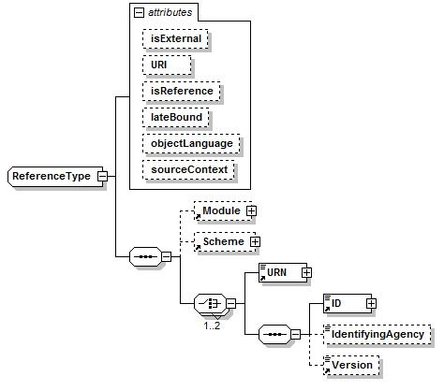
S08

Slide 65
Reference Examples
Internal
<VariableReference isReference=“true” isExternal=“false” lateBound=“false”>
<Scheme isReference=“true” isExternal=“false” lateBound=“false”>
<ID>VarSch01</ID>
<IdenftifyingAgency>us.mpc</IdentifyingAgency>
<Version>1.4.0</Version>
</Scheme>
<ID>V1</ID>
<IdenftifyingAgency>us.mpc</IdentifyingAgency>
<Version>1.1.0</Version>
</VariableReference>
S08

Slide 66
Reference Examples
External
<VariableReference isReference=“true” isExternal=“true” lateBound=“false”>
<urn>urn:ddi:us.mpc:VariableScheme.VarSch01.1.4.0:Variable.V1.1.1.0</urn>
</VariableReference>
S08

Slide 67
Notes
Expanded detail
  Identifiable type
  Note type (DDI specified content)
  Subject (Controlled Vocabulary)
  Relationship (Reference, Relationship Description)
  Responsibility
  Header
  Content
Can be attached to any element that has an ID using Relationship
Single note with multiple references
S08

Slide 68
A Note about Notes
Notes are allowed in many parts of the DDI structure
  DDIInstance
  At the module level
When using Notes, it is a good idea to keep them inside the module which contains the items to which the Note is attached if possible
  Otherwise, they may get lost when the DDI instance is stored
  In DDI 3.2, Notes will be included inside all maintainables, including schemes
S08

Slide 69
Other Material
Cover a multitude of DDI 1/2 materials
  Source documents
  Section 5 “other materials”
  Physical maps
  Geographic files (shape files)
The purpose of this section is reference and so contains only the basic bibliographic citation and location information if available
Can be linked to any element with an ID
As for Notes, the placement of Other Materials inside modules and instances should be done carefully
S08

Slide 70
Other Material DDI 3.1
Added Segment information
  Allows designating start and stop information for
    Text
    Audio
    Video
    XML
  Allows linking to specific segments of other forms of electronic materials
S08

Slide 71
Citations
Citations are available in several modules:
  Instance
  Study Unit
  Group
  Resource Package
  Physical Instance
In addition to the standard citation elements you can also include simple Dublin Core elements in their native format
S08

Slide 72
Coverage
There are three types of Coverage in DDI 3:
  Spatial (geographic)
  Temporal (time)
  Topical (subject and keyword)
S08

Slide 73
Coverage Restrictions
Spatial, Temporal, and Topical Coverage are available in all modules
Top level (instance, study, group, or resource package) should be inclusive of all contained modules
Individual modules may declare limited coverage
S08

Slide 74
Examples
Study covers:
  US, 1790-2000, Population-Age and Population-Gender
Individual data file:
  US, 1850, Male-Age
The individual data file would inherit the Spatial Coverage and limit the Topical and Temporal Coverage.
S08

Slide 75
Spatial Coverage
Describe the geographic cover in detail
References the geographic hierarchies found in the data and which have data summarized at that level
Provides information on the smallest and largest spatial object type found in the data
References Geographic Structure and Locations
S08

Slide 76
Bounding Box
<r:BoundingBox>
<r:NorthLatitude>+76.63</r:NorthLatitude>
<r:EastLongitude>-61.48</r:EastLongitude>
<r:SouthLatitude>+13.71</r:SouthLatitude>
<r:WestLongitude>-177.1</r:WestLongitude>
</r:BoundingBox>
S08

Slide 77
Description
<r:Description translated="false" translatable="true">
<xhtml:p>United States, Region, Division, State, County, County Subdivision, Place, Tract/Block Numbering Area within Place/Remainder within County Subdivision.</xhtml:p>
</r:Description>
S08

Slide 78
Spatial Object
Point
  Address
  Coordinate point
Line
  Street
  Boundary
Polygon
Linear Ring
  Point and radius
S08

Slide 79
Geography
Attributes
  Does it have summary data?
  Is it the top level? Lowest level?
  Is it exhaustive?
S08

Slide 80
Reference to Reusable Geographic Description
Spatial coverage can contain a reference to an appropriate
  Geographic Structure Scheme
  Geographic Location Scheme
These schemes may also be included in Conceptual Components or published in a Resource Package.
These do not replace the other items in Spatial Coverage, but provide detail and support comparability between studies using the same geographies
S08

Slide 81
External maps
Other Materials
  Available in all modules
  Uniform citation structure
  Typed [currently a string but will be controlled]
  Link to any element with an ID
    Mapping of a specific variable
    Shape files for specific geographic levels
S08

Slide 82
Temporal Coverage
S08
Set of Reference Dates describing the time period covered by the study and data
<Date>
<StartDate>2009-03-30</StartDate>
<HistoricalStartDate>
March 30, 2009
</HistoricalStartDate>
<EndDate>2009-04-03</EndDate>
<HistoricalEndDate>
April 3, 2009
</HistoricalEndDate>
</Date>

Slide 83
Dates
ISO required structure
Combine various year+month+day+time
SimpleDate
Date Ranges
Noting Historical Date structures
Calendar types of the Historical Date
DateTime Response Domains
  Declare type used for non-ISO structures
S08

Slide 84
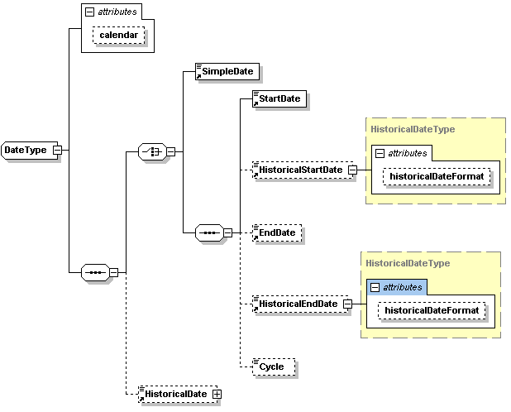
Dates
S08

Slide 85
Topical Coverage
Subject
  A structured set of terms expressing topical coverage of the study content. Examples include: U.S. Library of Congress Subject Headings, Medical Subject Headings (MESH), etc.
Keyword
  Unstructured words selected due to frequency of occurrence within a study or terms that may be linked to subjects in external systems such as synonyms or representations of a subject. Example of a keyword “Blue”: this can be a color or a feeling. Searches of keywords do not differentiate.
Maps to Dublin Core elements
S08

Slide 86
International Code Value
Content – can be any type of string, but is usually a value from a controlled vocabulary
Attributes:
  ISO language code (xml:lang) - required
  Boolean “translated” – default “false”
  Boolean “translatable” – default “false”
  Genericode code list identification (codelistID)
  Agency maintaining the code list (codeListAgency)
  Version of the code list (codeListVersion)
All types of controlled vocabularies in DDI function the same way, but not all are International – some are just Code Value Type
S08

Slide 87
Subject Example
<r:Subject xml:lang="en" codeListID="DDI_MESH" codeListAgency="MESH" codelistVersion="1.0">
Arthritis.Rheumatoid
</Subject>
S08

Slide 88
Controlled Vocabularies
One feature which is now being addressed is the use of controlled vocabularies
  These occur in many places in the schemas
  There is a working group looking at these issues and making recommendations
There is an OASIS standard called “Genericode” which addresses the use of controlled vocabularies in XML standards
  It allows them to be customized by different user communities
  It separates them from the versioning of the XML standard itself
DDI will use Genericode to handle controlled vocabularies in 3 and moving ahead
S08

Slide 89
Genericode
Every place in the DDI XML which uses a controlled vocabulary has a set of attributes:
  Codelist ID
  Codelist Name
  Codelist Agency Name
  Codelist version ID
  Codelist URN
  Codelist Scheme URN
These point to an external codelist maintained in Genericode XML
  The Genericode term for a controlled vocabulary is “codelist”
Controlled vocabularies are not validated not by the normal XML parser using the DDI schemas
  They are validated after-the-fact using a separate mechanism such as Schematron
S08

Slide 90
Genericode Example
S08
<Row>
<Value ColumnRef="Code">
<SimpleValue>Arthritis.Rheumatoid</SimpleValue>
</Value>
<Value ColumnRef="ParentCode">
<SimpleValue>Arthritis</SimpleValue>
</Value>
<Value ColumnRef=“LowestLevelCode">
<SimpleValue>Rheumatoid</SimpleValue>
</Value>
<Value ColumnRef="Caption">
<SimpleValue>Rheumatoid Arthritis</SimpleValue>
</Value>
<Value ColumnRef="Definition">
<SimpleValue>Inflammatory arthritis, a chronic symptom
disease, primarily of the joints</SimpleValue>
</Value>
</Row>

Slide 91
DDI Overall Metadata Content, Structure and Component Parts
Learning DDI: Pack S04
Copyright © GESIS – Leibniz Institute for the Social Sciences, 2010
Published under Creative Commons Attribute-ShareAlike 3.0 Unported
S04

Slide 92
using
Study
Survey
Instruments
measures
made up of
about
Concepts
Questions
Universes
S04

Slide 93
Categories/
Codes,
Numbers
with values of
Questions
Variables
collect
made up of
Responses
Data Files
resulting in
S04

Slide 94
Introduction to XML and Metadata
How this section is structured
  High-level view of the XML structure
  Introduction to the modules and what metadata they contain
  A first look at DDI “schemes” and reusable metadata
Be aware that we will come back to all of these subjects – this is just a first glimpse!
S04

Slide 95
DDI Instance
Citation
Coverage
Other Material / Notes
Translation Information
Study Unit
Group
3.1 Local Holding Package
Resource Package
S04

Slide 96
Study Unit
Citation / Series Statement
Abstract / Purpose
Coverage / Universe / Analysis Unit / Kind of Data
Other Material / Notes
Funding Information / Embargo
Conceptual
Components
Data
Collection
Logical
Product
Physical
Data
Product
Physical
Instance
Archive
DDI
Profile
S04

Slide 97
Group
Citation / Series Statement
Abstract / Purpose
Coverage / Universe
Other Material / Notes
Funding Information / Embargo
Conceptual
Components
Data
Collection
Logical
Product
Physical
Data
Product
Sub Group
DDI
Profile
Study Unit
Comparison
Archive
S04

Slide 98
Resource Package
Citation / Series Statement
Abstract / Purpose
Coverage / Universe
Other Material / Notes
Funding Information / Embargo
Any Scheme:
Organization
Concept
Universe
Geographic Structure Geographic Location Question
Interviewer Instruction
Control Construct
Category
Code
Variable
NCube
Physical Structure
Record Layout
Any module
EXCEPT
Study Unit or
Group
S04

Slide 99
3.1 Local Holding Package
Citation / Series Statement
Abstract / Purpose
Coverage / Universe
Other Material / Notes
Funding Information / Embargo
Depository Study Unit OR Group Reference:
[A reference to the stored version of the deposited study unit.]
Local Added Content:
[This contains all content available in a Study Unit whose source is the local archive.]
S04

Slide 100
DDI 3 Lifecycle Model and Related Modules
Groups and Resource Packages are a means of publishing any portion or combination of sections of the life cycle
Local
Holding
Package
Logical
Product
Physical
Data
Product
Study
Unit
Data
Collection
Physical
Instance
Archive
S04

Slide 101
Study Unit
Study Unit
  Identification
  Coverage
    Topical
    Temporal
    Spatial
  Conceptual Components
    Universe
    Concept
    Representation (optional replication)
  Purpose, Abstract, Proposal, Funding
Identification is mapped to Dublin Core and basic Dublin Core is included as an option
Geographic coverage mapped to FGDC / ISO 19115
  bounding box
  spatial object
  polygon description of levels and identifiers
Universe Scheme, Concept Scheme
  link of concept, universe, representation through Variable
  also allows storage as a ISO/IEC 11179 compliant registry
S04

Slide 102
Data Collection
Methodology
Question Scheme
  Question
  Response domain
Instrument
  using Control Construct Scheme
Coding Instructions
  question to raw data
  raw data to public file
Interviewer Instructions
Question and Response Domain designed to support question banks
  Question Scheme is a maintainable object
Organization and flow of questions into Instrument
  Used to drive systems like CASES and Blaise
Coding Instructions
  Reuse by Questions, Variables, and comparison
S04

Slide 103
Logical Product
Category Schemes
Coding Schemes
Variables
NCubes
Variable and NCube Groups
Data Relationships
Categories are used as both question response domains and by code schemes
Codes are used as both question response domains and variable representations
Link representations to concepts and universes through references
Built from variables (dimensions and attributes)
  Map directly to SDMX structures
  More generalized to accommodate legacy data
S04

Slide 104
Physical storage
Physical Data Structure
  Links to Data Relationships
  Links to Variable or NCube Coordinate
  Description of physical storage structure
    in-line, fixed, delimited or proprietary
Physical Instance
  One-to-one relationship with a data file
  Coverage constraints
  Variable and category statistics
S04

Slide 105
Archive
An archive is whatever organization or individual has current control over the metadata
Contains persistent lifecycle events
Contains archive specific information
  local identification
  local access constraints
S04

Slide 106
Group
Resource Package
  Allows packaging of any maintainable item as a resource item
Group
  Up-front design of groups – allows inheritance
  Ad hoc (“after-the-fact”) groups – explicit comparison using comparison maps for Universe, Concept, Question, Variable, Category, and Code
Local Holding Package
  Allows attachment of local information to a deposited study without changing the version of the study unit itself
S04

Slide 107
DDI Schemes
Brief overview of what DDI schemes are and what they are designed to do including:
  Purpose of DDI Schemes
  How a DDI Study is built using information held in schemes
S04

Slide 108
DDI Schemes: Purpose
A maintainable structure that contains a list of versionable things
Supports registries of information such as concept, question and variable banks that are reused by multiple studies or are used by search systems to location information across a collection of studies
Supports a structured means of versioning the list
May be published within Resource Packages or within DDI modules
Serve as component parts in capturing reusable metadata within the life-cycle of the data
S04

Slide 109
Building from Component Parts
S04
UniverseScheme
CategoryScheme
NCube
Scheme
CodeScheme
ConceptScheme
Variable
Scheme
QuestionScheme
ControlConstructScheme
RecordLayout
Scheme
[Physical Location]
Instrument
LogicalRecord
PhysicalInstance

Slide 110
DDI XML Schemas and Main Structures
Learning DDI: Pack S09
Copyright © GESIS – Leibniz Institute for the Social Sciences, 2010
Published under Creative Commons Attribute-ShareAlike 3.0 Unported
S09

Slide 111
XML Schemas, DDI Modules, and DDI Schemes
Correspond to a stage in the lifecycle
XML Schemas
DDI Modules
<file>.xsd
<file>.xsd
<file>.xsd
<file>.xsd
May Contain
May Correspond
DDI Schemes
S09

Slide 112
XML Schemas
archive
comparative
conceptualcomponent
datacollection
dataset
dcelements
DDIprofile
ddi-xhtml11
ddi-xhtml11-model-1
ddi-xhtml11-modules-1
group
inline_ncube_recordlayout
instance
logicalproduct
ncube_recordlayout
physicaldataproduct
physicalinstance
proprietary_record_layout
reusable
simpledc20021212
studyunit
tabular_ncube_recordlayout
xml
set of xml schemas to support xhtml
S09

Slide 113
Types of DDI XML Schemas
Packaging / Structural Modules
Scheme-Based Modules (contain maintainable schemes)
Non-Scheme-Based Modules
Sub-Modules (used exclusively in other modules)
External XML Schemas (eg, Dublin Core)
Reusable (commonly needed components)
S09

Slide 114
Types of DDI XML Schemas
Packaging / Structural
Scheme-Based (contain maintainable schemes)
Non-Scheme-Based
Sub-Modules (used exclusively in other modules)
External XML Schemas
Reusable (commonly needed components)
DDI Instance
Study Unit
Group
S09

Slide 115
Types of DDI XML Schemas
archive
  OrganizationScheme
datacollection
  QuestionScheme
  ControlConstructScheme
  InterviewerInstructionScheme
conceptualcomponent
  ConceptScheme
  UniverseScheme
  GeographicStructureScheme
  GeographicLocationScheme
logicalproduct
  CategoryScheme
  CodeScheme
  VariableScheme
  NCubeScheme
physicaldataproduct
  PhysicalStructureScheme
  RecordLayoutScheme
Packaging / Structural
Scheme-Based (contain maintainable schemes)
Non-Scheme-Based
Sub-Modules (used exclusively in other modules)
External XML Schemas
Reusable (commonly needed components)
S09

Slide 116
Types of DDI XML Schemas
Packaging / Structural
Scheme-Based (contain maintainable schemes)
Non-Scheme-Based
Sub-Modules (used exclusively in other modules)
External XML Schemas
Reusable (commonly needed components)
physicalinstance
comparative
DDIprofile
S09

Slide 117
Types of DDI XML Schemas
Packaging / Structural
Scheme-Based (contain maintainable schemes)
Non-Scheme-Based
Sub-Modules (used exclusively in other modules)
External XML Schemas
Reusable (commonly needed components)
Used in physicaldataproduct:
inline_ncube_recordlayout
ncube_recordlayout
tabular_ncube_recordlayout
dataset
proprietary
S09

Slide 118
Types of DDI XML Schemas
Packaging / Structural
Scheme-Based (contain maintainable schemes)
Non-Scheme-Based
Sub-Modules (used exclusively in other modules)
External XML Schemas
Reusable (commonly needed components)
dcelements
simpledc20021212
ddi-xhtml11
ddi-xhtml11-model-1
ddi-xhtml11-modules-1
folder full of xml schemas to support xhtml
xml
S09

Slide 119
Types of DDI XML Schemas
Packaging / Structural
Scheme-Based (contain maintainable schemes)
Non-Scheme-Based
Sub-Modules (used exclusively in other modules)
External XML Schemas
Reusable (commonly needed components)
Reusable
  defines elements and complex elements used by the various XML schemas
    Label
    Description
    Notes
    etc.
S09

Slide 120
Reminder: DDI Modules and Schemes
DDI has two important structures:
  “Modules”
  “Schemes”
A module is a package of metadata corresponding to a stage of the lifecycle or a specific structural function
A scheme is a list of reusable metadata items of a specific type
Many DDI modules contain DDI schemes
S09

Slide 121
XML Schemas, DDI Modules, and DDI Schemes
Correspond to a stage in the lifecycle
XML Schemas
DDI Modules
<file>.xsd
<file>.xsd
<file>.xsd
<file>.xsd
May Contain
May Correspond
DDI Schemes
S09

Slide 122
XML Schemas, DDI Modules, and DDI Schemes
Data Collection
Logical Product
Physical Data Structure
Archive
Conceptual Component
Reusable
Ncube
Inline ncube
Tabular ncube
Proprietary
Dataset
Instance
Study Unit
Physical Instance
DDI Profile
Comparative
S09

Slide 123
XML Schemas, DDI Modules, and DDI Schemes
Data Collection
Logical Product
Physical Data Structure
Archive
Conceptual Component
Reusable
Ncube
Inline ncube
Tabular ncube
Proprietary
Dataset
Instance
Study Unit
Physical Instance
DDI Profile
Comparative
S09

Slide 124
XML Schemas, DDI Modules, and DDI Schemes
    Data Collection
      Question Scheme
      Control Construct Scheme
      Interviewer Instruction Scheme
    Logical Product
      Category Scheme
      Code Scheme
      Variable Scheme
      NCube Scheme
    Physical Data Structure
      Physical Structure Scheme
      Record Layout Scheme
    Archive
      Organization Scheme
    Conceptual Component
      Concept Scheme
      Universe Scheme
      Geographic Structure Scheme
      Geographic Location Scheme
Reusable
Ncube
Inline ncube
Tabular ncube
Proprietary
Dataset
Instance
Study Unit
Physical Instance
DDI Profile
Comparative
S09

Slide 125
Why Schemes?
You could ask “Why do we have all these annoying schemes in DDI?”
There is a simple answer: reuse!
DDI 3 supports the concept of metadata registries (eg, question banks, variable banks)
DDI 3 also needs to show specifically where something is reused
  Including metadata by reference helps avoid error and confusion
  Reuse is explicit
S09

Slide 126
Designed to Support Registries
A “Registry” is a catalog of metadata resources
Resource package
  Structure to publish non-study-specific materials for reuse
Extracting specified types of information in to schemes
  Universe, Concept, Category, Code, Question, Instrument, Variable, etc.
Allowing for either internal or external references
  Can include other schemes by reference and select only desired items
Providing Comparison Mapping
  Target can be external harmonized structure
S09

Slide 127
DDI’s “Meta-Module”
One module is unlike all of the others in DDI – the DDI Profile
This is a “meta-module” – it talks about how the DDI 3 is being used by a specific application or organization
  We do not go into great detail
  Be aware that Profiles exist however: developers love them!
S09

Slide 128
DDI Profiles
The DDI Profile module lets you describe which fields you use in your institution’s flavor of DDI
  It is useful for performing machine validation of received instances
  It is useful documentation for human users
You provide a set of information for each element allowed in a complete DDI instance
  If it is used or not used
  If optional fields (per the XML schema) are required
Provides the ability to describe DDI Templates
  Element AlternateName, Description and Instructions
  Required, default, fixed values
S09

Slide 129
<DDIProfile xmlns="ddi:profile:3_1"
id="DDIProfileSTUDYNO">
<XPathVersion>1.0</XPathVersion>
<DDINamespace>3.1</DDINamespace>
<XMLPrefixMap>
<XMLPrefix>s</XMLPrefix>
<XMLNamespace>ddi:studyunit:3_1</XMLNamespace>
</XMLPrefixMap>
<Used path="/DDIInstance/VersionResponsibility"/>
<Used path="/DDIInstance/Citation/Title“/>
<Used path="/DDIInstance/Citation/Creator" required="true" >
<AlternateName>Author</AlternateName>
<Used path="/DDIInstance/StudyUnit/Citation/Title"/>
.....
<NotUsed path="/DDIInstance/StudyUnit/FundingInformation"/>
</DDIProfile>
S09

Slide 130
The XML Document
The XML document is organized into a series of namespace modules:
  “ddi:” holds the DDI Instance
  “s:” for StudyUnit
  “c:” for conceptual component (concepts and universes)
  “d:” for datacollection (question text)
  “l:” for logicalproduct (variables, categories, and codes)
  “p:” for physicaldataproduct
  “pi:” for physicalinstance
  “r:” for reusable
This describes the sequence of DDI 3 modules within the XML document, and covers many of the basic constructs within DDI 3.
Open the document “AmericanNationalElectionSurvey.xml” on your machine in Internet Explorer
  The file “AmericanNationalElectionSurvey_outline.html” provides an outline view of the structure
  The file “AmericanNationalElectionSurvey_tooltip.html” provides a browser view with inline tool tips
S09

Slide 131
American National Election Survey Example: Schematic
Study Unit
Conceptual
component
Logical
product
Physical data
product
Concepts
Variables
Record
Layout
Universes
Codes
Physical
instance
Categories
Data collection
Category
Stats
Questions
S09

Slide 132
Group
Grouping and Inheritance
Resource Packages
Local Holding Packages
Learning DDI: Pack S18
Copyright © GESIS – Leibniz Institute for the Social Sciences, 2010
Published under Creative Commons Attribute-ShareAlike 3.0 Unported
S18

Slide 133
Understanding DDI Grouping
Many types of studies exist in relationship to other studies
  Because the data is being compared
  Because the studies are grouped for organizational purposes into a package (by time, by topic, by geography, etc.)
Some metadata can be re-used
  It needs to be published independent of a particular study
Archives often add a layer of metadata in addition to what is supplied with the study to be archived
The DDI Group module supports these functions (they are unrelated functions)
  DDI 3 Groups and SubGroups for grouping studies
  DDI 3 ResourcePackages for publishing metadata for re-use
  DDI 3 LocalHoldingPackages for archival add-on metadata
S18

Slide 134
Types of Grouping
There are three mechanisms for grouping DDI contents
  Group: 2 or more Study Units - can be contained within sub-groups if desired
  Resource Package: means of publishing one or more modules or DDI schemes EXCEPT for Group, Study Unit, or Local Holding Package
  Local Holding Package: Contains a ‘deposited’ Study Unit or Group PLUS local or value added by the local “archive” (This added value information is held within a Study Unit)
S18

Slide 135
Group:
Grouping and Inheritance
Grouping is the feature which allows DDI 3 to package groups of studies into a single XML instance, and express relationships between them
To save repetition – and promote re-use – there is an inheritance mechanism, which allows metadata to be automatically shared by studies
This can be a complicated topic, but it is the basis for many of DDI 3’s features, including comparison of studies
There is a switch which can be used to “turn off” inheritance
S18

Slide 136
Group Contents
A group can contain study units, subgroups, and resource packages:
  Study units document individual studies
  Subgroups (inline or by reference)
  Any of the content modules (Logical Product, Data Collection, etc.)
Groups can nest indefinitely
They have a set of attributes which explain the purpose of the group (as well as having a human-readable description):
  Grouping by Time
  Grouping by Instrument
  Grouping by Panel
  Grouping by Geography
  Grouping by Data Set
  Grouping by Language
  Grouping by User-Defined Factor
S18

Slide 137
Inheritance
S18
Group A
Subgroup B
Subgroup C
Study D
Study E
Study F
Study G
Study H
Study I
Modules can be attached at any level
They are shared – without repetition – by all child study units and subgroups
If Group A has declared a concept called “X”, it is available to Study Units D – I.
If Subgroup C has declared a Variable “Gender”, it is available to Study Units H
and I without reference or repetition
Inherited metadata can be changed using local overrides which add, update, or
delete inherited properties

Slide 138
Actions in Identifiers
In some places – especially in groups where lots of metadata is being inherited – you can Add, Update, and Delete items using identifiers.
  Using @action attribute = Add/Delete/Update
  Repeat the identifier of the inherited object being locally modified
This allows for local re-definition that is not reflected in a new version of the scheme
  It cannot be reused
For re-use, schemes should be versioned!
S18

Slide 139
German Social Economic Panel (SOEP) Study Example
The following slides show how different types of metadata can be shared using grouping and inheritance
The SOEP is a panel study, with different panels on different years
  Variables change over time
  New questions and data are added
S18

Slide 140
Group
1997 - 2003
Person-level information
Satisfaction with life
School degree
Subgroup
Subgroup
Currency is Euro
Currency is DM
Size of Company
(v 1.0)
Reuse variable scheme
by reference
1997
1998
Subgroup
2002
2003
Size of company
with concerns
about Euro (v1.1)
[currency is still DM]
1999
2000
2001
S18

Slide 141
Comparison
S18

Slide 142
Comparison
There are two types of comparison in DDI 3:
  Comparison by design
  Ad-hoc (after-the-fact) comparison
Comparison by design can be expressed using the grouping and inheritance mechanism
Ad-hoc comparison can be described using the comparison module
The comparison module is also useful for describing harmonization when performing case selection activities
S18

Slide 143
Data Comparison
To compare data from different studies (or even waves of the same study) we use the metadata
  The metadata explains which things are comparable in data sets
When we compare two variables, they are comparable if they have the same set of properties
  They measure the same concept for the same high-level universe, and have the same representation (categories/codes, etc.)
  For example, two variables measuring “Age” are comparable if they have the same concept (e.g., age at last birthday) for the same top-level universe (i.e., people, as opposed to houses), and express their value using the same representation (i.e., an integer from 0-99)
  They may be comparable if the only difference is their representation (i.e., one uses 5-year age cohorts and the other uses integers) but this requires a mapping
S18

Slide 144
DDI Support for Comparison
For data which is completely the same, DDI provides a way of showing comparability: Grouping
  These things are comparable “by design”
  This typically includes longitudinal/repeat cross-sectional studies
For data which may be comparable, DDI allows for a statement of what the comparable metadata items are: the Comparison module
  The Comparison module provides the mappings between similar items (“ad-hoc” comparison)
  Mappings are always context-dependent (e.g., they are sufficient for the purposes of particular research, and are only assertions about the equivalence of the metadata items)
S18

Slide 145
Study A
Study B
Group
uses
Variable A
uses
uses
Variable B
Variable A
Variable A
Variable C
Variable B
Variable B
Variable C
Variable C
Variable D
Variable X
contains
contains
Study A
Study B
uses
uses
Variable D
Variable X

Slide 146
Comparison Module
Is the Same As
Study A
Study B
uses
Is the Same As
uses
Variable A
Variable W
Variable B
Is the Same As
Variable X
Variable C
Variable Y
Variable D
Is the Same As
Variable Z

Slide 147
Comparison Content
A comparison element is placed on a group or subgroup
It contains:
  Description of the comparison
  Concept maps
  Variable maps
  Question maps
  Category maps
  Code maps
  Universe maps
  Notes
Each map provides for a description of how two compared items correlate and/or differ, and also allows for a coding to be associated with the correlation
S18

Slide 148
Ad Hoc Groups
Creating a course specific group
  3 files on aging
  Create the group and declare the reason for selecting and including these studies
  Note common or comparable concepts OR clarify why they are similar but NOT the same
  Map any needed recodes for comparability
  Provide the links (for example geographic)
S18

Slide 149
Equivalencies
FIPS
  01 Alabama
  02 Alaska
  04 Arkansas
  06 California
  08 Colorado
  09 Connecticut
  10 Delaware
  11 District of Columbia
  12 Florida
CENSUS
  63 Alabama
  94 Alaska
  86 Arkansas
  71 California
  84 Colorado
  16 Connecticut
  51 Delaware
  53 District of Columbia
  59 Florida
=
S18

Slide 150
Providing Comparative Information
Create the category and coding schemes
Use the comparison maps to provide comparability
  Codes, Categories, Variables, Concepts Questions, Universe
Example:
  6 files using 3 different age variables
  Single year, five year, and ten year cohorts
Map each equivalent structure to a single example
Map the single year to the five year
Map the five year to the ten year
Provide the software command to do the conversion
S18

Slide 151
SINGLE YEARS
< 1 year
1 year
2 years
3 years
4 years
5 years
6 years
7 years
8 years
9 years
10 years
11 years
12 years
13 years
14 years
15 years
16 years
17 years
18 years
19 years
20 years
Etc.
5 YEAR COHORTS
< 5 years
5 to 9 years
10 to 14 years
15 to 19 years
20 years plus
10 YEAR COHORTS
< 10 years
10 to 19 years
20 years plus
S18

Slide 152
SINGLE YEARS
< 1 year
1 year
2 years
3 years
4 years
5 years
6 years
7 years
8 years
9 years
10 years
11 years
12 years
13 years
14 years
15 years
16 years
17 years
18 years
19 years
20 years
Etc.
5 YEAR COHORTS
< 5 years
5 to 9 years
10 to 14 years
15 to 19 years
20 years plus
10 YEAR COHORTS
< 10 years
10 to 19 years
20 years plus
S18

Slide 153
SINGLE YEARS
< 1 year
1 year
2 years
3 years
4 years
5 years
6 years
7 years
8 years
9 years
10 years
11 years
12 years
13 years
14 years
15 years
16 years
17 years
18 years
19 years
20 years
Etc.
5 YEAR COHORTS
< 5 years
5 to 9 years
10 to 14 years
15 to 19 years
20 years plus
10 YEAR COHORTS
< 10 years
10 to 19 years
20 years plus
Each with both a human readable and
machine-actionable command
S18

Slide 154
Comparability
The comparability of a question or variable can be complex. You must look at all components. For example, with a question you need to look at:
  Question text
  Response domain structure
    Type of response domain
    Valid content, category, and coding schemes
The following table looks at levels of comparability for a question with a coded response domain
More than one comparability “map” may be needed to accurately describe comparability of a complex component
S18

Slide 155
Detail of question comparability
S18
Comparison Map | Textual Content of Main Body |  | Category |  | Code Scheme
 | Same | Similar | Same | Similar | Same | Different
Question | X |  | X |  | X
 | X |  | X |  |  | X
 | X |  |  | X | X
 | X |  |  | X |  | X
 |  | X | X |  | X
 |  | X | X |  |  | X
 |  | X |  | X | X
 |  | X |  | X |  | X

Slide 156
Resource Packages
S18

Slide 157
Resource Packages
Used to publish reusable information outside of a specific study
Examples:
  Geographic Code Scheme
  Industry Codes
  Question Scheme [common questions within an organization]
  Concept Scheme
S18

Slide 158
Special Considerations
References to external DDI Schemes can be made at the DDI Scheme level
  Items to exclude can be listed within this reference
Large DDI Schemes should be packaged for easy reference of sub-sections
  For example: an overall Occupation Coding Scheme may consist of multiple sub-Schemes for each major Occupation Group making it easier to reference a single Occupation Group within the overall Occupation Coding Scheme
S18

Slide 159
Local Holding Package
Local Added Content is of type StudyUnit
  Value added material
  Process information
No effect on version number of deposited content
Local Holding Package
Depository
Study Unit
OR
Group
Reference
Local
Added
Content
S18

Slide 160
DDI 3 Use Cases
Learning DDI: Pack S06
Copyright © GESIS – Leibniz Institute for the Social Sciences, 2010
Published under Creative Commons Attribute-ShareAlike 3.0 Unported
S06

Slide 161
Study Design/Survey Instrumentation
This use case concerns how DDI 3 can support the design of studies and survey instrumentation
  Without benefit of a question or concept bank
S06

Slide 162
Types of Metadata:
Concepts (conceptual module)
Universe (conceptual module)
Questions (datacollection module)
Flow Logic (datacollection module)
<DDI 3>
Concepts
Universes
<DDI 3>
Concepts
Universes
Final
Drafting/
Review/
Revision
+
<DDI 3>
Questions
Flow Logic
<DDI 3>
Concepts
Universes
Questions
Flow Logic
As the survey instrument
is tested, all revisions and
history can be tracked
and preserved. This would
include question translation
and internationalization.
Final
Drafting/
Testing/
Revision

Slide 163
studyunit.xsd conceptualcomponent.xsd datacollection.xsd logicalproduct.xsd
<s:StudyUnit>
required and optional study unit elements plus
<cc:ConceptualComponents>
<cc:ConceptScheme>
<cc:UniverseScheme>
<d:DataCollection>
<d:QuestionScheme>
<d:ControlConstructScheme>
<d:Processing>
<l:LogicalProduct>
<l:CategoryScheme>
<l:CodeScheme>
S06

Slide 164
Questionnaire Generation, Data Collection, and Processing
This use case concerns how DDI 3 can support the creation of various types of questionnaires/CAI, and the collection and processing of raw data into microdata.
S06

Slide 165
Paper
Questionnaire
Types of Metadata:
Concepts (conceptual module)
Universe (conceptual module)
Questions (datacollection module)
Flow Logic (datacollection module)
Variables (logicalproduct module)
Categories/Codes (logicalproduct module)
Coding (datacollection module)
<DDI 3>
Concepts
Universes
Questions
Flow Logic
Online Survey
Instrument
Final
CAI
Instrument
Raw Data
Microdata
DDI captures
the content – XML
allows for each
application to do
its own presentation
<DDI 3>
Concepts
Universes
Questions
Flow Logic
<DDI 3>
Variables
Coding
<DDI 3>
Categories
Codes
Physical Data Product
Physical Data Instance
+
+

Slide 166
studyunit.xsd conceptualcomponent.xsd datacollection.xsd logicalproduct.xsd physicaldatastructure.xsd physicalinstance.xsd
Previous structure PLUS
<l:LogicalProduct>
<l:DataRelationship>
<l:VariableScheme>
<pd:PhysicalDataStructure>
<pd:PhysicalStructureScheme>
<pd:RecordLayoutScheme>
<pi:PhysicalInstance>
S06

Slide 167
Data Recoding, Aggregation, etc.
This use case concerns how DDI 3 can describe recodes, aggregation, and similar types of data processing.
S06

Slide 168
Could be a recode,
an aggregation,
or other process.
Initial microdata has:
Concepts (conceptual module)
Universes (conceptual module)
Questions (datacollection module)
Flow Logic (datacollection module)
Variables (logicalproduct module)
Coding (datacollection module)
Categories (logicalproduct module)
Codes (logicalproduct module)
Physical Data Product
Physical Data Instance
Recode adds:
More codings (datacollection module)
New variables
New categories
New codes
NCubes (for aggregation)
Microdata/
Aggregates
Microdata
<DDI 3>
Conceptual
Datacollection
Variables
Categories
Codes
<DDI 3>
Codings
Variables (new)
Categories (new)
Codes (new)
NCubes
+

Slide 169
studyunit.xsd conceptualcomponent.xsd datacollection.xsd logicalproduct.xsd physicaldatastructure.xsd physicalinstance.xsd
ADD to the following schemas
<d:DataCollection> new <d:Processing> elements
<l:LogicalProduct>
<l:NCubeScheme>
<pd:PhysicalDataStructure> new NCube Record Layout
<pi:PhysicalInstance> additional physical instances
S06

Slide 170
Data Dissemination/Data Discovery
This use case concerns how DDI 3 can support the discovery and dissemination of data.
S06

Slide 171
Rich metadata supports
auto-generation of websites,
packages of specific, related materials, and other delivery formats and applications
<DDI 3>
Can add archival
events meta-data
Codebooks
<DDI 3>
[Full meta-
data set]
Websites
+
Databases,
repositories
Research
Data Centers
Microdata/
Aggregates
Data-Specific
Info Access
Systems
Registries
Catalogues
Question/Concept/
Variable Banks

Slide 172
<cc:ConceptScheme>
<cc:UniverseScheme>
<cc:GeographicStructureScheme>
<cc:GeographicLocationScheme>
<d:QuestionScheme>
<d:ControlConstructScheme>
<l:VariableScheme>
<l:CategoryScheme>
<l:CodeScheme>
<pd:PhysicalStructureScheme>
<pd:RecordLayoutScheme>
<a:OrganizationScheme>
<s:StudyUnit> [descriptive content]
Store as separate resources
Use content to feed a different registry structure
S06

Slide 173
Archival Ingestion and
Metadata Value-Add
This use case concerns how DDI 3 can support the ingest and migration functions of data archives and data libraries.
S06

Slide 174
Dissemination
Systems
Supports automation
of processing if good DDI metadata is captured upstream
Provides a neutral format for data migration as analysis packages are versioned
<DDI 3>
[Full meta-
data set]
(?)
Data Archive
Data Library
Ingest
Processing
+
Microdata/
Aggregates
Can package
Data and
metadata for
preservation
purposes
– populate
other standard
formats
<DDI 3>
[Full or
additional
metadata]
Archival events
Preservation
Systems
Provides good format &
foundation for value-
added metadata by
archive

Slide 175
<g:LocalHoldingPackage>
<s:StudyUnit>
  with full content
  OR
<g:Group>
  with full content
<s:StudyUnit>
  new value added content
  <a:Archive>
    <a:LifeCycleEvents>
    capture ingest processing events
+
S06

Slide 176
Question/Concept/Variable Banks
This use case describes how DDI 3 can support question, concept, and variable banks. These are often termed “registries” or “metadata repositories” because they contain only metadata – links to the data are optional, but provide implied comparability. The focus is metadata reuse.
S06

Slide 177

Because DDI has links, each type of bank
functions in a modular, complementary way.
<DDI 3>
Questions
Flow Logic
Codings
Question
Bank
<DDI 3>
Questions
Flow Logic
Codings
Users
and
Applications
<DDI 3>
Variables
Categories
Codes
Variable
Bank
<DDI 3>
Variables
Categories
Codes
Users
and
Applications
<DDI 3>
Concepts
<DDI 3>
Concepts
Users
and
Applications
Concept
Bank
Supports but
does not require
ISO 11179

Slide 178
<g:ResourcePackage>
Question Bank
  <d:QuestionScheme>
  <d:ControlConstructScheme>
Variable Bank
  <l:CategoryScheme>
  <l:CodeScheme>
  <l:VariableScheme>
Concept Bank
  <cc:ConceptScheme>
S06

Slide 179
DDI For Use within a Research Project
This use case concerns how DDI 3 can support various functions within a research project, from the conception of the study through collection and publication of the resulting data.
S06

Slide 180


Prinicpal
Investigator
Research Staff
Collaborators
<DDI 3>
Variables
Physical Stores
<DDI 3>
Questions
Instrument
<DDI 3>
Concepts
Universe
Methods
Purpose
People/Orgs
<DDI 3>
Funding
Revisions
+
+
+
+
<DDI 3>
Data Collection
Data Processing
$
€ £
Data
Archive/
Repository
Submitted
Proposal
Presentations
+
Publication

Slide 181
<s:StudyUnit>
<s:Abstract>
<s:Purpose>
<r:FundingInformation>
<c:ConceptualComponents>
<cc:Concepts>
<c:Universe>
<d:DataCollection>
<d:Methodology>
<d:QuestionScheme>
<d:ControlConstructScheme>
<l:LogicalProduct>
<l:DataRelationship>
<l:CategoryScheme>
<l:CodeScheme>
<l:VariableScheme>
<p:PhysicalDataProduct>
<pi:PhysicalInstance>
<a:Archive>
<a:OrganizationScheme>
Version 1.0.0 Preparing the proposal for funding
S06

Slide 182
<s:StudyUnit>
<s:Abstract>
<s:Purpose>
<r:FundingInformation>
<c:ConceptualComponents>
<cc:Concepts>
<c:Universe>
<d:DataCollection>
<d:Methodology>
<d:QuestionScheme>
<d:ControlConstructScheme>
<l:LogicalProduct>
<l:DataRelationship>
<l:CategoryScheme>
<l:CodeScheme>
<l:VariableScheme>
<p:PhysicalDataProduct>
<pi:PhysicalInstance>
<a:Archive>
<a:OrganizationScheme>
Version 1.0.0 Preparing the proposal for funding
Version 1.1.0 Entering funding information and revising/versioning earlier content
S06

Slide 183
<s:StudyUnit>
<s:Abstract>
<s:Purpose>
<r:FundingInformation>
<c:ConceptualComponents>
<cc:Concepts>
<c:Universe>
<d:DataCollection>
<d:Methodology>
<d:QuestionScheme>
<d:ControlConstructScheme>
<l:LogicalProduct>
<l:DataRelationship>
<l:CategoryScheme>
<l:CodeScheme>
<l:VariableScheme>
<p:PhysicalDataProduct>
<pi:PhysicalInstance>
<a:Archive>
<a:OrganizationScheme>
Version 1.0.0 Preparing the proposal for funding
Version 1.1.0 Entering funding information and revising/versioning earlier content
Version 2.0.0 Preparing for data collection
S06

Slide 184
<s:StudyUnit>
<s:Abstract>
<s:Purpose>
<r:FundingInformation>
<c:ConceptualComponents>
<cc:Concepts>
<c:Universe>
<d:DataCollection>
<d:Methodology>
<d:QuestionScheme>
<d:ControlConstructScheme>
<l:LogicalProduct>
<l:DataRelationship>
<l:CategoryScheme>
<l:CodeScheme>
<l:VariableScheme>
<p:PhysicalDataProduct>
<pi:PhysicalInstance>
<a:Archive>
<a:OrganizationScheme>
Version 1.0.0 Preparing the proposal for funding
Version 1.1.0 Entering funding information and revising/versioning earlier content
Version 2.0.0 Preparing for data collection
Version 3.0.0 Completing the study and preparing the data
S06

Slide 185
Capture of Metadata Regarding
Data Use
This use case concerns how DDI 3 can capture information about how researchers use data, which can then be added to the overall metadata set about the data sources they have accessed.
S06

Slide 186
Types of Metadata
Recodes (datacollection module)
Record subsets (physicalinstance module)
Variable subsets (logicalproduct module)
Comparison (comparative module)
Data Sets
<DDI 3>
StudyUnit
DataCollection
LogicalProduct
PhysicalDataProduct
PhysicalInstance
₊
<DDI 3>
Recodes
Case Selection
Variable Selection
Comparison to original study
Resulting physical file descriptions
Data
Data Analysis
₊

Slide 187
Metadata Mining for Comparison, etc.
This use case concerns how collections of DDI 3 metadata can act as a resource to be explored, providing further insight into the comparability and other features of a collection of data to help researchers identify data sets for re-use.
S06

Slide 188
Types of Metadata
Universe (comparative module)
Concept (comparative module)
Question (datacollection module)
Variable (logicalproduct module)
Questions
Variable
Metadata
Repositories/
Registries
Concepts
Universe
<DDI 3>
Instances
<DDI 3>
Comparison
Questions
Categories
Codes
Variables
Universe
Concepts
Recodes
Harmonizations
?
Data Sets

Slide 189
Metadata Mining for Data Management
This use case describes how access to metadata captured during analysis can be used to better manage the data collection within an RDC or data production environment
S06

Slide 190
Metadata/Data
Repository
Scripts
<DDI>
Researcher
Examples:
If data are never used by
researchers, they do not
need to be collected.
Disclosure risk can be better
managed, based on actual use
of variables across research projects.
Efficiency of data processing and quality of data can be measured.
Parses scripts, data
files, and metadata.
Creates information (“paradata”) for
data management.
Metadata
Mining
Tool

Slide 191
Generating Instruction Packages/Presentations
This use case concerns how DDI 3 can support automation around the instruction of students and others.
S06

Slide 192
Types of Metadata
Individual studies (studyunit module)
Grouping purpose (group module)
Linking information (comparative module)
Processing assistance (group module)
<DDI 3>
StudyUnit 1
<DDI 3>
StudyUnit 2
<DDI 3>
StudyUnit 1
StudyUnit 2
StudyUnit 3
StudyUnit 4
Comparative
OtherMaterials
<DDI 3>
StudyUnit 3
<DDI 3>
StudyUnit 4
Topically related studies selected
Group is made with description of the intended use for the group
Comparative information is added indicating matching fields for linking and mapping between similar variables
Other materials such as SAS/SPSS recode command are referenced from the group
<DDI 3>
StudyUnit 1
StudyUnit 2
StudyUnit 3
StudyUnit 4
Instructional
Package

Slide 193
<s:StudyUnit id=“SU_1”>
<s:StudyUnit id=“SU_2”>
<s:StudyUnit id=“SU_3”>
<s:StudyUnit id=“SU_4”>
<g:Group>
<g:Abstract>
<g:Purpose>
<g:StudyUnit>
<g:Reference>
<r:ID>SU_1</r:ID>
<g:StudyUnit>
<r:Reference>
<r:ID>SU_2</r:ID>
<g:StudyUnit>
<r:Reference>
<r:ID>SU_3</r:ID>
<g:StudyUnit>
<r:Reference>
<r:ID>SU_4</r:ID>
<cm:Comparison>
S06

Slide 194
Register/Administrative Data
This use case concerns how DDI 3 can support the retrieval, organization, presentation, and dissemination of register data
S06

Slide 195
Generation Instruction (data collection module)
Lifecycle Events (Archive module)
Other
Data
Collection
Register/
Administrative
Data Store
Query/
Request
Processing (Data
Collection module)
Register
Admin.
Data
File
Variables, Categories, Codes,
Concepts, Etc.
Integrated Data Set
Comparison/mapping
(Comparison module)
[Lifecycle continues normally]

Slide 196
<g:Group>
<cm:Comparison>
<s:StudyUnitReference>
<s:StudyUnit>
<d:DataCollection>
<d:Methodology>
<d:ProcessEvent>
<l:LogicalProduct>
<l:DataRelationship>
<l:VariableScheme>
<pd:PhyscialDataProduct>
<pi:PhyscialInstance>
Emphasis is on
the process of
collection
May include
NCube Logical
Product
If data is obtained from multiple studies, Group and comparison may be used
S06

Slide 197
DDI Work Process & Future Development
Learning DDI: Pack S20
Copyright © GESIS – Leibniz Institute for the Social Sciences, 2010
Published under Creative Commons Attribute-ShareAlike 3.0 Unported
S20

Slide 198
New Features
Currently there are three active committees working on new features
  Controlled Vocabularies
  Qualitative Data
  Survey Design & Implementation
Many other topics have been mentioned, but there are not currently active committees
  Preservation is in the process of forming
S20

Slide 199
Controlled Vocabularies
The charge of this group is to:
  Examine locations where controlled vocabularies are appropriate in DDI
  Create and publish a set of DDI controlled vocabularies
The group is currently preparing the first set of controlled vocabularies for publication in early December 2010
S20

Slide 200
Qualitative Data
The charge of this group is to develop a robust XML based schema for qualitative data exchange (compliant with DDI) and encourage tools development based upon these needs.
  Useful for adding metadata and annotations to textual information (interviews, etc.)
  Would support a mix of quantitative and qualitative data and metadata in the same study
  Includes all types of media (including mixed media)
  This is an expansion of the work done on QuDex to cover a broader set of requirements
S20

Slide 201
Survey Design & Implementation
Covers the process prior to data collection in the lifecycle
  Survey methodology (sampling)
  Questionnaire development (question testing, order testing, comparable language, etc.)
  Reviewing the concept structures
Sampling and questionnaire development structures are being finalized for testing
S20

Slide 202
Preservation
This group is in the process of forming
Charge:
  To identify elements necessary for long-term preservation for integration into the DDI specification;
  To develop a plan for digital preservation of DDI documentation that takes into account the referencing mechanisms.
S20

Slide 203
Other Topics
Future versions of DDI will include more metadata to describe register/administrative data
Future versions will also cover more information about data quality
  This may be based on national and international data quality frameworks such as DQAF (from the IMF) and similar European frameworks (Eurostat, OECD)
S20

Slide 204
Extension Methodology
You may need to add specific metadata to DDI 3 which is not part of the standard – for this, there is an extension methodology
Many people made ad-hoc extensions to DDI 1/2 by simply adding to the DTD
  This was a major reason for moving to version 3
  Ad-hoc extensions made the DDI instances unusable by others
In DDI 3, there is a controlled methodology for extensions
  The user declares a new namespace (which they own) and which imports the DDI 3 modules
  They use XML schema extensions and refinements to adjust the payload of DDI 3 types
  This means that there is a guarantee that all the existing DDI elements will be the same – they will only be different where they are extensions, and these are easily identified
S20

Slide 205
New Features?
Alliance members can suggest new features
  A call for participation will go out
  Prioritization is driven by the membership
  If there is interest, the work can be started
Existing prior work is generally taken as a starting point, but will not be adopted wholesale
Joining the DDI Alliance will provide input into this process
  It is generally open and receptive
S20

Slide 206
Known Issues
DDI tracks all issues in a bug-tracking system: http://mantis.ddialliance.org
Anyone can log in as a guest and view the issues
Some aspects of the DDI 3 design were put off for future versions, and will be addressed moving forward
Moving to a different system which combines bug tracking, version control, wiki’s and other interactive communications systems
S20

Slide 207
Process
The process for making fixes to the XML schemas and other work will be:
  TIC will review bugs as they are reported, and recommend to the Director if a new release is needed
    New releases will typically be very minor (documentation changes, minor bug-fixes)
  It is possible to have a new release as often as every 3 months
    This is very unlikely!
    Typically one or two new releases a year
S20

Slide 208
Strategic Plan for DDI
Can be found at: http://www.ddialliance.org/DDI/org/strategic-plan.pdf
Describes the future directions and strategy of DDI for those who are thinking of joining the organization
S20

Slide 209
DDI 3 Resources, Events, and Tools
S20

Slide 210
DDI Resources
DDI Alliance Site
  http://www.ddialliance.org
  General link to all resources/news
  Link to Sourceforge for standards distributions
  Link to prototype page – good for examples
Tools/Resources Page
  http://tools.ddialliance.org
  Best place for tools, slides, and resources
Mailing Lists
  www.icpsr.umich.edu/mailman/admin/
  All of the lists starting with “DDI” are related to DDI topics
    DDI Users (best place to link into the group)
    List for each sub-committee (not all groups are active)
S20

Slide 211
DDI Resources (cont.)
Open Data Foundation Site
  www.opendatafoundation.org
  White papers, other resources/tools
DDI Developer’s Group
  groups.google.com/group/ddi-developers
  A DDI developer’s group has recently been started on Google Groups.
  This is an unofficial group, but is a good place to get answers for questions about technical DDI issues
S20

Slide 212
DDI Resources (cont.)
DDI Agency Registry
  http://tools.ddialliance.org/?lvl1=community&lvl2=agencyid
  Sign up for unique global agency identifier – helps provide interoperability between organizations
  Currently taking pre-registrations – site will be permanent in future
International Household Survey Network
  http://surveynetwork.org
  DDI 2-based toolkit available for developing countries (some free tools)
  Catalog of surveys, many documented in DDI
S20

Slide 213
Recent DDI Publications
Best Practices Across the Data Life Cycle
  www.ddialliance.org/resources/publications/working/bestpractices
  The work of 25 individuals who came together at Schloss Dagstuhl, in Wadern Germany, in November 2008
Use Cases
  www.ddialliance.org/resources/publications/working/usecases
  These papers on DDI 3 use cases are the outcomes of a workshop held at Schloss Dagstuhl - Leibniz Center for Informatics in Wadern, Germany, November 2-6, 2009.
IASSIST Quarterly v.33:1-2 spring/summer 2009
  www.iassistdata.org/iq/
  A special double feature focusing on various projects related to DDI 3 and it’s enhanced features
  Articles related to DDI can be found in many issues of the IQ
S20

Slide 214
Best Practices
Implementation and Governance
Work flows - Data Discovery and Dissemination: User Perspective
Work flows - Archival Ingest and Metadata Enhancement
Work flows for Metadata Creation Regarding Recoding, Aggregation and Other Data Processing Activities
Controlled Vocabularies
Creating a DDI Profile
DDI 3.0 Schemes
Versioning and Publication
DDI as Content for Registries
Management of DDI 3.0 Unique Identifiers
DDI 3.0 URNs and Entity Resolution
High-Level Architectural Model for DDI Applications
S20

Slide 215
Use Cases
Questasy: Documenting and Disseminating Longitudinal Data Online Using DDI 3
Building a Modular DDI 3 Editor
Using DDI 3 for Comparison
Extracting Metadata From the Data Analysis Workflow
Questionnaire Management and DDI: The QDDS Case
Grouping of Survey Series Using DDI 3
An Archive's Perspective on DDI 3
S20

Slide 216
DDI Events
IASSIST
  www.iassistdata.org
  Not an official DDI event, but many DDI-related presentations and meetings
  DDI Alliance Expert Committee meets before or after every year
  37th Meeting in Vancouver BC Canada, 30 May – 3 June 2011
  DDI Workshops given day before the meeting
  Annual meetings go US-Canada-US-Outside North America-US-Canada-US-Outside North America etc.
S20

Slide 217
DDI Events (cont.)
European DDI User’s Group
  2st meeting will be in Utrecht, The Netherlands 8-9 December 2010
  Preceded by a DDI Implementers 2.5 day workshop, 6-8 December 2010
GESIS-Sponsored Autumn Events
  Schloss Dagstuhl workshops
Open Data Foundation meetings
  Spring meeting in Europe
  Winter meeting in the US
  DDI is a major topic of discussion, especially as it is used with other standards
S20

Slide 218
Relationship to Other Standards: Archival
Dublin Core
  Basic bibliographic citation information
  Basic holdings and format information
METS
  Upper level descriptive information for managing digital objects
  Provides specified structures for domain specific metadata
OAIS
  Reference model for the archival lifecycle
PREMIS
  Supports and documents the digital preservation process
S20

Slide 219
Dublin Core [AGLS]
Purpose: describe resources
  Standard for cross-domain information resource description
  Widely used to describe digital materials such as video, sound, image, text, and composite media
  Small core set of elements – can be extended
  Used for survey documentation
Sponsors: Dublin Core Metadata Initiative
http://dublincore.org/
S20

Slide 220
METS: Metadata Encoding & Transmission Standard
A standard for encoding descriptive, administrative, and structural metadata regarding objects within a digital library
Expressed using XML Schema
Maintained in the Network Development and MARC Standards Office of the Library of Congress,
Developed as an initiative of the Digital Library Federation.
The editorial board endorses DDI for use with METS
http://www.loc.gov/standards/mets/
S20

Slide 221
PREMIS: Preservation Metadata Implementation Strategies
Preservation metadata makes digital objects self documenting over time
XML based standard which can be used as an implementation of OAIS or other archival model
Addresses:
  Provenance
  Authenticity
  Preservation activity
  Technical environment
  Rights management
http://www.loc.gov/standards/premis/
S20

Slide 222
Relationship to Other Standards: Non-Archival
ISO 19115 – Geography
  Metadata structure for describing geographic feature files such as shape, boundary, or map image files and their associated attributes
ISO/IEC 11179
  International standard for representing metadata in a Metadata Registry
  Consists of a hierarchy of “concepts” with associated properties for each concept
SDMX
  Exchange of statistical information (time series/indicators)
  Supports metadata capture as well as implementation of registries
S20

Slide 223
ISO 19115
Purpose: Capture geography
  It is a component of the series of ISO 191xx standards for Geospatial metadata.
  ISO 19115 defines how to describe geographical information and associated services, including contents, spatial-temporal purchases, data quality, access and rights to use.
  DDI 3 supports the ISO 19115 model
Sponsors: ISO/TC 211 Geographic information/Geomatics
http://www.isotc211.org/
S20

Slide 224
ISO/IEC 11179
Purpose: Manage registries / concepts
  International standard for representing metadata for an organization in a Metadata Registry (a central location in an organization where metadata definitions are stored and maintained in a controlled fashion)
  Compliance with this standard is important for other standards, and both DDI 3 and SDMX have mapping mechanisms
Sponsors: ISO/IEC Joint Technical Committee on Metadata Standards
http://metadata-standards.org/
S20

Slide 225
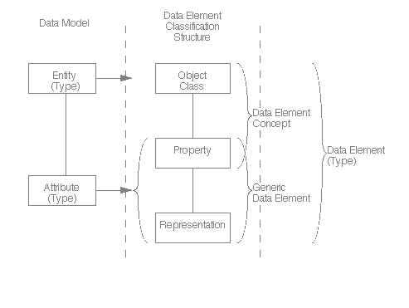
ISO/IEC 11179-1
Universe
Concept
Variable OR
Question Construct
Data Element
Concept
Variable Representation
Question Response Domain
International Standard ISO/IEC 11179-1: Information technology – Specification and standardization of data elements – Part 1: Framework for the specification and standardization of data elements Technologies de l’informatin – Spécifiction et normalization des elements de données – Partie 1: Cadre pout la specification et la normalization des elements de données. First edition 1999-12-01 (p26) http://metadata-standards.org/11179-1/ISO-IEC_11179-1_1999_IS_E.pdf
S20

Slide 226
Statistical Data and Metadata Exchange (SDMX)
Purpose: Exchange of statistical information (time series/indicators).
  Covers the metadata capture as well as implementation of registries.
  Currently version 2.0 and also an ISO standard (17369:2005)
Sponsors: Bank for International Settlements (BIS), European Central Bank (ECB), EUROSTAT, International Monetary Fund (IMF), Organization for Economic Cooperation and Development (OECD), United Nations (UN), World Bank
Can actually be used for many other purposes. It’s a metadata metadata model.
http://www.sdmx.org
S20

Slide 227
DDI 3 & SDMX 2.0
S20
Are complementary specifications
DDI 3 and SDMX 2.0 have been designed to work with each other
  SDMX registries can wrap DDI documents
  Microdata: single point in time / geography, high level of details (for statisticians, researchers)
  Macrodata: high level indicators across time and geography (for economists, policy makers)
  Using DDI+SDMX allows linkages and drilling down from indicator to its source
See "DDI and SDMX: Complementary, Not Competing, Standards", A. Gregory, P. Heus, July 2007 available at http://www.opendatafoundation.org/?lvl1=resources&lvl2=papers

Slide 228
OAIS: Open Archival Information System
Addresses a full range of archival information preservation functions including ingest, archival storage, data management, access, and dissemination.
ISO 14721:2003
http://nost.gsfc.nasa.gov/isoas/
S20

Slide 229
Some major XML metadata specifications for data management
Statistical Data and Metadata Exchange (SDMX)
  Macrodata, time series, indicators, registries
  http://www.sdmx.org
Data Documentation Initiative (DDI)
  Microdata (surveys, studies), aggregate, administrative data
  http://www.ddialliance.org
ISO/IEC 11179
  Semantic modeling, concepts, registries
  http://metadata-standards.org/11179/
ISO 19115
  Geography
  http://www.isotc211.org/
Dublin Core
  General resources (documentation, images, multimedia)
  http://www.dublincore.org
S20
Notes:
This is a set of specifications for socio-economic data
When it comes to implementation, these are complemented with commonly used ICT specifications such as the XML family of recommendations, SOAP, OASIS WS-* security specifications, SVG, etc.

Slide 230
Interacting Standards for Data
Dublin Core
ISO/IEC 11179
ISO 19115 – Geography
Statistical Packages
METS
PREMIS
SDMX
DDI
Citation structure
Coverage
  Temporal
  Topical
  Spatial
Location specific information
S20

Slide 231
Interacting Standards for Data
Dublin Core
ISO/IEC 11179
ISO 19115 – Geography
Statistical Packages
METS
PREMIS
SDMX
DDI
Structure and content of a data element as the building block of information
Supports registry functions
Provides
  Object
  Property
  Representation
S20

Slide 232
Interacting Standards for Data
Dublin Core
ISO/IEC 11179
ISO 19115 – Geography
Statistical Packages
METS
PREMIS
SDMX
DDI
i.e., ANZLIC and US FGDC
Focus is on describing spatial objects and their attributes
S20

Slide 233
Interacting Standards for Data
Dublin Core
ISO/IEC 11179
ISO 19115 – Geography
Statistical Packages
METS
PREMIS
SDMX
DDI
Proprietary standards
Content is generally limited to:
  Variable name
  Variable label
  Data type and structure
  Category labels
Translation tools used to transport content
S20

Slide 234
Interacting Standards for Data
Dublin Core
ISO/IEC 11179
ISO 19115 – Geography
Statistical Packages
METS
PREMIS
SDMX
DDI
Digital Library Federation
Consistent outer wrapper for digital objects of all type
Contains a profile providing the structural information for the contained object
S20

Slide 235
Interacting Standards for Data
Dublin Core
ISO/IEC 11179
ISO 19115 – Geography
Statistical Packages
METS
PREMIS
SDMX
DDI
Preservation information for digital objects
S20

Slide 236
Interacting Standards for Data
Dublin Core
ISO/IEC 11179
ISO 19115 – Geography
Statistical Packages
METS
PREMIS
SDMX
DDI
Developed for statistical tables
Supports well structured, well defined data, particularly time-series data
Contains both metadata and data
Supports transfer of data between systems
S20

Slide 237
Interacting Standards for Data
Dublin Core
ISO/IEC 11179
ISO 19115 – Geography
Statistical Packages
METS
PREMIS
SDMX
DDI
Version 3 covers life-cycle of data and metadata
Data collection
Processing
Management
Reuse or repurposing
Support for registries
Grouping & Comparison
S20

Slide 238
Metadata Coverage
[Packaging]
Citation
Geographic Coverage
Temporal Coverage
Topical Coverage
Structure information
  Physical storage description
  Variable (name, label, categories, format)
Source information
Methodology
Detailed description of data
Processing
Relationships
Life-cycle events
Management information
Tabulation/aggregation
Dublin Core
ISO/IEC 11179
ISO 19115
Statistical Packages
METS
PREMIS
SDMX
DDI
S20

Slide 239
DDI and SDMX Combined Data Model
DDI 3 focuses on:
  collection and production of microdata
  reuse and sharing of common data structures
  conversion to statistical tables (matrices)
  preservation and multiple storage options
SDMX focuses on:
  statistical tables
  reuse and sharing of common data structures
  consistent data transfer structure
Together they form a coherent data management model for data capture, storage and interchange with a wide area of overlap
S20

Slide 240
Generic Process Example
S20
DDI
Survey/Register
Anonymization, cleaning,
recoding, etc.
Aggregate Data Set
(Lower level)
Tabulation, processing,
case selection, etc.
Raw Data Set
Micro-Data Set/
Public Use Files
Aggregation,
harmonization
Aggregation,
harmonization
SDMX
Aggregate Data Set
(Highest-Level)
Aggregate Data Set
(Higher Level)

Slide 241
The Generic Staistical Business Process Model (GSBPM)
The METIS group is a part of UN/ECE which addresses metadata issues for national statistical agencies (and other producers of official statistics)
  This community uses both SDMX and DDI
They have produced a reference model of the statistical production process
  The DDI 3 Lifecycle Model was a major input
  GSBPM has a much greater level of detail
S20

Slide 242
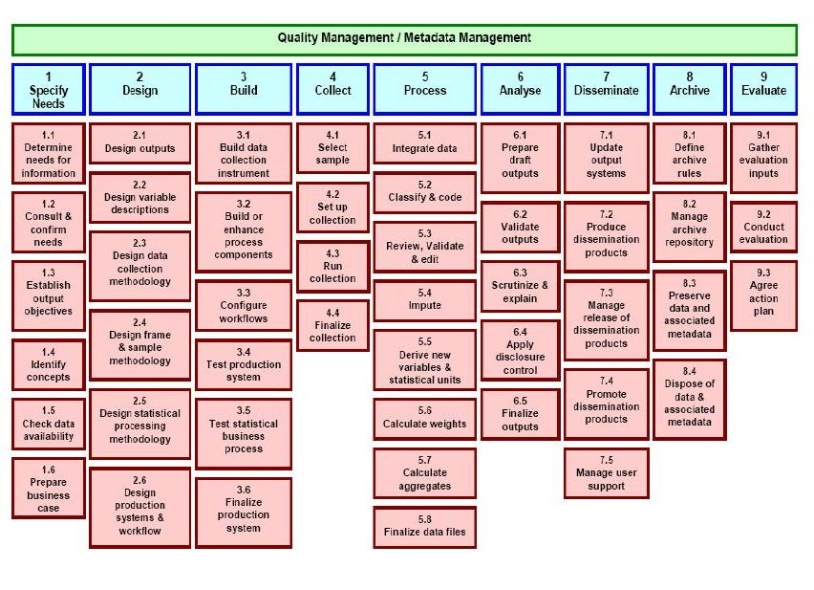
S20

Slide 243
The Generic Statistical Information Model (GSIM)
Early work on an information model to accompany the GSBPM is starting
  Still informal, very early
  Involves some of the statistical agencies which lead the work on GSBPM
GSIM will take as a major input both the DDI and SDMX information models
  Will also cover other metadata
  Will also draw on other standards (Neuchatel Model for Classifications, etc.)
Goal is to publish GSIM through METIS alongside the GSBPM
S20

