Slide 1
Layer 1
Layer 2
Layer N
x₁
x₂
x_{i}
Velocity < 0
x_{N}
x_{N+1}
u₁
u₂
$$u_{i− \frac{1}{2}}$$
u_{i}
$$u_{i+\frac{1}{2}}$$
u_{N}
Control volume
Velocity > 0

Slide 2
Layer 1
Layer N
x₁
x₂
x_{i}
x_{N}
x_{N+1}
Ghost node Left
Ghost node Right
u₁
u₂
$$u_{i− \frac{1}{2}}$$
u_{i}
$$u_{i+\frac{1}{2}}$$
u_{N}
u_{N+1}
u_{N+2}
Control volume

Slide 3
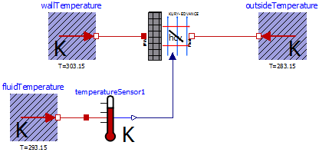
Outlet to outside
Fluid at room temperature
Fluid moved by the buoyancy
Air suction from the room

Slide 4
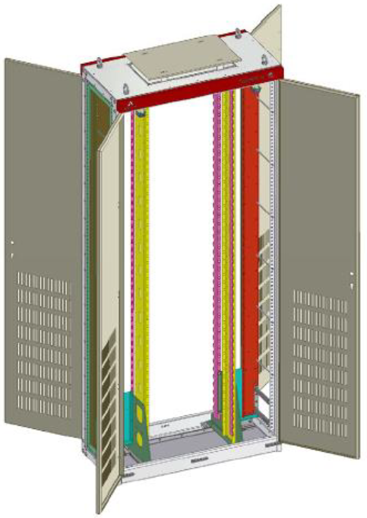
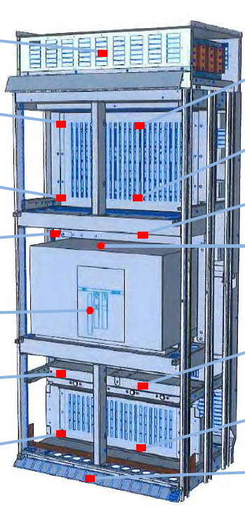
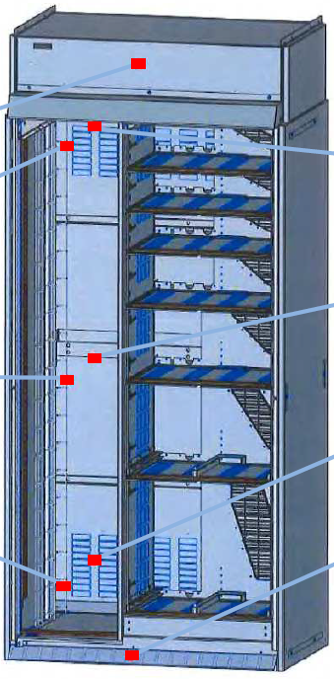
Outer cabinet area
Radiant-convective internal surface: A_in_casing
Casing
Block N
Heatsink
Inner cabinet area
Emitter (heat sink):
Convective surface: A_conv_emitter
Equivalente radiant surface: A_rad_emitter
Equivalent emissivity
Mass:
Internal heat load
Outer heatsink area
Convective outer surface : A_conv_casing
Block …
Heatsink
Equivalent radiant outer surface : A_rad_casing
Block 2
Equivalent thermal arrangement
Characteristic length of emitter: Lc_emitter
Heatsink
Block 1
Characteristic length of casing: Lc_casing
Heatsink

Slide 5
Outer cabinet area
Casing
Block N
Heatsink
Inner cabinet area
Emitter (heat sink):
Convective surface
Equivalente radiant surface
Equivalent emissivity
Mass:
Internal heat load
Outer heatsink area
Block …
Heatsink
Block 2
Equivalent thermal arrangement
Heatsink
Block 1
Heatsink

