Slide 1


BUSINESS HEALTH
AI-POWERED GROWTH INTELLIGENCE
82
Growth Potential
ASCEND
Revenue
↑ +8.4%
Expenses
↑ +3.1%
Aaryaman Chopra, Ethan De Guzman, Palash Desarda, Kaiyaan Faisal
P6 Special Topics
Cash Flow
↑ +11.2%
✦ Opportunity Detected
Weekday sales are underperforming.
Notes:
Ascend brings AI-powered growth intelligence to small businesses.
1

Slide 2
THE PROBLEM
Small businesses have data. They don't have a data team.
TODAY
57%
Transactions
Expenses
Revenue
Payroll
Inventory
Cash Flow
of small employer firms reported reaching customers and growing sales as an operational challenge in the Federal Reserve's 2024 Small Business Credit Survey.
SPREADSHEETS
Business owners can see what happened.
They struggle to understand what happens next.
Notes:
Small businesses have data but no data team to interpret it.
2

Slide 3
THE OPPORTUNITY
What if every small business had its own data analyst?
01
02
03
UNDERSTAND
PREDICT
GROW
What changed?
What is likely to happen next?
Where is the next opportunity?
DATA
INTELLIGENCE
GROWTH
Ascend turns historical business data into forward-looking growth intelligence.
Notes:
Ascend turns historical data into forward-looking growth intelligence.
3

Slide 4
WHAT WE ARE BUILDING
Meet Ascend
FINANCIAL
ASCEND
Revenue
Expenses
Cash flow
Payroll
FINANCIAL
DATA
OPERATIONAL
DATA
EXTERNAL
DATA
OPERATIONAL
Customers
Inventory
Transactions
TIME-SERIES AI ENGINE
EXTERNAL
FORECAST
ANOMALIES
OPPORTUNITIES
Seasonality
Industry trends
Economic conditions
GROWTH DASHBOARD
The Federal Reserve's Small Business Credit Survey tracks revenue growth, profitability, financial challenges, and financing outcomes. This sets a real-world basis for the signals Ascend analyzes.
Notes:
Financial, operational, and external data feed a time-series AI engine that outputs a growth dashboard.
4

Slide 5
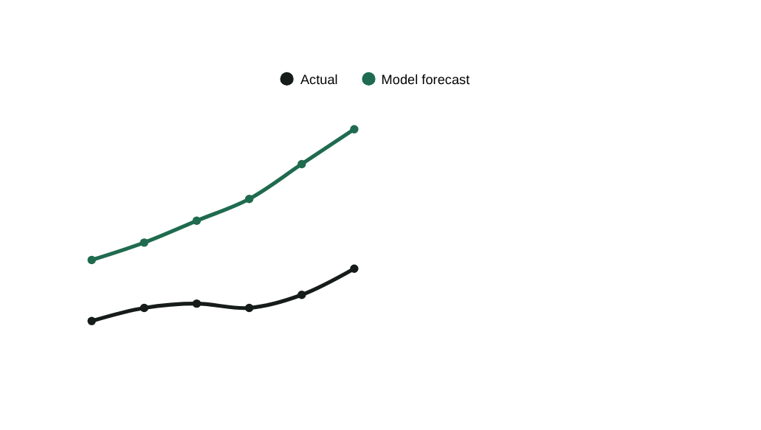

THE NEURAL NETWORK
How our neural network learns a business
12–24 MONTHS OF DATA
Revenue
Expenses
Cash Flow
Customers
Inventory
Payroll
REVENUE
PATCHTST MODEL
TIME-SERIES TRANSFORMER
FORECAST
CHANGE
SIGNAL
GROWTH
SIGNAL
PatchTST converts historical time-series data into patches and uses a Transformer architecture to model patterns across time.
Past
Future
Notes:
PatchTST models 12-24 months of business time-series data as a Transformer.
5

Slide 6
FROM PREDICTION TO GROWTH
We don't stop at forecasting.
INPUT
Revenue
Expenses
Customers
Inventory
↓ 7%
↑ 12%
↓ 4%
↑ 18%
NEURAL NETWORK: Detects deviation from historical pattern
ASCEND: GROWTH OPPORTUNITY DETECTED
Inventory turnover has fallen 16% below your historical pattern.
Your strongest-selling category is maintaining demand while slower inventory is increasing.
View inventory
Explore scenario
The neural network detects the pattern. Ascend translates the pattern into something a business owner can act on.
Notes:
The network detects the pattern; Ascend translates it into an actionable opportunity.
6

Slide 7

THE USER EXPERIENCE
From raw data → one clear picture
Bella's Café
Growth Health 82 / 100
Revenue
Cash Flow
Growth Signal
$48,240
$11,820
HIGH
↑ 8.4%
↑ 11.2%
Revenue vs. Forecast
✦ Opportunity Weekday demand is 18% below your weekend-adjusted potential.
Explore why →
Notes:
A Stripe-like dashboard for Bella's Café showing growth health and opportunities.
7

Slide 8
WHY THIS IS DIFFERENT
Traditional tools show the past. Ascend learns the pattern.
TRADITIONAL BUSINESS SOFTWARE | ASCEND
Shows revenue | Forecasts revenue
Shows expenses | Detects unusual changes
Shows cash flow | Learns cash-flow patterns
Static reports | Continuous predictions
Generic benchmarks | Business-specific patterns
Data dashboard | Growth intelligence
Every business has a different situation.
Ascend learns it.
Notes:
Every business has its own definition of normal. Ascend learns it.
8

Slide 9
SCALE
Start with one business. Build a financial intelligence network.
RESTAURANT
1
BUSINESS
Individual growth intelligence
RETAIL
SERVICES
E-COMMERCE
2
INDUSTRY
Industry-specific models
Ascend Neural Network
3
PLATFORM
Website for accounting/business software
Learn from patterns without requiring businesses to expose sensitive financial information to one another.
Businesses
Advisors
Platforms
Notes:
From one business, to industry models, to a platform API — with privacy-first data governance.
9

Slide 10
Every large company has a data team.
We're building one for everyone else.
ASCEND
Understand your business
Predict what's changing
Discover opportunities
GROW WITH DATA
ASCEND
Notes:
Every large company has a data team. We're building one for everyone else.
10

Slide 11
WHAT ASCEND DOES
Your next move
→
THANK YOU
See what changed
✓
Understand why
✓
We appreciate your time.
Find your next opportunity
✓
✦ Questions?
We’d love to hear them.
Notes:
1

