Slide 1


Unit 2: The Entity-Relationship Model
I.E.S Rodrigo Caro
ASIR

Slide 2
Index
Database Lifecycle
Initial Study
Design
Conceptual Data Model
Entities
Attributes
Relations
Extended ER Model: Hierarchy relationships
Redundancy
References

Slide 3
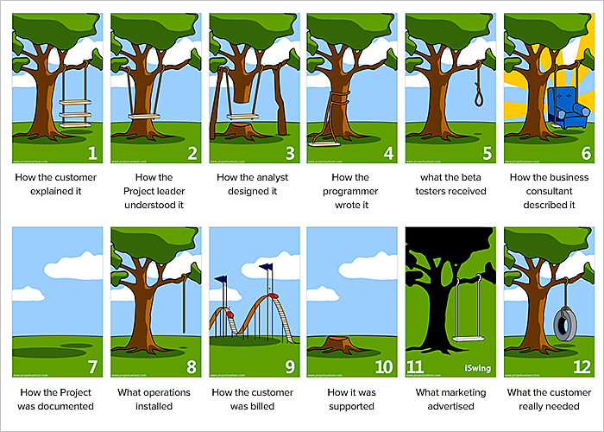
Database Lifecycle

Slide 4
Database Lifecycle
According to Coronel and Morris (2019), the database life cycle consists of six phases, namely:
Database initial study
Database design
Implementation and loading
Testing and evaluation
Operation
Maintenance and evolution.

Slide 5
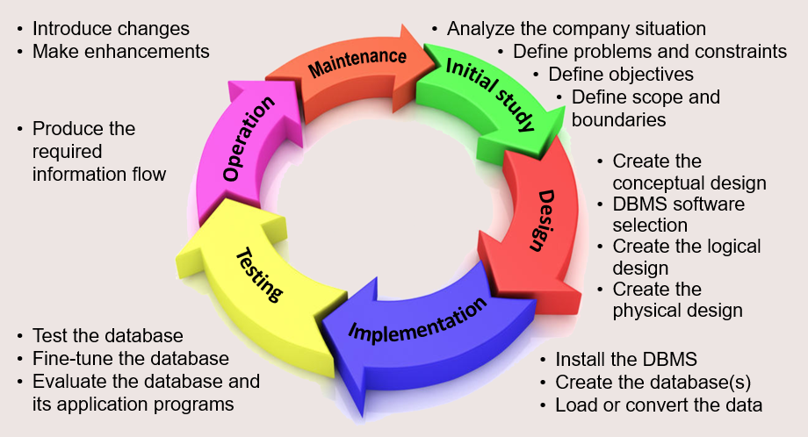
Database Lifecycle

Slide 6
Database Lifecycle: Initial Study
The first we should think about is:
Purpose. The purpose of a database depends on the nature of the data and how they relate to each other.
Universe discourse. This is the context. It can be defined as the set of needs to be fulfilled. They are also called information requirements, as they are the needs of the data.
Planning – This stages of database design concepts are concerned with planning of entire Database Development Life Cycle.
Exercises

Slide 7
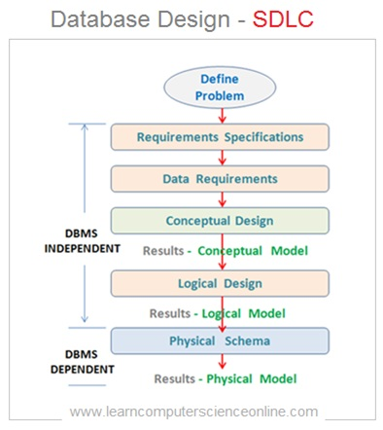
Database Lifecycle: Design

Slide 8
Database Lifecycle: Design
Requirements Collection
Functional requirements are the document that includes the detailed requirements provided by the users. Phases:
Customers interviews. The database designers have to interview the customers (database users) to understand the proposed system.
Build data requirements document. It should describe in natural language:
what the data items are
what attributes they have
what constraints apply
the relationships that hold between the data items.
Review the final document with the customers to get the global agreement.

Slide 9
Database Lifecycle: Design
Conceptual Data Model
Data analysis begins with the statement of data requirements and then produces a conceptual data model.
The conceptual data model then is a formal representation of what data a database should contain and the constraints the data must satisfy. This should be expressed in terms that are independent of how the model may be implemented. As a result, analysis focuses on the questions, “What is required?” not “How is it achieved?”
Here we could build de Entity-Relationship model.

Slide 10
Database Lifecycle: Design
Logic Design
Database design starts with a conceptual data model and produces a specification of a logical schema; this will determine the specific type of database system (network, relational, object-oriented) that is required.
The relational representation is still independent of any specific DBMS; it is another conceptual data model.
We could do some transformation to optimize the model. Normalized database.

Slide 11
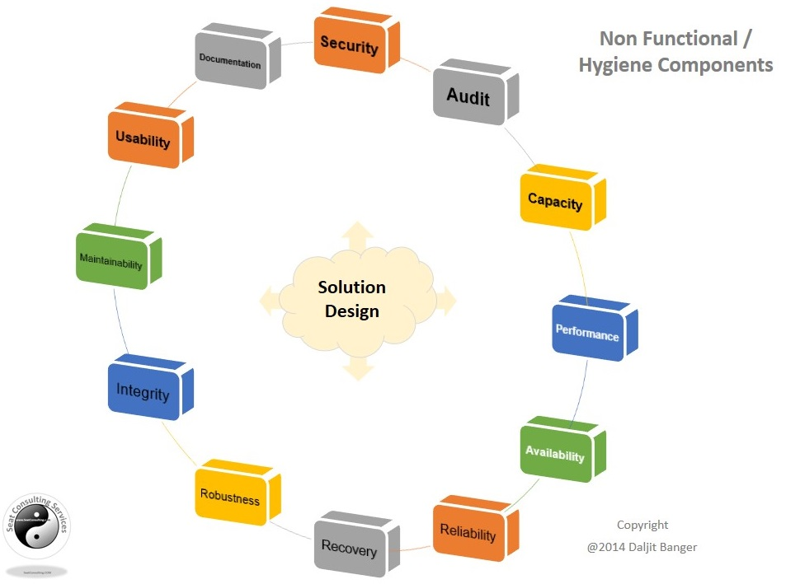
Database Lifecycle: Design
Physical Schema
The goal of this phase is to get the internal schema.
In this phase, it is necessary to know the hardware and software resources available. Non-functional requirements such as data security policies will be taken into account.

Slide 12
Conceptual Data Model: ER model
Definition: It is also called the entity-relationship model and it is a special graphical representation technique that incorporates information about the data and and the relationship between them.
It is independent of its final structure. (1976, Codd)
ER modelling is based on two concepts:
Entities with attributes (data)
Relationships, defined as the associations or interactions between entities

Slide 13
E/R Model
Definition: It is also called the entity-relationship model and it is a special graphical representation technique that incorporates information about the data and and the relationship between them. (1976, Codd). Main
It reflects only the existence of the data, not what is done with it.
It is independent of specific databases and operating systems.
It does not take into account non functional requirements.

Slide 14
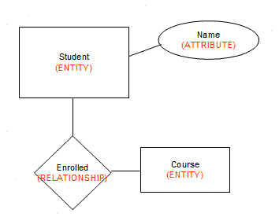
E/R Model
ER modelling is based on two concepts:
Entities with attributes (data)
Relationships, defined as the associations or interactions between entities

Slide 15
E/R Model: Entities
An entity is an object in the real world with an independent existence that can be differentiated from other objects.
An entity might be:
An object with physical existence
An object with conceptual existence.
All instances of an entity type must have the same properties.
Each instance, occurrence or instance of a type of entity must be distinguishable from the others.
It is recommended to write the name of the type of entity in singular.

Slide 16
E/R Model: Entities
Weak Entities
A weak entity is an entity that cannot be uniquely identified by its attributes alone; therefore, it must use a foreign key in conjunction with its attributes to create a primary key.
Weak entity is depend on strong entity to ensure the existence of weak entity.
Weak entities are represented with double rectangular box in the ER Diagram and the identifying relationships are represented with double diamond. Partial Key attributes are represented with dotted lines.

Slide 17
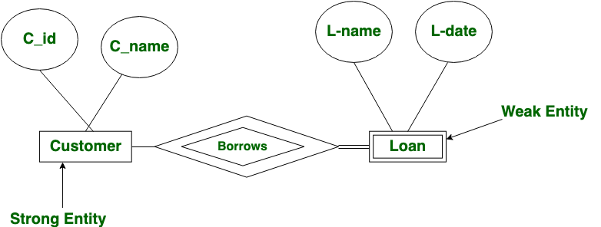
E/R Model: Entities
Weak Entities
A loan entity can not be created for a customer if the customer doesn’t exist

Slide 18
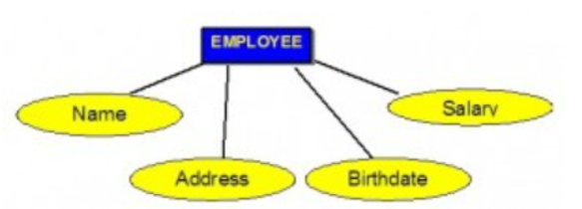
E/R Model: Attributes
An entity contains a set of attributes. They are the properties which define the entity.
Each attribute has a name and is associated with an entity and a domain of legal values. However, the information about attribute domain is not presented on the ERD.
Each attribute is represented by an oval with a name inside.

Slide 19
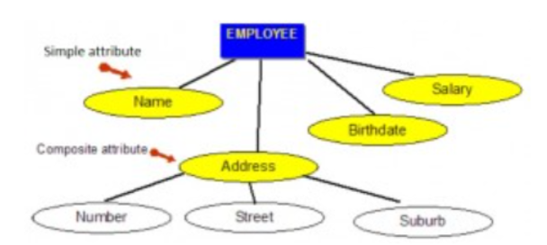
E/R Model: Types of Attributes
Simple attributes are those drawn from the atomic value domains; they are also called single-valued attributes. In the COMPANY database, an example of this would be:
Name = {John} ; Age = {23}
Composite attributes are those that consist of a hierarchy of attributes.

Slide 20
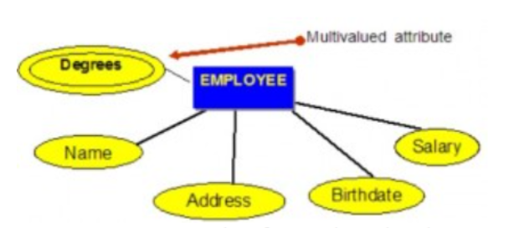
E/R Model: Types of Attributes
Multivalued attributes are attributes that have a set of values for each entity.

Slide 21
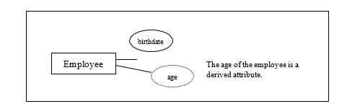
E/R Model: Types of Attributes
Derived attributes are attributes that contain values calculated from other attributes. Age can be derived from the attribute Birthdate. In this situation, Birthdate is called a stored attribute, which is physically saved to the database.

Slide 22
E/R Model: Keys
Key attribute is an attribute or a group of attributes whose values can be used to uniquely identify an individual entity in an entity set.
Types:
Candidate Key is a simple or composite key that is unique and minimal. It is unique because no two rows in a table may have the same value at any time. It is minimal because every column is necessary in order to attain uniqueness.
Composite Key is composed of two or more attributes, but it must be minimal. For example: first and last name.

Slide 23
E/R Model: Keys
The list of attributes which are key attributes are the candidate attributes.
Primary Key (PK) From all possible candidate keys which identifies the whole entity set, the primary key is the chosen candidate. It must uniquely identify tuples in a table and not be null. The primary key is indicated in the ER model by underlining the attribute.

Slide 24
E/R Model: Keys
A foreign key (FK) is an attribute in a table that references the primary key in another table OR it can be null. Both foreign and primary keys must be of the same data type.
A secondary key is used strictly for retrieval purposes and accessing records . These keys do not have to be unique. The term secondary key is also occasionally used as a synonym for alternate key. Example: first and last name
Nulls is a special symbol, independent of data type, which means either unknown or inapplicable. It does not mean zero or blank. It represents an unknown attribute value.

Slide 25
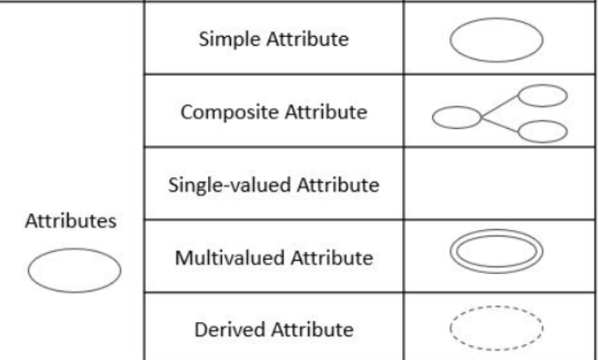
E/R Model: Exercise
Design the E/R for Student entity.
You should:
Identify PK
Classify each attribute according to the following schema.

Slide 26
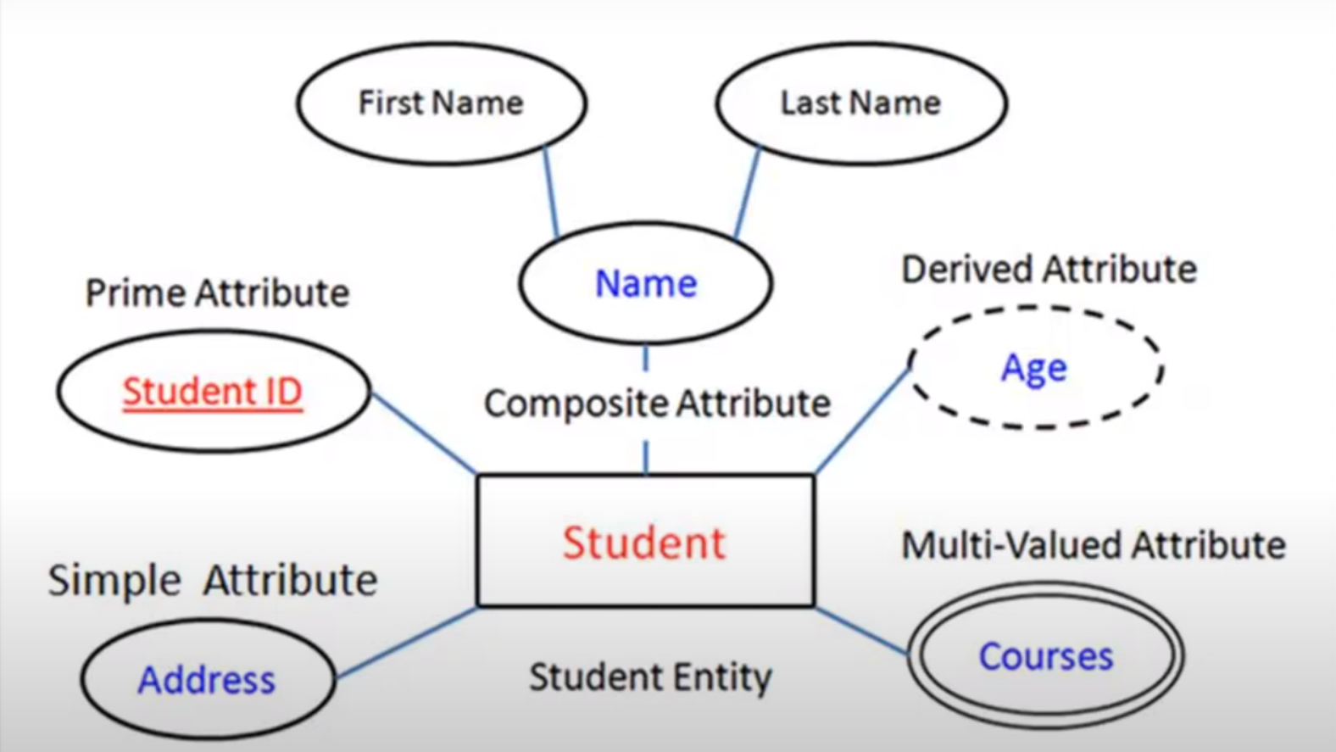
E/R Model: Exercise: Solution

Slide 27
E/R Model: Relationships
Relationships are are used to connect related information between entities.
A relationship could contain attributes
Relationship strength is based on how the primary key of a related entity is defined.
A weak, or non-identifying, relationship exists if the primary key of the related entity does not contain a primary key component of the parent entity. Example: company database examples include: Customer(CustID, CustName), Order(OrderID, CustID, Date)
A strong, or identifying, relationship exists when the primary key of the related entity contains the primary key component of the parent entity. Examples: Course(CrsCode, DeptCode, Description) Class(CrsCode, Section, ClassTime…)

Slide 28
E/R Model:
Referential integrity refers to the relationship between tables. Because each table in a database must have a primary key, this primary key can appear in other tables because of its relationship to data within those tables. When a primary key from one table appears in another table, it is called a foreign key.
Foreign keys join tables and establish dependencies between tables.
Referential integrity is the logical dependency of a foreign key on a primary key.
For example, you can not delete a row with a primary key if there are other rows in other tables that contain the same key as foreign key. To do keeping the referential integrity: you should delete on cascade, for example.

Slide 29
E/R Model: Type of Relationships
Cardinality: the cardinality of a relationship is the number of tuples (rows) in a relationship. Cardinality ratio means to denote the number of entities to which another entity can be linked through a certain relation set.
Let's start by focusing on binary relationships (2 entities) and their cardinalities. We could consider these types:
one-to-one
one-to-many
many-to-one
many-to-many
Unary (recursive)

Slide 30
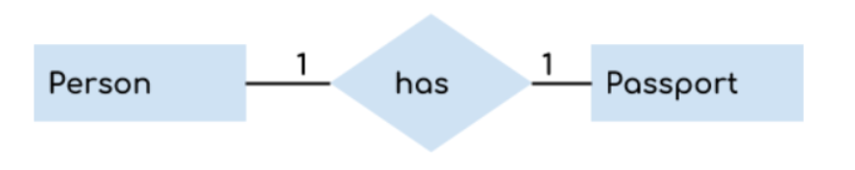
E/R Model: Type of Relationships
One to one (1:1) relationship is the relationship of one entity to only one other entity, and viceversa.
It should be rare in any relational database design. In fact, it could indicate that two entities actually belong in the same table.
A person can have only one passport in force and a passport belongs to only one person.

Slide 31
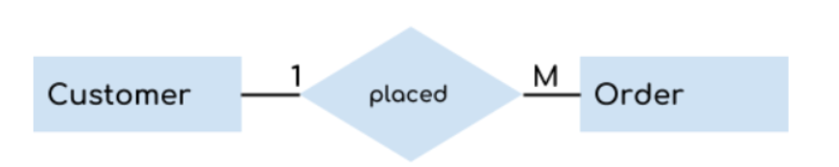
E/R Model: Type of Relationships
One to many (1:m) When a single instance of an entity is associated with more than one instances of another entity then it is called one to many relationship.
A customer can place many orders but a order cannot be placed by many customers.

Slide 32
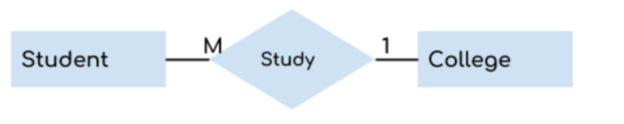
E/R Model: Type of Relationships
Many to one (m:1) When more than one instances of an entity is associated with a single instance of another entity then it is called many to one relationship.
Many students can study in a single college but a student cannot study in many colleges at the same time.

Slide 33
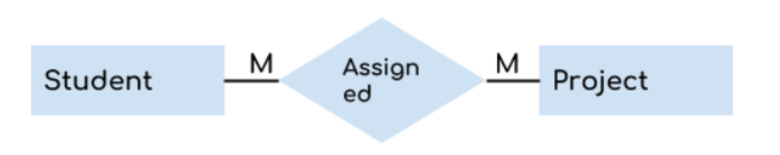
E/R Model: Type of Relationships
Many to many (m:n) When more than one instances of an entity is associated with more than one instances of another entity then it is called many to many relationship.
An student can be assigned to many projects and a project can be assigned to many students.

Slide 34
E/R Model: Type of Relationships
It cannot be implemented as such in the relational model!!
To model these relations we could create a third table.
The primary key of this third table is composed of the both other primary keys
Additional attributes may be assigned as needed.
In our previous example, we should create a third table called projectAssignment. Its primary key is composed of idStudent and idProject

Slide 35
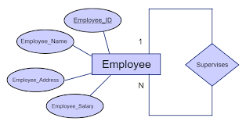
E/R Model: Type of Relationships
Unary or reflexive relationship, it is also called recursive, is one in which a relationship exists between occurrences of the same entity set.
In this relationship, the primary and foreign keys are the same, but they represent two entities with different roles.
For some entities in a unary relationship, a separate column can be created that refers to the primary key of the same entity set.

Slide 36
E/R Model: Type of Relationships
Exercise
We want to design the database of an high school. In the database you want to store the data of:
The teachers (ID number, name, address and telephone numbers).
The teachers teach modules, and each module has a code and a name.
Each student is enrolled in one or more modules.
For each student you want to save the file number, name, surname and date of birth.
Teachers can teach several modules, but a module can only be taught by one teacher.
Each course has a group of students, one of whom is the group delegate.

Slide 37
E/R Model: Type of Relationships

Slide 38
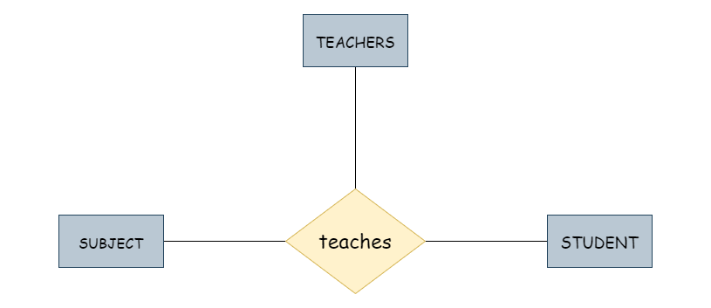
E/R Model: Ternary Relationships
A ternary relationship is a relationship that involves three entities.
To manage the ternary relationships, we should convert into binary relationships, building a new entity with the same attributes, at least with the three primary keys as foreign keys.

Slide 39
Extended ER Model: Hierarchy relationships
Extended ER model includes E/R plus Hierarchy relationships
Superclass
Exercise
Imagine, we want to make a DB about the animals of a Zoo. We will have the entities: FELINE, BIRD, REPTILE and INSECT. All these ones are ANIMAL, so we would have an entity ANIMAL and a relationship between each animal.
Define all the requirements, considering we want to store the size for feline, if the reptil is venomous or not and about the insects: number of legs and whether flyer or not.
Try to design this ER model

Slide 40
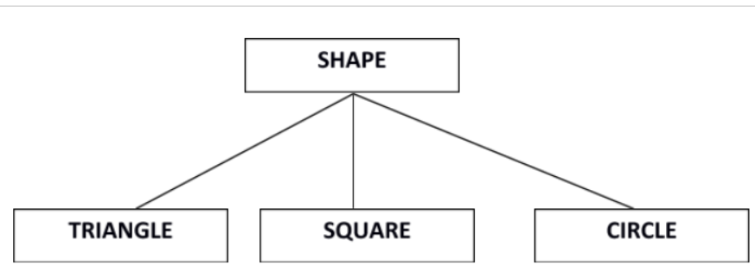
Extended ER Model: Hierarchy relationships
Superclass is an entity that can be divided into further subtypes. For example:
Superclass shape has sub groups: Triangle, Square and Circle.
Subclasses are the group of entities with some unique attributes. Subclass inherits the properties and attributes from super class.

Slide 41
Extended ER Model: Hierarchy relationships
The two main reasons for identifying subclasses:
To add descriptive attributes that makes sense only for the entities in the subclasses.
To identify the set of entities that participates in some relationship.

Slide 42
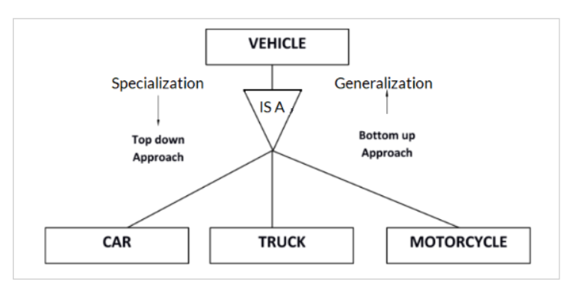
Extended ER Model: Hierarchy relationships
Class hierarchy can be viewed one of two ways:
Specialization (Top Down Approach)
Generalization (Bottom Up Approach)

Slide 43
Extended ER Model: Hierarchy relationships
Specialization is a process of identifying subsets of an entity that shares different characteristics. It breaks an entity into multiple entities from higher level (super class) to lower level (subclass).
For example, the class vehicle can be specialized into Car, Truck and Motorcycle ( Top Down Approach). They could have specific attributes
Hence, vehicle is the superclass and Car, Truck, Motorcycle are sub

Slide 44
Extended ER Model: Hierarchy relationships
Generalization i is a Bottom up process. The entity that is created will contain the common features.
The entities: Car, Truck and motorcycle can be generalised into Vehicle. (Bottom Up Approach). Car, Truck and Motorcycle are subclasses while vehicle is the superclass.
Basically, Vehicle contains the common attributes that were shared between Car, Truck and Motorcycle.classes. They hierarch all the Car’s attributes.

Slide 45
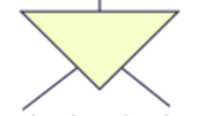
Extended ER: Types Hierarchy relationships
Classification focusing on subclasses:
Depending if a there is common entities with different subclasses:
Disjoint - There is no entity common to the subclasses. For example, consider it could the case for We subdivide the entity Employee into: Engineer, Secretary and Technician. In our DB no employee belongs to more than one sub-entity.

Slide 46
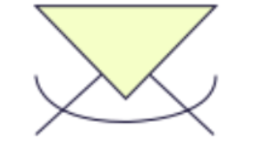
Extended ER Model: Types Hierarchy relationships
Overlapping – There is at least one entity common to the subclasses. It could be the case of Employee if we subdivide the entity Employee into: Engineer, Secretary and Technician and in our DB there may be employees who are both Engineers and Secretaries, or Secretaries and Technicians, etc.

Slide 47
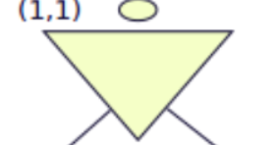
Extended ER Model: Types Hierarchy relationships
B. Depending if there are o not entities which don't belong
to a subclass.
Full or Total - All the entities of the superclass belong to at least one of the subclasses. Also known as covering.
We subdivide the entity Employee into: Engineer, Secretary
and Technician and in our DB there is no other employee
who does not belong to one of these three types.

Slide 48

Extended ER Model: Types Hierarchy relationships
Partial - At least one of the entities of the superclass doesn’t belong to either of the subclasses.
We subdivide the entity Employee into: Engineer, Secretary an
technician but in our DB there may be employees who do
not belong to any of these three types.

Slide 49
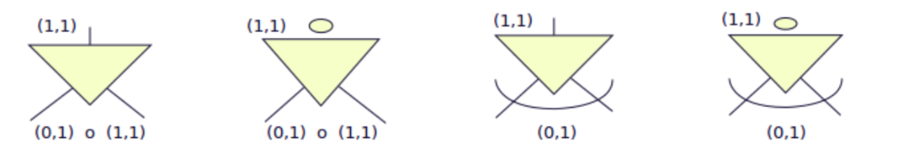
Extended ER Model: Types Hierarchy relationships
Joint & Partial Joint & Total Overlapping & Partial Overlapping & Total

Slide 50
Extended ER Model: Types Hierarchy relationships
Exercise
Returning to the exercise about animals. Draw now the E/R model considering:
Superclass and subclasses
And the type of hierarchy: joint or overlapping and partial or total.

Slide 51
Extended ER Model: Other Types
2. Now we are going to focus on the superclasses:
Aggregation It consists of constructing a new entity type as a composition of others and their relationship type and thus being able to handle it at a higher level of abstraction.
Exercise
Our system should store the information about courses.
R1.- A college offers course.
R2.- A student applies for a course at a college
R3.- We would like to register each apply of one student for a course at one college.

Slide 52
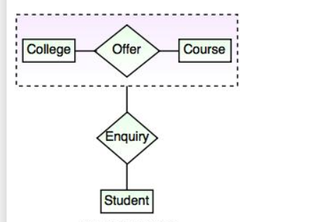
Extended ER Model: Other Types
Exercise Solution
The relation between College and Course is acting as an Entity in Relation with Student.
This is shown by enclosing the relationship and the corresponding entity sets in a box and then treating it as a single entity.

Slide 53
ER Model: Redundancy
A schema is redundant when by removing an element from the schema, no information is lost.
Conditions that must be met for redundancy to exist:
There must be a cycle: it occurs when, by linking entities by relationships, a circle is formed between some relationships.
The relations involved in the cycle must be
semantically equivalent (similar meaning).
The cardinalities must be such that one of the relations can be eliminated without losing information.
However, we must bear in mind that just because there is a cycle does NOT imply that there is a redundancy.

Slide 54
ER Model: Redundancy
Exercise
We would like to design a database to store information about animals, the country where they live and information about the national park where you can find them.
Define the requirements
Design the E/R model
Define relations and cardinalities.

Slide 55
ER Model: Redundancy
Exercise Possible Solution
Requirements
animal: idAnimal, name, animal family type
county: idCountry, name, location
national park: idPark, name, location, phone, web
An animal could live in many countries.
An animal may not live in a national country.

Slide 56
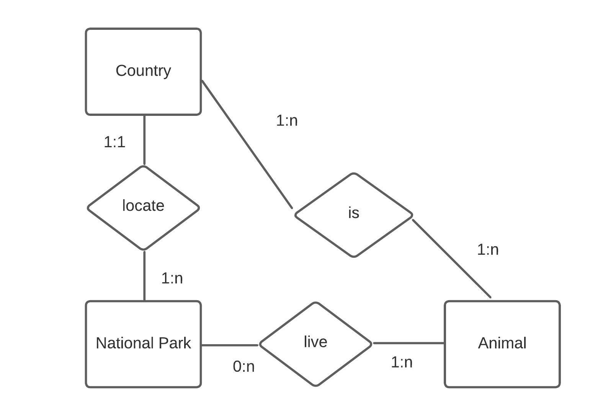
ER Model: Redundancy
Exercise Possible Solution
3. Relationship and cardinalities

Slide 57
ER Model: Redundancy
There is cycle. Is there also a redundancy?
Let’s try to analyse if it is or not redundant. How?
Try to fill these tables with example values.
Could we eliminate any relation without losing information?
Could we eliminate “is” relation? No, because if an animal does not live in any national park but it lives in a country, we are going to lose this information because it is not possible to know which country it is in through the park.

Slide 58
ER Model: Redundancy
Exercise
We would like to design a database to store books information. In particular, we want to store information about books, about authors and about editorials.
Define the requirements
Design the E/R model
Define the cardinality

Slide 59
ER Model: Redundancy
Exercise Possible Solution
Requirements
book: ISBN, title, printed place, written date, published date, edition number
author: full name, email, instagram, phones, address
publisher: cif, name, address, phones, web
A book can be written by several writers and is published by one publisher
In the same way, a writer could collaborate with different publishers

Slide 60
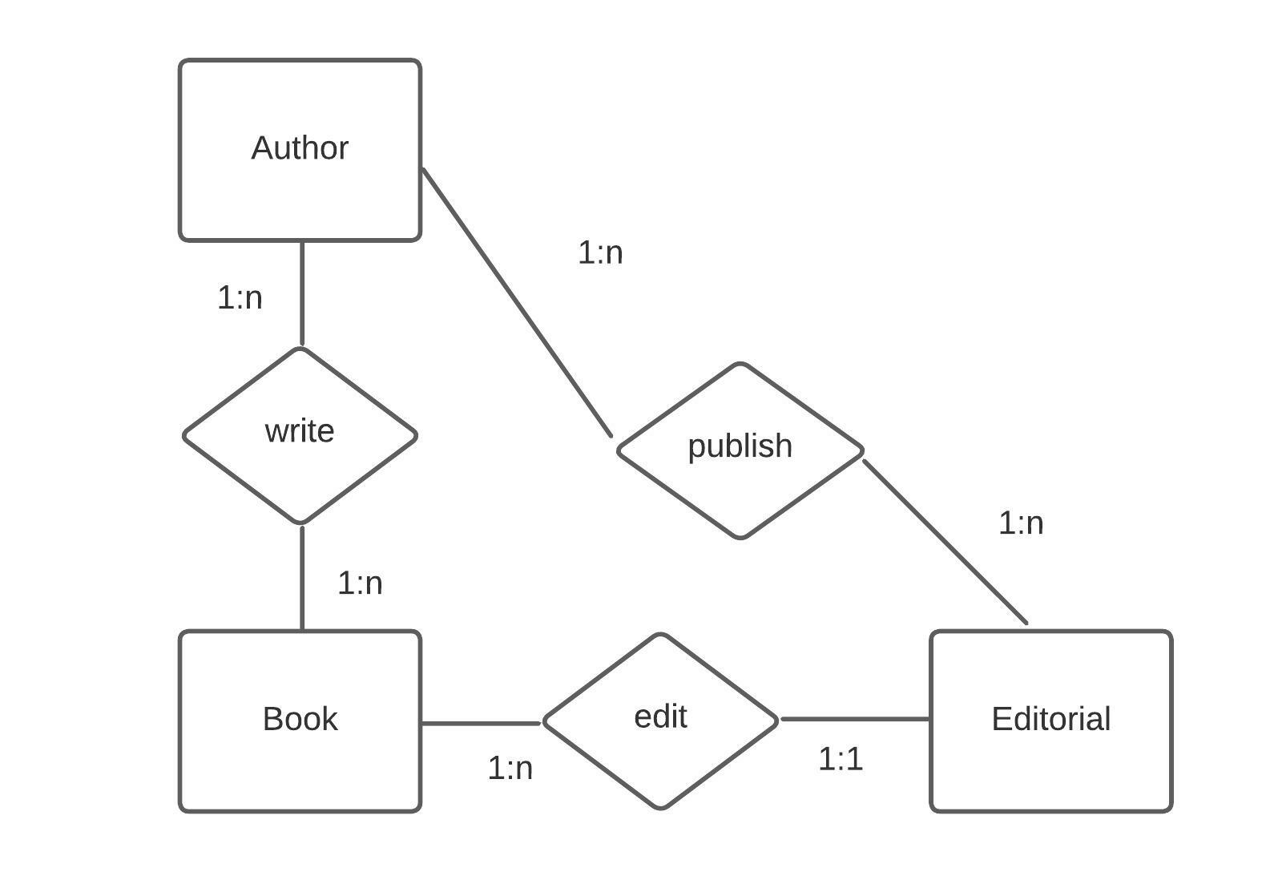
ER Model: Redundancy
Exercise Possible Solution
3. Relationship and cardinalities

Slide 61
ER Model: Redundancy
There is cycle. Is there also a redundancy?
Let’s try to analyse if it is or not redundant. How?
Try to fill these tables with example values.
Could we eliminate any relation without losing information?

Slide 62
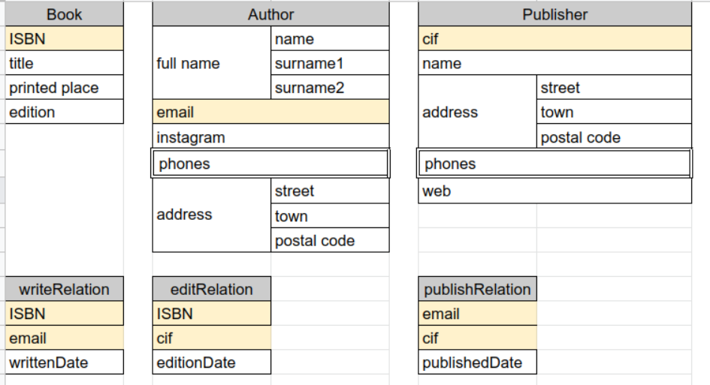
ER Model: Redundancy

Slide 63
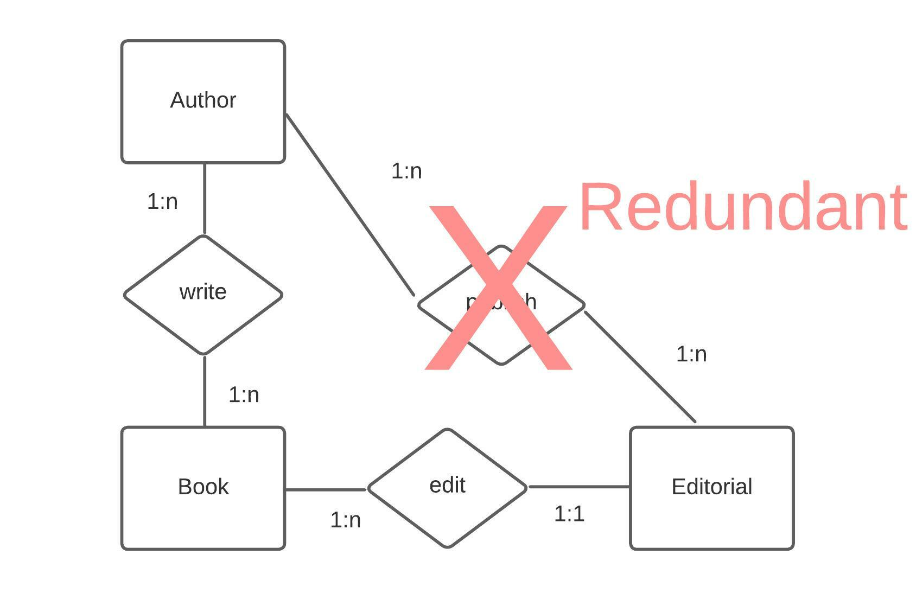
ER Model: Redundancy

Slide 64


Slide 65
References
Rafael Lozano, Introducción a las Bases de Datos
Antonio Postigo Palacios, Gestión de base de datos Editorial Paraninfo Madrid 2022
https://opentextbc.ca/dbdesign01/chapter/chapter-13-database-development-process/
https://dalbanger.wordpress.com/2014/01/08/a-basic-non-functional-requirements-checklist/comment-page-1/
https://opentextbc.ca/dbdesign01/chapter/chapter-8-entity-relationship-model/
https://jcsites.juniata.edu/faculty/rhodes/dbms/ermodel.htm
https://prepinsta.com/dbms/weak-entity-and-strong-entity/
https://www.datasciencecentral.com/key-attributes-in-er-diagrams/
https://opentextbc.ca/dbdesign01/chapter/chapter-8-entity-relationship-model/
https://beginnersbook.com/2015/04/e-r-model-in-dbms/
https://www.geeksforgeeks.org/cardinality-in-dbms/
https://www.ibm.com/docs/en/informix-servers/14.10?topic=integrity-referential

