Slide 1


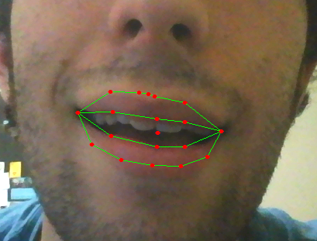
GPU-Accelerated Lip-Tracking
Alex DeBoni and Jesse Harder
Santa Clara University
Overview
Current state-of-the-art methods of lip tracking involve using statistical models to fit contours to the lips in the image. These methods are efficient, but not fast enough to run in real time on a video feed. We present a novel way of tracking lip movement with a CUDA-enabled GPU (Nvidia Tegra K1) and OpenCV.
CPU
GPU
Texture Memory
Edge detection Color segmentation Scale & transform
Images
Images
Update parameters
Conform shapes
Search profiles
Methods
First, the image is preprocessed by performing edge detection and color segmentation. This increases the initial accuracy of the statistical model later used, and thus allows it to finish in fewer iterations. If this is a single frame or the first frame in a video, then a Haar Cascade is used to quickly find the region of interest. Finally, an Active Shape Model that has been trained with over 3500 hand-marked images is used to find the final contour. This process involves iteratively fitting the statistical model to the target frame.
Contours
Contours
Ratio of execution time between CPU and GPU
Results
This modelling technique has reliably and accurately been able to find and track lip contours in images and video in real time. Video processing performance is especially improved with the GPU over a CPU.

