Slide 1
Using eCAS Curation
Supporting eCAS Curation Release beta-0.1.0
John J. Tran, Andrew F. Hart, Heather L. Kincaid, and Chris A. Mattmann

Slide 2
Overview
Prerequisites
  Please download ecas_exercise_1.zip and ecas_exercise_2.zip from https://cancer.jpl.nasa.gov/documents/applications/catalog-and-archive-service/ecas-walkthrough-tutorial
Exercise #1
  Ingestion with an existing “test_policy” dataset
    Only need to upload extractor configuration files
Exercise #2
  Upload a new dataset to the eCAS curator
  Ingestion using the same flow as above

Slide 3
Outline for Exercise #1
Steps:
  Entry Screen
  Determine Dataset
  Select Product Type
  Upload Extractor Config files
  Review and Begin Ingest

Slide 4
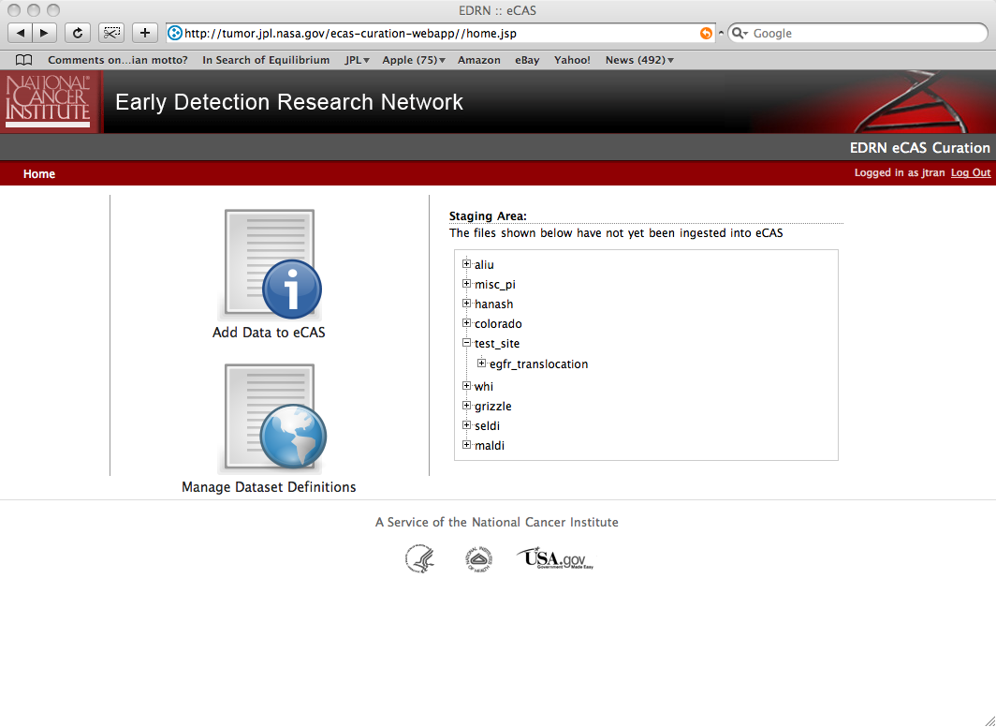
Entry Screen
Select “Add Data to eCAS”
Optional for viewing into “available” data to be ingested

Slide 5
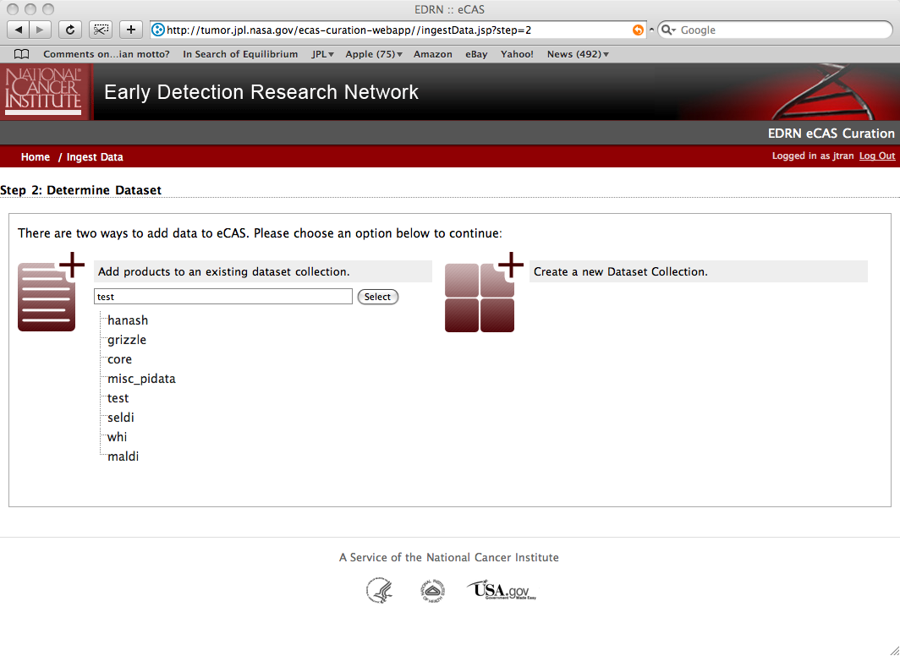
Determine Dataset
Select “test_policy” dataset for this exercise.
Click on Select.

Slide 6
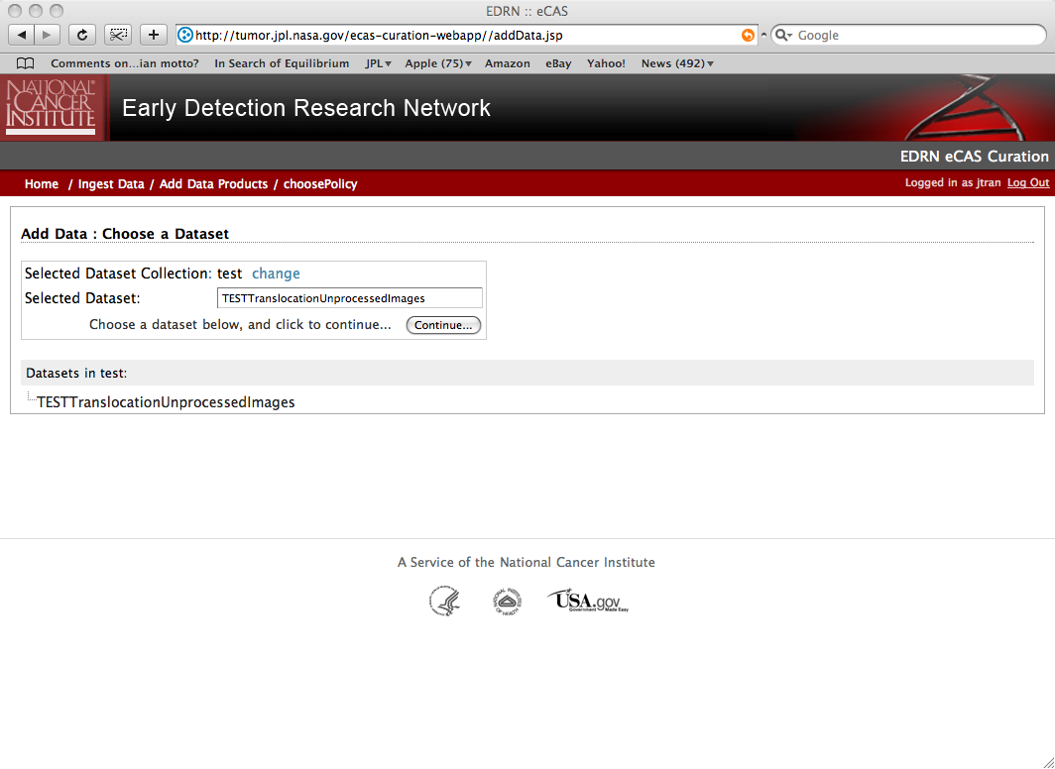
Select Product Type
Select
“TEST…” product type specific to this data set. Click on Continue…

Slide 7
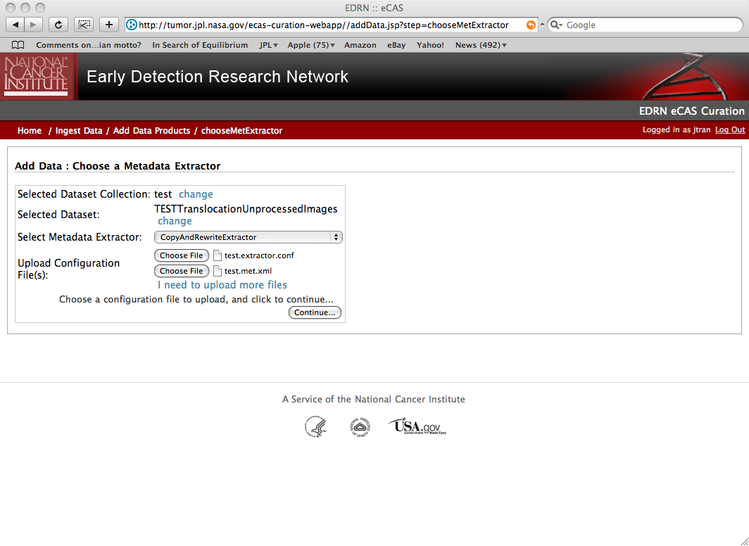
Upload Config Files
Upload the test meta extractor conf (test1.extractor.conf) file and the test meta extractor basis (test1.met.xml) files found in the “ecas_exercise_1/extractor” folder that you downloaded in the Prereqs (slide 2).
Very Important: Please upload the meta extractor configuration file (.conf) first
Note that only “copy and rewrite” extractor are presented here at the moment – in the future we will implement more and support customized extractors

Slide 8
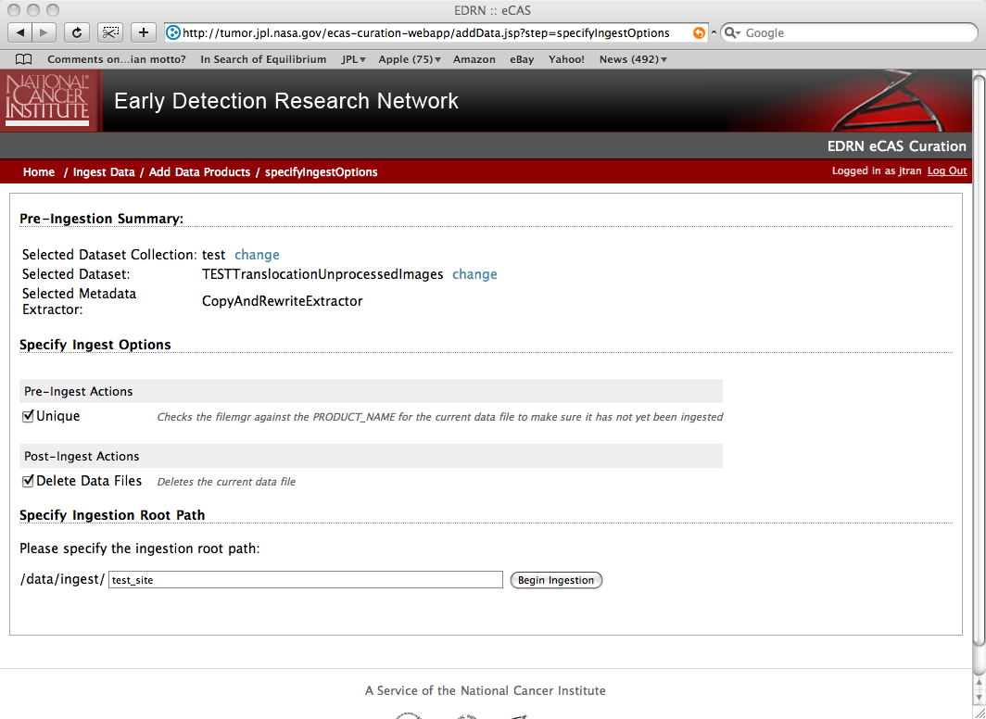
Review and Begin Ingest
Optional delete data in staging area after products have been successfully ingested
Check “Unique” to ensure that we do not ingest duplicates
Enter “test_site_1” for this exercise

Slide 9
Done!
At this point data should have been ingested and results can be viewed at http://tumor/ecas

Slide 10
Outline for Exercise #2
Steps:
  Entry Screen
  Upload new Dataset
  Determine Dataset
  Select Product Type
  Upload Extractor Config Files
  Review and Begin Ingest

Slide 11
Entry Screen
Select “Add Data to eCAS”
Optional for viewing into “available” data to be ingested

Slide 12
Determine Dataset
Select “Create a new Dataset Collection”

Slide 13
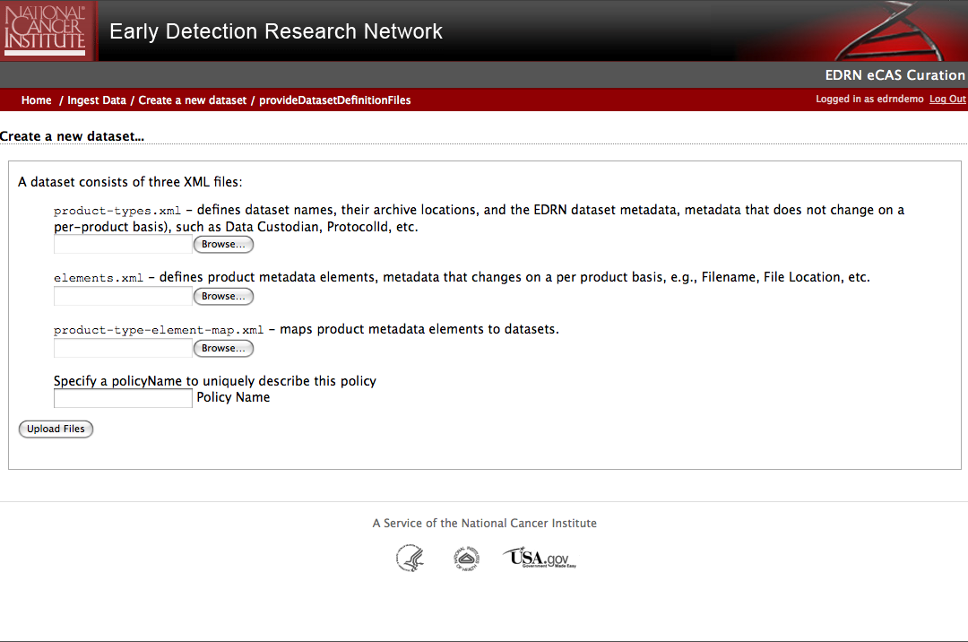
Upload new Dataset Collection
Upload the dataset files: product-types.xml, elements.xml, and product-type-map.xml – found in the “ecas_exercise_2/new_policy” folder
Enter a policy name, for this exercise put “new_policy”

Slide 14
Determine Dataset
Select “new_policy” dataset for this exercise

Slide 15
Select Product Type
Select
“TEST…” product type specific to this data set

Slide 16
Upload Config Files
Upload the test meta extractor conf (test2.extractor.conf) file and the test meta extractor basis (test2.met.xml) files found in the “ecas_exercise_2/extractor” folder
Very Important: Please upload the meta extractor configuration file (.conf) first
Note that only “copy and rewrite” extractor are presented here at the moment – in the future we will implement more and support customized extractors

Slide 17
Review and Begin Ingest
Optional delete data in staging area after products have been successfully ingested
Check “Unique” to ensure that we do not ingest duplicates
Enter “test_site_2” for this exercise

Slide 18
Done!
At this point data should have been ingested and results can be viewed at http://tumor/ecas
To repeat the exercise with other options, an “unfreeze” script will have to be executed on the server to restore eCAS catalog and ingestion area to its original state

