Slide 1





FIGURE 1.
Sample collection
Sample processing
1
2
Data collection
Study preparation
Data generation
4
Publication
and archiving
3
Computational approaches
ENCORE

Slide 2
FIGURE 2.
sFSS
Project
Project
Project team
execution
Version
Code
GitHub repository
control
Share
Researchers
Reviewers
Archiving
Access
(optional)

Slide 3
FIGURE 3.
(5) ENCORE user documentation
(1) standardized File System Structure (sFSS) template
Project
Project documentation
Data
Processing
Code + documentation
(3) GitHub
repository
(4) sFSS Navigator
Data
NameOfComputation 1
NameOfComputation 2
Data
Code
Results
(2) Documentation in (pre-defined) files

Slide 4
ID_ProjectName 00_README-FIRST.{md, txt}
0_GETTINGSTARTED.{docx, tex, txt, html}
0_PROJECT.md
1_Step-by-Step-ENCORE-Guide.{docx,pdf}
2_CITATION.{md, txt}
Navigate.py / Navigate_U.sh / Test_Navigate_Module.py
Navigation.conf
.navigate
Data 0_README.md
NameOfDataset_1
Meta 0_README.md
Processed 0_README.md
Raw 0_README.md
Processing README.md, github.txt, gitignore-templates
.git
0_SoftwareEnvironment 0_README.md
Anaconda 0_README-General.md, 0_README-ProjectSpecific.md
C++
Matlab
Python
R
Data
NameOfDataset_1
Meta
Processed
Raw
NameOfComputation_1
Code 0_README.md
CodeDocumentation 0_README.md
Data
NameOfDataset_1
Meta
Processed
Raw
NoteBooks 0_README.md
Results 0_README.md
Settings 0_README.md
ProjectDocumentation LabJournal.{docx, tex, md, txt}
BackgroundDocumentation
Literature 0_README.md
MyPresentations 0_README.md
Manuscript 0_README.md
Sharing 0_README.md
FIGURE 4.

Slide 5
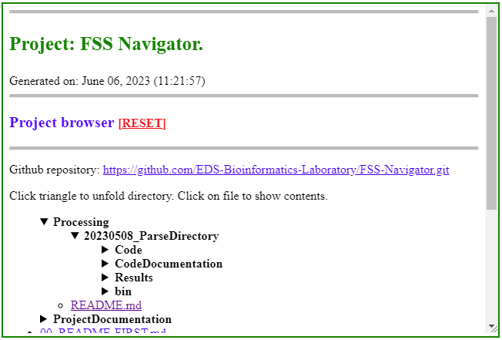
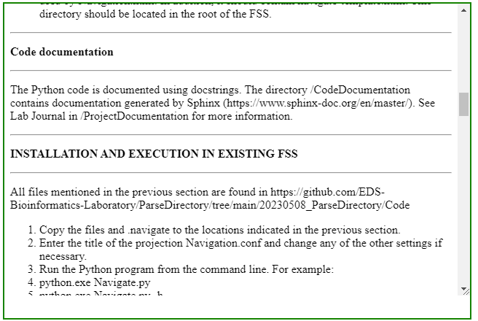
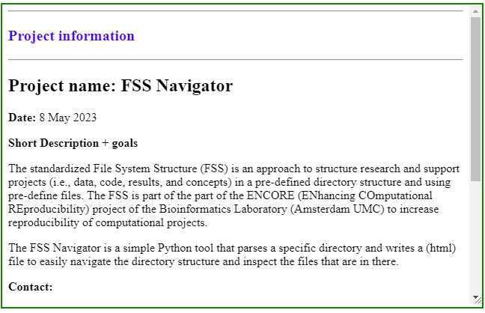
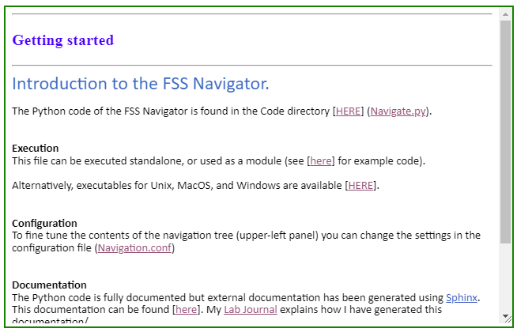
FIGURE 5.
a)
b)
c)
d)

Slide 6





FIGURE 6.
ENCORE
2023
Future extensions and modifications
2022
ENCORE
v.4.0.
ENCORE
v.3.1.
2021
First version of the FSS Navigator
Evaluation. Reproducibility
JUL
Revision of documentation
Improved the FSS Navigator
ENCORE
v.3.0.
ENCORE
v.3.5.
2020
NOV
ENCORE
v.2.0.
2018/19
Evaluation. Implementations
SEPT
APR
JAN
Initial discussions about reproducibility for research and support
Evaluation. General experience
NOV
ENCORE
v.1.0.
GitHub organization account
OCT

Slide 7
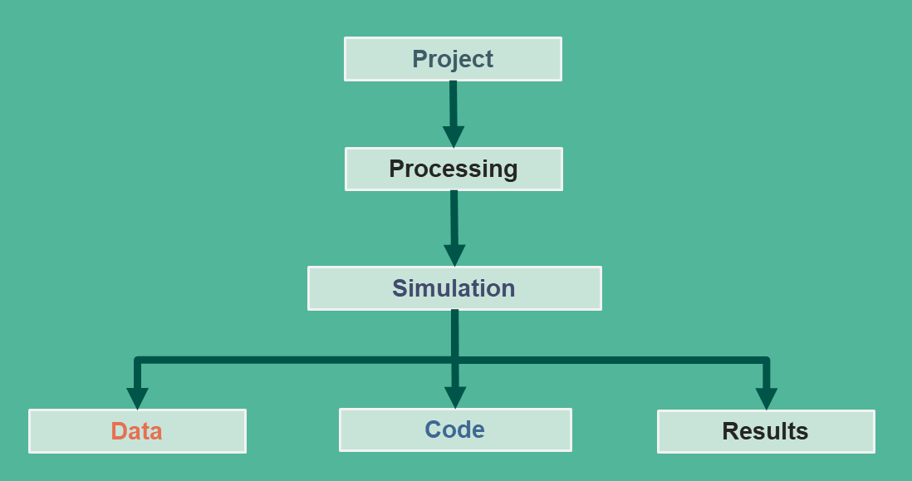



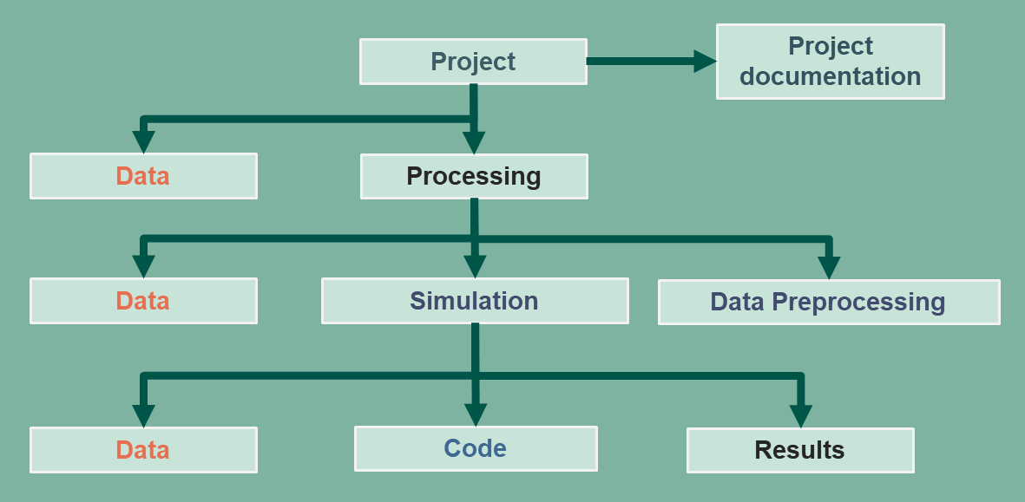
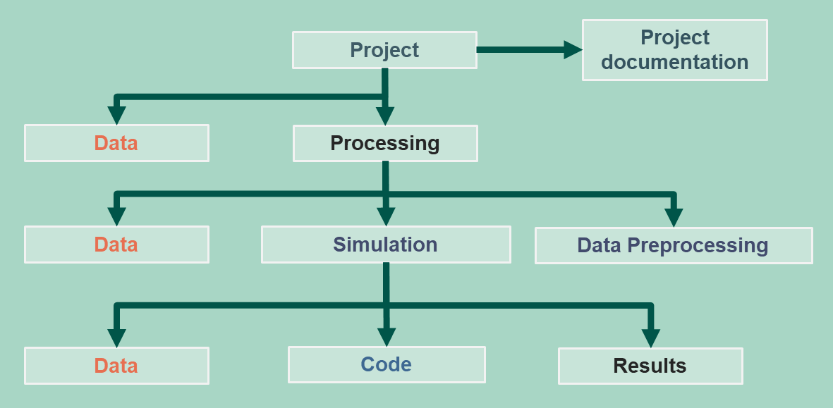
FIGURE 7.
Remote computer system
Cluster, GPU
Transfer
Transfer
Synchronize
Local computer
CLOUD

