Slide 1
NIGHT CLASS
Night Class Template
Learning Targets
Preview the title, concept, practice, and summary layouts.
Grade 10 | Template Preview
A classroom-ready deck with guided explanation, practice, and checks for understanding.
4 lesson slides
Built for teaching, discussion, and revision.

Slide 2
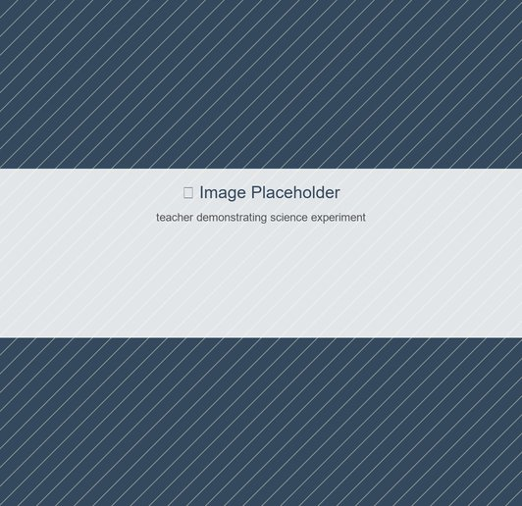
INTRODUCTION
01
Start With A Strong Hook
REMEMBER
Open with one curiosity question
Key Points
Name the core idea in simple language
Show why it matters beyond the textbook
Preview what students will be able to do
Notes:
Use this slide to set purpose and activate prior knowledge.

Slide 3
CONCEPT
02
Make The Core Idea Visible
UNDERSTAND
Teach one key idea per slide
What students should notice
Pair the idea with an example or analogy
Call out one misconception early
End with a quick check question
Explain a concept with a visual anchor.
Notes:
Keep the slide concise and put the extra explanation here.

Slide 4
ACTIVITY
03
Practice With Feedback
APPLY
Question: Which option best explains the idea?
Work Time
Teacher Key
B) A cause-and-effect relationship
Answer: B
C) An unrelated example
Explanation: Students should identify the relationship, not just recall words.
D) A memorized definition
Notes:
Let students answer first, then reveal the teacher key.

Slide 5
SUMMARY
04
Close With Transfer
CREATE
REMEMBER
CONNECT
APPLY NEXT
Students can define the key idea
Students can explain it with an example
Students can avoid the common misconception
Students can apply it to a new scenario
Notes:
Use this as an exit-ticket prompt.

Slide 6
Ready for class
4
Use the notes, activities, and visual prompts to adapt the lesson live.
slides
Quick Finish
Ask one retrieval question
Let students explain one visual
Collect one exit-ticket response

