Slide 1
Edu2Job: Predicting Job Roles from Educational Background
INFOSYS SPRINGBOARD INTERNSHIP 6.0
BATCH - 10
Presented by
Vivek Kumar
Gyanaranjan Sahoo
M Harini
Soumalya Ganguly
Kushwanth Nethi
Guided By
Dr Manju J R

Slide 2
The Problem: Navigating Career Uncertainty
Career Confusion
75% of graduates face significant uncertainty about their career paths.
Skill Gap
Disparity between academic skills and industry demands.
Lack of Guidance
Limited personalized career counseling resources.
Rising Unemployment
Qualified graduates struggle to find suitable employment.

Slide 3
Our Solution: Edu2Job
AI-Driven Platform
Leveraging advanced AI for precise predictions.
Personalized Recommendations
Tailored job roles based on individual profiles.
Skill Gap Analysis
Clear roadmaps to bridge education to employment.

Slide 4
Key Objectives Achieved
Accurate ML Model
Intuitive User Interface
Secure Dual Authentication
Comprehensive Admin Dashboard
Model Retraining Capabilities
Personalized Career Insights

Slide 5
Technology Architecture
Frontend
React (Vite)
Tailwind CSS
Framer Motion (Animations)
Axios.
AI/ML
Scikit-learn (Random Forest)
Security
JWT Authentication Google OAuth 2.0
Backend
Django
Django REST Framework
Database
MySQL (Cloud).
Integration:
n8n (Workflow Automation).

Slide 6
Milestone 1: User Authentication & Profile Management
Secure Onboarding
Robust registration and login processes.
Profile Creation
Users build comprehensive personal and academic profiles.
Data Privacy
Ensuring confidentiality and protection of user data.

Slide 7
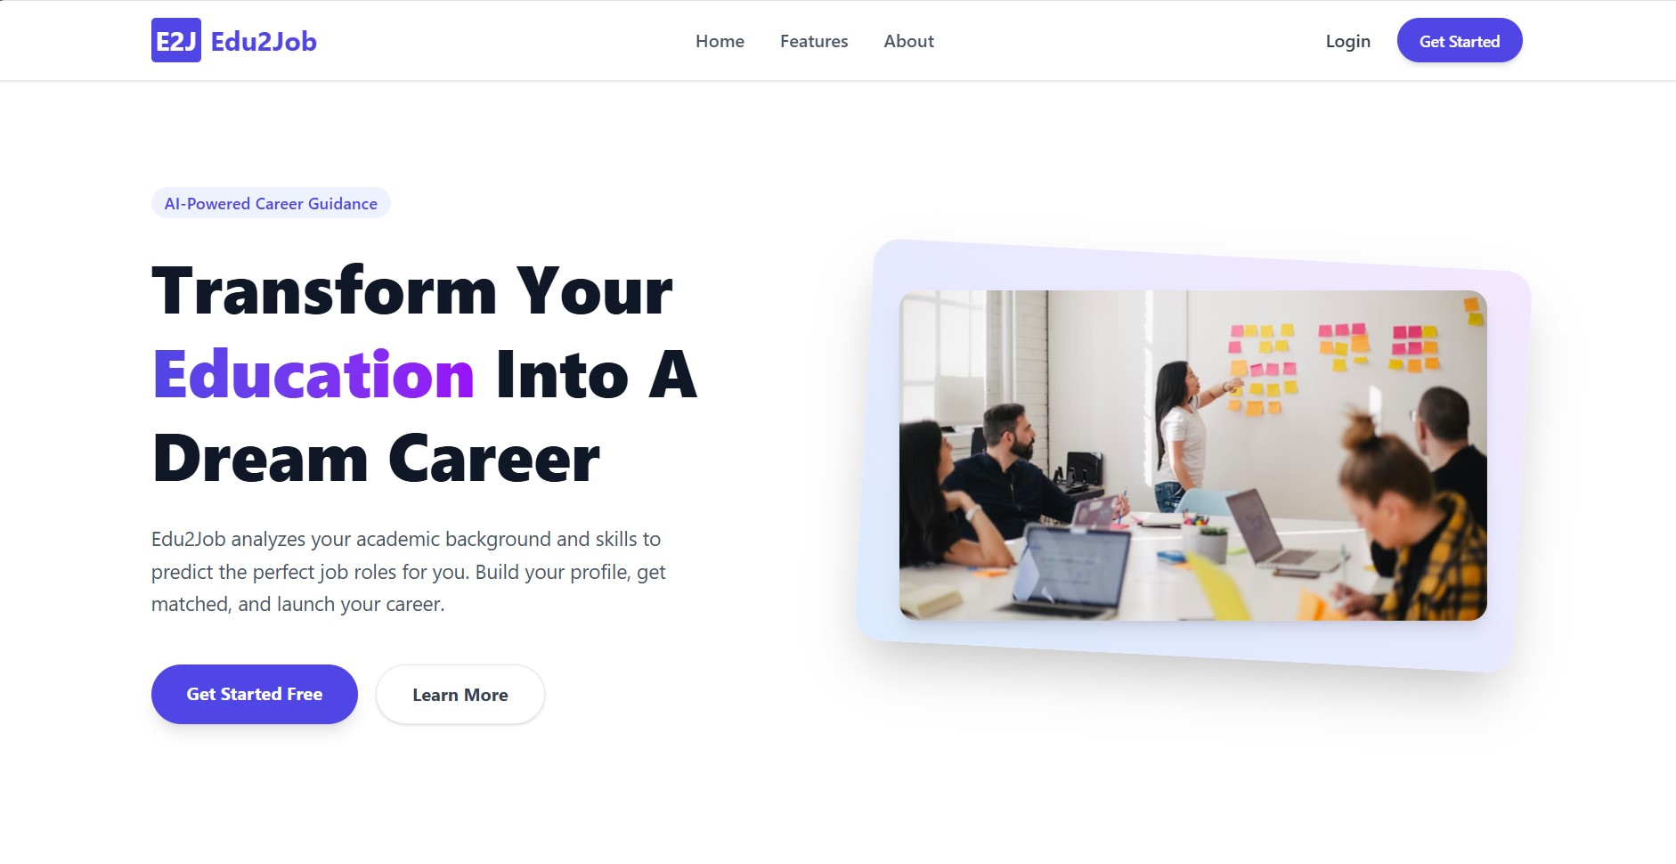

Slide 8
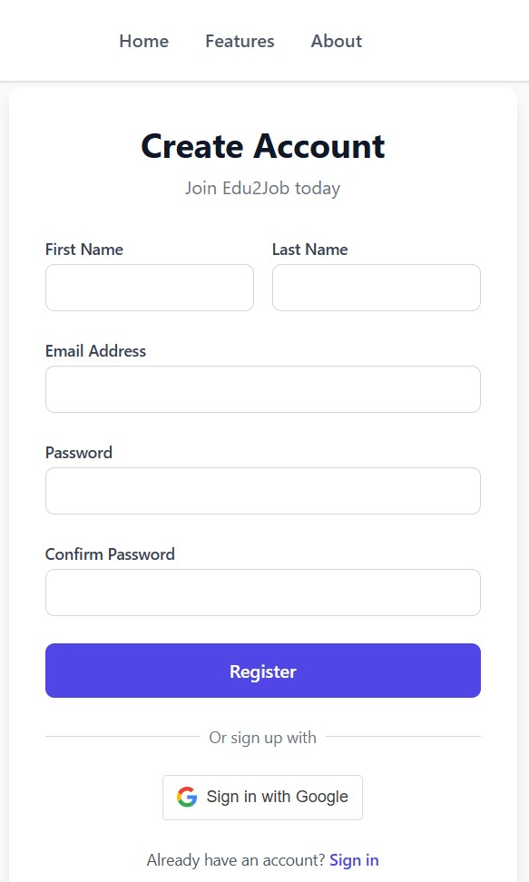
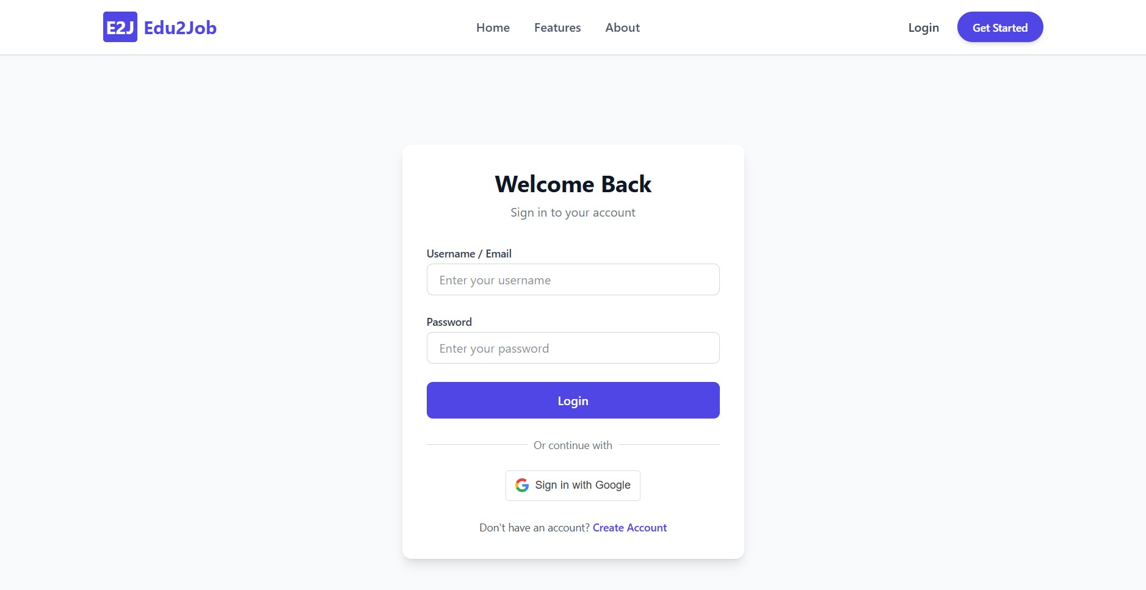
Registration Page
Login Page

Slide 9
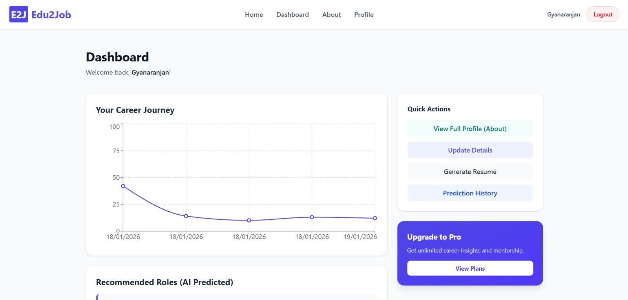

Slide 10
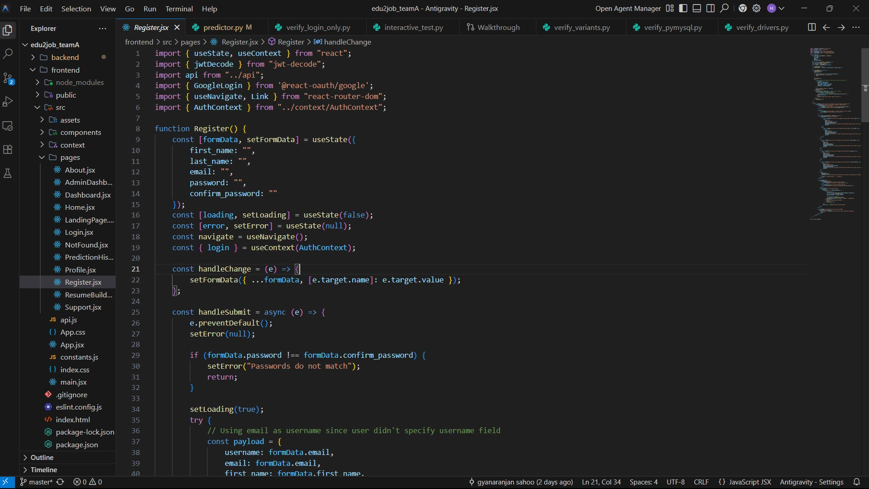

Slide 11
Milestone 2: Education Details Input & Preprocessing Module
Academic Data Capture
Structured input for courses, grades, and qualifications.
Data Cleaning
Automated processes for consistency and accuracy.
Feature Engineering
Transforming raw data into meaningful ML features.

Slide 12
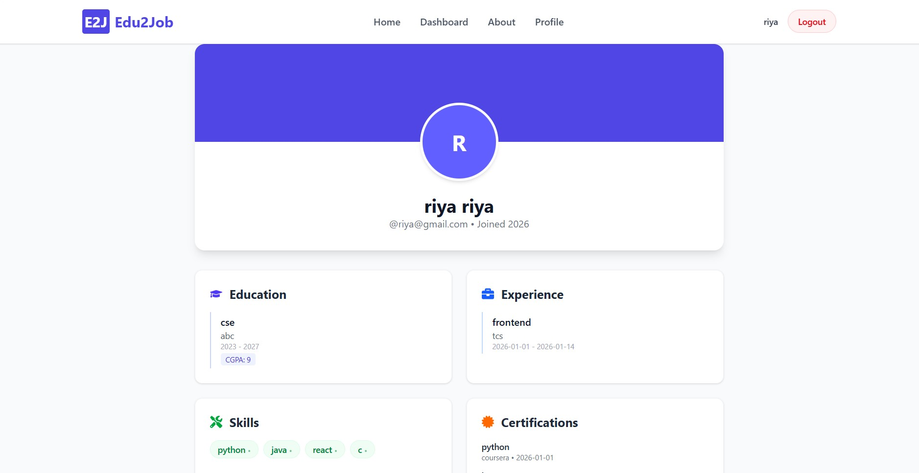

Slide 13
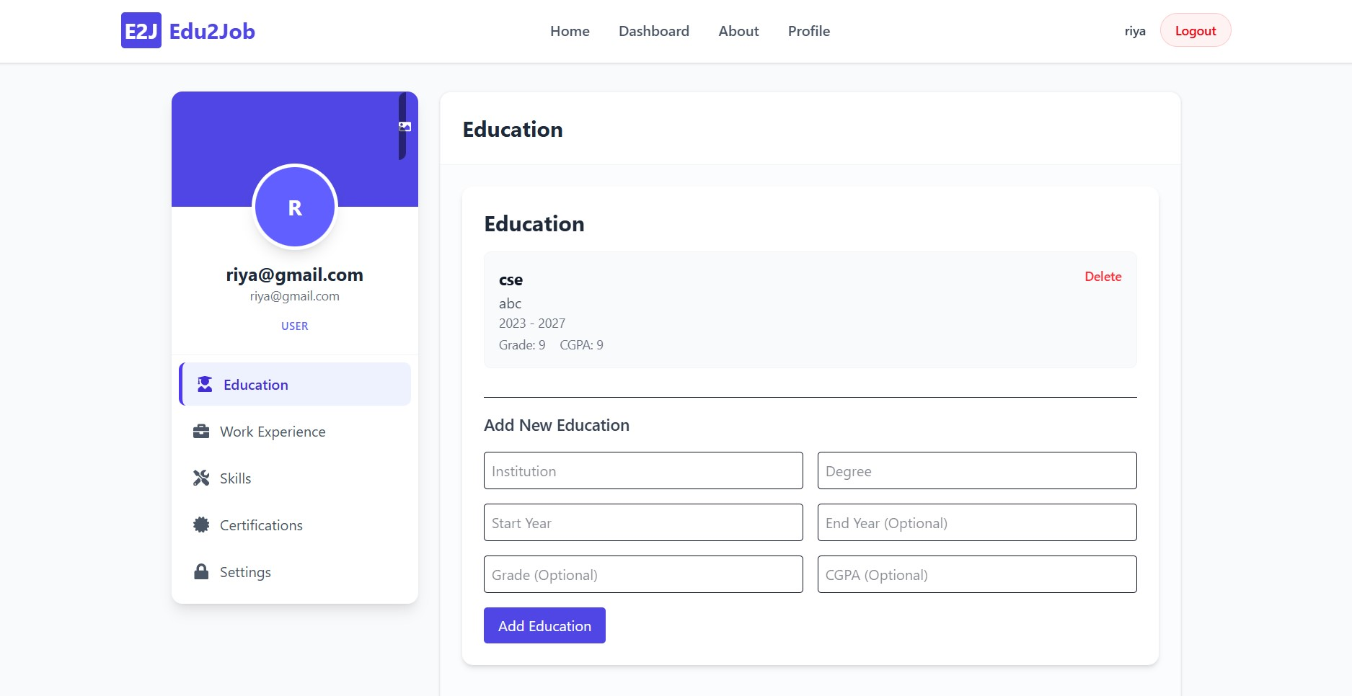

Slide 14
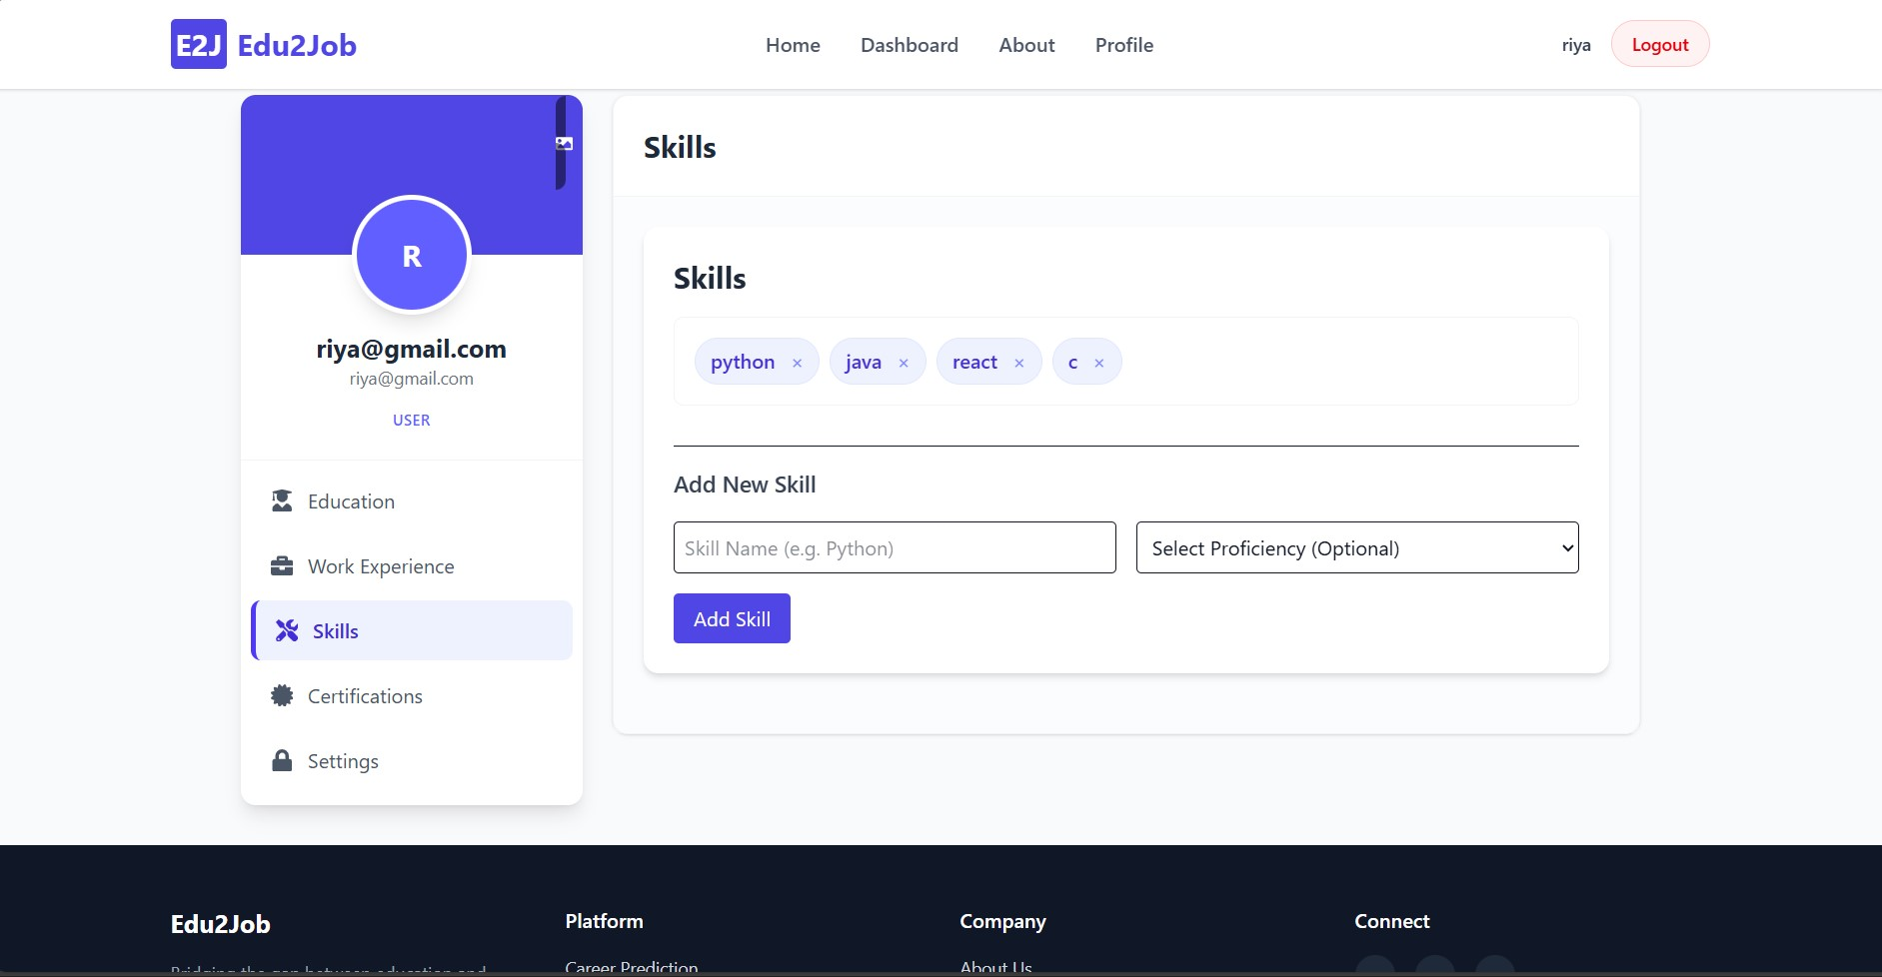

Slide 15
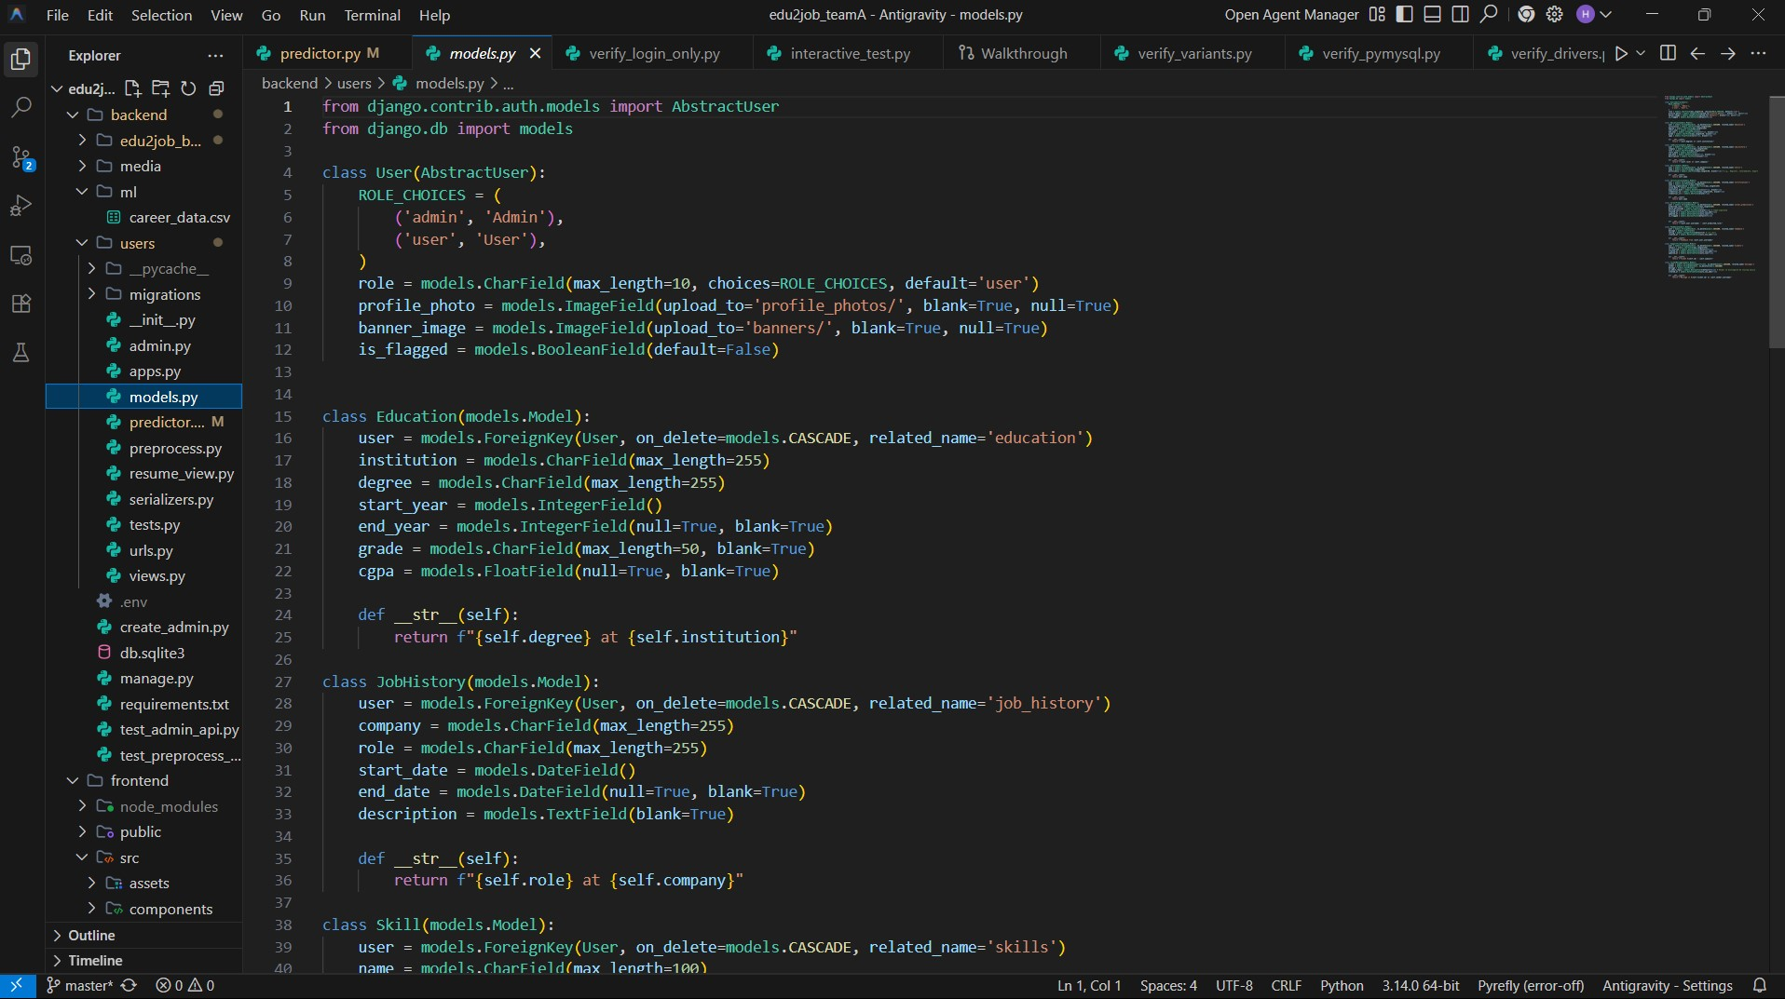

Slide 16
Milestone 3: Job Role Prediction Module
User Data Integration
Feeding processed education and profile data.
ML Prediction Engine
Utilizing Random Forest for career forecasting.
Personalized Recommendations
Generating relevant job role suggestions.

Slide 17
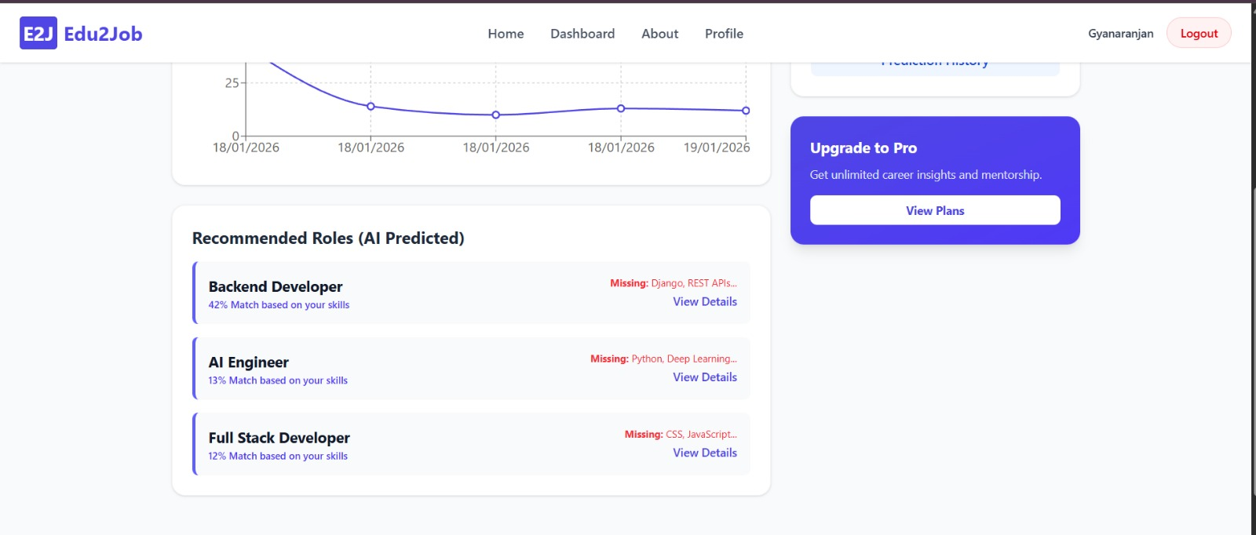

Slide 18
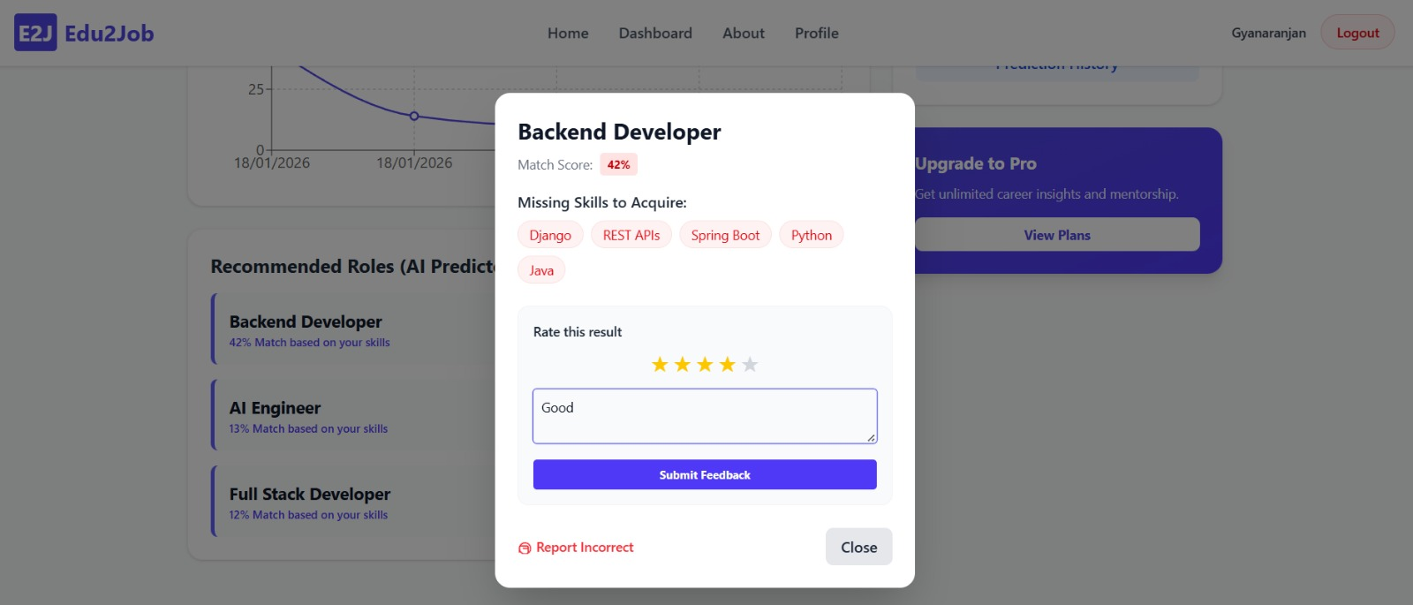

Slide 19
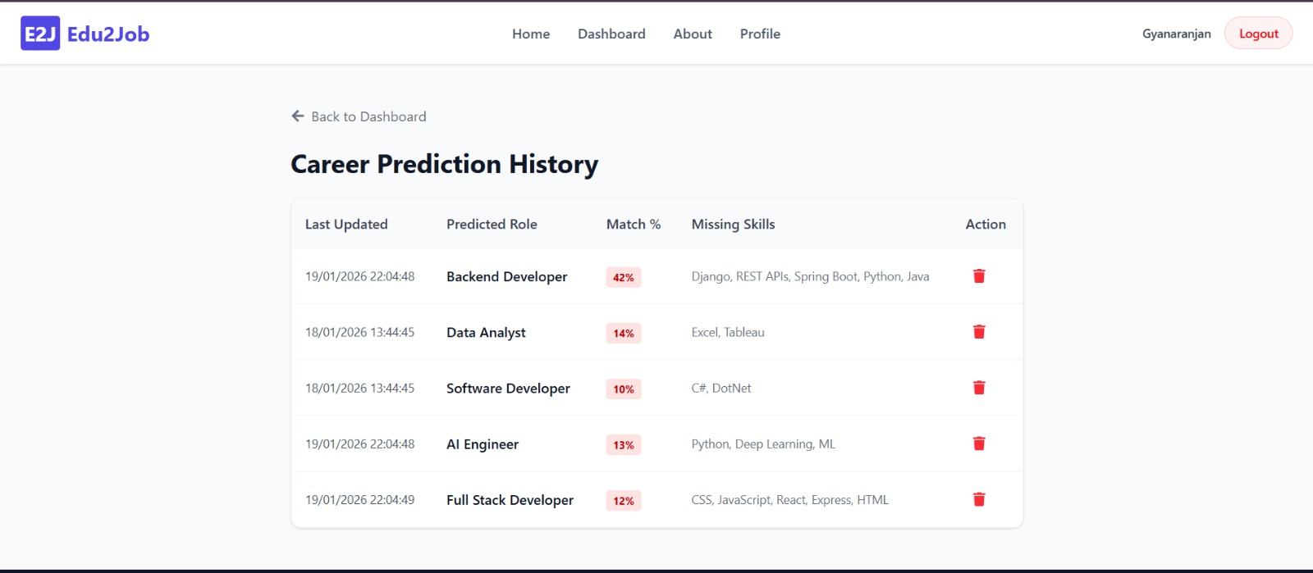

Slide 20
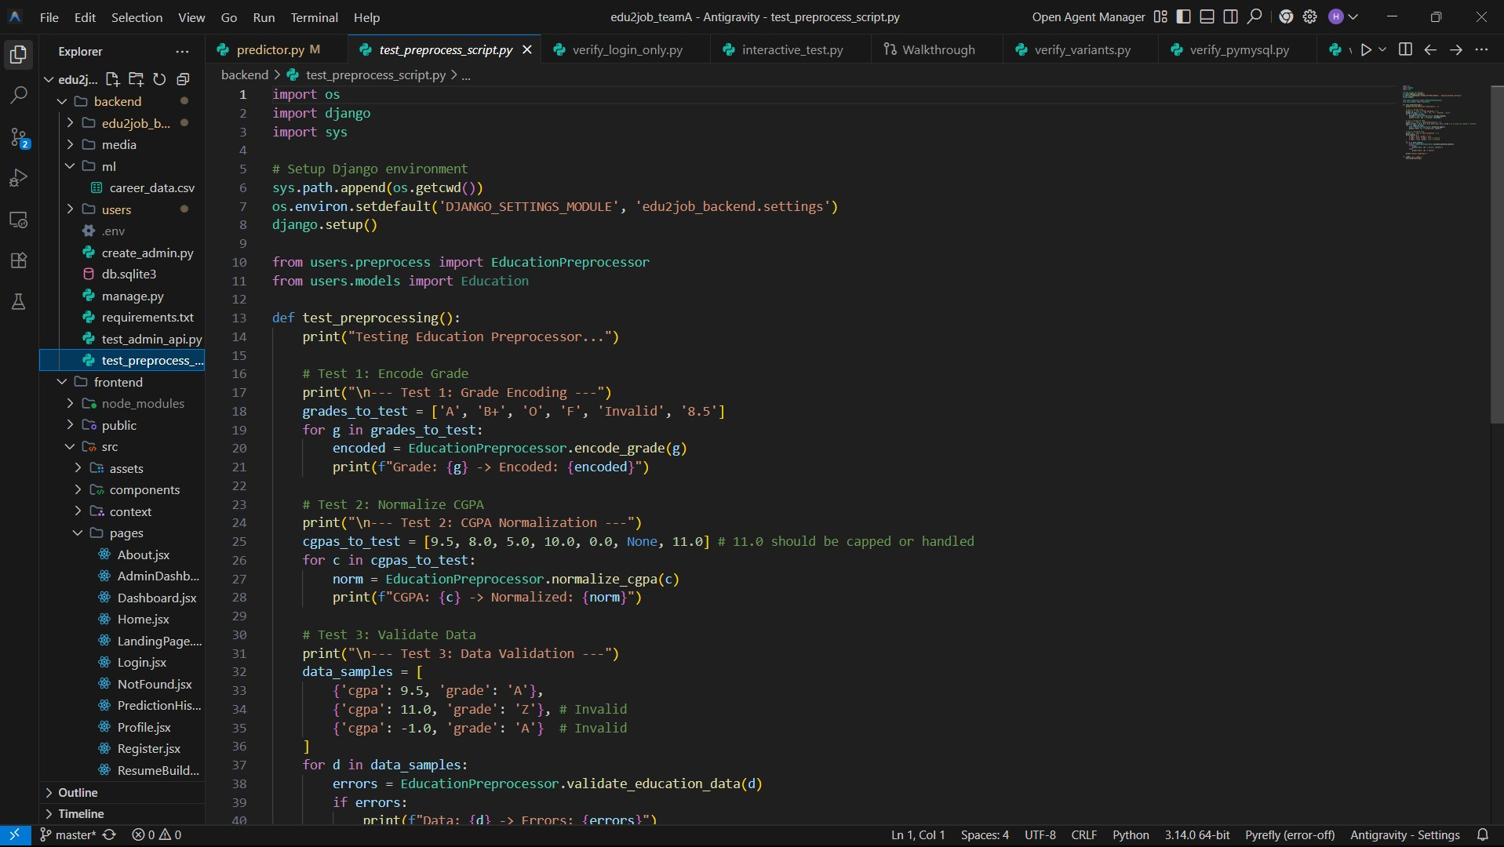

Slide 21
Milestone 4: Admin Dashboard & Model Management
User Management
Data Monitoring
Model Performance
Retraining Control
System Analytics
Content Updates

Slide 22
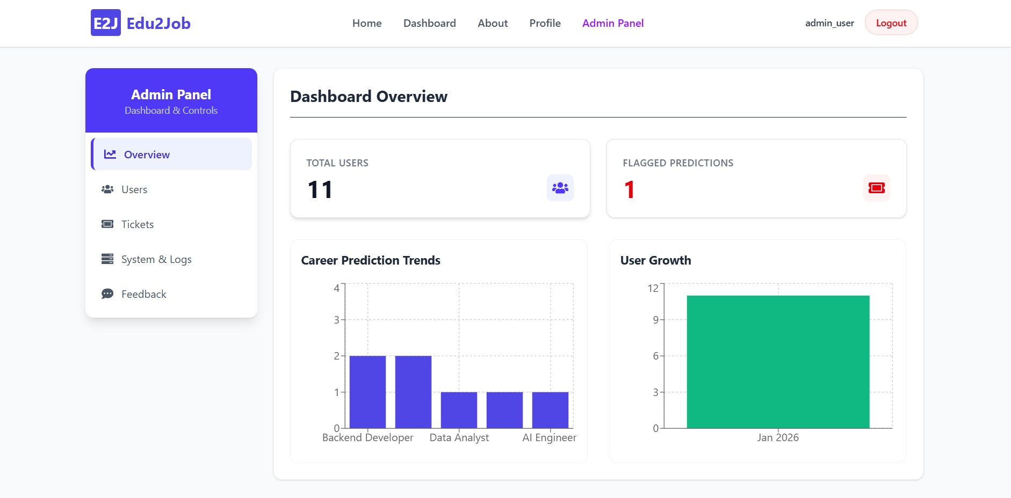

Slide 23
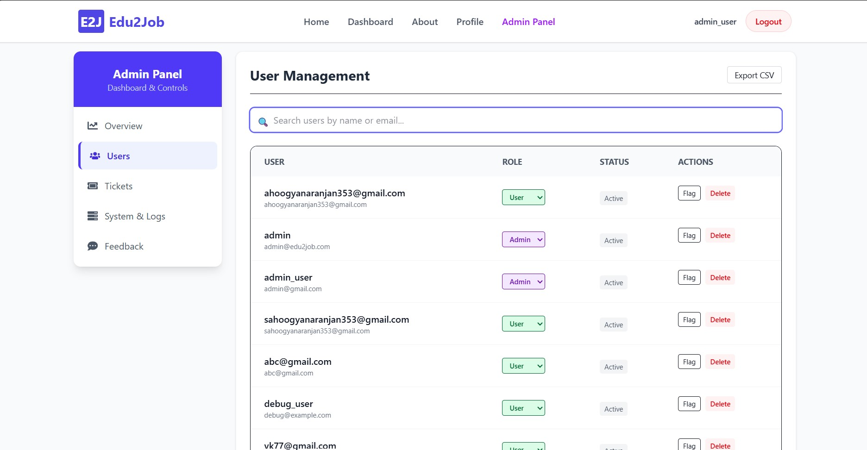

Slide 24
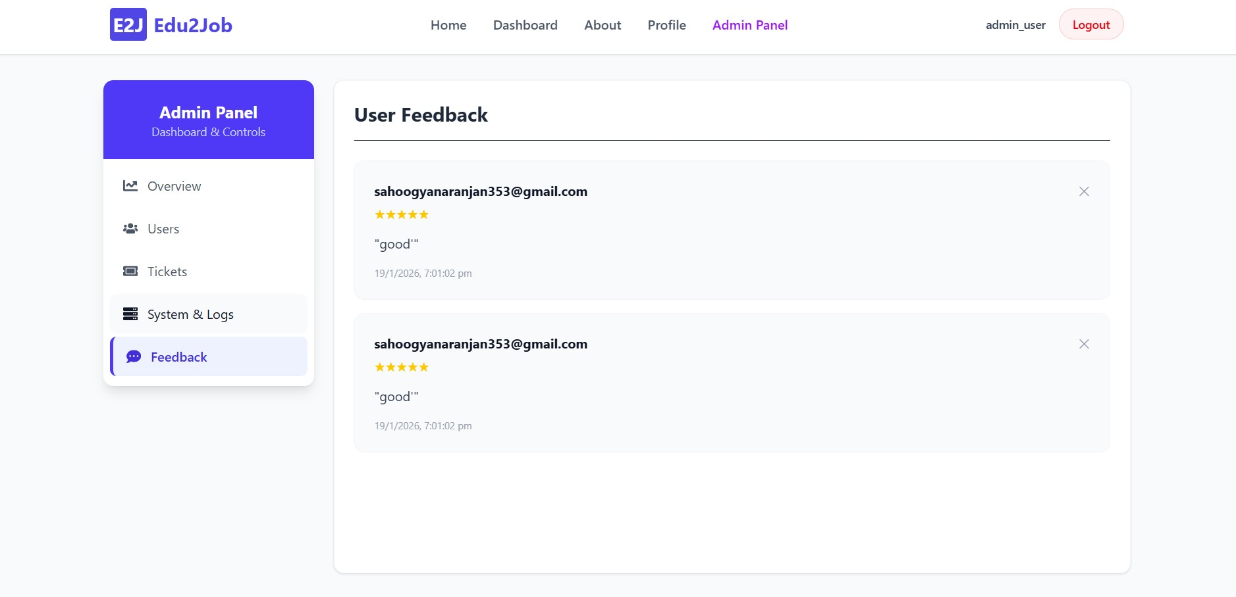

Slide 25
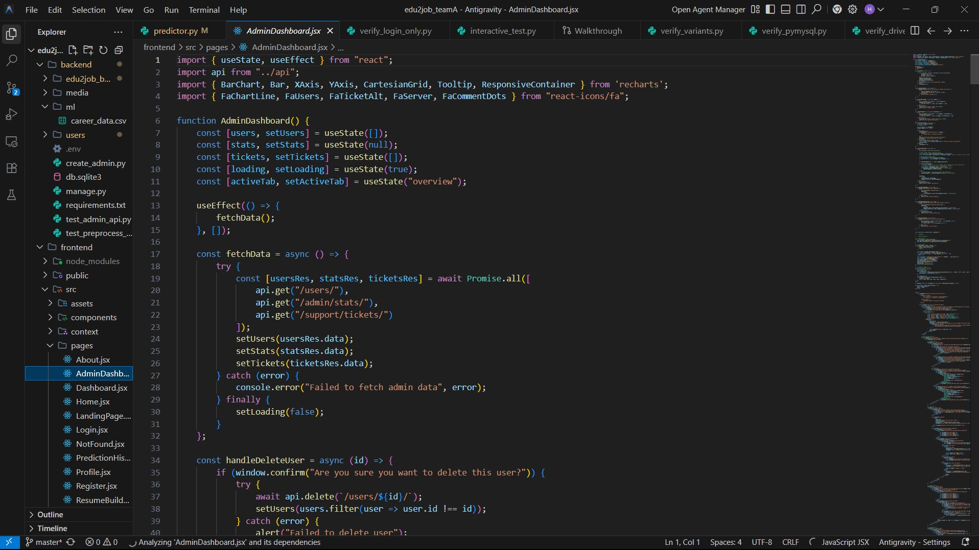

Slide 26
Performance Metrics
95%
Prediction Accuracy
Highly reliable career path suggestions.
< 2s
Response Time
Instant feedback and recommendations.
4.7/5
User Interface Score
Exceptional usability and satisfaction.
99.9%
System Uptime
Consistent availability and reliability.

Slide 27
Future Enhancements: Scaling Impact
Mobile Application
Reach a wider audience on-the-go.
Advanced ML Models
Integration of Neural Networks for deeper insights.
Company Partnerships
Connecting users directly with employers.

Slide 28
Thank You

