Slide 1
Mini-Tutorial: Bedtools
19 November 2020
MICB405 Systems Immunology Project

Slide 2
Refresher: BED File
3 mandatory columns
Sequence (usually a chromosome or fragment)
Start position
End Position
Tab-delimited

Slide 3
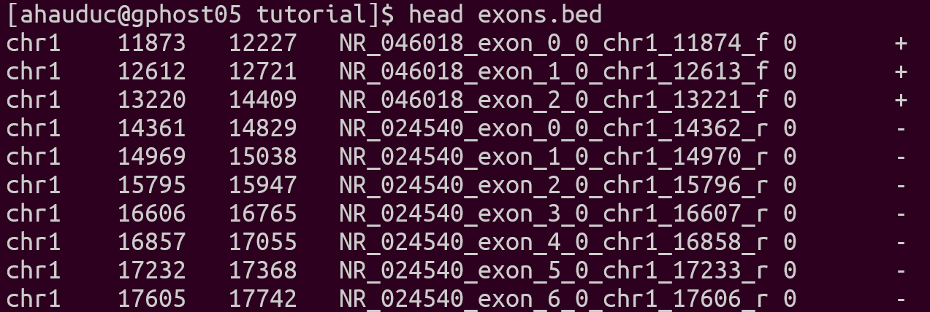
Sequence name
Start
Stop
Feature name
Score
Strand

Slide 4
ChIP-seq Peak Calling

Slide 5
ChIP-seq Peak Calling
chr1 100 500
chr1 900 1300

Slide 6
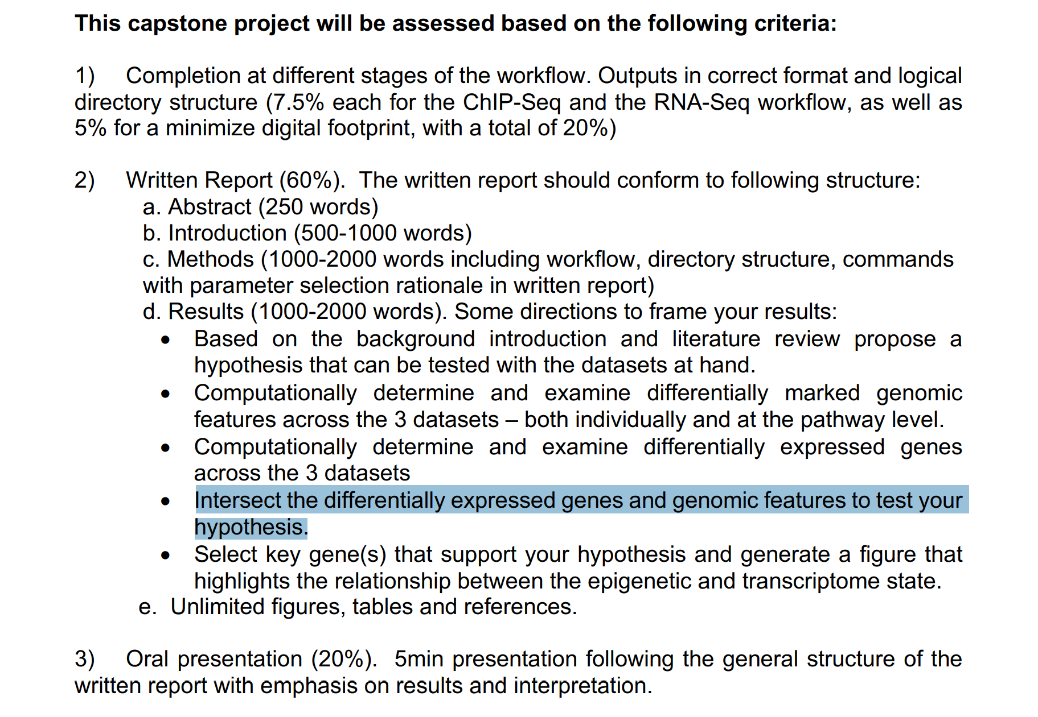

Slide 7
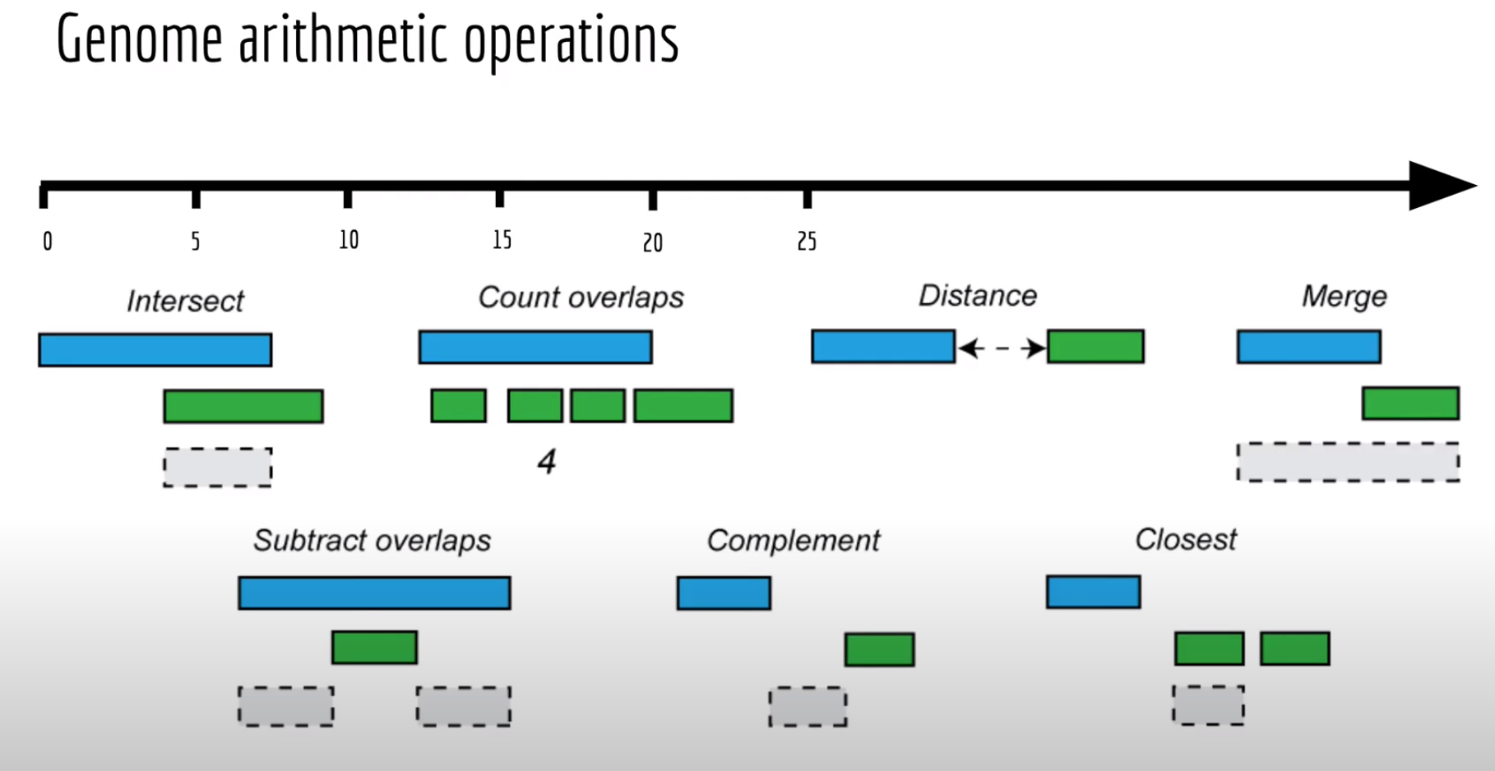

Slide 8
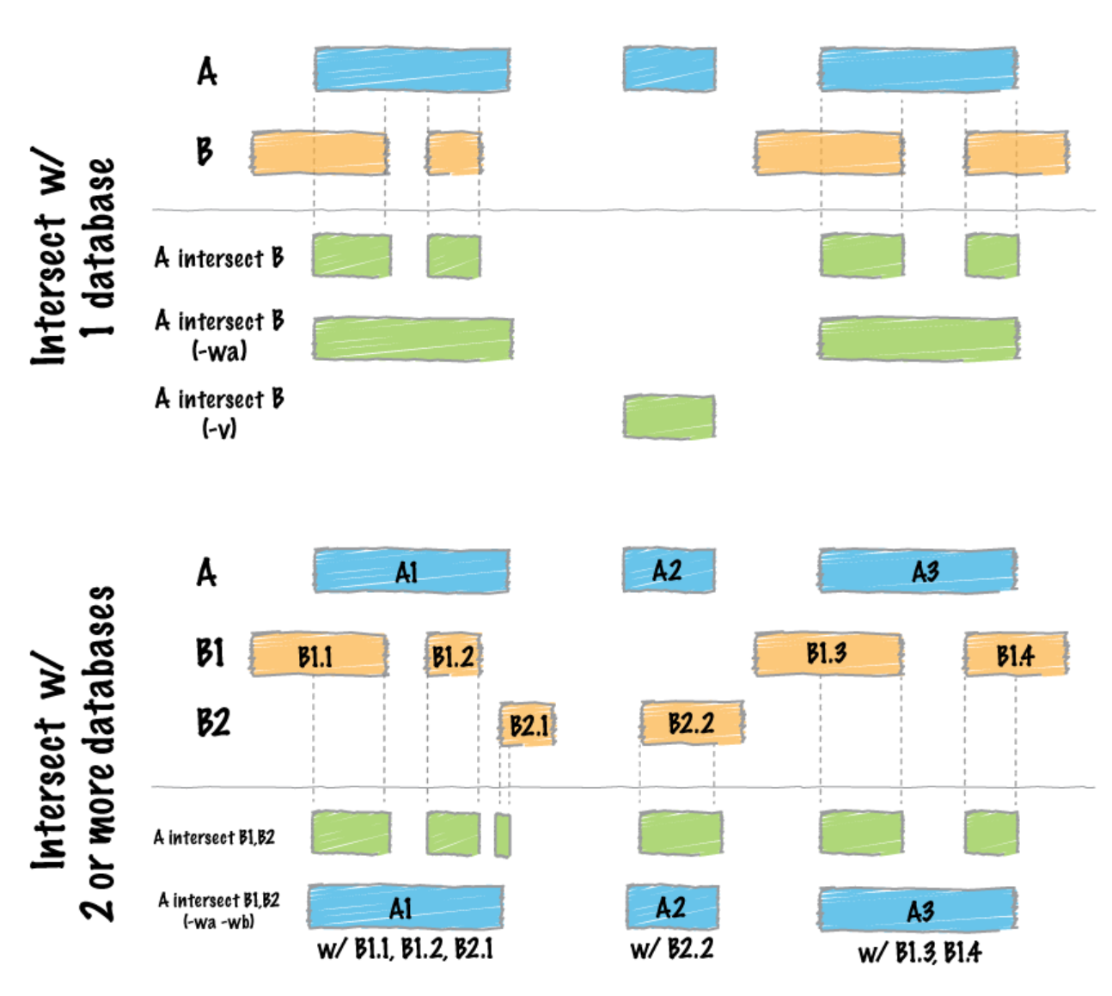
bedtools intersect

Slide 9
bedtools closest

Slide 10
Don’t forget bedtools sort !!!
bedtools sort –i input.bed > input.sorted.bed

Slide 11
More info
https://bedtools.readthedocs.io/en/latest/content/bedtools-suite.html
Bedtools documentation
https://www.youtube.com/watch?v=1R1KocKEzYY&ab_channel=AaronQuinlan
Bedtools lecture from original creator
http://quinlanlab.org/tutorials/bedtools/bedtools.html
Bedtools tutorial including more sub-commands
https://www.ncbi.nlm.nih.gov/geo/query/acc.cgi?acc=GSM3439934
Example ChIP-seq peak calls used in practice

