Slide 1

Team “Sladkoyezhki”

Slide 2
Contents
Team members
Project idea
Technologies used
Steps of Realization
Work Plan

Slide 3
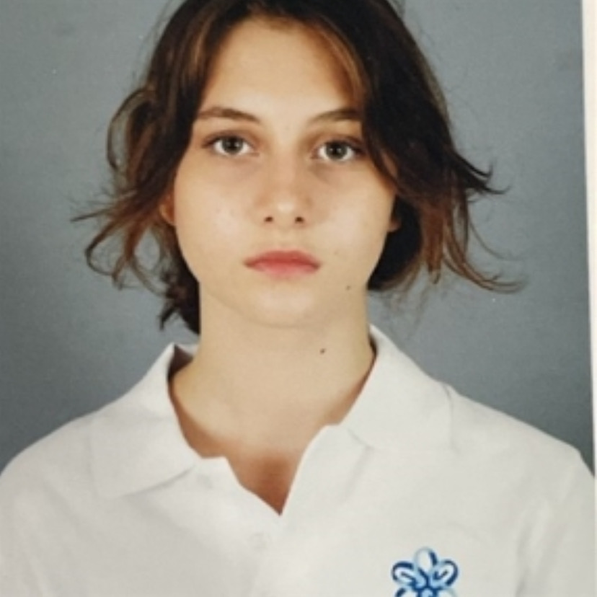
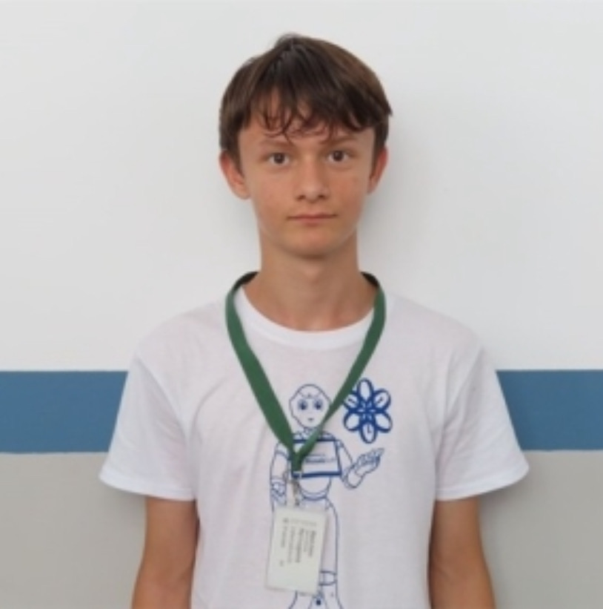
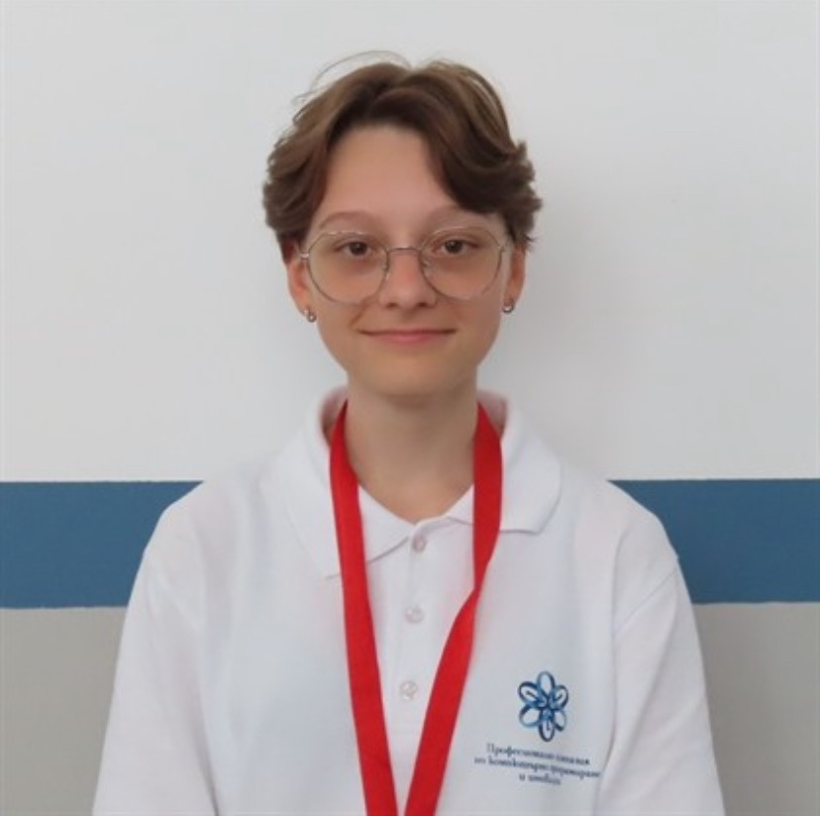
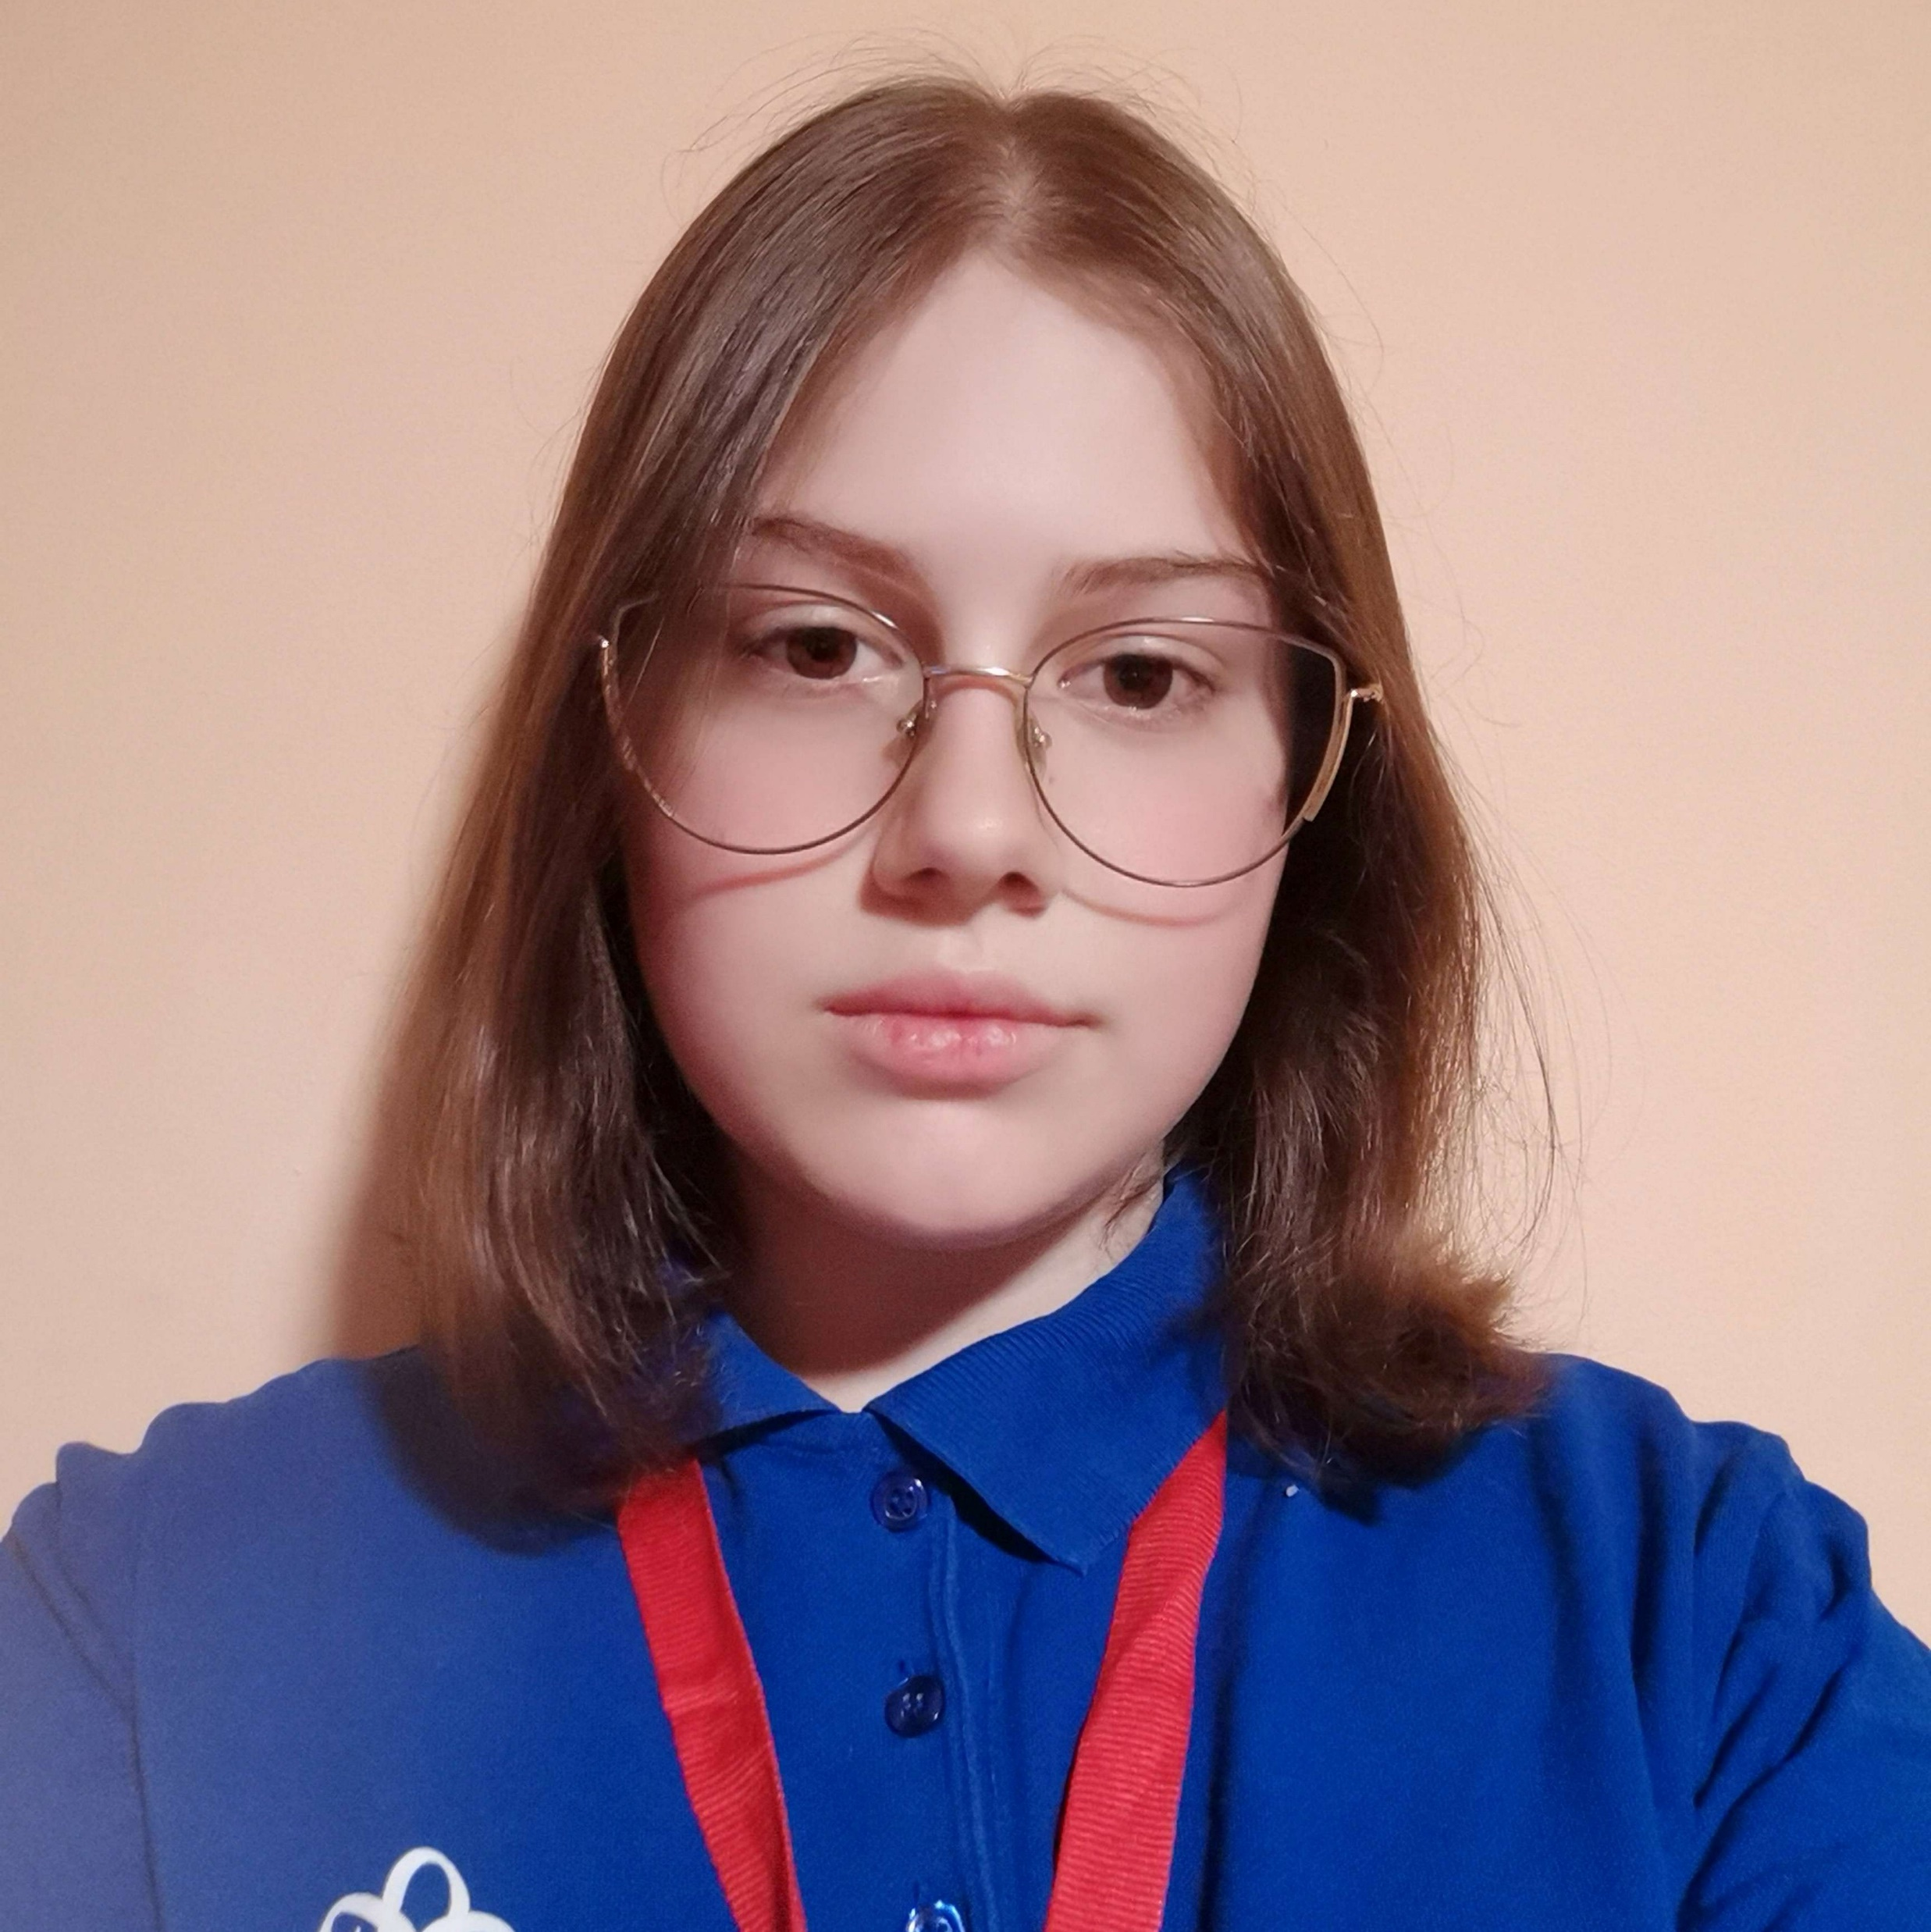
Team members
Ivaila Keserdzhieva
Developer
Ivelin Metodiev
Developer
Ekaterina Zalinskaya
Scrum trainer
Elizaveta Furnika
Designer

Slide 4
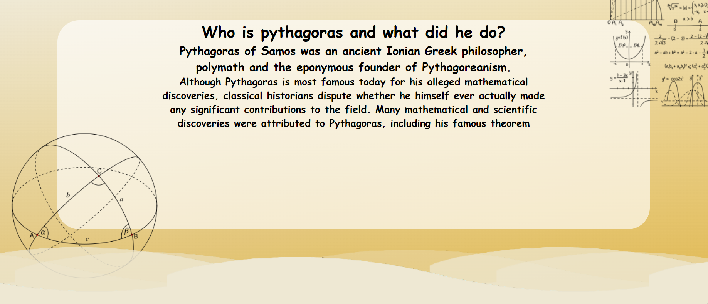
Project idea
It is a site where you can find some information about famous mathematicians and their discoveries. You can learn more about them, their formulas and how they influenced the world of mathematics.

Slide 5








Technologies used

Slide 6
Steps of Realization
Planning — Our team divided the roles and discussed which part are we going to do.
Process — We had team meetings almost every day to discuss the entire process.
Completing — Considering to deadlines, we split the amount of work for each day and had enough time to finish it.

Slide 7
Work Plan
Create a site
Add Sign Up page
Add pages with the main information
Create design
Create documentation

