Slide 1
Hunting Leopards
with Half a Brain
Split inference for Arabian leopard detection on off-grid hardware
Omar Alharbi, Abdullah Alhindi, Abdullah Alghanim, Rasheed Hamidaddin,
Basil Alshareef, Basil Alshehri
Mentor: Mojtaba Alshams
KAUST Academy
Notes:
Good morning. I am happy to present our project, Hunting Leopards with Half a Brain, where we built
a split detection system for the Arabian leopard that does not rely on the cloud.

Slide 2
Abstract
▪ Why: a critically endangered species whose habitat has no power grid and no network.
▪ How: one YOLO26 Large model split across many low cost camera nodes and one shared server.
▪ The key piece: a learned compression step sitting in the middle of the model.
▪ The cost: almost nothing measurable on the class we actually act on.
Notes:
This is the whole thing on one slide, and then I will take each piece in turn.
Why: a critically endangered species living somewhere with no power grid and no network. How: take
one YOLO26 Large model and split it across many cheap camera nodes and one shared server. The piece
that makes that actually work: a learned compression step sitting in the middle of the model. And
what it costs us: almost nothing on the one class we care about.

Slide 3
INTRODUCTION
Why the Arabian leopard
▪ Roughly 200 left in the wild. Critically endangered on the IUCN Red List.
▪ Saudi Arabia is investing heavily in its recovery:
The Arabian Leopard Fund, run by the Royal Commission for AlUla
Breeding at the Prince Saud Al-Faisal Wildlife Research Center in Taif, six cubs born in 2025
Ibex, gazelle and oryx reintroduced to rebuild the food chain
Partners include the IUCN, Panthera, Catmosphere and the Smithsonian
▪ All of that work runs on one input: where the animals actually are, right now.
Notes:
So, why the Arabian leopard.
About two hundred remain in the wild, and the International Union for Conservation of Nature lists
the subspecies as critically endangered.
Saudi Arabia is putting serious money behind bringing it back. The Royal Commission for AlUla runs
the Arabian Leopard Fund. The breeding programme at the Prince Saud Al Faisal Wildlife Research
Center in Taif produced six cubs last year. Ibex, gazelle and oryx are being reintroduced to rebuild
the food chain, with the IUCN, Panthera, Catmosphere and the Smithsonian as partners.
All of that work runs on a single input: where the animals actually are, right now. And that has to
be measured in places with no power grid and no network.

Slide 4
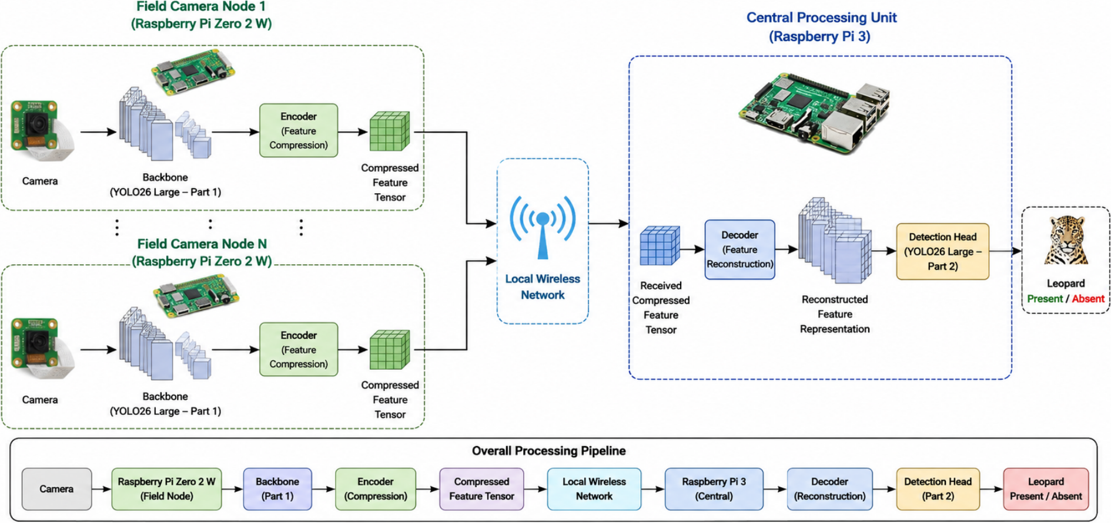
SYSTEM OVERVIEW
A network of camera nodes, one shared server
The heavy part of the model exists once and is shared, so covering more ground costs one more camera, not one more server.
Notes:
Here is the shape of what we built.
The camera node is a Raspberry Pi Zero 2 W. It runs the first three layers of the model and nothing
else. What comes out goes over local Wi-Fi to a Raspberry Pi 3, which runs the remaining twenty
layers and the detection head.
The reason it is arranged this way is scale. The heavy part of the model exists once and is shared,
so covering more ground costs one more camera, not one more server.
And if the link drops, the camera does not go dark. It falls back to a smaller model it can run on
its own until the link returns.

Slide 5
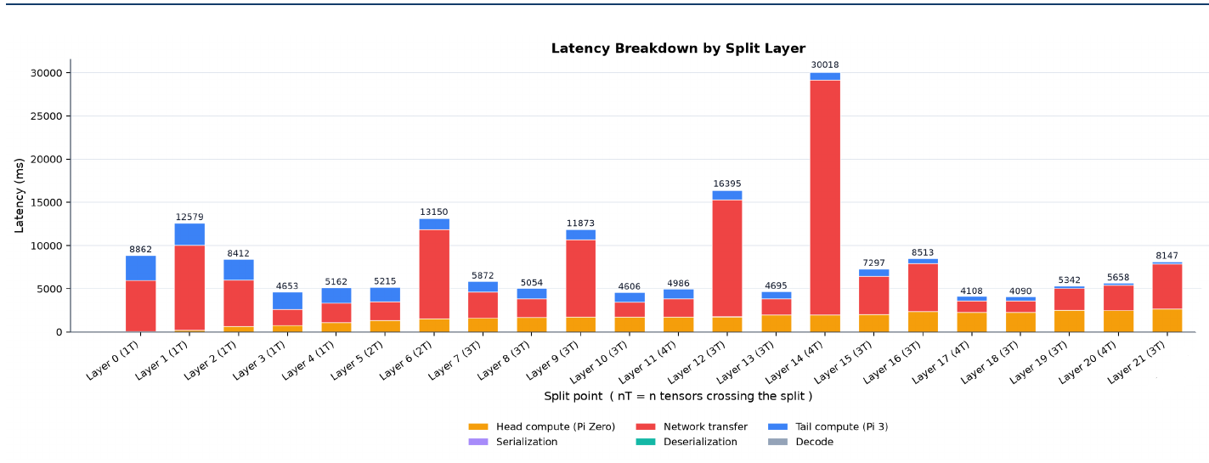
METHODOLOGY
Where we cut the model
▪ Data from LILA BC, seven open Roboflow datasets, and our own background images.
▪ Eight classes. The leopard is the only one we act on (Other classes are negatives to prevent hallucination).
▪ Cut point chosen empirically: 18 admissible candidates, all profiled on the real devices.
▪ Layer 3 choosen. It leaves 3.4% of the parameters on the camera, plus a small encoder.
Notes:
Two decisions sit behind that picture.
The data first. We built the training set from LILA BC, a public camera trap archive, plus seven
open Roboflow datasets and our own background photographs. Eight classes are labelled, but the
leopard is the only one we act on. The other seven share its habitat, and they are there so the
model learns what a leopard is not.
Then the cut point, which we did not guess. We enumerated the eighteen places in the exported graph
where exactly one tensor crosses the boundary, and profiled every one of them on the real devices.
Layer three won. It leaves three point four percent of the parameters on the camera.

Slide 6
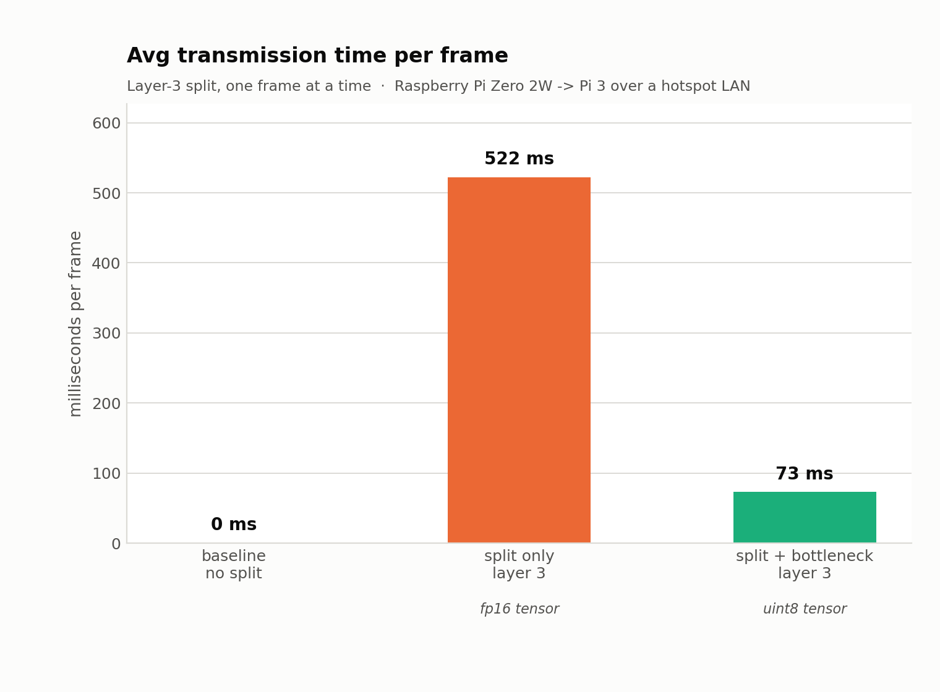
METHODOLOGY
The learned bottleneck
64x
smaller payload
1600 KB to 25 KB per frame
7x
faster to send
522 ms to 73 ms per frame
▪ A 4,112 parameter encoder narrows the feature map from 256 channels to 16, sent as uint8.
▪ A larger decoder rebuilds it on the server, where the compute is affordable.
▪ Everything downstream of the split is left completely unchanged.
Notes:
Which brings me to the thing that decides whether any of this is practical: what actually crosses
the link.
Cut at layer three and the tensor you have to send is sixteen hundred kilobytes for one frame. On a
single wireless link shared by many cameras, that is the ceiling on how many nodes a server can
carry.
So we trained an encoder and decoder pair that straddles the cut. The encoder narrows the feature
map from two hundred and fifty six channels down to sixteen and sends it as eight bit integers. It
costs four thousand parameters on the camera, and the expensive reconstruction sits on the server.
Two numbers come out of that. The payload drops sixty four times, from sixteen hundred kilobytes to
twenty five. And the time spent transmitting drops seven times, from five hundred and twenty two
milliseconds down to seventy three, measured on the devices.

Slide 7
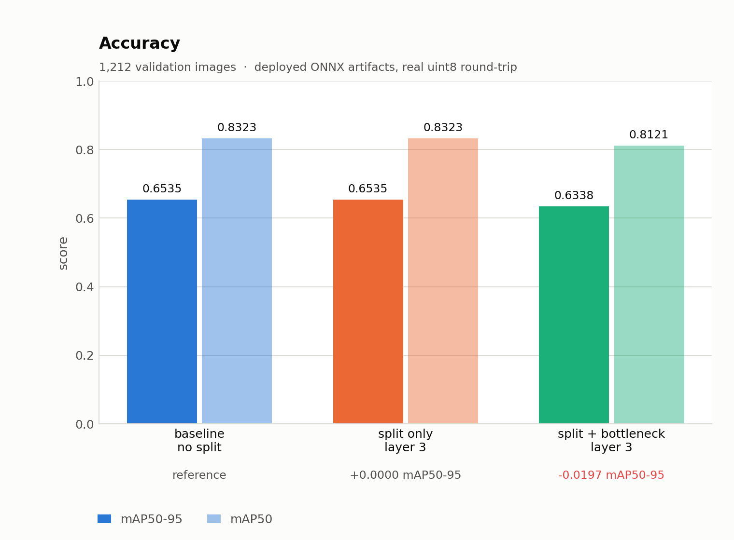
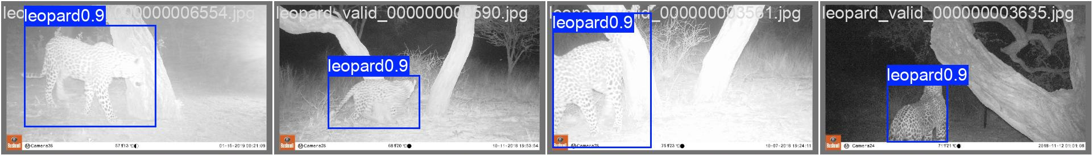
RESULTS AND DISCUSSION
Accuracy holds, throughput improves
▪ Leopard AP@0.5 of 0.988. Compression costs it 0.011 AP50-95.
▪ Across all eight classes the drop is 0.0197 mAP50-95.
Notes:
So what did that cost us?
Almost nothing where it matters. On the leopard the model reaches nought point nine eight eight
average precision, and the compression takes about one hundredth of a point off that. Across all
eight classes together the drop is two hundredths. These are measured on the deployed ONNX artefacts
over a real link, not simulated.
On speed we gained. Overlapping the camera and the server so two frames are in flight at once takes
us from nought point three two to nought point five frames per second, a fifty eight percent
improvement on identical hardware.

Slide 8
CONCLUSION
Conclusion
▪ A model no single field device can run in real time now runs across a whole reserve.
▪ The wireless link is no longer the limit on how many cameras a reserve can carry.
▪ Next: skipping empty frames on the camera, detection-aware bottleneck training, a live field trial.
github.com/EE-Omar/Hunting-Leopards-with-Half-Brain
Notes:
So, the consequence.
A model that no single field device can run in real time now runs across a whole reserve, and the
wireless link is no longer what limits how many cameras that reserve can carry.
Next steps are skipping empty frames on the camera itself, and a live trial in the field.
Thank you.

Slide 9
Thank You
Omar Alharbi
omar.alharbi@kaust.edu.sa
Abdullah Alhindi
abdullah-ghulam@outlook.com
Abdullah Alghanim
abdullah.alghanim@kaust.edu.sa
Rasheed Hamidaddin
rasheed.hamidaddin@kaust.edu.sa
Basil Alshareef
basilahmed.alshareef@gmail.com
Basil Alshehri
basil.alshehri55@gmail.com
KAUST Academy

