Slide 1
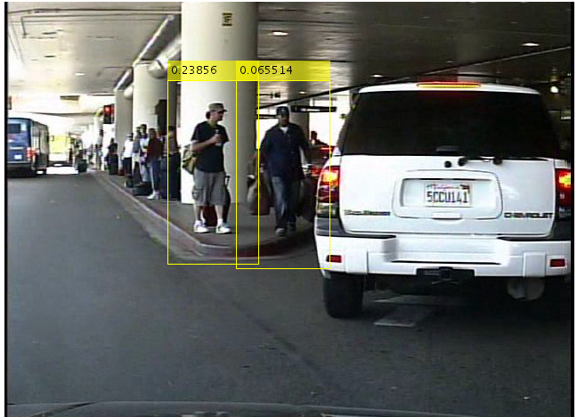

Real-time Pedestrian Detection in Consecutive Frames
Andrey Zaytsev, Jerry Guo, Shubhendra Chauhan, Yiming Wang Department of Computer Science, College of Engineering, University of Illinois at Urbana-Champaign
INTRODUCTION
The problem of pedestrian detection is a vital part of autonomous driving. Cars need to know where the pedestrians are not only for the purposes of safety, but also for tasks such as picking passengers up, getting background information about the environment, as well as getting more accurate location information.
For instance, if there are a lot of people standing on the curb, one may infer that the car is driving through an airport. In addition, seeing a lot of pedestrians cross the road in front of the car allows us to conclude that there must be a red light even if it is obscured by some other objects.
Challenges
In contrast to a static camera, where people can be easily detected using any trivial background subtraction algorithms, pedestrian detection is a more complex problem. Since a camera mounted on a car is constantly moving, one needs to be able to detect people on any
METHOD
HOG Person Detection
We used HOG-person detector as the base pedestrian detector.
Keypoint Tracking
Keypoint tracking is done using Kalman filters.
Automatic Height Estimation
In order to do automatic height estimation, we first find horizontal vanishing points in the image.
RESULTS
We achieved an improvement over the baseline HOG pedestrian detector by adding keypoint tracking and height estimation.
One can see the difference between the original HOG and our improved version on the following sequences of frames:
In the original sequence, the person on the right is lost by the second frame. This happens because the pedestrian detector does not have any information about the results of the previous frame.
In comparison, our detector uses keypoint tracking, which allows us to detect the person on the second frame even though we get no data on him from the detector.
RESULTS (CONTINUED)
Example output of a pedestrian detector.
The detected pedestrians are enclosed in yellow boxes with a provided score by the HOG detector.
CONCLUSIONS
By running our experiments and observing the improvement over traditional person detection methods, we conclude that it is vital to make use of the continuous nature of frames in videos.
APPROACH
In order to improve the accuracy of a static person detector, we make use of the continuity of the frames in a video. Specifically, we
We use a combination of HOG person detector, keypoint tracking, and automatic height estimation through vanishing point (VP) detection.
ACKNOWLEDGEMENTS
We used the Matlab libraries provided by the Computer Vision Toolbox. In addition, the frames are taken from the Caltech Pedestrian Detection Dataset.

Slide 2
Captions set in a serif style font such as Times, 18 to 24 size, italic style.
Duis autem vel eum iriure dolor in hendrerit in vulputate velit esse molestie consequat.
Captions set in a serif style font such as Times, 18 to 24 size, italic style.
Duis autem vel eum iriure dolor in hendrerit in vulputate velit esse molestie consequat.

