Slide 1


Visual Data Warehousing
A Practical Use Case
Data Visualization Meetup
Munich, 03.05.2017

Slide 2



About Me
Frode Voll Aasen
Business Intelligence and Data Management
frode.voll.aasen@ventum.de
Ventum Consulting
Technology and IT Consulting
Notes:
Transition: Details about Data Warehousing required. Quick poll: How many know about DWH / Data Vault?

Slide 3
Data Vault: A Brief Overview
2 challenges:
Multi-Layer architecture makes traceability difficult
Hub and Spoke model causes a lot of database objects (tables and views)
Automatization
Data Source
Staging
Data Vault
Business Layer
Acess Layer
Target
Notes:
Explain the basic concepts. Focus on the pain points that lead to DVB

Slide 4
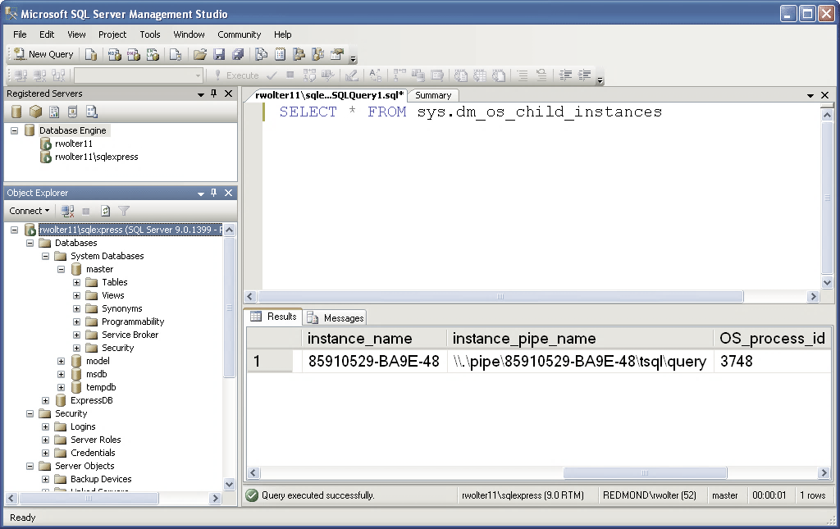
Data Vault: DB Style
Working with procedures, queries and tabular output
> 2000 tables and views, meaning search was our friend
Limited data exploration capabilites

Slide 5
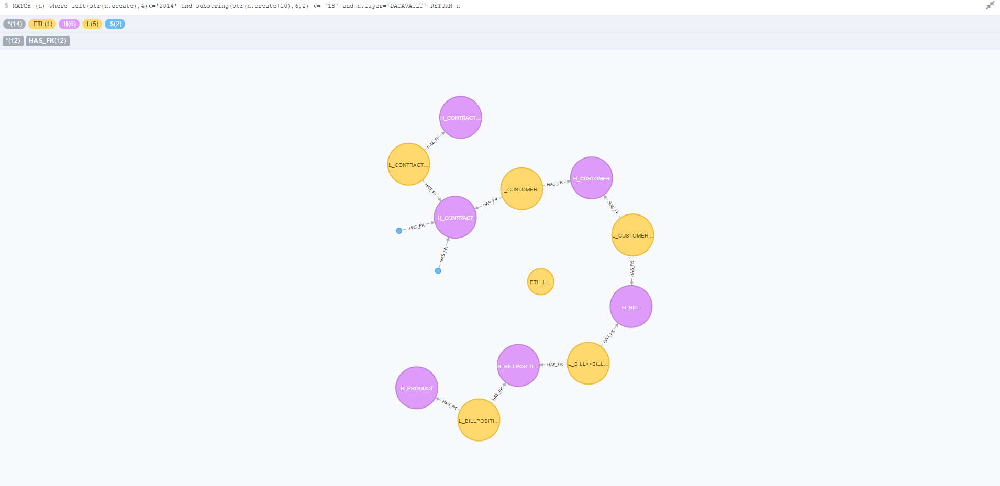
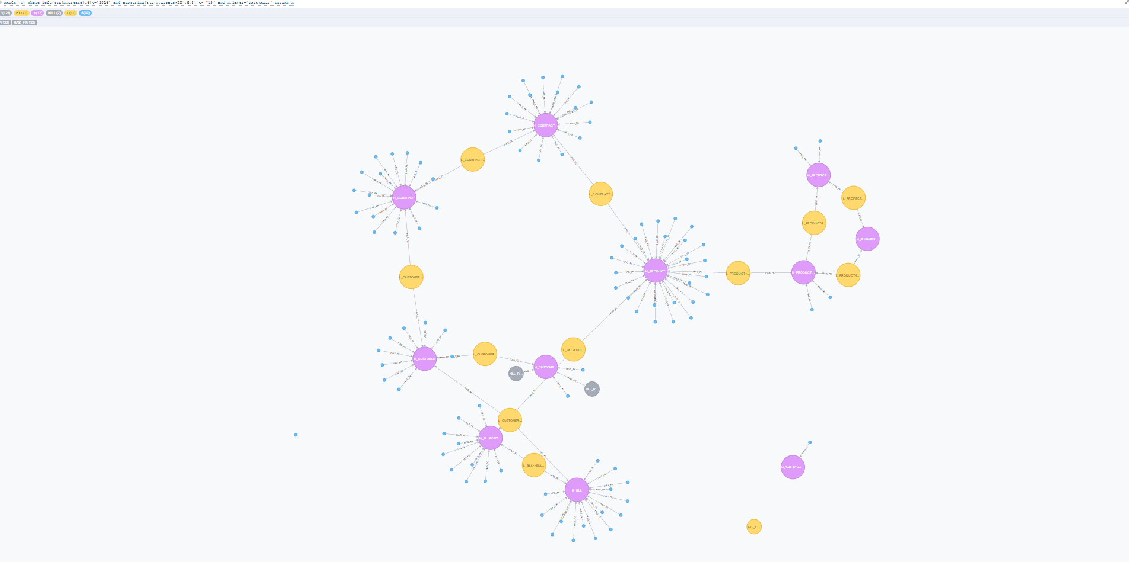
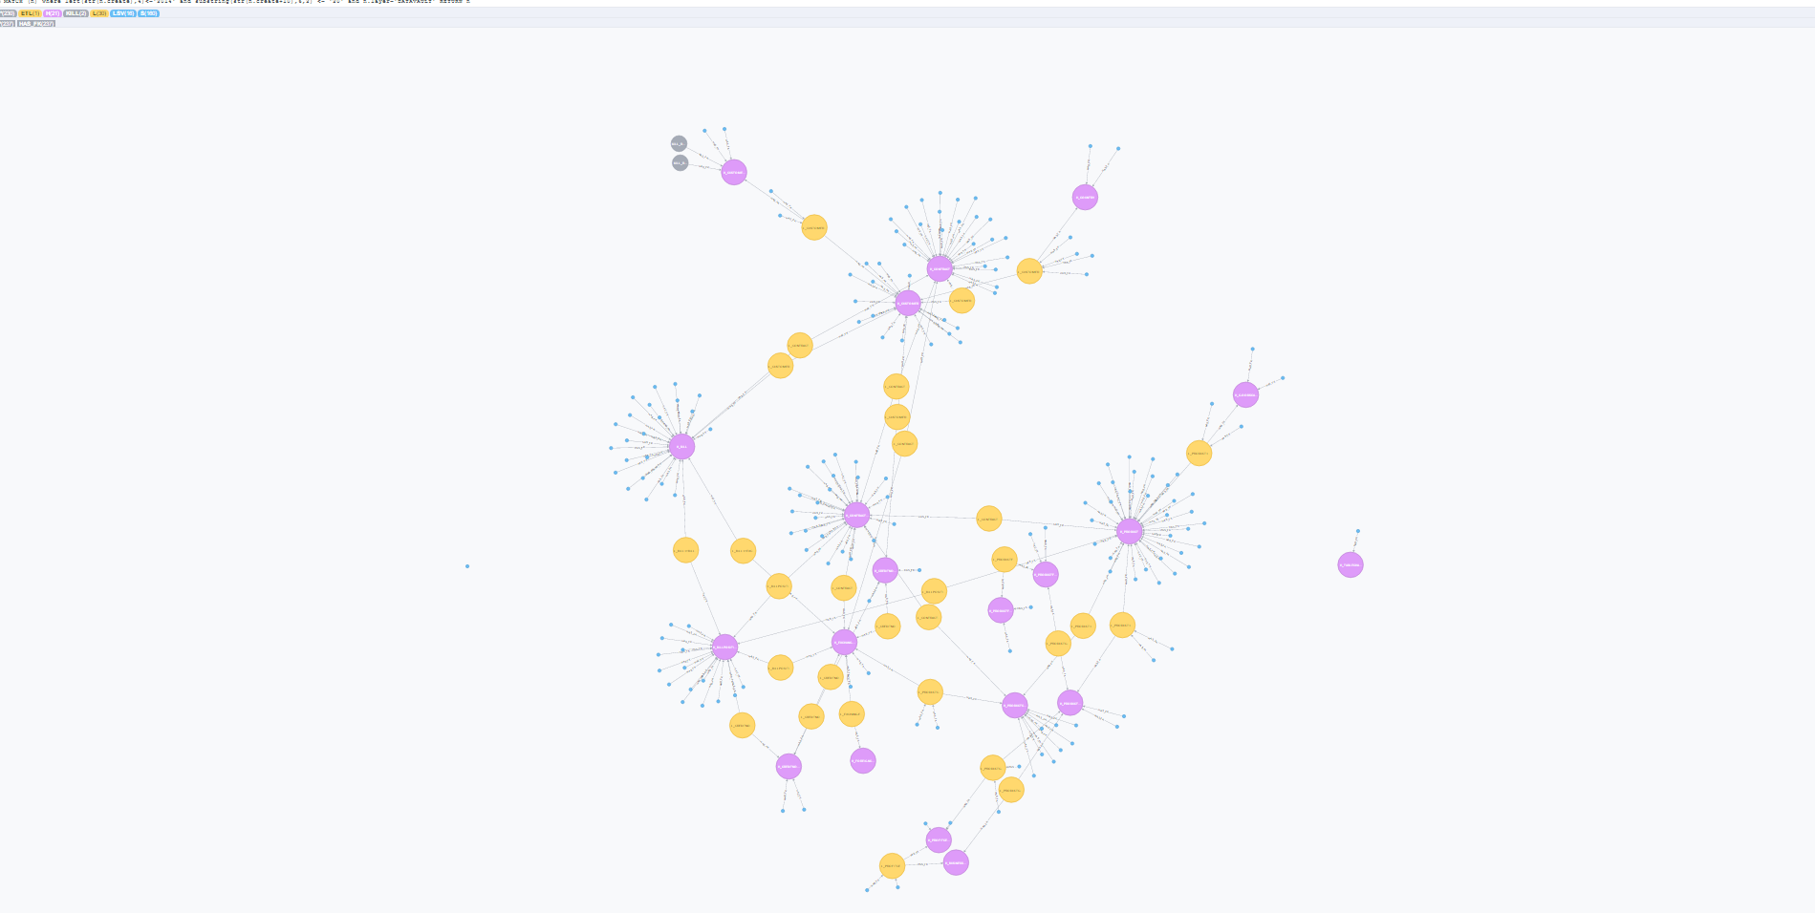
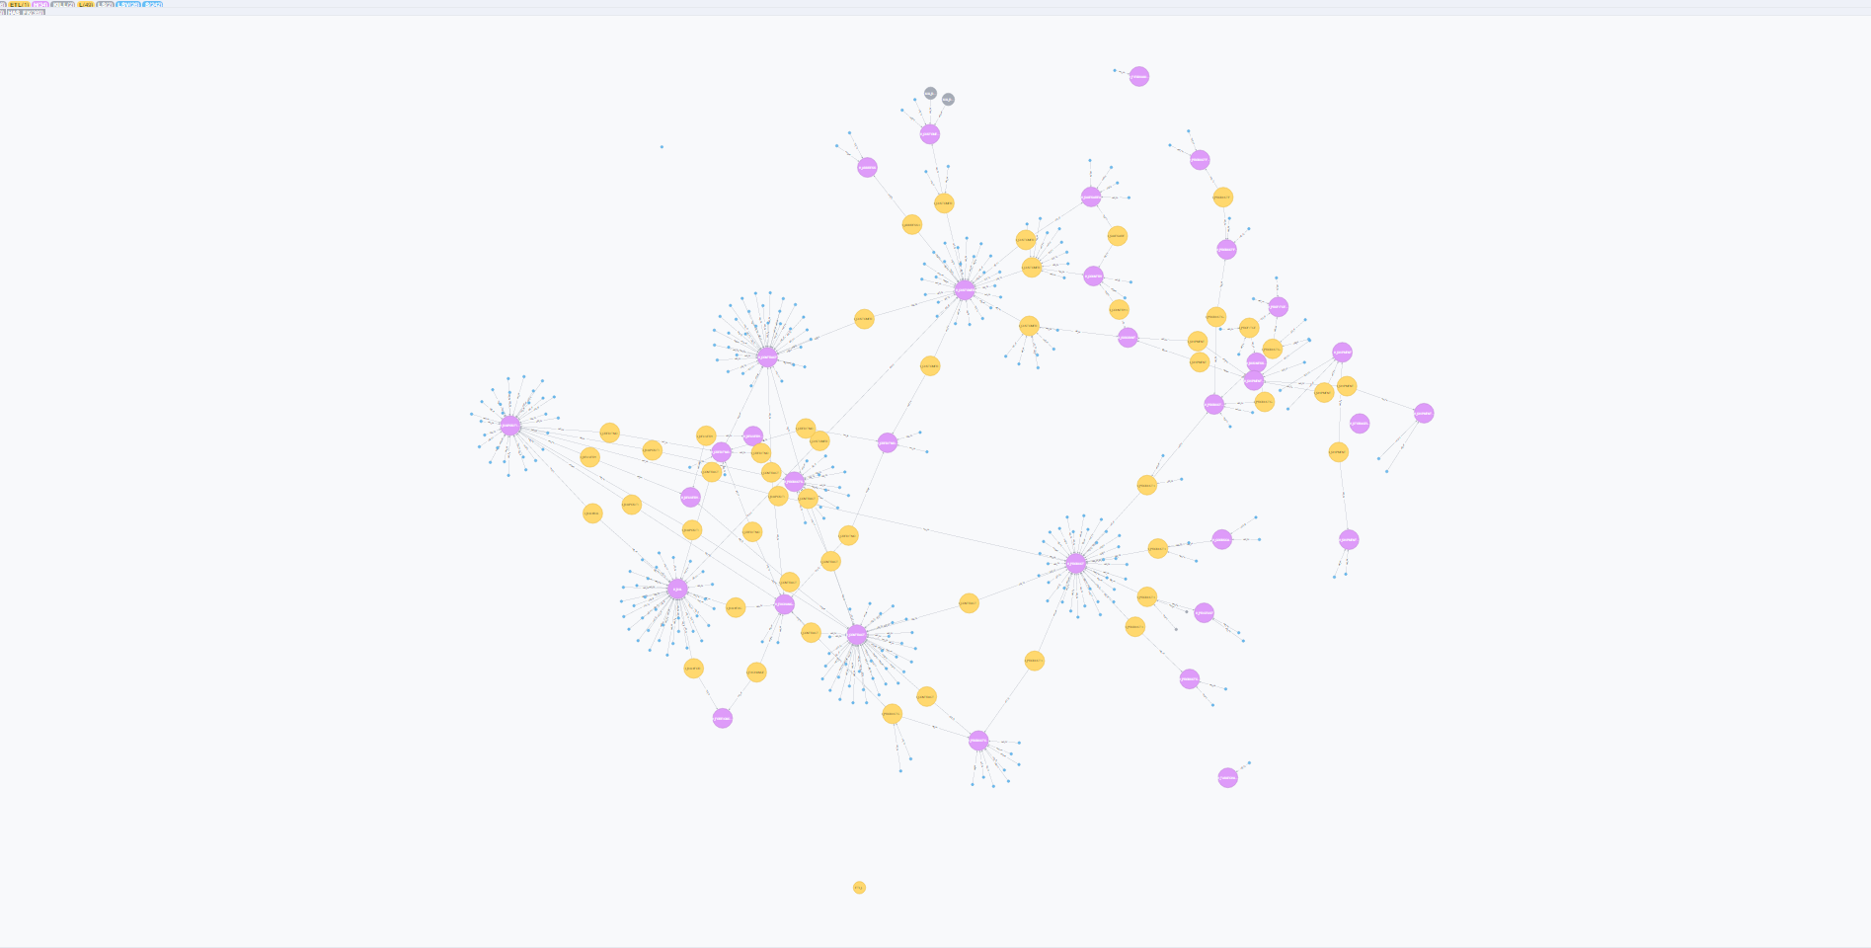
The Idea
August 2014
September 2014
Oktober 2014
November 2014

Slide 6
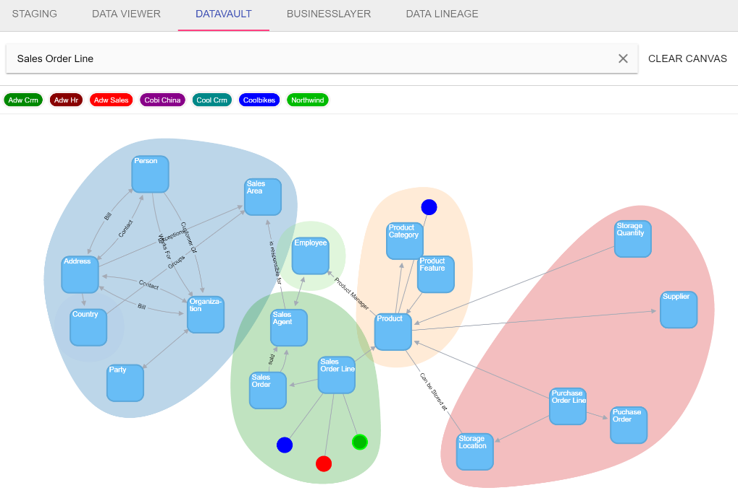
Data Modeling: D3.js
Notes:
Convex Hull
Directed Graph

Slide 7
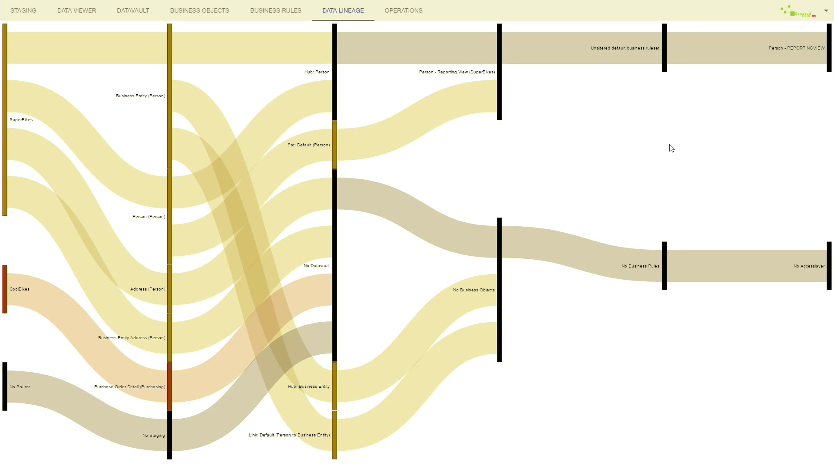
Data Lineage: d3.chart.sankey
Notes:
Sankey Path: Mouseover highlights the data lineage

Slide 8
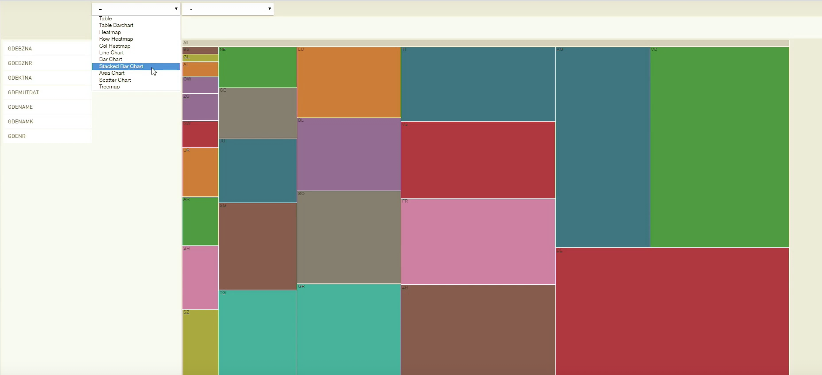
Data Viewer: JQuery Pivot Table and C3.js

Slide 9
Questions?
?
http://datavault-builder.com
frode.voll.aasen@ventum.de

