Slide 1
Item Explorer: How to interactively explore combinatorial questions
Dr. Mihael Ankerst
Munich, Feb 2nd 2017

Slide 2
Content
motivation
demo
design choices
how can you use the tool?

Slide 3
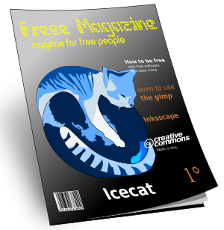



What kind of products do customers typically buy together in a grocery store?
# customers | fruit | beer | candy | magazines | …
6.388.860 | 1 | 0 | 0 | 0
898.973 | 1 | 0 | 1 | 0
4.231.452 | 0 | 1 | 0 | 0
5.123.433 | 0 | 1 | 1 | 1
… | … | … | … | …

Slide 4
Sorting by frequency …
# customers | fruit | beer | candy | magazines | …
6.567.680 | 1 | 1 | 0 | 0
6.549.840 | 1 | 1 | 1 | 0
6.488.320 | 1 | 0 | 1 | 0
6.388.860 | 1 | 0 | 0 | 0
… | … | … | … | …

Slide 5
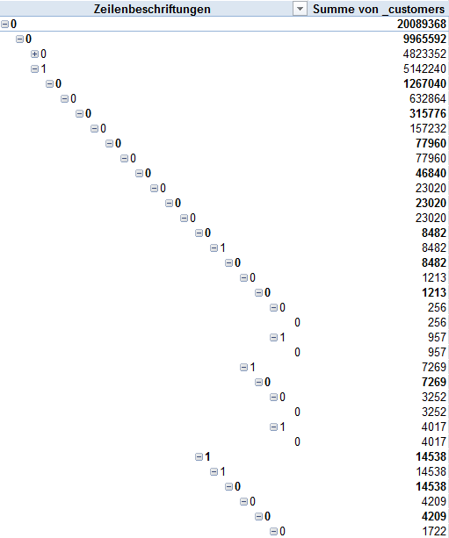


… or creating a pivot table ….

Slide 6


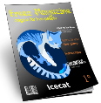

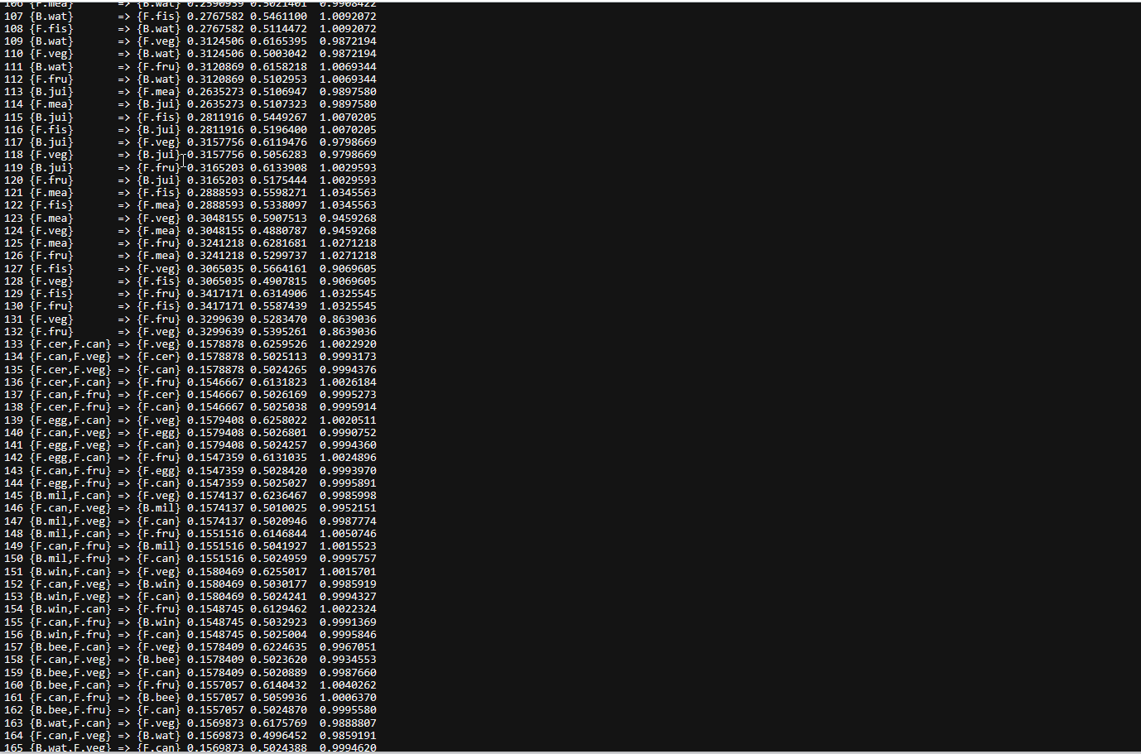
… or mining association rules doesn‘t give you the full picture!
+
+
→
Output of arules package in R Studio

Slide 7
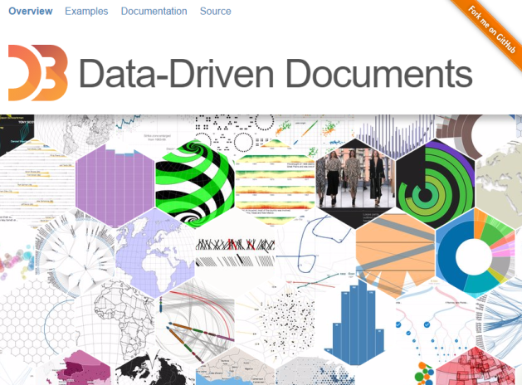
The idea of item explorer was born
D3.js
Use bar charts to represent item frequencies!

Slide 8
Content
motivation
demo
design choices
how can you use the tool?

Slide 9
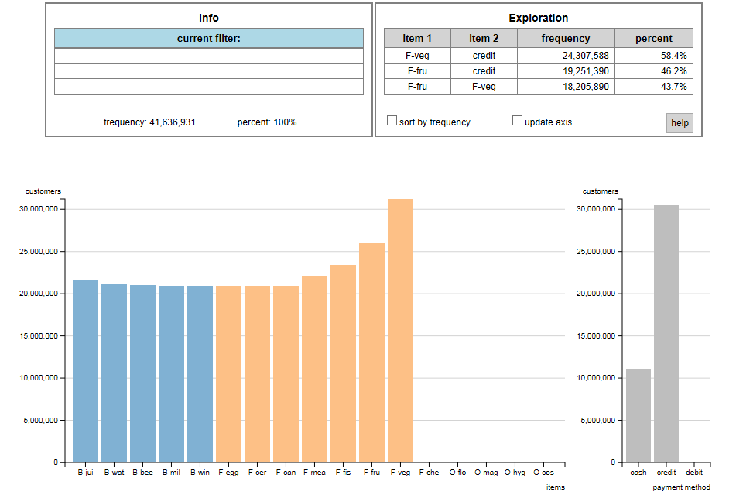
Demo: item explorer

Slide 10
Content
motivation
demo
design choices
how can you use the tool?

Slide 11
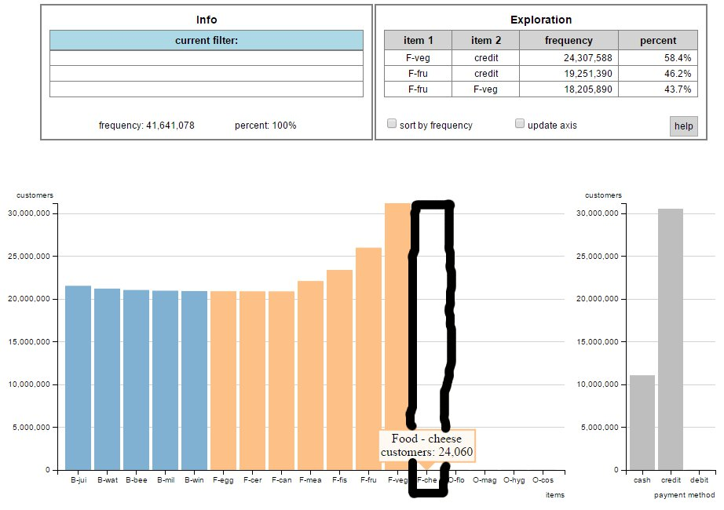
Design choices: #1 – virtual area for tooltip

Slide 12
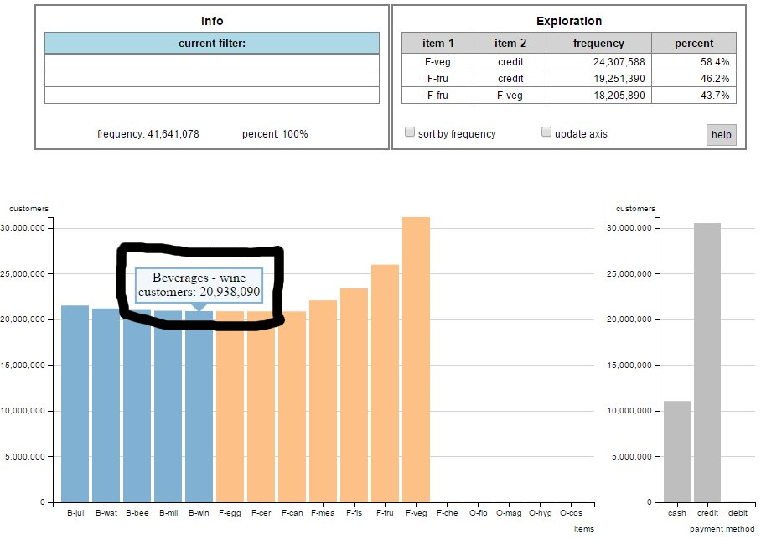
Design choices: #2 – descriptive name of item in the tooltip

Slide 13
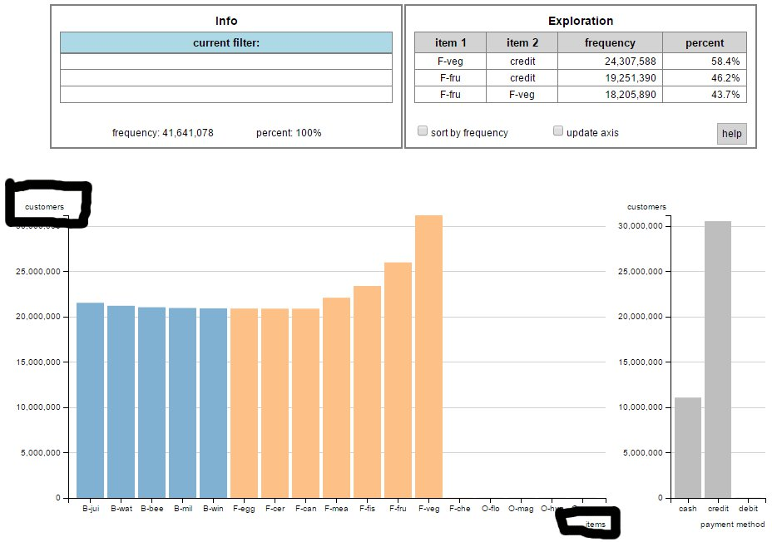
Design choices: #3 – separate chart area from axis labels

Slide 14
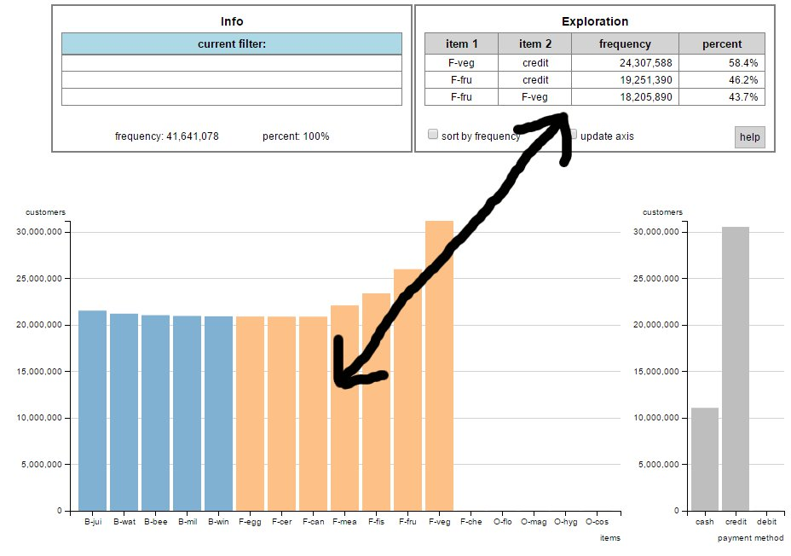
Design choices: #4 – combine interactive exploration with algorithmic guidance

Slide 15
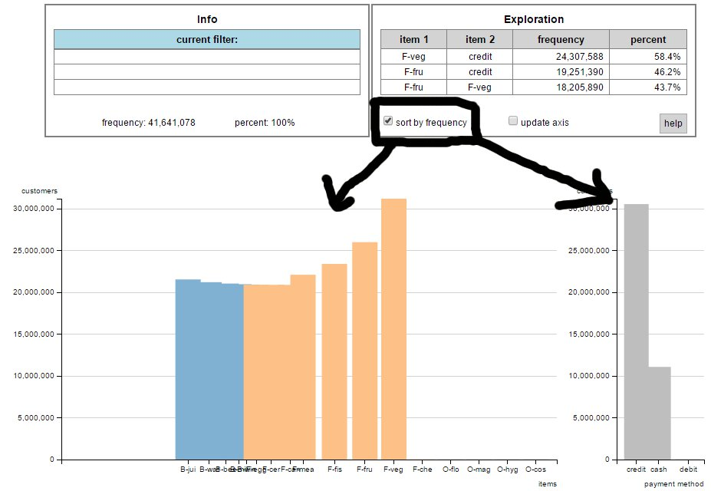
Design choices: #5 – resorting with staggered delay

Slide 16
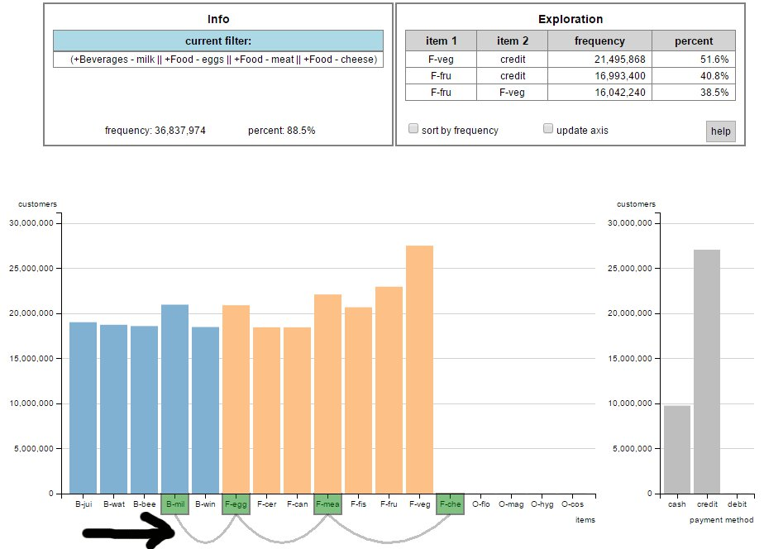
Design choices: #6 – displaying OR selections

Slide 17
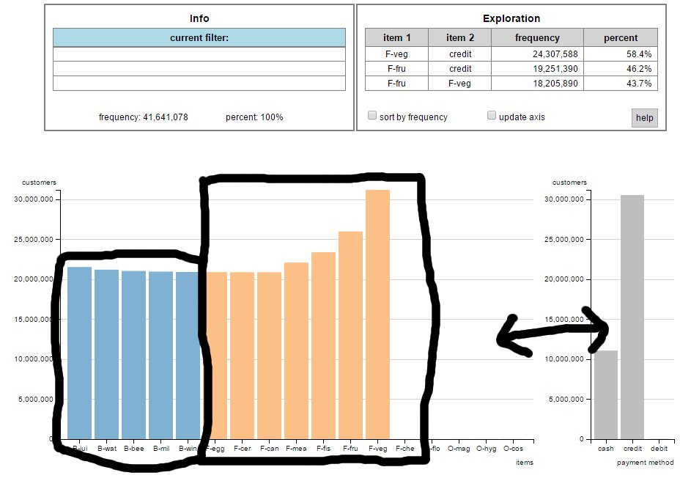
Design choices: #7 – displaying additional structure

Slide 18
Content
motivation
demo
design choices
how can you use the tool?

Slide 19
How can I use it?
Go to the github page
Click on the link: „reference to data embedded in html file“

Slide 20
How can I use it?
3) Scroll down to index.html
4) Copy the code and paste it into an editor. Save file as „index.html“
5) Change data in <pre></pre> tag to your data
6) Save file as „index.html“
7) Open file in browser
For data formatting or advanced visualization
options, see docu on github site.
…

Slide 21
Links
http://www.ankerst.de/Mihael/proj/mbc/
and
https://github.com/EE2dev/item-explorer

