Slide 1
Visualization in the big data era
Dr. Mihael Ankerst
Allianz Deutschland AG
Munich, April, 7th 2016

Slide 2



Introduction of myself – something big about me
I have worked for big employers
I have big interest in data mining, visualization and scalability
My daughter has big expectations
👱
Notes:
Big institutions, big data, big expectations from my daughter

Slide 3
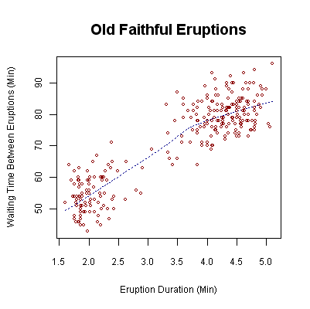


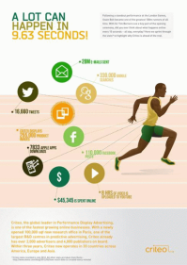
Big data and visualization don‘t seem to be a good match…
Lots of data !
Visualization does not scale easily
How to represent various data formats?
increasing variety
Don‘t we want to automate as much as possible?
data is coming fast …

Slide 4
The relevant space for data analysis:
unaccessible information
information in our minds
digital information
Notes:
We might argue about how much we know as human beings- however – that depends on the topic we are analyzing
The goal the analysis is typically to discovery some unknown relationships which are novel, applicable and valid.
Human:
Domain knowledge
Visual perception
Understanding and trusting the model
Judgement
Computer:
Searching in combinatorial spaces
Efficient processing, e.g. Multivariate mathematics
Since the evaluation of
Interactive visualization is key to discovering meaningful unknown relationships

Slide 5
The goal of any big data analysis is a result, that is…
… valid
… new
… and applicable!
Notes:
We might argue about how much we know as human beings- however – that depends on the topic we are analyzing
The goal the analysis is typically to discovery some unknown relationships which are novel, applicable and valid.
Human:
Domain knowledge
Visual perception
Understanding and trusting the model
Judgement
Computer:
Searching in combinatorial spaces
Efficient processing, e.g. Multivariate mathematics
Since the evaluation of
Interactive visualization is key to discovering meaningful unknown relationships

Slide 6
Let‘s look at the following box…

Slide 7
Let‘s look at the following box…
12
12
y
30
12
z
12
x
Box has the side lengths: (x, y, z) = (30,12,12)

Slide 8
Let‘s look at the following box…
12
12
y
30
12
z
12
A
6
1
x
Box has the side lengths: (x, y, z) = (30,12,12)
Ant A: is standing at (x, y, z) = (0,1,6)

Slide 9
Let‘s look at the following box…
12
12
B
y
30
6
12
11
z
12
A
6
1
x
Box has the side lengths: (x, y, z) = (30,12,12)
Ant A: is standing at (x, y, z) = (0,1,6)
Ant B: is standing at (x, y, z) = (30,11,6)

Slide 10
What is the shortest path to come from A to B ?
12
12
B
y
30
6
12
11
z
12
A
6
1
x
Box has the side lengths: (x, y, z) = (30,12,12)
Ant A: is standing at (x, y, z) = (0,1,6)
Ant B: is standing at (x, y, z) = (30,11,6)
Question: What is the shortest path for ant A to come to ant B ?
(ant B does not move and moving is just on the surface of box possible - the box is solid)

Slide 11
The solution of the puzzle Part 1…
Unfold the box …
11
30
1

Slide 12
The solution of the puzzle Part 2…
Answer: The shortest path is just 40 units long!
1
30
1
Representation matters!

Slide 13
What is the shortest path to come from A to B ?
12
12
y
30
12
z
12
1
30
1
x

Slide 14
What is the shortest path to come from A to B ?
12
12
y
30
12
z
12
1
30
1
x

Slide 15
Visualization is the data analysts‘ best friend if …
it is based upon an intuitive representation
Notes:
Representation matches the user‘s intuition / mental model and maps to an adequate search space

Slide 16
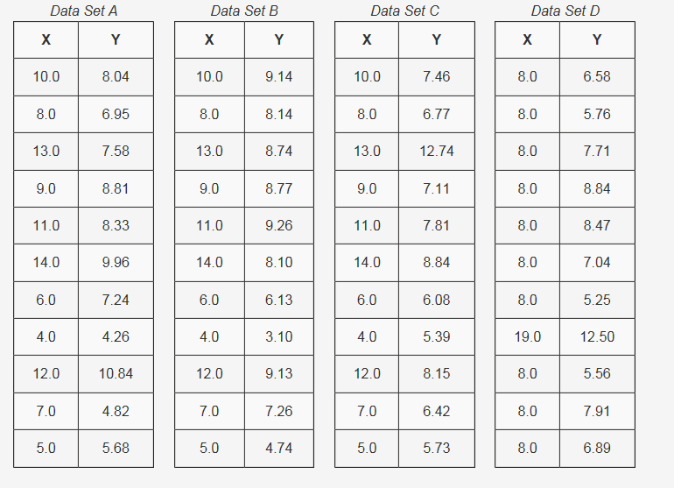
Why should we visualize data ? - 1
Anscombe's Quartet Data Table
Notes:
A picture can also be worth 1000 data points. In 1973, the statistician Francis Anscombe demonstrated the importance of graphing data. The Anscombe's Quartet shows how four sets of data with identical simple summary statistics can vary considerably when graphed.

Slide 17
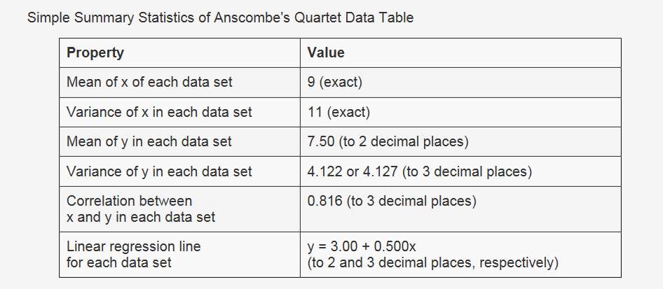
Why should we visualize data ? - 2

Slide 18
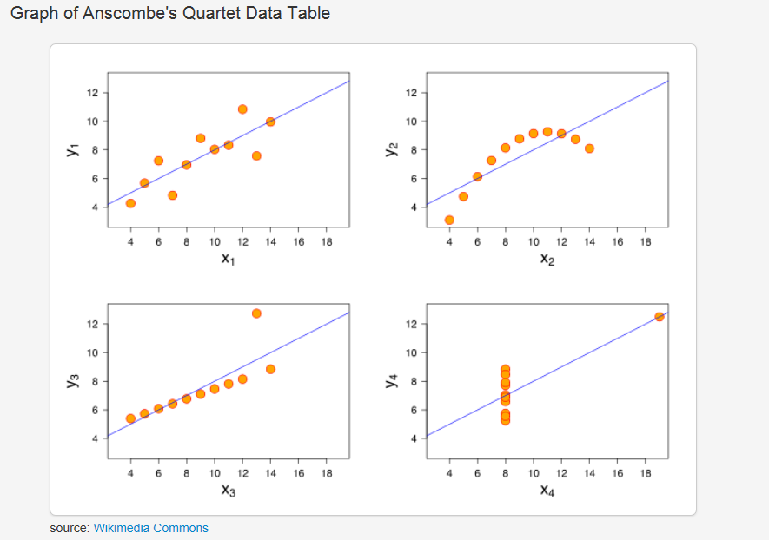
Why should we visualize data ? - 3

Slide 19
Visualization is the data analysts‘ best friend if …
it is based upon an intuitive representation
it leverages the perceptual capabilities of the user
Notes:
Representation matches the user‘s intuition / mental model and maps to an adequate search space

Slide 20
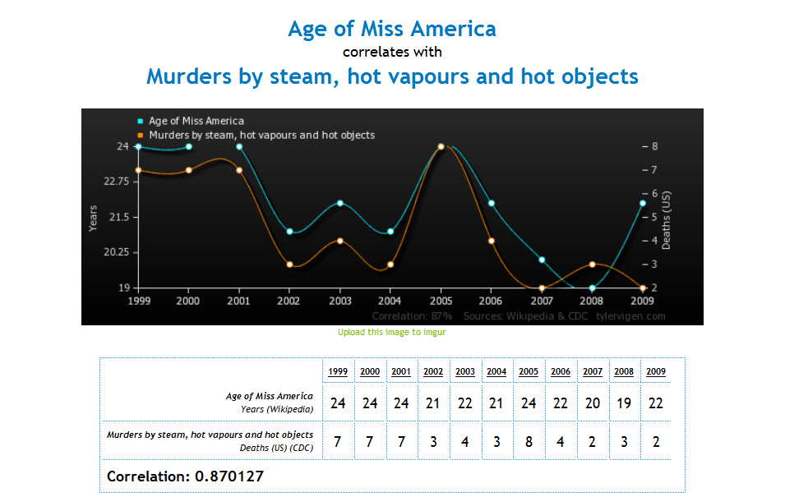
Correlation is not causation
→ This and many more examples: http://www.tylervigen.com/

Slide 21
How to incorporate domain knowledge?
Age | Weeks since last purchase | Last purchased product
35 | 8 | P-H
47 | 6 | P-H
20 | 24 | P-K

Slide 22
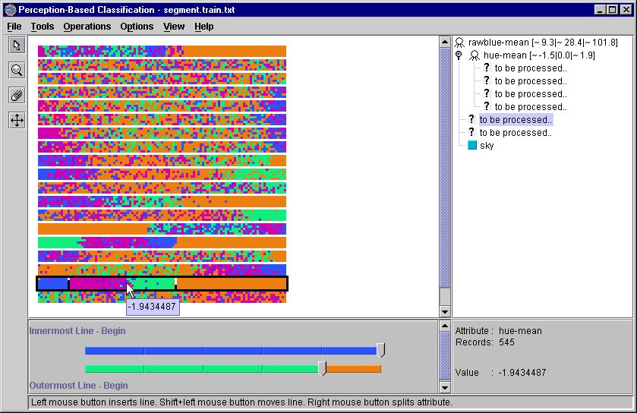
Illustration 1: Incorporating domain knowledge into the decision tree building process
animated
split lines
magnified
split lines
exact split point

Slide 23
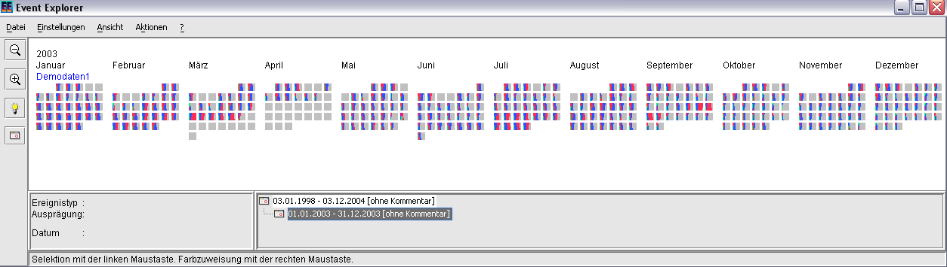
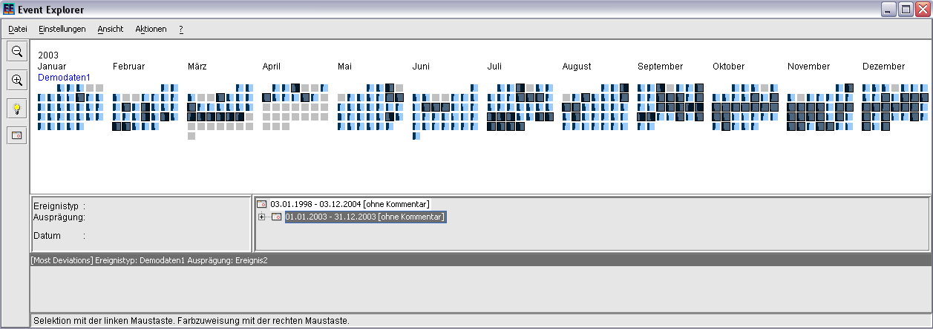
Illustration 2: Incorporating domain knowledge into the analysis of event data

Slide 24
Visualization is the data analysts‘ best friend if …
it is based upon an intuitive representation
it leverages the perceptual capabilities of the user
it enables the incorporation of domain knowledge
Notes:
Representation matches the user‘s intuition / mental model and maps to an adequate search space

Slide 25




What kind of products do customers typically buy together in a grocery store?
# customers | fruit | beer | candy | magazines | …
6.388.860 | 1 | 0 | 0 | 0
898.973 | 1 | 0 | 1 | 0
4.231.452 | 0 | 1 | 0 | 0
5.123.433 | 0 | 1 | 1 | 1
… | … | … | … | …

Slide 26
Sorting by frequency …
# customers | fruit | beer | candy | magazines | …
6.567.680 | 1 | 1 | 0 | 0
6.549.840 | 1 | 1 | 1 | 0
6.488.320 | 1 | 0 | 1 | 0
6.388.860 | 1 | 0 | 0 | 0
… | … | … | … | …

Slide 27
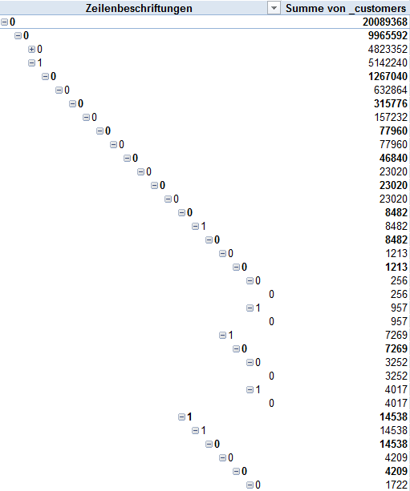


… or creating a pivot table ….

Slide 28





… or mining association rules doesn‘t give you the full picture!
+
+
→
Output of arules package in R Studio

Slide 29
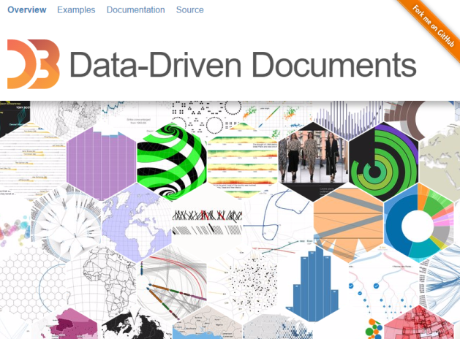
The idea of item explorer was born
D3.js
Use bar charts to represent item frequencies!

Slide 30
Development of item explorer – part 1
My daughter‘s face
😐
Munich, March 8th, 2015, 5.15 p.m.

Slide 31
Development of item explorer – part 2
My daughter‘s face
😒
20 minutes later …
Munich, March 8th, 2015, 5.35 p.m.

Slide 32
Development of item explorer – part 3
My daughter‘s face
😠
40 minutes later …
Munich, March 8th, 2015, 5.55 p.m.

Slide 33
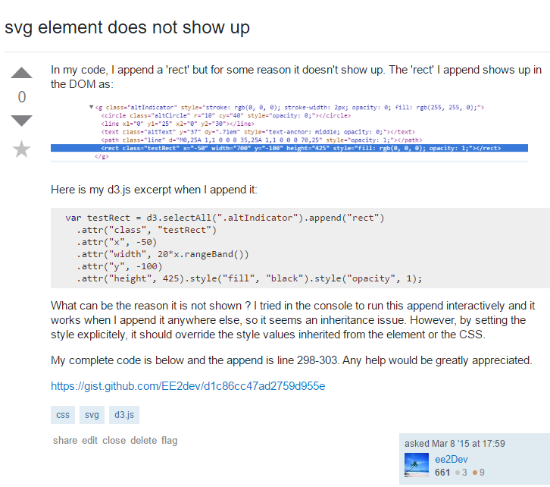
Development of item explorer – part 4
44 minutes later …
Munich, March 8th, 2015, 5.59 p.m.

Slide 34
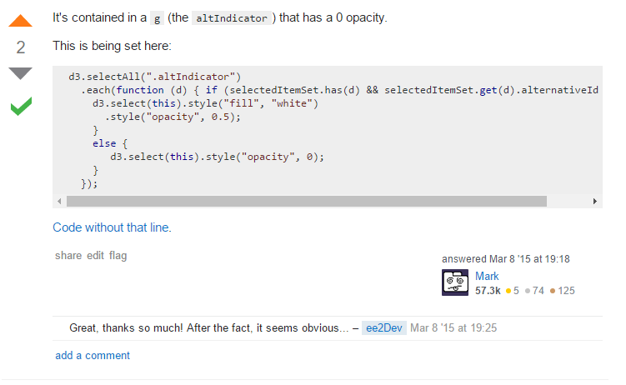
Development of item explorer – part 5
…after playing Badminton
Munich, March 8th, 2015, 7.18 p.m.

Slide 35
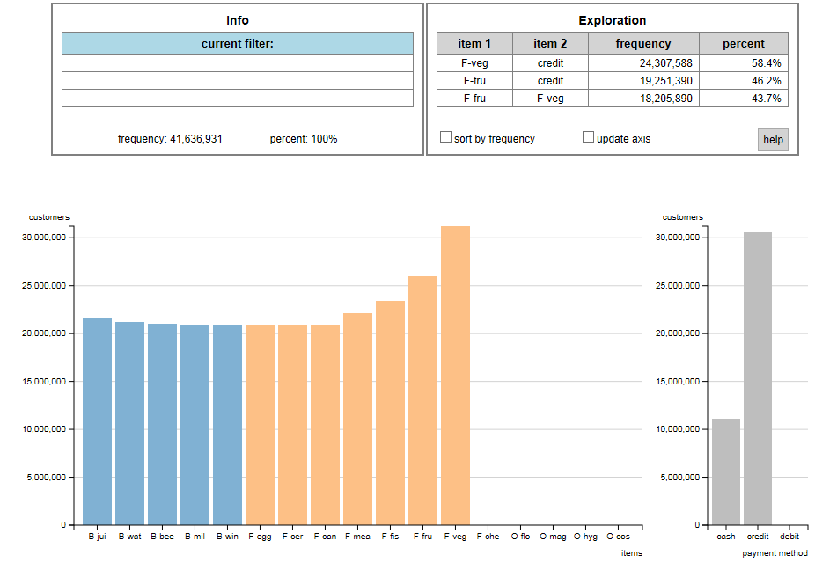
http://www.ankerst.de/Mihael/proj/mbc/
Demo: item explorer

Slide 36
Visualization is the data analysts‘ best friend if …
it is based upon an intuitive representation
it leverages the perceptual capabilities of the user
it enables the incorporation of domain knowledge
it facilitates the understanding of the data and the results
Notes:
Representation matches the user‘s intuition / mental model and maps to an adequate search space

