Slide 1
Github
Workflow and concepts

Slide 2
Workflow
Git is typically used for collaboration
It makes working on changes and then incorporating those changes easy
Git stores the entire repository locally
The whole magic is in adding changes to the local repository
Changes are then shared to other repositories via pulling commits
Github is a service based on Git
Offers free hosting, a web interface, and a windows GUI
Let’s look at an example workflow
With pictures!

Slide 3
Git Workflow
Main Repository
Fork
Personal Repository
Clone
Local
Repository
Commit
Can’t
Push
Push,
Sync
Main Repository
Personal Repository
Changed Local
Repository
Online, on Github
Local

Slide 4
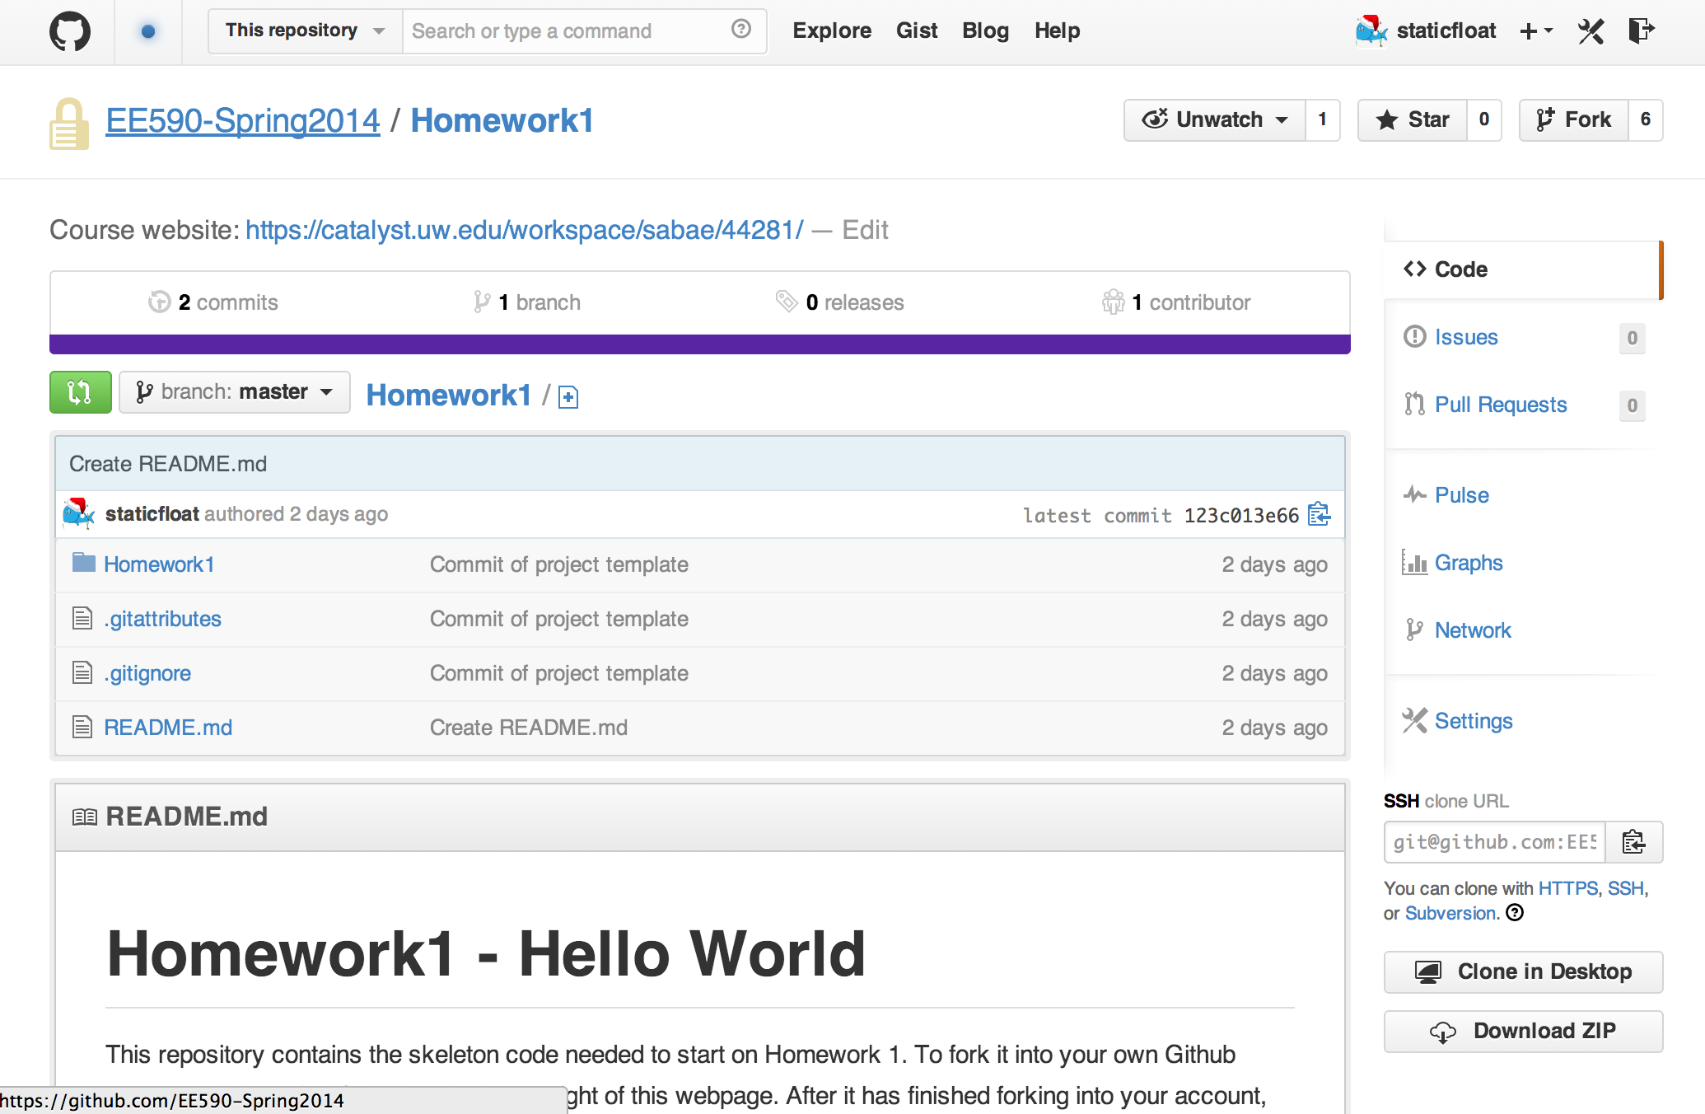


Github Workflow
First, we fork the repository to our personal account
This allows us to make any changes we want, since we own the fork
To incorporate changes back into the main repository, make Pull Requests

Slide 5
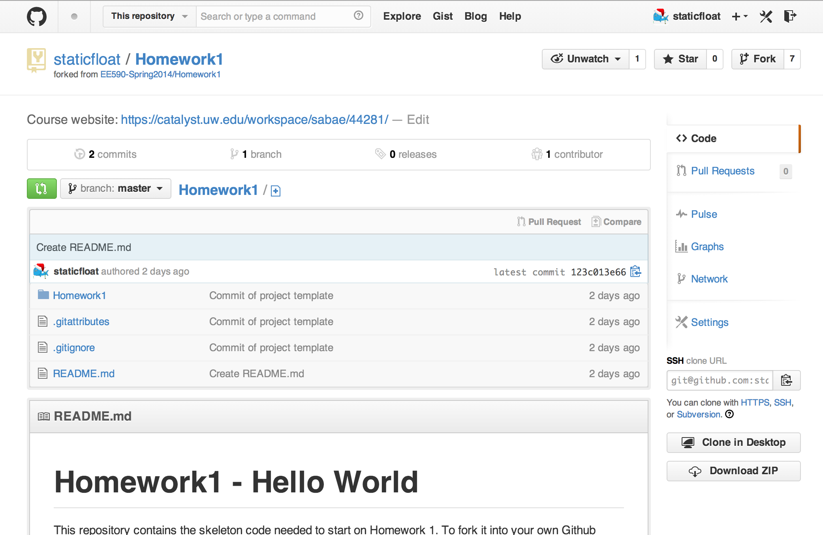

Github Workflow
Next, we clone the project to our local computer
We could modify the files directly using the web interface.
It is also technically possible to move a mountain with a shovel
You can also use the “clone” function in the Github Desktop app
Make sure you clone your personal fork, not the one you forked from!

Slide 6
Github Workflow
Difference between personal fork and main repo
You do not have permissions to modify the main repository
This is why you create a personal fork; you have complete control there
Cloning the main repository to your computer works
But then trying to push/sync any changes will fail
If you’ve already done this, there is a fix
Open a repository in the Github app, (the view with commits on the left)
Click the gear in the top right, select “repository settings”
Change “Primary Remote” to the URL of your repository on Github
Just change “EE590-Spring2014” to your username, for example:
Old: https://github.com/EE590-Spring2014/Homework1.git
New: https://github.com/staticfloat/Homework1.git

Slide 7
Github Workflow
We’ll talk more about collaboration later
For now, just get used to making changes, committing, and pushing them
Make a .ZIP when your homework is in a final state
You can do this either locally, or via “Download .ZIP” on the web
This button is right underneath “Clone in Desktop”
Upload this .ZIP to the class dropbox.
Finally, if you have questions, Ask!
Email me, open issues on Github, post on the discussion board

