Slide 1

G2M Case Study
Virtual Internship
15-March-2021

Slide 2
Background –G2M(cab industry) case study
Intern Info
Name: Ajaegbu Ebuka Emmanuel
Location: Lagos, Nigeria
Team: Data and Analytics
Date:15- March-2021.

Slide 3
Background –G2M(cab industry) case study
XYZ is a private equity firm in US. Due to remarkable growth in the Cab Industry in last few years and multiple key players in the market, it is planning for an investment in Cab industry.
Objective : Provide actionable insights to help XYZ firm in identifying the right company for making investment.
The analysis has been divided into four parts:
Data Understanding
Data Analytics
Insights and Conclusion
Recommendations for investment

Slide 4
Data Exploration
21 Features
Timeframe of the data: 2016-01-31 to 2018-12-31
Total data points : 359,392
Assumptions:
Profit of rides are calculated keeping other factors constant and only
Price_Charged and Cost_of_Trip features used to calculate profit.
Each Variable is draw from an independently and identically distributed
Each variables is randomly distributed from a normal population
Cab_Data.csv
Customer_ID.csv
Transaction_ID.csv
City.csv
Final cab data

Slide 5
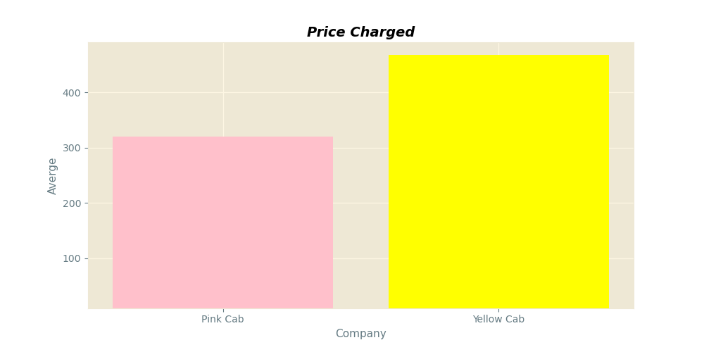
Profit Analysis
Price Charged Analysis: Overall
Company | Price Charged( Average)
Pink Cab | 310.800856
Yellow Cab | 458.181990
There is a difference in the average price charged by the two cab company. The Yellow Cab Company Charged on an average 147 more than the Pink cab
The T test was conducted to test this Hypotheses
Ttest_indResult(statistic=176.94201665608205, pvalue=0.0)
From the Result, The P value is smaller than the alpha(0.05). The Null hypothesis of no difference was rejected. There is a significant difference in the average price charged by the Pink and Yellow Cab. The Yellow Cab Charged More.

Slide 6
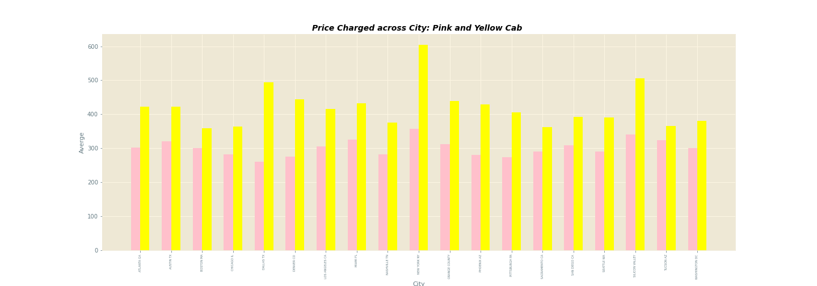
Profit Analysis
Price Charged Analysis: Across City

Slide 7
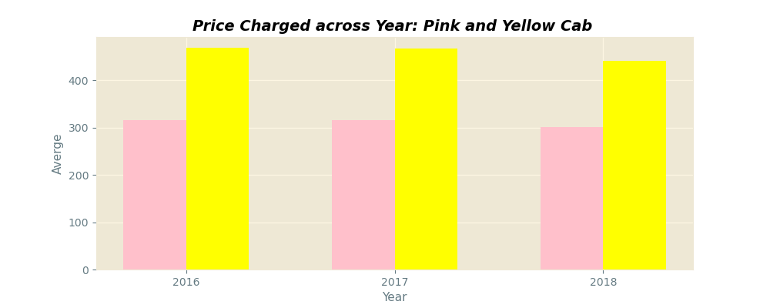
Profit Analysis
Price Charged Analysis: Across Year
There is a difference in the Priced Charged by the
Pink Cab and the Yellow Cab.
Across the City, The Yellow cab charged a higher price when compared to the pink cab. There is no city wherein the Pink cab charged more price when compared to the Yellow cab.
Across the Year, The Yellow cab also charged more price
when compared to the pink cab.

Slide 8
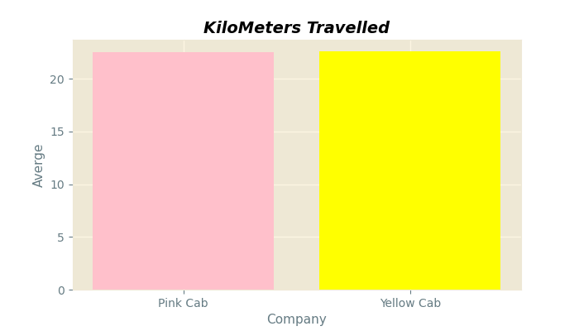
Profit Analysis
KM Travelled : Overall
Company | KM Travelled ( Average)
Pink Cab | 22.559917
Yellow Cab | 22.569517
There is a slight difference in the average KM Travelled by the two cab company. The Yellow Cab Company Travelled a little more than the Pink cab by 0.009600 Kilometers
The T test was conducted to test this Hypotheses
Ttest_indResult(statistic=0.1997029,pvalue=0.8417131770119453)
From the Result, The P value is bigger than the alpha(0.05). The Null hypothesis of no difference was failed to be rejected. There is no significant difference in the average KM Travelled by the Pink and Yellow Cab.

Slide 9
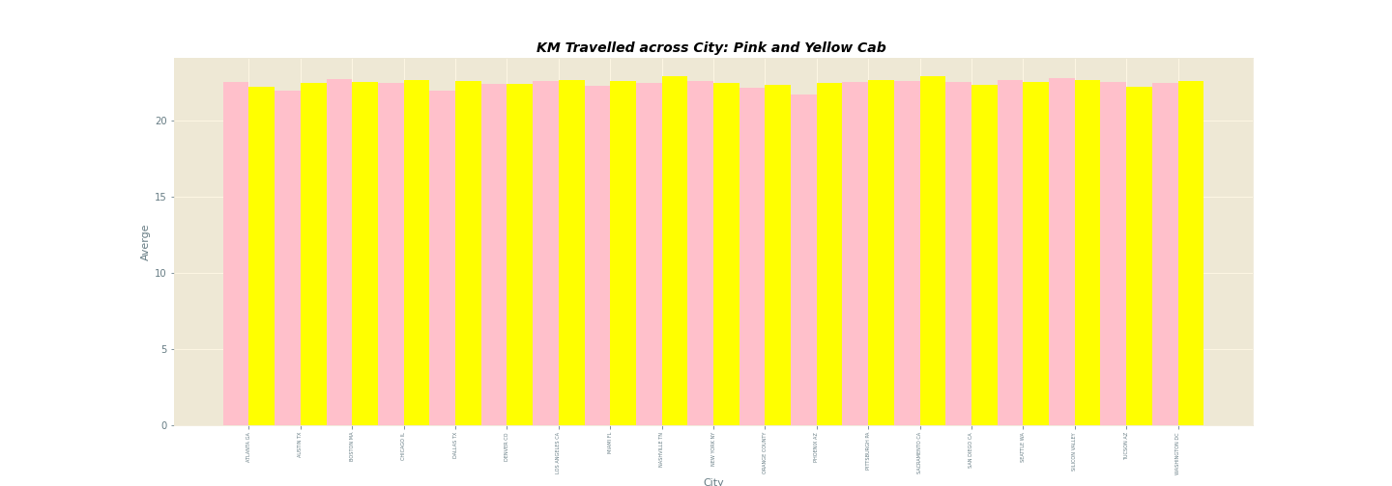
Profit Analysis
KM Travelled: Across City

Slide 10
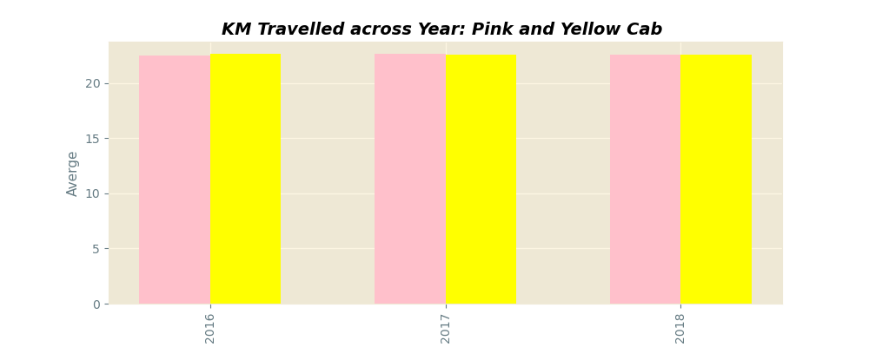
Profit Analysis
KM Travelled : Across Year
There is no difference in the average KM Travelled by the
Pink Cab and the Yellow Cab.
Across the City, The Yellow cab travelled the same KM
when compared to the pink cab. There is no city wherein the pink cab and yellow cab travelled more when compared to each other.
Across the Year, The Yellow cab also travelled the same average kilometer when compared to the Pink cab.

Slide 11
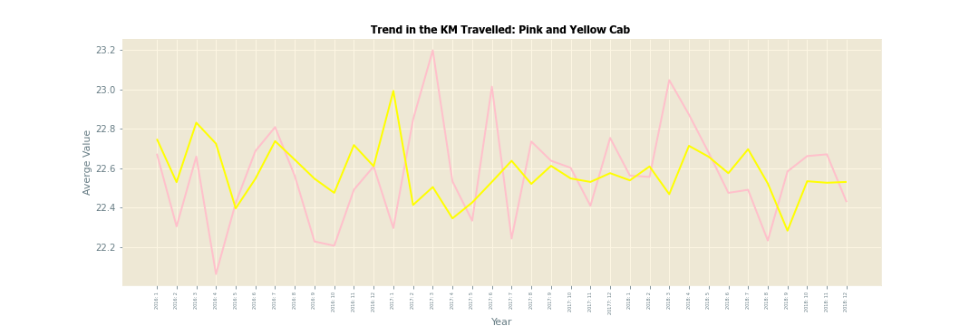
Profit Analysis
KM Travelled: Trend

Slide 12
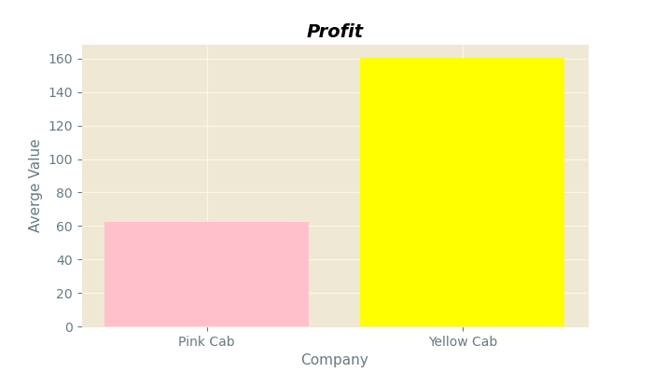
Profit Analysis
Profit: Overall
Company | Profit ( Average)
Pink Cab | 62.652174
Yellow Cab | 160.259986
There is a difference in the average Profit made by the two cab company. The Yellow Cab made more profit than the Pink cab. The yellow cab is higher by an average 97.6078 dollars
The T test was conducted to test this Hypotheses
Ttest_indResult(statistic=230.99551452746326,pvalue=0.0)
From the Result, The P value is less than the alpha(0.05). The Null hypothesis of no difference was rejected. There is a significant difference in the average profit made by the Pink and Yellow Cab.

Slide 13
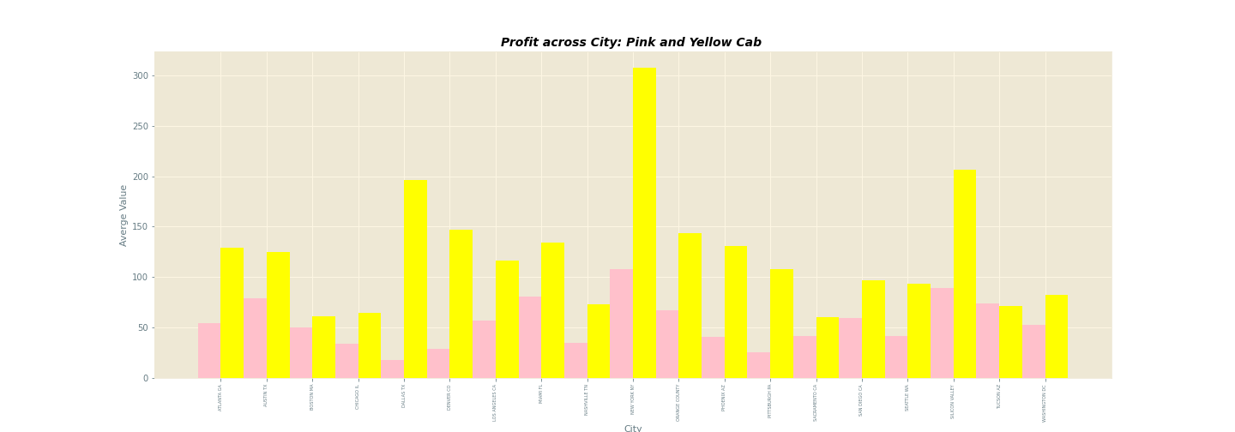
Profit Analysis
Profit : Across City

Slide 14
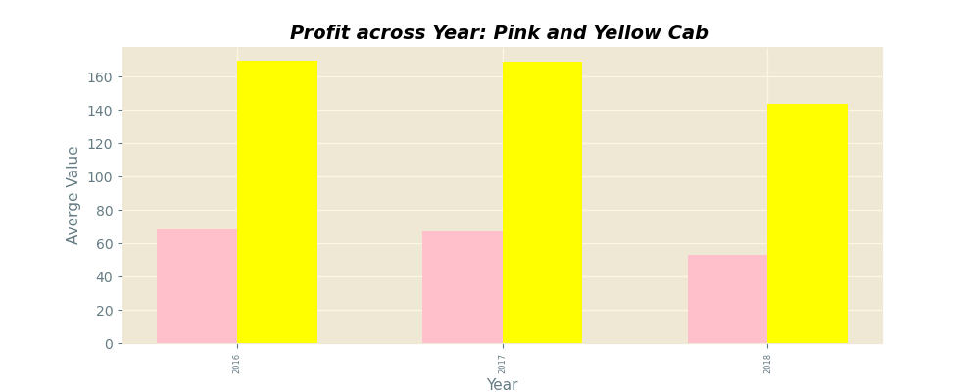
Profit Analysis
Profit : Across Year
There is a difference in the Profit made by the Pink Cab and the Yellow Cab.
Across the City, The Yellow cab made a higher profit when compared to the pink cab. There is no city wherein the Pink cab made more profit when compared to the Yellow cab.
Across the Year, The Yellow cab also made more profit when compared to the pink cab.

Slide 15
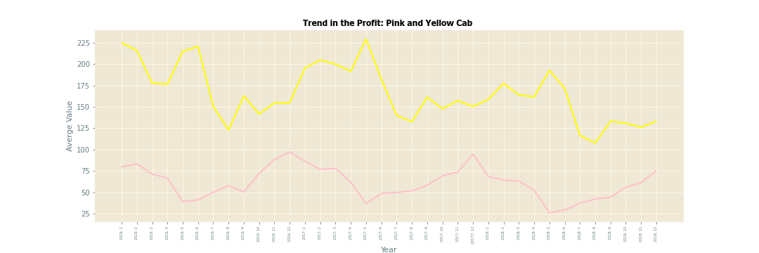
Profit Analysis
Profit: Trend

Slide 16
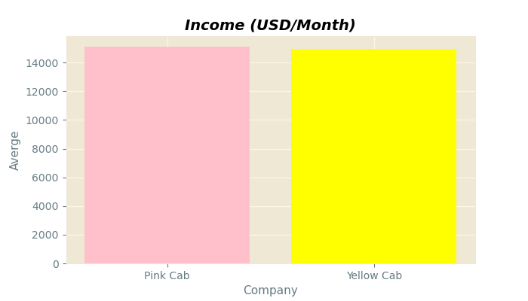
Profit Analysis
Income: Overall
Company | Income ( Average)
Pink Cab | 15094.171960
Yellow Cab | 14952.263514
There is a slight difference in the average income of the customer of the two cab company. The pink cab customer earn an average of 141.908 more than the yellow cab customer.
The T test was conducted to test this Hypotheses
Ttest_indResult(statistic=-1.77950344,pvalue=0.075)
From the Result, The P value is greater than the alpha(0.05). The Null hypothesis of no difference was failed to be rejected. There is a no significant difference in the average income earned by the Pink and Yellow Cab Customers.

Slide 17
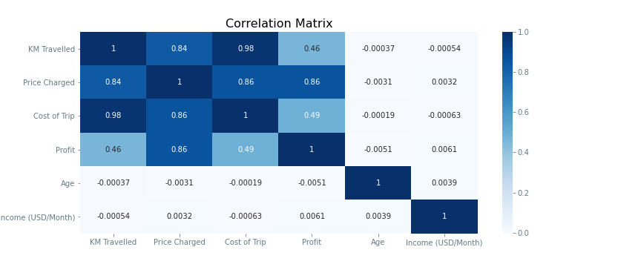
Profit Analysis
Relationships/ Associations Among the Variables
As observed ,
KM travelled, Price Charged , Cost of Trip ,Profit earned shows a strong association with each other. The Income and Age are not strongly associated with the other variables in the datasets.
This is indicating some predictive Power.

Slide 18
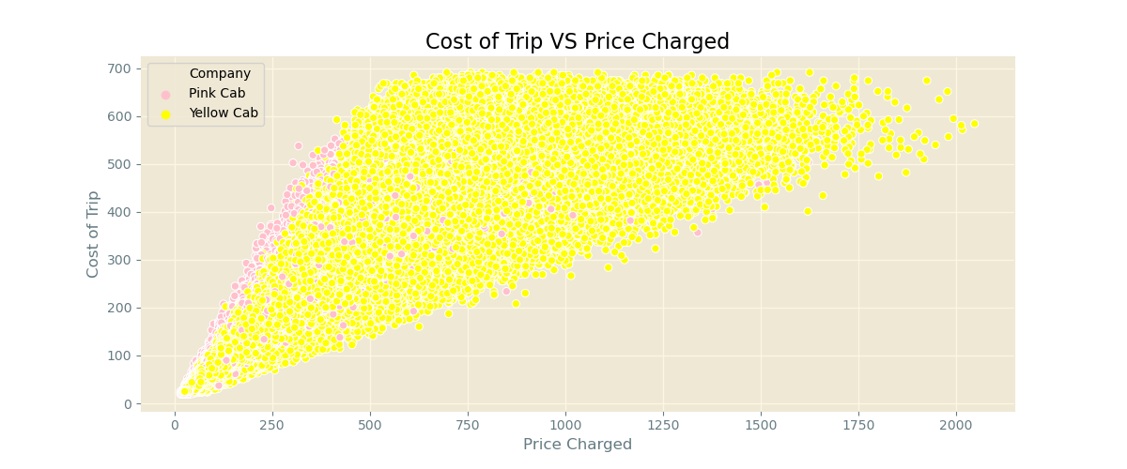
Profit Analysis
Price Charged VS Cost of Trip
There is a strong positive association/ relationship between Cost of Trips and Priced Charged. The Higher the Cost of Trip, the more price is charged .
This association was tested for it significance.
H0: The correlation between price charged and Cost of Trip is not significant.
H1: The correlation between price charged and Cost of Trip is statistically significant.
Correlation , P Value : (0.8598117262915436, 0.0)
The Pvalue 0.0 is less the alpha 0.05,we reject the Null hypothesis. The correlation between price charged and Cost of Trip is statistically significant.

Slide 19
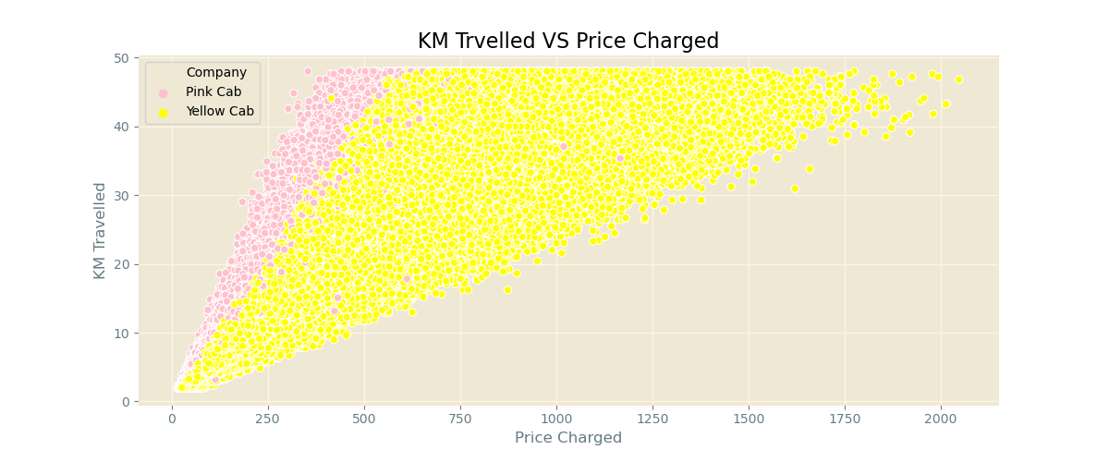
Profit Analysis
Price Charged VS KM Travelled
There is a strong positive association/ relationship between KM Travelled and Priced Charged. The more the Kilometer travelled, the more price is charged .
This association was tested for it significance.
H0: The correlation between price charged and KM Travelled is not significant.
H1: The correlation between price charged and KM Travelled is statistically significant.
Correlation , P Value : (0.8357531580209058, 0.0)
The Pvalue 0.0 is less the alpha 0.05,we reject the Null hypothesis. The correlation between price charged and KM Travelled is statistically significant.

Slide 20
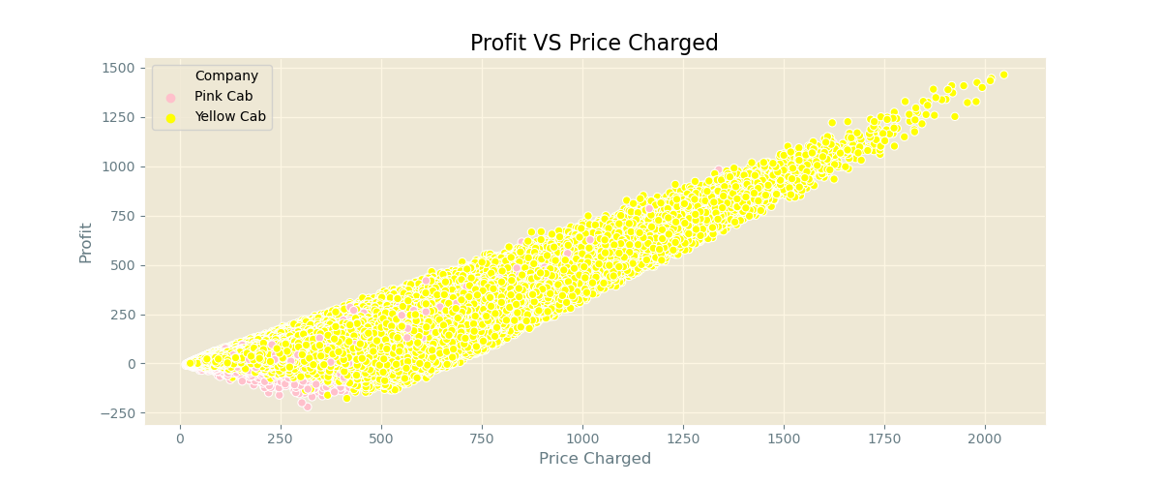
Profit Analysis
Price Charged VS Profit
There is a strong positive association/ relationship between Profit and Priced Charged. The more the price charged , the more the profit made.
This association was tested for it significance.
H0: The correlation between price charged and Profit is not significant.
H1: The correlation between price charged and Profit is statistically significant.
Correlation , P Value : (0.8641539467506472, 0.0)
The Pvalue 0.0 is less the alpha 0.05,we reject the Null hypothesis. The correlation between price charged and Profit made is statistically significant.

Slide 21
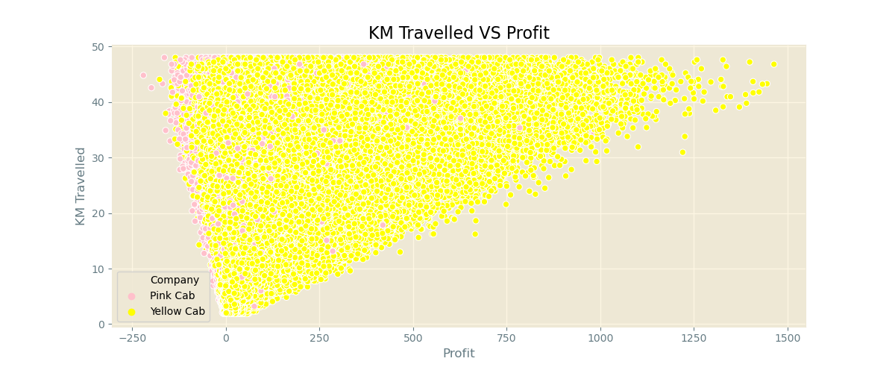
Profit Analysis
Profit VS KM Travelled .
There is somewhat a kind of positive association/ relationship between Profit and KM Travelled . The more the KM Travelled, the more the profit made.
This association was tested for it significance.
H0: The correlation between KM Travelled and Profit is not significant.
H1: The correlation between KM Travelled and Profit is statistically significant.
Correlation , P Value : (0.4627681978970966, 0.0)
The Pvalue 0.0 is less the alpha 0.05,we reject the Null hypothesis. The correlation between KM Travelled and Profit made is statistically significant.

Slide 22
Recommendations
I evaluated the performance of the two cab company in their performance for KM Travelled, Price Charged and Profit Made. Overall Performance was Evaluated and the performance Across the City and Over the Year and Month was evaluated.
After Evaluating the Average KM Travelled, there is no clear difference in the KM Travelled by both the Pink and Yellow Cab
The Yellow cab charged a more price per trip even in the same city where the same KM was Traveled by the Pink and Yellow Cab.
KM Travelled is the same, but the Yellow cab charged more price per trip compared to the pink cab
As a result, the Yellow cabs makes more profit than the Pink Cab
We also observed some positive and significant association between then Price Charged, Cost of Trip, Profit and KM Travelled while Income and Age has no significant association with the other variables in study. This tells us we can make some predictions with the variables we have in study.
On the basis of above point , we will recommend Yellow cab for investment.

Slide 23
Thank You

