Slide 1
Bioinformatics pipeline
Brian Arnold

Slide 2
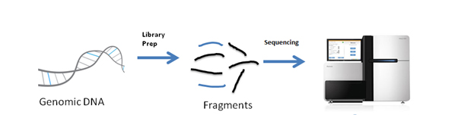
WGS summary: programs to get there
Fst
fastp
BWA
Picard
GATK
vcftools
RAW
FASTQ
CLEANED
FASTQ
BAM
deduplicated
BAM
VCF
PLINK
PCA
PLINK
snpEff
allele frequencies
mutation impact
Notes:
There are a bunch of different programs you need to use to get there. Academic groups typically specialize in one part of the process and don’t make an entire program that does everything, they typically make a program that does just one piece, so biologists like us have to tie everything together with scripts.
For instance, each of these tools is associated with a separate, published paper, in which a small group of people specialized on doing one part of this whole process of analyzing whole genome sequences, to try to make the absolute best method for that part of the process.
This is why we have to make pipelines, because the bioinformatics tools that exist out there are extremely specialized. Again, we get the whole thing done in the end by tying everything together in a pipeline of scripts.

Slide 3
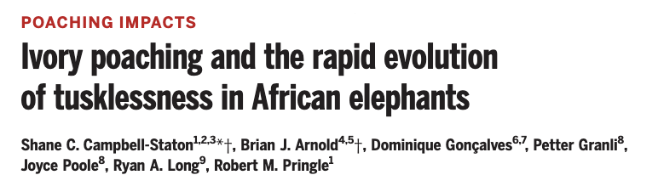
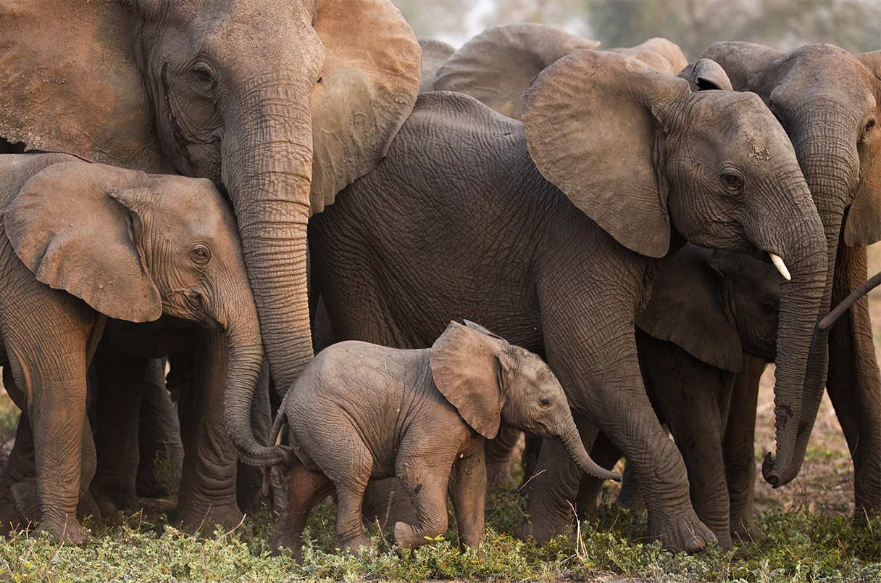

Slide 4
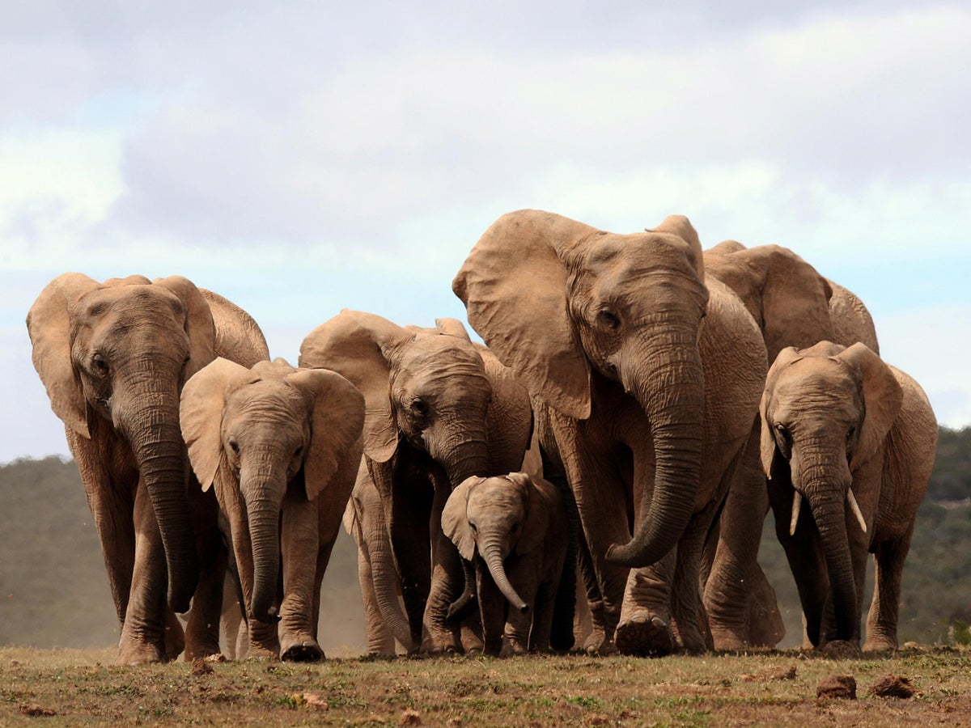
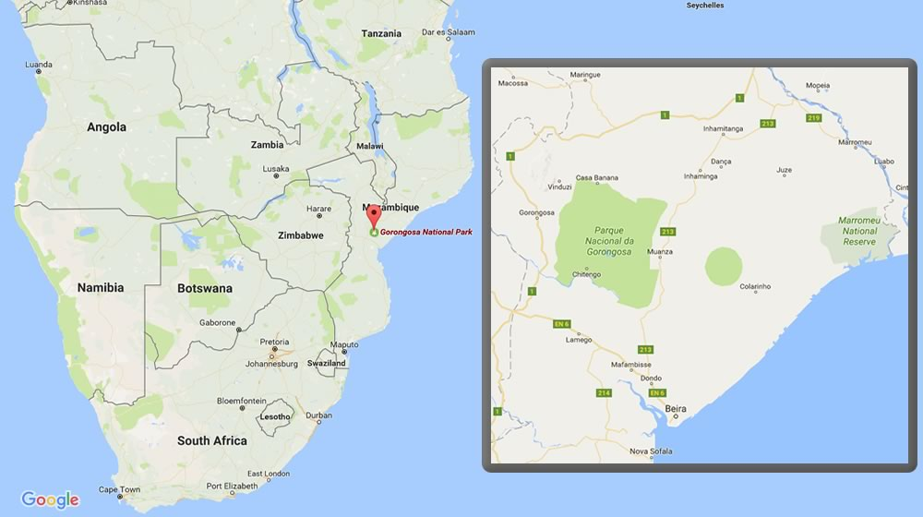
questions
is tusklessness a beneficial trait?
which mutation(s) cause tusklessness?
why are females only tuskless?
data
WGS from 10 tuskless matriarchs, 7 tusked matriarchs from Gorongosa National Park, MZ
decades of survey data on elephant families
This was extremely important

Slide 5
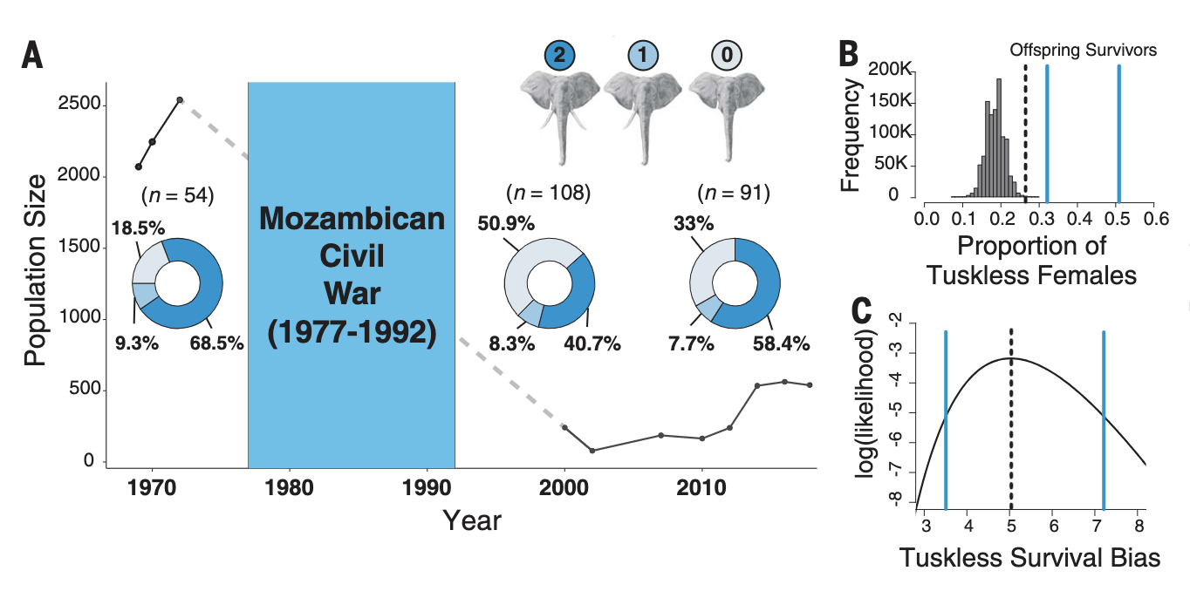
Survey data
Conclusion 1: tusked elephants selectively targeted, 5 tusked elephants were killed for every tuskless elephant

Slide 6
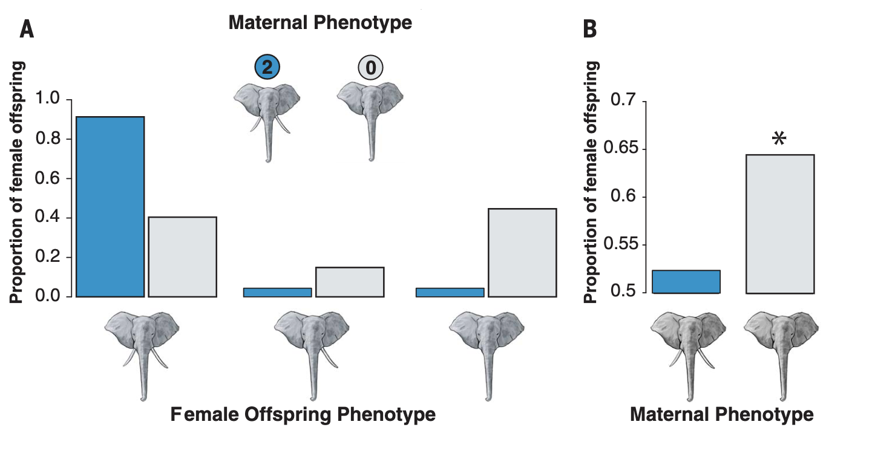
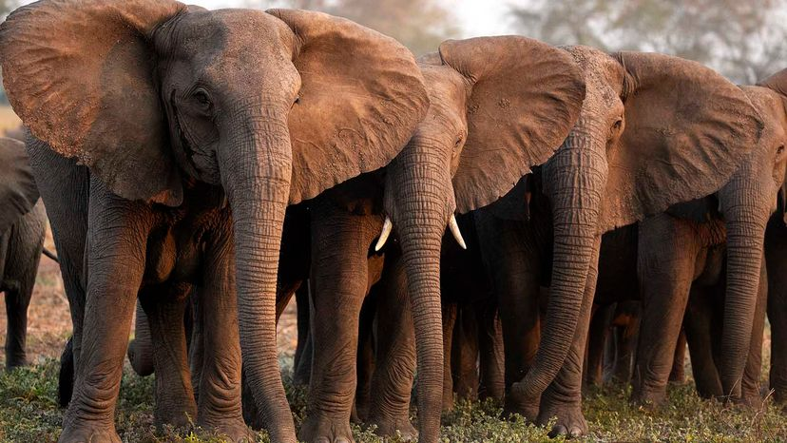
Survey data
Conclusion 2: tuskless trait looks genetic, specific to females
tusked moms birth tusked daughters
tuskless moms birth both tusked and tuskless daughters
Matriach Junia (left) stands with her young tusked son and Isabella, her adult tuskless daughter.

Slide 7
Survey data
tuskless moms birth significantly more female offspring
Suggested biological mechanism involves mutation on X chromosome with 2 effects:
Dominant for tusklessness
Recessive for lethality
tuskless
mom
dad
+
sons:
or
X
X
X
Y
X
Y
X
Y
½ of sons from tuskless moms prematurely dying, so they birth more daughters
Conclusion 3: female-specificity of tuskless trait appears to be caused by male-lethal mutation on X chromosome

Slide 8
WGS summary: programs to get there
Fst
fastp
BWA
Picard
GATK
vcftools
RAW
FASTQ
CLEANED
FASTQ
BAM
deduplicated
BAM
VCF
PLINK
snpEff
allele frequencies
in original study, we used GATK4 to call variants, not freebayes
but freebayes significantly easier to use
mutation impact
Notes:
There are a bunch of different programs you need to use to get there. Academic groups typically specialize in one part of the process and don’t make an entire program that does everything, they typically make a program that does just one piece, so biologists like us have to tie everything together with scripts.
For instance, each of these tools is associated with a separate, published paper, in which a small group of people specialized on doing one part of this whole process of analyzing whole genome sequences, to try to make the absolute best method for that part of the process.
This is why we have to make pipelines, because the bioinformatics tools that exist out there are extremely specialized. Again, we get the whole thing done in the end by tying everything together in a pipeline of scripts.

Slide 9
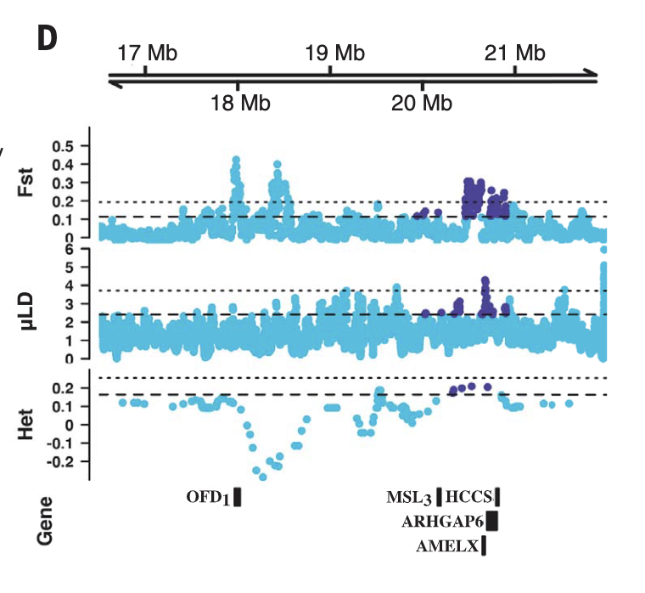
Selection scans implicate known tooth gene

Slide 10
Go to cluster for demo
Simple pipeline where each step is run in its own bash script
Next time: automate with snakemake!

