Slide 1
Snakemake
Andrew Webb

Slide 2
Our pipeline
RAW
FASTQs
Cleaned
FASTQs
Aligned
BAMs
Deduped
BAMs
VCF
fastp
BWA
sambamba
freebayes
Previously we used separate SLURM scripts to run step of our pipeline
Problems with this approach
We had to wait for a step to finish before we could proceed
Each script only processed a single sample
Not taking full advantage of the HPC

Slide 3
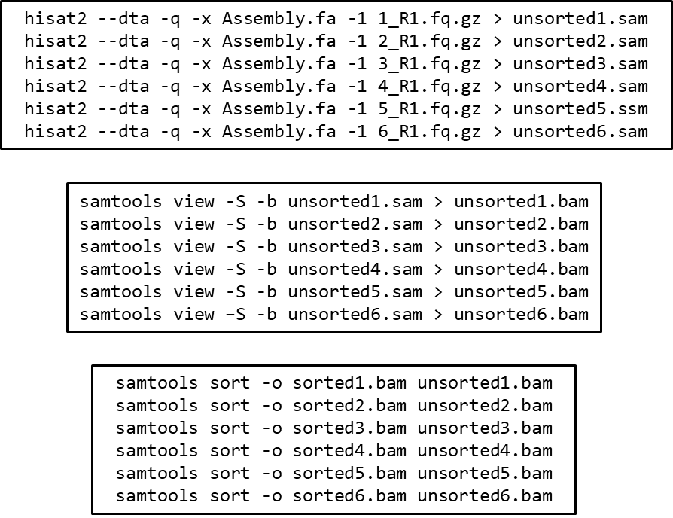
Solutions?
Long lists of commands
Simple
Able to run multiple samples with a single script
Better usage of HPC systems
Still inefficient and poorly optimized
Difficult record keeping

Slide 4
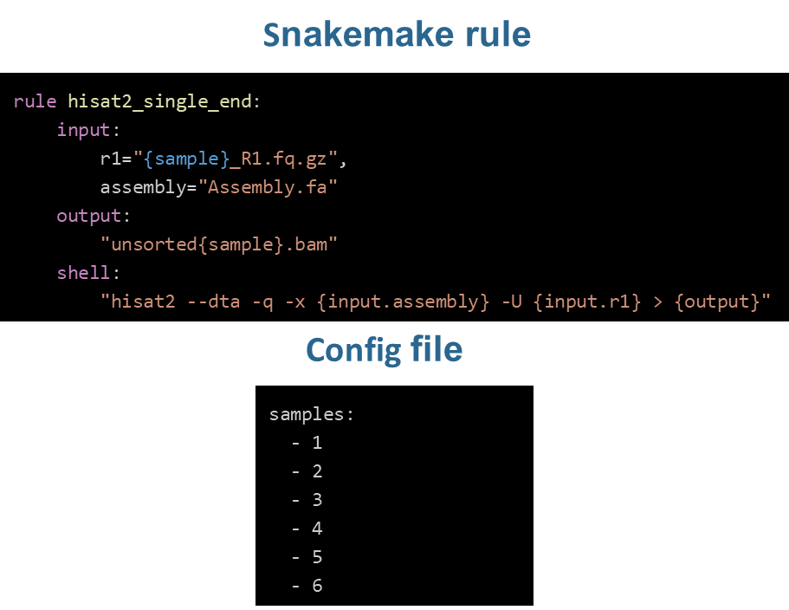
Solutions?
Snakemake
Python-based workflow language
Consists of a set of rules with the following:
input: file(s) that must exist for rule to run
output: file(s) that must exist after rule runs
If not present, will result in an error
shell or run: operation(s) for the rule to produce the output
shell if running a LINUX/BASH command
run for python command
Snakemake rules finish successfully if
The output is successfully created
The shell/run did not result in an error

Slide 5
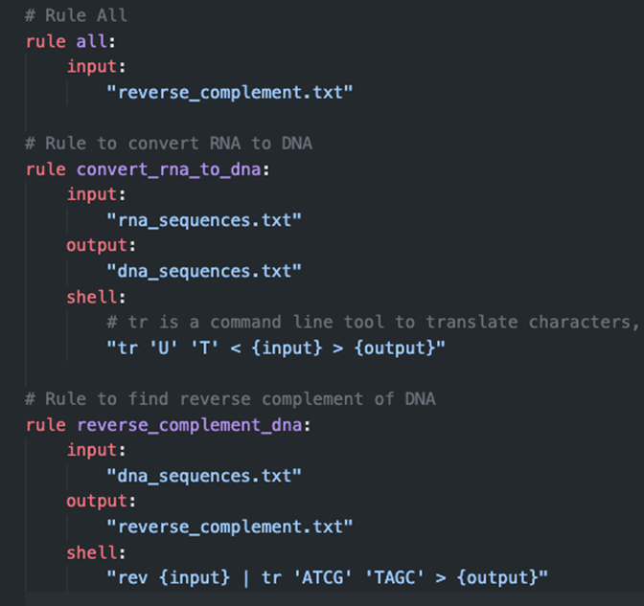
Example snakemake pipeline
A simple workflow (written by chatGPT4)
Convert RNA sequence to DNA sequence
Get the reverse complement of DNA sequence
How does the pipeline know what to create?
rule all:
Typically written towards top of file
Defines the final input of the pipeline
Snakemake will determine the rules needed (and order) to produce the file(s)

Slide 6
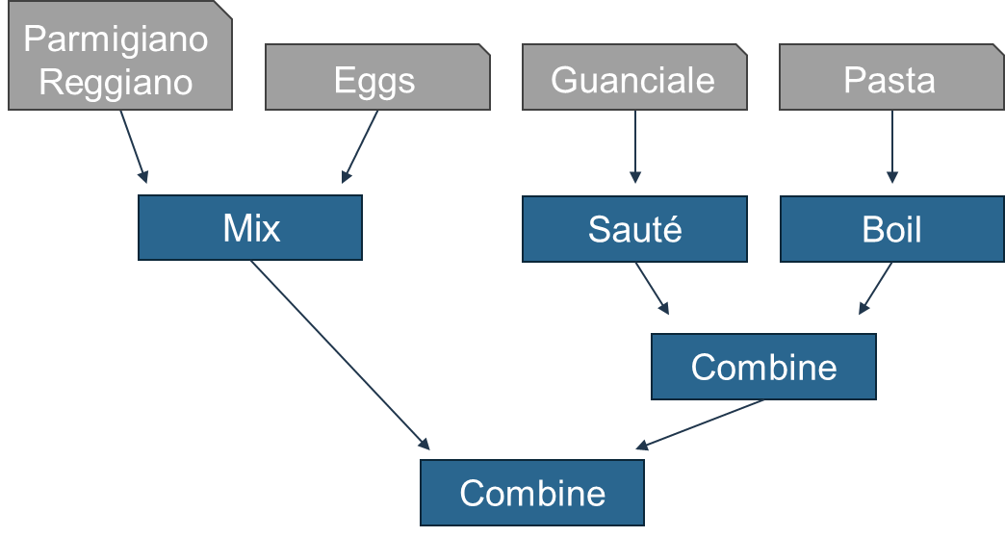
Snakemake as pasta

Slide 7
Cluster example

Slide 8
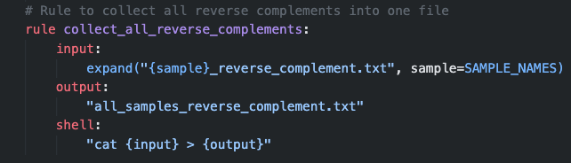
Snakemake – Wildcards
Wildcards allow snakemake to process lists
Multiple samples
Different species
Snakemake uses wildcards to
Perform rules on each samples or species
Expand a rule to operate on all samples/species
SAMPLE_NAMES
List of sample names

Slide 9
Cluster example

Slide 10
Our pipeline
RAW
FASTQs
Cleaned
FASTQs
Aligned
BAMs
Deduped
BAMs
VCF
fastp
BWA
sambamba
freebayes
Analyses
Ancestry estimation
PCA
GWAS
ADMIXTURE
plink
gemma

Slide 11
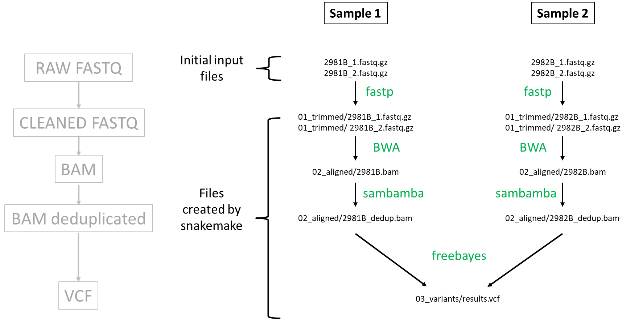
Snakemake pipeline

Slide 12
Cluster example

