Slide 1
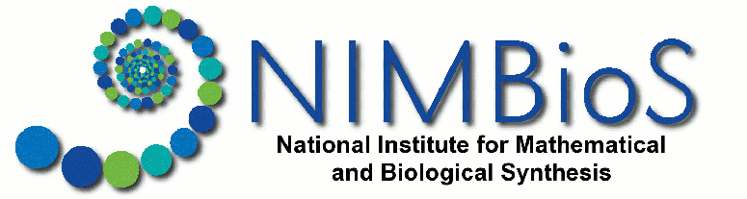
Introduction to EEB504 – Scientific Computing for Biologists
Louis J. Gross
National Institute for Mathematical and Biological Synthesis
Departments of Ecology and Evolutionary Biology and Mathematics
University of Tennessee, Knoxville

Slide 2
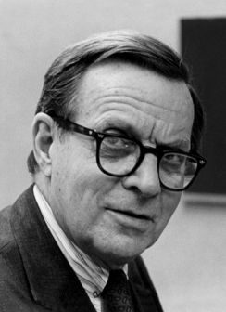

What is science?
Science is thought to be a process of pure reductionism, taking the meaning out of mystery, explaining everything away, concentrating all our attention on measuring things and counting them up. It is not like this at all. The scientific method is guesswork, the making up of stories. The difference between this and other imaginative works of the human mind is that science is then obliged to find out whether the guesses are correct, the stories true. Curiosity drives the enterprise, and the open acknowledgement of ignorance.
Lewis Thomas - Sierra Club Bulletin, March/April 1982, P. 52

Slide 3
What is science?
Science is thought to be a process of pure reductionism, taking the meaning out of mystery, explaining everything away, concentrating all our attention on measuring things and counting them up. It is not like this at all. The scientific method is guesswork, the making up of stories. The difference between this and other imaginative works of the human mind is that science is then obliged to find out whether the guesses are correct, the stories true. Curiosity drives the enterprise, and the open acknowledgement of ignorance.
Lewis Thomas - Sierra Club Bulletin, March/April 1982, P. 52
Models

Slide 4
What is science?
Science is thought to be a process of pure reductionism, taking the meaning out of mystery, explaining everything away, concentrating all our attention on measuring things and counting them up. It is not like this at all. The scientific method is guesswork, the making up of stories. The difference between this and other imaginative works of the human mind is that science is then obliged to find out whether the guesses are correct, the stories true. Curiosity drives the enterprise, and the open acknowledgement of ignorance.
Lewis Thomas - Sierra Club Bulletin, March/April 1982, P. 52
Data

Slide 5
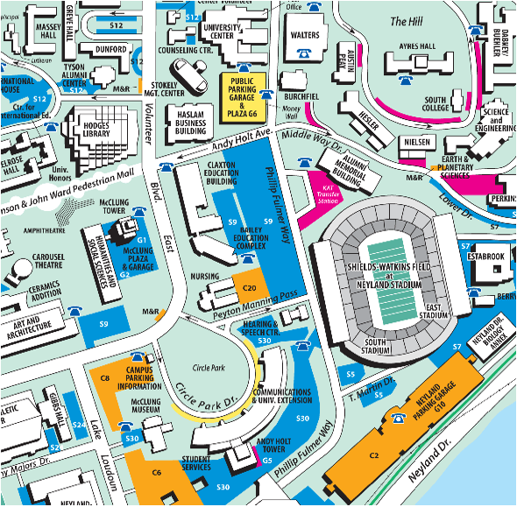
The “stories” in science are models
A model is a simplification of reality. Think of it as a map - it includes some features that represent what we observe but not others. Modeling is the process of selective ignorance - we select what to include and what to ignore.

Slide 6
Methods of Scientific Investigation
Observation – classic “natural history”, descriptive science, now “data-enabled discovery”
Experimental manipulation - field or lab - isolate effects of some factors on some aspect of system under investigation and observe behavior - observe response to interactions of several factors
Theory development - abstract general properties of a system by ignoring certain components and emphasizing others (selective ignorance). Can do this: (i) ad hoc - don’t think it’s important so will ignore it; (ii) data suggests a factor or set of factors can be ignored; (iii) based upon scale so processes on a fast or slow time scale (or equivalently spatial) are ignored dependent upon scale you are interested in
Hypothesis-driven science

Slide 7
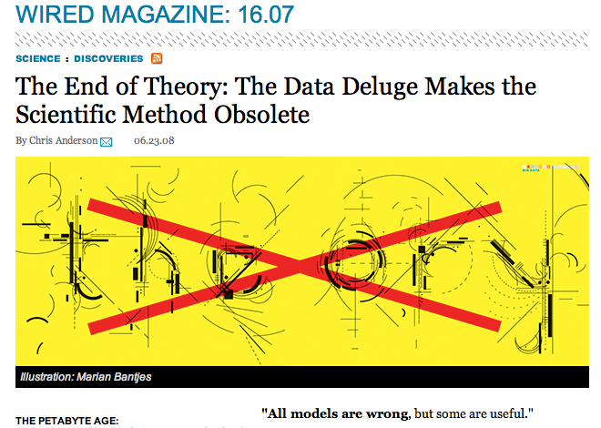
But this view is being challenged

Slide 8
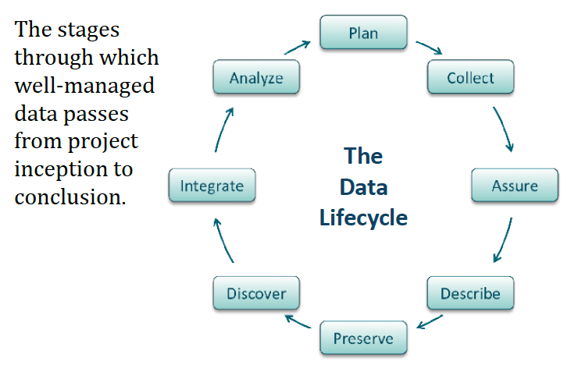
Cyclical Aspects of Data
From DataONE.org

Slide 9
Cyclical Aspects of Data
Models
Model
From DataONE.org

Slide 10

If you think Big Data is challenging, what about Big Models!
All of the concerns regarding big data (heterogeneity, data quantity, data quality, curation, metadata characterization) also apply to the complex models applied to provide regulatory or management guidance.
Notes:
There are much more developed protocols for data for many of these issues than there are for models, indeed there are whole courses on how to manage data collections - yet nothing like this at all for model collections. Yet many of decisions for managing systems based upon data utilize models.

Slide 11
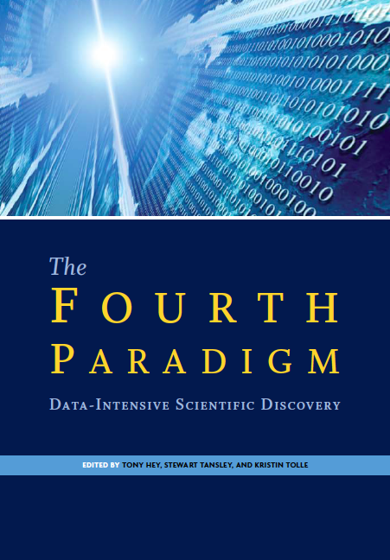
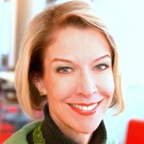
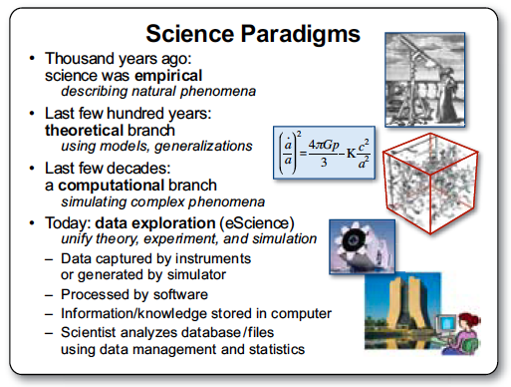
One Vision for Data-Exploration

Slide 12
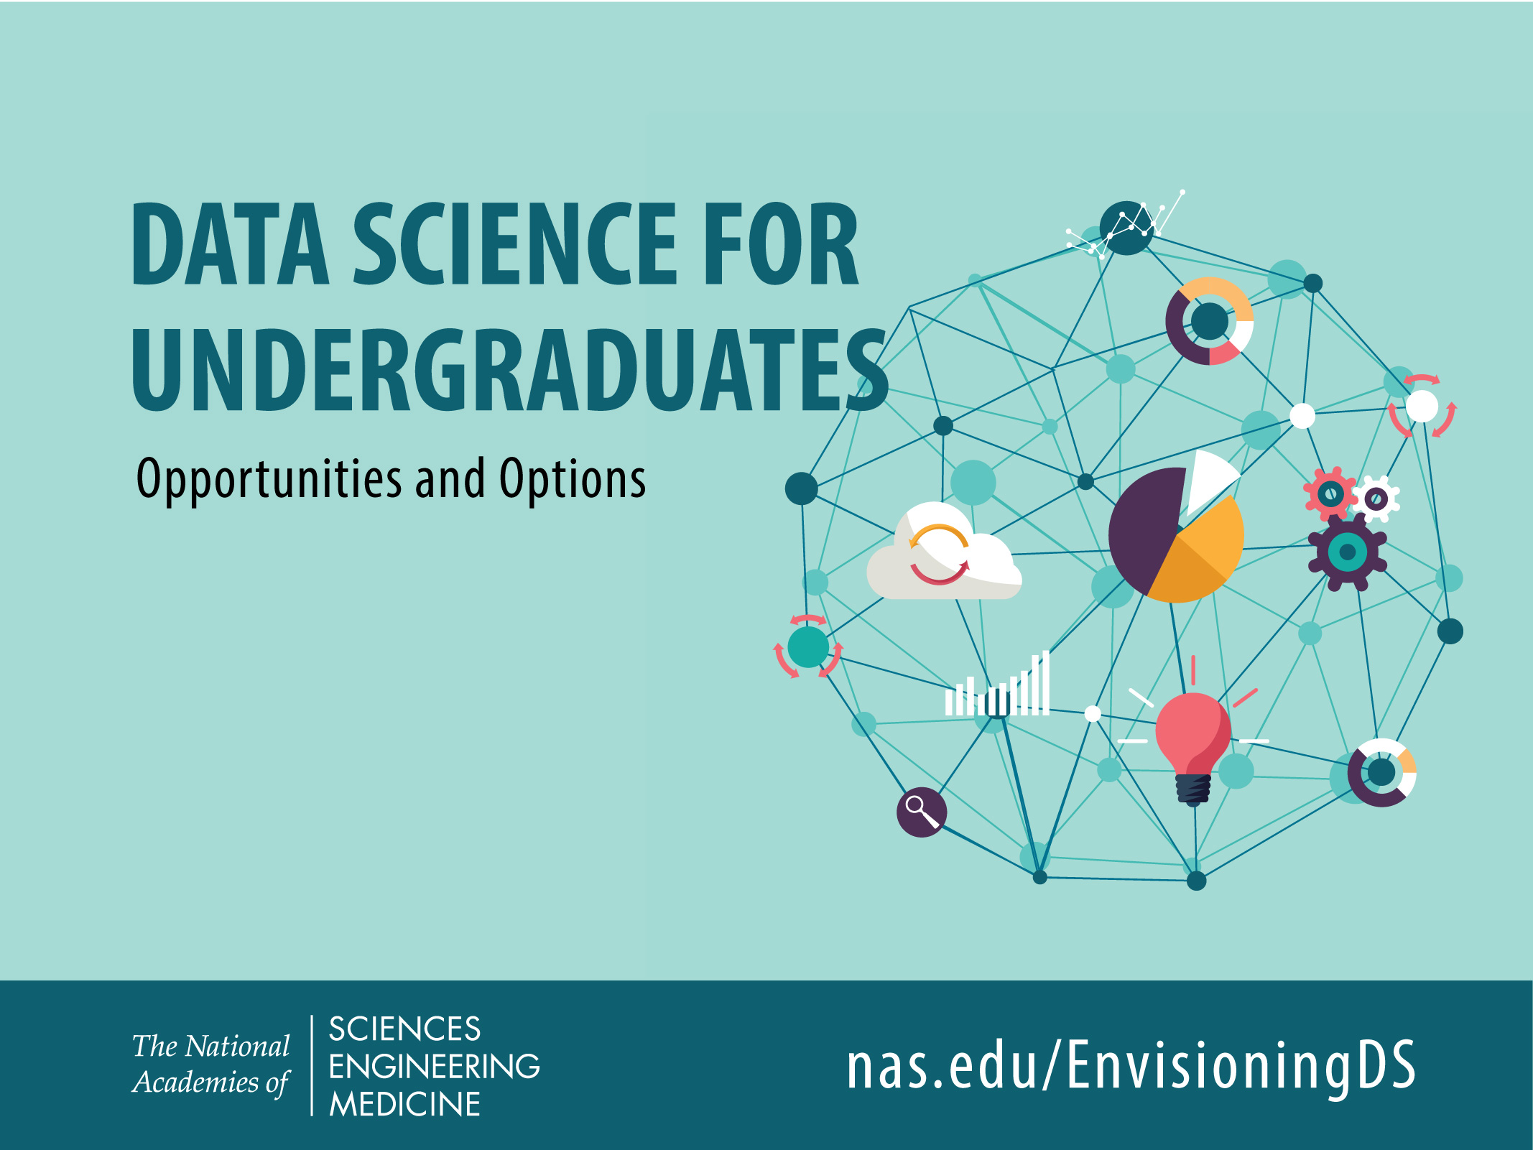
Study funded by the
National Science Foundation

Slide 13
A Central Finding
Finding 2.3 A critical task in the education of future data scientists is to instill data acumen. This requires exposure to key concepts in data science, real-world data and problems that can reinforce the limitations of tools, and ethical considerations that permeate many applications. Key concepts involved in developing data acumen include the following:
Mathematical foundations
Computational foundations
Statistical foundations
Data management and curation
Data description and visualization
Data modeling and assessment
Workflow and reproducibility
Communication and teamwork
Domain-specific considerations
Ethical problem solving.

Slide 14
Data Science Oath (Hippocratic)
I swear to fulfill, to the best of my ability and judgment, this covenant:
I will respect the hard-won scientific gains of those data scientists in whose steps I walk and gladly share such knowledge as is mine with those who follow.
I will apply, for the benefit of society, all measures which are required, avoiding misrepresentations of data and analysis results.
I will remember that there is art to data science as well as science, and that consistency, candor, and compassion should outweigh the algorithm’s precision or the interventionist’s influence.
I will not be ashamed to say, “I know not,” nor will I fail to call in my colleagues when the skills of another are needed for solving a problem.

Slide 15
Data Science Oath (Hippocratic)
I swear to fulfill, to the best of my ability and judgment, this covenant:
I will respect the privacy of my data subjects, for their data are not disclosed to me that the world may know, so I will tread with care in matters of privacy and security. If it is given to me to do good with my analyses, all thanks. But it may also be within my power to do harm and this responsibility must be faced with humbleness and awareness of my own limitations.
I will remember that my data are not just numbers without meaning or context, but represent real people and situations, and that my work may lead to unintended societal consequences, such as inequality, poverty, and disparities due to algorithmic bias. My responsibility must consider potential consequences of my extraction of meaning from data and ensure my analyses help make better decisions.

Slide 16
Data Science Oath (Hippocratic)
I swear to fulfill, to the best of my ability and judgment, this covenant:
I will perform personalization where appropriate, but I will always look for a path to fair treatment and nondiscrimination.
I will remember that I remain a member of society, with special obligations to all my fellow human beings, those who need help and those who don’t.
If I do not violate this oath, may I enjoy vitality and virtuosity, respected for my contributions and remembered for my leadership thereafter. May I always act to preserve the finest traditions of my calling and may I long experience the joy of helping those who can benefit from my work.

Slide 17
CSM (Climate Social Model)
Beckage, B., L. J. Gross, K. Lacasse, E. Carr, S. S. Metcalf, J. M. Winter, P. D. Howe, N. Fefferman, T. Franck, A. Zia, A. Kinzig and F. M. Hoffman. 2018. Linking models of human behavior and climate alters projected climate change. Nature Climate Change 8, 79–85

Slide 18
Model dynamics of change in global temperature from preindustrial under different model assumptions

Slide 19
Effect of interactions of perceived social norm and perceived behavioral control on temperature change from preindustrial in 2100 for cumulative mitigation mode

Slide 20
Regression tree partitioning of variation in mean global temperature in 2100 across 766,000 model simulations varying functional form and parameters for mitigation mode

