Slide 1
EEB 590: RStats Workshop Data Management
30 August 2016

Slide 2
Outline
Nuts & bolts
Data management- from conception to reproducible, analyzable, and shareable data
Data management plan
Collecting data
Entering data
Cleaning data
Metadata
Preserving data

Slide 3
1. Nuts & Bolts
Can everyone access GitHub from RStudio?
Jitter
Repositories - each person make their own repository for their own work

Slide 4
2. Data Management Overview

Slide 5
Why Manage Data: Researcher Perspective
Manage your data for yourself:
Keep yourself organized – be able to find your files (data inputs, analytic scripts, outputs at various stages of the analytic process, etc)
Track your science processes for reproducibility – be able to match up your outputs with exact inputs and transformations that produced them
Better control versions of data – identify easily versions that can be periodically purged
Quality control your data more efficiently
Notes:
Manage your data for yourself:
Keep yourself organized – be able to find your files (data inputs, analytic scripts, outputs at various stages of the analytic process, etc)
Track your science processes for reproducibility – be able to match up your outputs with exact inputs and transformations that produced them
Better control versions of data – identify easily versions that can be periodically purged
Quality control your data more efficiently

Slide 6
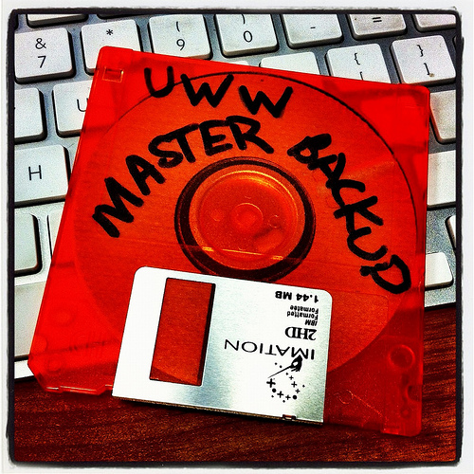
Why Data Management: Researcher Perspective
Make backups to avoid data loss
Format your data for re-use (by yourself or others)
Be prepared: Document your data for your own recollection, accountability, and re-use (by yourself or others)
Prepare it to share it – gain credibility
and recognition for your science efforts!
CC image by UWW ResNet on Flickr
Notes:
Manage your data for yourself:
Make backups to avoid data loss
Format your data for re-use (by yourself or others)
Be prepared: Document your data for your own recollection and re-use (by yourself or others)
Prepare it to share it – gain credibility and recognition for your science efforts

Slide 7
Why Data Management: Foundation to Advance Science
Data is a valuable asset – it is expensive and time consuming to collect
Data should be managed to:
maximize the effective use and value of data and information assets
continually improve the quality including: data accuracy, integrity, integration, timeliness of data capture and presentation, relevance and usefulness
ensure appropriate use of data and information
facilitate data sharing
ensure sustainability and accessibility in long term for re-use in science
Notes:
Data is a valuable asset – it is expensive and time consuming to collect
Data should be managed to:
maximize the effective use and value of data and information assets
continually improve the quality including: data accuracy, integrity, integration, timeliness of data capture and presentation, relevance and usefulness
ensure appropriate use of data and information
facilitate data sharing
ensure sustainability and accessibility in long term for re-use in science

Slide 8
What is the Data Life Cycle?
Assure
Preserve
Discover
Integrate
Analyze
Plan
Describe
Collect
Notes:
A data lifecycle illustrates stages thru which well-managed data passes from the inception of a research project to its conclusion. In the reality of science research, the stages do not always follow a continuous circle.

Slide 9
Data management goals
Data that are:
Well-organized
Documented
Preserved
Accessible
Verified as to Accuracy and validity
Result in:
High quality data
Easy to share and re-use in science
Citation and credibility to the researcher
Cost-savings to science
Notes:
For each stage of the data lifecycle…there are best practices…..and….tools to help!
The following data management lessons will illustrate in detail each stage of the data lifecycle
Your well-managed and accessible data can contribute to science in ways you may not even imagine today!

Slide 10
Reproducible research
Research is reproducible when:
Data and code are organized such that others can re-create your results.
Keys to reproducible research:
Data is saved in raw format.
Everything is done via code, not hand-editing, copy/paste, or point/click.
Code is well-documented so others can follow what you did, ideally in a reproducible report (e.g. Rnotebook, or Rmarkdown/knitr)

Slide 11
2a. Data management plan

Slide 12
What is a Data Management Plan?
Formal document
Outlines what you will do with your data during and after you complete your research
Ensures your data is safe for the present and the future
From University of Virginia Library
Notes:
A DMP is a formal document that outlines what you will do with your data both during and after your research project.
Data management plans are meant to ensure that your data will be preserved and useful both now and in the future, by both you and other researchers.

Slide 13
Components of a General DMP
Information about data & data format
Metadata content and format
Policies for access, sharing and re-use
Long-term storage and data management
Budget
Notes:
For a general DMP, there are five main categories of information that should be included. Some funders or institutions may require specific elements in a data management plan; you should check with the agency or group for which you are preparing your DMP before beginning.
The slides that follow will go into more detail for each of the general categories on this slide. They are 1) Information about the data and its format, 2) information about the metadata content and format that will be used, 3) policies for access, sharing, and reuse of data, 4) long-term storage and data management, and 5) budget considerations for data management.

Slide 14
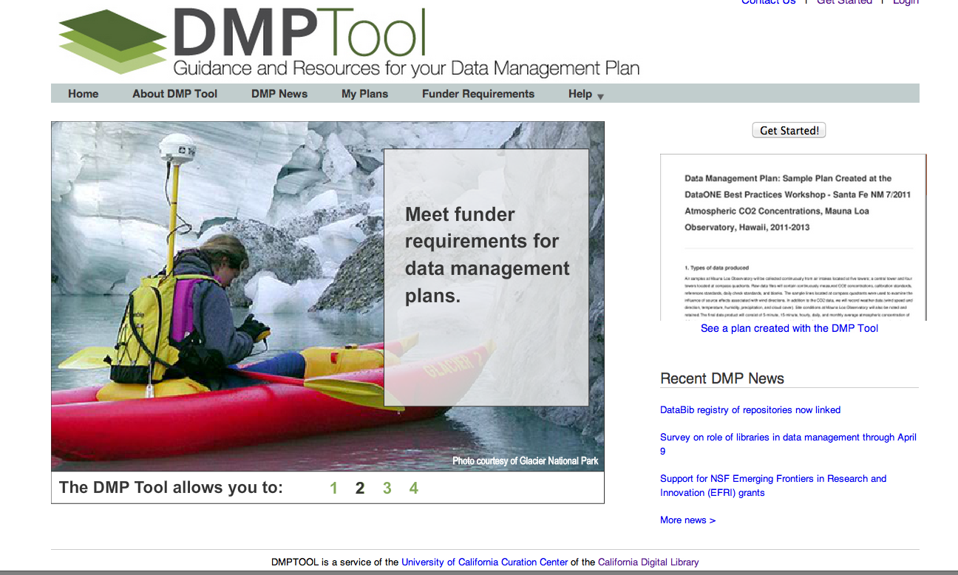
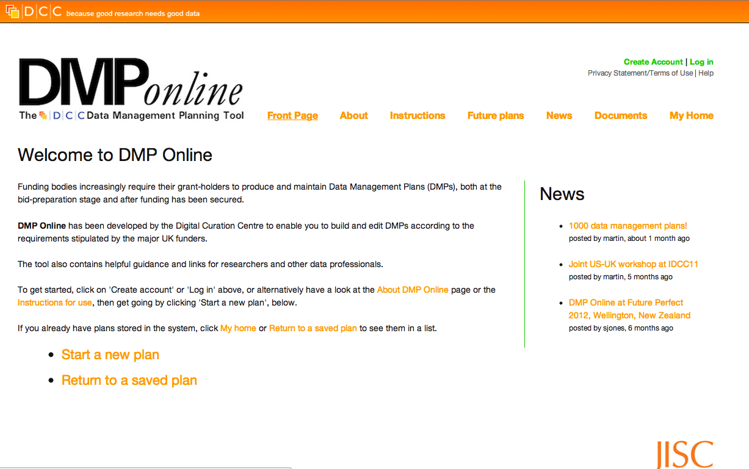
Tools for Creating Data Management Plans
dmp.cdlib.org
dmponline.dcc.ac.uk
Notes:
There are several tools available for creating data management plans. Two of the most commonly used are the DMPTool and DMP Online.
Both operate as “wizards” and provide prompts for the user to fill out in order to create their data management plan. You can save your plan, print it, or export it to your computer.

Slide 15
Find a data management plan online
https://dmptool.org/public_dmps
One to check out: https://dmptool.org/plans/20143.pdf
You should have a data management plan for your own dataset. If you don’t already, use dmptool.org to create one. Start it now, and save it to your repository along with your final project.

Slide 16
2b. Collecting data
What should you use to collect data?
Field notebook or datasheet or electronic data entry?

Slide 17
Designing good datasheets
Evaluate the datasheet in GitHub called “ExampleDatasheet.csv”
What is good about it?
What would you change?

Slide 18
Designing good datasheets
Organization - what does a row mean?
"Column variable, row observation"
Units of measurement clearly demarcated on datasheet
Use consistent codes (guide to codes at bottom)
Enough space to record data clearly
Room for notes

Slide 19
2c. Entering Data
What format?
Excel vs csv vs txt vs other formats
Readxl is a good package if use Excel

Slide 20
Best practices in data entry
Hadley Wickham's Tidy Data (http://vita.had.co.nz/papers/tidy-data.pdf)
In tidy data:
Each variable forms a column.
Each observation forms a row.
Each type of observational unit forms a table.

Slide 21
Exercise
What’s wrong with this database?
Look at preycapture_asentered

Slide 22
Best practices in data entry cont.
Name columns with R in mind
Use consistent codes (if Excel, consider data validation)
Remember, case matters in R (upper vs lower)
Store with appropriate date/time formats
Identify estimated data (should not be entered in a manner identical to measured data)
Identify missing values and define missing value codes; make sure true zeros are distinguished from missing data.
Separate data from notes
Use R-safe delimiters (avoid commas within a cell, symbols)
Avoid using delimiters that also occur in the data fields or avoid putting delimiters in data field.
If this cannot be avoided, enclose data fields that also contain a delimiter in single or double quotes.

Slide 23
Raw data vs processed data
Can create a new datafile each time you enter data, then use script to compile data files
Save raw data files, and never touch them again.

Slide 24
Quality assurance
Double-checking
Cleaning data
Reproducibility is key (therefore do it in a script)
RNotebook is great!
Look for inconsistencies in naming/codes
Look for outliers in numerical data
Look for leading or trailing spaces
Mark problematic data with QC flags (note in Notes section)
From dyamic ecology:
tons of tools for data cleaning. In business called ETL (extract, transform and load). Data Carpentry uses OpenRefine. I like awk. Many bioinformaticians prefer PERL. You could write VBA scripts in Excel. And R. hand editing Excel spreadsheets is right out.
Always check against raw data to make sure things ran as you expected it

Slide 25
Exercise
Find errors in this database (SaipanGuamTransplant_asentered.csv).
Some common things you can fix
Case (tolower), date format
Tidyr
Wide to long, long to wide
One column into several
Several columns into one
We’ll work more on cleaning datasets next week.

Slide 26
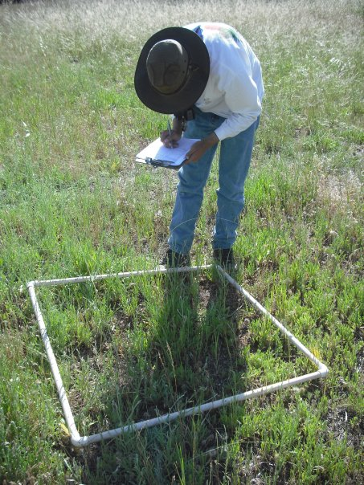
What is Metadata?
Metadata is: Data ‘reporting’
WHO created the data?
WHAT is the content of the data?
WHEN were the data created?
WHERE is it geographically?
HOW were the data developed?
WHY were the data developed?
Photo by Michelle Chang. All Rights Reserved
Notes:
Metadata is data about data. It describes the content, quality, condition, and other characteristics of a dataset.
Metadata records answer questions such as:
Why was the data set created?
What processes were used to create the data set?
What projection is the data in?
When was the data last updated?
Who created the data?
What scale was used?
What fields are in the table?
What do the values in those fields mean?
Who do I contact about getting more information about the data?
How do I obtain a copy of the data?
Do the data cost anything?
Are there any limitations to the data?
Metadata is a valuable tool. Metadata records preserve the usefulness of data over time by detailing methods for data collection and data set creation. Metadata greatly minimizes duplication of effort in the collection of expensive digital data and fosters the sharing of digital data resources.

Slide 27
Multiple Metadata Standards Exist: Examples
Ecological Metadata Language (EML)
Focus on ecological data
http://knb.ecoinformatics.org/eml_metadata_guide.html
Darwin Core
Emphasis on museum specimens
http://rs.tdwg.org/dwc/index.htm
Geography Markup Language (GML)
Emphasis on geographic features (roads, highways, bridges)
http://www.opengeospatial.org/standards/gml
Notes:
There are many standards available to document data. Each has a different focus, yet ask for similar information about the data set.

Slide 28
Steps to Create Quality Metadata
Organize your information
Did you write a project abstract to obtain funding for your proposal? Re-use it in your metadata!
Did you use a lab notebook or other notes during the data development process that define measurements and other parameters?
Do you have the contact information for colleagues you worked with?
What about citations for other data sources you used in your project?
Write your metadata using a metadata tool
Review for accuracy and completeness
Have someone else read your record
Revise the record, based on comments from your reviewer
Review once more before you publish
Notes:
Steps in creating quality metadata includes the following:
Organize your information. Before you begin gather your resources, particularly anything you may have already written about the dataset for another purpose. For example, a grant proposal that has a well-written abstract and purpose for the research is a great resource.
Write your metadata.
Review the record for accuracy and completeness.
Ask someone else read your record.
Revise your information based on comments from your reviewer, then review it once more before you publish it.

Slide 29
Preserving data
Short term storage
Duplicate versions of hard copies of data
Back up electronic copies of data both on site and offsite (e.g. ISU network, CyBox, Dropbox, GitHub)
Long term storage
Data sharing
Dryad – data underlying scientific & medical pubs
Figshare – any data, published or unpublished; get a DOI for each submission with all support files
Taxon or field-specific (e.g. ITIS, NCBI, GBIF, FlyBase)

Slide 30
Dryad – data sharing
How can I make my data submission as accessible and reusable as possible?
Provide ALL files needed to replicate your results, including code. One way to help ensure completeness is to explicitly link your data files (through their titles/descriptions) to the figures and analyses in your publication.
Submit your data files in non-proprietary formats from which data can be easily extracted (e.g., CSV rather than PDF).
Keep your file names short, informative, unique, and free of special characters.
Consider submitting your data files in multiple formats if you think that will enhance their ability to be reanalyzed. View additional guidance and a list preferred Dryad file formats.
Provide descriptive information within your data files (e.g., column headers in a spreadsheet).
Provide a ReadMe file that provides contextual information about the data file so that it can be interpreted correctly.
Provide titles, descriptions and keywords for your datafiles, to make the data more discoverable and to assist in understanding the relationship of the datafile to the publication.

