Slide 1
R Intro
Haldre Rogers

Slide 2
Starting an R session
R vs R Studio
Console vs Workspace; save your scripts!
Set working directory
setwd(“fill_in_here")
What is the working directory? getwd()
What is in the working directory? dir()
Need help?
?cmd
Help.start() - opens web browser with links to help
Google searches

Slide 3
Bringing data into R
Create csv file (or use readxl package to bring in directly from excel)
One worksheet only
No special formatting, filters, comments etc.
Copy only columns and rows with your data to the CSV, as R will read in columns without data sometimes
Name your variables well
self-explanatory, unique, lowercase, short-ish, one-word names
Read in data
CSV files: iris.df <- read.csv("iris_df.csv", header=T)
Write data
write.csv(dataframe, “dataframename.csv”), OR
Notes:
Header=T means first row contains variable names

Slide 4
Preparing your data for R
What makes clean data?
Correct spelling
Identical capitalization (e.g. Premna vs premna)
If myvector <- c(3, 4, 5), calling Myvector does not work!
No spaces between words (spaces turned into “.”)
Generally try to avoid, use underscores instead
NA or blank (if using csv) for missing values
Find and replace to get rid of spaces after words

Slide 5
Important R syntax
# is for notes
<- or = are assignment operators
Whatever you want to name a function or a vector or a dataframe goes to the left of <- or =
c(“a”, “b”, “c”) is used when you have a string of objects
[row,column] = address for arrays or data frames
Function(arguments) note- order matters

Slide 6
R Data Structures
Dimensions | Same type of information | Different type of information
1-dimensional | Vector | List
2-dimensional | Matrix | Data Frame
N-dimensional | Array | ---
Vector- Sequence of any values, including numeric, character, and NA
Matrix- Vector of vectors; all same type of information (numeric); this is a type of an array
Data Frame- Matrix-like structure, but each column can be a different type (e.g. factor, numeric, character etc.)
Array- multi-dimensional generalization of vectors
List- Ordered sequences of objects which can be of any type

Slide 7
Data classes
Integer- whole numbers
Numeric- real numbers
Logical – True/false
Character- alphanumeric strings
Factor- Categorical data (R stores as a set of levels, with a # associated with each level)
Date
Use ‘class’ to check type of data in a vector

Slide 8
Exploring dataframes
str(dataframe) - column classes and dimensions
head(dataframe) and tail() - first and last 6 rows
names(dataframe) - column names
row.names(dataframe) - row names
attributes(dataframe) - column and row names and object class
summary(dataframe) – gives a lot of good information
Make sure variables are appropriate class
Character/string, Numeric, Factor, Integer, logical
Make sure mins, maxs, means, etc. seem right
Make sure you don’t have typing errors so Premna and premna are two separate factors
Use: unique(iris$species) to see what all unique values of a column are
Or use: levels(spider$species) to see different levels
Notes:
Some numbers are actually factors- think of 0/1 for dead/alive or zipcodes (average zipcode?)

Slide 9
Working on your dataset
Go to R script to play around with your own data
Start a new R script
Read in data
Check to see if:
All of your data is present- you have right # rows and columns, and NA’s
Each column is in the right class (e.g. numeric, factor)
You have the correct levels in each factor (i.e. no spelling errors)

Slide 10
R Packages
3,262 packages!!!!
Packages are extensions written by anyone for any purpose, usually loaded by:
install.packages(”packagename”), then
require(packagename) or library()
Use ?functionname for help on any function in base R or in R packages
In RStudio, just press tab when in parentheses after the function name to see function options!!!
Explore packages at the CRAN site:
http://cran.r-project.org/web/packages/
Inside-R package reference:
http://www.inside-r.org/packages

Slide 11
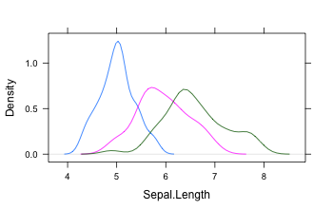
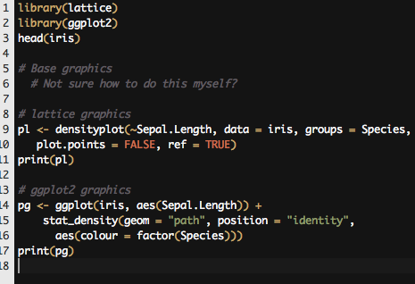
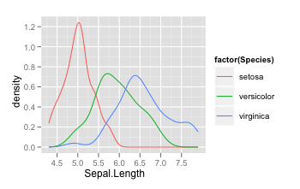
Visualizations
A few different approaches:
Base graphics
Lattice graphics
Grid graphics
ggplot2 graphics
Further reading: http://www.slideshare.net/dataspora/a-survey-of-r-graphics
An example:

Slide 12
Visualizations
Histogram
Barplot
Boxplot
Using both boxplot and bwplot [Lattice]

Slide 13
Style
Style is important so YOU and OTHERS can read your code and actually use it
Google style guide:
http://google-styleguide.googlecode.com/svn/trunk/google-r-style.html#generallayout
Henrik Bengtsson style guide:
http://www1.maths.lth.se/help/R/RCC/
Hadley Wickham's style guide:
https://github.com/hadley/devtools/wiki/Style

Slide 14
Other Intros to R:
http://www.stat.duke.edu/programs/gcc/ResourcesDocuments/RTutorial.pdf
http://www.cyclismo.org/tutorial/R/
http://www.r-tutor.com/r-introduction
Quick R: http://www.statmethods.net/
http://www.bioconductor.org/help/course-materials/2011/CSAMA/Monday/Morning%20Talks/R_intro.pdf

