Slide 1
Can I suppress weeds by extending my crop rotation? A meta-analysis.
Gina Nichols
EEB698 Final Presentation

Slide 2
Question:
Are longer crop rotations associated with less weed pressure?

Slide 3
Why should you care?
Herbicides are really bad for ecosystems
Herbicides are probably bad for you.
Weeds are becoming resistant to our herbicides because we use them too heavily.
We need other EFFECTIVE ways to reduce weeds. People THINK crop rotation reduces weeds, but no one has actually quantified it.

Slide 4
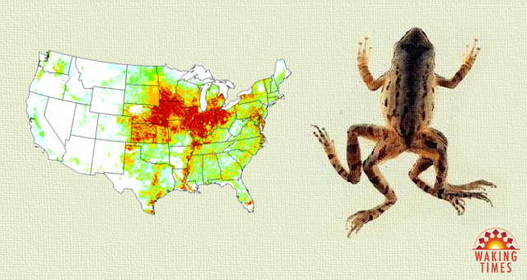
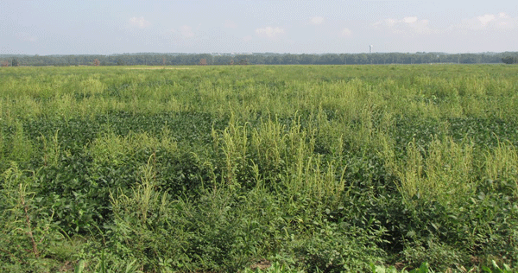
https://www.wakingtimes.com/2016/11/18/banned-eu-dangerous-chemical-americans/atrazine-frog-usa/
https://www.no-tillfarmer.com/articles/5057-rising-pigweed-presence-in-soybeans

Slide 5
Methods
How did you test your question?
Searched the literature for studies that report weed density or weed biomass under different crop rotations (paired data).
Converted data into a response ratio:
weeds in long rotation / weeds in short rotation
Recorded other management information thought to be pertinent based on previous literature/availability

Slide 6
Methods
Moderator | Levels
System tillage (n = 349) | Tilled, zero-tillage
System weed control method (n = 381) | Herbicides, other
Fallow present in short rotation (n = 395) | Yes, no
Perennial in long rotation (n = 395) | Yes, no
Study climate classification (n = 393) | Temperate (latitude >35) (sub)tropical (latitude <35)
Weed measurement unit (n = 393) | Single species, community

Slide 7
Analysis - models
Transformed data - took natural log of response ratio (LRR)
Two types of models
Used a mixed model with study as a random effect, weighted by number of replicates
Used a mixed model with modifier as a fixed effect, and study as a random effect, weighted by number of replicates
Formula:
(1) LRR ~ B0 + a1*study + e
(2) LRR ~ B0 + B1*mod1 + a1*study + e

Slide 8
Analysis - significance
Three methods:
Overall effects different (p<0.01) from 0?
Single modifier levels different (p<0.01) from 0?
Modifier levels different (p<0.01) from each other?

Slide 9
Analysis - packages
tidyverse, readxl, purr, and broom packages
data wrangling/figures
lme4 package
lmer function for mixed model fitting
emmeans package
Emmeans function for confidence intervals and p-values
Pairs function for comparisons between modifier levels

Slide 10
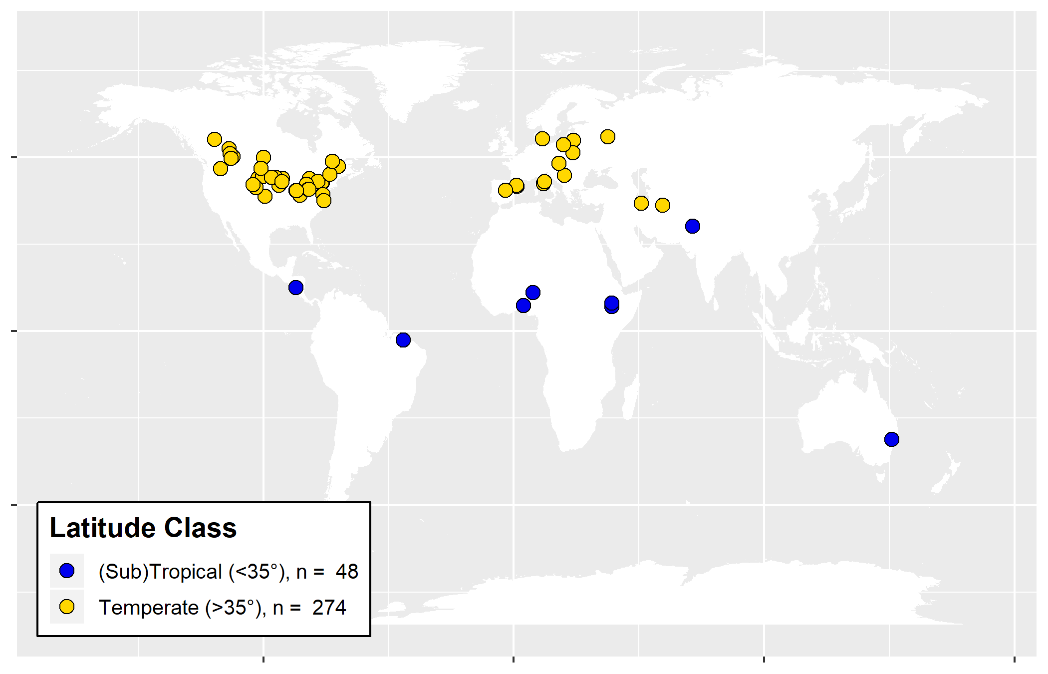
Results - database

Slide 11
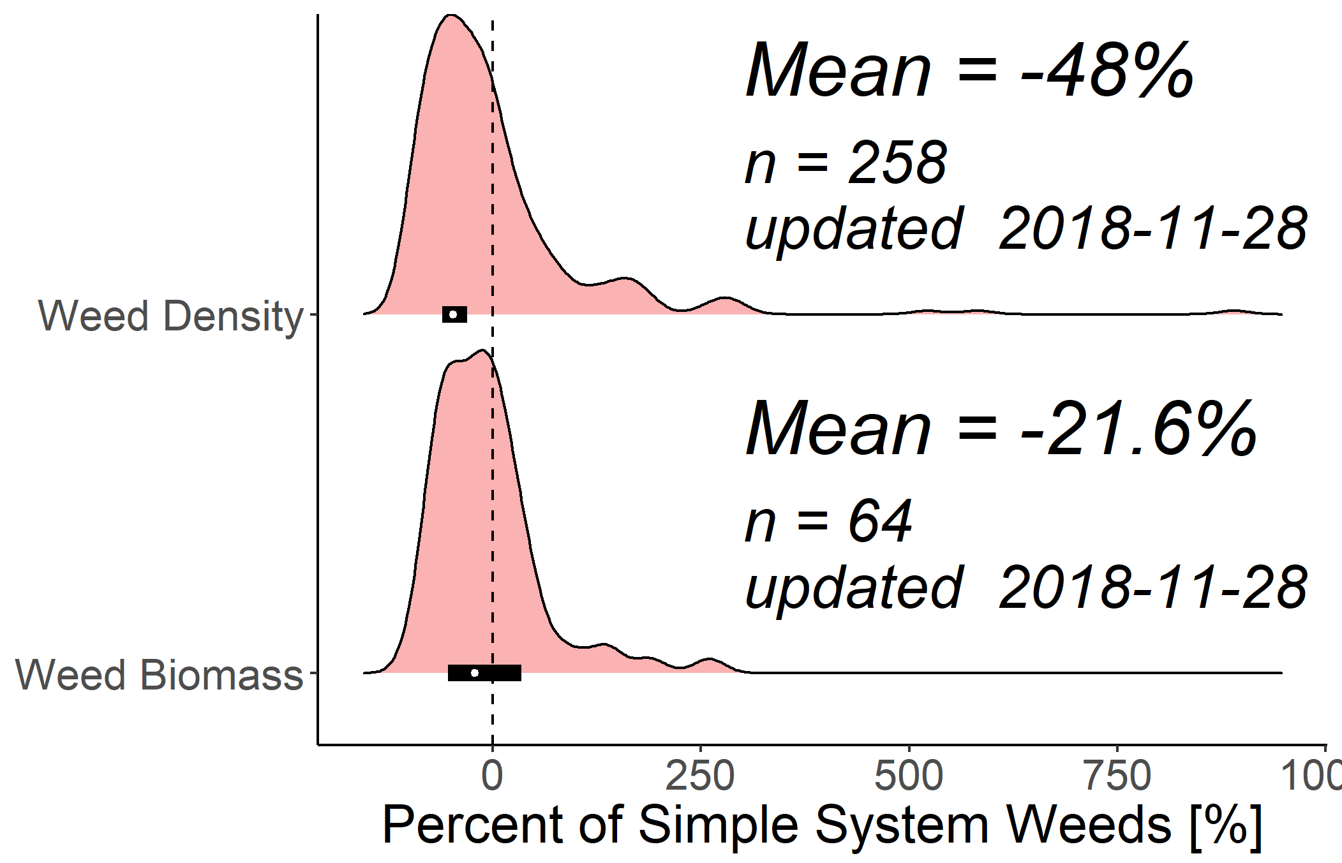
Results – overall effects

Slide 12
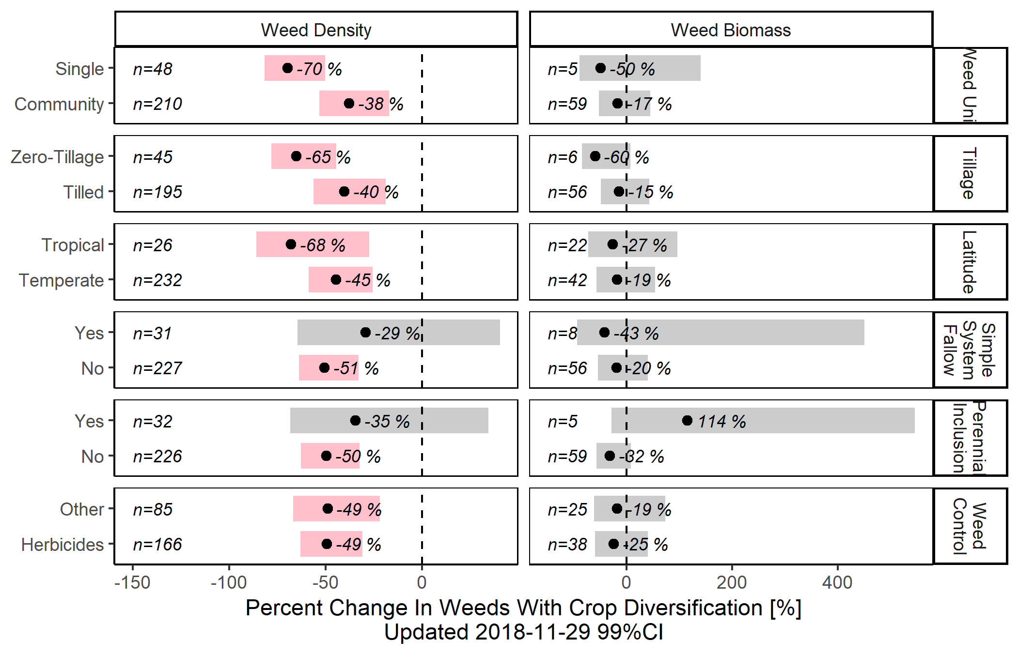
Results – modifiers

Slide 13
Question: Are longer crop rotations associated with less weed pressure?
Longer crop rotations reduce weed density by ~50%
Weed biomass trends towards a reduction, but not significantly.

Slide 14
Under what circumstances?
Longer crop rotations reduce single (likely problematic) weeds more so than the entire weed community.

Slide 15
Under what circumstances?
Weed density is particularly reduced in zero-tillage systems.

Slide 16
Under what circumstances?
Long rotations help in both herbicide- and organic-based systems.

Slide 17
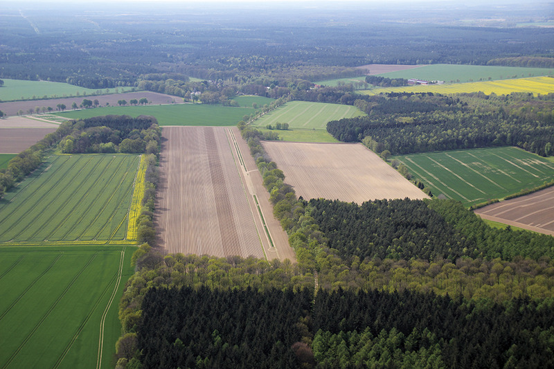
Crop rotation reduces weed density by ~50%.

