Slide 1
Can I suppress weeds by extending my crop rotation? A meta-analysis.
Gina Nichols
EEB698 Final Presentation

Slide 2
Introduction
Question:
Are extended crop rotations associated with less weed pressure?
Why should you care?
Herbicides are really bad for ecosystems, and you. Plus, weeds are becoming resistant to our herbicides because we use them too heavily. We need other EFFECTIVE ways to reduce weeds. People THINK crop rotation reduces weeds, but no one has actually quantified it.

Slide 3
Methods
How did you test your question?
Searched the literature for studies that report weed density or weed biomass different crop rotations.
Converted data into a response ratio:
weeds in long rotation / weeds in short rotation
Recorded potential modifier values

Slide 4
Methods
Moderator | Levels
System tillage (n = 349) | Tilled, zero-tillage
System weed control method (n = 381) | Herbicides, mechanical only, none
Fallow present in short rotation (n = 395) | Yes, no
Perennial in long rotation (n = 395) | Yes, no
Study climate classification (n = 393) | Temperate (latitude >35) (sub)tropical (latitude <35)
Weed measurement unit (n = 393) | Single species, community

Slide 5
Analysis (~3 slides)
Took natural log of response ratio (LRR)
Two types of models
Used a mixed model with study as a random effect, weighted by number of replicates
Used a mixed model with modifier as a fixed effect, and study as a random effect, weighted by number of replicates
Formula:
(1) LRR ~ B0 + a*study
(2) LRR ~ B0 + B1*x1 + a*study

Slide 6
Analysis (~3 slides)
How did you assess significance/importance of predictors?
Three methods for looking at modifiers:
Looking at overall effects (w/o accounting for modifiers)
See if either of modifier levels were significantly different from 0 (99% confidence intervals)
See if modifier levels were significantly different from each other

Slide 7
Analysis packages
Used lme4 package
lmer function for model fitting
Used emmeans package
Emmeans function for confidence intervals and p-values
Pairs function for comparisons between modifier levels

Slide 8
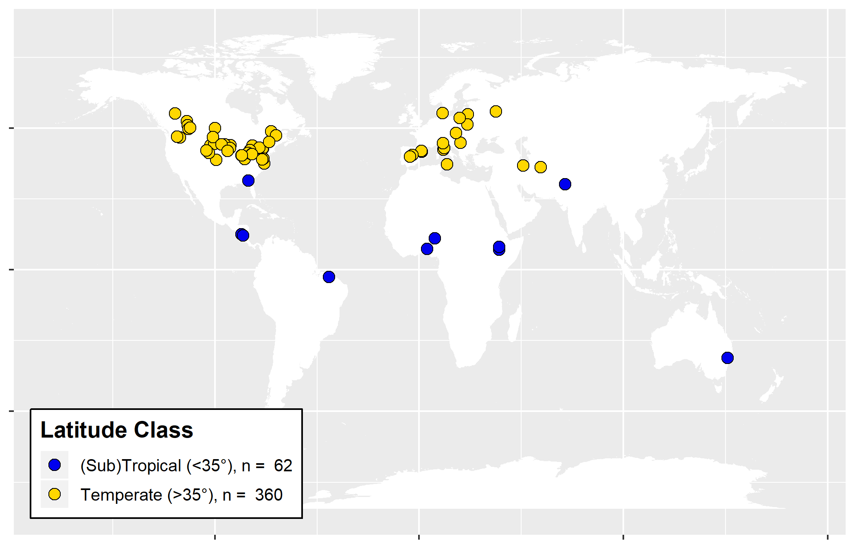
Results - database

Slide 9
Results – overall effects

Slide 10
Results – modifiers

Slide 11
Discussion
Are extended crop rotations associated with less weed pressure?
Longer crop rotations reduce weed density, but not weed biomass.
This makes sense. Other factors, like what crop you are growing, what method of weed control you are using, etc. are stronger drivers of weed biomass than the rotation the crop is grown in.
Weed density is particularly reduced in zero-tillage systems.
Longer crop rotations reduce single (likely problematic) weeds more so than the entire weed community.

