Slide 1
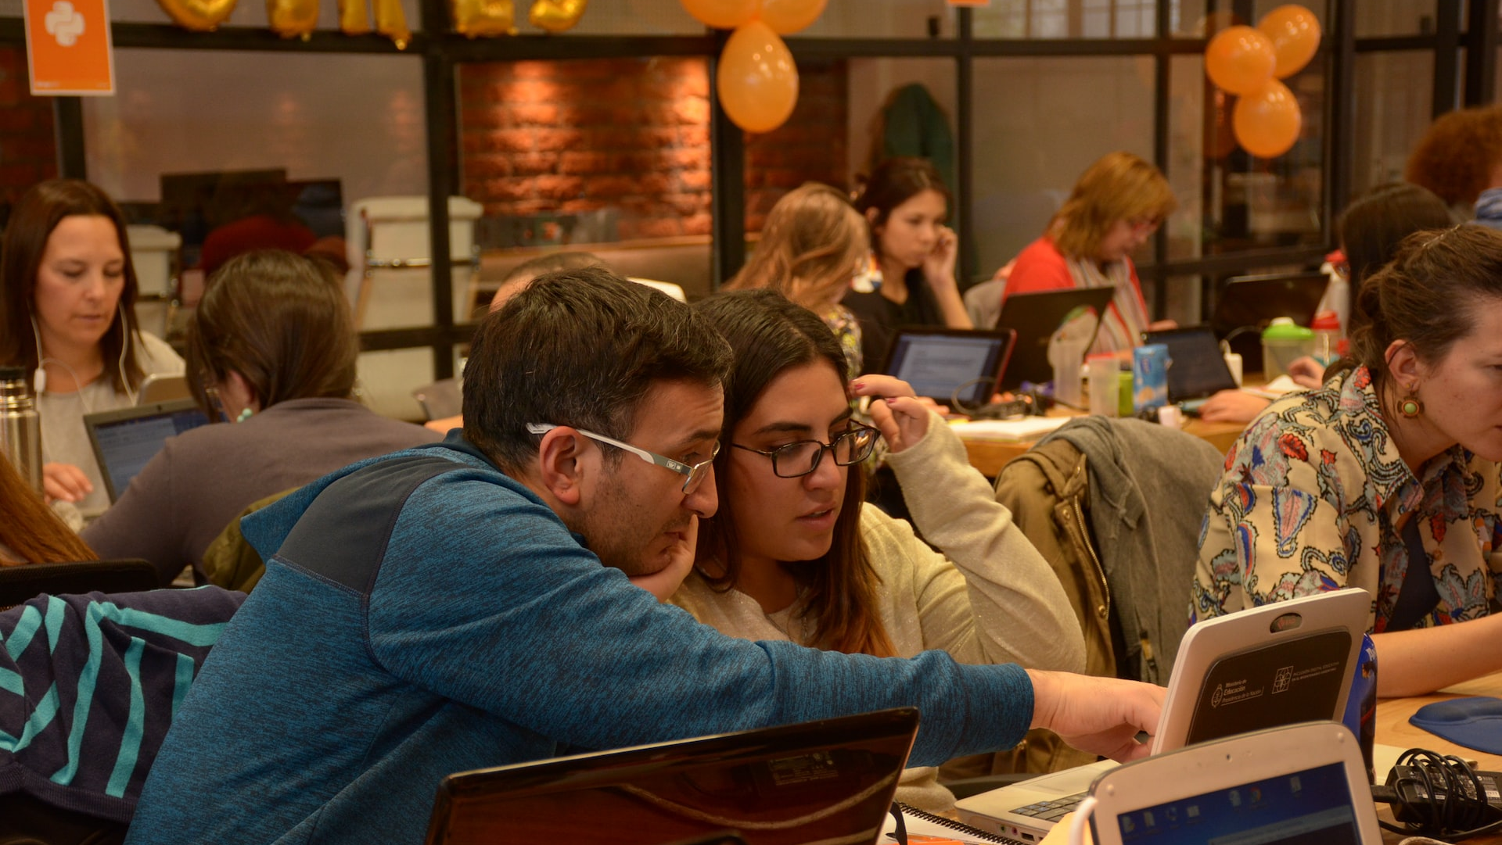
BearcatHelper A modern approach to at home tutoring
Team Blue
What alternatives are available?
What does our app do?
Our app is a place where students and tutors can connect with our primary focus being those studying at UC. Students get on the app and select their role (tutor/learner). Roles are not locked to an account and can be set every time you log on. Students are then paired with someone that could help with their work.
What problem does it solve?
We believe anyone can help anyone. Students can choose to be learner or tutor every time they log on, so this app is for anyone at any level of education!
Who is it mainly for?
We believe anyone can help anyone. Students can choose to be learner or tutor every time they log on, so this app is for anyone at any level of education!
Many alternates are available such as TutorMe. However, we are different! Our app is straight forward and not fee locked. Users just log on and can quickly connect to someone.
What problem does it solve?
Sometimes it makes a big difference when someone just looks at your work with you and minor help can go a long way. This is for students that just need another brain to help them. It solves that annoying problem where we get stuck on something minor on homework.
Why is this project compelling and worth developing?
Describe the top-level objectives, differentiators, target customers, and scope of your product.
We believe something like this will be a big help. Students don't want to cheat or miss assignments but that mental block can really push them. Finding valuable help is key in this mindset. Tutoring companies make so much money off of students, we believe this can be major help.
What are the competitors and what is novel in your approach?
Top-level objectives: Create a functional web app that connects tutors to students.
Differentiators: Stright forward and free.
Target customers: Students at universities.
Scope: A web application with a front end and backend.
The University of Cincinnati has a tutor website called TracCloud that matches up tutors with students
https://traccloud.go-redrock.com/uclearningcommons/trac/entryinc.php?tbl=main&form=dashboard&recNum=1&shoutbox=WW91IGhhdmUgYmVlbiBsb2dnZWQgYmFjayBpbg

