Slide 1
Time Series Data Quick Analyzer
Team Keith

Slide 2
Vision
Goal
Provide an uncomplicated interface for visualizing CSV time-variant data.
Target users
Students, engineers, programmers, and anyone with data.
Why this approach?
Most existing solutions are overcomplicated or expensive. When viewing simple trends, all that's needed is data visualization and a short summary.

Slide 3
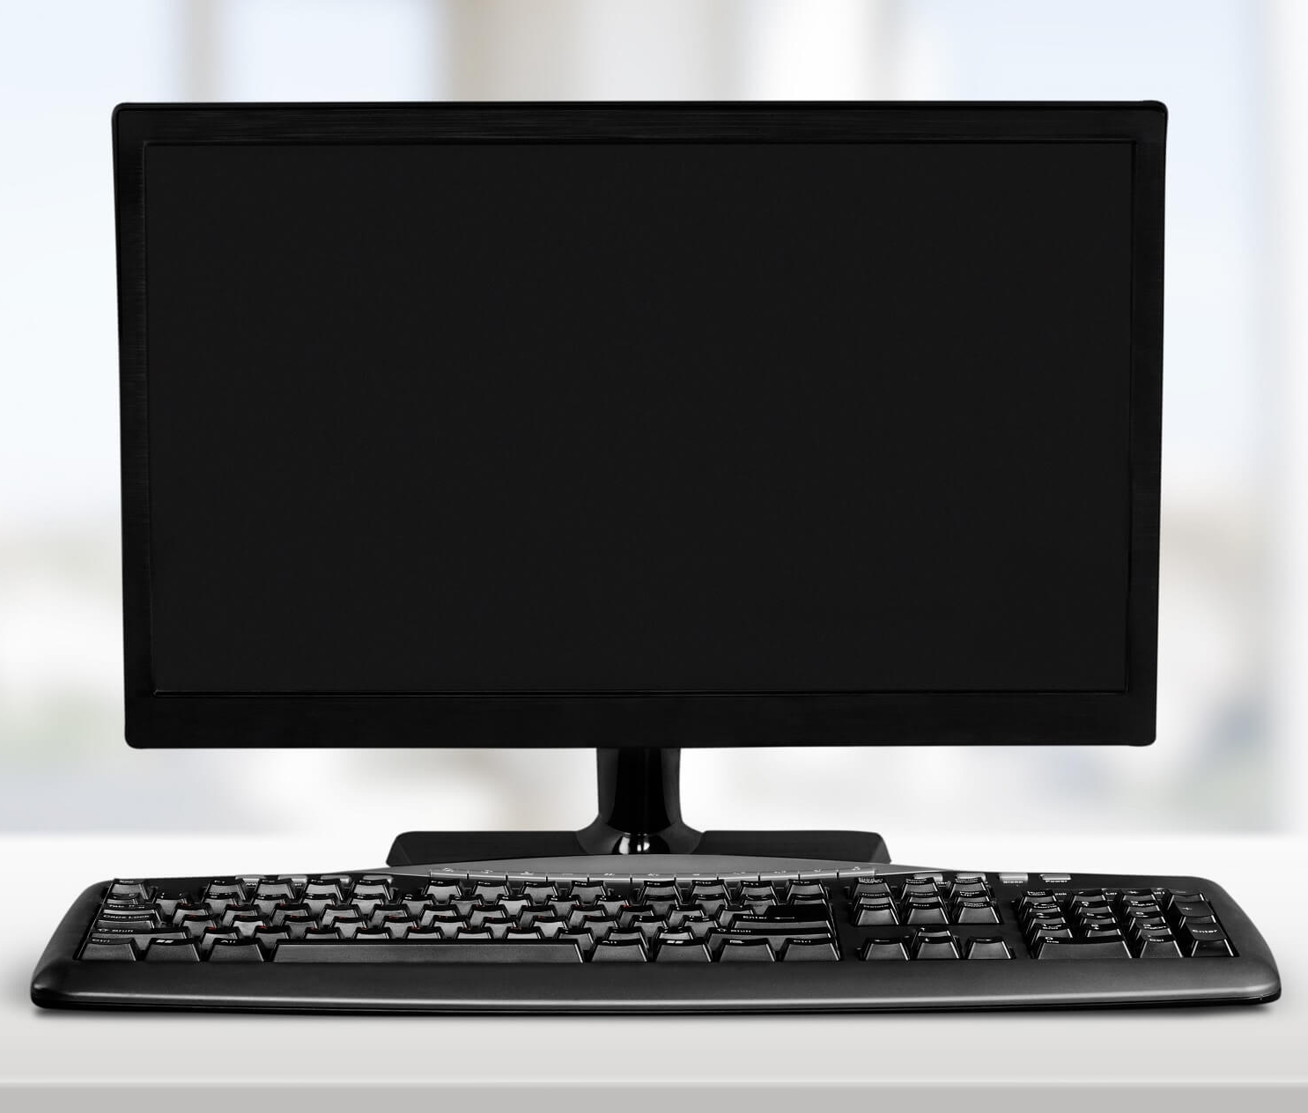
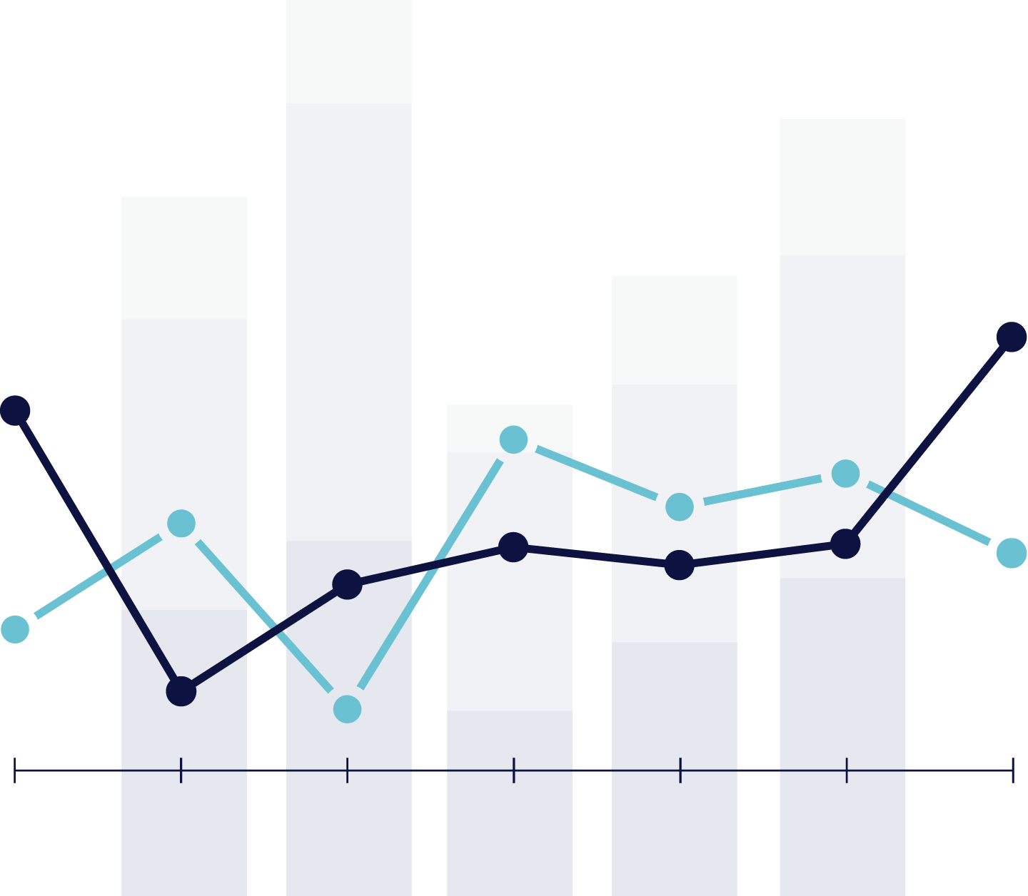
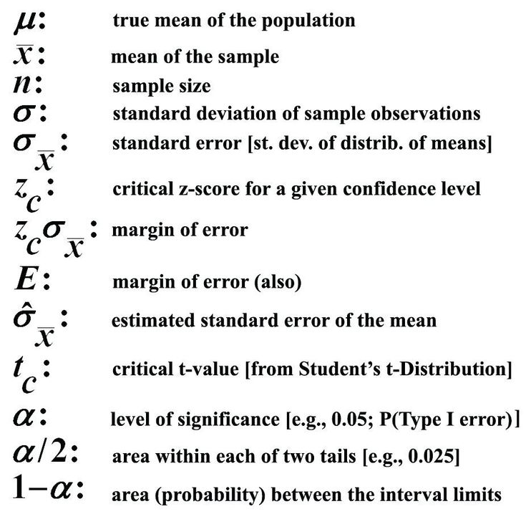


Software Architecture
Visualization and summary
Online Data (.csv)
App
User's Local
Data (.csv)
Powered by

Slide 4
Software Architecture: Specifics
User interface and visualizations
Powered by Python using matplotlib, pandas, and PyQt
Underlying data processing API
Written in C/C++
Access to local and web-based data files
Using simple file import functionality and an external API for requesting public data tables.

Slide 5
Risks
The biggest risk would come when integrating the different components of our app. (Our data processing API, the GUI, and the code for accessing database APIs.)
We can combat this risk by planning ahead and starting to research solutions ASAP.

