Slide 1
Discussion 10
Gate Sizing, RC Delay, Logical Effort, Power/Energy, Adders

Slide 2
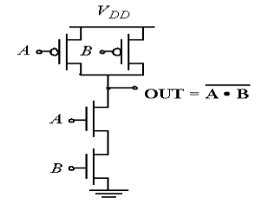
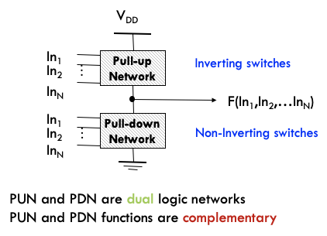
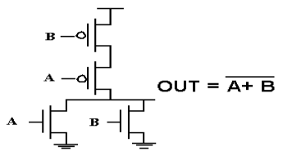
CMOS Logic

Slide 3
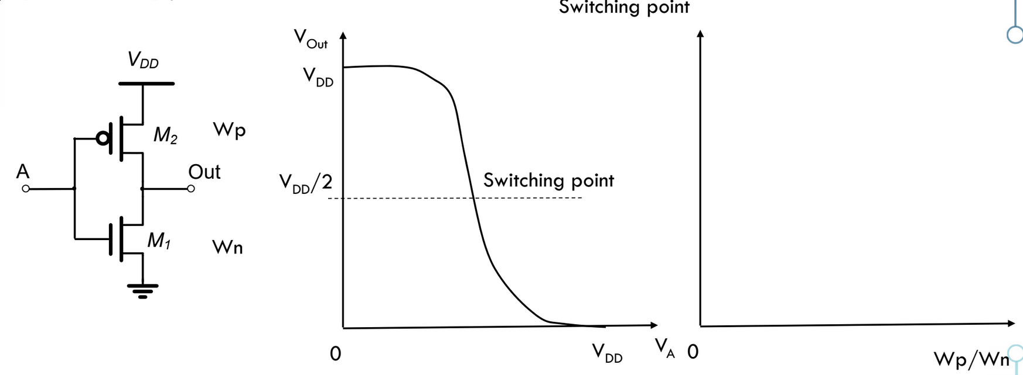
Inverter Sizing
R_{on} of each FET is inversely proportional to its width
Assume V_{th,n} = V_{th,p}
Assume R_{on,n} = R_{on,p} for the same width unless otherwise specified
Wp = Wn = switching threshold of Vdd/2
If Wp >> Wn, Vm approaches VDD | If Wn >> Wp, Vm approaches 0 (exponentially)

Slide 4
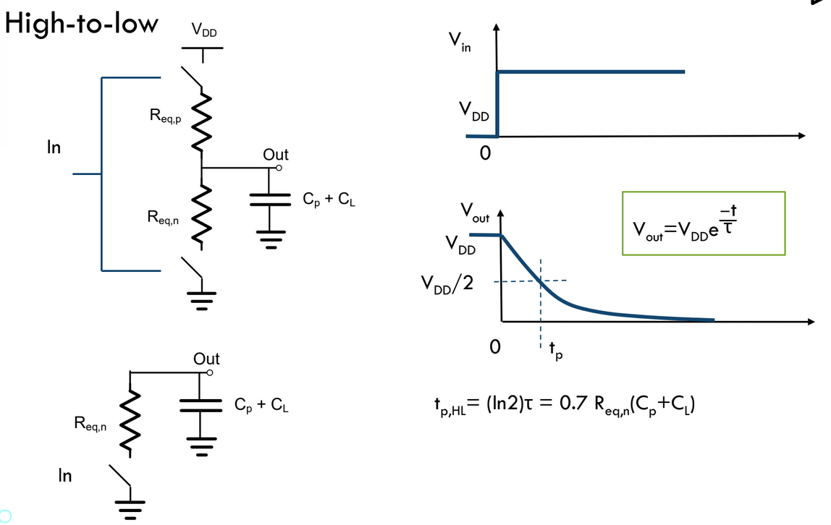
Inverter RC Delay (High -> Low)
High to low output transition time governed by strength of NMOS pulling low
Can lower the time constant by increasing the NMOS width

Slide 5
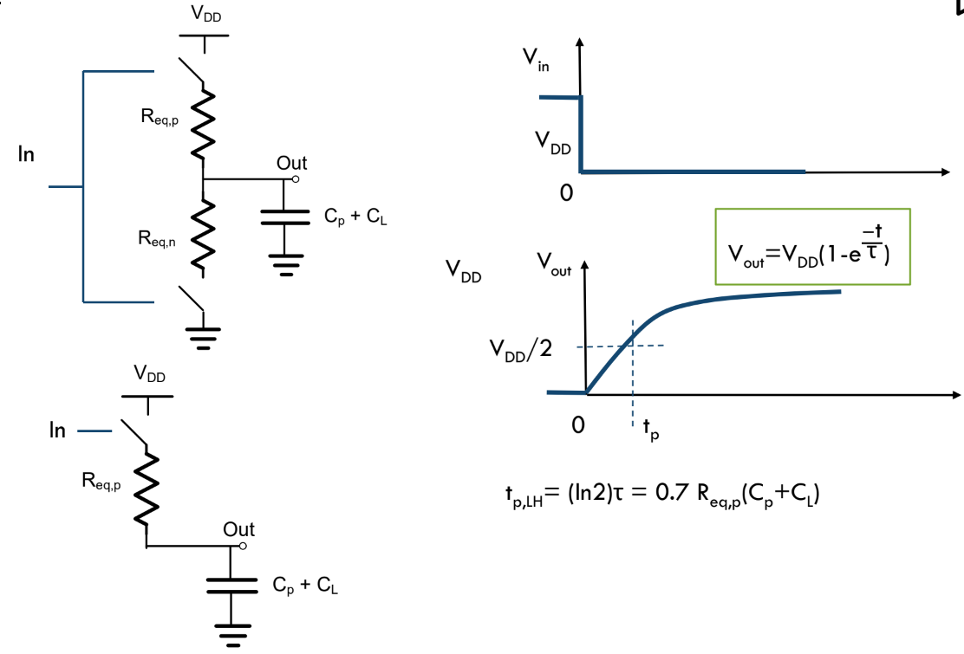
Inverter RC Delay (Low -> High)
Low to high output transition time governed by strength of PMOS pulling high
Can lower the time constant by increasing the PMOS width

Slide 6
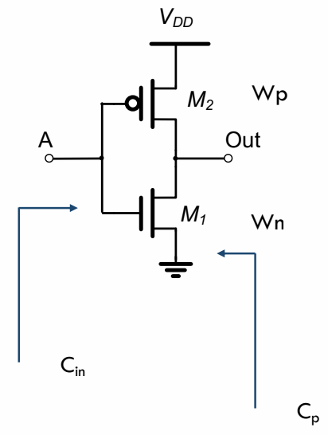
Inverter Sizing
Cin (gate input capacitance) and Cp (intrinsic drain capacitance) are proportional to W
You may see Cp referred to Cd in other sources
Cp = γ Cin
How does the inverter delay change if either PMOS/NMOS width is doubled?
If both widths are doubled, does the intrinsic (unloaded) delay improve?
Inverters are usually sized to equalize high->low and low->high delays

Slide 7
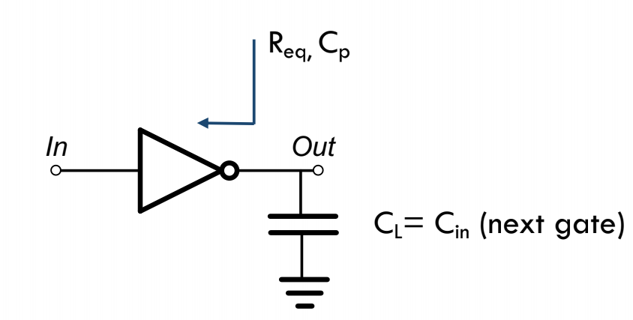
Inverter Delay
t_{p,inv} = R_{eq} (C_{p,tot} + C_L) = R_{eq} C_{p,tot} (1 + (C_L / C_{p,tot})) = R_{eq} C_{p,tot} (1 + (C_L / C_{in} γ)) = R_{eq} C_{p,tot} (1 + (f / γ)) = tau_{inv} (1 + (f / γ))
Delay can be split into 2 parts, intrinsic and extrinsic
Fanout f = ratio between output and input cap (CL / Cin)
This delay formula can be generalized for any CMOS gate
t_{p,gate} = tau_{inv} (p + gf/γ)
Often assume γ = 1

Slide 8
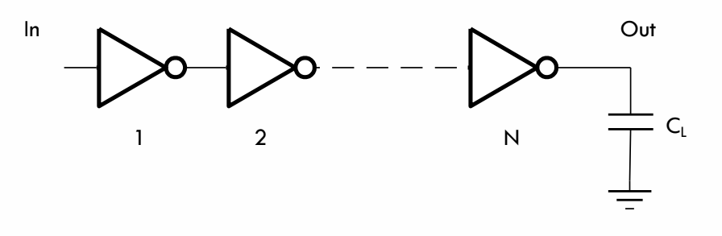
Sizing an Inverter Chain
We want to minimize the delay of this inverter chain
Assume the 1st inverter has a size of 1
Delay = tp1 + … + tpn = (1+f1) + (1+f2) + … + (1+fn) Take partial derivatives of this expression wrt C2, … Cn Solution is f1 = f2 = f3 = … = fN Each inverter has a fanout = the n-th root of F (total fanout)

Slide 9
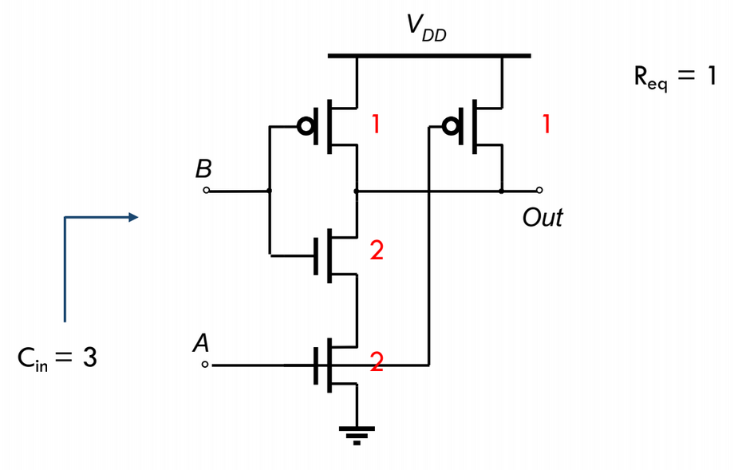
Logical Effort
g = logical effort
To find g for a CMOS gate:
Size the gate to have R_{eq} equal to that of an inverter
Find the input capacitance of the gate (for a particular input)
Take the ratio C_{in,gate} / C_{in,inv}
For a NAND2 gate: g = 3/2
For a NOR2 gate: g = 3/2
How do these change if the PMOS is half as strong as an nMOS?
Can the logical effort be different for different inputs?

Slide 10
Intrinsic Delay
p = intrinsic delay
To find p for a CMOS gate:
Size the gate to have R_{eq} equal to that of an inverter
Find the output (intrinsic) capacitance of the gate
Take the ratio C_{out,gate} / C_{out,inv}
For a NAND2 gate: g = 4/2
For a NOR2 gate: g = 4/2
How do these change if the PMOS is half as strong as an nMOS?

Slide 11
Path Delay
Path logical effort G = g1 * g2 * … gN
Path fanout F = CL / C_{in,1}
This is called H in lecture
Branching factor bi = ratio of total cap seen / on-path cap
Path total effort H = GFB
This is called F in lecture
We want to minimize the delay of a path through a series of gates
Each stage i in the chain has an effective fanout gi * fi
The solution is to make the effective fanout of each stage the same
EF_{opt} = H^{1/N}
EF = gi * fi = gi * (C_{load} / C_{in})
C_{in} (i.e. the gate size) = gi * C_{load} / EF
The optimal path delay D = N * H^{1/N} + p1 + … + pN

Slide 12
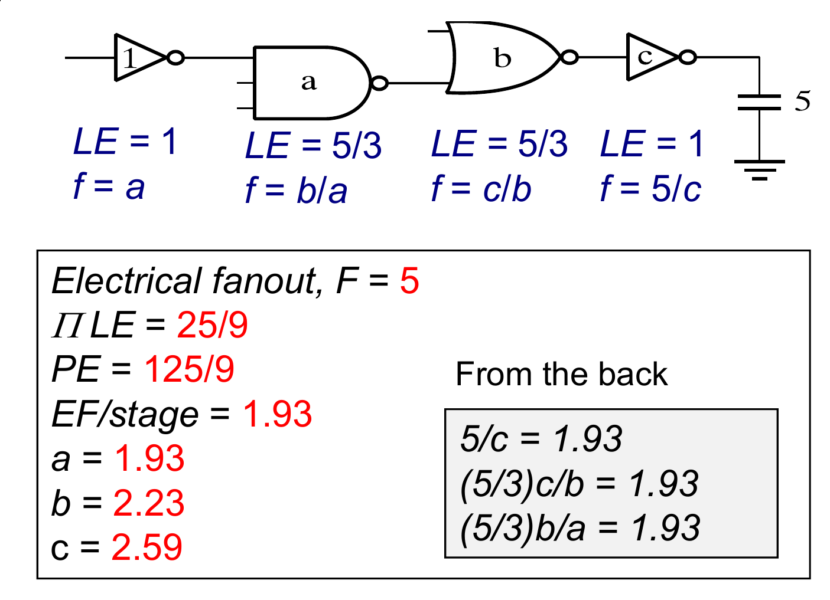
Sizing a Logic Path for Minimum Delay
This example assumes the NMOS is twice as strong as the PMOS
EF/stage is calculated as the 4th-root of G*F
gi * fi = EF of stage i
Easier to calculate gate sizes from the load cap backwards

Slide 13
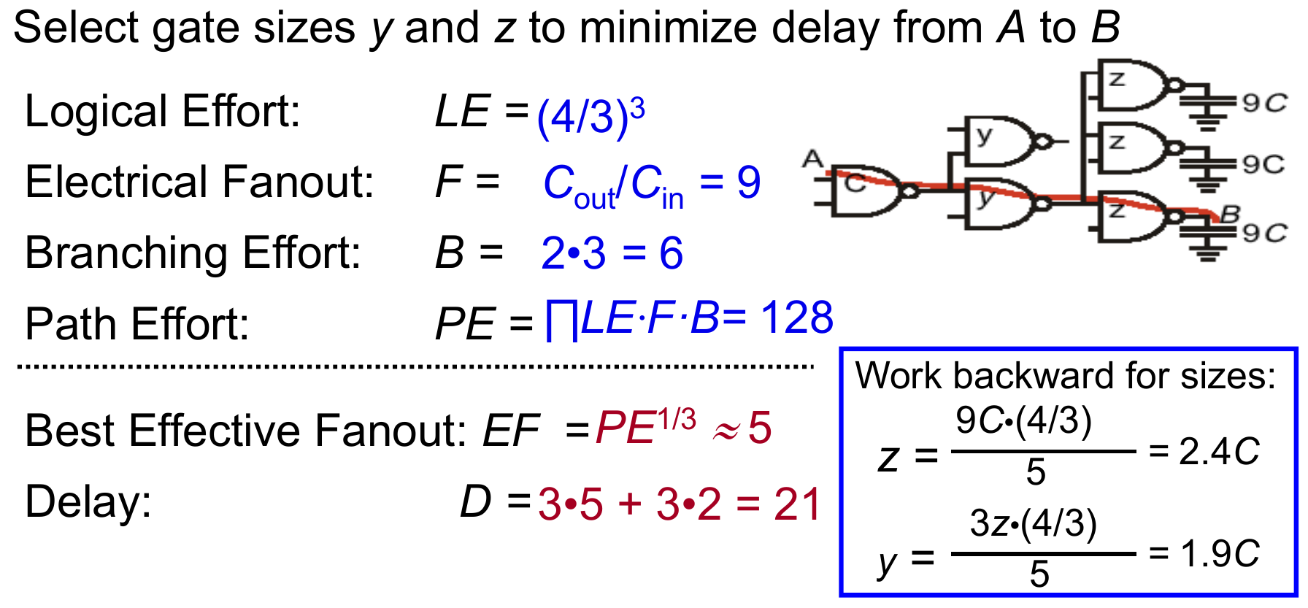
Sizing a Logic Path for Minimum Delay (Branching)
This example also assumes the NMOS is twice as strong as the PMOS
Note that when calculating the size y, you must consider the total load cap (3z) instead of just z
Recall: D_{opt} = N * H^{1/N} + p1 + … + pN

Slide 14
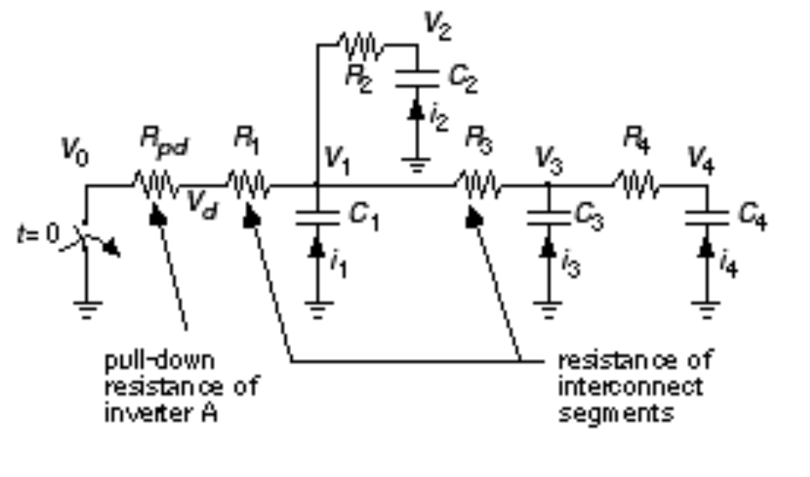
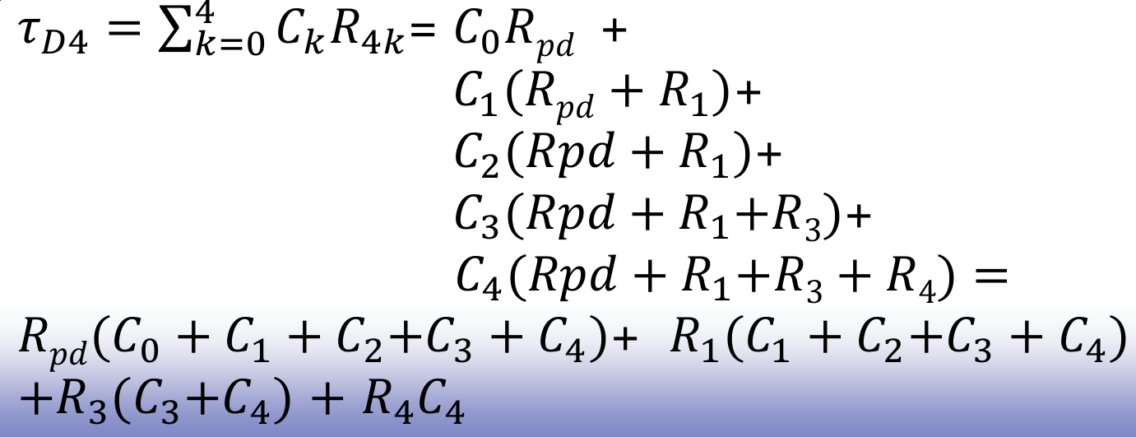
Elmore Delay Approximation
Approximates the dominant time constant of a RC network for a given input and output node
2 methods (same result):
Take every capacitor and multiply it by the sum of resistors on the path charging it
Take every resistor on the path and multiply it by the sum of capacitances it charges

Slide 15
Energy and Power
CV^2 joules drawn from supply when charging cap to VDD
½ CV^2 stored on capacitor
No additional charge drawn from supply when the cap discharges
The other ½ CV^2 is burned on the charging resistance and dissipates as heat
Dynamic switching power = f C V^2 alpha_{0 -> 1}

Slide 16
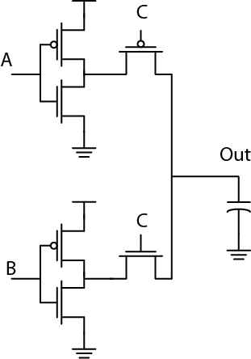
Problem
Assume A = VDD, B = 0V
Vthn = 0.2V
|Vthp| = 0.3V
Rp = Rn
Draw a VTC when Vc is swept from 0 to VDD

Slide 17
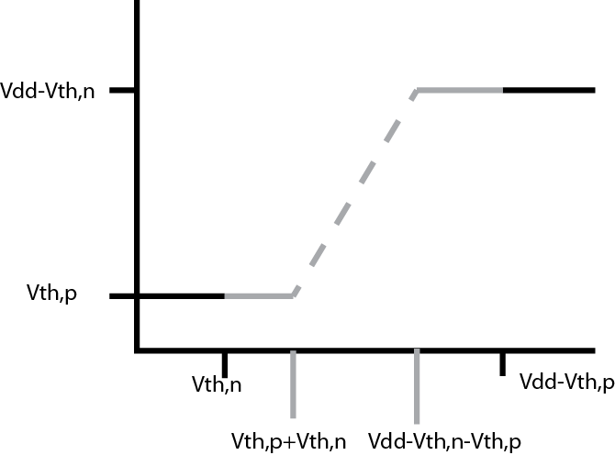
Problem

Slide 18
Problem
What is the energy pulled from the supply when B = 1, C = 0, and A goes from 1 to 0? Assume CL is initially at 0V.
The output cap is charged from 0V to VDD
C * VDD^2
Using the final voltage from the last part as the new initial condition, how much energy is dissipated when C goes from 0 to 1?
½ C * VDD^2

Slide 19
Problem
What is the energy pulled from the supply when A = 1, C = 1, and B goes from 1 to 0? Assume CL is initially 0V.
Recall E_VDD = CL * VDD * V_{delta}, where V_{delta} is the change in voltage across the capacitor
CL * VDD * (VDD - Vthn)
Using the final voltage from the last part, how much energy is dissipated when C goes from 1 to 0?
½ CL ((VDD - Vthn)^2 - (Vthp)^2)
Cap starts at VDD - Vthn and ends at Vthp. The energy difference is dissipated.

Slide 20
Adders
Let’s look at last semester’s discussion slides: http://inst.eecs.berkeley.edu/~eecs151/sp19/files/discussion11.pdf

