Slide 1
Discussion 11
Adders, Midterm 2
Sp19 Discussion 11 (adders): http://inst.eecs.berkeley.edu/~eecs151/sp19/files/discussion11.pdf
Sp19 Discussion 12 (multipliers): http://inst.eecs.berkeley.edu/~eecs151/sp19/files/discussion12.pdf

Slide 2
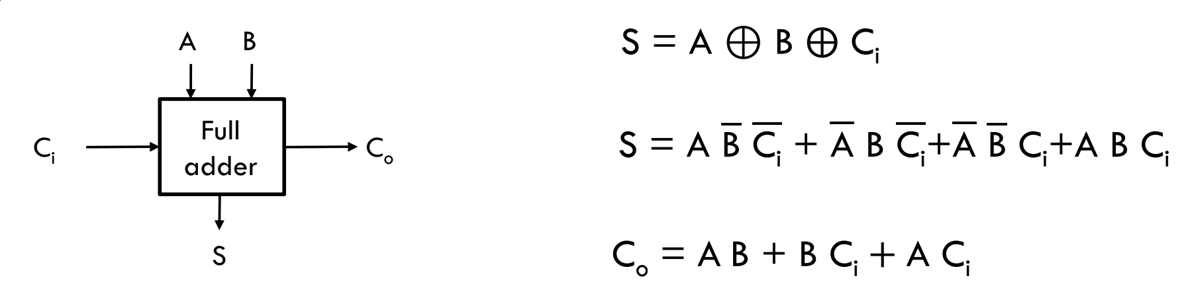
Full Adder
A full adder implements a single-bit adder with carry in
A half adder doesn’t have a carry in, but still has a carry out
The full adder is the primitive used in many adder topologies
The path from Ci -> Co is often on the critical path

Slide 3
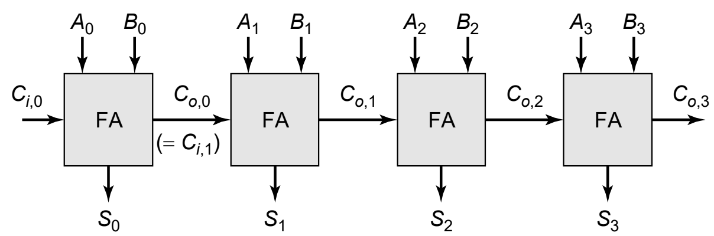
Ripple Carry Adder
For a N-bit ripple carry adder
Delay = (N-1) * t_{FA,Ci -> Co) + t_{FA, Ci -> S) = O(N)
Area = N * A_{FA} = O(N)
Delay is dominated by the carry chain

Slide 4
Carry Select Adder
One way to reduce critical path is to cut the adder into 2 parts, severing the carry chain.
Problem: The LSB side of the adder will work as expected but the MSB side still depends on the value of the carry!
Solution: There are 2 possibilities for the carry-in to the MSB adder, 0 and 1. Calculate the result of BOTH cases and pick the correct one
Allows the MSB computations to occur in parallel with the LSB calculation with a small delay to select the correct value
Downside: Replicated logic, wasted effort (energy) on result that is not used
Notes:
Basically, we are betting on a horse race, except we are betting on all horses, so we are bound to win! A perfectly hedged bet!

Slide 5
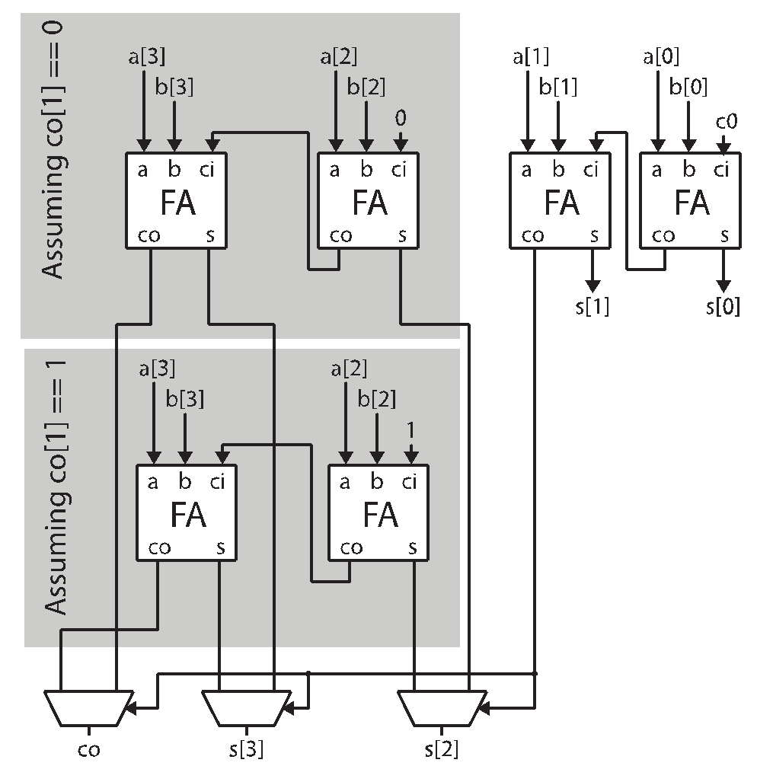
Carry Select Example:
0
1
1
1
0
1
0
1
1
0
1
Example:
4’b0111 (7)
+ 4’b0101 (5)
-----------
5’b01100 (12)
0
1
0
0
1
0
0
0
1
1
1
0
1
1
0
1
1

Slide 6
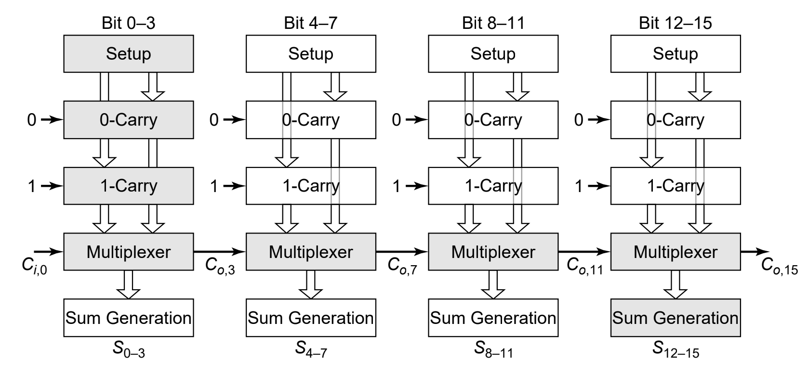
Linear Carry-Select
For a N-bit linear carry-select adder with M sections:
Delay = (N/M) * t_{FA,Ci -> Co) + M * t_{mux} + t_{FA,Ci -> S}
Take a partial wrt M, M_{opt} = sqrt(N)
Area = 2 * N * A_{FA} + M * A_{mux}

Slide 7
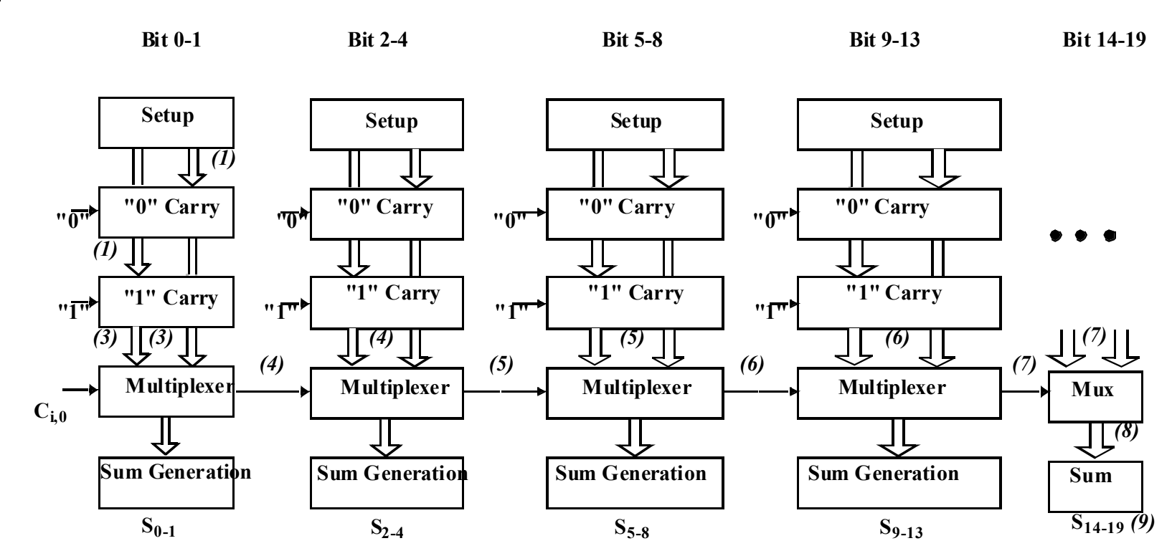
Non-Linear Carry-Select Adder
A linear carry-select adder has the same number of FAs per stage
This is non-optimal because all FA chains complete in parallel at the same time, and thus arrive at the muxes before the control signal arrives
The goal is the equalize the delays of each stage
t_{stage0, setup->Co) = t_{stage1, setup->mux} = … = t_{stageM, setup->mux}
Solution depends on mux vs FA delay, solve numerically

Slide 8
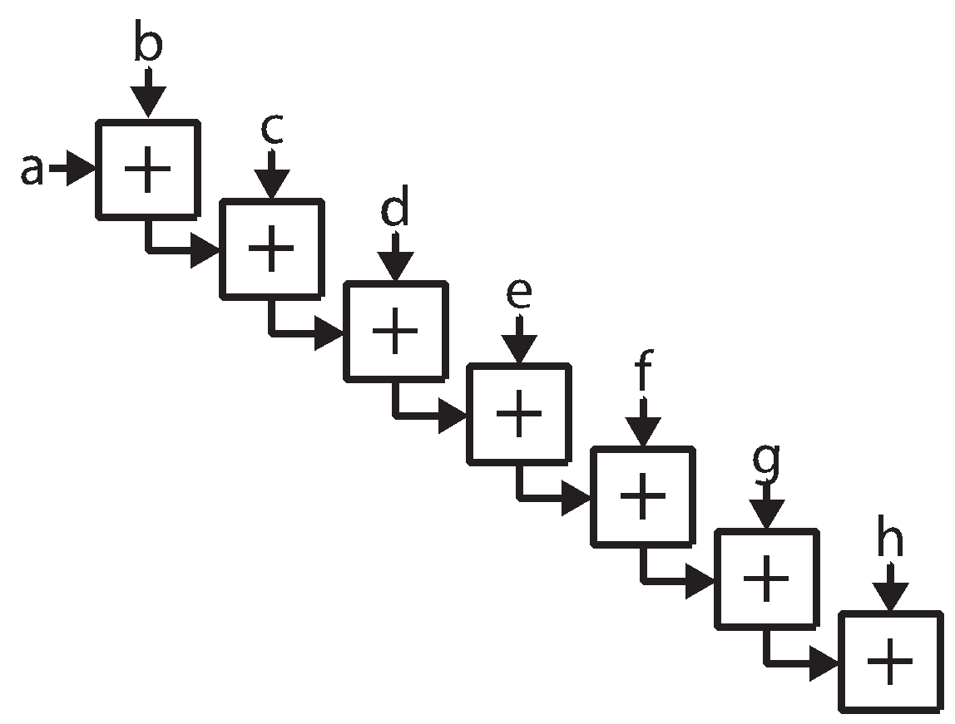
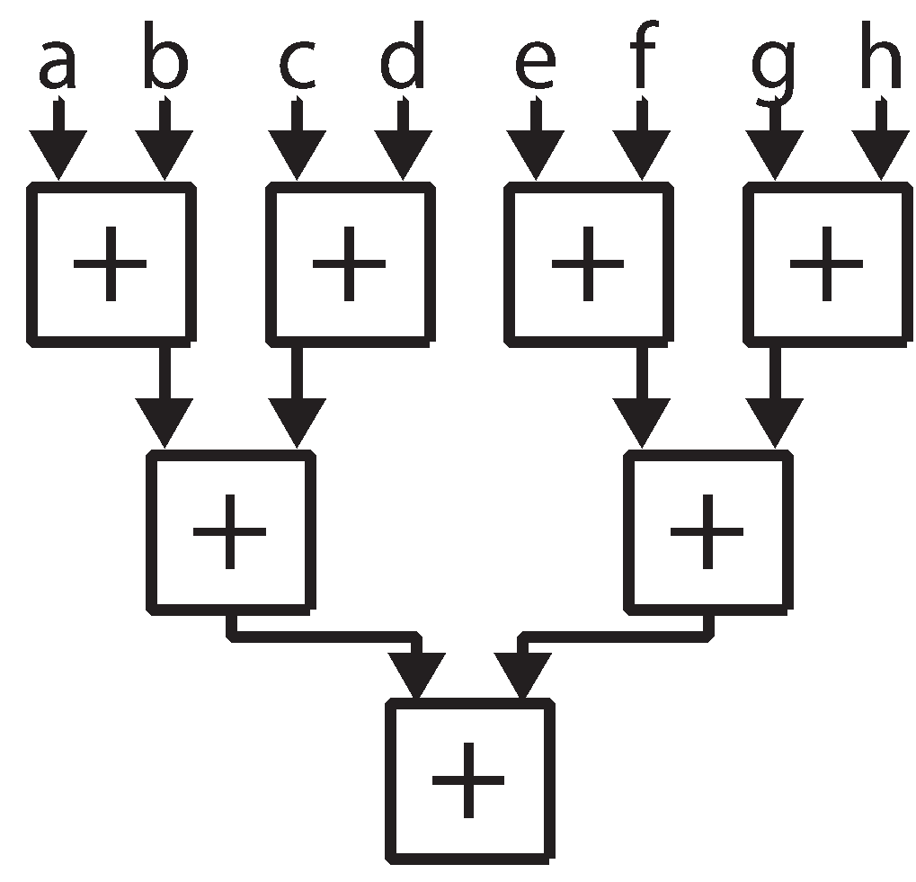
Quick Aside: Associativity
An operator, #, is associative if the following is true: (a # b) # c = a # (b # c)
Addition*, multiplication, AND, OR, XOR, are associative
This allows us to compute them in a tree structure
Ex. Compute: a+b+c+d+e+f+g+h
((((((a+b) + c) + d) + e) + f) + g) + h | ((a+b) + (c+d)) + ((e+f) + (g+h))
Delay: 7 Additions HW Requirements: 7 Adders | Delay: 3 Additions HW Requirements: 7 Adders
Adders in same layer can be computed in parallel!
See: Weisstein, Eric W. "Associative." From MathWorld--A Wolfram Web Resource. http://mathworld.wolfram.com/Associative.html
* Addition of floating point numbers is generally not considered associative
Notes:
Note, the same amount of hardware is required in both cases. We are just changing the order in which we evaluate the adds in order to allow some to be computed in parallel.

Slide 9
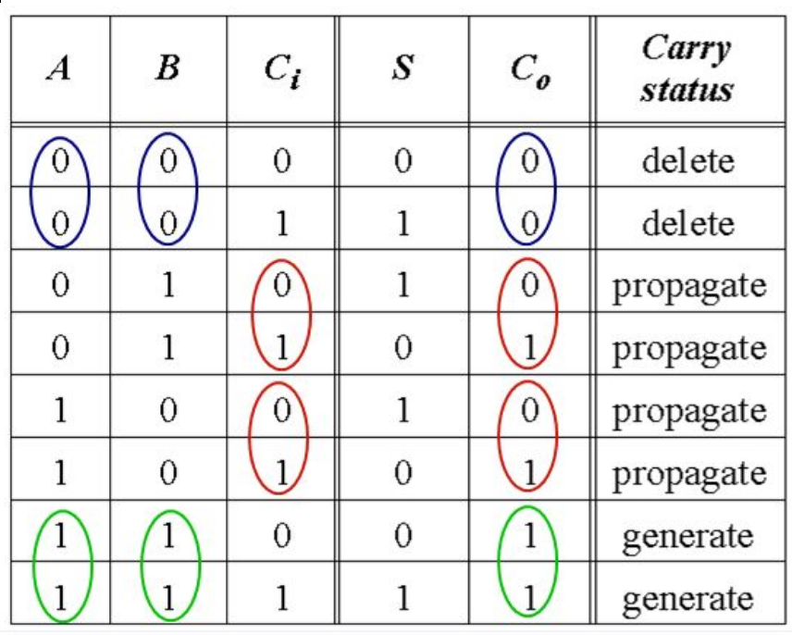
Propagate/Generate
We want to make our adder topology associative so we can avoid the carry propagation being in the critical path. Define p, g signals:
Propagate (p) indicates when Co = Ci
Generate (g) indicates when Co = 1
p = A + B (= A XOR B)
Propagate can be high along with generate, as its redundant
g = AB
Let’s use propagate to implement a carry-bypass adder

Slide 10
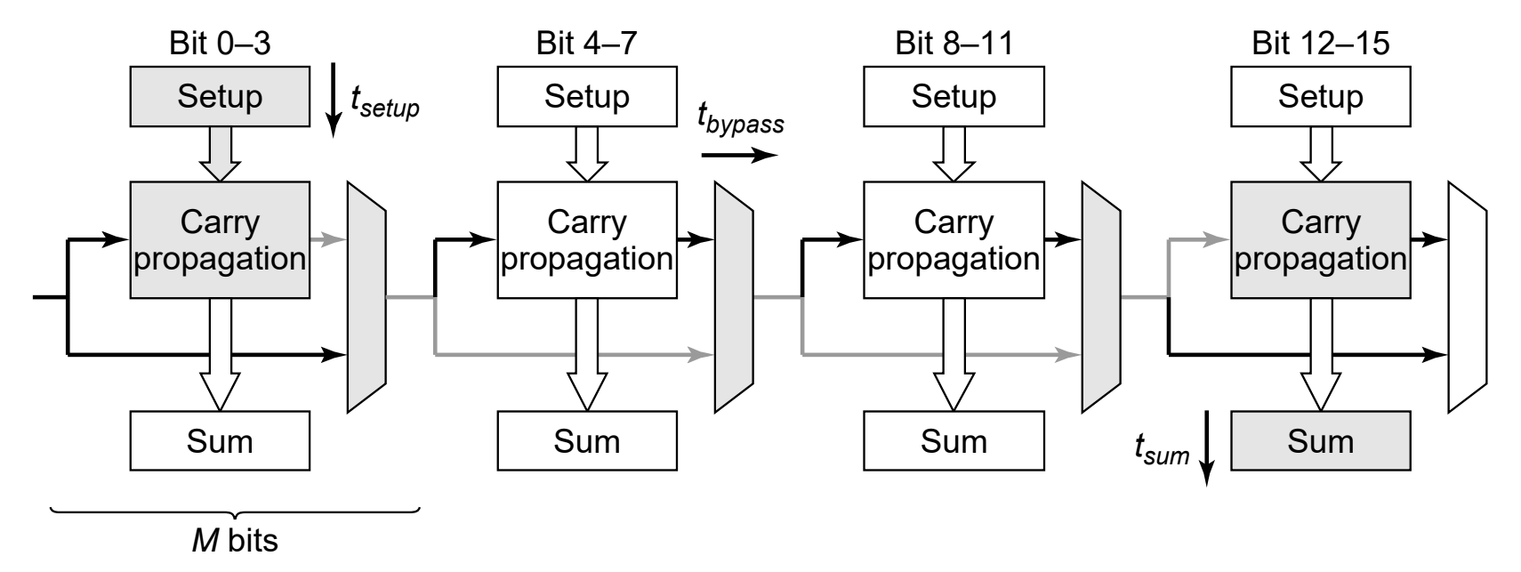
Carry-Bypass (Carry-Skip) Adder
Muxes are controlled by block propagate (P = p1*p2*...*pM)
P can be computed using a tree (log critical path)
Critical path starts at LSB carry chain, then goes through carry bypass muxes, and the final carry chain to create the sum bits
Why doesn’t the critical path go through every carry block? If block propagate is true, then none of the carry paths matter. If it’s false, then the carry in doesn’t matter! (false path)

Slide 11
Carry Lookahead Adder
The carry logic, as we have presented it, is not associative
We need to compute the bits in order from LSB to MSB, since each FA needs the carry-out of the previous stage
This is a problem as it limits us to a linear chain of FAs, preventing us from doing work in parallel
Solution: Make the carry logic associative through re-defining the FAs

Slide 12
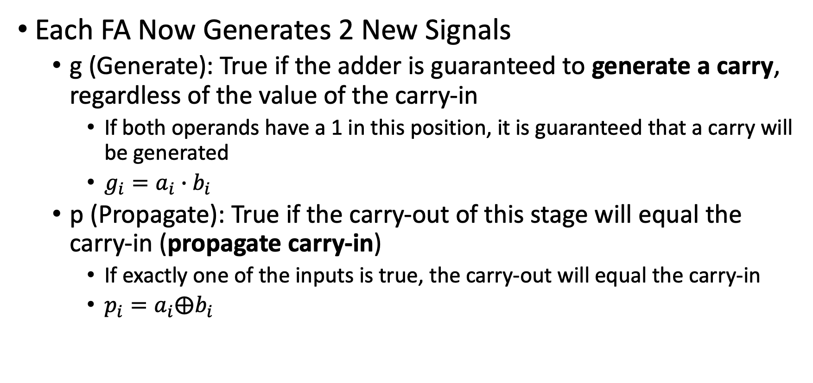
Redefining FAs: Carry Generate and Propagate

Slide 13
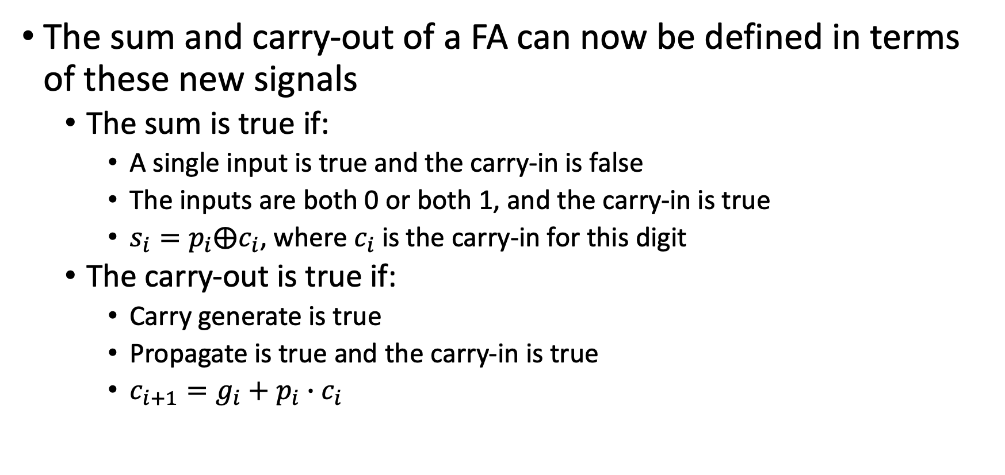
Redefining FAs: Carry Generate and Propagate

Slide 14
What good did that do?
Note that the sum and carry-out bits in each FA still depend on the values of the carry-in.
This means that we still need the compute the carry-in value for each bit position and have logic to generate the sum
However, the p and g values can all be computed simultaneously
There is no dependence on carry-in when computing p and g!
We leverage this property in the carry lookahead adder by grouping together adders and creating P and G signals for the entire group
P represents if the entire group will propagate a carry signal
G represents if the entire groups generates a carry signal
The P and G signals can be processed in a tree structure

Slide 15
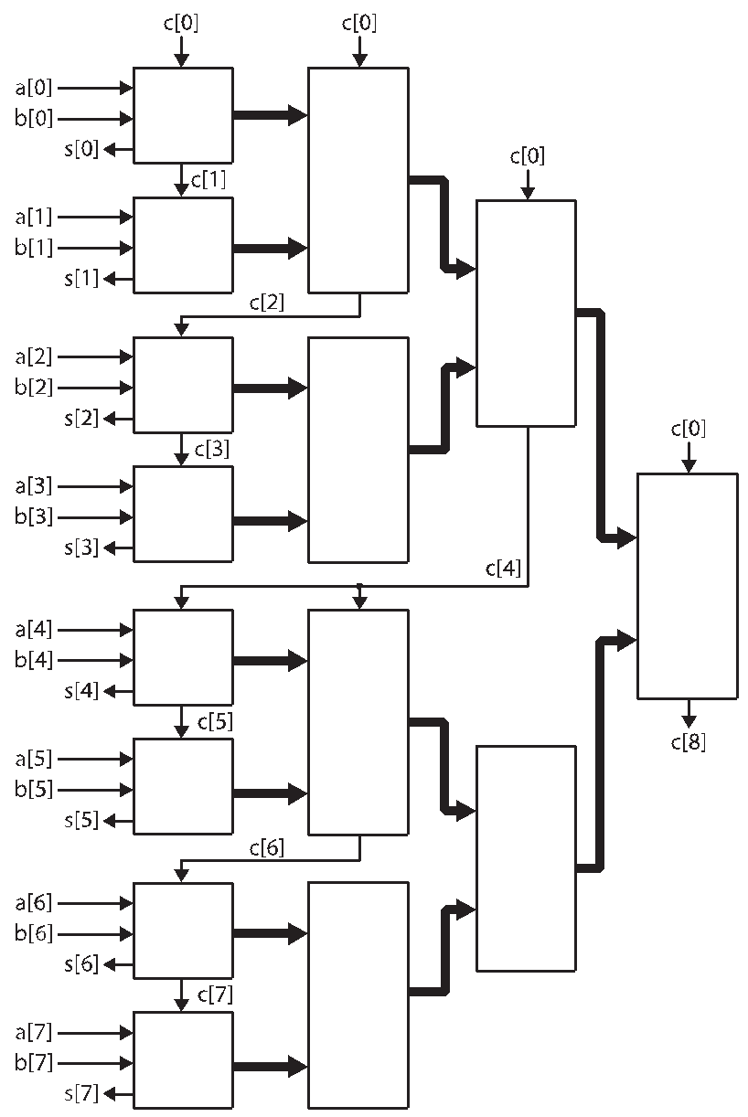
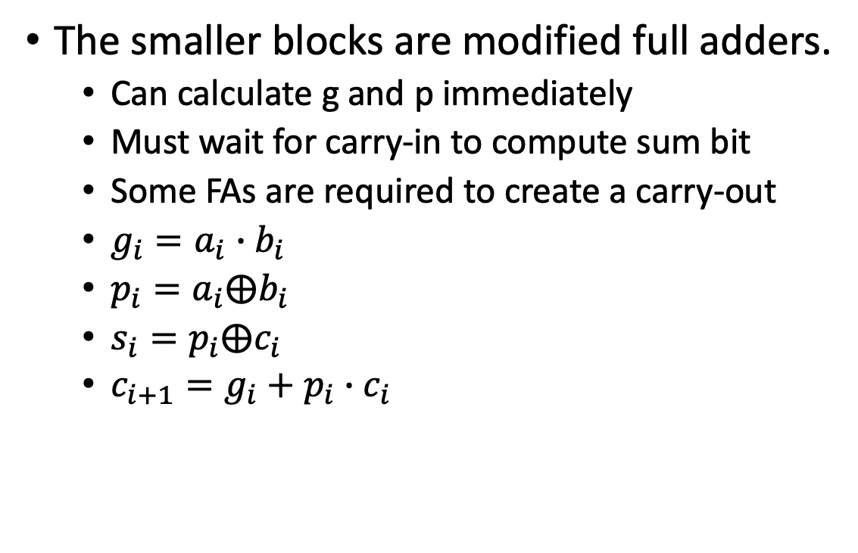
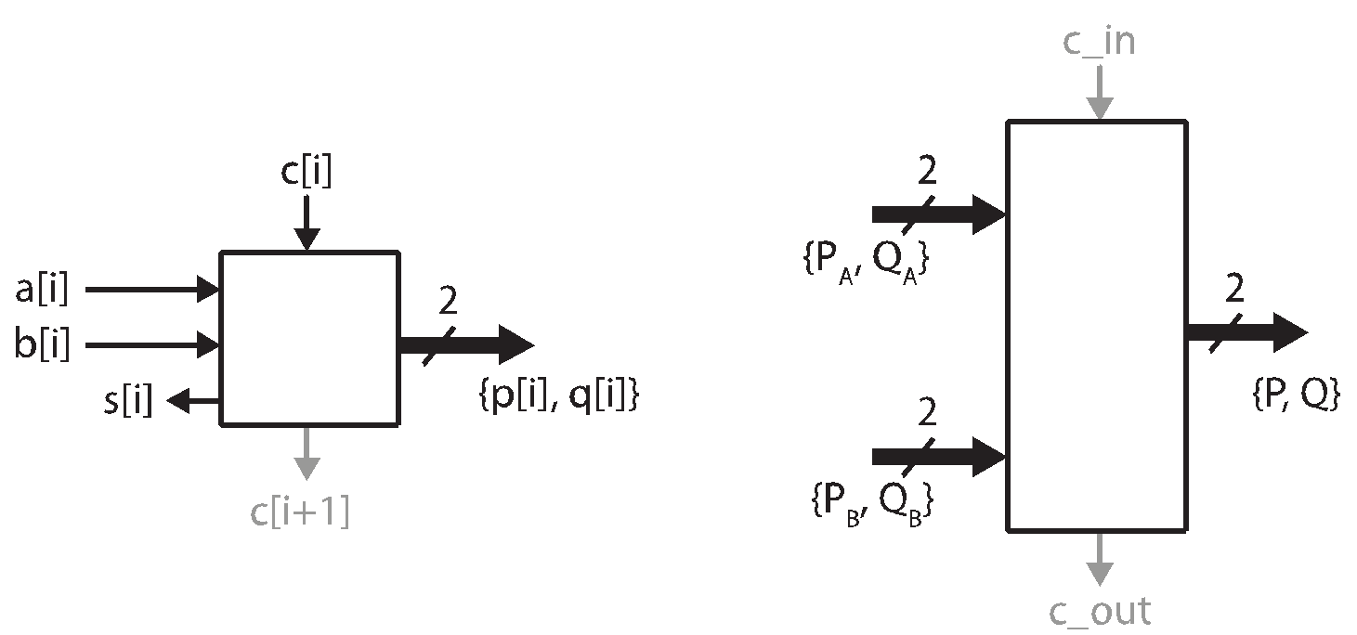
Carry Look-ahead Adder
No Dependence on carry-in
Depend on carry-in

Slide 16
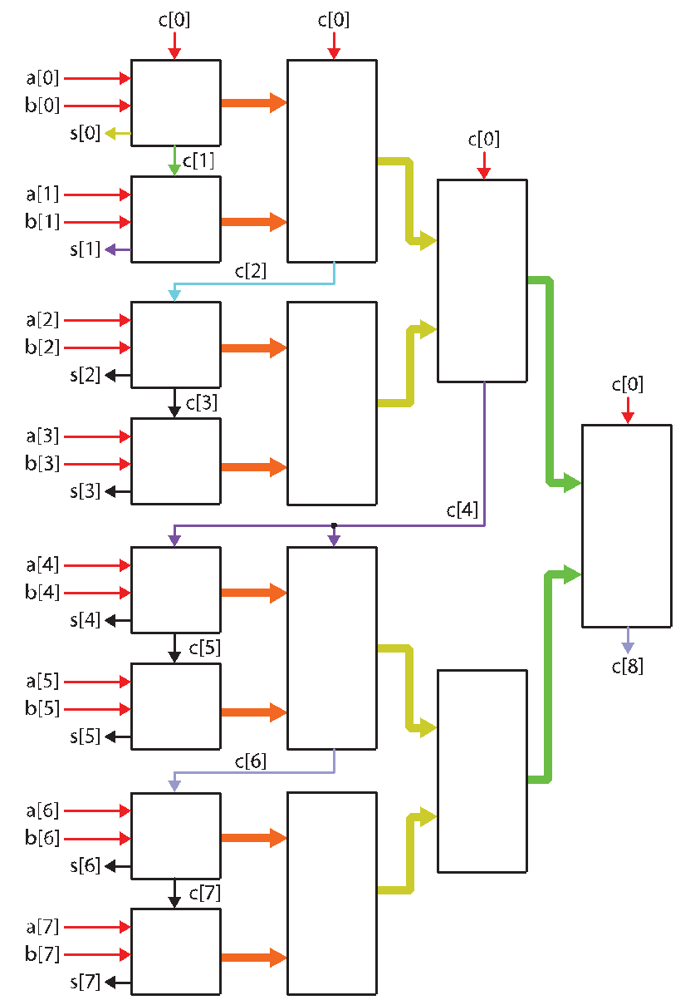
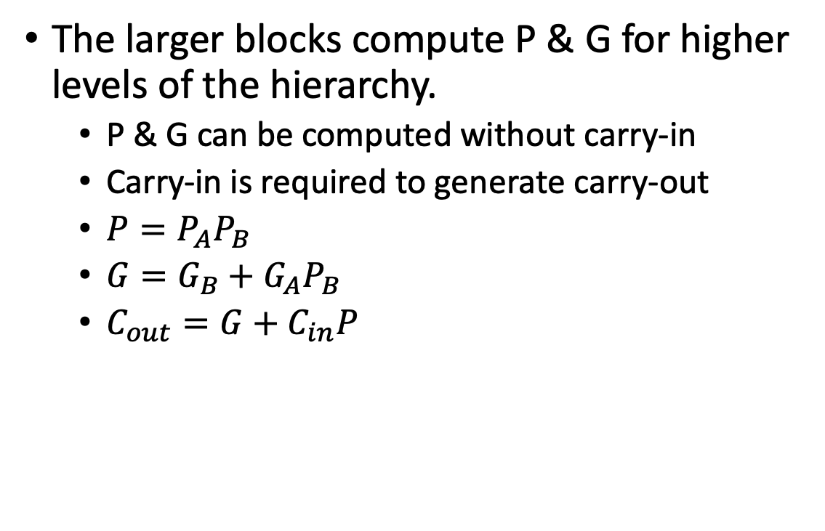
Carry Look-ahead Adder
No Dependence on carry-in
Depend on carry-in
Notes:
Walk through this. Colors are things that become available at the same time

Slide 17
Parallel Prefix Adder
One disadvantage of the carry lookahead adder as described in the lecture slides is that the carry-out bit still ripple through the groups in the first layer
An alternative is to compute the carry bits directly without any grouping
However, we don’t want to fall back to a carry ripple solution.
Trick: unroll the expression for the carry bit

Slide 18
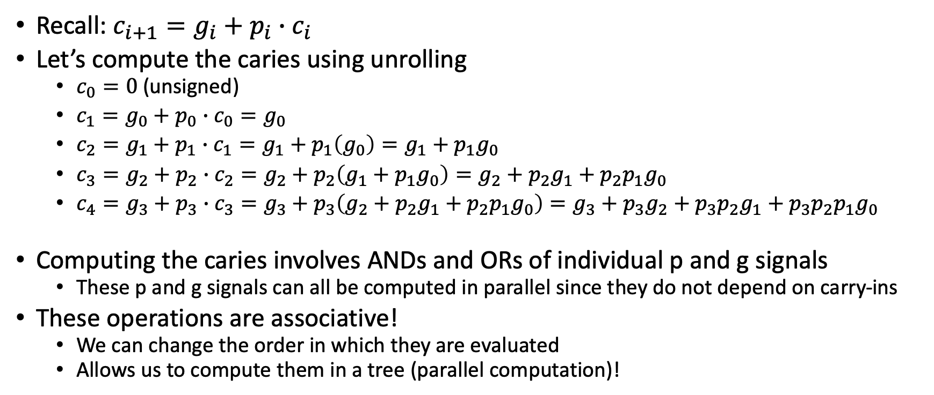
Unrolling the Carry-in

Slide 19
Parallel Prefix Trees
Similar to a reduction tree except that you want to keep the intermediate values
Intermediate values are re-used when computing
In our case, we could use a reduction tree to compute the last carry.
This would be of limited use to us because we need all of the intermediate carry bits that would be computed as part of the reduction tree
Parallel prefix trees give us these intermediate values!
Work on operators that are associative

Slide 20
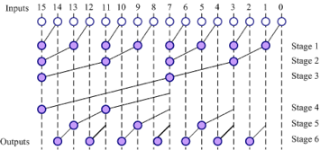
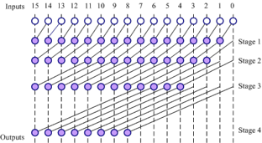
Different Parallel Prefix Trees
There is a tradeoff in parallel prefix trees in how intermediate values are computed/reused
Note that both of these graphs produce the same outputs (the partial results)
Brent-Kung (Diagram from Lecture Slides)
Most reuse (minimal logic) but with a longer critical path
Kogge-Stone (Diagram from Lecture Slides) Requires more resources but has a shorter critical path.

Slide 21
Parallel Prefix Adder
The Parallel Prefix Tree Described Above is for computing the carry bits
We still need full adders to produce the p & g signals and to calculate the final sum
Modified full adders feed the parallel prefix tree with p and g values
Full adders receive the carry in from the parallel prefix tree to compute the sum bit

Slide 22
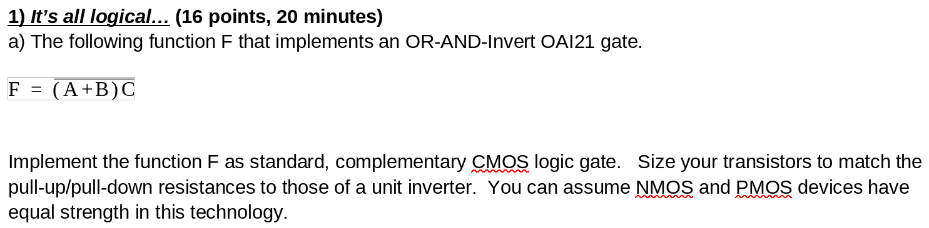
Midterm 2

Slide 23
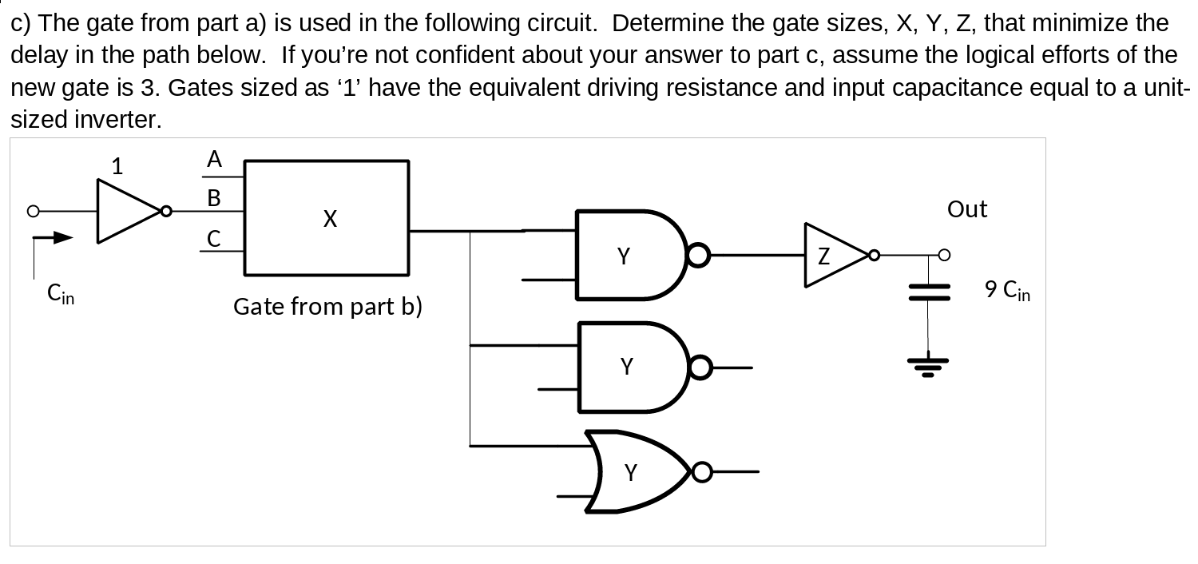
Midterm 2

Slide 24
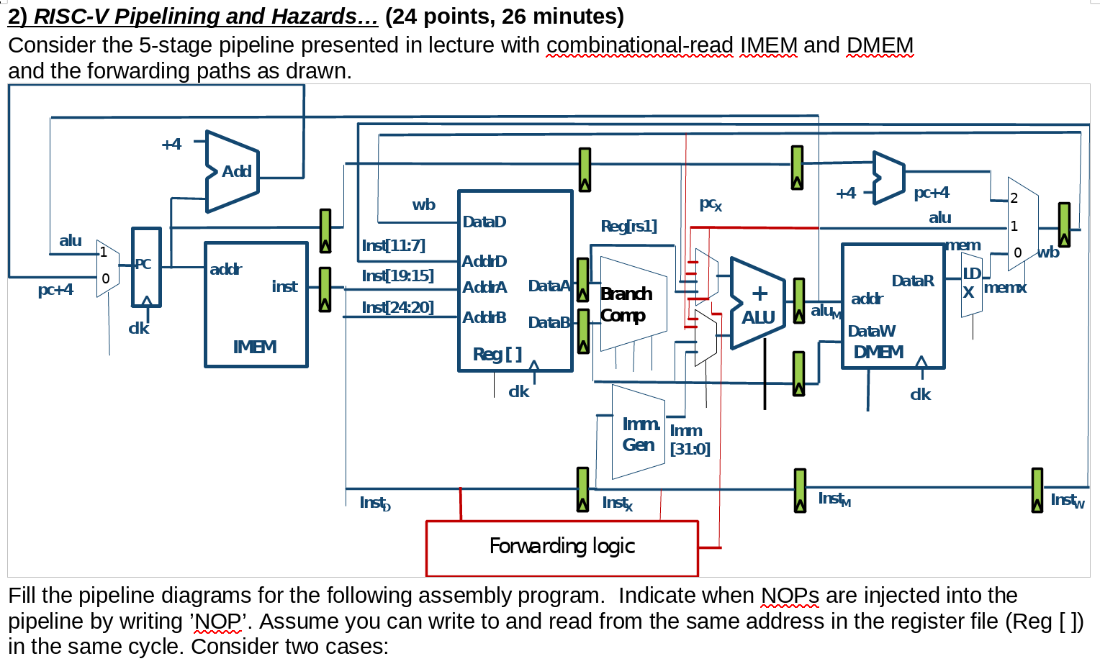
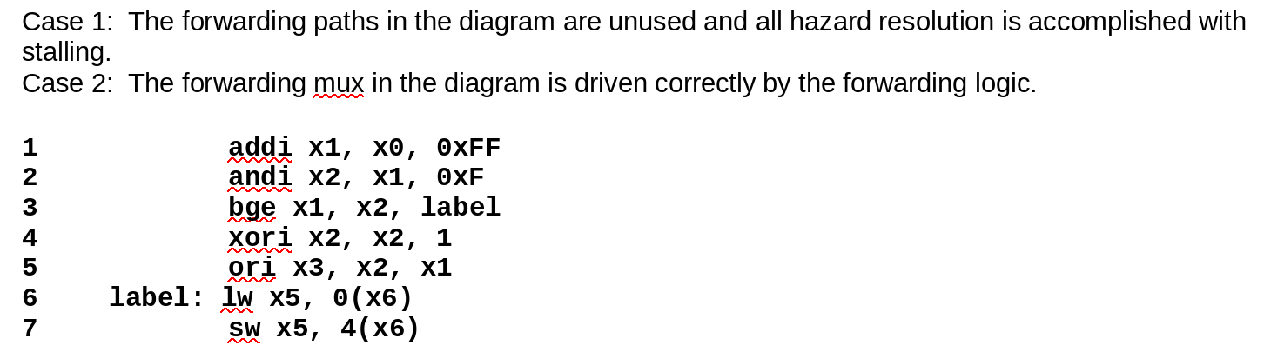
Midterm 2

Slide 25
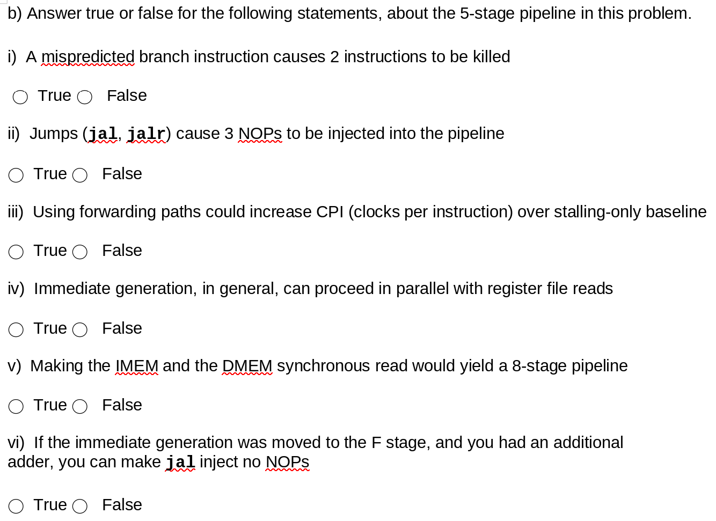
Midterm 2

Slide 26
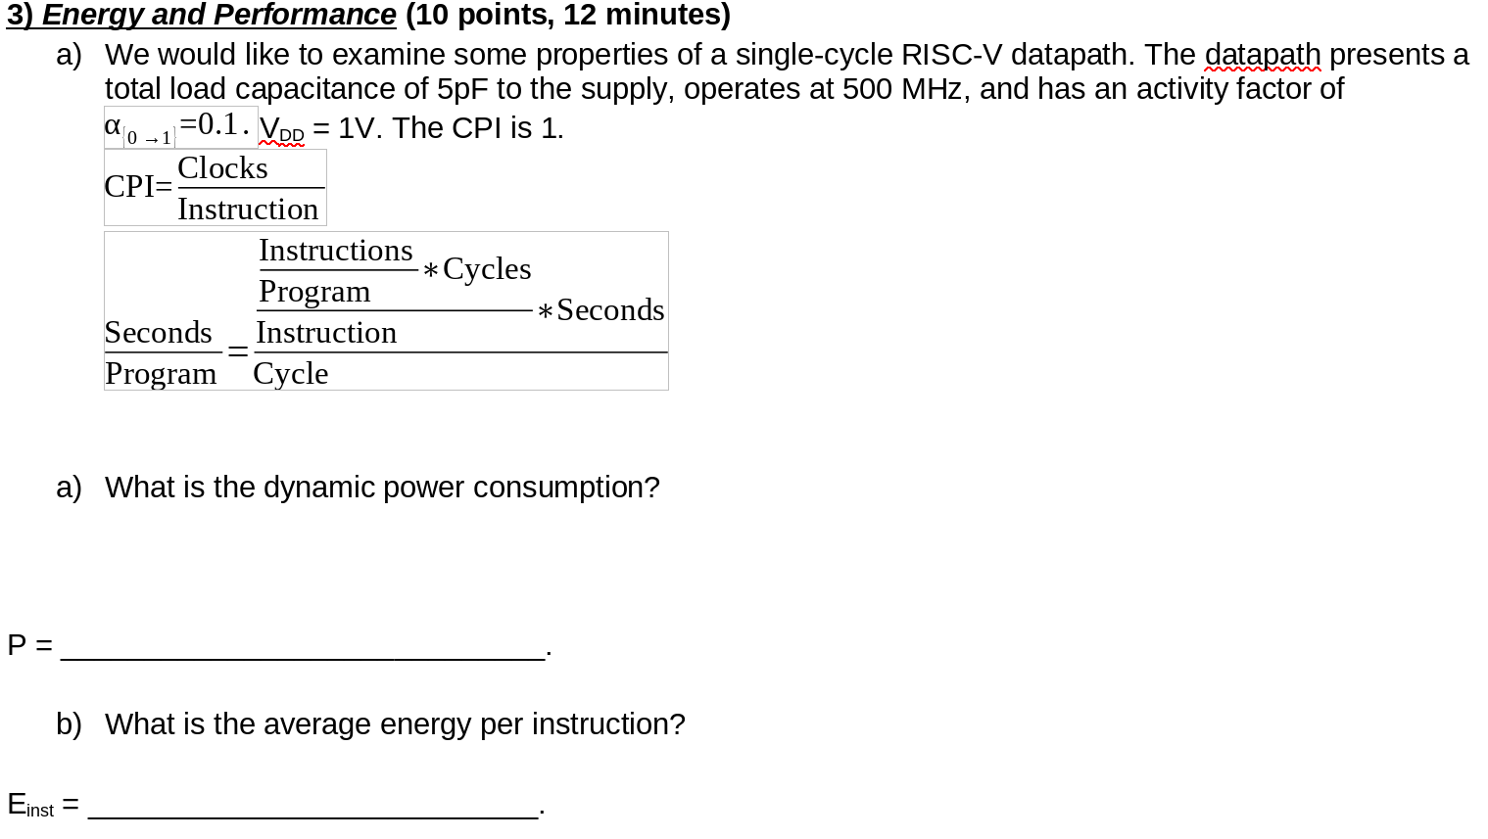
Midterm 2

Slide 27
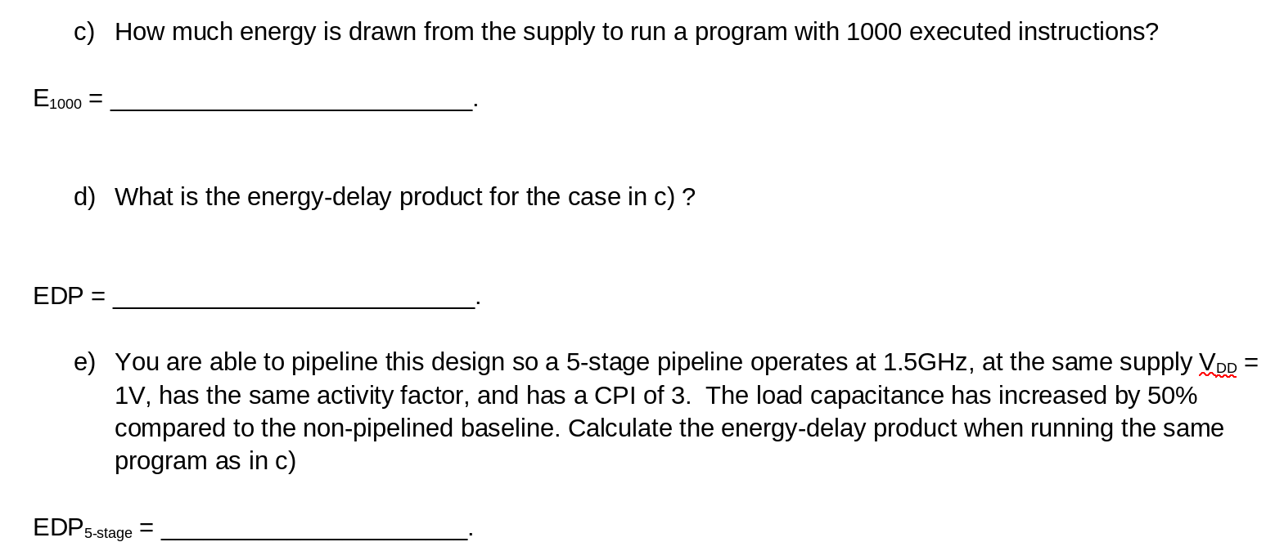
Midterm 2

Slide 28
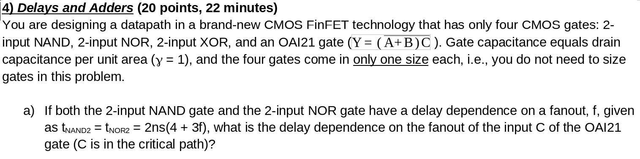
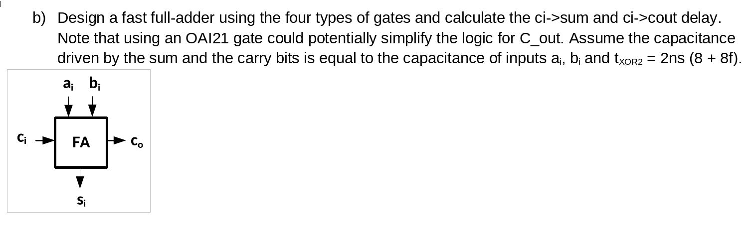
Midterm 2

Slide 29
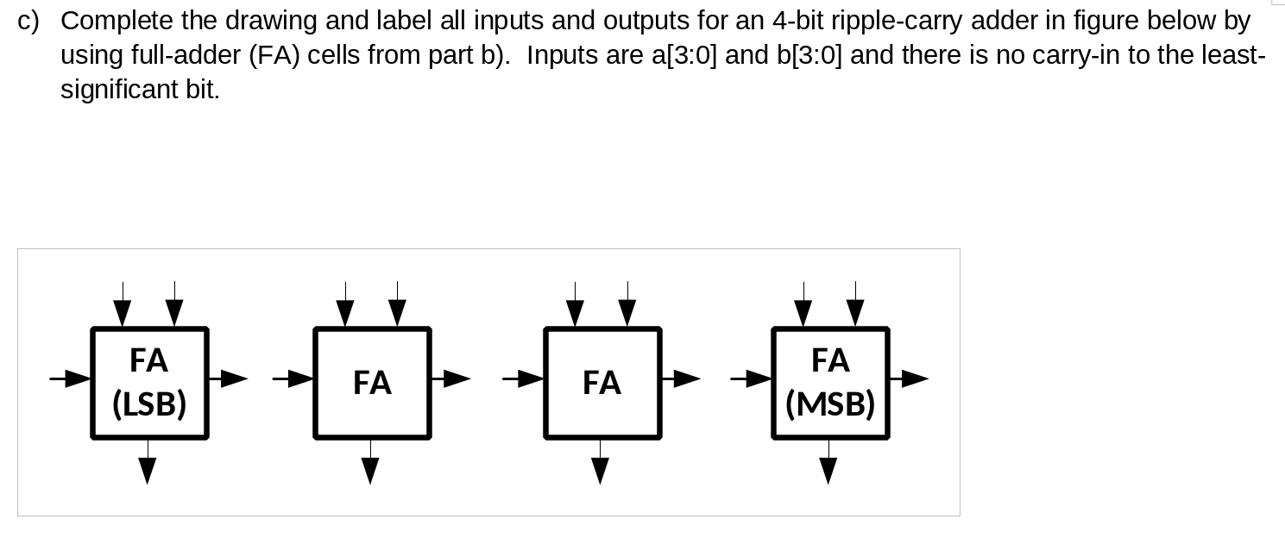
Midterm 2

Slide 30
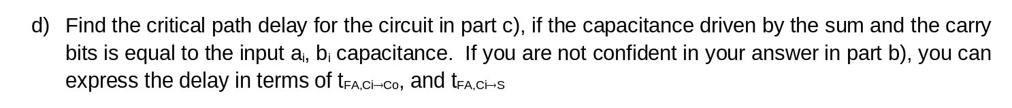
Midterm 2

