Slide 1
Discussion 12
Multipliers, Timing, FF/Latch Design, SRAMs
Sp19 Discussion 12 (multipliers): http://inst.eecs.berkeley.edu/~eecs151/sp19/files/discussion12.pdf

Slide 2
Unsigned Multiplication Example
4’b0011 (3)
* 4’b0110 (6)
4’b0011 (3)
* 4’b0110 (6)
-------
0000
0011
0011
+ 0000
---------
00010010 (18)
Partial Products can be generated in parallel
Let’s try to improve the addition of the partial products
Partial Products

Slide 3
Multipliers
Remember, the mechanics of multiplication in binary are generally the same as decimal multiplication (signed multiply requires a slight tweak).
2 Steps to Multiplication:
Generation of partial products
Adding partial products
Making faster multipliers mostly involves changing how we deal with generating and adding the partial products

Slide 4
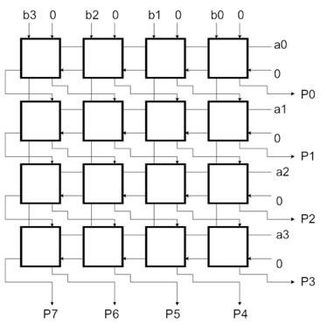
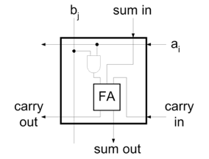
Accelerating the Addition of Partial Products
Let’s look at an (unsigned) array multiplier
The products can be computed in parallel but the carry chain when adding partial products is limiting the speed
How do we improve performance without having a large increase in hardware?
We could implement each adder as a parallel prefix or a carry-lookahead adder
However, remember that these adders require more logic than a simple carry ripple adder
Figures from Lecture Slides

Slide 5
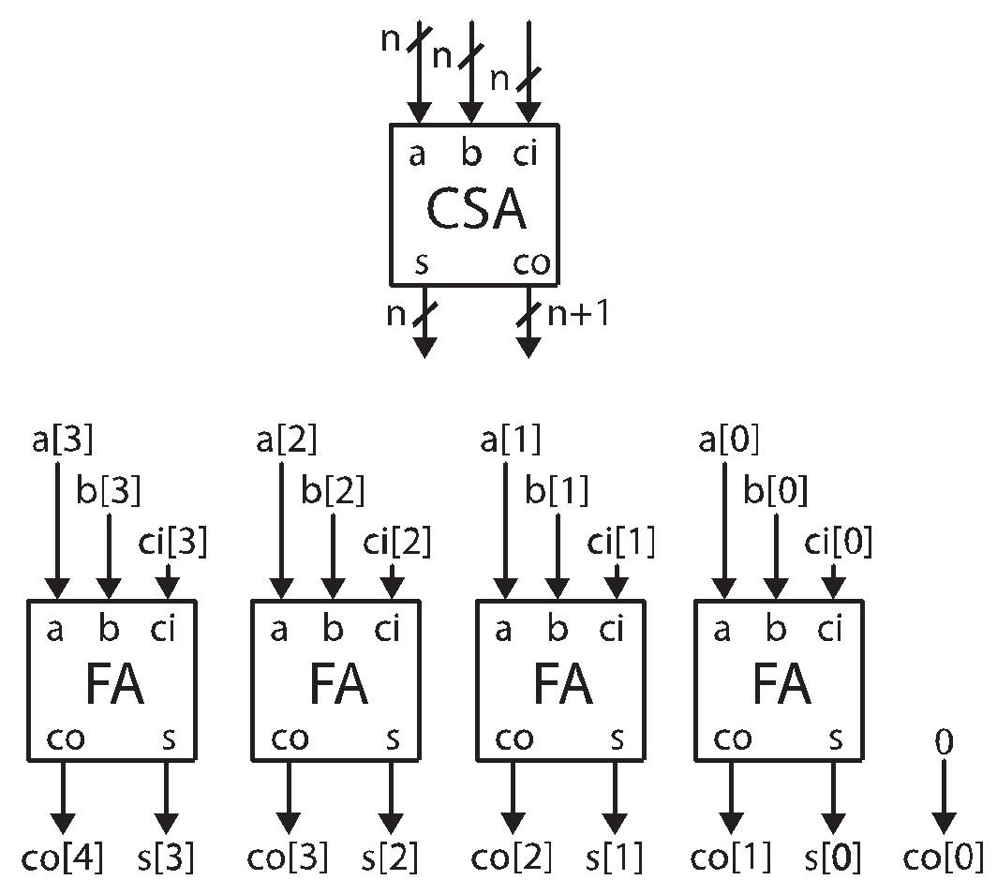
Carry Save Addition
When we generate a carry in a given column of an addition, we add it to the 2 values in the next column.
This addition may in turn generate its own carry
If adding carries is just like another addition, can we delay adding the carry bits until later?
Yes, so long as we remember what the carry bits need to be added
This is the basis of the carry save adder:
Takes in a, b, and carry_in (multi-bit)
Produces a sum and carry_out (multi-bit)

Slide 6
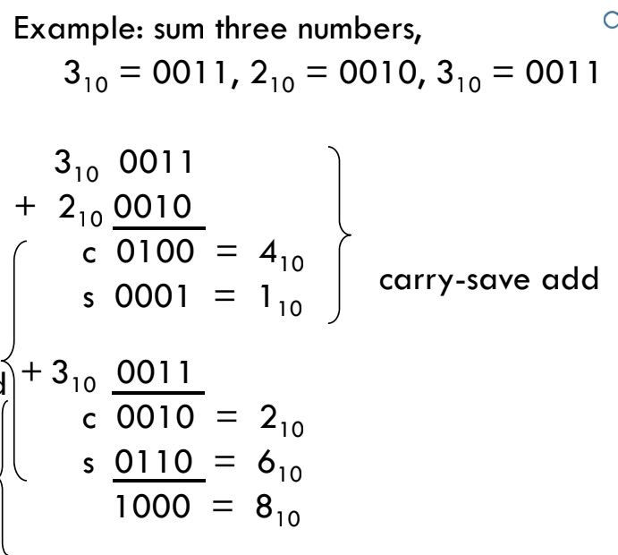
Carry Save Addition

Slide 7
Using Carry Save Addition
Using Carry Save Addition Allows us to create a multi-input adder that is:
Relatively fast: Carry Save Adders do not have a carry ripple
Relatively small: do not need the logic to handle the carry logic to create a fast adder
However, still need a standard adder at the end to add the final carry-out and sum.
This is one of the fast adders such as the Carry Lookahead or Parallel Prefix Adders
Good news! We only need one of them.

Slide 8
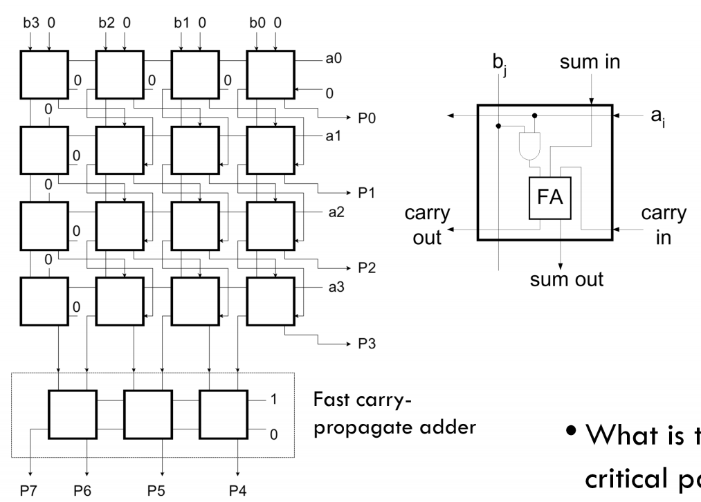
Using Carry Save Addition in Multipliers
Carry now propagates down each column.
Carry ripple across rows is eliminated in the array
Still need to handle carries at the end with a fast adder
Critical path now down a column + the carry-propagate adder delay

Slide 9
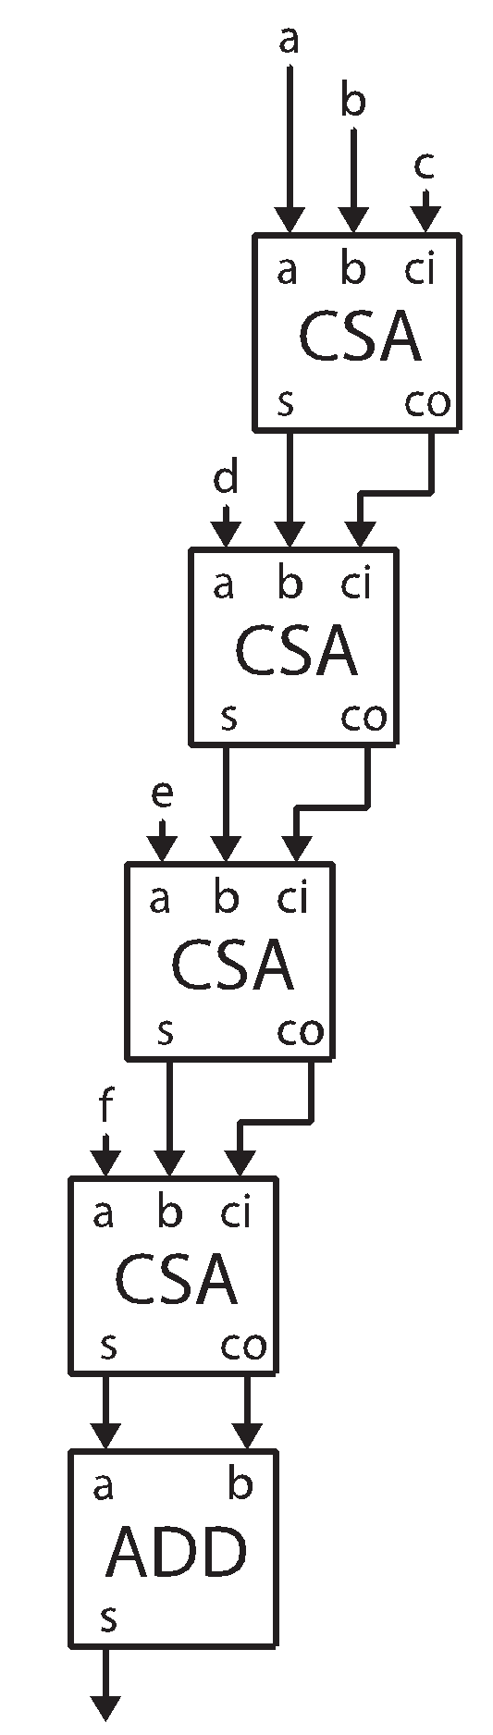
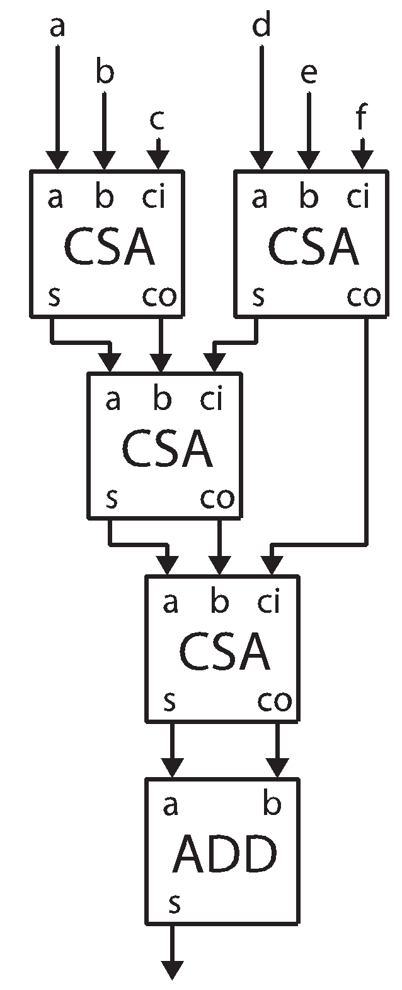
Using Carry Save Addition
Because addition is associative, it actually does not matter what order the carry bits are added back into the sum
Can use a tree structure

Slide 10
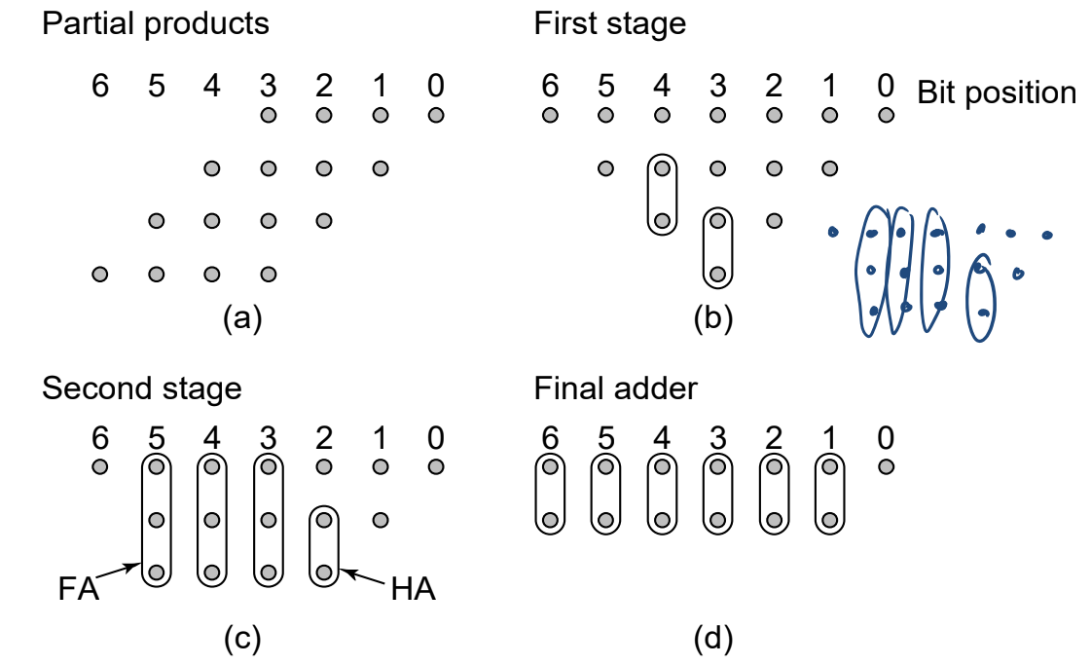
Wallace Tree Multiplier
Method to construct a Wallace Tree:
Draw a dot diagram where each column has as many dots as the number of partial products
Group dots in the same column by 2 (half adder) or 3 (full adder)
Propagate carries and sum by adding one dot in the grouped column and one dot in the next column

Slide 11
Radix and Multiplication
Binary arithmetic has some advantages
Partial product generation is just a series of AND gates (including sign extension)
However, there are also disadvantages
There is a partial product for each bit of the multiplier
That leads to a lot of partial products (a lot of additions)
Ex. 3*4
single partial product in base 10
4 partial products in base 2.
Why don’t we consider a larger radix?

Slide 12
Radix 4 Multiplication
Let’s consider 2 bits at a time
Halve the number of partial products we generate
Radix 4 multiplication A*B
Partial Product Shift By 2 bits each time
Recall: Multiplications by powers of 2 are left shifts
Can we use this property?
B Digit | Partial Product | Partial Product (Rewritten)
0 | 0*A | 0
1 | 1*A | A
2 | 2*A | 4*A - 2*A
3 | 3*A | 4*A - A

Slide 13
Booth Recoding
Uses radix 4 arithmetic
Modification: Partial Products for B==2 and B==3 can be separated into 4*A – {2, 1}A
4*A can be implemented as a shift to the left by 2
2*A can be implemented as a shift to the left by 1
Recall that we are doing radix 4 multiplication, we shift left by 2 positions for the next partial product
Therefore, any 4*A term can be handled in the next partial product!
To do this, the multiplier needs to look at 3 (rather than just 2) bits. The extra bit is the MSB of the previous
B Digit | Partial Product | Partial Product (Rewritten)
0 | 0*A | 0
1 | 1*A | A
2 | 2*A | 4*A - 2*A
3 | 3*A | 4*A - A

Slide 14
Booth Recoding
B_{i+1} | B_{i} | B_{i-1} | Action | Comment
0 | 0 | 0 | Add 0
0 | 0 | 1 | Add A | Includes +4*A from previous radix 4 digit = +A in this position due to left shift by 2
0 | 1 | 0 | Add A
0 | 1 | 1 | Add 2*A | Includes +4*A from previous round (+A in this position). *2 is implemented as a left shift by 1
1 | 0 | 0 | Sub 2*A | 4*A will be added in when handling next radix 4 digit. *2 is implemented as a left shift by 1
1 | 0 | 1 | Sub A | 4*A will be added in when handling next radix 4 digit. Includes +4*A from previous radix 4 digit (+A in this position)
1 | 1 | 0 | Sub A | 4*A will be added in when handling next radix 4 digit.
1 | 1 | 1 | Add 0 | 4*A will be added in when handling next radix 4 digit. Includes +4*A from previous radix 4 digit (+A in this position)
B Digit | Partial Product | Partial Product (Rewritten)
0 | 0*A | 0
1 | 1*A | A
2 | 2*A | 4*A - 2*A
3 | 3*A | 4*A - A

Slide 15
Booth Recoding Example (Unsigned)
Example: 6*4
B₋₁ = 0
4’b0110 (6)
* 4’b0111 (7)
-------
- 0110 ( Sub A)
+ 01100 (Add 2A)
+ 0000 ( Add 0)
---------
+ 11111010 ( Sub A)
+ 01100 (Add 2A)
+ 0000 ( Add 0)
---------
(1)00101010 (42)
B_{i+1} | B_{i} | B_{i-1} | Action
0 | 0 | 0 | Add 0
0 | 0 | 1 | Add A
0 | 1 | 0 | Add A
0 | 1 | 1 | Add 2*A
1 | 0 | 0 | Sub 2*A
1 | 0 | 1 | Sub A
1 | 1 | 0 | Sub A
1 | 1 | 1 | Add 0

Slide 16
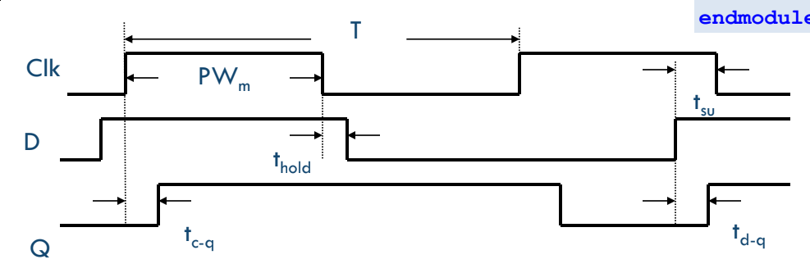
Latch Timing
A positive latch is transparent (q = d) when the clock is high and opaque (q = d, during negedge clock) when the clock is low
t_{d->q} is the delay from d to q when the latch is transparent
t_{clk->q} is the delay from the rising clock edge to the new value of d propagating to q

Slide 17
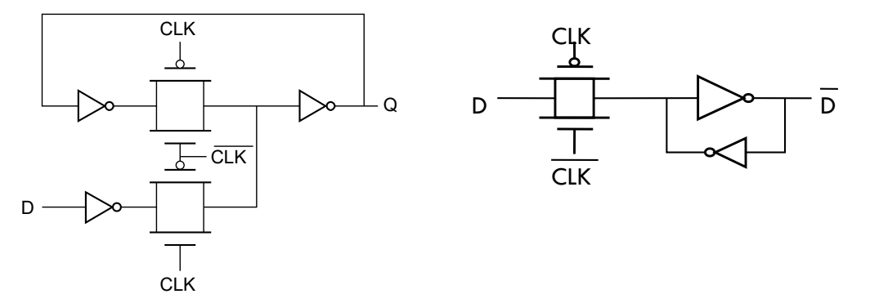
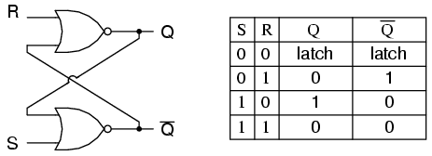
Latch Circuits
‘Feedback-breaking’ mux latch
Transparent high
‘State-forcing’ latch
Transparent low
SR latch
Common interview question

Slide 18
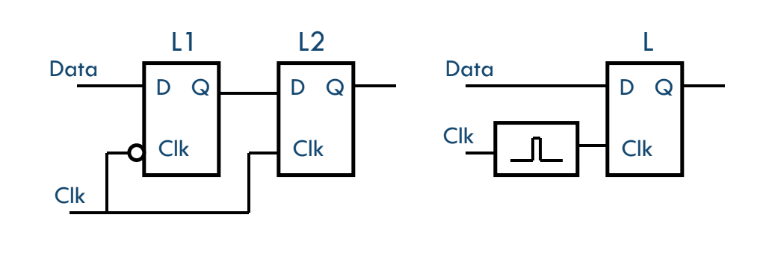
Building a Flip-Flop from Latches
Clock pulsed latch
Latch becomes transparent for a short time and holds the value it received on the pulse
Not common anymore, sometimes used in high performance circuits
Master-slave latches
Commonly used technique, go over timing diagram on board

Slide 19
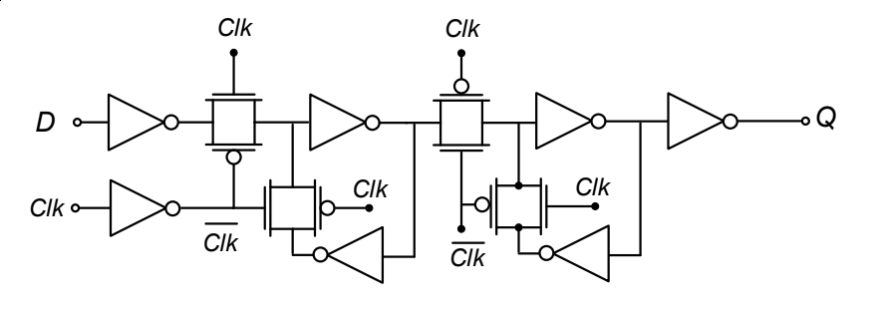
Flip-Flop Hold/Setup/clk->q Time
This is a negative edge flip-flop as drawn
We’ll consider the positive edge case
Hold time = the amount of time after a clock edge that the data input needs to be stable for
Setup time = the amount of time before a clock edge that the data input needs to be stable to be properly latched internally
Clk-q time = delay from a clock edge to q being updated with the new value

Slide 20
Path Timing Constraints (Hold + Setup)
Setup constraint: T_{clk} > t_{clk->q} + t_{logic,max} + t_{setup}
Hold constraint: t_{hold} < t_{clk->q} + t_{logic,min}
Skew is the deterministic clock arrival time difference between 2 flops
Positive skew = receiving edge arrives later than nominal
Negative skew = receiving edge arrives earlier than nominal
Jitter is non-deterministic clock arrival differences
Can be treated like skew in timing calculations, assuming worst case jitter
New timing equations:
T_{clk} > t_{clk->q} + t_{logic,max} + t_{setup} - t_{skew}
Note positive skew can improve clock frequency
t_{hold} + t_{skew} < t_{clk->q} + t_{logic,min}
Note positive skew hurts hold margin

Slide 21
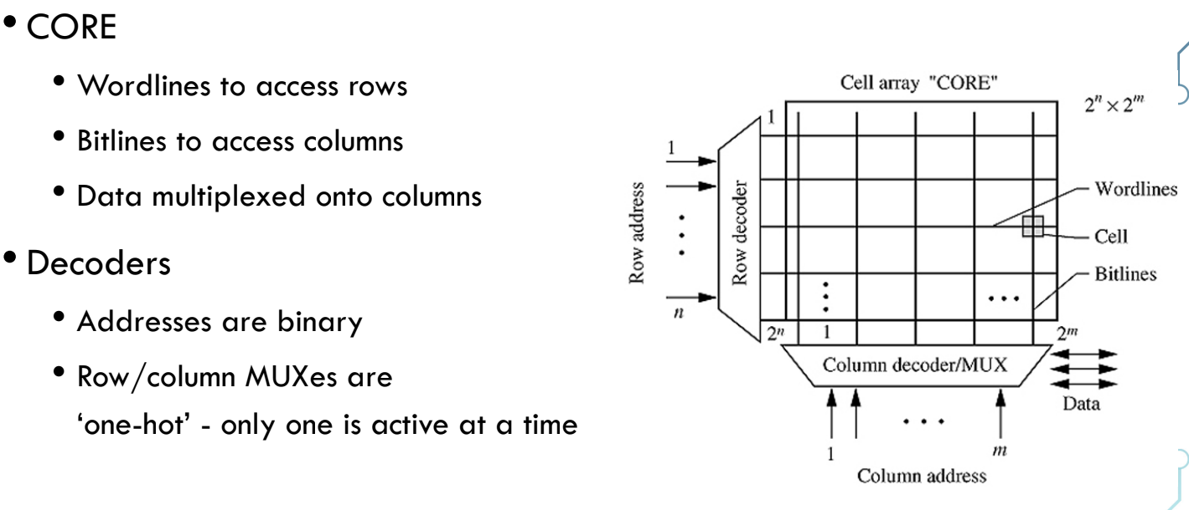
SRAM Architecture
SRAM cells arranged in a grid
Bitlines are shared across cells in a column, they are often long wires with a large capacitive load (connect to drains of access transistors)
Wordlines are shared across cells in a row, they connect to the gates of access transistors
Peripheral circuitry (bitline drivers, sense amp, decoders)

Slide 22
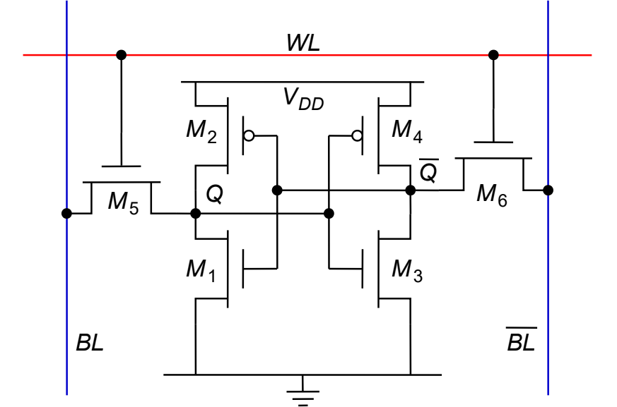
6T SRAM Cell
Inverters in positive feedback form the memory element
M5/M6 are the access transistors; they allow the bitlines to access the memory nodes (Q, Qbar) when WL = 1
Only 1 WL in an SRAM array is active at a time and it addresses an entire row of SRAM cells
Bitlines are controlled differently for read and write

Slide 23
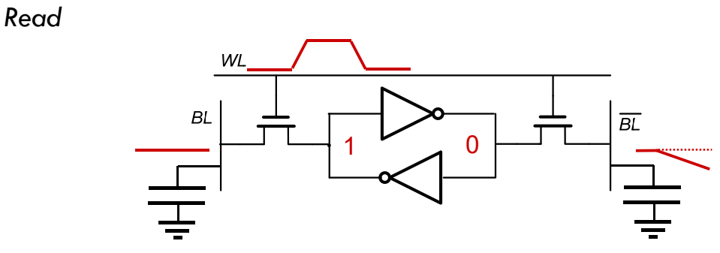
SRAM Read
1) precharge BL and BLbar to VDD, 2) raise WL, 3) sense dip on one bitline with sense amp, 4) lower WL, 5) discharge bitlines
Read stability = reading doesn’t corrupt the value stored in Q and Qbar
The pass transistor shouldn’t overpower the node storing a ‘0’ and flip its state (consider voltage divider from bitline to Q)
We choose to make the NMOSes in the inverters stronger than the pass transistor = (Wn > Wpass) to prevent read corruption

Slide 24
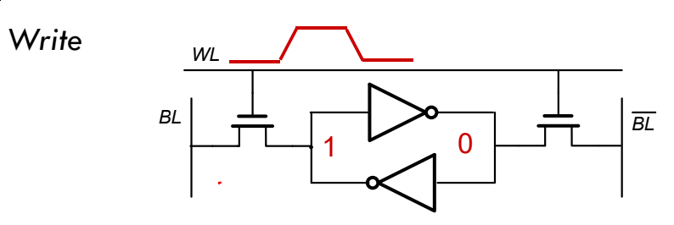
SRAM Write
1) drive BL and BLbar with new values, 2) raise WL, 3) wait some time (write time), 4) lower WL, 5) discharge bitlines
Write-ability = the cell’s memory value can be changed
requires the pass transistor overpower one of the data nodes
If we assume the cell is read stable, the inverter NMOS is stronger than the pass transistor. This means the node with ‘0’ can’t be overpowered => so we must overpower PMOS.
Pass transistor strength > PMOS pullup strength = (Wpass > Wp)
Voltage divider on ‘1’ node must be strong enough to cause inverters to switch

