Slide 1
Discussion 13
Timing, FF/Latch Design, SRAMs, Caches

Slide 2
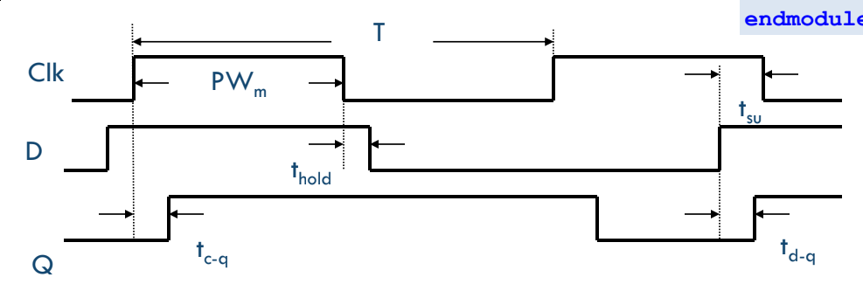
Latch Timing
A positive latch is transparent (q = d) when the clock is high and opaque (q = d, during negedge clock) when the clock is low
t_{d->q} is the delay from d to q when the latch is transparent
t_{clk->q} is the delay from the rising clock edge to d propagating to q

Slide 3
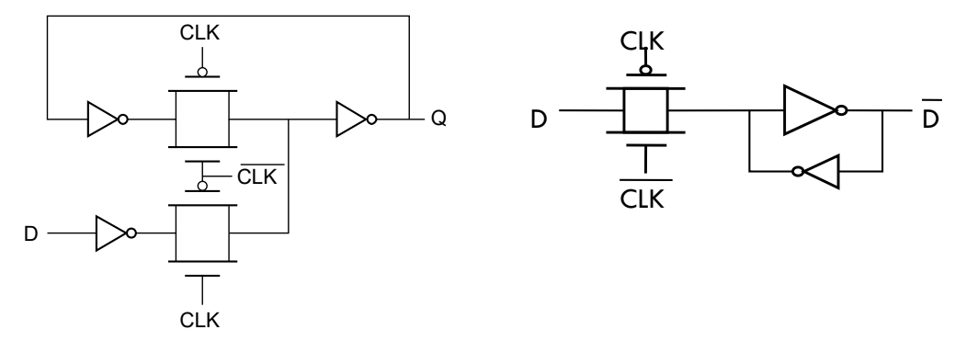
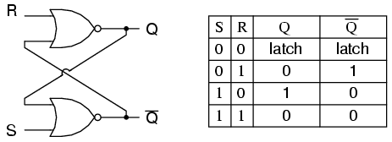
Latch Circuits
‘Feedback-breaking’ latch
Transparent high
‘State-forcing’ latch
Transparent low
SR latch
Common interview question

Slide 4
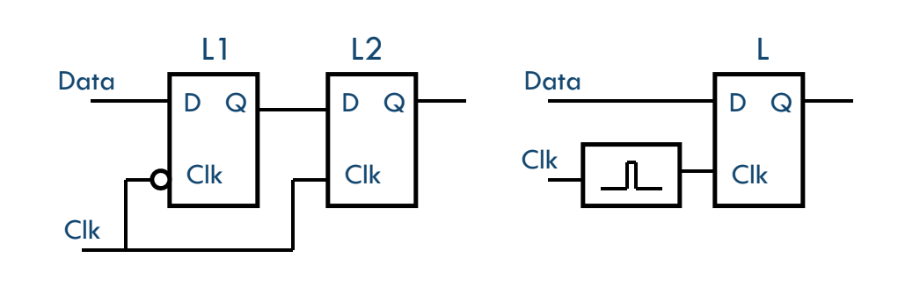
Building a Flip-Flop from Latches
Clock pulsed latch
Latch becomes transparent for a short time and holds the value it received on the pulse
Not common anymore, sometimes used in high performance circuits
Positive hold time
Master-slave latches
Commonly used technique. L2 holds output data stable when clock is high. L2
Negative hold time

Slide 5
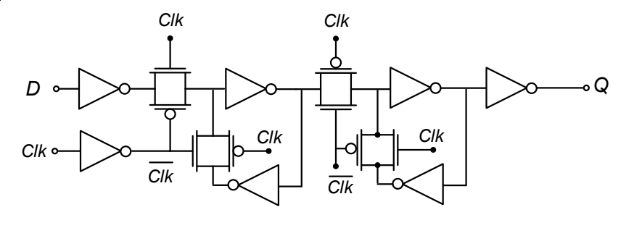
Flip-Flop Hold/Setup/clk->q Time
This is a negative edge flip-flop as drawn
We’ll consider the positive edge case
Hold time = the amount of time after a clock edge that the data input needs to be stable for (can be negative)
Setup time = the amount of time before a clock edge that the data input needs to be stable to be properly latched internally
Clk-q time = delay from a clock edge to q being updated with the new value written

Slide 6
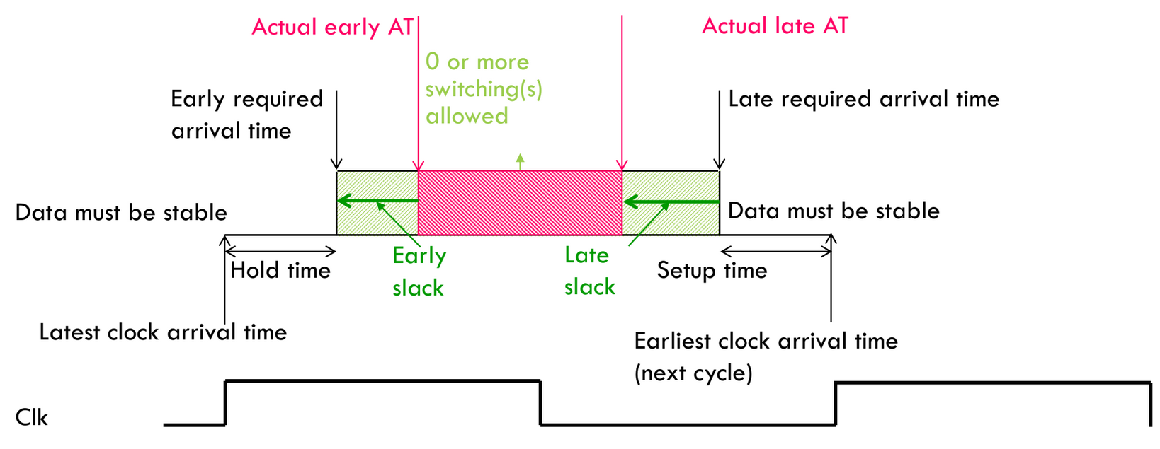
Path Timing Constraints
Setup constraint: T_{clk} > t_{clk->q} + t_{logic,max} + t_{setup}
The clock period must be greater than the delay of the critical path
Hold constraint: t_{hold} < t_{clk->q} + t_{logic,min}
The minimum logic delay must be greater than the hold time

Slide 7
False Paths
Be careful about finding the critical path by statically adding up delays
Some paths may not be exercised based on logic expressions
Here, the critical path is 300ns, not 400ns
a
200 ns
200 ns
0
1
0
1
c
b
100 ns
100 ns
s

Slide 8
Clock Skew
Setup constraint: T_{clk} > t_{clk->q} + t_{logic,max} + t_{setup}
Hold constraint: t_{hold} < t_{clk->q} + t_{logic,min}
Skew is the deterministic clock arrival time difference between 2 flops
Positive skew = receiving edge arrives later than nominal
Negative skew = receiving edge arrives earlier than nominal
New timing equations:
T_{clk} > t_{clk->q} + t_{logic,max} + t_{setup} - t_{skew}
Note positive skew can improve clock frequency
Negative skew hurts setup margin
t_{hold} + t_{skew} < t_{clk->q} + t_{logic,min}
Note positive skew hurts hold margin

Slide 9
Clock Jitter
Jitter is the non-deterministic difference in clock arrival times
Can be treated like skew in timing calculations
Assuming worst case jitter in the unfavorable direction for each timing calculation
Can lump the jitter of both the launching and receiving FFs into an equivalent skew

Slide 10
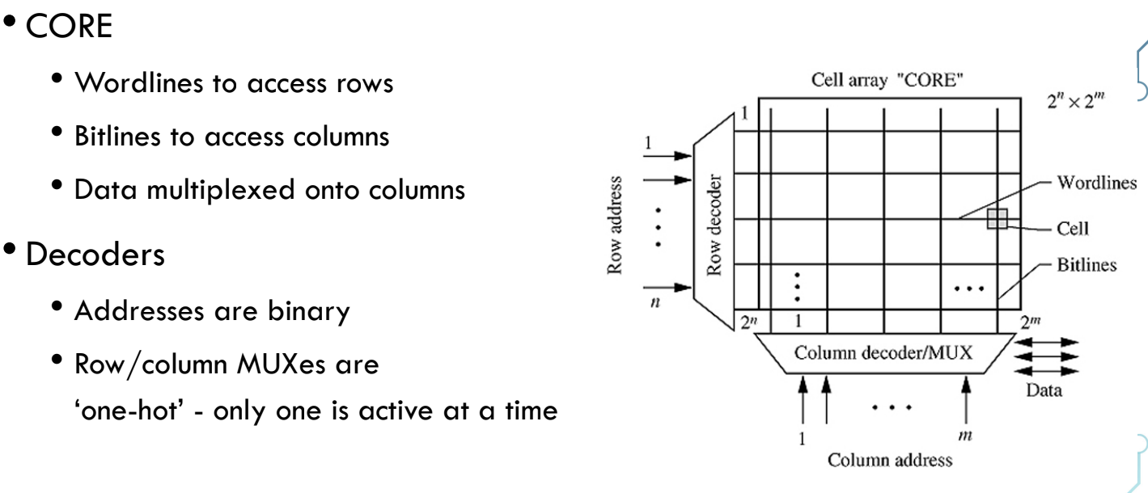
SRAM Architecture
SRAM bitcells arranged in a grid
Bitlines (vertical) are shared across cells in a column, they are often long wires with a large capacitive load (connect to drains of access transistors)
Wordlines (horizontal) are shared across cells in a row, they connect to the gates of access transistors
Peripheral circuitry (bitline drivers, sense amp, decoders)

Slide 11
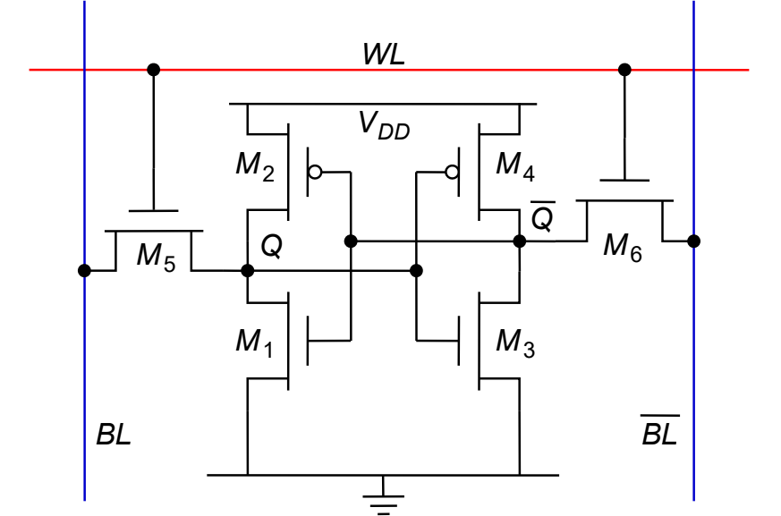
6T SRAM Cell
Inverters in positive feedback form the memory element (similar to a latch)
M5/M6 are the access transistors; they allow the bitlines to access the memory nodes (Q, Qbar) when WL = 1
Only 1 WL in an SRAM array is active at a time and it addresses an entire row of SRAM cells
Bitlines are controlled differently for read and write

Slide 12
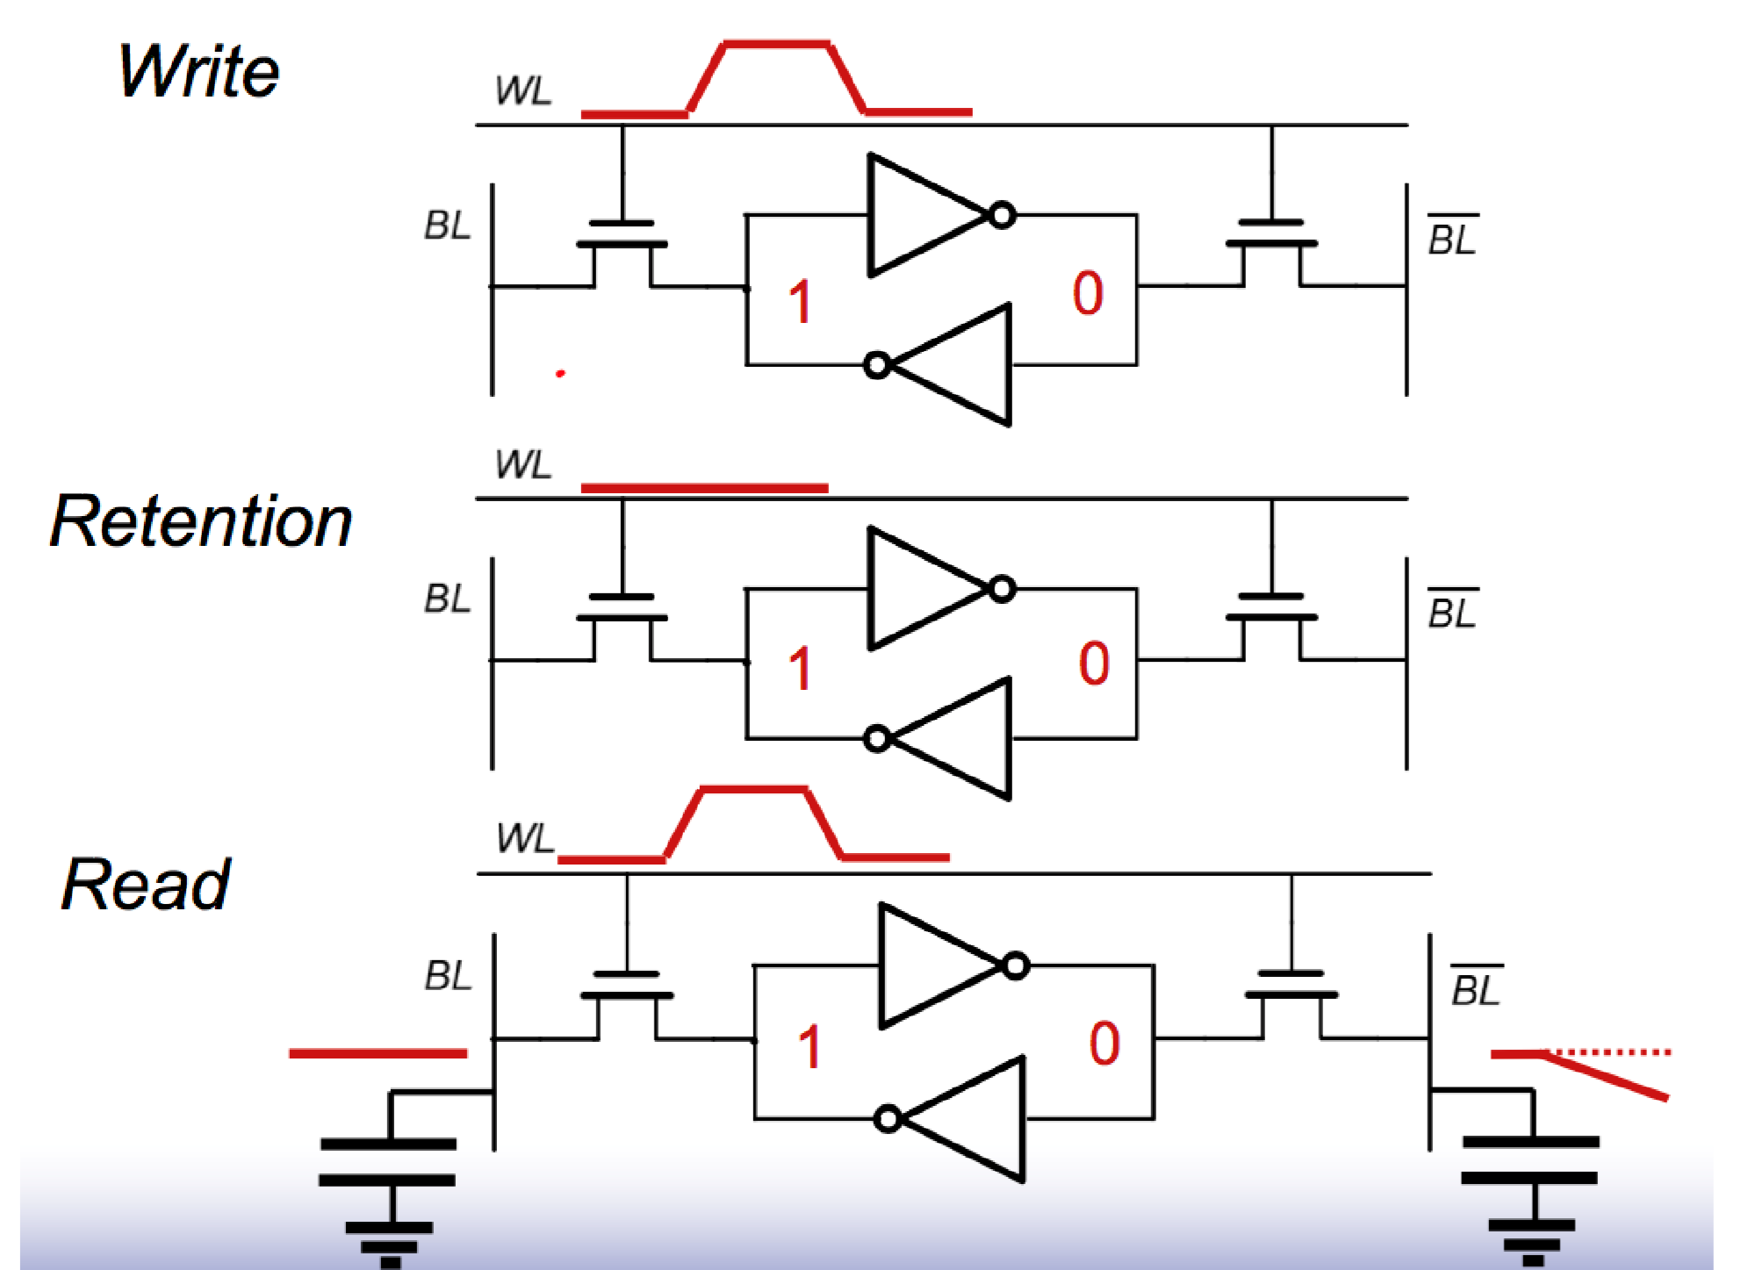
6T SRAM Cell - 3 Modes of Operation

Slide 13
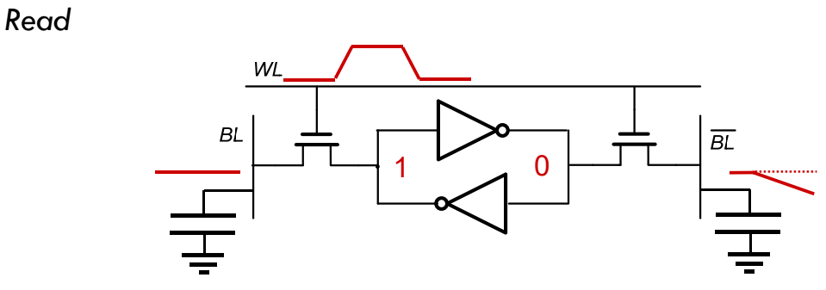
SRAM Read
1) precharge BL and BLbar to VDD, 2) raise WL, 3) sense dip on one bitline with sense amp, 4) lower WL, 5) discharge bitlines
Read stability = reading doesn’t corrupt the value stored in Q and Qbar
The pass transistor shouldn’t overpower the node storing a ‘0’ and flip its state (consider voltage divider from bitline to Q)
We choose to make the NMOSes in the inverters stronger than the pass transistor = (Wn > Wpass) to prevent read corruption

Slide 14
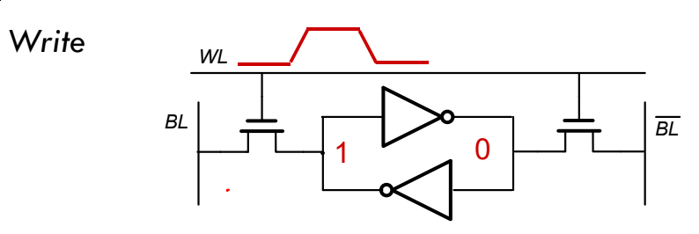
SRAM Write
1) drive BL and BLbar with new values, 2) raise WL, 3) wait some time (write time), 4) lower WL, 5) discharge bitlines
Write-ability = the cell’s memory value can be changed
requires the pass transistor overpower one of the data nodes
If we assume the cell is read stable, the inverter NMOS is stronger than the pass transistor. This means the node with ‘0’ can’t be overpowered => so we must overpower PMOS.
Pass transistor strength > PMOS pullup strength = (Wpass > Wp)
Voltage divider on ‘1’ node must be strong enough to cause inverters to switch

Slide 15
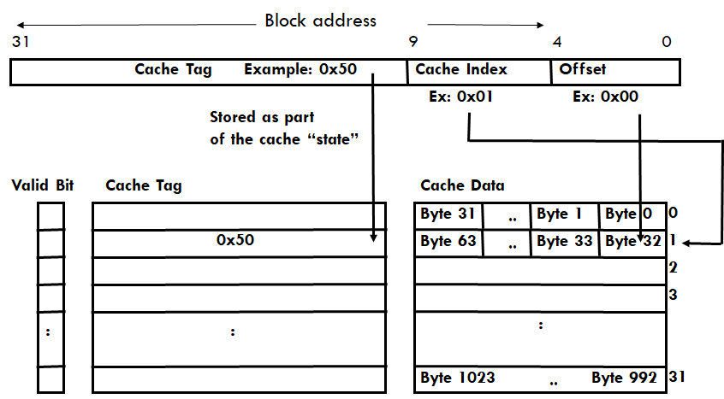
Caches - Direct Mapped

Slide 16
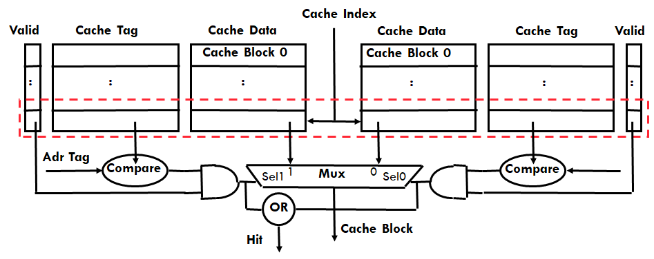
Caches - N-Way Set Associative

Slide 17
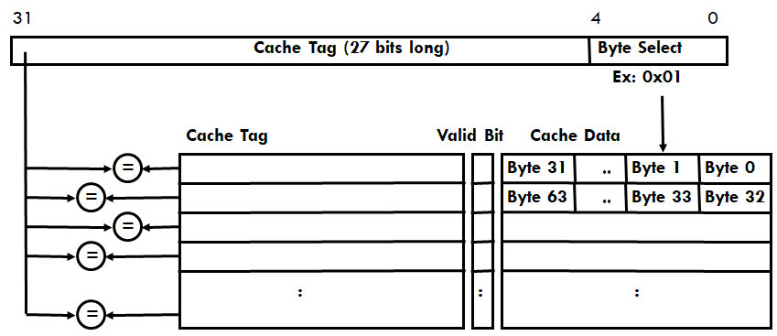
Caches - Fully Associative

