Slide 1
Discussion 14
Caches, FIFOs, DRAMs, Clocking,
Parallelism, Pipelining

Slide 2
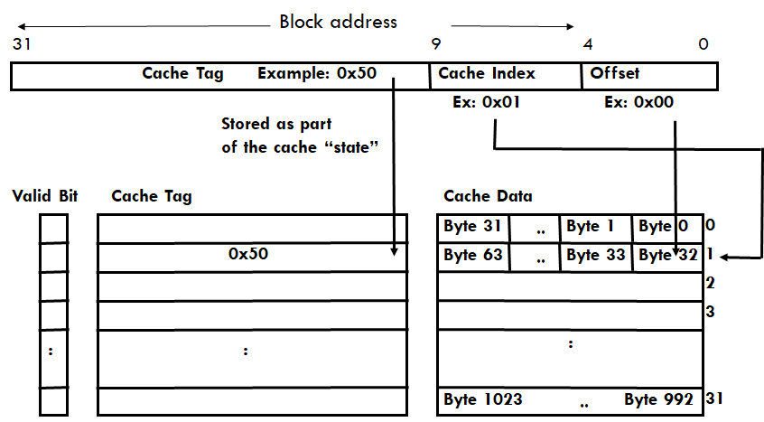
Caches - Direct Mapped

Slide 3
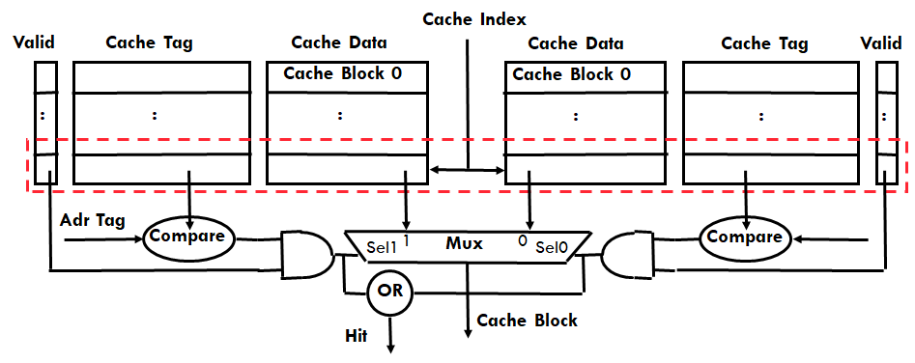
Caches - N-Way Set Associative

Slide 4
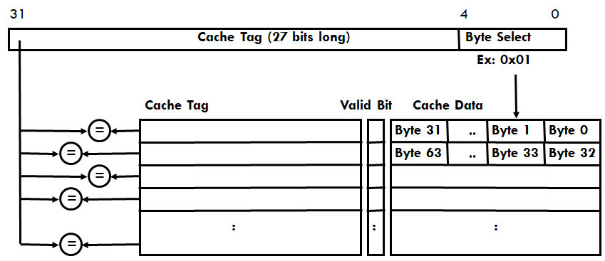
Caches - Fully Associative

Slide 5
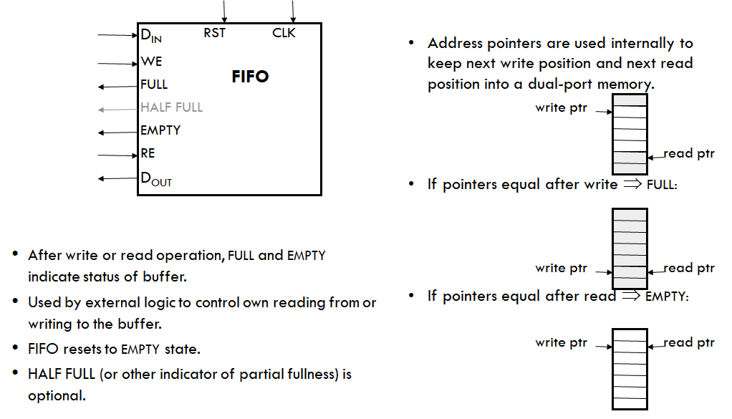
FIFO Interfaces

Slide 6
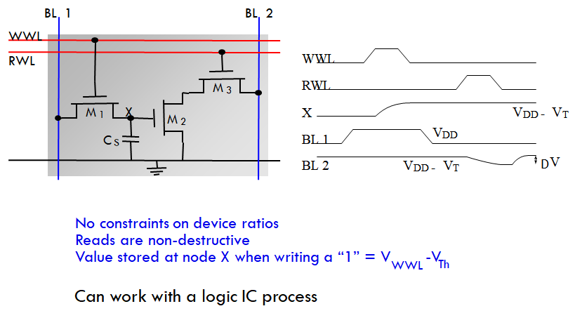
3T DRAM

Slide 7
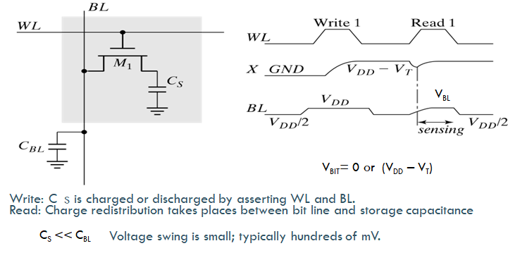
1T DRAM

Slide 8
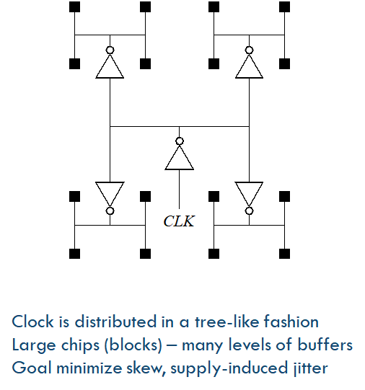
Clock Distribution

Slide 9
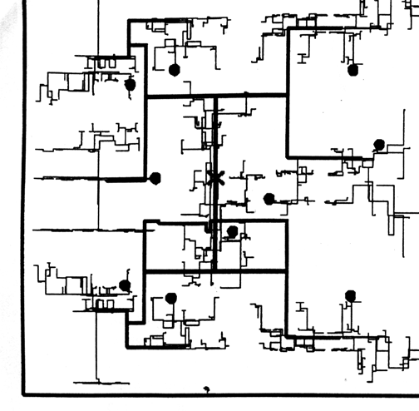
Clock Distribution

Slide 10
Parallelism

Slide 11
Pipelining

