Slide 1
Discussion 6
RISC-V instructions, Pipelining, and Hazards

Slide 2
RISC-V ISA
Branch instructions
beq, bne, blt, bge, bltu, bgeu
How many comparator units are required in the branch unit?
What’s the maximum branch jumping range?
+- 4 kiB
Branch immediate implicitly sets LSB to 0 (must be a multiple of 2 bytes). Why? Compressed ISA extension
How are branches resolved in a pipelined datapath?
Branch prediction and recovery/flushing on a mispredict
Bubble insertion / stalling

Slide 3
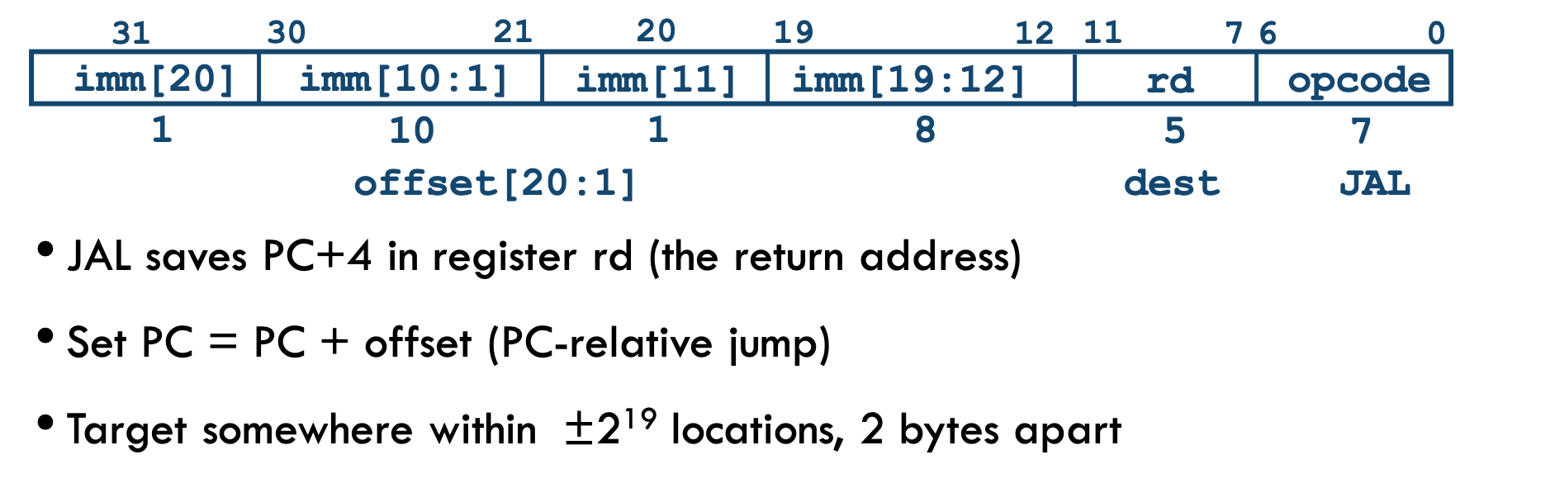
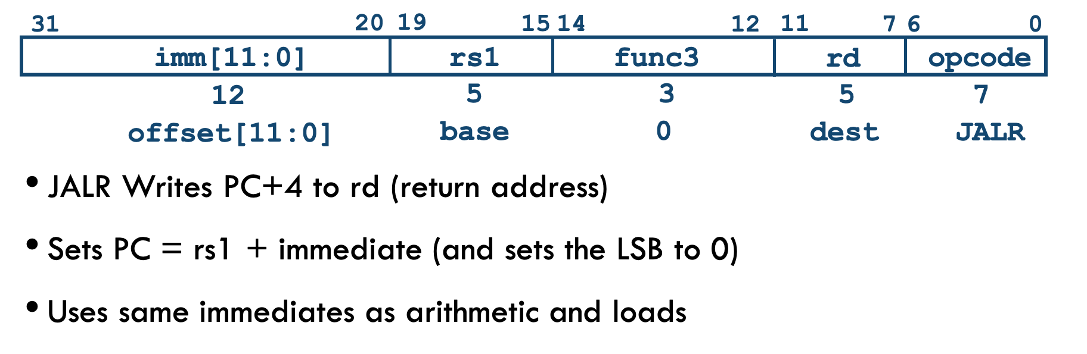
RISC-V ISA

Slide 4
RISC-V ISA
Jump instructions
JAL
Jump and link
Used commonly to jump within a +- 1 MiB range (PC relative)
Link = writeback of PC + 4, used to return from a function call
Plain unconditional jumps writeback to x0
JALR
Jump and link register
Used less frequently to jump to any address (non-PC relative)
LUI + JALR is a common combination to jump across large ranges
Can also be paired with AUIPC
What hazards are introduced by jumps in pipelined datapaths?

Slide 5
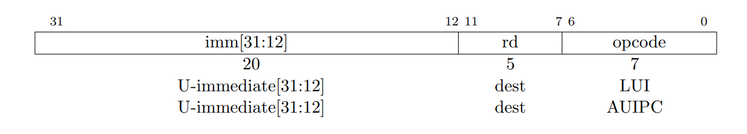
RISC-V ISA
Register load instructions, 20-bit U immediate
AUIPC
rd = PC + (imm<<12)
Can be used to fetch the current PC
LUI
rd = imm << 12

Slide 6
JAL example
0x0: li x1, 0
0x4: jal x2, 8
0x8: li x1, 100
0xc: li x3, 200
X1 = ?
X2 = ?
X3 = ?

Slide 7
JAL example
0x0: li x1, 0
0x4: jal x2, 8
0x8: li x1, 100
0xc: li x3, 200
X1 = 0
X2 = PC + 4 = 0x4 + 4 = 0x8
X3 = 200

Slide 8
JALR example
0x0: li x1, 4
0x4: jalr x2, x1, 8
0x8: li x3, 100
0xc: li x3, 200
X1 = ?
X2 = ?
X3 = ?

Slide 9
JALR example
0x0: li x1, 4
0x4: jalr x2, x1, 8
0x8: li x3, 100
0xc: li x3, 200
X1 = 4
X2 = PC + 4 = 0x4 + 4 = 0x8
X3 = 200

Slide 10
JALR example
0x0: nop
0x4: nop
0x8: nop
0xc: auipc x1, 0x8
X1 = PC + (0x8 << 12) = ?

Slide 11
JALR example
0x0: nop
0x4: nop
0x8: nop
0xc: auipc x1, 0x8
X1 = PC + (0x8 << 12) = 0xc + 0x8000 = 0x800c

Slide 12
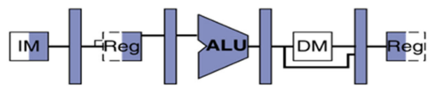
Pipelining

Slide 13
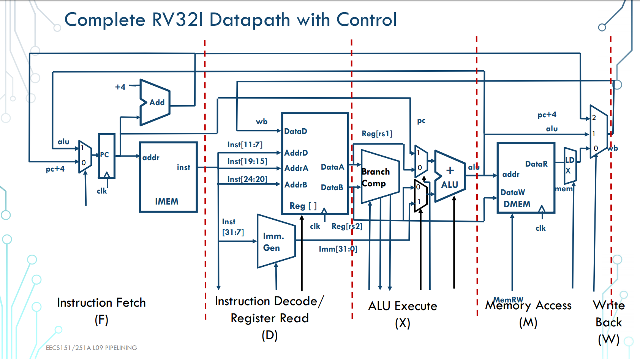

Slide 14
Pipeline flow diagram (cycle 1)
Assume x1, x2, x3 are initialized
i1. Add x6, x1, x2
i2. Add x7, x3, x3
i3. Sub x8, x1, x2
i4. And x8, x1, x3
i5. Lw x9, 40(x1)
i6. Sw x10, 20(x6)
1 | 2 | 3 | 4 | 5
F(i1) | D | Ex | Mem | Wb

Slide 15
Pipeline flow diagram (cycle 2)
Assume x1, x2, x3 are initialized
i1. Add x6, x1, x2
i2. Add x7, x3, x3
i3. Sub x8, x1, x2
i4. And x8, x1, x3
i5. Lw x9, 40(x1)
i6. Sw x10, 20(x6)
1 | 2 | 3 | 4 | 5
F(i1) | D(i1) | Ex | Mem | Wb
F(i2) | D | Ex | Mem | Wb

Slide 16
Pipeline flow diagram (cycle 3)
Assume x1, x2, x3 are initialized
i1. Add x6, x1, x2
i2. Add x7, x3, x3
i3. Sub x8, x1, x2
i4. And x8, x1, x3
i5. Lw x9, 40(x1)
i6. Sw x10, 20(x6)
1 | 2 | 3 | 4 | 5
F(i1) | D(i1) | Ex(i1) | M | Wb
F(i2) | D(i2) | Ex | M | Wb
F(i3) | D | Ex | M | Wb

Slide 17
Pipeline flow diagram (cycle 4)
Assume x1, x2, x3 are initialized
i1. Add x6, x1, x2
i2. Add x7, x3, x3
i3. Sub x8, x1, x2
i4. And x8, x1, x3
i5. Lw x9, 40(x1)
i6. Sw x10, 20(x6)
1 | 2 | 3 | 4 | 5
F(i1) | D(i1) | Ex(i1) | M(i1) | Wb
F(i2) | D(i2) | Ex(i2) | M | Wb
F(i3) | D(i3) | Ex | M | Wb
F(i4) | D | Ex | M | Wb

Slide 18
Pipeline flow diagram (cycle 5)
Assume x1, x2, x3 are initialized
i1. Add x6, x1, x2
i2. Add x7, x3, x3
i3. Sub x8, x1, x2
i4. And x8, x1, x3
i5. Lw x9, 40(x1)
i6. Sw x10, 20(x6)
1 | 2 | 3 | 4 | 5
F(i1) | D(i1) | Ex(i1) | M(i1) | W(i1)
F(i2) | D(i2) | Ex(i2) | M(i2) | W
F(i3) | D(i3) | Ex(i3) | M | W
F(i4) | D(i4) | Ex | M | W
F(i5) | D | Ex | M | W

Slide 19
Pipeline flow diagram (cycle 6)
Assume x1, x2, x3 are initialized
i1. Add x6, x1, x2
i2. Add x7, x3, x3
i3. Sub x8, x1, x2
i4. And x8, x1, x3
i5. Lw x9, 40(x1)
i6. Sw x10, 20(x6)
DONE!
1 | 2 | 3 | 4 | 5 | 6
F(i1) | D(i1) | Ex(i1) | M(i1) | W(i1)
F(i2) | D(i2) | Ex(i2) | M(i2) | W(i2)
F(i3) | D(i3) | Ex(i3) | M(i3) | W
F(i4) | D(i4) | Ex(i4) | M | W
F(i5) | D(i5) | Ex | M | W
F(i6) | D | Ex | M | W

Slide 20
Pipeline flow diagram (cycle 6+)
Assume x1, x2, x3 are initialized
i1. Add x6, x1, x2
i2. Add x7, x3, x3
i3. Sub x8, x1, x2
i4. And x8, x1, x3
i5. Lw x9, 40(x1)
i6. Sw x10, 20(x6)
DONE!
1 | 2 | 3 | 4 | 5 | 6 | 7
ALSO DONE!
F(i1) | D(i1) | Ex(i1) | M(i1) | W(i1)
F(i2) | D(i2) | Ex(i2) | M(i2) | W(i2)
F(i3) | D(i3) | Ex(i3) | M(i3) | W(i3)
F(i4) | D(i4) | Ex(i4) | M(i4) | W
F(i5) | D(i5) | Ex(i5) | M | W
F(i6) | D(i6) | Ex | M | W
F(xx) | D | Ex | M | W
… .... etc... etc...

Slide 21
Pipeline flow diagram (round 2)
Assume x1, x2, x3 are initialized
i1. Add x6, x1, x2
i2. Add x7, x3, x3
i3. Sub x8, x6, x2
1 | 2 | 3 | 4 | 5
F(i1) | D | Ex | Mem | Wb

Slide 22
Pipeline flow diagram (round 2)
Assume x1, x2, x3 are initialized
i1. Add x6, x1, x2
i2. Add x7, x3, x3
i3. Sub x8, x6, x2
1 | 2 | 3 | 4 | 5
F(i1) | D | Ex | Mem | Wb
F(i2) | D(i2) | Ex(i2) | M(i2) | W(i2)
F(i3) | D(i3) | Ex(i3) | M(i3) | W(i3)
What happens here?

Slide 23
Pipeline flow diagram (round 2)
Assume x1, x2, x3 are initialized
i1. Add x6, x1, x2
i2. Add x7, x3, x3
i3. Sub x8, x6, x2
1 | 2 | 3 | 4 | 5
F(i1) | D | Ex | Mem | Wb
F(i2) | D(i2) | Ex(i2) | M(i2) | W(i2)
F(i3) | D(i3) | Ex(i3) | M(i3) | W(i3)
Pipelining leads to hazards
Data hazards (read after write)
ALU -> ALU dependency (add then add)
Memory -> ALU dependency (lw then add)
ALU -> Memory dependency (add then sw)
Memory -> Memory dependency (lw then sw)
Control hazards (jal, jalr, branch)

Slide 24
Hazards

Slide 25
Pipelining Hazards
A hazard is a situation that prevents starting the next instruction in the next clock cycle
3 Types:
Structural hazards
A required resource is busy
Data hazards
Data dependency between nearby instructions
Control hazards
Flow of execution depends on previous instruction (branches)
i1. Add x6, x1, x2
i2. Add x7, x3, x3
i3. Sub x8, x6, x2

Slide 26
Solving Hazards
Depends on type of hazard you want to solve
Add more hardware (duplicate ALUs, etc…)
Add more ports to memories (can read/write multiple values at a time!)
Add branch prediction to make educated guess about control flow!
Forward values as soon as they’re calculated (sometimes referred to as bypassing)
Stalling (a.k.a. adding bubbles a.k.a. interlocking)
Will always work but will cost performance

Slide 27
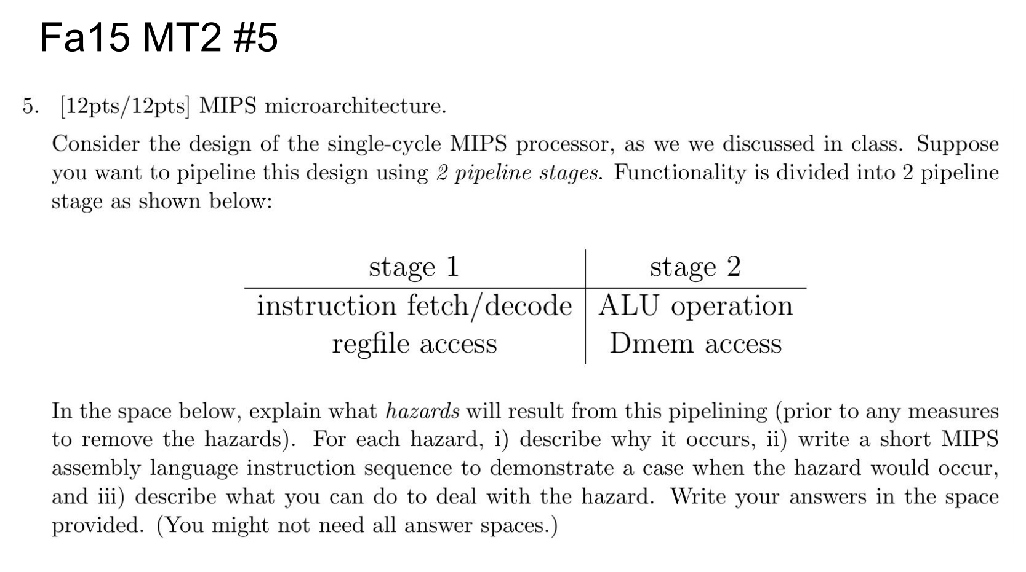

Slide 28
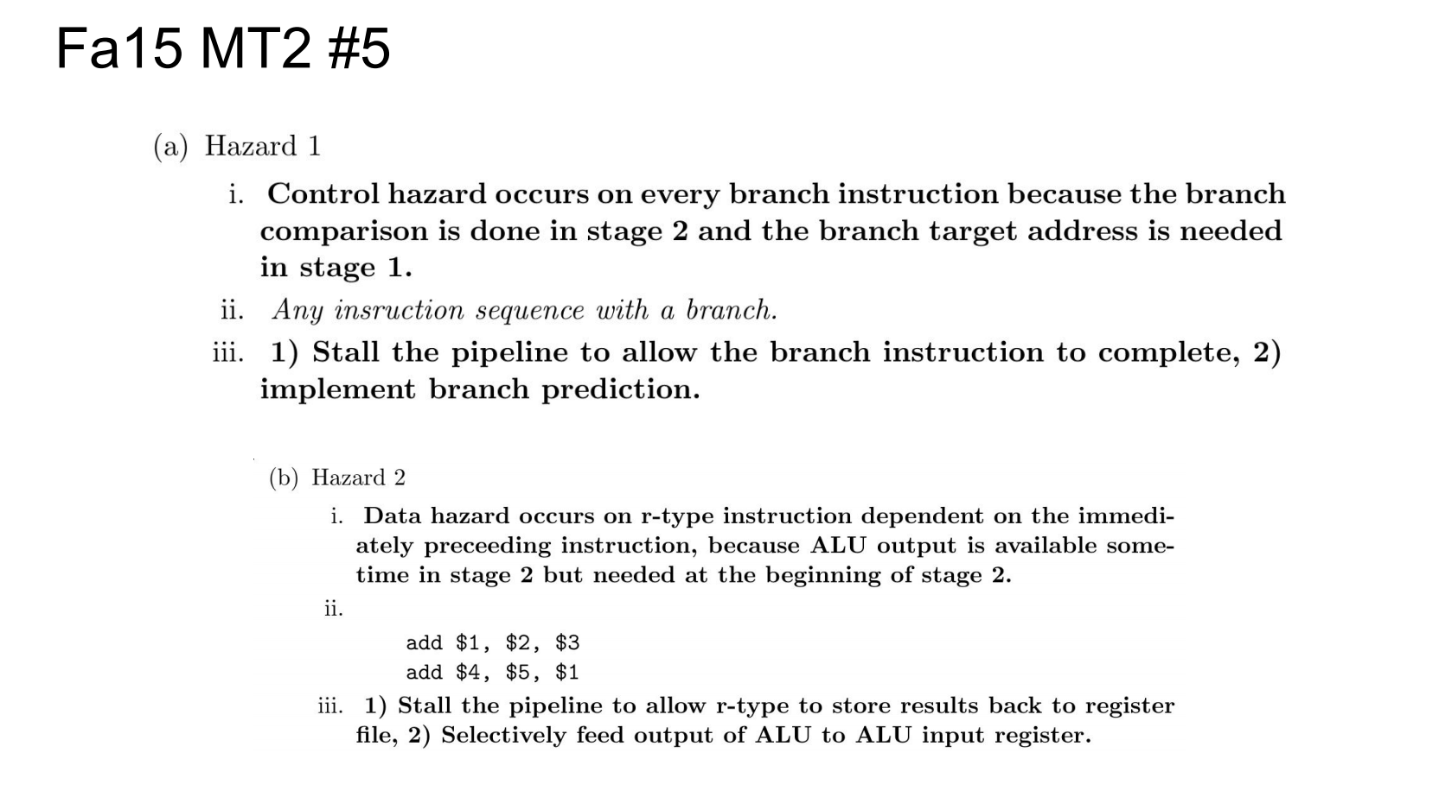

Slide 29
