Slide 1
Discussion 7
Pipelining, hazards and FPGA

Slide 2
Pipeline hazards
Structural Hazard
An instruction in the pipeline may need a resource being used by another instruction in the pipeline
Solution: Stalling newer instruction, or adding more hardware
Data Hazard:
An instruction may depend on a data value produced by an earlier instruction
Control Hazard (branches, exceptions)
An instruction may depend on the next instruction’s address

Slide 3
Structural hazard
Memory access
Register files have multiple ports (2 read, 1 write)
Separate instruction memory and data memory

Slide 4
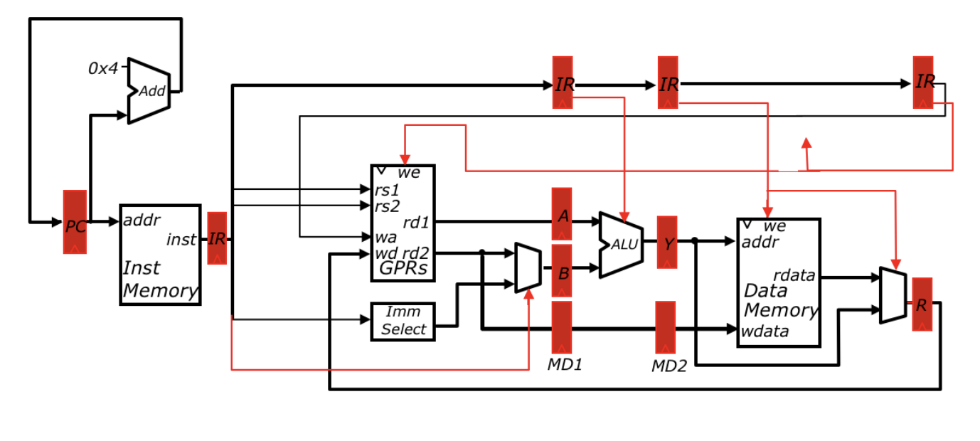
Data Hazard
x1 <- x0 + 10
x4 <- x1 + 3
x5 <- x1 + 5

Slide 5
Data Hazard
Time | x1 <- x0 + 10 | x4 <- x1 + 3 | x5 <- x1 + 5
t0 | IF
t1 | ID | IF
t2 | EX | ID | IF
t3 | MA | ? | ID
t4 | WB |  | ?
t5
t6
t7

Slide 6
Data Hazard: Stalling
Notes:
Draw the additional components on this slide

Slide 7
Data hazard: stalling
Time | x1 <- x0 + 10 | x4 <- x1 + 3 | x5 <- x1 + 5
t0 | IF
t1 | ID | IF
t2 | EX | ID | IF
t3 | MA | ID | IF
t4 | WB | ID | IF
t5 |  | EX | ID
t6 |  | MA | EX
t7 |  | WB | MA
Assume register file can be written and read at the same time

Slide 8
Data Hazard: forwarding
Notes:
Draw the forwarding diagram here

Slide 9
Data Hazard: forwarding
Time | x1 <- x0 + 10 | x4 <- x1 + 3 | x5 <- x1 + 5
t0 | IF
t1 | ID | IF
t2 | EX | ID | IF
t3 | MA | EX | ID
t4 | WB | MA | EX
t5 |  | WB | MA
t6 |  |  | WB
t7

Slide 10
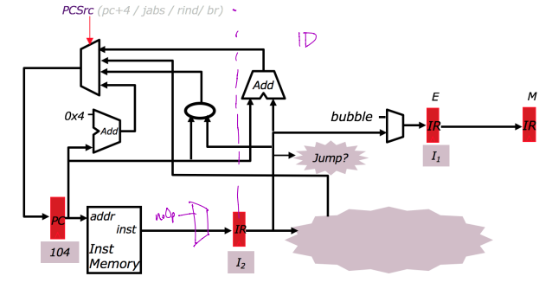
Control Hazard: jump
Example
096 ADD
100 J 304
104 ADD
……
304 ADD
Automatically fetched into pipeline, need to kill it

Slide 11
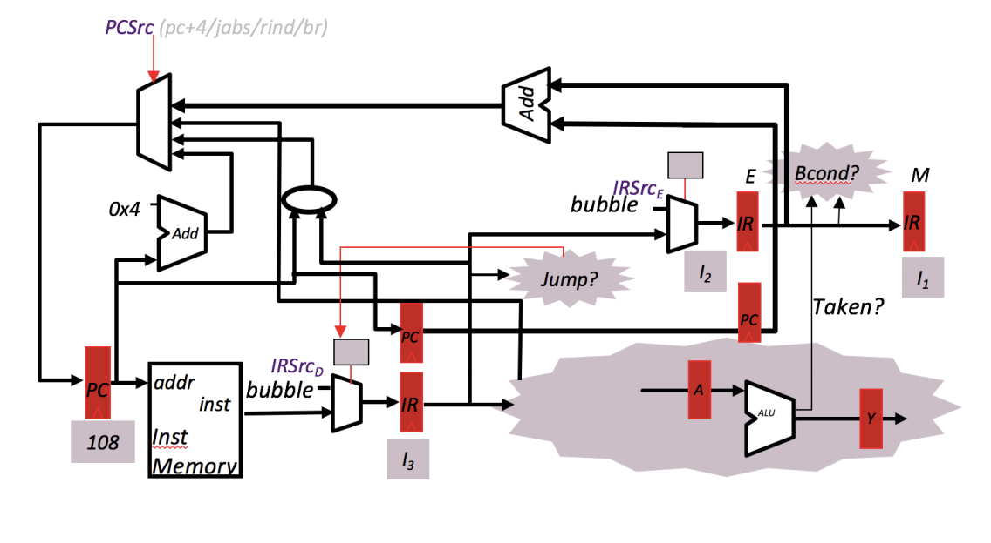
Control Hazard: conditional branch
Example
096 ADD
100 BEQ x1, x2, 200
104 ADD
108 ADD
112 ADD
Notes:
Assume pc+4 continues to execute. Then flush results if prediction was incorrect.

Slide 12
Example 1
Draw the datapath that would eliminate data hazards for a 3-stage pipeline

Slide 13
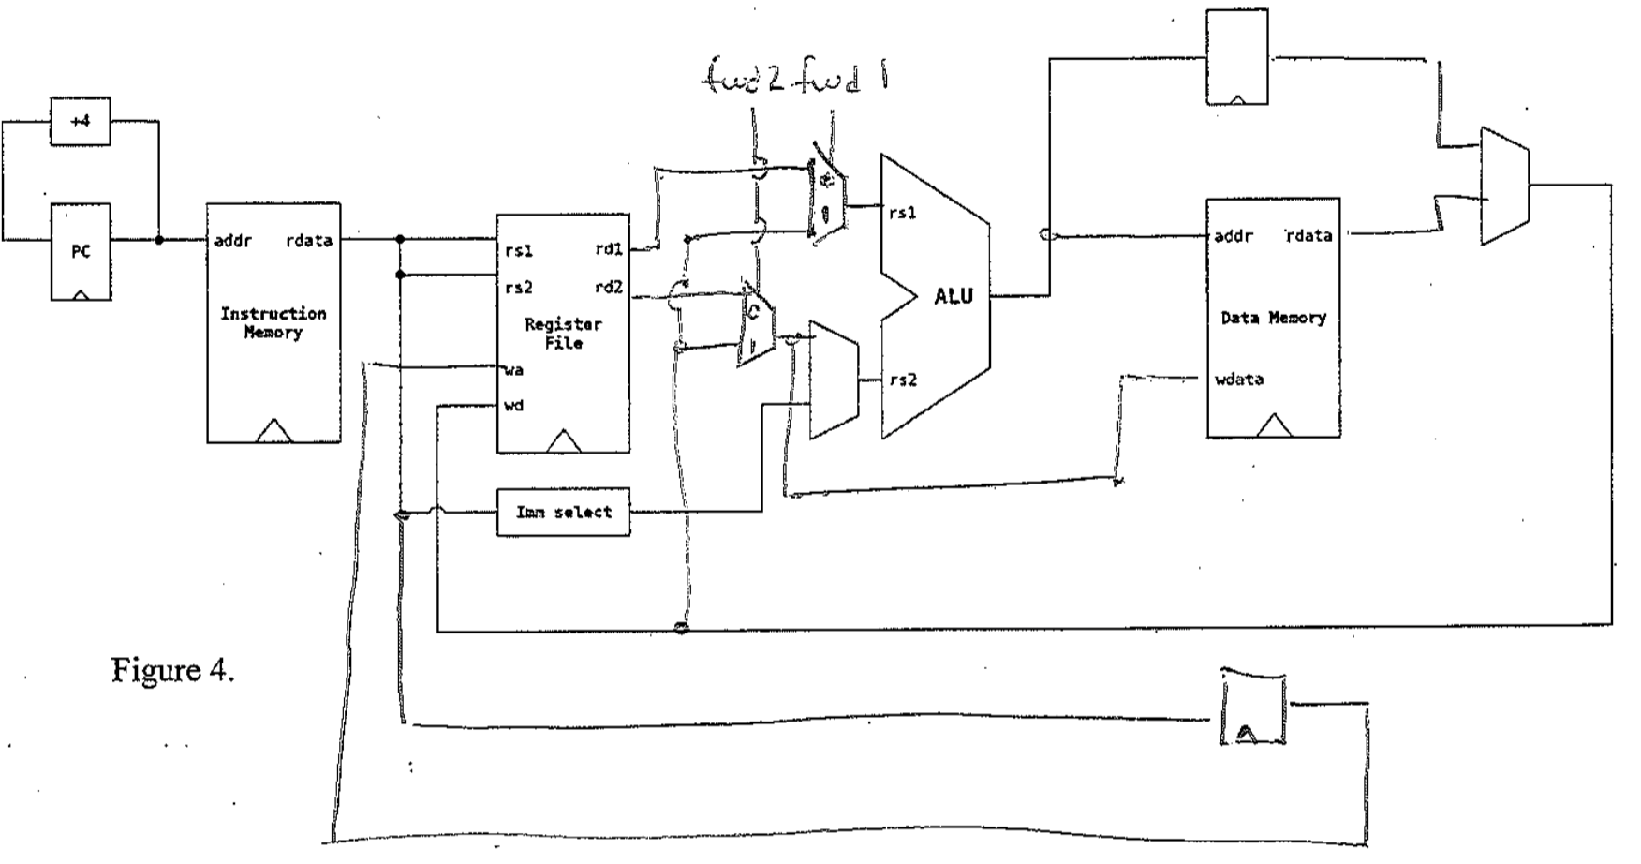
Example 1
Draw the datapath that would eliminate data hazards for a 3-stage pipeline

Slide 14
Example 1
2. Write verilog code to describe the control logic you drew above

Slide 15
Example 1
2. Write verilog code to describe the control logic you drew above
assign fwd1=(wa == rs1) && (wa != 0)
assign fwd2=(wa==rs2) && (wa != 0)

Slide 16
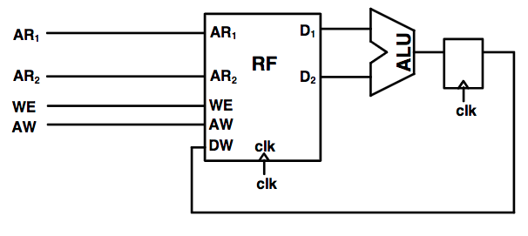
Example 2
Shown below is a portion of a prototype design for a pipelined CPU’s datapath that uses a register file with synchronous reads and writes. However, even ignoring any potential data hazards, this design does not function corretly - in particular, register type instructions. Explain what the error is caused by and add any extra components necessary to correct the design.

Slide 17
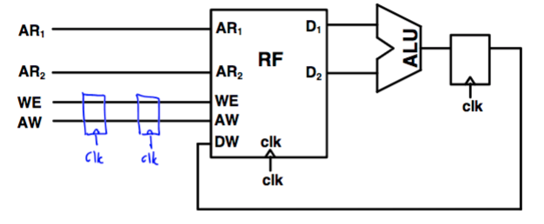
Example 2
Notes:
Problem is that it takes two more cycles for AR1/AR2 to propagate through the regfile and ALU (then back to the regfile) than it takes the WE/AW to be applied to the regfile.

Slide 18
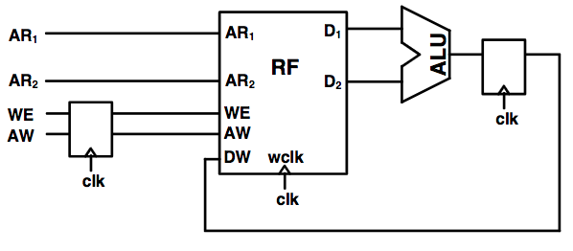
Example 2
Now this register file has synchronous writes with asynchronous reads. Add appropriate forwarding to eliminate all data hazards.

Slide 19
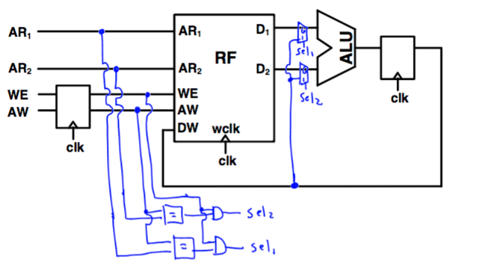
Example 2

Slide 20
LUT
LUT is short for “Look Up Table”
The number of rows in the table is 2^N where N = number of input bits
There is 1 row for every possible input combination
If you view the inputs as a single multiple bit wide wire, you can think of it as specifying an address in the LUT
The designer determines what the output will be for each row of the table

Slide 21
Implementing functions with LUTs
You can view the entries of an N-input LUT as being entries in a truth table for an N-input combinational logic block
Since the LUT contains a row for every possible combination of inputs, we can implement any combination function by specifying the output values for each row in the table.

Slide 22
What function is this?
This outputs 1 only when exactly 1 of A, B and C are true
A&(~B)&(~C) | (~A)&B&(~C) | (~A)&(~B)&C
 | C | B | A | Out
0 | 0 | 0 | 0 | 0
1 | 0 | 0 | 1 | 1
2 | 0 | 1 | 0 | 1
3 | 0 | 1 | 1 | 0
4 | 1 | 0 | 0 | 1
5 | 1 | 0 | 1 | 0
6 | 1 | 1 | 0 | 0
7 | 1 | 1 | 1 | 0

Slide 23
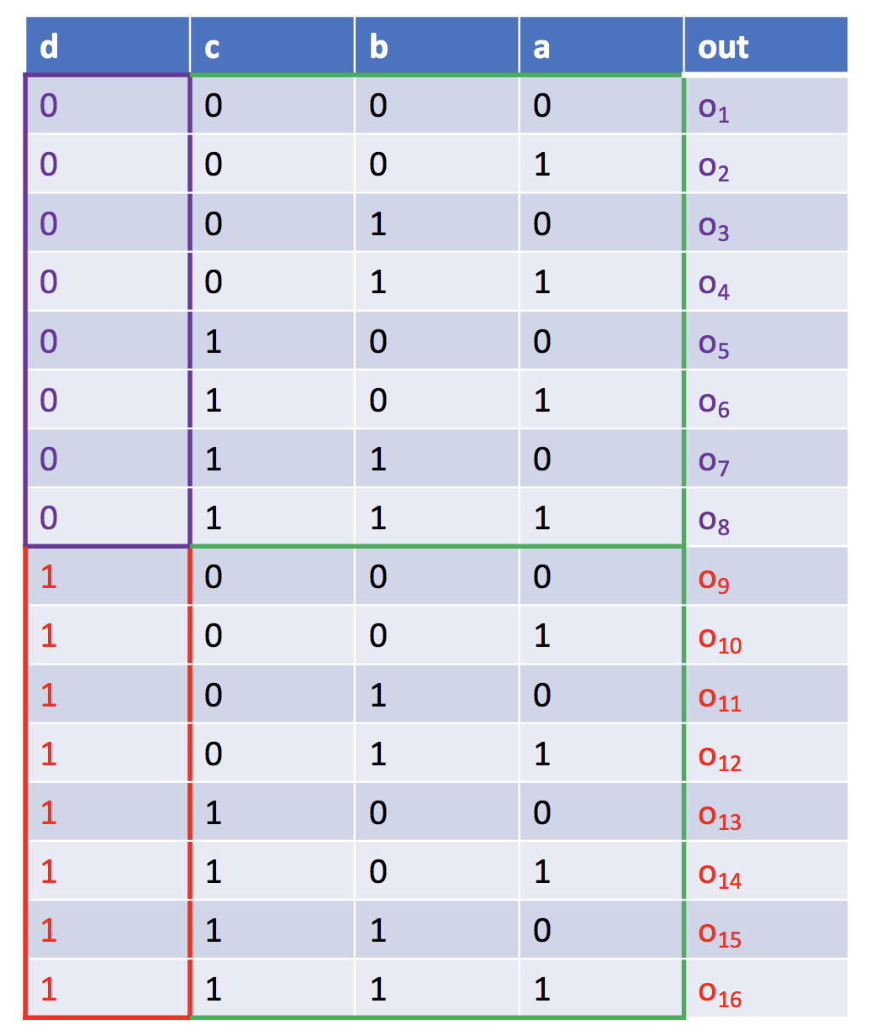
Building larger LUTs
The bottom half of the table looks like a repeat of the top half of the table except
The top half of the table is when d is 0, the bottom half is when d is 1
The top and bottom halves of the table have different outputs.

Slide 24
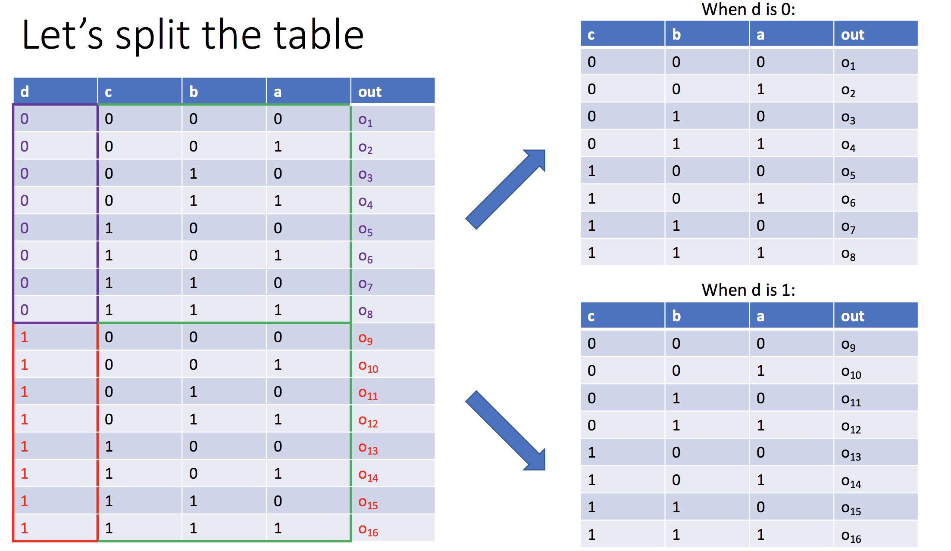

Slide 25
