Slide 1
Discussion 8
Pipeline Hazards, MOS Switch, CMOS Logic

Slide 2
Pipeline hazards
Structural Hazard
An instruction in the pipeline may need a resource being used by another instruction in the pipeline
Solution: Stalling newer instruction, or adding more hardware
Data Hazard:
An instruction may depend on a data value produced by an earlier instruction
Control Hazard (branches, exceptions)
An instruction may depend on the next instruction’s address

Slide 3
Structural hazard
Memory access
Register files have multiple ports (2 read, 1 write)
Separate instruction memory and data memory

Slide 4
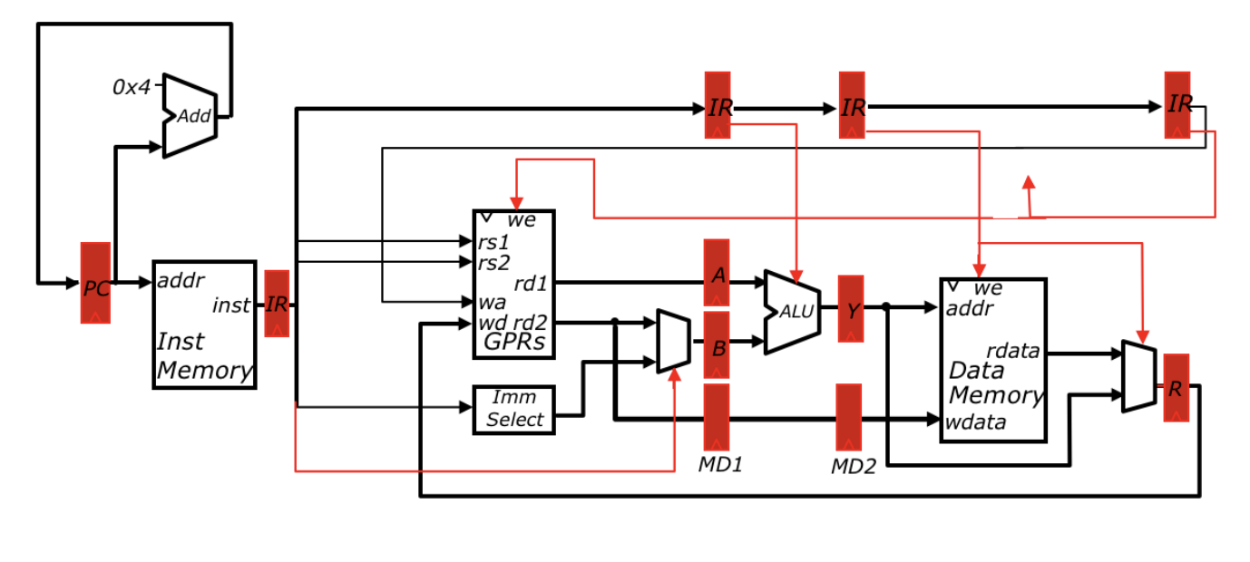
Data Hazard
x1 <- x0 + 10
x4 <- x1 + 3
x5 <- x1 + 5

Slide 5
Data Hazard
Time | x1 <- x0 + 10 | x4 <- x1 + 3 | x5 <- x1 + 5
t0 | IF
t1 | ID | IF
t2 | EX | ID | IF
t3 | MA | ? | ID
t4 | WB |  | ?
t5
t6
t7

Slide 6
Data Hazard: Stalling
Notes:
Draw the additional components on this slide

Slide 7
Data hazard: stalling
Time | x1 <- x0 + 10 | x4 <- x1 + 3 | x5 <- x1 + 5
t0 | IF
t1 | ID | IF
t2 | EX | ID | IF
t3 | MA | ID | IF
t4 | WB | ID | IF
t5 |  | ID | IF
t6 |  | EX | ID
t7 |  | MA | EX
Assume register file can be written and read at the same time

Slide 8
Data Hazard: forwarding
Notes:
Draw the forwarding diagram here

Slide 9
Data Hazard: forwarding
Time | x1 <- x0 + 10 | x4 <- x1 + 3 | x5 <- x1 + 5
t0 | IF
t1 | ID | IF
t2 | EX | ID | IF
t3 | MA | EX | ID
t4 | WB | MA | EX
t5 |  | WB | MA
t6 |  |  | WB
t7

Slide 10
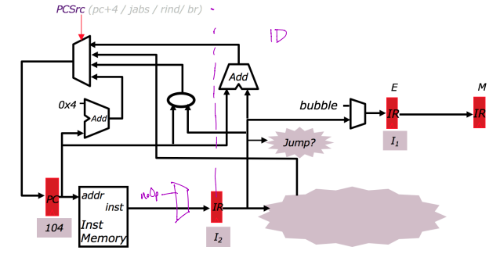
Control Hazard: jump
Example
096 ADD
100 J 304
104 ADD
……
304 ADD
Automatically fetched into pipeline, need to kill it

Slide 11
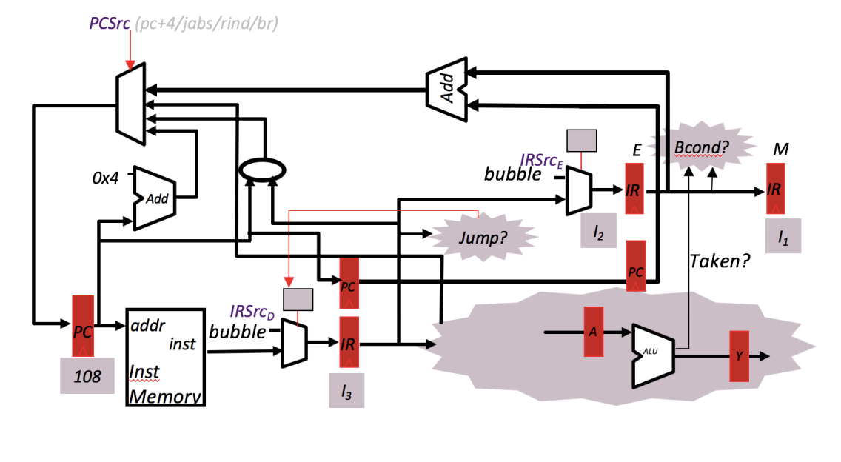
Control Hazard: conditional branch
Example
096 ADD
100 BEQ x1, x2, 200
104 ADD
108 ADD
112 ADD
Notes:
Assume pc+4 continues to execute. Then flush results if prediction was incorrect.

Slide 12
Forwarding vs. Stalling
There are many ways to implement a combination of forwarding or stalling in a pipelined datapath
You have to find the right tradeoff between a longer critical path, balancing pipeline stage delays, and pipeline stalled cycles
Consider an Load -> ALU dependency
Could forward the load result the same cycle and incur a long critical path but have no stall cycles
Could stall the ALU instruction 1 cycle until the load result is in a pipeline register but get a shorter critical path
What is better? Try both and see!
Intuitively the longer critical path would make the pipeline stages very unbalanced and would hurt max frequency (fmax) more than it would help latency (CPI)
Iron Law: Execution time = # Insns * CPI * T_clk

Slide 13
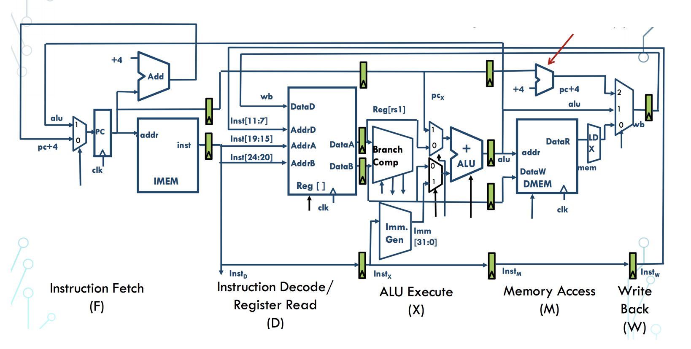
HW5 #3 Branch Clarification
What’s the resolution latency of a branch instruction for the 5-stage pipeline from lecture? How many instructions need to be killed?

Slide 14
HW5 #3 Branch Clarification
How should we implement a branch always taken naive predictor? Waiting until the ALU for the branch target address doesn’t make sense.

Slide 15
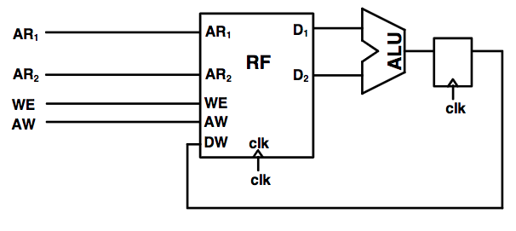
Example
Shown below is a portion of a prototype design for a pipelined CPU’s datapath that uses a register file with synchronous reads and writes. However, even ignoring any potential data hazards, this design does not function correctly - in particular, register type instructions. Explain what the error is caused by and add any extra components necessary to correct the design.

Slide 16
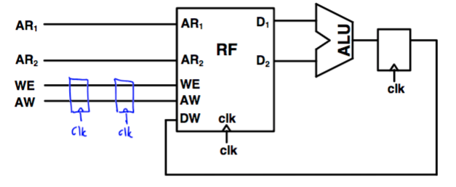
Example
Notes:
Problem is that it takes two more cycles for AR1/AR2 to propagate through the regfile and ALU (then back to the regfile) than it takes the WE/AW to be applied to the regfile.

Slide 17
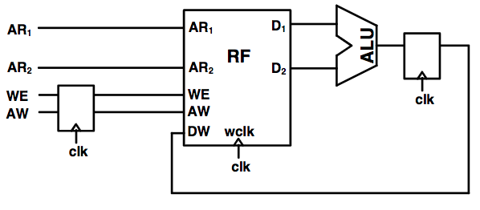
Example
Now this register file has synchronous writes with asynchronous reads. Add appropriate forwarding to eliminate all data hazards.

Slide 18
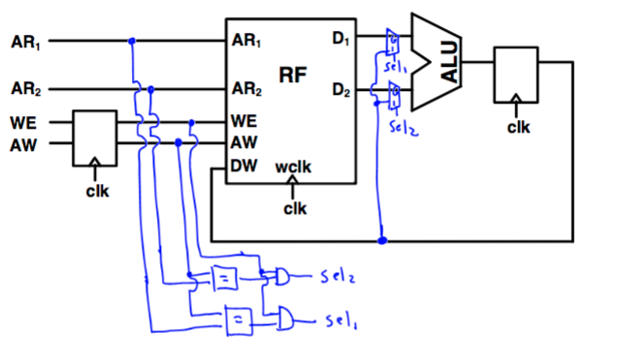
Example 2

Slide 19
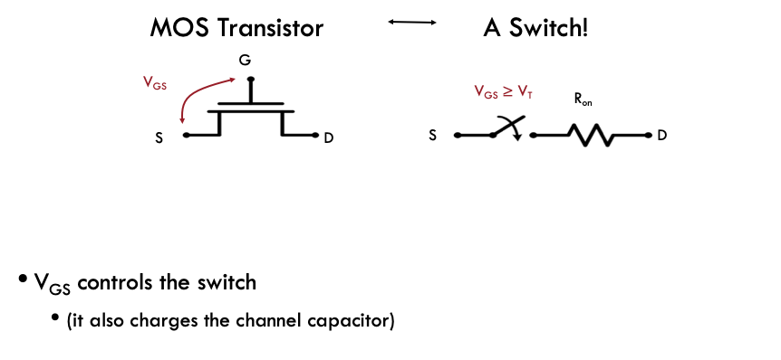
MOS Switch

Slide 20
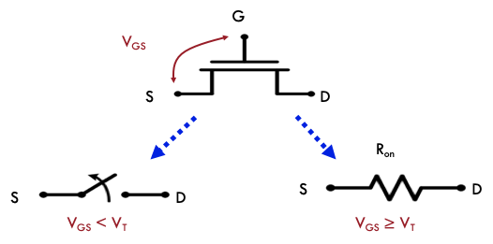
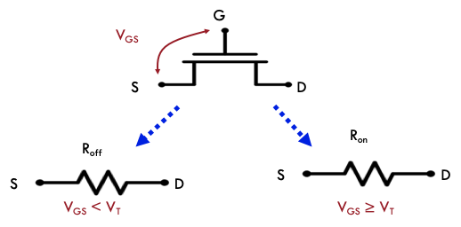
MOS Switch
ON/OFF Model
“More Realistic” Model

Slide 21
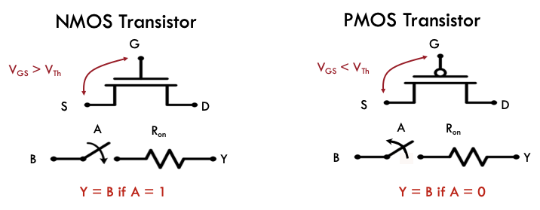
MOS Switch
Source of NMOS always at lower voltage
Source of PMOS always at higher voltage
The ‘effective’ source node can change depending on the voltage at the MOS’ terminals

Slide 22
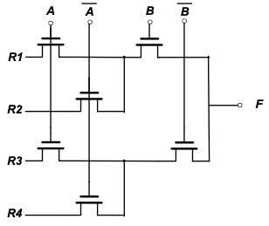
Switch Logic

Slide 23
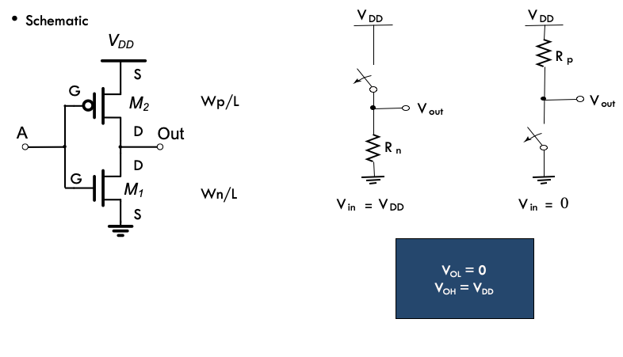
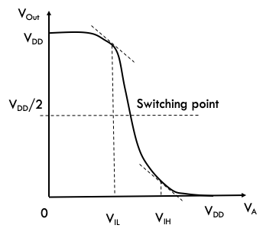
CMOS Inverter

Slide 24
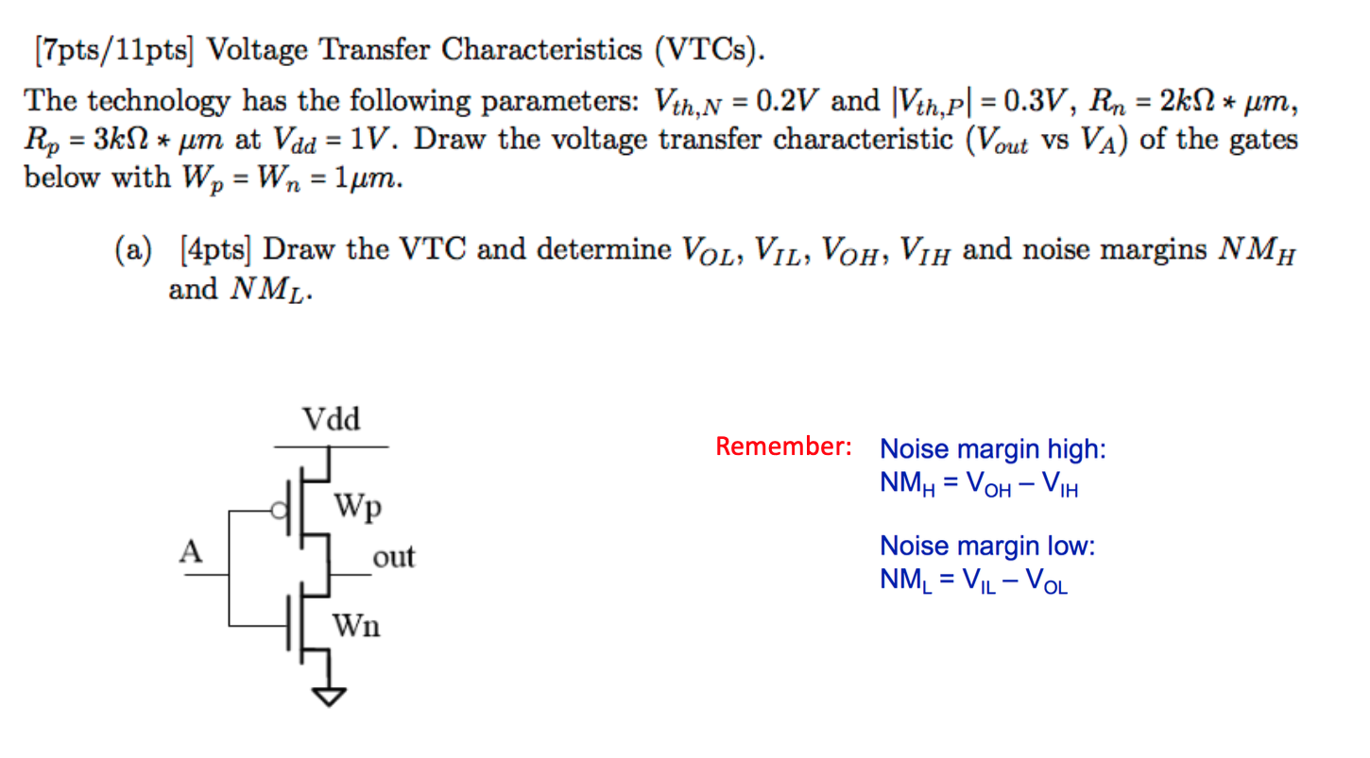
Inverter VTC

Slide 25
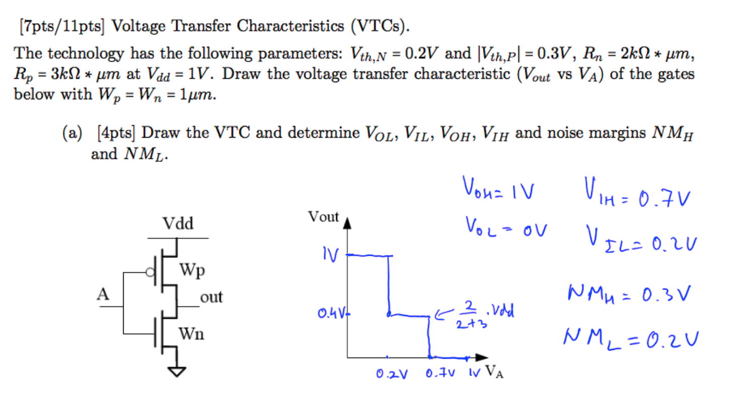
Inverter VTC

Slide 26
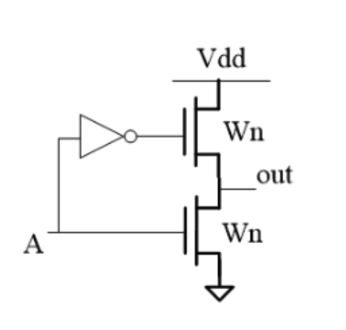
Inverter VTC

Slide 27
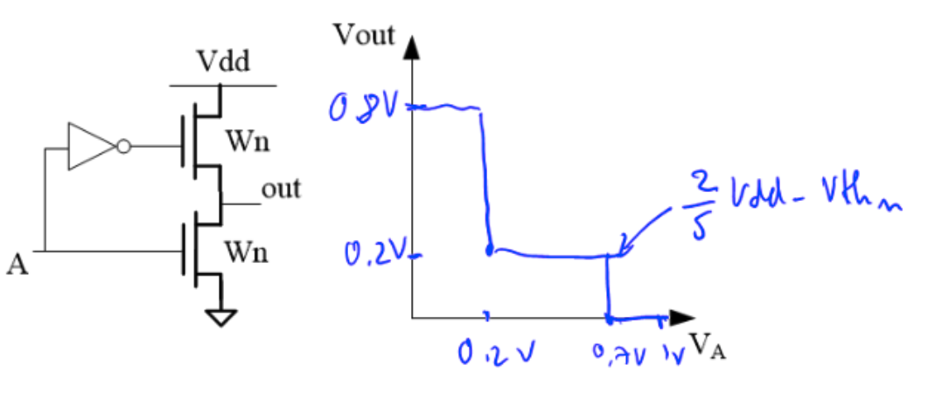
Inverter VTC

Slide 28
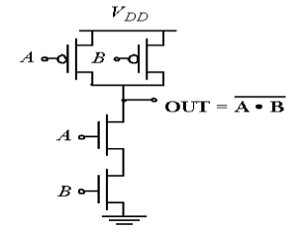
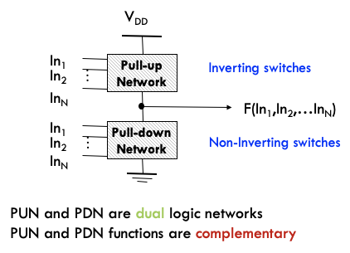
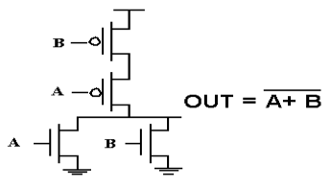
CMOS Logic

Slide 29
CMOS Logic
XNOR:

Slide 30
CMOS Logic
AND2:

