Slide 1
Discussion 9
MOS Switch, VTCs, CMOS Gates, Sizing, RC Delay, Logical Effort

Slide 2
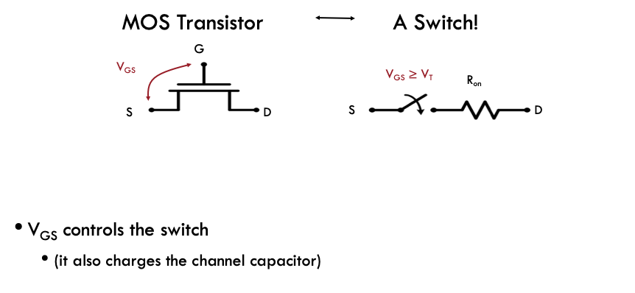
MOS Switch

Slide 3
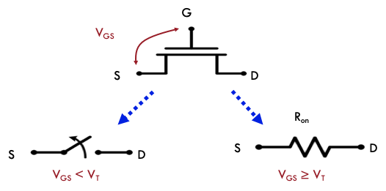
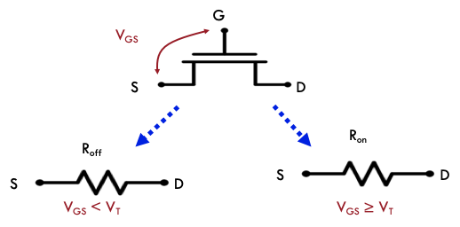
MOS Switch
ON/OFF Model
“More Realistic” Model

Slide 4
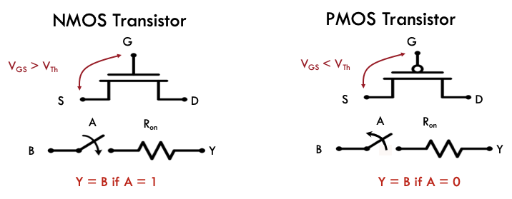
MOS Switch
Source of NMOS always at lower voltage
Source of PMOS always at higher voltage
The ‘effective’ source node can change depending on the voltage at the MOS’ terminals

Slide 5
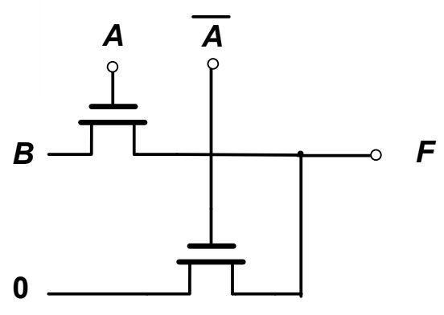
AND Switch Gate Analysis
F = AB
Assume CL starts at 0 V
Draw the VTC for both cases where A = 0 and A = 1
Vf
VDD
A = 1
VDD - Vthn
A = 0
0V
VDD - Vthn
Vb

Slide 6
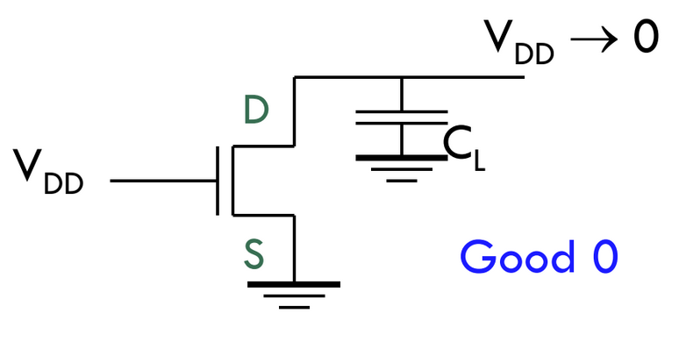
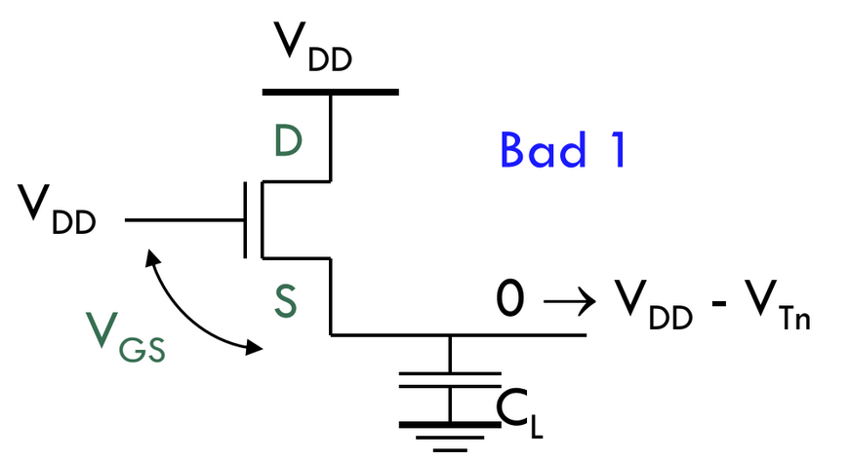
NMOS VTC
NMOS can pull a ‘strong’ 0
NMOS can only pull a ‘weak’ 1
Can only go up to Vg - Vthn
Remember NMOS source always at lower voltage

Slide 7
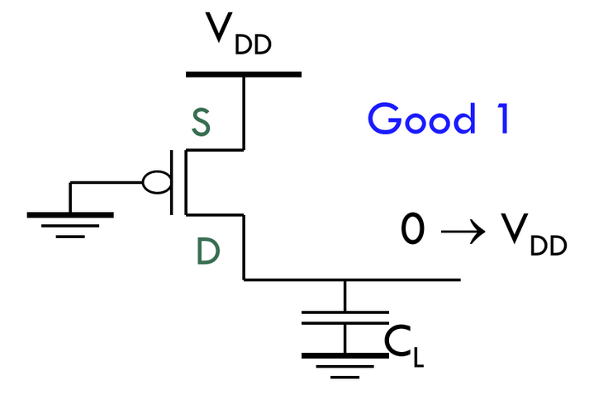
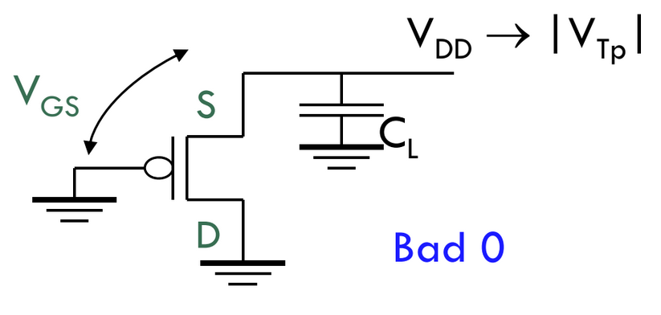
PMOS VTC
PMOS can pull a ‘strong’ 1
PMOS can only pull a ‘weak’ 0
Can only go down to Vg + |Vthp|
Remember PMOS source always at higher voltage

Slide 8
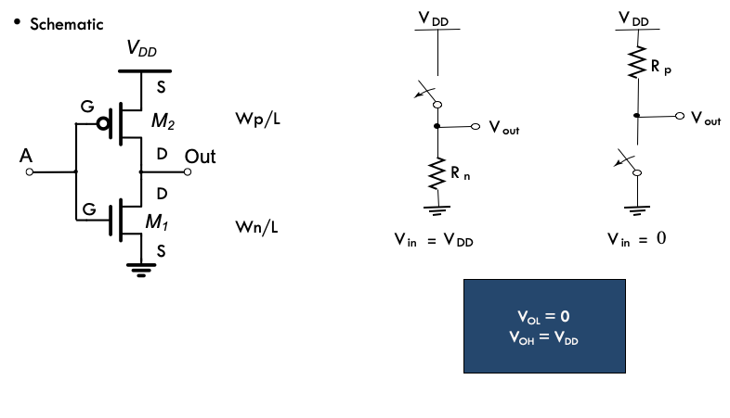
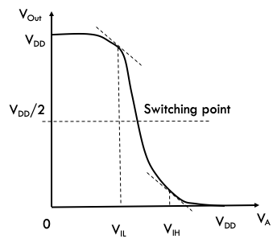
CMOS Inverter

Slide 9
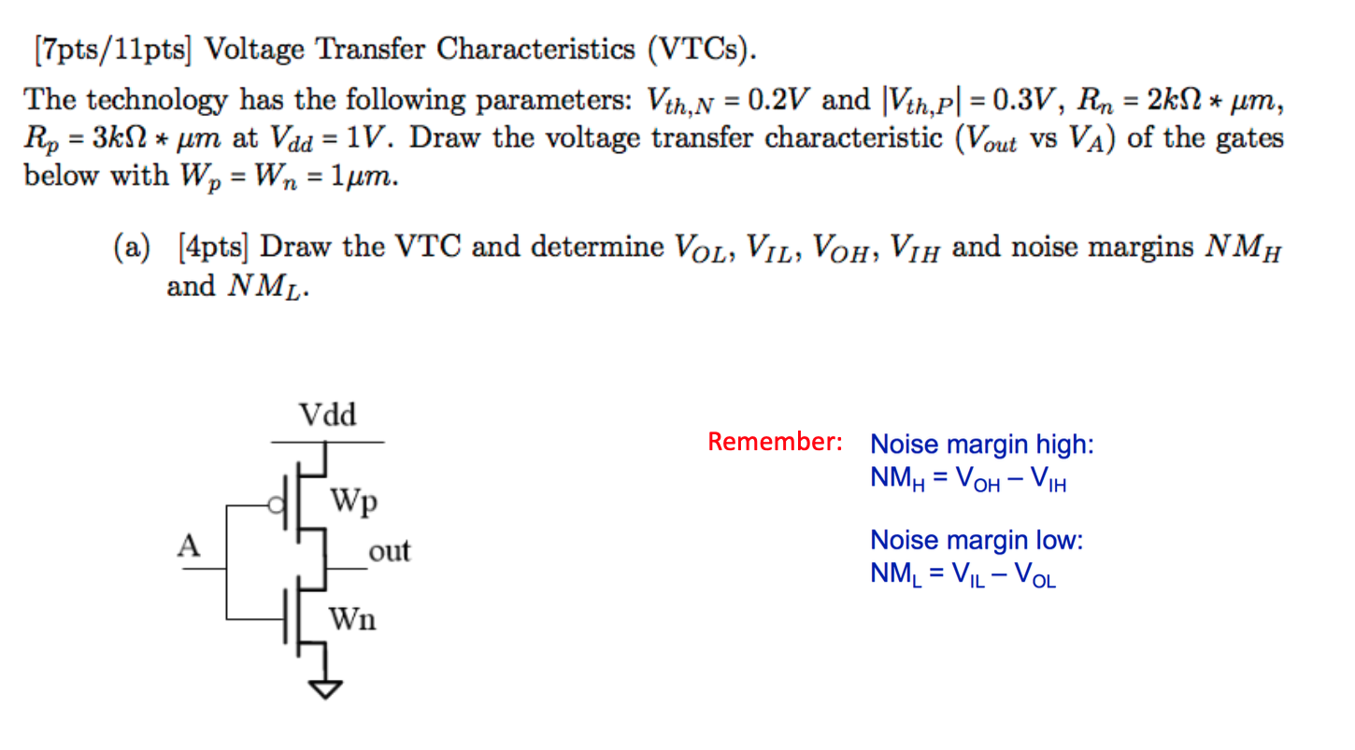
Inverter VTC

Slide 10
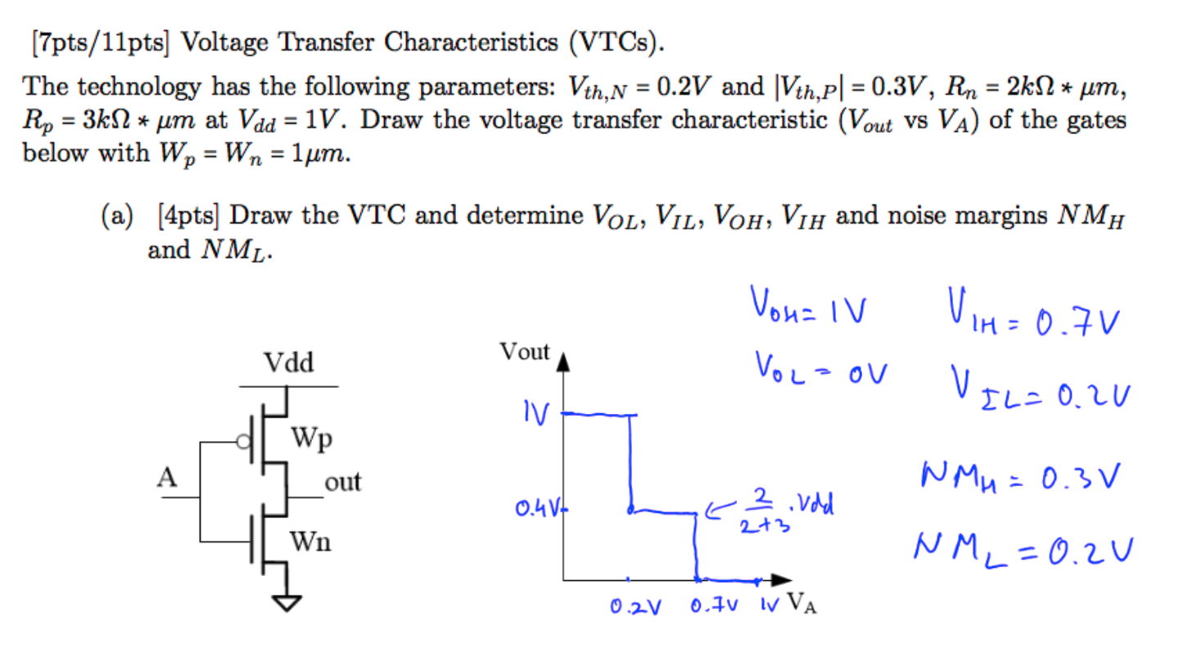
Inverter VTC

Slide 11
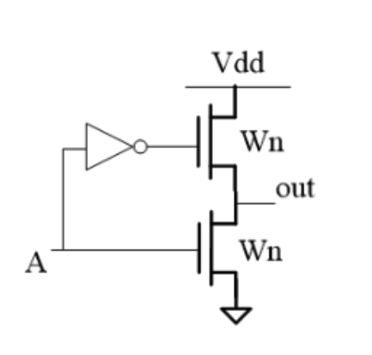
Inverter VTC

Slide 12
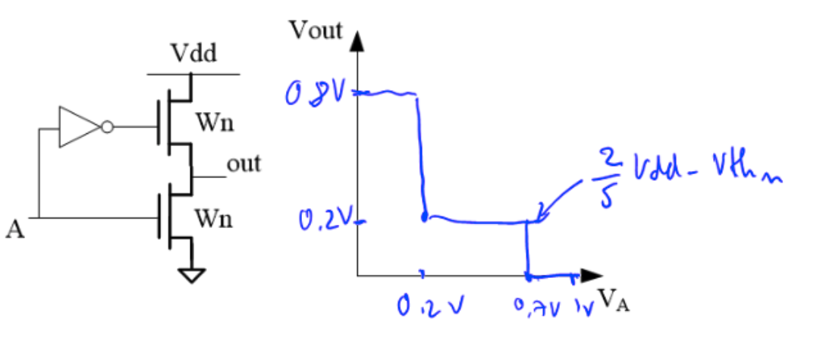
Inverter VTC

Slide 13
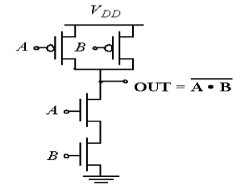
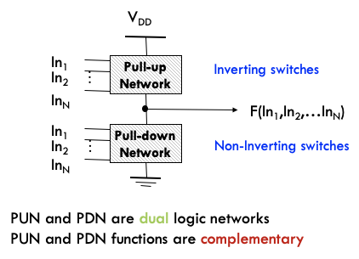
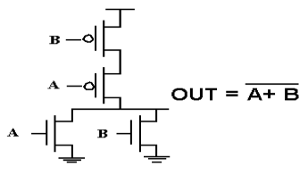
CMOS Logic

Slide 14
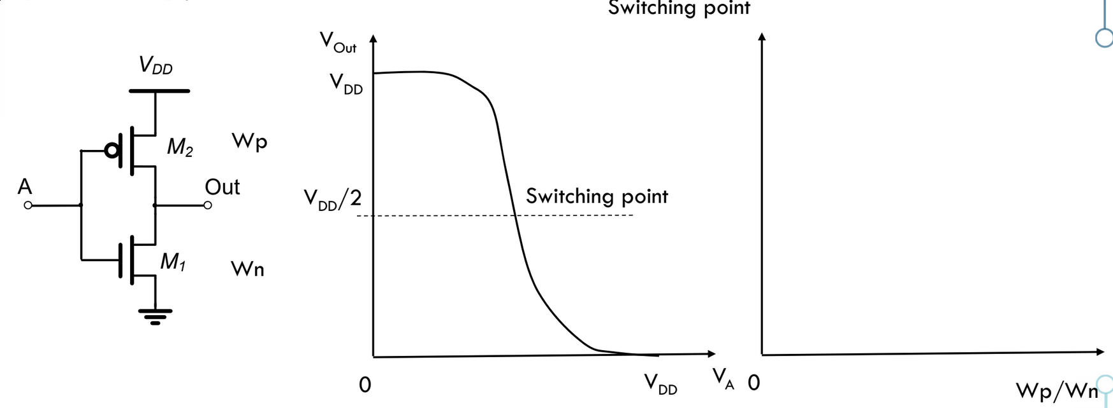
Inverter Sizing
R_{on} of each FET is inversely proportional to its width
Assume V_{th,n} = V_{th,p}
Assume R_{on,n} = R_{on,p} for the same width unless otherwise specified
Wp = Wn = switching threshold of Vdd/2
If Wp >> Wn, Vm approaches VDD | If Wn >> Wp, Vm approaches 0 (exponentially)

Slide 15
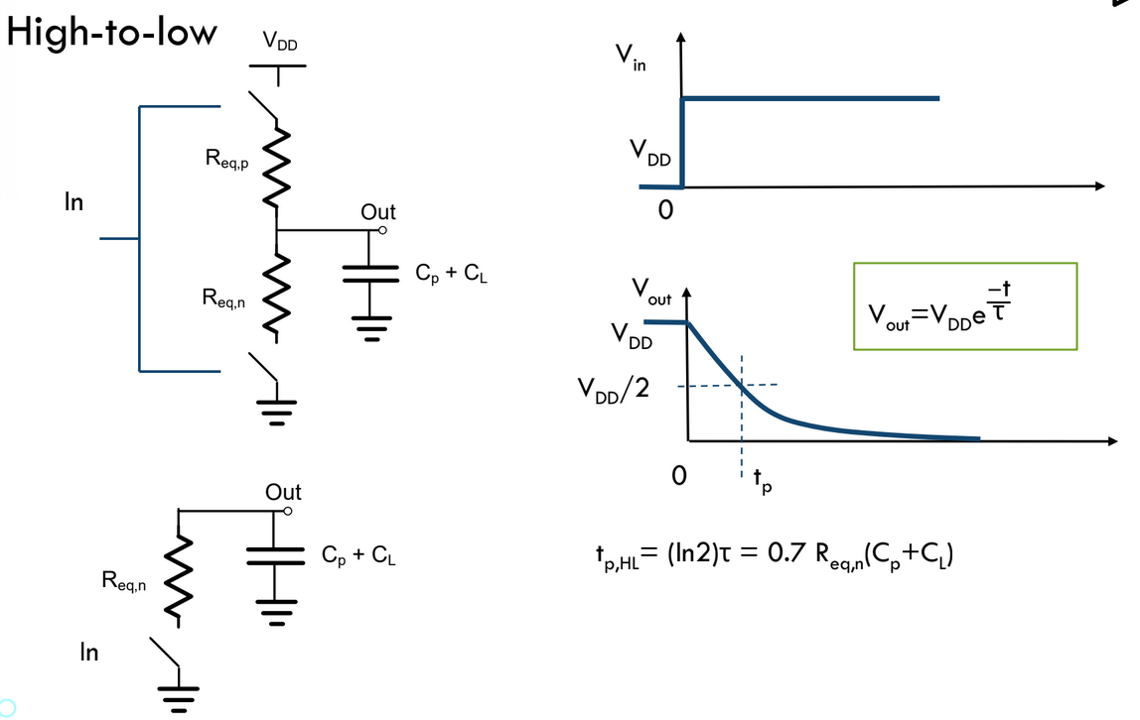
Inverter RC Delay (High -> Low)
High to low output transition time governed by strength of NMOS pulling low
Can lower the time constant by increasing the NMOS width

Slide 16
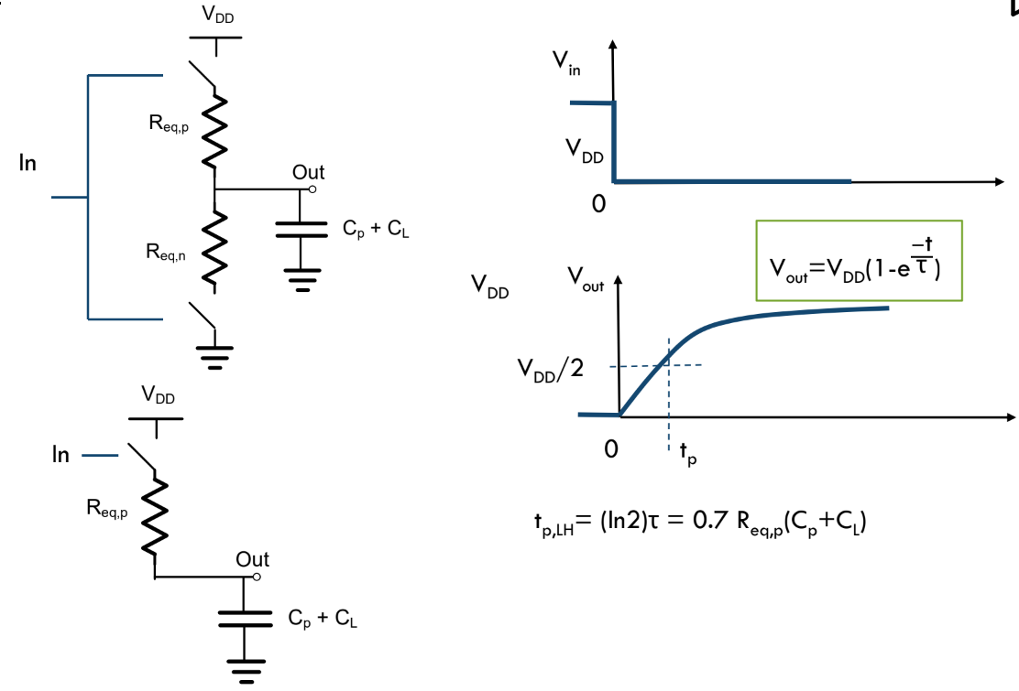
Inverter RC Delay (Low -> High)
Low to high output transition time governed by strength of PMOS pulling high
Can lower the time constant by increasing the PMOS width

Slide 17
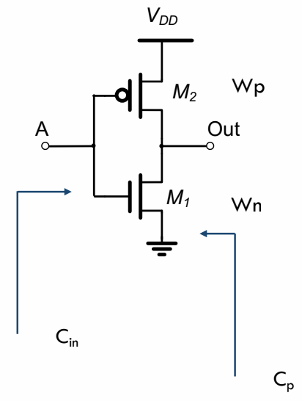
Inverter Sizing
Cin (gate input capacitance) and Cp (intrinsic drain capacitance) are proportional to W
You may see Cp referred to Cd in other sources
Cp = γ Cin
How does the inverter delay change if either PMOS/NMOS width is doubled?
If both widths are doubled, does the intrinsic (unloaded) delay improve?
Inverters are usually sized to equalize high->low and low->high delays

Slide 18
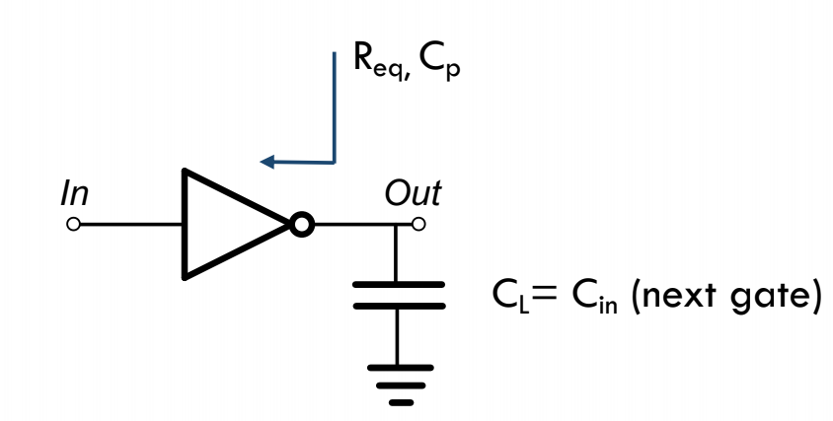
Inverter Delay
t_{p,inv} = R_{eq} (C_{p,tot} + C_L) = R_{eq} C_{p,tot} (1 + (C_L / C_{p,tot})) = R_{eq} C_{p,tot} (1 + (C_L / C_{in} γ)) = R_{eq} C_{p,tot} (1 + (f / γ)) = tau_{inv} (1 + (f / γ))
Delay can be split into 2 parts, intrinsic and extrinsic
Fanout f = ratio between output and input cap (CL / Cin)
This delay formula can be generalized for any CMOS gate
t_{p,gate} = tau_{inv} (p + gf/γ)
Often assume γ = 1

Slide 19
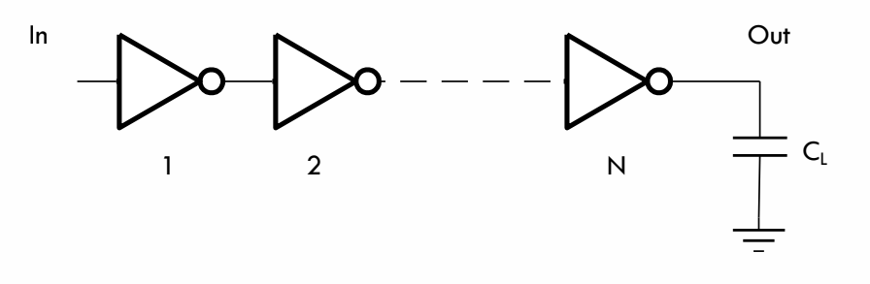
Sizing an Inverter Chain
We want to minimize the delay of this inverter chain
Assume the 1st inverter has a size of 1
Delay = tp1 + … + tpn = (1+f1) + (1+f2) + … + (1+fn) Take partial derivatives of this expression wrt C2, … Cn Solution is f1 = f2 = f3 = … = fN Each inverter has a fanout = the n-th root of F (total fanout)

Slide 20
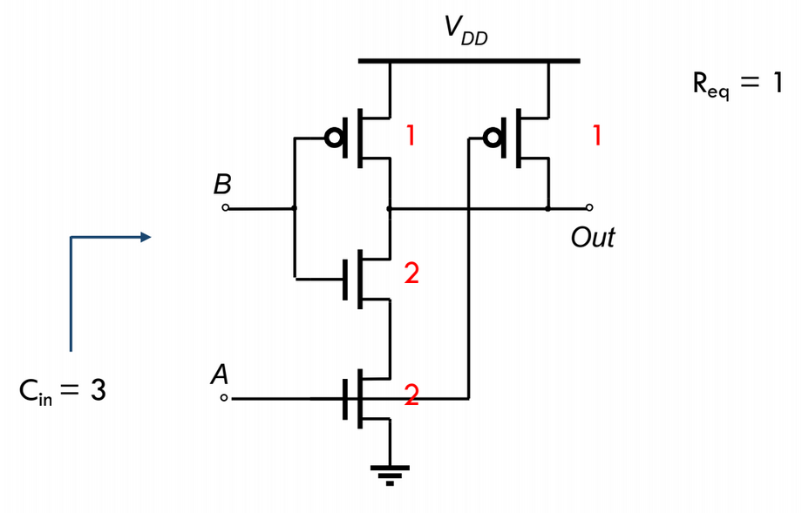
Logical Effort
g = logical effort
To find g for a CMOS gate:
Size the gate to have R_{eq} equal to that of an inverter
Find the input capacitance of the gate
Take the ratio C_{in,gate} / C_{in,inv}
For a NAND2 gate: g = 3/2
For a NOR2 gate: g = 3/2
How do these change if the PMOS is half as strong as an nMOS?

Slide 21
Intrinsic Delay
p = intrinsic delay
To find p for a CMOS gate:
Size the gate to have R_{eq} equal to that of an inverter
Find the output (intrinsic) capacitance of the gate
Take the ratio C_{out,gate} / C_{out,inv}
For a NAND2 gate: g = 4/2
For a NOR2 gate: g = 4/2
How do these change if the PMOS is half as strong as an nMOS?

Slide 22
Path Delay
Path logical effort G = g1 * g2 * … gN
Path fanout F = CL / C_{in,1}
Branching factor bi = ratio of total cap seen / on-path cap
Path total effort H = GFB
We want to minimize the delay of a path through a series of gates
Each stage i in the chain has an effective fanout gi * fi
The solution is to make the effective fanout of each stage the same
EF_{opt} = H^{1/N}
EF = gi * fi = gi * (C_{load} / C_{in})
C_{in} (i.e. the gate size) = gi * C_{load} / EF
The optimal path delay D = N * H^{1/N} + p1 + … + pN

Slide 23
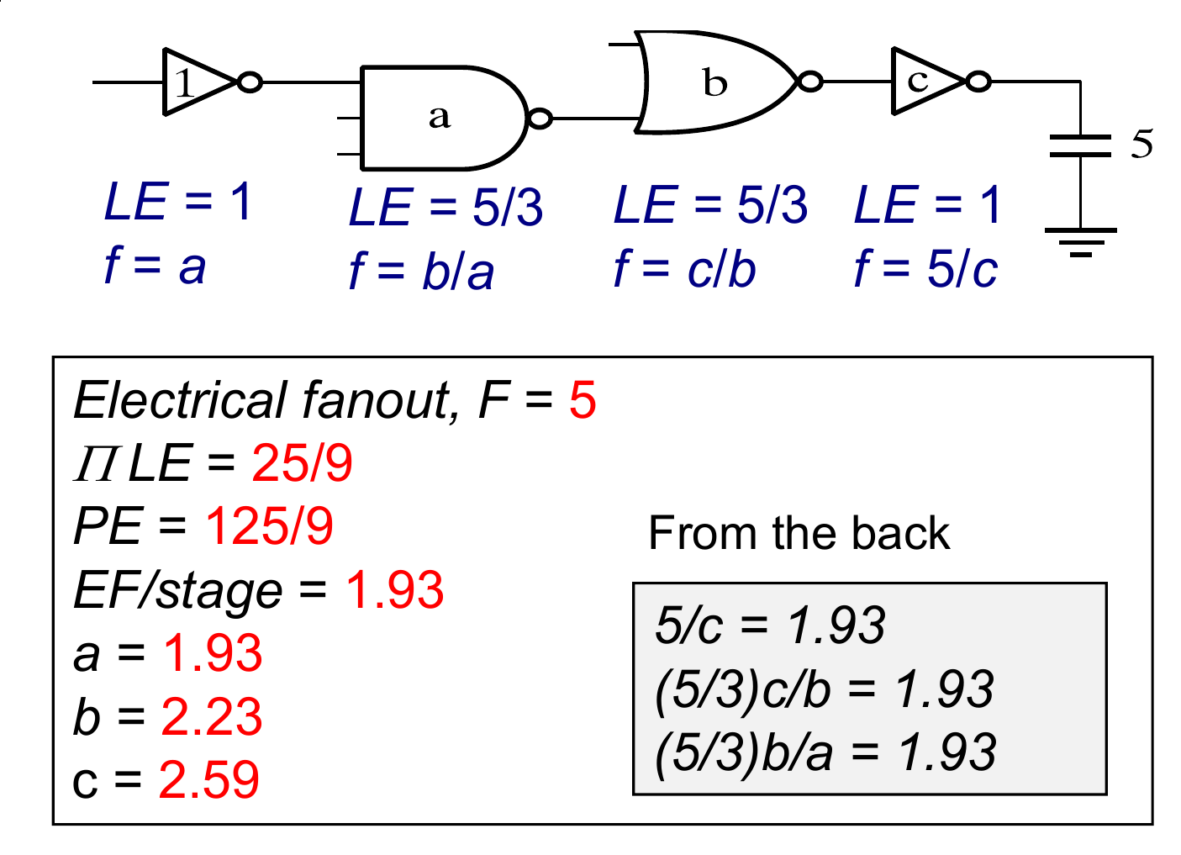
Sizing a Logic Path for Minimum Delay
This example assumes the NMOS is twice as strong as the PMOS
EF/stage is calculated as the 4th-root of G*F
gi * fi = EF of stage i
Easier to calculate gate sizes from the load cap backwards

Slide 24
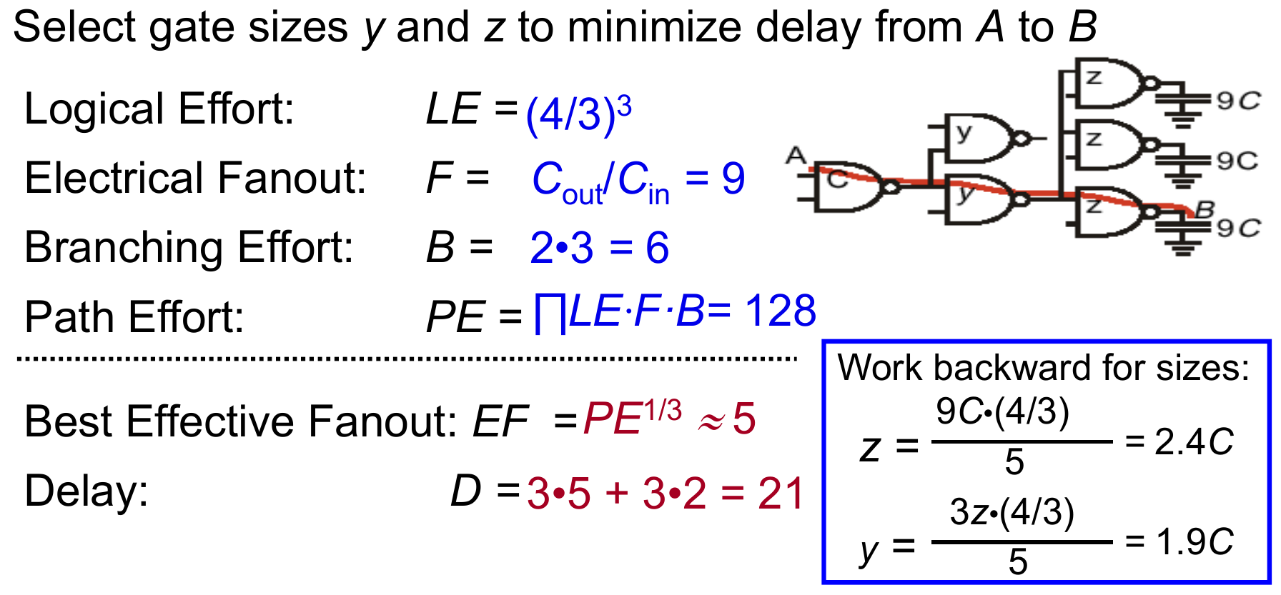
Sizing a Logic Path for Minimum Delay (Branching)
This example also assumes the NMOS is twice as strong as the PMOS
Note that when calculating the size y, you must consider the total load cap (3z) instead of just z
Recall: D_{opt} = N * H^{1/N} + p1 + … + pN

Slide 25
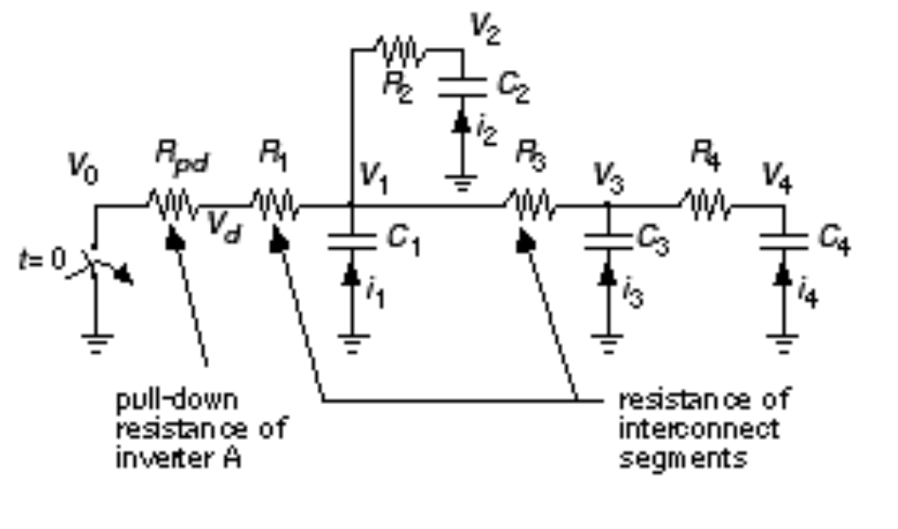
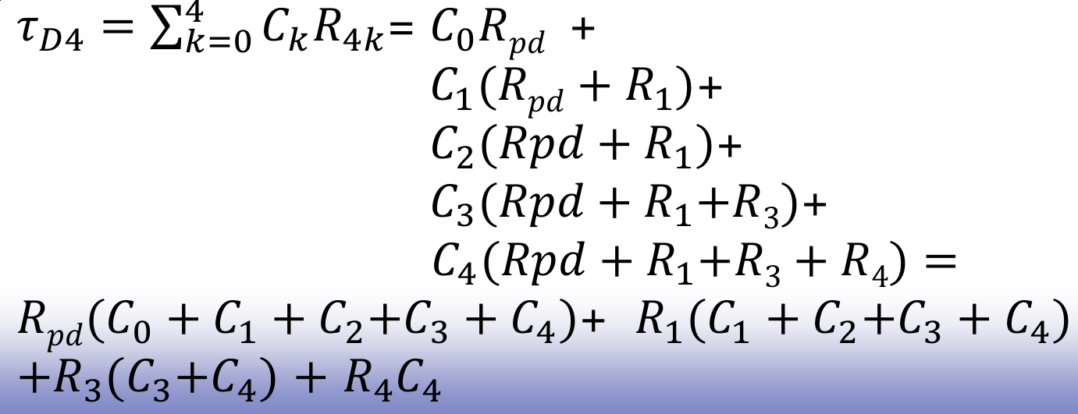
Elmore Delay Approximation
Approximates the dominant time constant of a RC network for a given input and output node
2 methods (same result):
Take every capacitor and multiply it by the sum of resistors on the path charging it
Take every resistor on the path and multiply it by the sum of capacitances it charges

Slide 26
Switching Energy
½ CV^2 charge dumped on cap during charge cycle from VDD
No additional charge drawn from supply when the cap discharges
The other ½ CV^2 is burned on the charging resistance and dissipates as heat
When the cap discharges the rest of the charge bleeds to ground via the discharging resistor
Derive this result

Slide 27
Digital Power Consumption
Dynamic switching power (f C V^2 alpha_{0 -> 1})
Static leakage power (I_{d,leak}), what is it proportional to?
Model as an R_{off}

Slide 28
Sizing an Inverter Chain for Minimum Delay
Don’t introduce the technique of logical effort based sizing yet, but go through writing the delay equation and take partials of every inverter size
Then make it clear that the fanout of each stage should be the same and that determines the sizing
A spice example would be nice here

