Slide 1
EECS151/251A Discussion 11
Christopher Yarp
Apr. 19, 2019

Slide 2
Plan for Today
Adders
Multipliers
Pipelining
Questions

Slide 3
Adders
Earlier in the term, we discussed the Carry Ripple Adder
Replicates how we add by hand
Compute sum[i] and carry_out[i] based on A[i], B[i], and carry_in[i]
carry_in[i] = carry_out[i-1], carry_in[0] = 0 if unsigned.
Primary Downside: Long Critical Path
The carry ripple results in a critical path that goes through each FA
Grows linearly with the number of bits added
How do we make adders faster?
Cut the critical path!
How?
Change how we work with carries!
Notes:
At the end of the day, remember that we are still in many ways replicating what we do by hand. What we are primarily changing is how we deal with carries.

Slide 4
Carry Select Adder
One way to reduce critical path is to cut the adder into 2 parts, severing the carry chain.
Problem: The LSB side of the adder will work as expected but the MSB side still depends on the value of the carry!
Solution: There are 2 possibilities for the carry-in to the MSB adder, 0 and 1. Calculate the result of BOTH cases and pick the correct one
Allows the MSB computations to occur in parallel with the LSB calculation with a small delay to select the correct value
Downside: Replicated logic, wasted effort (energy) on result that is not used
Notes:
Basically, we are betting on a horse race, except we are betting on all horses, so we are bound to win! A perfectly hedged bet!

Slide 5
Carry Select Example:
0
1
1
1
0
1
0
1
1
0
1
Example:
4’b0111 (7)
+ 4’b0101 (5)
-----------
5’b01100 (12)
0
1
0
0
1
0
0
0
1
1
1
0
1
1
0
1
1

Slide 6
Quick Aside: Associativity
An operator, #, is associative if the following is true: (a # b) # c = a # (b # c)
Addition*, multiplication, AND, OR, XOR, are associative
This allows us to compute them in a tree structure
Ex. Compute: a+b+c+d+e+f+g+h
((((((a+b) + c) + d) + e) + f) + g) + h | ((a+b) + (c+d)) + ((e+f) + (g+h))
Delay: 7 Additions HW Requirements: 7 Adders | Delay: 3 Additions HW Requirements: 7 Adders
Adders in same layer can be computed in parallel!
See: Weisstein, Eric W. "Associative." From MathWorld--A Wolfram Web Resource. http://mathworld.wolfram.com/Associative.html
* Addition of floating point numbers is generally not considered associative
Notes:
Note, the same amount of hardware is required in both cases. We are just changing the order in which we evaluate the adds in order to allow some to be computed in parallel.

Slide 7
Carry Lookahead Adder
The carry logic, as we have presented it, is not associative
We need to compute the bits in order from LSB to MSB, since each FA needs the carry-out of the previous stage
This is a problem as it limits us to a linear chain of FAs, preventing us from doing work in parallel
Solution: Make the carry logic associative through re-defining the FAs

Slide 8
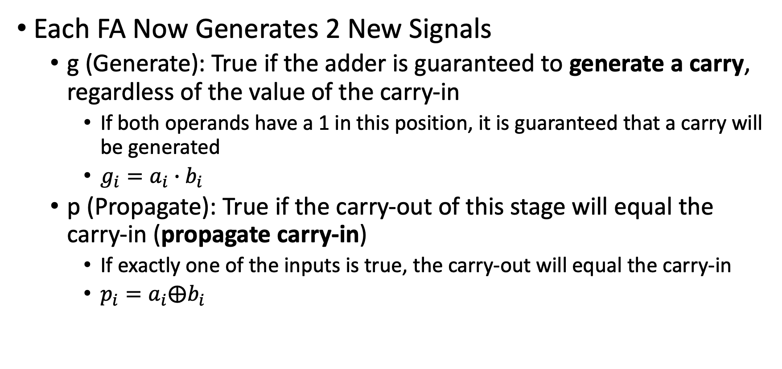
Redefining FAs: Carry Generate and Propagate
Each FA Now Generates 2 New Signals
g (Generate): True if the adder is guaranteed to generate a carry, regardless of the value of the carry-in
If both operands have a 1 in this position, it is guaranteed that a carry will be generated
$g_{i}=a_{i}∙b_{i}$
p (Propagate): True if the carry-out of this stage will equal the carry-in (propagate carry-in)
If exactly one of the inputs is true, the carry-out will equal the carry-in
$p_{i}=a_{i}⨁b_{i}$

Slide 9
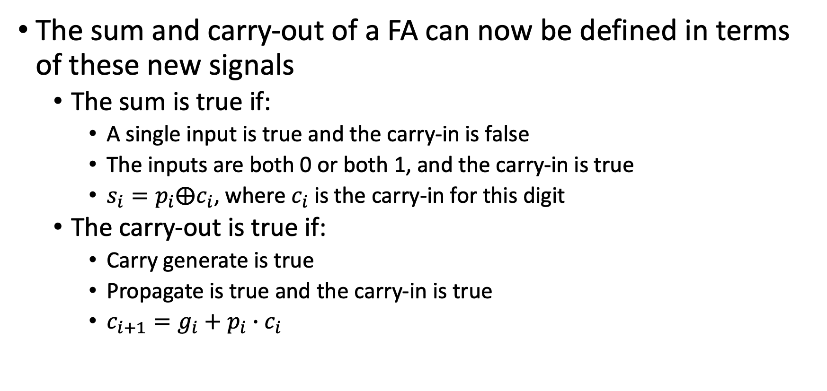
Redefining FAs: Carry Generate and Propagate
The sum and carry-out of a FA can now be defined in terms of these new signals
The sum is true if:
A single input is true and the carry-in is false
The inputs are both 0 or both 1, and the carry-in is true
$s_{i}=p_{i}⨁c_{i}$, where $c_{i}$ is the carry-in for this digit
The carry-out is true if:
Carry generate is true
Propagate is true and the carry-in is true
$c_{i+1}=g_{i}+p_{i}∙c_{i}$

Slide 10
What good did that do?
Note that the sum and carry-out bits in each FA still depend on the values of the carry-in.
This means that we still need the compute the carry-in value for each bit position and have logic to generate the sum
However, the p and g values can all be computed simultaneously
There is no dependence on carry-in when computing p and g!
We leverage this property in the carry lookahead adder by grouping together adders and creating P and G signals for the entire group
P represents if the entire group will propagate a carry signal
G represents if the entire groups generates a carry signal
The P and G signals can be processed in a tree structure

Slide 11

Carry Look-ahead Adder
The smaller blocks are modified full adders.
Can calculate g and p immediately
Must wait for carry-in to compute sum bit
Some FAs are required to create a carry-out
$g_{i}=a_{i}∙b_{i}$
$p_{i}=a_{i}⨁b_{i}$
$s_{i}=p_{i}⨁c_{i}$
$c_{i+1}=g_{i}+p_{i}∙c_{i}$
No Dependence on carry-in
Depend on carry-in

Slide 12

Carry Look-ahead Adder
The larger blocks compute P & G for higher levels of the hierarchy.
P & G can be computed without carry-in
Carry-in is required to generate carry-out
$P=P_{A}P_{B}$
$G=G_{B}+G_{A}P_{B}$
$C_{out}=G+C_{in}P$
No Dependence on carry-in
Depend on carry-in
Notes:
Walk through this. Colors are things that become available at the same time

Slide 13
Parallel Prefix Adder
One disadvantage of the carry lookahead adder as described in the lecture slides is that the carry-out bit still ripple through the groups in the first layer
An alternative is to compute the carry bits directly without any grouping
However, we don’t want to fall back to a carry ripple solution.
Trick: unroll the expression for the carry bit

Slide 14
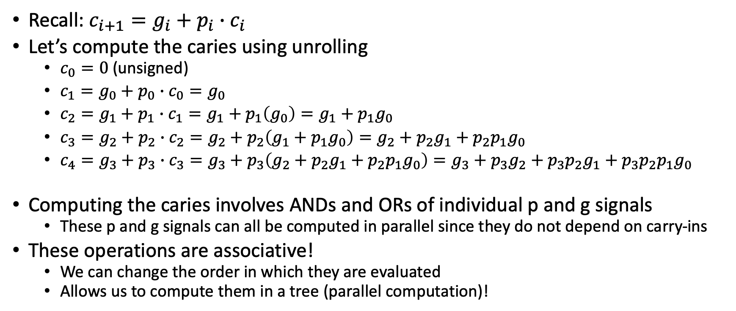
Unrolling the Carry-in
Recall: $c_{i+1}=g_{i}+p_{i}∙c_{i}$
Let’s compute the caries using unrolling
$c_{0}=0$ (unsigned)
$c_{1}=g_{0}+p_{0}∙c_{0}=g_{0}$
$c_{2}=g_{1}+p_{1}∙c_{1}=g_{1}+p_{1}\left(g_{0}\right)=g_{1}+p_{1}g_{0}$
$c_{3}=g_{2}+p_{2}∙c_{2}=g_{2}+p_{2}\left(g_{1}+p_{1}g_{0}\right)=g_{2}+p_{2}g_{1}+{p_{2}p}_{1}g_{0}$
$c_{4}=g_{3}+p_{3}∙c_{3}=g_{3}+p_{3}\left(g_{2}+p_{2}g_{1}+{p_{2}p}_{1}g_{0}\right)=g_{3}+p_{3}g_{2}+p_{3}p_{2}g_{1}+p_{3}p_{2}p_{1}g_{0}$
Computing the caries involves ANDs and ORs of individual p and g signals
These p and g signals can all be computed in parallel since they do not depend on carry-ins
These operations are associative!
We can change the order in which they are evaluated
Allows us to compute them in a tree (parallel computation)!

Slide 15
Parallel Prefix Trees
Similar to a reduction tree except that you want to keep the intermediate values
Intermediate values are re-used when computing
In our case, we could use a reduction tree to compute the last carry.
This would be of limited use to us because we need all of the intermediate carry bits that would be computed as part of the reduction tree
Parallel prefix trees give us these intermediate values!
Work on operators that are associative

Slide 16
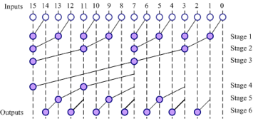
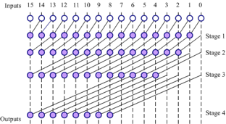
Different Parallel Prefix Trees
There is a tradeoff in parallel prefix trees in how intermediate values are computed/reused
Note that both of these graphs produce the same outputs (the partial results)
Brent-Kung (Diagram from Lecture Slides)
Most reuse (minimal logic) but with a longer critical path
Kogge-Stone (Diagram from Lecture Slides) Requires more resources but has a shorter critical path.

Slide 17
Parallel Prefix Adder
The Parallel Prefix Tree Described Above is for computing the carry bits
We still need full adders to produce the p & g signals and to calculate the final sum
Modified full adders feed the parallel prefix tree with p and g values
Full adders receive the carry in from the parallel prefix tree to compute the sum bit

Slide 18
Multipliers
Remember, the mechanics of multiplication in binary are generally the same as decimal multiplication (signed multiply requires a slight tweak).
2 Steps to Multiplication:
Generation of partial products
Adding partial products
Making faster multipliers mostly involves changing how we deal with generating and adding the partial products

Slide 19
Unsigned Multiplication Example
4’b0011 (3)
* 4’b0110 (6)
4’b0011 (3)
* 4’b0110 (6)
-------
0000
0011
0011
+ 0000
---------
00010010 (18)
Partial Products can be generated in parallel
Let’s try to improve the addition of the partial products
Partial Products

Slide 20
Carry Save Addition
When we generate a carry in a given column of an addition, we add it to the 2 values in the next column.
This addition may in turn generate its own carry
If adding carries is just like another addition, can we delay adding the carry bits until later?
Yes, so long as we remember what the carry bits need to be added
This is the basis of the carry save adder:
Takes in a, b, and carry_in (multi-bit)
Produces a sum and carry_out (multi-bit)

Slide 21
Using Carry Save Addition
Using Carry Save Addition Allows us to create a multi-input adder that is:
Relatively fast: Carry Save Adders do not have a carry ripple
Relatively small: do not need the logic to handle the carry logic to create a fast adder
However, still need a standard adder at the end to add the final carry-out and sum.
This is one of the fast adders such as the Carry Lookahead or Parallel Prefix Adders
Good news! We only need one of them.

Slide 22
Using Carry Save Addition
Because addition is associative, it actually does not matter what order the carry bits are added back into the sum
Can use a tree structure

Slide 23
Quick Note on Pipelining With Feedback
Pipelining in the presence of feedback is problematic due to the dependence
However, if the feedback loop includes operators that are associative and commutative, we may be able to make the feedback loop shorter.
Tightening the feedback path pushes some logic outside of the loop
Logic outside of the feedback loop (feed forward) can usually be pipelined relatively easily.
Notes:
Yes, associativity is back again!

Slide 24
Example from Lecture
Orig: y[i] = (y[i-1]+x[i])+a
Reorg: y[i] = y[i-1]+(x[i]+a)
Feed Forward Section Pipelined
Notes:
Yes, associativity is back again!

Slide 25
Piping Feedback
Is it possible to pipeline feedback at all?
It is, if you can shift the loop dependency to a previous cycle

