Slide 1
EECS151/251A Discussion 12
Christopher Yarp
Apr. 26, 2019

Slide 2
Plan for Today
Multipliers (including reminders from last lecture)
Constant Multiplication
Questions

Slide 3
Multipliers (From Last Week)
Remember, the mechanics of multiplication in binary are generally the same as decimal multiplication (signed multiply requires a slight tweak).
2 Steps to Multiplication:
Generation of partial products
Adding partial products
Making faster multipliers mostly involves changing how we deal with generating and adding the partial products

Slide 4
Unsigned Multiplication Example (From Last Week)
4’b0011 (3)
* 4’b0110 (6)
4’b0011 (3)
* 4’b0110 (6)
-------
0000
0011
0011
+ 0000
---------
00010010 (18)
Partial Products can be generated in parallel
Partial Products

Slide 5
Number Representations
Unsigned Binary
Each bit place represents a different power of 2
Ex: 11 in unsigned binary = 2³ +2¹ + 2⁰ = 8 +2 + 1 = 11
Signed Binary – 2’s Complement
Each bit place still represents a different power of 2, except the most significant bit has negative weight
Converting to/from 2’s complement can be accomplished by performing a bitwise negation and adding 1. Ex. -11 in 2’s complement = -2⁵ + 2⁴ + 2² + 2⁰ = -32 + 16 + 4 + 1 = -11
2⁵ | 2⁴ | 2³ | 2² | 2¹ | 2⁰
32 | 16 | 8 | 4 | 2 | 1
0 | 0 | 1 | 0 | 1 | 1
-2⁵ | 2⁴ | 2³ | 2² | 2¹ | 2⁰
-32 | 16 | 8 | 4 | 2 | 1
1 | 1 | 0 | 1 | 0 | 1

Slide 6
Signed Multiplication Example
4’b0011 (3)
* 4’b1100 (-4)
-------
+ 00000000
+ 0000000
+ 000011
- 00011
---------
+ 00001100
+ 11100111+1
---------
+ 00001100
+ 11101000
---------
11110100 (-12)
4’b0011 (3)
* 4’b1100 (-4)
In 2’s Complement, the MSB is given negative weight
Need to sign extend numbers when writing partial products
Need to subtract partial product for MSB
Carry bit of additions is discarded

Slide 7
Signed Multiplication Example
4’b1100 (-4)
* 4’b0011 (3)
-------
+ 11111100
+ 1111100
+ 000000
- 00000
---------
+ 11110100
+ 11111111+1
---------
+ 11110100
+ 00000000
---------
11110100 (-12)
4’b1100 (-4)
* 4’b0011 (3)
In 2’s Complement, the MSB is given negative weight
Need to sign extend numbers when writing partial products
Need to subtract partial product for MSB
Carry bit of additions is discarded

Slide 8
Signed Multiplication Example
4’b1100 (-4)
* 4’b1101 (-3)
-------
+ 11111100
+ 0000000
+ 111100
- 11100
---------
+ 11101100
+ 00011111+1
---------
+ 11101100
+ 00100000
---------
(1)00001100 (12)
4’b1100 (-4)
* 4’b1101 (-3)
In 2’s Complement, the MSB is given negative weight
Need to sign extend numbers when writing partial products
Need to subtract partial product for MSB
Carry bit of additions is discarded

Slide 9
Signed Multiplication Example
4’b0100 (4)
* 4’b0011 (3)
-------
+ 00000100
+ 0000100
+ 000000
- 00000
---------
+ 00001100
+ 11111111+1
---------
+ 00001100
+ 00000000
---------
00001100 (12)
4’b0100 (4)
* 4’b0011 (3)
In 2’s Complement, the MSB is given negative weight
Need to sign extend numbers when writing partial products
Need to subtract partial product for MSB
Carry bit of additions is discarded

Slide 10
Accelerating Multiplication

Slide 11
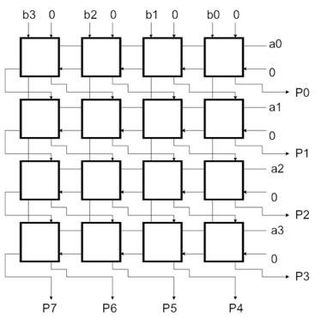
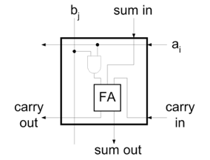
Accelerating the Addition of Partial Products
Let’s look at an (unsigned) array multiplier
The products can be computed in parallel but the carry chain when adding partial products is limiting the speed
How do we improve performance without having a large increase in hardware?
We could implement each adder as a parallel prefix or a carry-lookahead adder
However, remember that these adders require more logic than a simple carry ripple adder
Figures from Lecture Slides

Slide 12
One Solution: Carry Save Addition
When we generate a carry in a given column of an addition, we add it to the 2 values in the next column.
This addition may in turn generate its own carry
If adding carries is just like another addition, can we delay adding the carry bits until later?
Yes, so long as we remember what the carry bits need to be added
This is the basis of the carry save adder:
Takes in a, b, and carry_in (multi-bit)
Produces a sum and carry_out (multi-bit)

Slide 13
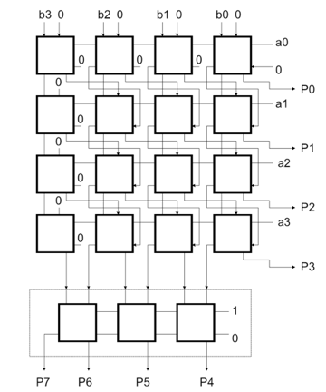
Using Carry Save Addition in Multipliers
Carry now propagates down each column.
Carry ripple across rows is eliminated in the array
Still need to handle carries at the end with a fast adder
Figure from Lecture Slides

Slide 14
Using Carry Save Addition
Remember, sums are associative and communitive.
We can add the partial products in a tree structure using carry save adders!
Now have a number of layers that scales logarithmically!
This is the basis of the Wallace Tree Multiplier

Slide 15
Radix and Multiplication
Binary arithmetic has some advantages
Partial product generation is just a series of AND gates (including sign extension)
However, there are also disadvantages
There is a partial product for each bit of the multiplier
That leads to a lot of partial products (a lot of additions)
Ex. 3*4
single partial product in base 10
4 partial products in base 2.
Why don’t we consider a larger radix?

Slide 16
Radix 4 Multiplication
Let’s consider 2 bits at a time
Halve the number of partial products we generate
Radix 4 multiplication A*B
Partial Product Shift By 2 bits each time
Recall: Multiplications by powers of 2 are left shifts
Can we use this property?
B Digit | Partial Product | Partial Product (Rewritten)
0 | 0*A | 0
1 | 1*A | A
2 | 2*A | 4*A - 2*A
3 | 3*A | 4*A - A

Slide 17
Booth Recoding
Uses radix 4 arithmetic
Modification: Partial Products for B==2 and B==3 can be separated into 4*A – {2, 1}A
4*A can be implemented as a shift to the left by 2
2*A can be implemented as a shift to the left by 1
Recall that we are doing radix 4 multiplication, we shift left by 2 positions for the next partial product
Therefore, any 4*A term can be handled in the next partial product!
To do this, the multiplier needs to look at 3 (rather than just 2) bits. The extra bit is the MSB of the previous
B Digit | Partial Product | Partial Product (Rewritten)
0 | 0*A | 0
1 | 1*A | A
2 | 2*A | 4*A - 2*A
3 | 3*A | 4*A - A

Slide 18
Booth Recoding
B_{i+1} | B_{i} | B_{i-1} | Action | Comment
0 | 0 | 0 | Add 0
0 | 0 | 1 | Add A | Includes +4*A from previous radix 4 digit = +A in this position due to left shift by 2
0 | 1 | 0 | Add A
0 | 1 | 1 | Add 2*A | Includes +4*A from previous round (+A in this position). *2 is implemented as a left shift by 1
1 | 0 | 0 | Sub 2*A | 4*A will be added in when handling next radix 4 digit. *2 is implemented as a left shift by 1
1 | 0 | 1 | Sub A | 4*A will be added in when handling next radix 4 digit. Includes +4*A from previous radix 4 digit (+A in this position)
1 | 1 | 0 | Sub A | 4*A will be added in when handling next radix 4 digit.
1 | 1 | 1 | Add 0 | 4*A will be added in when handling next radix 4 digit. Includes +4*A from previous radix 4 digit (+A in this position)
B Digit | Partial Product | Partial Product (Rewritten)
0 | 0*A | 0
1 | 1*A | A
2 | 2*A | 4*A - 2*A
3 | 3*A | 4*A - A

Slide 19
Booth Recoding Example (Unsigned)
Example: 6*4
B₋₁ = 0
4’b0110 (6)
* 4’b0111 (7)
-------
- 0110 ( Sub A)
+ 01100 (Add 2A)
+ 0000 ( Add 0)
---------
+ 11111010 ( Sub A)
+ 01100 (Add 2A)
+ 0000 ( Add 0)
---------
(1)00101010 (42)
B_{i+1} | B_{i} | B_{i-1} | Action
0 | 0 | 0 | Add 0
0 | 0 | 1 | Add A
0 | 1 | 0 | Add A
0 | 1 | 1 | Add 2*A
1 | 0 | 0 | Sub 2*A
1 | 0 | 1 | Sub A
1 | 1 | 0 | Sub A
1 | 1 | 1 | Add 0

Slide 20
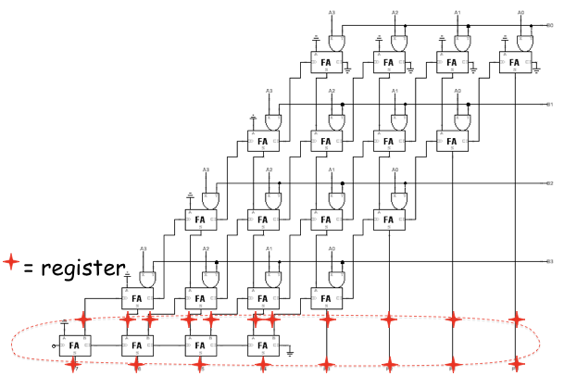
Additional Methods
Pipelining!
Used in many high performance systems
Upside: Increased throughput
Downside: Increased latency
Good if you have many independent multiplications to perform and latency is acceptable
Figure from Lecture Slides

Slide 21
Signed Multiplication Tricks
2 things we need to do for signed multiplication:
Sign extend partial products
Subtract last partial products
How can we simplify matters?
Sign extension requires additional logic
Add constants that allows us to eliminate the sign extension logic
Merge with the constant that is added when negating the last partial product

Slide 22
Trick with Sign Extension
Ex. Sign Extend 1100 to 8 bits: 11111100
Add 1000
Causes a carry to ripple 11111100 + 00001000 ----------- (1)00000100
Results in the original input with the MSB Inverted
Ex. Sign Extend 0100 to 8 bits: 00000100
Add 1000
No carry ripple 00000100 + 00001000 ----------- 00001100
Results in the original input with the MSB inverted
Allows us to eliminate the 4 AND gates required for sign extension
Need an inverter and to subtract the constant later

Slide 23
Application of Sign Extension Trick
1) Invert Last Partial Product (From Lecture Slides)
2) Add Constants (From Lecture Slides)
X3 X2 X1 X0
* Y3 Y2 Y1 Y0
--------------------
+ X3Y0 X3Y0 X3Y0 X3Y0 X3Y0 X2Y0 X1Y0 X0Y0
+ X3Y1 X3Y1 X3Y1 X3Y1 X2Y1 X1Y1 X0Y1
+ X3Y2 X3Y2 X3Y2 X2Y2 X1Y2 X0Y2
- X3Y3 X3Y3 X2Y3 X1Y3 X0Y3
-----------------------------------------
+ X3Y0 X3Y0 X3Y0 X3Y0 X3Y0 X2Y0 X1Y0 X0Y0
+ X3Y1 X3Y1 X3Y1 X3Y1 X2Y1 X1Y1 X0Y1
+ X3Y2 X3Y2 X3Y2 X2Y2 X1Y2 X0Y2
+ X3Y3 X3Y3 X2Y3 X1Y3 X0Y3 1 1 1
1
-----------------------------------------
Z7 Z6 Z5 Z4 Z3 Z2 Z1 Z0
X3 X2 X1 X0
* Y3 Y2 Y1 Y0
--------------------
+ X3Y0 X3Y0 X3Y0 X3Y0 X3Y0 X2Y0 X1Y0 X0Y0
+ 1 0 0 0
+ X3Y1 X3Y1 X3Y1 X3Y1 X2Y1 X1Y1 X0Y1
+ 1 0 0 0 0
+ X3Y2 X3Y2 X3Y2 X2Y2 X1Y2 X0Y2
+ 1 0 0 0 0 0
+ X3Y3 X3Y3 X2Y3 X1Y3 X0Y3
+ 1 (+1 from Neg)
+ 1 0 0 0 0 0 0
- 1 1 1 1 0 0 0
-----------------------------------------
Z7 Z6 Z5 Z4 Z3 Z2 Z1 Z0

Slide 24
Application of Sign Extension Trick
3) Add Constants (From Lecture Slides)
4) Negate Last Term (From Lecture Slides)
X3 X2 X1 X0
* Y3 Y2 Y1 Y0
--------------------
+ X3Y0 X2Y0 X1Y0 X0Y0
+ X3Y1 X2Y1 X1Y1 X0Y1
+ X3Y2 X2Y2 X1Y2 X0Y2
+ X3Y3 X2Y3 X1Y3 X0Y3
+ 1 (+1 from Neg)
- 1 1 1 1 0 0 0
-----------------------------------------
Z7 Z6 Z5 Z4 Z3 Z2 Z1 Z0
X3 X2 X1 X0
* Y3 Y2 Y1 Y0
--------------------
+ X3Y0 X2Y0 X1Y0 X0Y0
+ X3Y1 X2Y1 X1Y1 X0Y1
+ X3Y2 X2Y2 X1Y2 X0Y2
+ X3Y3 X2Y3 X1Y3 X0Y3
+ 1 (+1 from Neg)
+ 1 0 0 0 1 0 0 0
-----------------------------------------
Z7 Z6 Z5 Z4 Z3 Z2 Z1 Z0

Slide 25
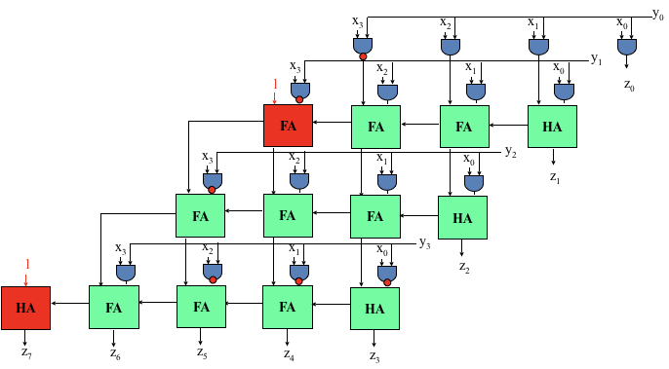
Application of Sign Extension Trick
5) Add Constants (From Lecture Slides)
Can be implemented with limited modifications to the unsigned multiplier!
Requires passing some constants to full adders and inverting some terms
X3 X2 X1 X0
* Y3 Y2 Y1 Y0
--------------------
+ X3Y0 X2Y0 X1Y0 X0Y0
+ X3Y1 X2Y1 X1Y1 X0Y1
+ X3Y2 X2Y2 X1Y2 X0Y2
+ X3Y3 X2Y3 X1Y3 X0Y3
+ 1 0 0 1 0 0 0 0
-----------------------------------------
Z7 Z6 Z5 Z4 Z3 Z2 Z1 Z0
Figure from Lecture Slides

Slide 26
Constant Coefficient Multipliers

Slide 27
Multiplying by a Constant
Observation: Every number can be factored into a sum of powers of 2
This is exactly what we do when we write a number in binary!
Ex. 11 = 2³ +2¹ + 2⁰ = 8 +2 + 1
Can we leverage this to help us multiply by constants?
Yes!
Use the distributive property
Ex. A*11 = A*(2³ +2¹ + 2⁰) = A*2³ + A*2¹ + A*2⁰
Use the fact that power of 2 multiplies are shifts
Ex. A*11 = A<<3 + A<<1 + A<<0
Turned a multiply into shifts by fixed amounts and additions

Slide 28
Extending to Use Subtraction
This concept can be extended to use subtraction
Ex. 15 = 2³ + 2² + 2¹ + 2⁰ = 2⁴ - 2⁰ =16 – 1
A*15 = A*2⁴ –A*2⁰ = A<<4 – A<<0
This is denoted by drawing a line over digits with negative weight
Ex. 15 = 001111 = 010001

Slide 29
Canonical Signed Digit
CSD Represents Numbers using 1, 0, 1 digits
Minimizes the number of nonzero digits
Minimizes the number of additions needed when multiplying by a constant
Procedure (2 Passes):
Replace any occurrence of 2 or more 1’s (01…10) with 10…10
Replace any occurrence of 2 or more 1’s (01…10) with 10…10 and Replace 0110 with 0010 and Replace 0110 with 0010
Ex (From Lecture).
0010111 = 23
0011001 (Pass 1)
0101001 (Pass 2) = 32 – 8 – 1

