Slide 1
EECS151/251A Discussion 3
Christopher Yarp
Feb. 8, 2019

Slide 2
Latches

Slide 3
Latches
There are several different flip-flop and latch types discussed in literature and the nomenclature can disagree at times.
In this class:
a “flip-flop” is assumed to be a d flip-flop (edge triggered)
a “latch” is assumed to be a device that passes a signal through when enabled (transparent) and holds the most recent value of its output when disabled (opaque)
They key difference between the flip-flop and latch is that the flip-flop only updates it’s output on a clock edge while the latch updates its output whenever its enable line is high and holds it otherwise

Slide 4
Inferring Latches in Verilog
Latches can be inferred in Verilog by not assigning a reg type in all possible cases
In the case when the reg type was not assigned, Verilog assumes it’s value should remain unchanged
This requires the previous value to be held …
… which requires a latch

Slide 5
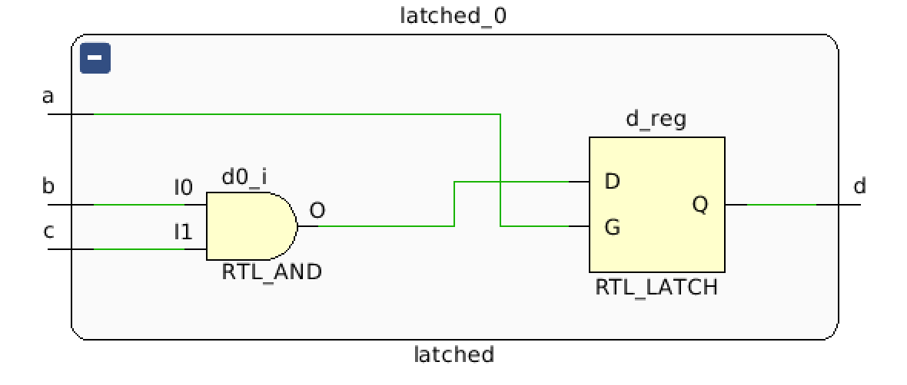
Inferring Latches in Verilog
Combinational
Latched (Sequential)
module combo(input a, input b, input c, output reg d);
always @(*) begin
if(a) begin
d = b & c;
end else begin
d = b;
end
end
endmodule
endmodule
module latched(input a, input b, input c, output reg d);
always @(*) begin
if(a) begin
d = b & c;
end
end
endmodule
WARNING: [Synth 8-327] inferring latch for variable 'd_reg'

Slide 6
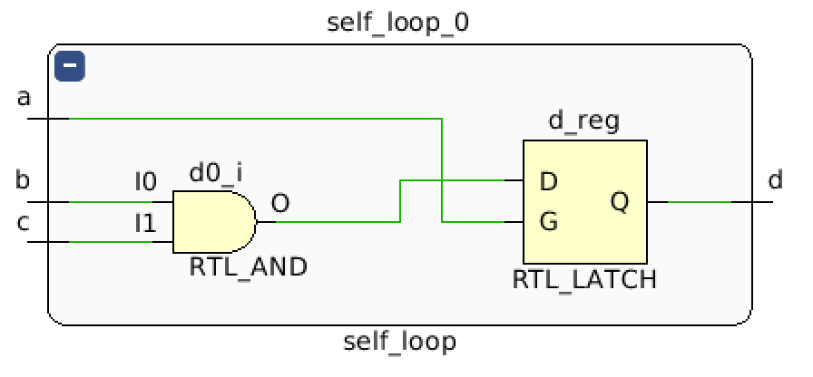
Inferring Latches in Verilog
Assigning a reg type to itself in an always @(*) block also infers a latch
module self_loop(input a, input b, input c, output reg d);
always @(*) begin
if(a) begin
d = b & c;
end else begin
d = d;
end
end
endmodule

Slide 7
Unintentional Latch Inference
Unintentional latch inference is one of the more common bugs you will probably come across
Especially when writing a big case statement or if/else tree (for example in an FSM), it can be easy to overlook assigning a reg type in all cases
Many synthesis tools will emit a warning if they infer a latch, look for these warnings and make sure any you see are intentional
Vivado Synthesis Log: WARNING: [Synth 8-327] inferring latch for variable 'd_reg'

Slide 8
Updating our understanding of always @ blocks
always @(*)
Always @(posedge clk)
Describes a combinational circuit if reg types are assigned in all possible cases
Describes a sequential circuit (with latches) if reg types are not assigned in all cases
Or are assigned to themselves
**Describes a sequential circuit (with latches) if not all signals are in the sensitivity list
The synthesis tools may assume you meant to include the signal in the sensitivity list -> Vivado does
Your simulator may not make the same assumption!
Describes sequential circuits (with flip-flops)

Slide 9
Blocking vs. Non-Blocking Assignment Conventions
… and why you should follow them

Slide 10
Sequential Logic
Non-Blocking
Blocking
always @(posedge clk)
begin
c <= a & b;
e <= c | d;
end
always @(posedge clk)
begin
c = a & b;
e = c | d;
end
Are these the same module?
Notes:
Move to discussion 2

Slide 11
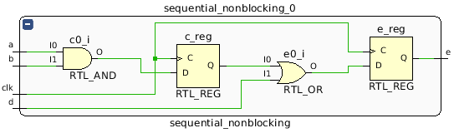
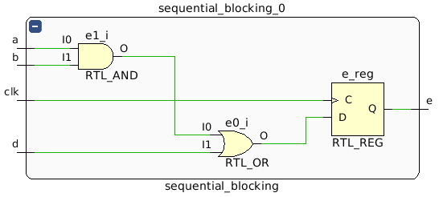
Sequential Logic
Non-Blocking
Blocking
Cycle | A | B | D | Non-Blocking | Blocking
0 | 0 | 1 | 0 | x | x
1 | 1 | 1 | 0 | x | 0
2 | 1 | 1 | 0 | 0 | 1
3 | 1 | 1 | 0 | 1 | 1
4 | 1 | 1 | 0 | 1 | 1
Are these the same module? – No

Slide 12
Combinational Logic
Blocking
Non-Blocking (Input Sensitivity)
Non-Blocking (Intermediate Sensitivity)
always @(a, b, d)
begin
c = a & b;
e = c | d;
end
always @(a, b, d)
begin
c <= a & b;
e <= c | d;
end
always @(a, b, d, c)
begin
c <= a & b;
e <= c | d;
end
Are these the same module?

Slide 13
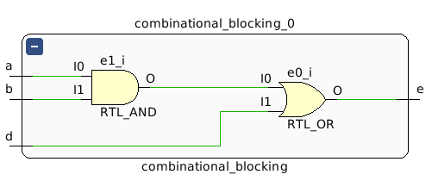
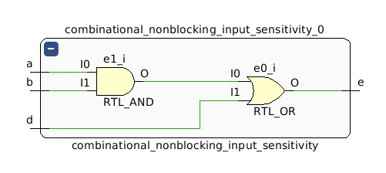
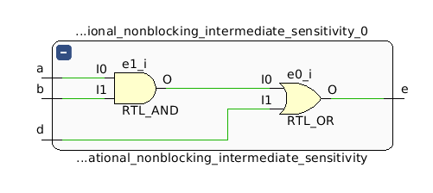
Combinational Logic
WARNING: [Synth 8-567] referenced signal 'c' should be on the sensitivity list [/home/cyarp/test_blocking/combinational_nonblocking_input_only.v:33]
Blocking
Non-Blocking (Input Sensitivity)
Non-Blocking (Intermediate Sensitivity)
Cycle | A | B | D | Blocking | Non-Blocking (Input Sensitivity) | Non-Blocking (Intermediate Sensitivity)
0 | 0 | 1 | 0 | 0 | x | 0
1 | 1 | 1 | 0 | 1 | 0 | 1
2 | 1 | 1 | 0 | 1 | 0 | 1
3 | 1 | 1 | 0 | 1 | 0 | 1
Looks like a latch. Where is it??
Are these the same module? – ??

Slide 14
Keep to the Rules of Thumb
Sequential Logic: Use non-blocking assignments
Combinational Logic: Use blocking assignments
You can always break up your sequential logic into combinational and sequential components
Allows you to cleanly have intermediates in your combinational logic
always @(*)
begin
c = a & b;
next_state = c | state;
end
always @(posedge clk)
begin
state <= next_state;
end
Comb. Logic
Comb. Logic
D
Q
clk

Slide 15
Implementing Logic Functions with LUTs

Slide 16
LUT
LUT is short for “Look Up Table”
The number of rows in the table is 2^{N} where N = number of input bits
There is 1 row for every possible input combination
If you view the inputs as a single multiple bit wide wire, you can think of it as specifying an address in the LUT
The designer determines what the output will be for each row of the table

Slide 17
Implementing Functions with LUTs
You can view the entries of an N-input LUT as being entries in a truth table for an N-input combinational logic block
Since the LUT contains a row for every possible combination of inputs, we can implement any combination function by specifying the output values for each row in the table

Slide 18
What function is this?
This LUT only outputs 1 when A, B, and C are all true.
This LUT is implementing A&B&C
{C,B,A} | C | B | A | Out
0 | 0 | 0 | 0 | 0
1 | 0 | 0 | 1 | 0
2 | 0 | 1 | 0 | 0
3 | 0 | 1 | 1 | 0
4 | 1 | 0 | 0 | 0
5 | 1 | 0 | 1 | 0
6 | 1 | 1 | 0 | 0
7 | 1 | 1 | 1 | 1

Slide 19
What function is this?
This outputs 1 only when exactly 1 of A, B, and C are true
A&(~B)&(~C) | (~A)&B&(~C) | (~A)&(~B)&C
{C,B,A} | C | B | A | Out
0 | 0 | 0 | 0 | 0
1 | 0 | 0 | 1 | 1
2 | 0 | 1 | 0 | 1
3 | 0 | 1 | 1 | 0
4 | 1 | 0 | 0 | 1
5 | 1 | 0 | 1 | 0
7 | 1 | 1 | 0 | 0
7 | 1 | 1 | 1 | 0

Slide 20
Implementing Functions with LUTs
If you can write a truth table for it (which you can with any combinational block), you can implement it with a single LUT!
This does not necessarily mean you should implement all combinational functions with a single LUT:
A combinational block with 64 inputs would require a LUT of 2⁶⁴ ≅ 1.84x10¹⁹ entries! Just storing all of the output bits would require 2305843 TB of data!
When would you want a 64 input combinational block? How about a 32 bit adder (32 bits for each input operand)
There is likely a more efficient way of implementing a 64 input combinational block

Slide 21
Building Larger LUTs
… with smaller LUTs

Slide 22
Building Larger LUTs
d | c | b | a | out
0 | 0 | 0 | 0 | o₁
0 | 0 | 0 | 1 | o₂
0 | 0 | 1 | 0 | o₃
0 | 0 | 1 | 1 | o₄
0 | 1 | 0 | 0 | o₅
0 | 1 | 0 | 1 | o₆
0 | 1 | 1 | 0 | o₇
0 | 1 | 1 | 1 | o₈
1 | 0 | 0 | 0 | o₉
1 | 0 | 0 | 1 | o₁₀
1 | 0 | 1 | 0 | o₁₁
1 | 0 | 1 | 1 | o₁₂
1 | 1 | 0 | 0 | o₁₃
1 | 1 | 0 | 1 | o₁₄
1 | 1 | 1 | 0 | o₁₅
1 | 1 | 1 | 1 | o₁₆
d | c | b | a | out
0 | 0 | 0 | 0 | o₁
0 | 0 | 0 | 1 | o₂
0 | 0 | 1 | 0 | o₃
0 | 0 | 1 | 1 | o₄
0 | 1 | 0 | 0 | o₅
0 | 1 | 0 | 1 | o₆
0 | 1 | 1 | 0 | o₇
0 | 1 | 1 | 1 | o₈
1 | 0 | 0 | 0 | o₉
1 | 0 | 0 | 1 | o₁₀
1 | 0 | 1 | 0 | o₁₁
1 | 0 | 1 | 1 | o₁₂
1 | 1 | 0 | 0 | o₁₃
1 | 1 | 0 | 1 | o₁₄
1 | 1 | 1 | 0 | o₁₅
1 | 1 | 1 | 1 | o₁₆
d | c | b | a | out
0 | 0 | 0 | 0 | o₁
0 | 0 | 0 | 1 | o₂
0 | 0 | 1 | 0 | o₃
0 | 0 | 1 | 1 | o₄
0 | 1 | 0 | 0 | o₅
0 | 1 | 0 | 1 | o₆
0 | 1 | 1 | 0 | o₇
0 | 1 | 1 | 1 | o₈
1 | 0 | 0 | 0 | o₉
1 | 0 | 0 | 1 | o₁₀
1 | 0 | 1 | 0 | o₁₁
1 | 0 | 1 | 1 | o₁₂
1 | 1 | 0 | 0 | o₁₃
1 | 1 | 0 | 1 | o₁₄
1 | 1 | 1 | 0 | o₁₅
1 | 1 | 1 | 1 | o₁₆
Let’s say we have 3 input LUTs, is there a way we could create a 4 input LUT?
Yes, let’s look at the truth table for a 4 input LUT
The bottom half of the table looks like a repeat of the top half of the table except …
The top half of the table is when d is 0, the bottom half is when d is 1
The top and bottom halves of the table have different outputs

Slide 23
Let’s split the table
When d is 0:
c | b | a | out
0 | 0 | 0 | o₁
0 | 0 | 1 | o₂
0 | 1 | 0 | o₃
0 | 1 | 1 | o₄
1 | 0 | 0 | o₅
1 | 0 | 1 | o₆
1 | 1 | 0 | o₇
1 | 1 | 1 | o₈
d | c | b | a | out
0 | 0 | 0 | 0 | o₁
0 | 0 | 0 | 1 | o₂
0 | 0 | 1 | 0 | o₃
0 | 0 | 1 | 1 | o₄
0 | 1 | 0 | 0 | o₅
0 | 1 | 0 | 1 | o₆
0 | 1 | 1 | 0 | o₇
0 | 1 | 1 | 1 | o₈
1 | 0 | 0 | 0 | o₉
1 | 0 | 0 | 1 | o₁₀
1 | 0 | 1 | 0 | o₁₁
1 | 0 | 1 | 1 | o₁₂
1 | 1 | 0 | 0 | o₁₃
1 | 1 | 0 | 1 | o₁₄
1 | 1 | 1 | 0 | o₁₅
1 | 1 | 1 | 1 | o₁₆
When d is 1:
c | b | a | out
0 | 0 | 0 | o₉
0 | 0 | 1 | o₁₀
0 | 1 | 0 | o₁₁
0 | 1 | 1 | o₁₂
1 | 0 | 0 | o₁₃
1 | 0 | 1 | o₁₄
1 | 1 | 0 | o₁₅
1 | 1 | 1 | o₁₆
Notes:
Note: Same set of inputs to each of the 2 tables. However, different outputs

Slide 24
Select which table to use
a
b
c
c | b | a | out
0 | 0 | 0 | o₁
0 | 0 | 1 | o₂
0 | 1 | 0 | o₃
0 | 1 | 1 | o₄
1 | 0 | 0 | o₅
1 | 0 | 1 | o₆
1 | 1 | 0 | o₇
1 | 1 | 1 | o₈
c | b | a | out
0 | 0 | 0 | o₉
0 | 0 | 1 | o₁₀
0 | 1 | 0 | o₁₁
0 | 1 | 1 | o₁₂
1 | 0 | 0 | o₁₃
1 | 0 | 1 | o₁₄
1 | 1 | 0 | o₁₅
1 | 1 | 1 | o₁₆
When d is 0:
When d is 1:
d
out

Slide 25
Simulation

Slide 26
Initial blocks
Initial blocks are executed at the start of the simulation
In general, initial blocks are not synthesized
You can have multiple initial blocks in the same module
Each will run in parallel starting at the beginning of the simulation
initial begin
$dumpfile("dump.vcd");
$dumpvars;
a = 1;
#4
a = 0;
#10
$finish();
end
initial begin
#1
forever begin
$strobe("time: %4d, a: %b, b: %b, c: %b", $time, a, b, c);
#2;
end
end

Slide 27
Forever blocks
Will execute a sequence of Verilog statements repeatedly forever (until the simulation ends)
initial begin
#1; //Wait 1 Cycle
forever begin //Print out values every 2 cycles
$strobe("time: %4d, a: %b, b: %b", $time, a, b);
#2;
end
end

Slide 28
Waiting for Events
So far, we have used the delay statement, #
If we want to wait for a particular even to happen, we can use another type of statement: @(posedge signal) or @(negedge signal)
initial begin
$dumpfile("dump.vcd");
$dumpvars;
a = 1;
@(negedge clk) //Continue simulation until the next negative edge of clk
a = 0;
@(negedge clk) //Continue simulation until the next negative edge of clk
#4 //Continue for 4 periods
$finish();
end

Slide 29
Repeat blocks
You may want to repeat a block of Verilog a fixed number of times
Repeat blocks let you do that
repeat (10) begin //Repeat this 10 times
signal = ~glitchy_signal;
@(negedge clk);
end

Slide 30
And even more …
There are other loop statements in Verilog
For loops
While loops
Note that these are different from generate loops
You can also fork multiple parallel threads of execution in an initial block, wait for all of them to finish, then continue executing Verilog expressions
These are called fork-join blocks
Having multiple initial blocks is also a way to create multiple parallel threads of execution that all start when the simulation starts

