Slide 1
EECS151/251A Discussion 4
Christopher Yarp
Feb. 15, 2019

Slide 2
Plan for Today
Show another Verilog trick
Talk briefly about Boolean Algebra and Optimization
Answer your questions!
Experiment!
Break into groups to do a practice problem
Reconvene to discuss solution
Work on a problem as a class

Slide 3
The casez statement
Making HW2 Problem 2c Easier!

Slide 4
casez
You want to use a case block but you want to include “don’t cares” / wildcards in your case statements instead of listing every possible case
casez allows you to insert ‘?’ to signify don’t cares / wildcards
﻿module circuit2_casez(a, y);
input [3:0] a;
output reg [1:0] y;
always @(*)
casez(a)
4'b???1: y = 2'b11;
4'b??10: y = 2'b10;
4'b?100: y = 2'b01;
4'b1000: y = 2'b00;
default: y = a[1:0];
endcase
endmodule

Slide 5
Boolean Algebra

Slide 6
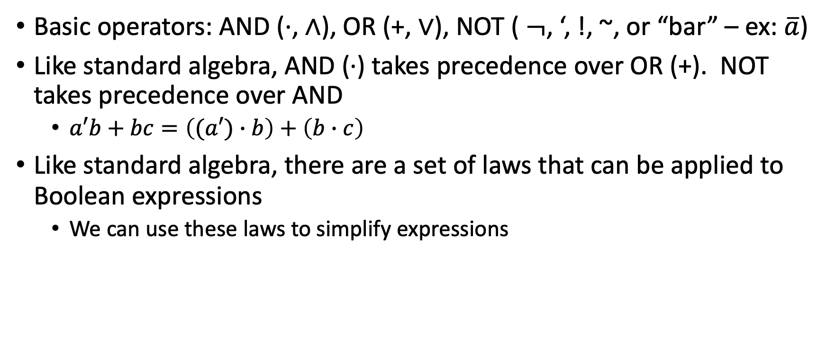
Boolean Algebra: A mathematical way of looking at logic
Basic operators: AND (·, $∧$), OR (+, $∨$), NOT ( $¬$, ‘, !, ~, or “bar” – ex: $\overline{a}$)
Like standard algebra, AND (·) takes precedence over OR (+). NOT takes precedence over AND
$a′b+bc=\left((a′)∙b\right)+\left(b∙c\right)$
Like standard algebra, there are a set of laws that can be applied to Boolean expressions
We can use these laws to simplify expressions

Slide 7
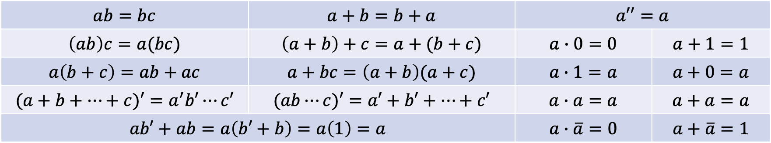
Important Properties
Many properties are listed in Lecture 6 Slides
Make a note of these properties, they will be useful!
Here is a short summary of some (but not all) of them:
$$ab=bc$$ | $$a+b=b+a$$ | $$a′′=a$$
$$\left(ab\right)c=a(bc)$$ | $$\left(a+b\right)+c=a+(b+c)$$ | $$a∙0=0$$ | $$a+1=1$$
$$a\left(b+c\right)=ab+ac$$ | $$a+bc=\left(a+b\right)(a+c)$$ | $$a∙1=a$$ | $$a+0=a$$
$$(a+b+⋯+c)′=a^{′}b′⋯c′$$ | $$(ab⋯c)′=a′+b′+⋯+c′$$ | $$a∙a=a$$ | $$a+a=a$$
$$ab′+ab=a\left(b′+b\right)=a\left(1\right)=a$$ |  | $$a∙\overline{a}=0$$ | $$a+\overline{a}=1$$

Slide 8

Useful Tricks
You can introduce redundant terms
$AB+BC=AB+BC+BC$
Why would you want to do this? To introduce terms from which you can factor

Slide 9
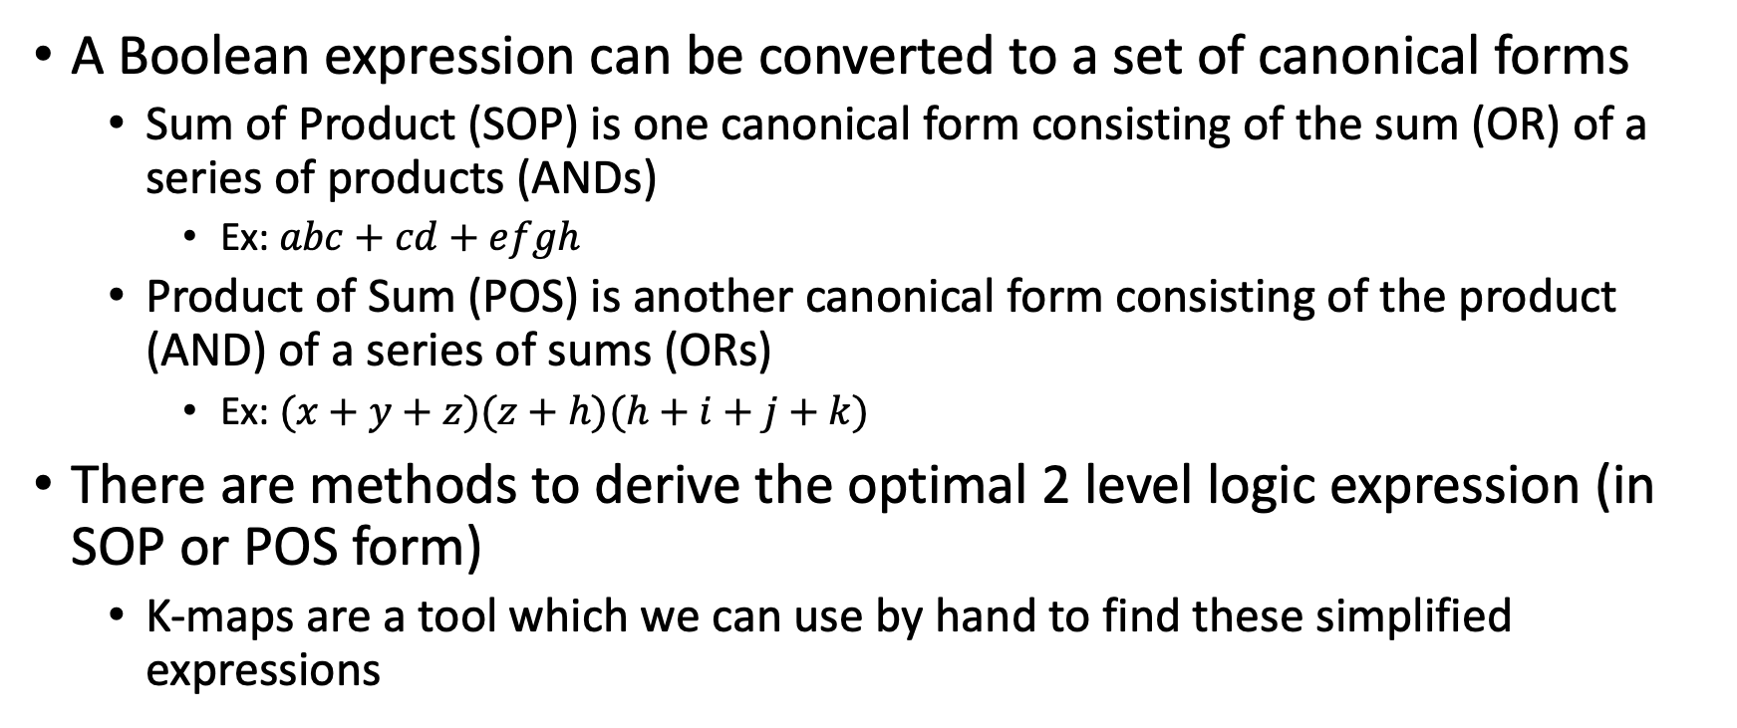
Canonical Forms
A Boolean expression can be converted to a set of canonical forms
Sum of Product (SOP) is one canonical form consisting of the sum (OR) of a series of products (ANDs)
Ex: $abc+cd+efgh$
Product of Sum (POS) is another canonical form consisting of the product (AND) of a series of sums (ORs)
Ex: $(x+y+z)(z+h)(h+i+j+k)$
There are methods to derive the optimal 2 level logic expression (in SOP or POS form)
K-maps are a tool which we can use by hand to find these simplified expressions

Slide 10
K-Maps
Method by which we can more easily observe adjacencies in the truth table
By constructing large rectangles that are even powers of 2, we can derive the minimal SOP or POS expression
CD\AB | 00 | 01 | 11 | 10
00
01
11
10
Example K-Map for 4 Input Expression

Slide 11
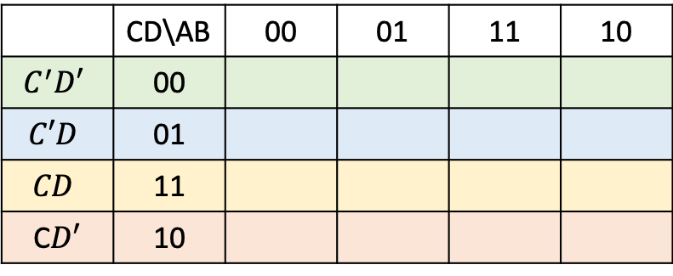
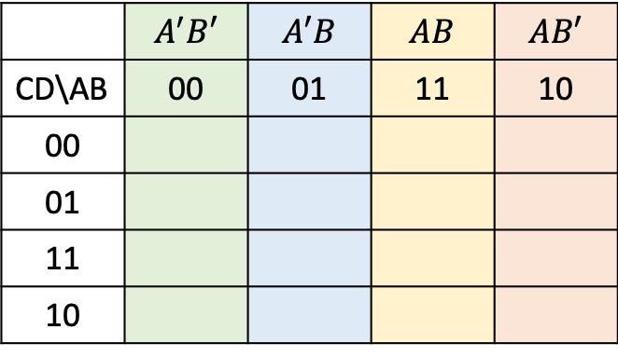
K-Maps
 | $$A^{′}B′$$ | $$A′B$$ | $$AB$$ | $$AB′$$
CD\AB | 00 | 01 | 11 | 10
00
01
11
10
 | CD\AB | 00 | 01 | 11 | 10
$$C^{′}D′$$ | 00
$$C′D$$ | 01
$$CD$$ | 11
C$D′$ | 10

Slide 12
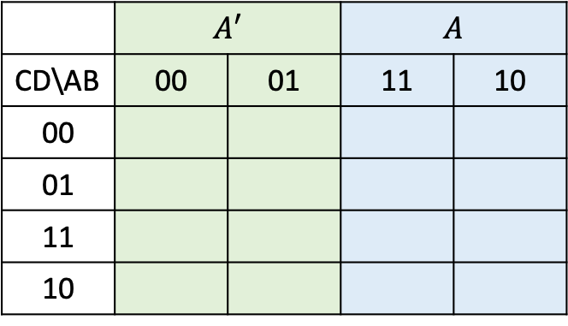
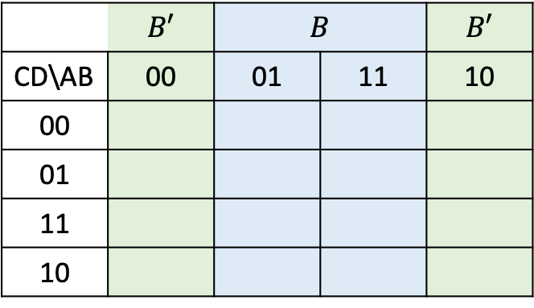
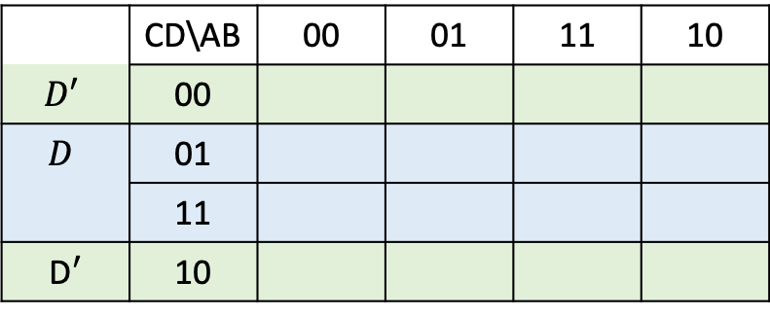
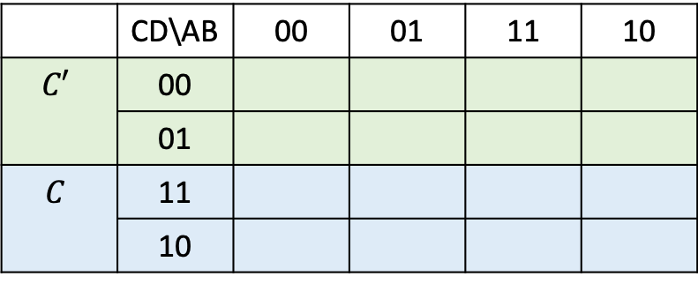
K-Maps
 | $$A′$$ |  | $$A$$
CD\AB | 00 | 01 | 11 | 10
00
01
11
10
 | CD\AB | 00 | 01 | 11 | 10
$$C′$$ | 00
 | 01
$$C$$ | 11
 | 10
 | $$B′$$ | $$B$$ |  | $$B′$$
CD\AB | 00 | 01 | 11 | 10
00
01
11
10
 | CD\AB | 00 | 01 | 11 | 10
$$D′$$ | 00
$$D$$ | 01
 | 11
D$′$ | 10

Slide 13
Finite State Machines (FSMs)

Slide 14
Finite State Machines (FSMs)
Allows us to design/model complex systems by viewing a system as having a set of possible states it can be in
The machine can only be in one state at a time
There are rules dictating how the machine moves between states
The output is either based solely on the current state (Moore style), the current state and current inputs (Mealy style), or a combination of these
Very common in digital logic
Often used to design “control logic”
ASIC and FPGA labs will both be using FSMs like this
So common that many EDA tools (including Vivado) have special optimization passes specifically for FSMs
Can also be used in software, particularly in Real-Time Systems & Mechatronics

Slide 15
Group Work

Slide 16
Problem 1
Simplify the following expressions using a k-map:
﻿module circuit1(a, b, c, y z)
input a, b, c;
output y,z;
assign y = a & b & c | a & b & ~c | a & ~b & c;
assign z = a & b | ~a & ~b;
endmodule
Use Boolean Algebra to transform the original expression into the simplified one from your k-map

Slide 17
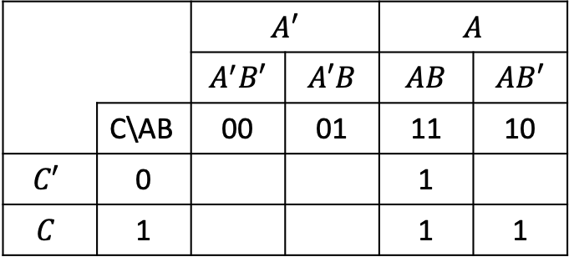
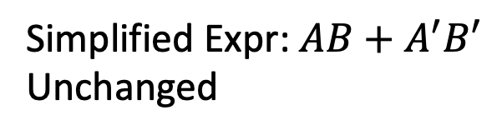
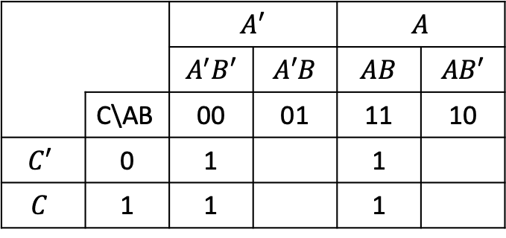
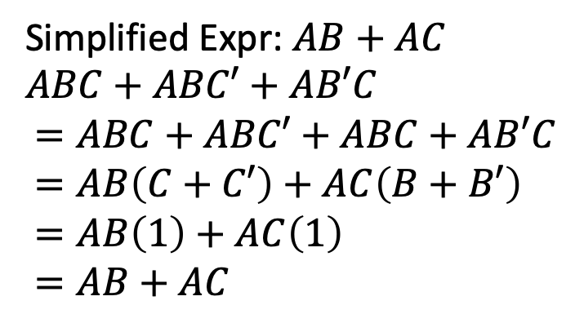
Problem 1
y
z
 |  | $$A′$$ |  | $$A$$
 |  | $$A^{′}B′$$ | $$A′B$$ | $$AB$$ | $$AB′$$
 | C\AB | 00 | 01 | 11 | 10
$$C′$$ | 0 |  |  | 1
$$C$$ | 1 |  |  | 1 | 1
 |  | $$A′$$ |  | $$A$$
 |  | $$A^{′}B′$$ | $$A′B$$ | $$AB$$ | $$AB′$$
 | C\AB | 00 | 01 | 11 | 10
$$C′$$ | 0 | 1 |  | 1
$$C$$ | 1 | 1 |  | 1
Simplified Expr: $AB+AC$
$ABC+ABC′+AB′C$
$=ABC+ABC′+ABC+AB′C$
$=AB\left(C+C′\right)+AC\left(B+B′\right)$
$=AB\left(1\right)+AC\left(1\right)$
$=AB+AC$
Simplified Expr: $AB+A^{′}B′$
Unchanged

Slide 18
Problem 2 - Designing a Door Controller for Cory
﻿The door is normally locked
Any Cal1Card will unlock the door for 10 seconds.
The card reader will not respond to another card during that time.
Cory 125 has a motion detector on the inside of the door. When motion is detected, the door may be opened from the inside for up to 30 seconds without sounding the alarm.
Any use of a Cal1Card during this time should unlock the door for the appropriate amount of time.
The alarm should not go off while the door is unlocked.
The alarm may still be disabled by the motion detector after the door is locked again.
Any activation of the motion detector while the alarm is disabled will delay the re-arming of the alarm until 30 seconds later.
If the door is opened without the motion detector being triggered or a Cal1Card being used, the alarm sounds.
The door can be returned to normal with the lab manager’s Cal1Card (ID = 0001).
All entry into Cory 125 is disabled when the alarm is sounding.
Timers for 10 and 30 seconds are provided
Both have a start input which resets and starts the counter when asserted
Both timers have a ”done” signal which will be brought high for 1 cycle when the timer expires

Slide 19
Problem 2 - Designing a Door Controller for Cory
Despite what seems like a simple job, the state machine for this problem can get complex
Mostly because of special cases we need to consider
We’ll make this manageable by looking at each state, one at a time

Slide 20
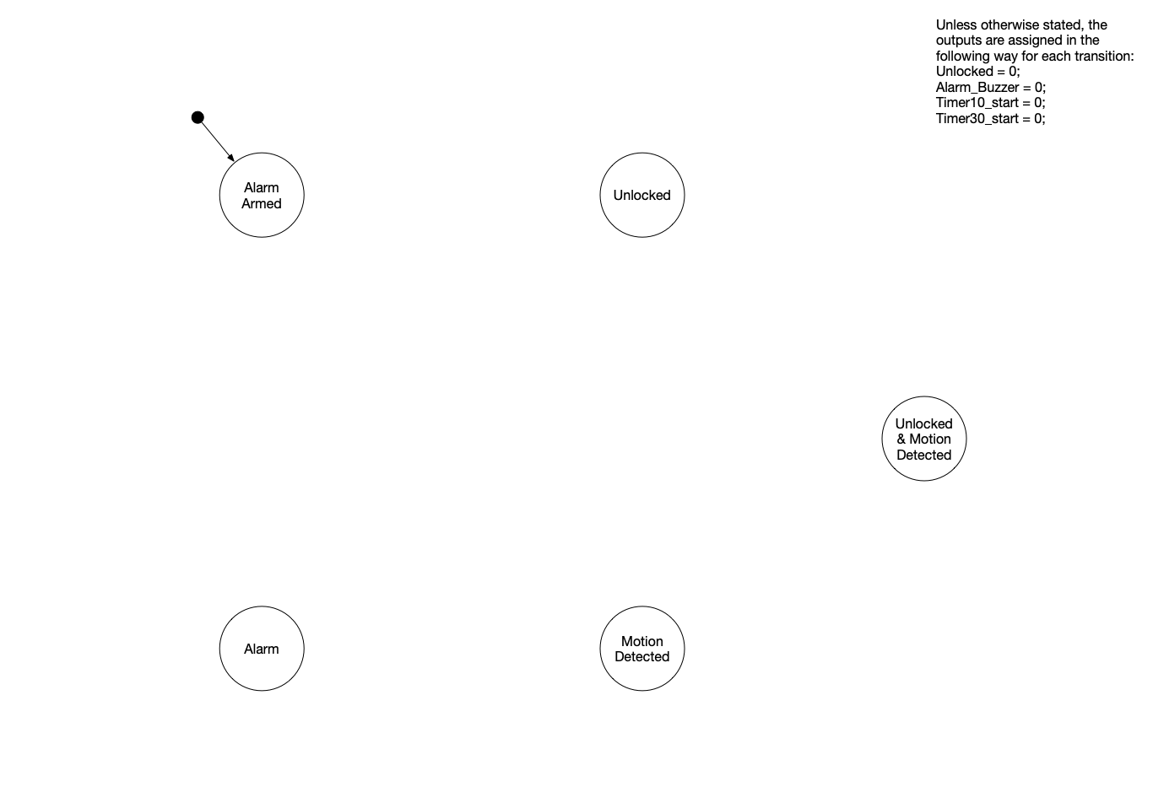

Slide 21
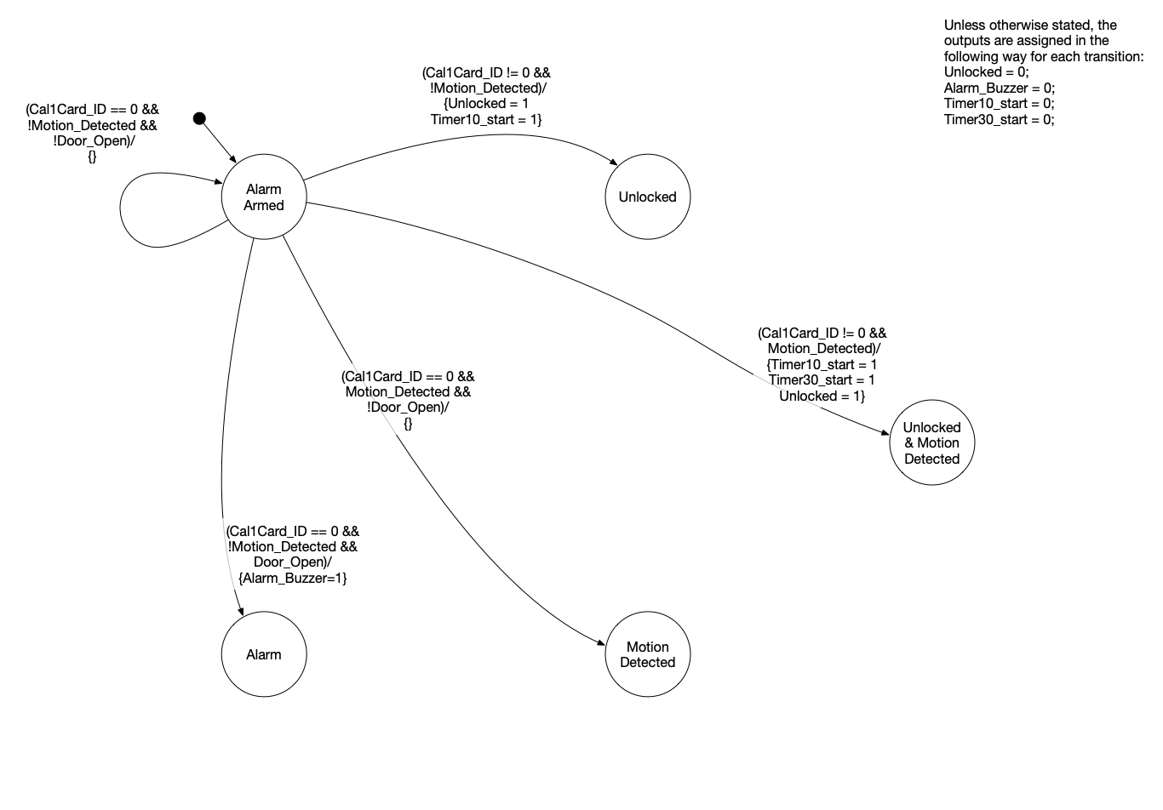

Slide 22
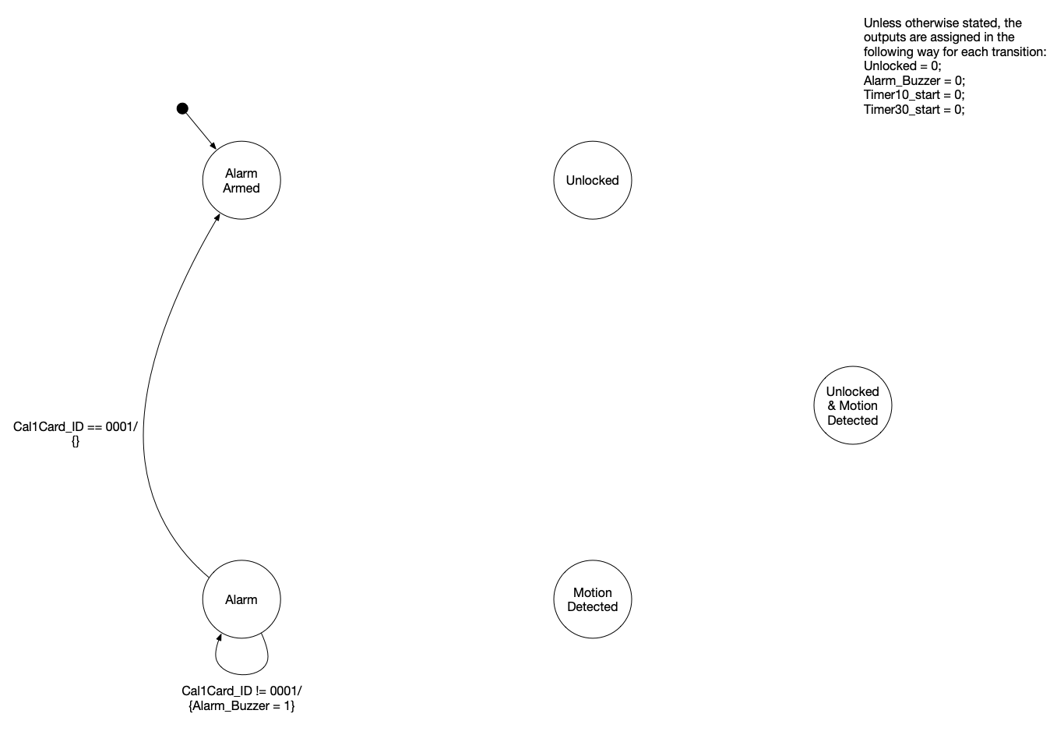

Slide 23
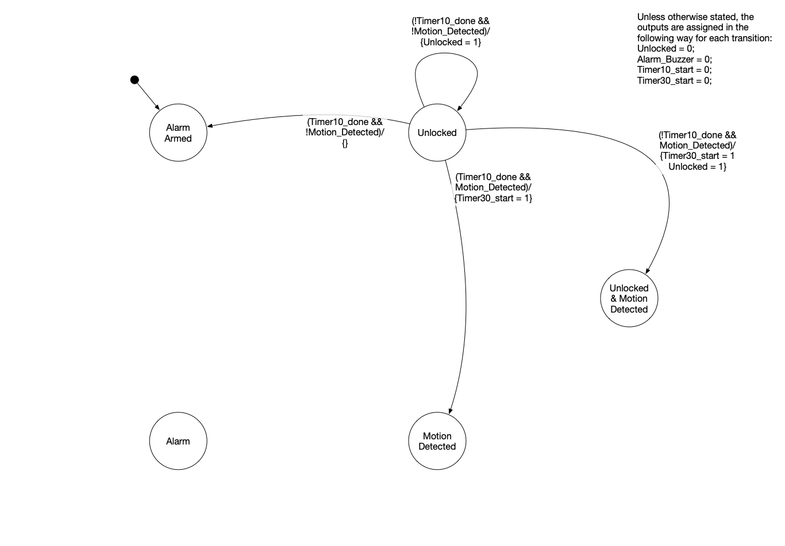

Slide 24
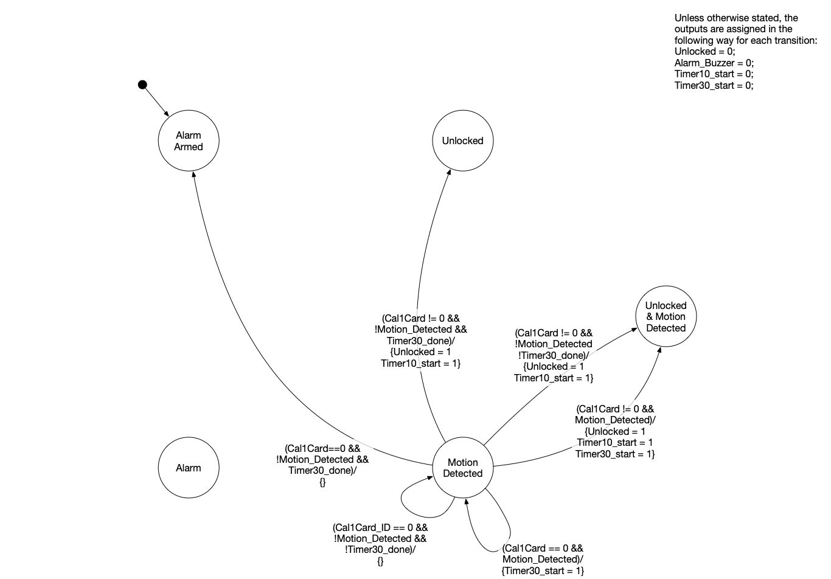

Slide 25
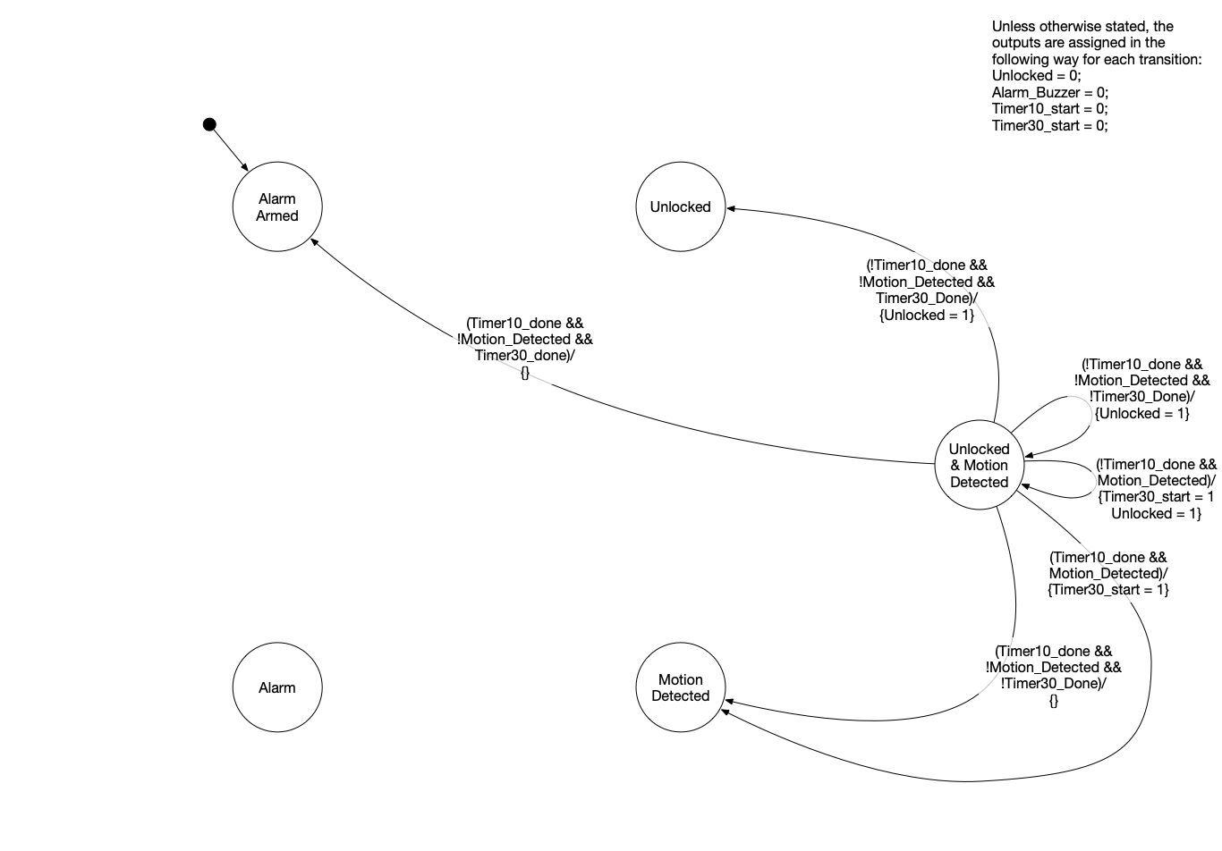

Slide 26
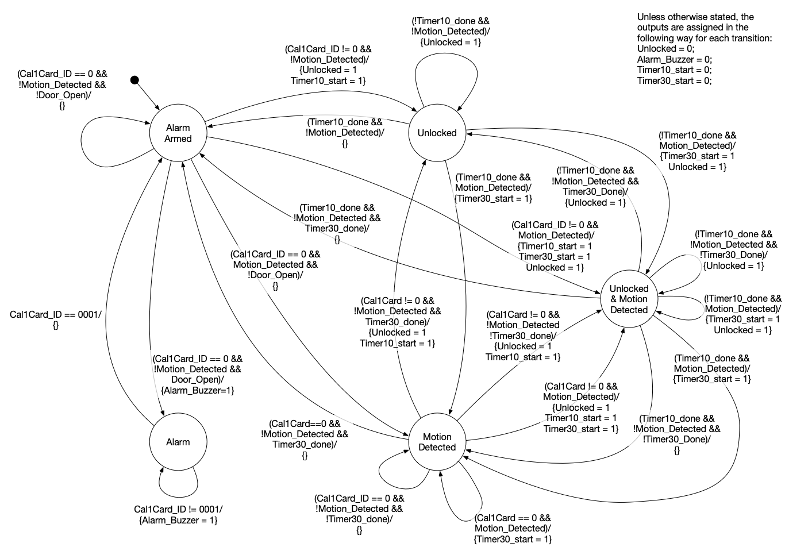

Slide 27
Observations about this FSM
Mealy vs. Moore
We designed a Mealy style FSM for the door controller
Would we need any extra states to formulate it as a Moore machine?
How about all those times we restarted timers?
If we had information on whether or not timers were running, we probably could have eliminated the “Unlocked & Motion Detected” state
Would have required changing/adding arcs to the FSM

