Slide 1
EECS151/251A Discussion 5
Christopher Yarp
Feb. 21, 2019

Slide 2
Plan for Today
FSM Practice
Ready/Valid Interfaces
Transistor Level Logic Implementation
Logic with Mux & Pass Gates

Slide 3
FSM Practice

Slide 4
Designing a Door Controller for Cory 125
﻿The door is normally locked
Any Cal1Card will unlock the door for 10 seconds.
The card reader will not respond to another card during that time.
Cory 125 has a motion detector on the inside of the door. When motion is detected, the door may be opened from the inside for up to 30 seconds without sounding the alarm.
Any use of a Cal1Card during this time should unlock the door for the appropriate amount of time.
The alarm should not go off while the door is unlocked.
The alarm may still be disabled by the motion detector after the door is locked again.
Any activation of the motion detector while the alarm is disabled will delay the re-arming of the alarm until 30 seconds later.
If the door is opened without the motion detector being triggered or a Cal1Card being used, the alarm sounds.
The door can be returned to normal with the lab manager’s Cal1Card (ID = 0001).
All entry into Cory 125 is disabled when the alarm is sounding.
Timers for 10 and 30 seconds are provided
Both have a start input which resets and starts the counter when asserted
Both timers have a ”done” signal which will be brought high for 1 cycle when the timer expires

Slide 5
Designing a Door Controller for Cory 125
Despite what seems like a simple job, the state machine for this problem can get complex
Mostly because of special cases we need to consider
We’ll make this manageable by looking at each state, one at a time

Slide 6
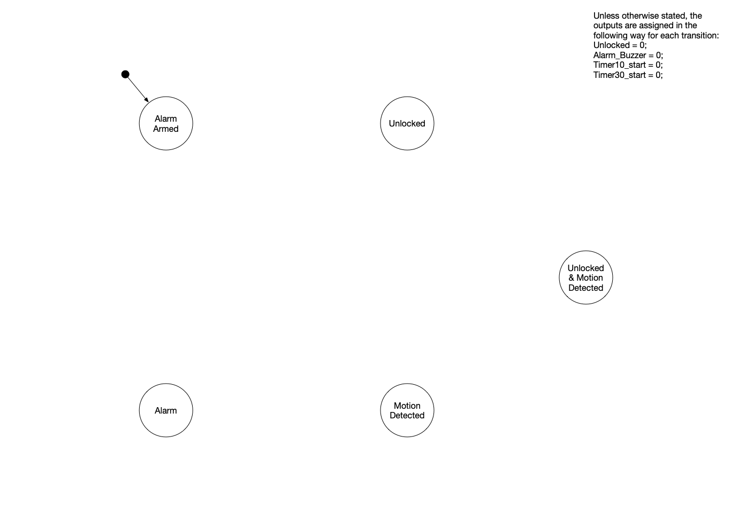

Slide 7
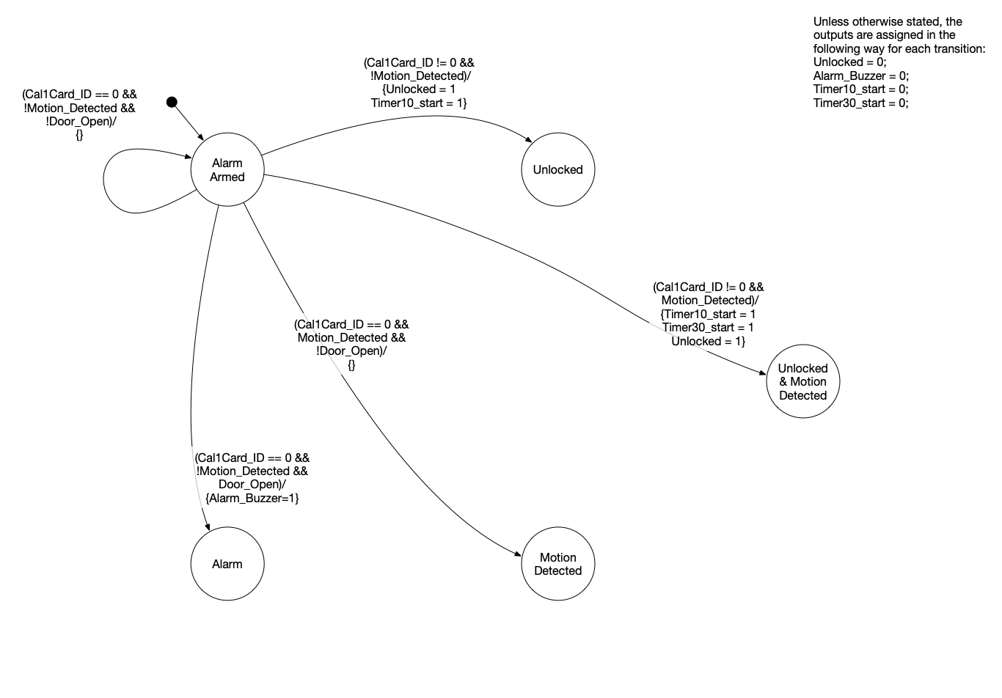

Slide 8
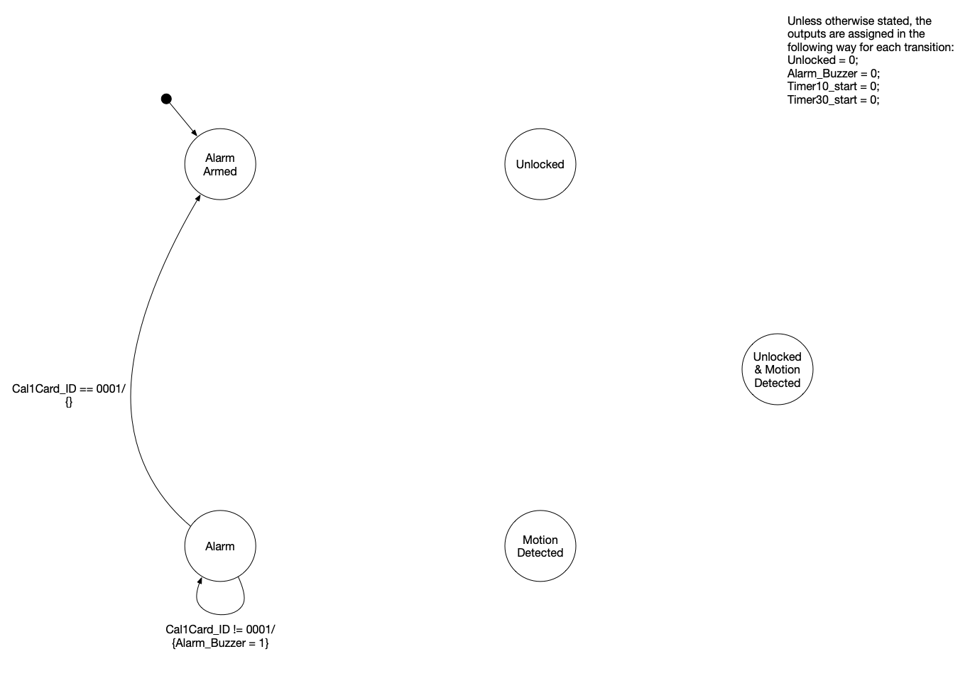

Slide 9
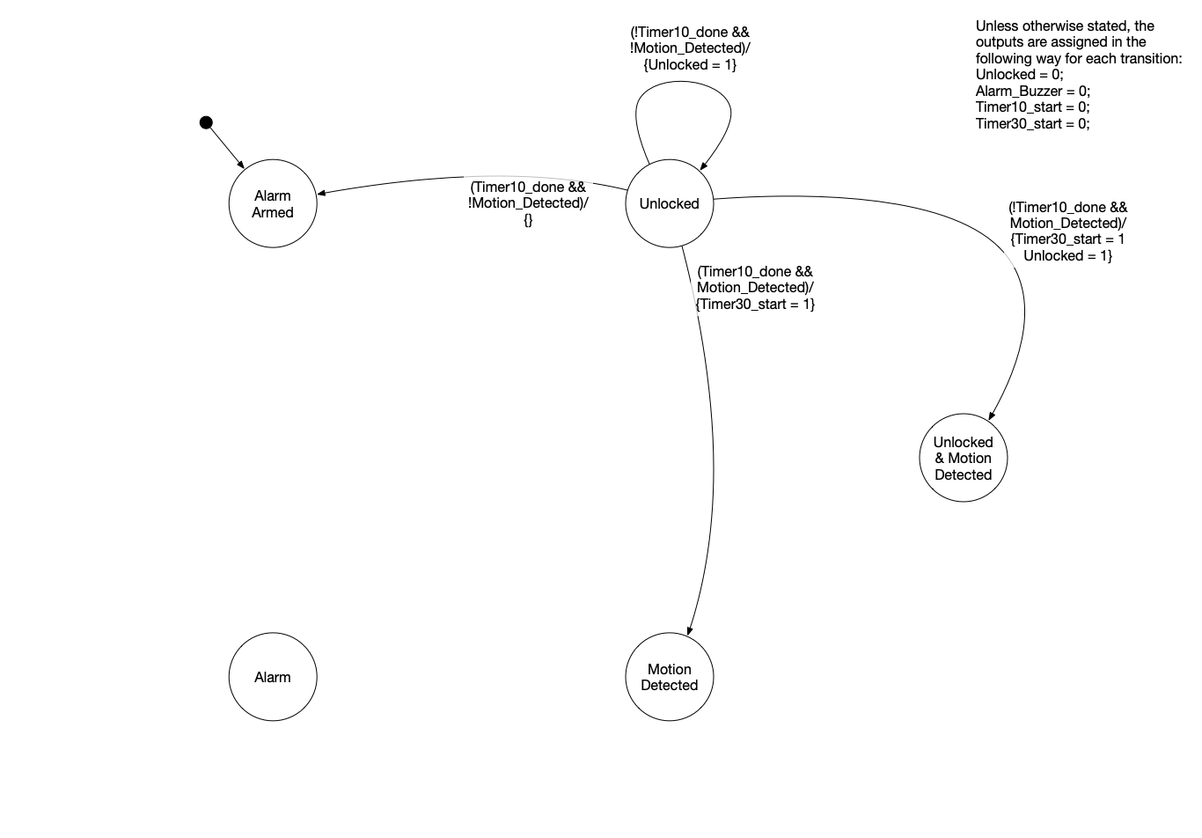

Slide 10
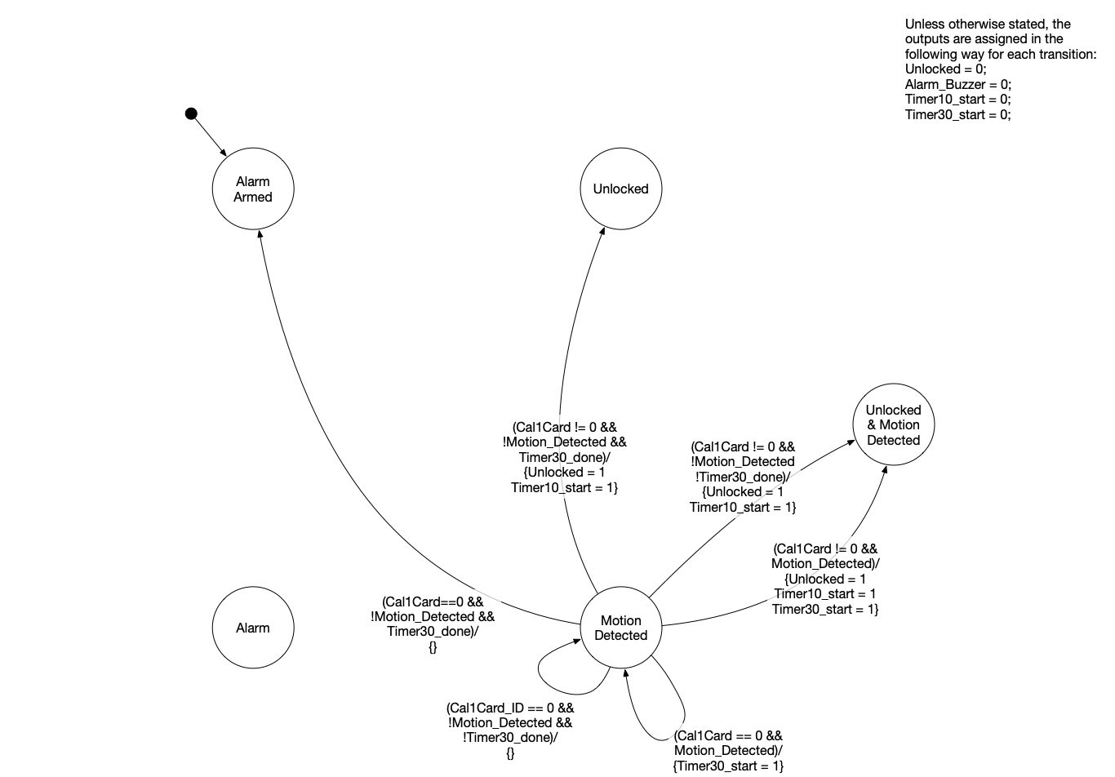

Slide 11
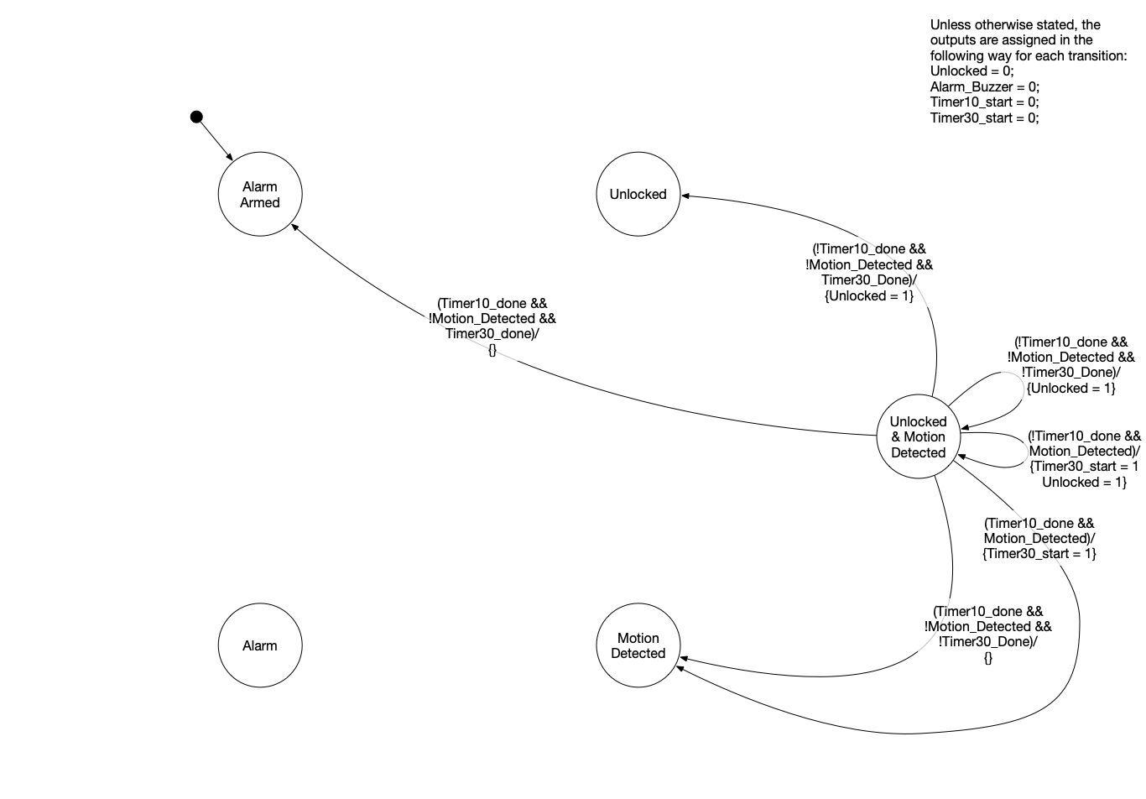

Slide 12
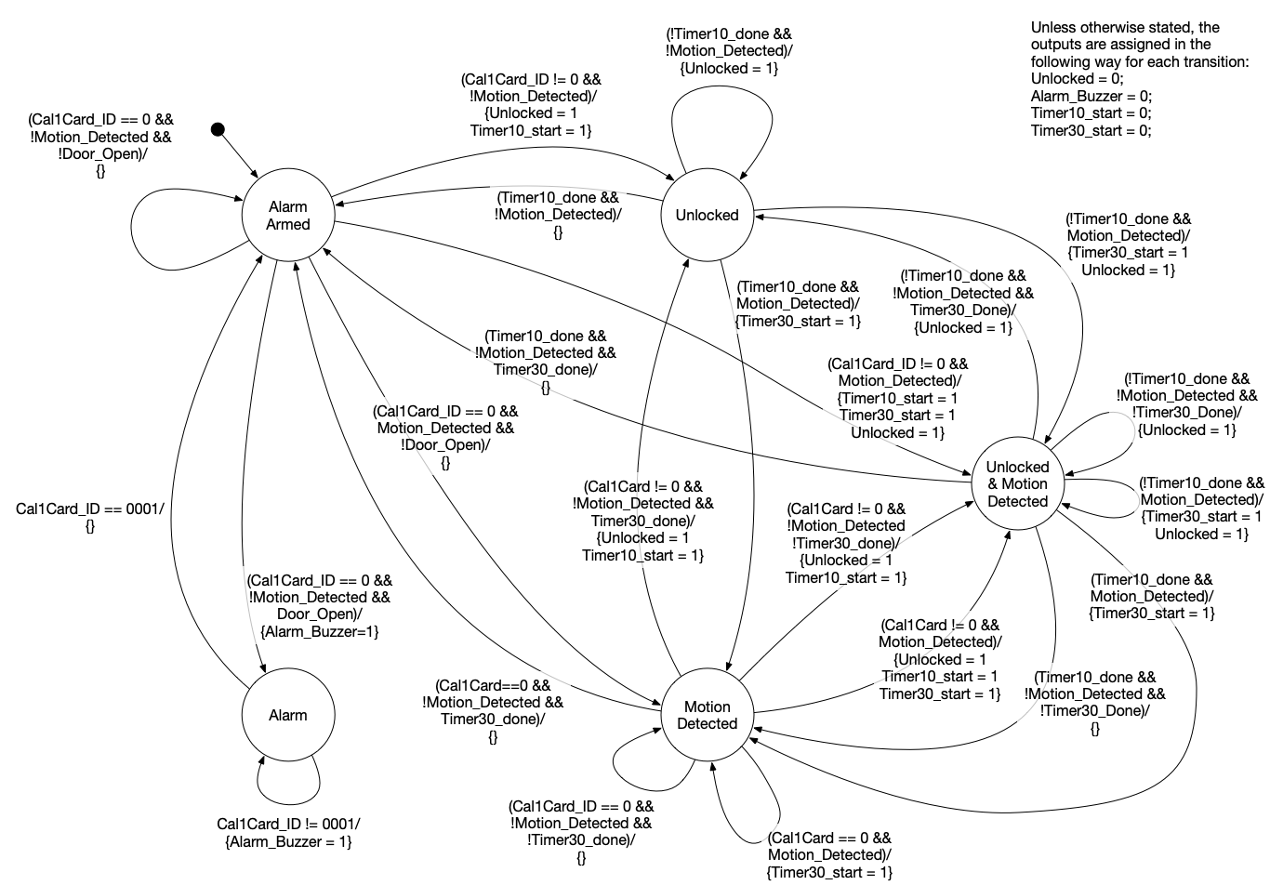

Slide 13
Observations about this FSM
Mealy vs. Moore
We designed a Mealy style FSM for the door controller
Would we need any extra states to formulate it as a Moore machine?
How about all those times we restarted timers?
If we had information on whether or not timers were running, we probably could have eliminated the “Unlocked & Motion Detected” state
Would have required changing/adding arcs to the FSM

Slide 14
Ready/Valid Interfaces

Slide 15
Interfacing Between Modules & Ready/Valid
Up to this point, we have been primarily using modules that we have written ourselves.
We know how the control logic for our modules works and how to interface with it
What if we want to integrate with modules written by others, without knowing all the specifics of their control logic?
Standard interfaces, such as ready/valid, help us do this

Slide 16
Semantics of Ready/Valid Transfer
The producer (source, master) is sending data to the consumer (sink, slave)
The data to be transferred is placed on the ‘data’ line
Valid = 1 indicates that the values on the ‘data’ line are valid
Ready = 1 indicates that the consumer is ready to consume ‘data’ on the next posedge of the clock
A transfer occurs at the positive edge of the clock when ready and valid are both high

Slide 17
Semantics of Ready/Valid Transfer

Slide 18
Semantics behind Ready/Valid Use
What are the responsibilities for the producing and consuming modules?
When should producer required to pull the valid line high?
Should the producer wait for the ready line to go high before pulling valid?
When should the consumer pull the ready line high?
Should the consumer wait for valid data to be present before pulling ready?
Module writers taking opposing assumptions can result in deadlock
Producer is waiting for consumer to become ready before raising valid high
Consumer is waiting for the producer to present valid data before becoming ready
Nothing will ever happen! They will wait for each other forever!

Slide 19
AXI4-Stream Ready/Valid Semantics
AXI4 Streaming is a Ready/Valid style interface standard which answers the question of what the producer and consumer are responsible for
Standard developed by ARM as part of the AMBA Series of Standards
A common bus standard used in SoC and FPGA projects
Most signal names have a ‘t’ prepended to them
tvalid, tdata, tready
Signal clock is called aclk
Reset is called aresetn (active low)
Contains additional optional control lines
ex. tlast denotes the last word transferred in a packet
Full specification available at: http://infocenter.arm.com/help/index.jsp?topic=/com.arm.doc.ihi0051a/index.html (requires registration with ARM)

Slide 20
AXI4-Stream Ready/Valid Semantics Summary
Transfer occurs when both valid and ready are asserted (at a positive clock edge)
Producer:
The producer is cannot to wait for ready to be high before asserting valid
The producer must assert valid when possible
The producer must hold valid high and data constant until transaction occurs
Consumer:
The consumer may wait for valid to be true before asserting ready
This can waist a clock cycle
The consumer may assert ready when no valid data is present
This is the best option for most consumers as transactions will occur on the next clk rising edge
The consumer is allowed to de-assert ready (if ready was already asserted) before valid is asserted

Slide 21
Implementing Logic With Pass Gates

Slide 22
Implementing Logic with Pass Gates

Slide 23
Implementing Logic with Pass Gates

