Slide 1
EECS151/251A Discussion 7
Christopher Yarp
Mar. 8, 2019

Slide 2
Plan for Today
Deriving Inverter Characteristics
Practice Problem
Your Questions

Slide 3
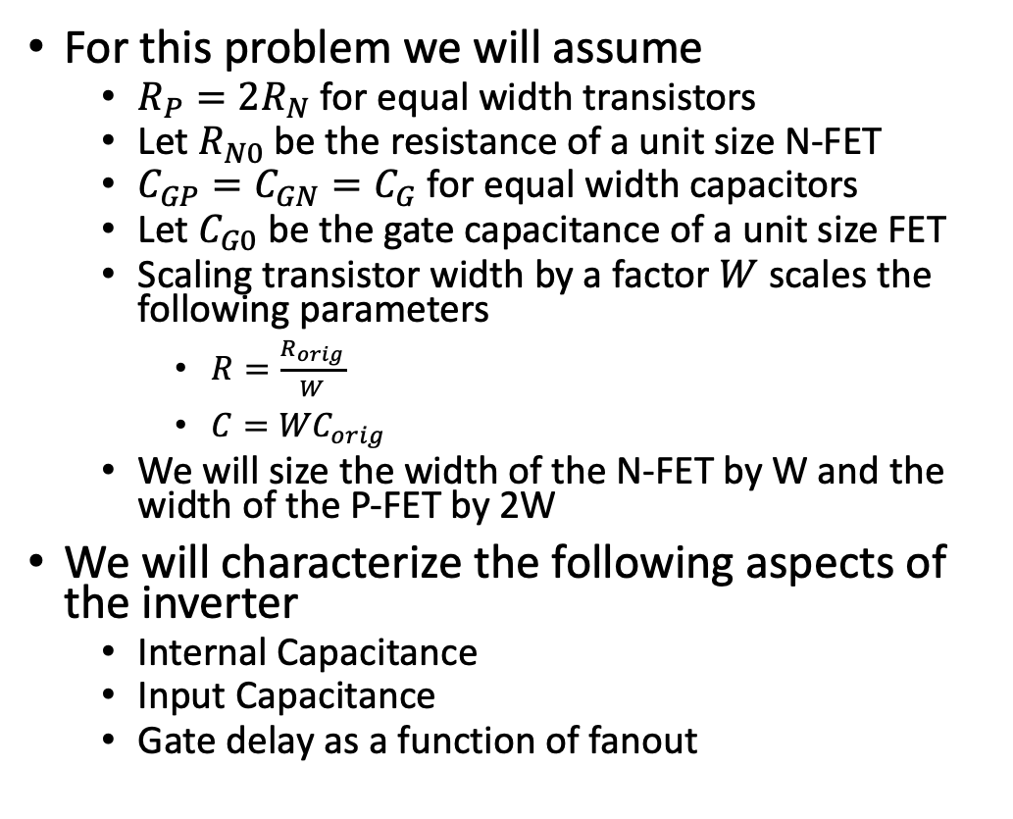
Inverter Characteristics
For this problem we will assume
$R_{P}=2R_{N}$ for equal width transistors
Let $R_{N0}$ be the resistance of a unit size N-FET
$C_{GP}=C_{GN}=C_{G}$ for equal width capacitors
Let $C_{G0}$ be the gate capacitance of a unit size FET
Scaling transistor width by a factor $W$ scales the following parameters
$R=\frac{R_{orig}}{W}$
$C={WC}_{orig}$
We will size the width of the N-FET by W and the width of the P-FET by 2W
We will characterize the following aspects of the inverter
Internal Capacitance
Input Capacitance
Gate delay as a function of fanout

Slide 4
Inverter Parasitics
The source capacitances are shorted to the voltage ranges and can be ignored
An equivalent model can be made by tying all capacitors connected to static voltage rails to ground (see Weste & Harris pg 144)

Slide 5
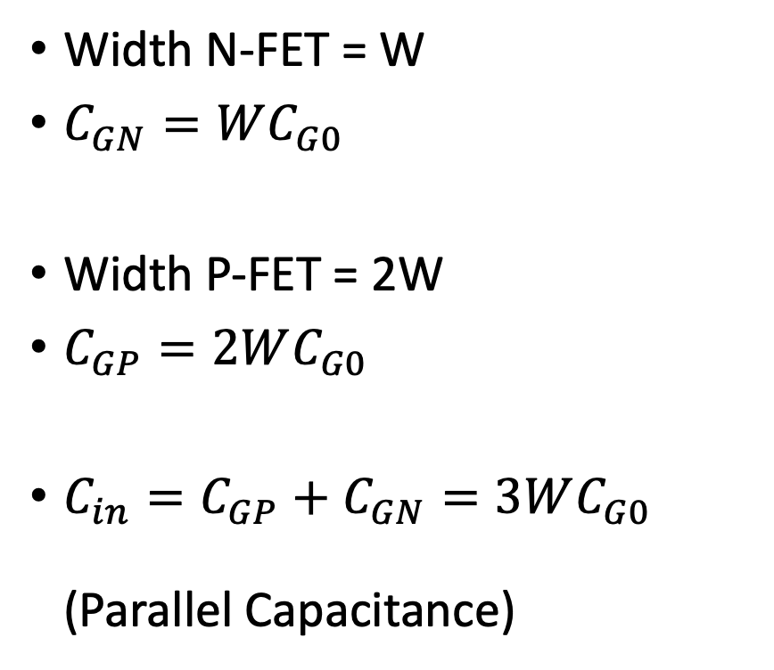
Input Capacitance
Width N-FET = W
$C_{GN}=WC_{G0}$
Width P-FET = 2W
$C_{GP}=2WC_{G0}$
${C_{in}=C}_{GP}+C_{GN}=3WC_{G0}$ (Parallel Capacitance)

Slide 6
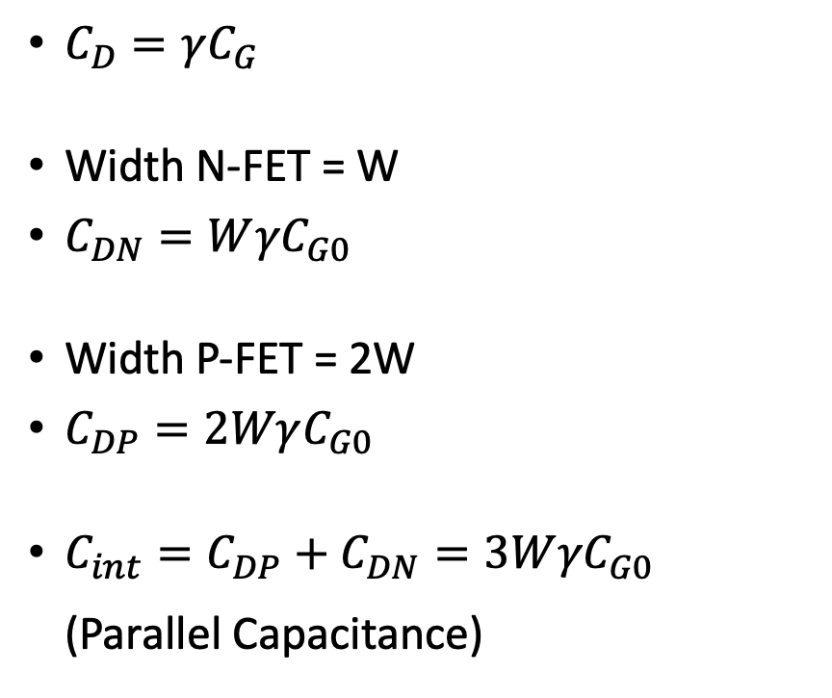
Internal Capacitance
$C_{D}=γC_{G}$
Width N-FET = W
$C_{DN}=W{γC}_{G0}$
Width P-FET = 2W
$C_{DP}=2WγC_{G0}$
${C_{int}=C}_{DP}+C_{DN}=3W{γC}_{G0}$ (Parallel Capacitance)

Slide 7

Output Capacitance
${C_{out}=C}_{int}+C_{load}=3W{γC}_{G0}+C_{load}$ (Parallel Capacitance)

Slide 8
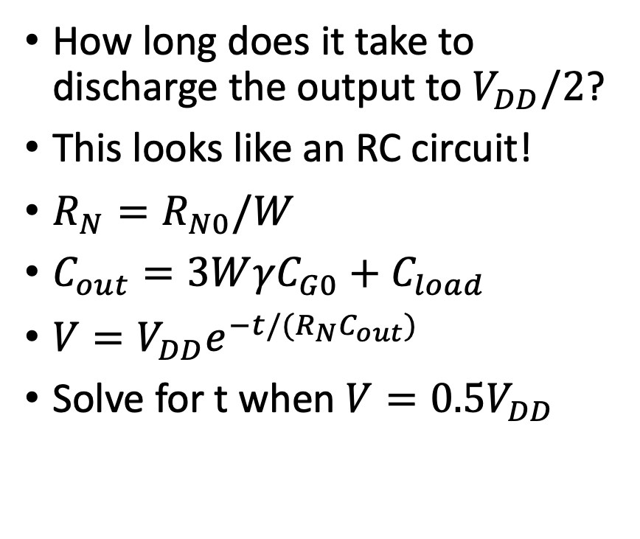
Discharge Time
How long does it take to discharge the output to $V_{DD}/2$?
This looks like an RC circuit!
$R_{N}=R_{N0}/W$
$C_{out}=3W{γC}_{G0}+C_{load}$
$V=V_{DD}e^{−t/(R_{N}C_{out})}$
Solve for t when $V=0.5V_{DD}$

Slide 9
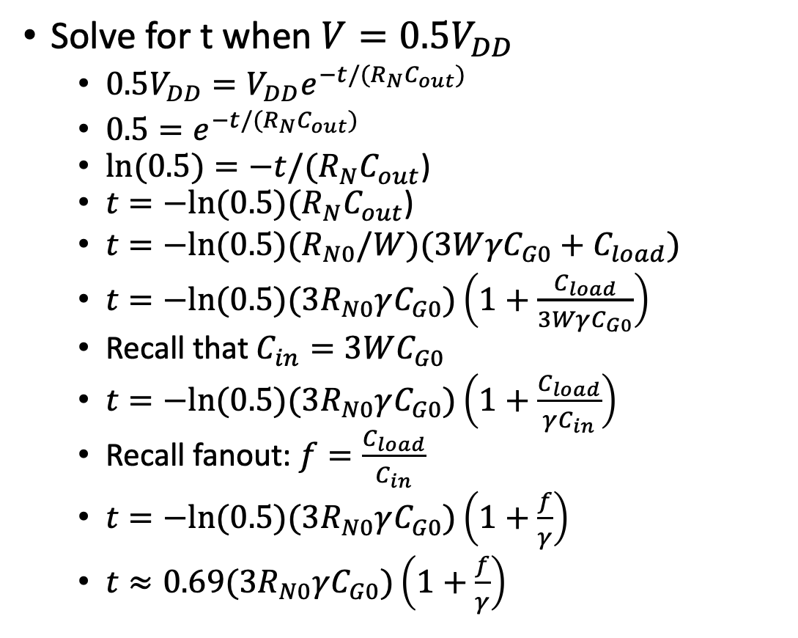
Discharge Time
Solve for t when $V=0.5V_{DD}$
$0.5V_{DD}=V_{DD}e^{−t/(R_{N}C_{out})}$
$0.5=e^{−t/(R_{N}C_{out})}$
$\ln{(0.5)}=−t/(R_{N}C_{out}$)
$t=−ln⁡(0.5)(R_{N}C_{out}$)
$t=−ln⁡(0.5)(R_{N0}/W)(3W{γC}_{G0}+C_{load})$
$t=−ln⁡(0.5)({3R}_{N0}γC_{G0})\left(1+\frac{C_{load}}{3WγC_{G0}}\right)$
Recall that $C_{in}=3WC_{G0}$
$t=−ln⁡(0.5)({3R}_{N0}γC_{G0})\left(1+\frac{C_{load}}{γC_{in}}\right)$
Recall fanout: $f=\frac{C_{load}}{C_{in}}$
$t=−ln⁡(0.5)({3R}_{N0}γC_{G0})\left(1+\frac{f}{γ}\right)$
$t≈0.69({3R}_{N0}γC_{G0})\left(1+\frac{f}{γ}\right)$

Slide 10
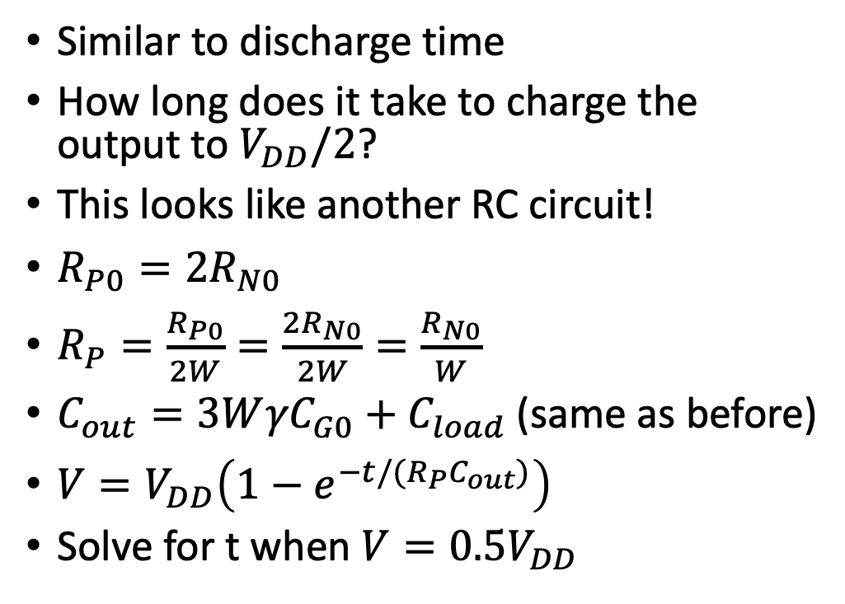
Charge Time
Similar to discharge time
How long does it take to charge the output to $V_{DD}/2$?
This looks like another RC circuit!
$R_{P0}={2R}_{N0}$
$R_{P}=\frac{R_{P0}}{2W}=\frac{{2R}_{N0}}{2W}=\frac{R_{N0}}{W}$
$C_{out}=3W{γC}_{G0}+C_{load}$(same as before)
$V=V_{DD}\left(1−e^{−t/(R_{P}C_{out})}\right)$
Solve for t when $V=0.5V_{DD}$

Slide 11
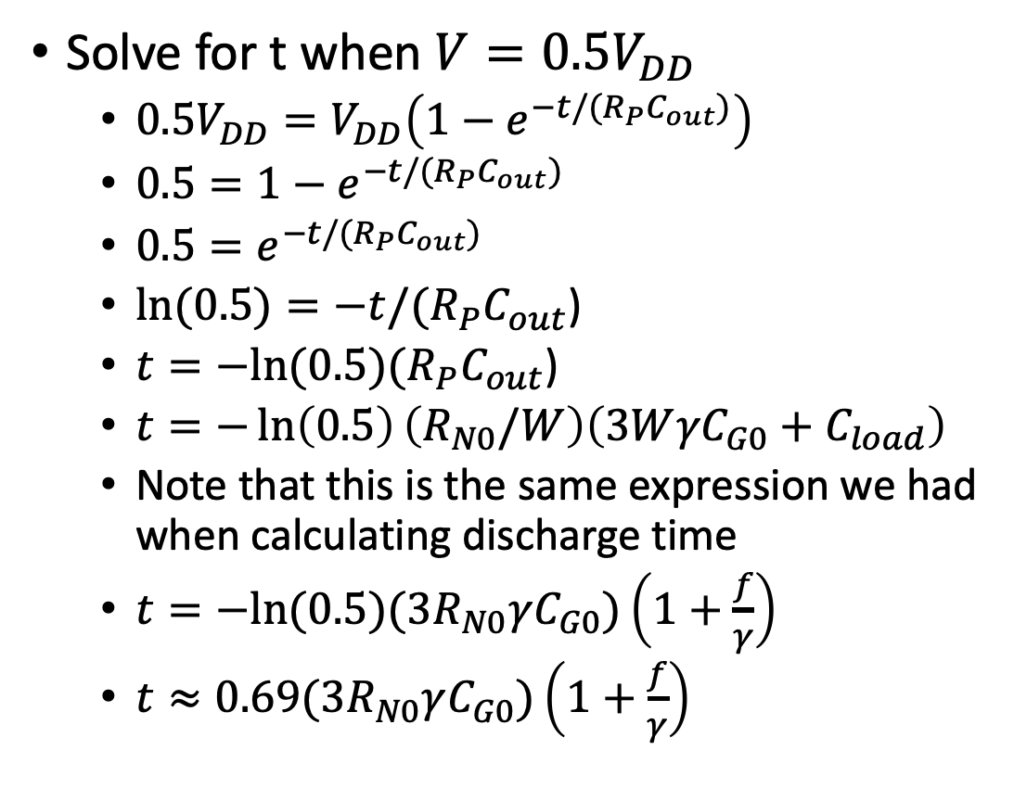
Charge Time
Solve for t when $V=0.5V_{DD}$
$0.5V_{DD}=V_{DD}\left(1−e^{−t/(R_{P}C_{out})}\right)$
$0.5=1−e^{−t/(R_{P}C_{out})}$
$0.5=e^{−t/(R_{P}C_{out})}$
$\ln{(0.5)}=−t/(R_{P}C_{out}$)
$t=−ln⁡(0.5)(R_{P}C_{out}$)
$t=−\ln\left(0.5\right)\left(R_{N0}/W\right)\left(3W{γC}_{G0}+C_{load}\right)$
Note that this is the same expression we had when calculating discharge time
$t=−ln⁡(0.5)({3R}_{N0}γC_{G0})\left(1+\frac{f}{γ}\right)$
$t≈0.69({3R}_{N0}γC_{G0})\left(1+\frac{f}{γ}\right)$

Slide 12
Notes on the Inverter
The sizing of the P-MOS to be 2x the width of the N-MOS was not an accident!
It caused the charge time and discharge times to be balanced
Generally, we try to design gates that exhibit balanced charge and discharge time

Slide 13
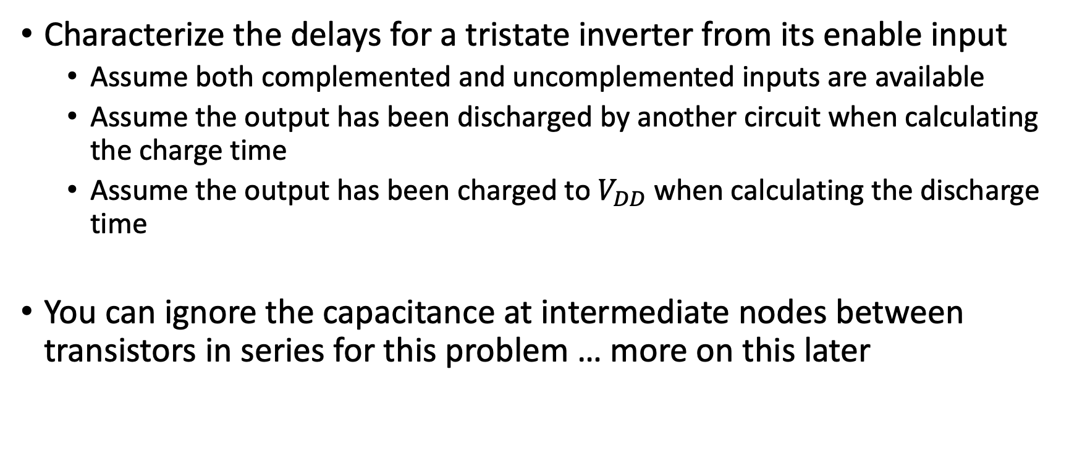
More Complex Gates – Tristate Inverter
Characterize the delays for a tristate inverter from its enable input
Assume both complemented and uncomplemented inputs are available
Assume the output has been discharged by another circuit when calculating the charge time
Assume the output has been charged to $V_{DD}$ when calculating the discharge time
You can ignore the capacitance at intermediate nodes between transistors in series for this problem … more on this later

Slide 14
Tristate Inverter Model

Slide 15
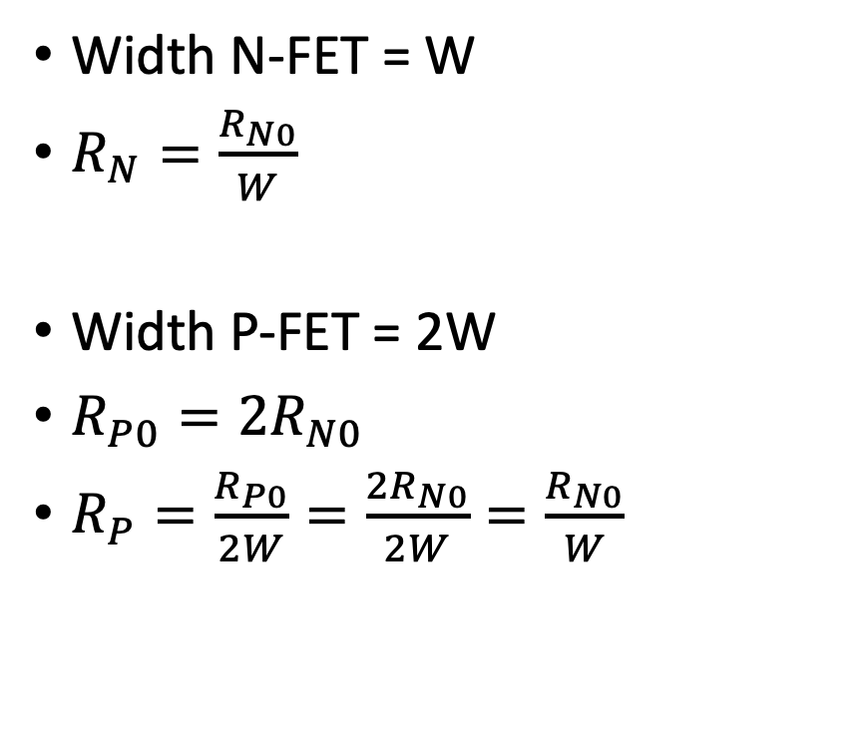
Calculating Resistance
Width N-FET = W
$R_{N}=\frac{R_{N0}}{W}$
Width P-FET = 2W
$R_{P0}={2R}_{N0}$
$R_{P}=\frac{R_{P0}}{2W}=\frac{{2R}_{N0}}{2W}=\frac{R_{N0}}{W}$

Slide 16
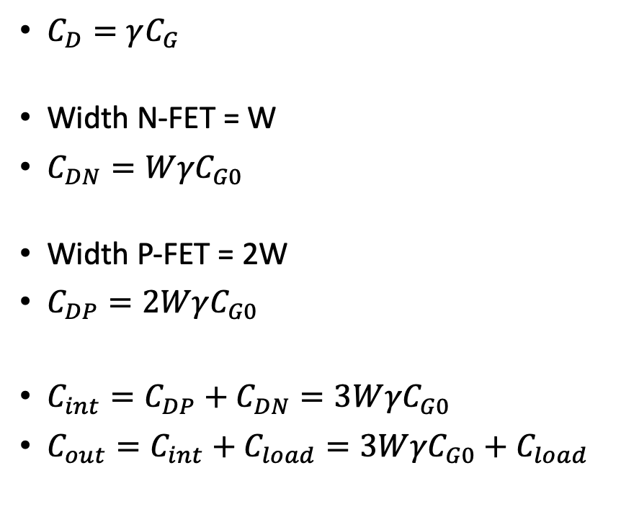
Calculating Capacitance
$C_{D}=γC_{G}$
Width N-FET = W
$C_{DN}=W{γC}_{G0}$
Width P-FET = 2W
$C_{DP}=2WγC_{G0}$
${C_{int}=C}_{DP}+C_{DN}=3W{γC}_{G0}$
${C_{out}=C}_{int}+C_{load}=3W{γC}_{G0}+C_{load}$

Slide 17
Ignoring the Intermediate Node Capacitance
When we have transistors in series, there exists some parasitic capacitance at the intermediate node they share
This capacitance stops us from using simple first order RC charge/discharge equations because we now need to account for charge that is stored in the intermediate node capacitance
For small intermediate node capacitance values, ignoring this second order effect will not change the calculated propagation delay by too much*
For a more accurate first order approximation that does not completely ignore the intermediate node capacitance, see Weste & Harris pg. 150.

Slide 18
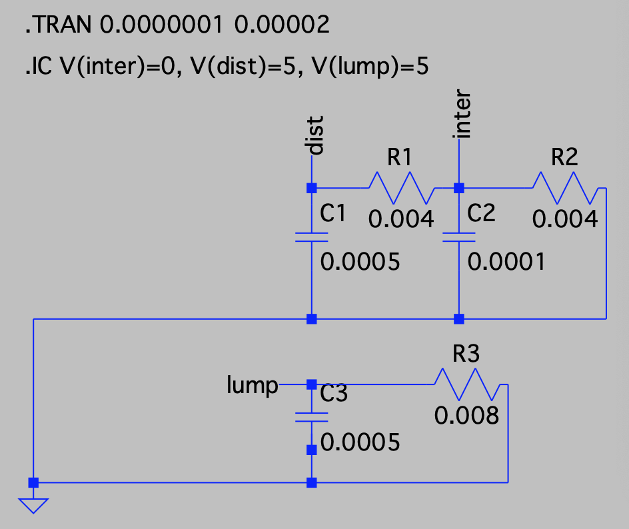
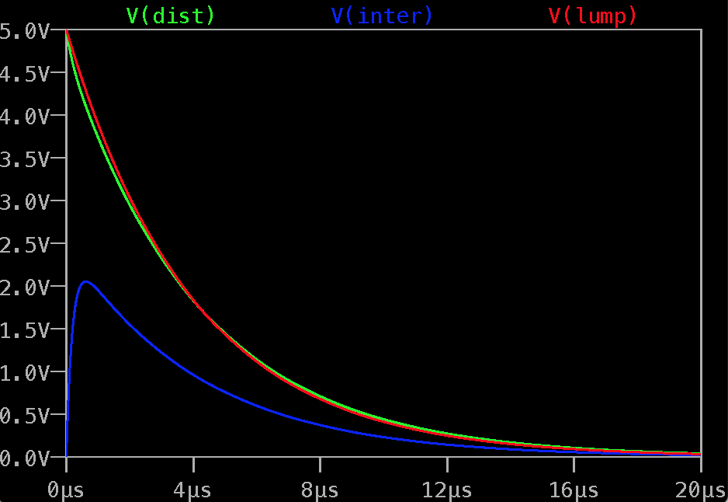
Quick aside to (LT)SPICE!

Slide 19
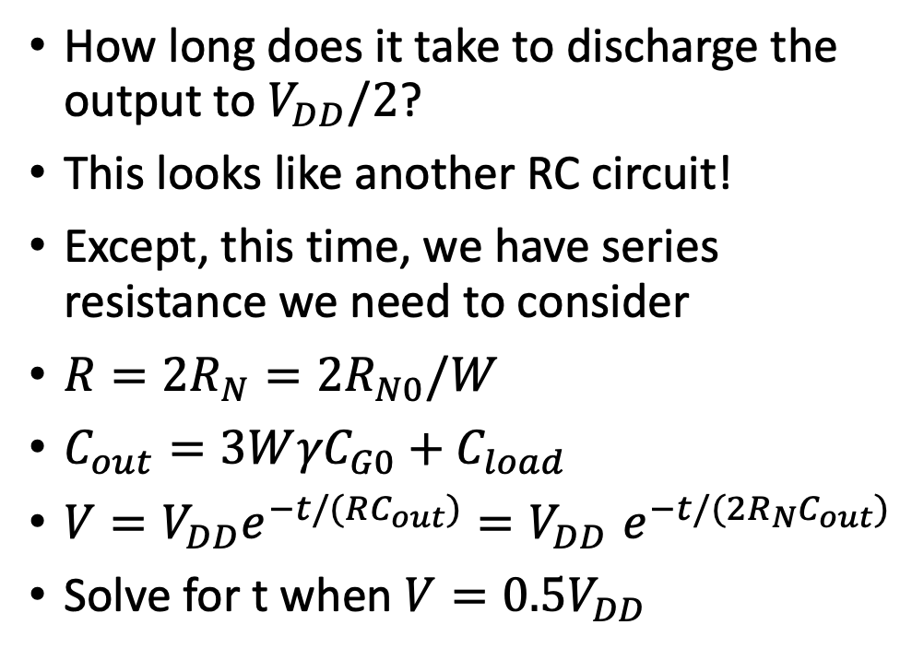
Discharge Time
How long does it take to discharge the output to $V_{DD}/2$?
This looks like another RC circuit!
Except, this time, we have series resistance we need to consider
$R=2R_{N}=2R_{N0}/W$
$C_{out}=3W{γC}_{G0}+C_{load}$
$V=V_{DD}e^{−t/(RC_{out})}{=V}_{DD}e^{−t/(2R_{N}C_{out})}$
Solve for t when $V=0.5V_{DD}$

Slide 20
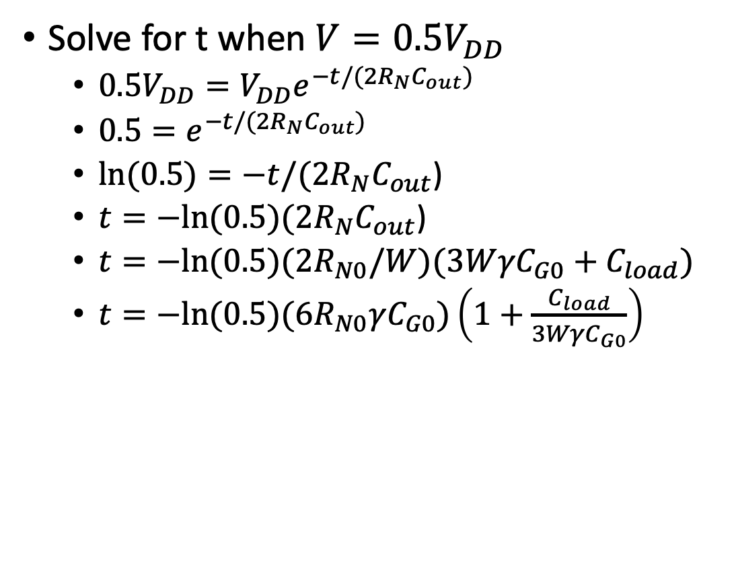
Discharge Time
Solve for t when $V=0.5V_{DD}$
$0.5V_{DD}=V_{DD}e^{−t/(2R_{N}C_{out})}$
$0.5=e^{−t/({2R}_{N}C_{out})}$
$\ln{(0.5)}=−t/({2R}_{N}C_{out}$)
$t=−ln⁡(0.5)({2R}_{N}C_{out}$)
$t=−ln⁡(0.5)(2R_{N0}/W)(3W{γC}_{G0}+C_{load})$
$t=−ln⁡(0.5)({6R}_{N0}γC_{G0})\left(1+\frac{C_{load}}{3WγC_{G0}}\right)$
Compared to the inverter, this term is 2x larger

Slide 21
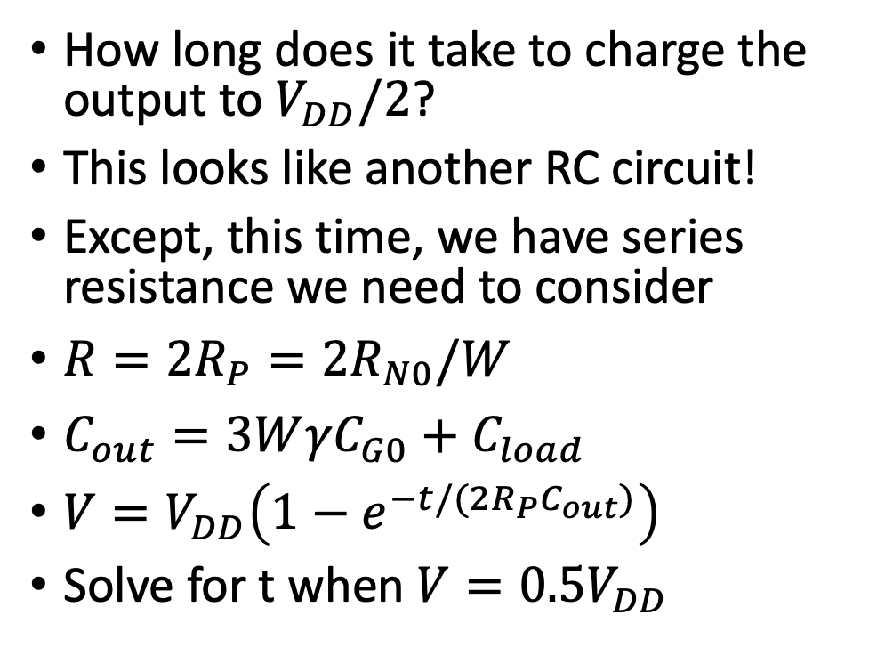
Charge Time
How long does it take to charge the output to $V_{DD}/2$?
This looks like another RC circuit!
Except, this time, we have series resistance we need to consider
$R=2R_{P}=2R_{N0}/W$
$C_{out}=3W{γC}_{G0}+C_{load}$
$V=V_{DD}\left(1−e^{−t/({2R}_{P}C_{out})}\right)$
Solve for t when $V=0.5V_{DD}$

Slide 22
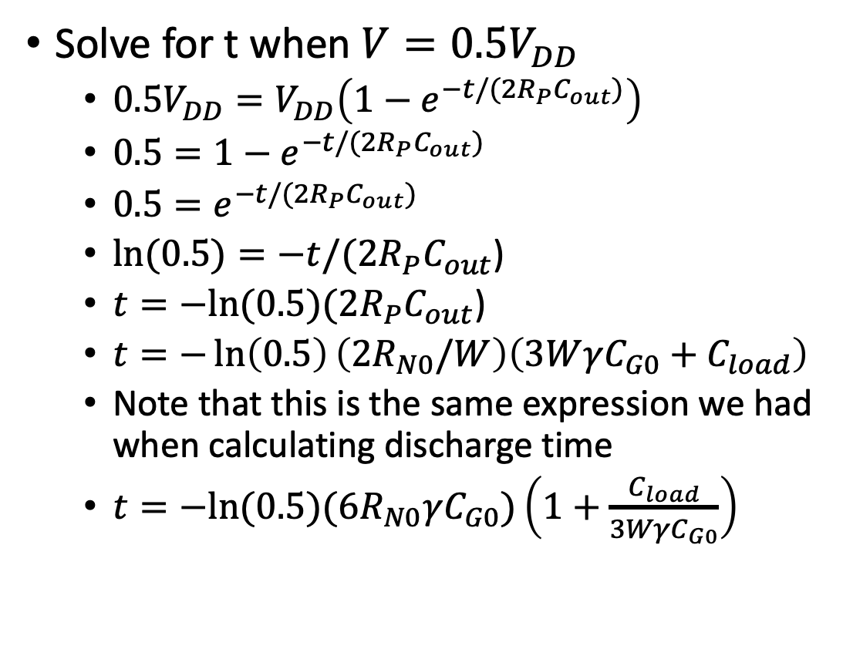
Charge Time
Solve for t when $V=0.5V_{DD}$
$0.5V_{DD}=V_{DD}\left(1−e^{−t/({2R}_{P}C_{out})}\right)$
$0.5=1−e^{−t/({2R}_{P}C_{out})}$
$0.5=e^{−t/({2R}_{P}C_{out})}$
$\ln{(0.5)}=−t/({2R}_{P}C_{out}$)
$t=−ln⁡(0.5)({2R}_{P}C_{out}$)
$t=−\ln\left(0.5\right)\left(2R_{N0}/W\right)\left(3W{γC}_{G0}+C_{load}\right)$
Note that this is the same expression we had when calculating discharge time
$t=−ln⁡(0.5)({6R}_{N0}γC_{G0})\left(1+\frac{C_{load}}{3WγC_{G0}}\right)$
Compared to the inverter, this term is 2x larger

