Slide 1
EECS151/251A Discussion 8
Christopher Yarp
Mar. 22, 2019

Slide 2
Plan for Today
Practice Problem
Your Questions

Slide 3
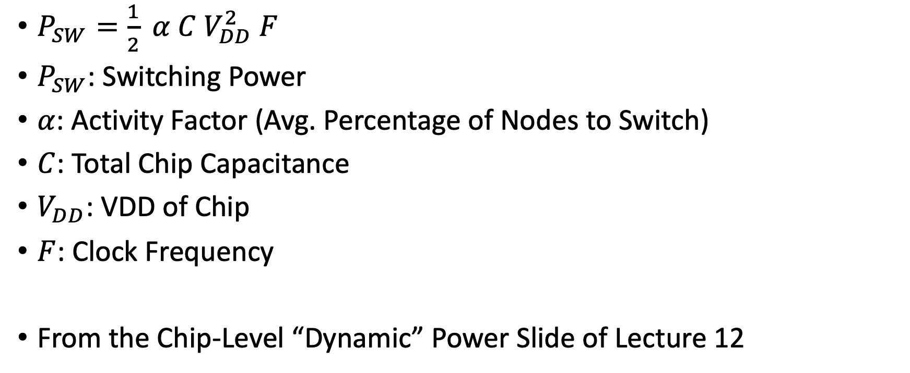
Quick Reminder about Dynamic Power
$P_{SW}=\frac{1}{2} α C V_{DD}^{2} F$
$P_{SW}$: Switching Power
$α$: Activity Factor (Avg. Percentage of Nodes to Switch)
$C$: Total Chip Capacitance
$V_{DD}$: VDD of Chip
$F$: Clock Frequency
From the Chip-Level “Dynamic” Power Slide of Lecture 12

Slide 4
Problem 1: Overclocking
Let us take a hypothetical CPU which nominally operates with a 3 GHz clock at a VDD of 0.9 V.
Let us assume that the VDD required to support a particular clock frequency can be approximated as the linear function VDD = 0.0002f + 0.3 where f is the clock frequency in MHz and VDD is in V.
Approximately what VDD is required to run the CPU at 4 GHz?
What is the ratio of active power dissipation between an overclocked CPU running at 4 GHz compared to the same CPU running at 3 GHz?

Slide 5

Problem 1(a): Finding New VDD
$V_{DD} = 0.0002f + 0.3$
$V_{DD} = 0.0002(4000) + 0.3$
$V_{DD} =1.1V$

Slide 6
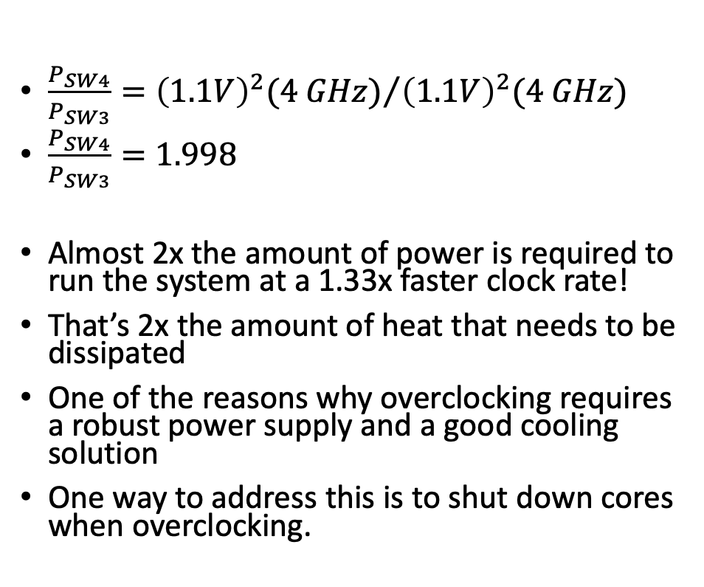
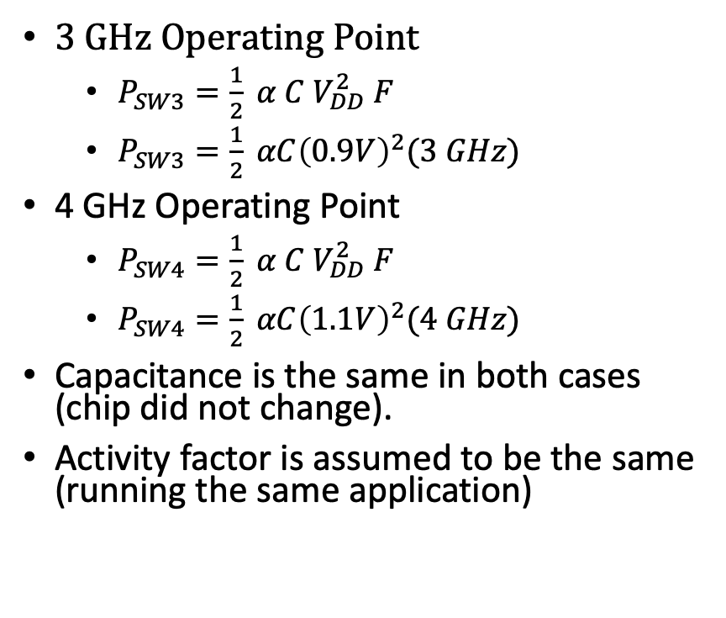
Problem 1(b): Power Ratio
3 GHz Operating Point
$P_{SW3}=\frac{1}{2} α C V_{DD}^{2} F$
$P_{SW3}=\frac{1}{2} αC{\left(0.9V\right)}^{2}(3 GHz)$
4 GHz Operating Point
$P_{SW4}=\frac{1}{2} α C V_{DD}^{2} F$
$P_{SW4}=\frac{1}{2} αC{\left(1.1V\right)}^{2}(4 GHz)$
Capacitance is the same in both cases (chip did not change).
Activity factor is assumed to be the same (running the same application)
$\frac{P_{SW4}}{P_{SW3}}={{\left(1.1V\right)}^{2}(4 GHz)}/{{\left(1.1V\right)}^{2}(4 GHz)}$
$\frac{P_{SW4}}{P_{SW3}}=1.998$
Almost 2x the amount of power is required to run the system at a 1.33x faster clock rate!
That’s 2x the amount of heat that needs to be dissipated
One of the reasons why overclocking requires a robust power supply and a good cooling solution
One way to address this is to shut down cores when overclocking.

Slide 7
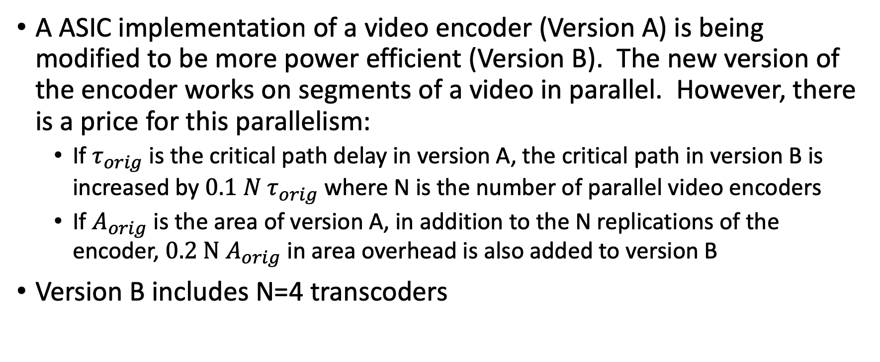
Problem 2: Parallelism for Lower Power
A ASIC implementation of a video encoder (Version A) is being modified to be more power efficient (Version B). The new version of the encoder works on segments of a video in parallel. However, there is a price for this parallelism:
If $τ_{orig}$ is the critical path delay in version A, the critical path in version B is increased by $0.1 N τ_{orig}$ where N is the number of parallel video encoders
If $A_{orig}$ is the area of version A, in addition to the N replications of the encoder, $0.2 N A_{orig}$ in area overhead is also added to version B
Version B includes N=4 transcoders

Slide 8
Problem 2: Parallelism for Lower Power
What is the new critical path length of version B?
If version B was run at the fastest rate possible and used all 4 of its encoders, how long would it take to transcode a video compared to version A? (Assume the required cycles to encode a video can be split evenly across the decoders)
Using all 4 transcoders, what clock rate is required to transcode a video in the same amount of time as version A?
What is the chip size of version B compared to version A?
How much power is consumed in version B as compared to version A when transcoding a video in the same amount of time (max rate of version A)?

Slide 9

Problem 2(a): New Critical Path Delay
${τ_{CPB}=τ}_{orig}+0.1\left(4\right)τ_{orig}$
${τ_{CPB}=1.4τ}_{orig}$
$τ_{CPB}≈1.4\left(333.3 ps\right)=466.7$
Fastest clk approx. 2.143 GHz

Slide 10
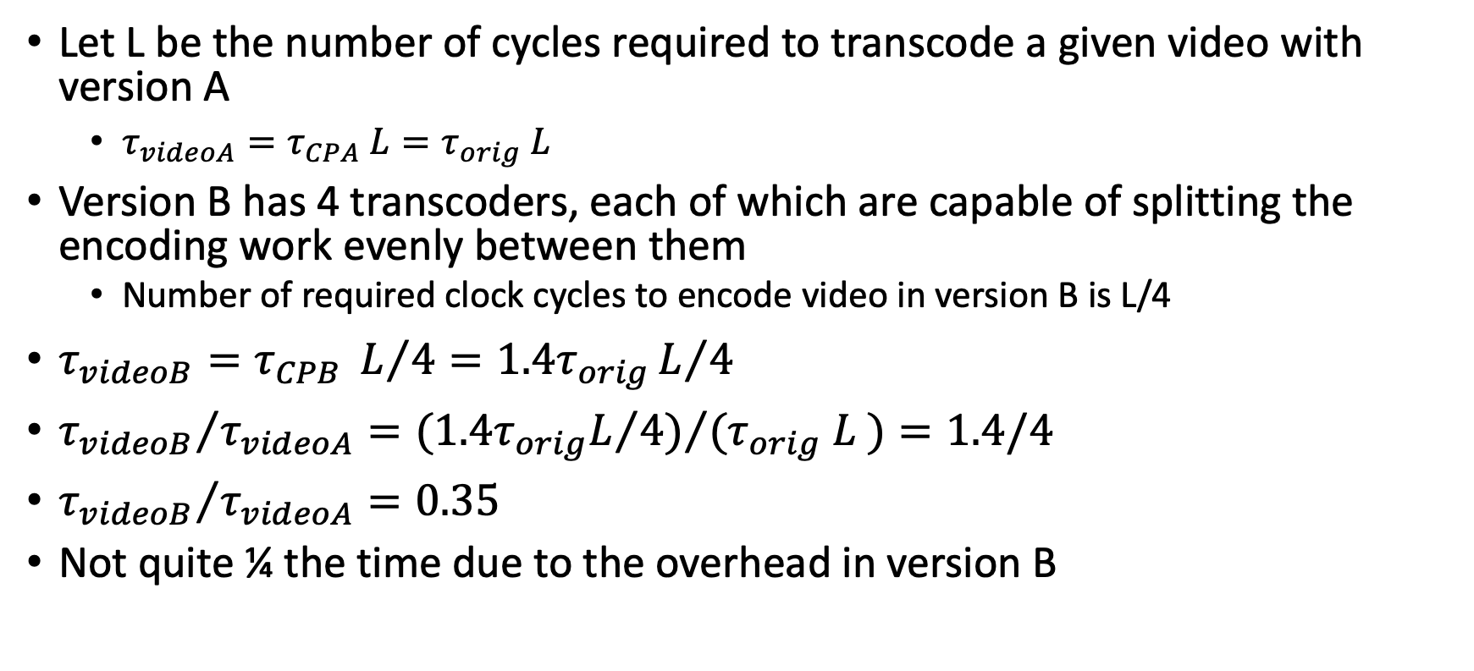
Problem 2(b): Transcode a Video at Full Speed
Let L be the number of cycles required to transcode a given video with version A
$τ_{videoA}=τ_{CPA} L=τ_{orig} L$
Version B has 4 transcoders, each of which are capable of splitting the encoding work evenly between them
Number of required clock cycles to encode video in version B is L/4
$τ_{videoB}=τ_{CPB} L/4={1.4τ}_{orig}L/4$
${τ_{videoB}}/{τ_{videoA}}={{(1.4τ}_{orig}L/4)}/{(τ_{orig} L )}=1.4/4$
${τ_{videoB}}/{τ_{videoA}}=0.35$
Not quite ¼ the time due to the overhead in version B

Slide 11
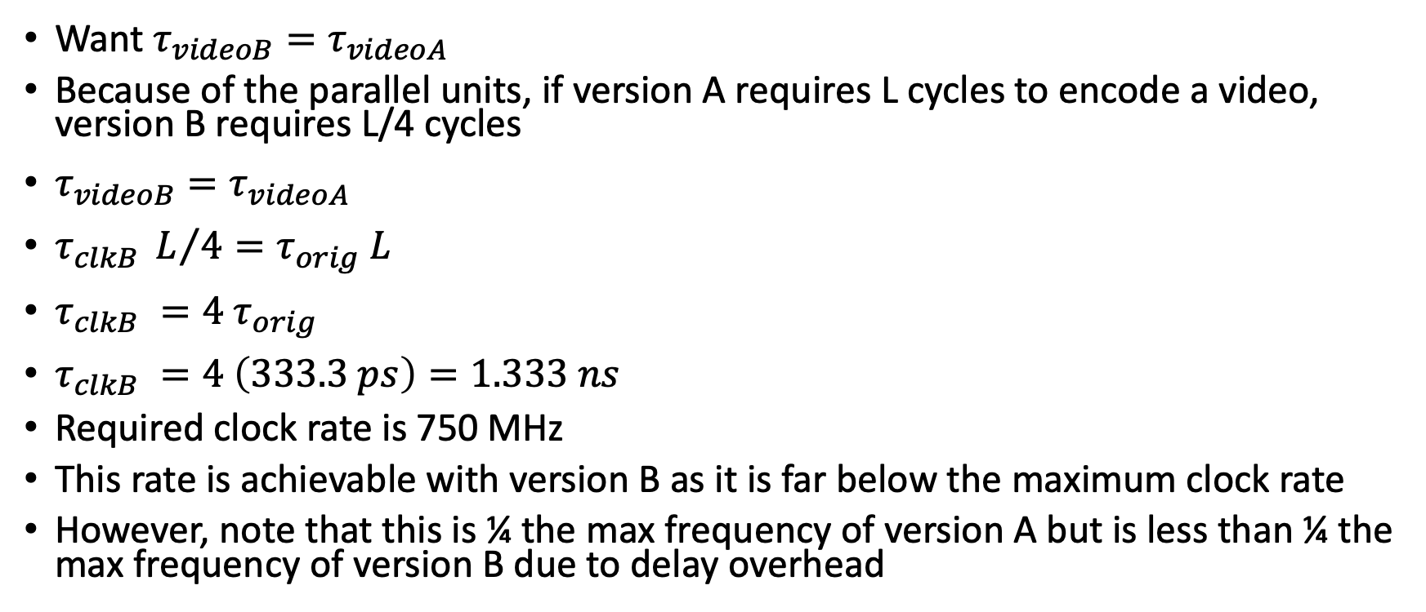
Problem 2(c): Slowing Clock Rate
Want $τ_{videoB}=τ_{videoA}$
Because of the parallel units, if version A requires L cycles to encode a video, version B requires L/4 cycles
$τ_{videoB}=τ_{videoA}$
$τ_{clkB} L/4=τ_{orig} L$
$τ_{clkB} =4 τ_{orig}$
$τ_{clkB} =4 \left(333.3 ps\right)=1.333 ns$
Required clock rate is 750 MHz
This rate is achievable with version B as it is far below the maximum clock rate
However, note that this is ¼ the max frequency of version A but is less than ¼ the max frequency of version B due to delay overhead

Slide 12
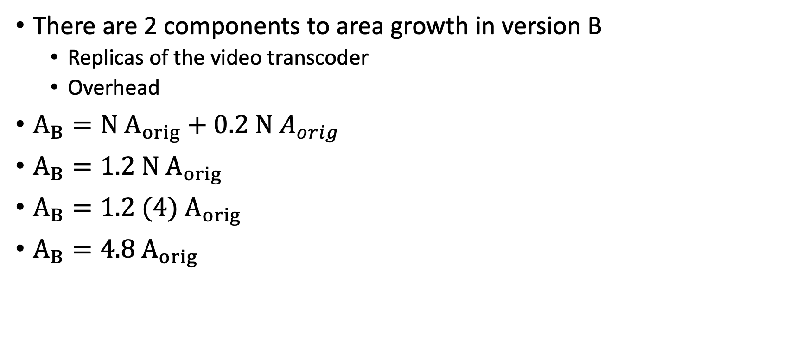
Problem 2(d): Chip Area
There are 2 components to area growth in version B
Replicas of the video transcoder
Overhead
$A_{B}={N A}_{orig}+0.2 N A_{orig}$
$A_{B}={1.2 N A}_{orig}$
$A_{B}={1.2 (4) A}_{orig}$
$A_{B}={4.8 A}_{orig}$

Slide 13
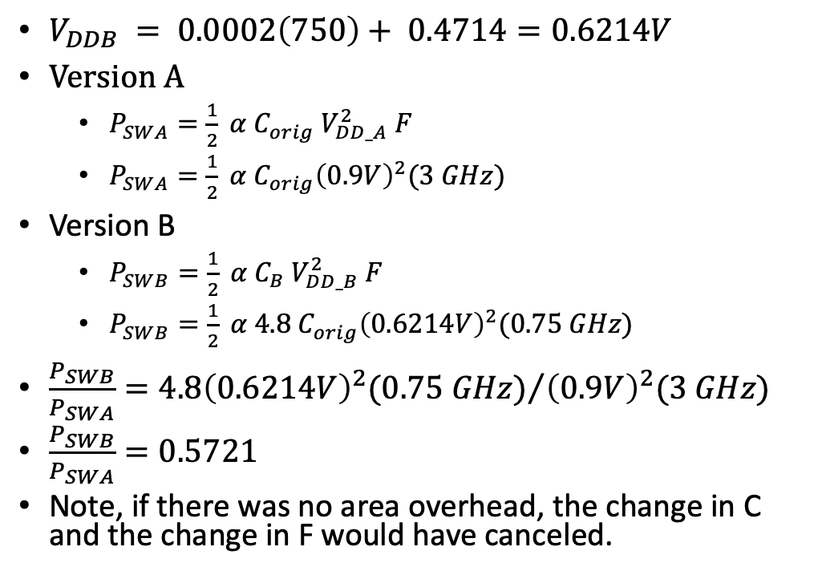
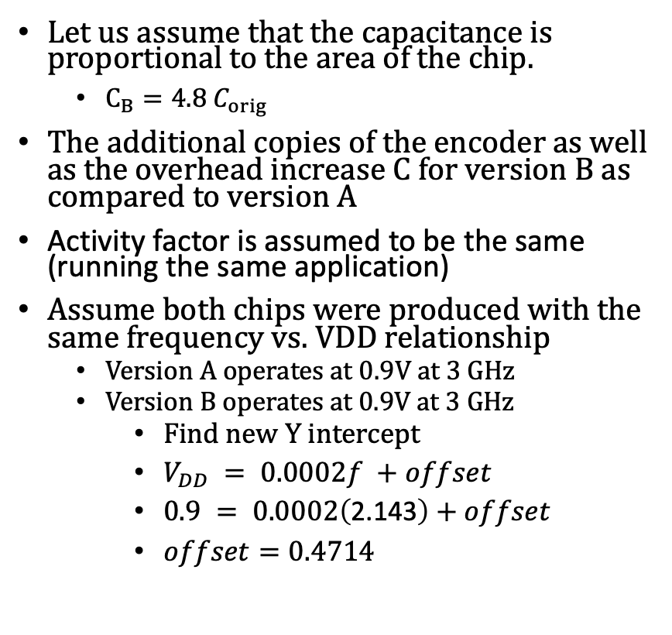
Problem 2(e): Dynamic Power Consumption
Let us assume that the capacitance is proportional to the area of the chip.
$C_{B}={4.8 C}_{orig}$
The additional copies of the encoder as well as the overhead increase C for version B as compared to version A
Activity factor is assumed to be the same (running the same application)
Assume both chips were produced with the same frequency vs. VDD relationship
Version A operates at 0.9V at 3 GHz
Version B operates at 0.9V at 3 GHz
Find new Y intercept
$V_{DD} = 0.0002f +offset$
$0.9 = 0.0002\left(\text{2.143}\right)+offset$
$offset=0.4714$
$V_{DDB} = 0.0002\left(750\right)+ 0.4714=0.6214V$
Version A
$P_{SWA}=\frac{1}{2} α C_{orig} V_{DD_A}^{2} F$
$P_{SWA}=\frac{1}{2} α C_{orig}{\left(0.9V\right)}^{2}(3 GHz)$
Version B
$P_{SWB}=\frac{1}{2} α C_{B} V_{DD_B}^{2} F$
$P_{SWB}=\frac{1}{2} α 4.8 C_{orig}{\left(0.6214V\right)}^{2}(0.75 GHz)$
$\frac{P_{SWB}}{P_{SWA}}={{4.8\left(0.6214V\right)}^{2}(0.75 GHz)}/{{\left(0.9V\right)}^{2}(3 GHz)}$
$\frac{P_{SWB}}{P_{SWA}}=0.5721$
Note, if there was no area overhead, the change in C and the change in F would have canceled.

