Slide 1
EECS 151/251 A Discussion 8: Midterm Concept Review
March 8, 2024
Kevin Anderson (he/him)

Slide 2
Overview
GSIs have not seen the midterm so we know nothing! Do not ask us questions!
This review was created to cover important topics
Review composed of two parts

Slide 3
Part 1: Circuitry
Transistors (Layout)
CMOS Static Circuits
FPGA LUTs and Interconnect
KMap

Slide 4
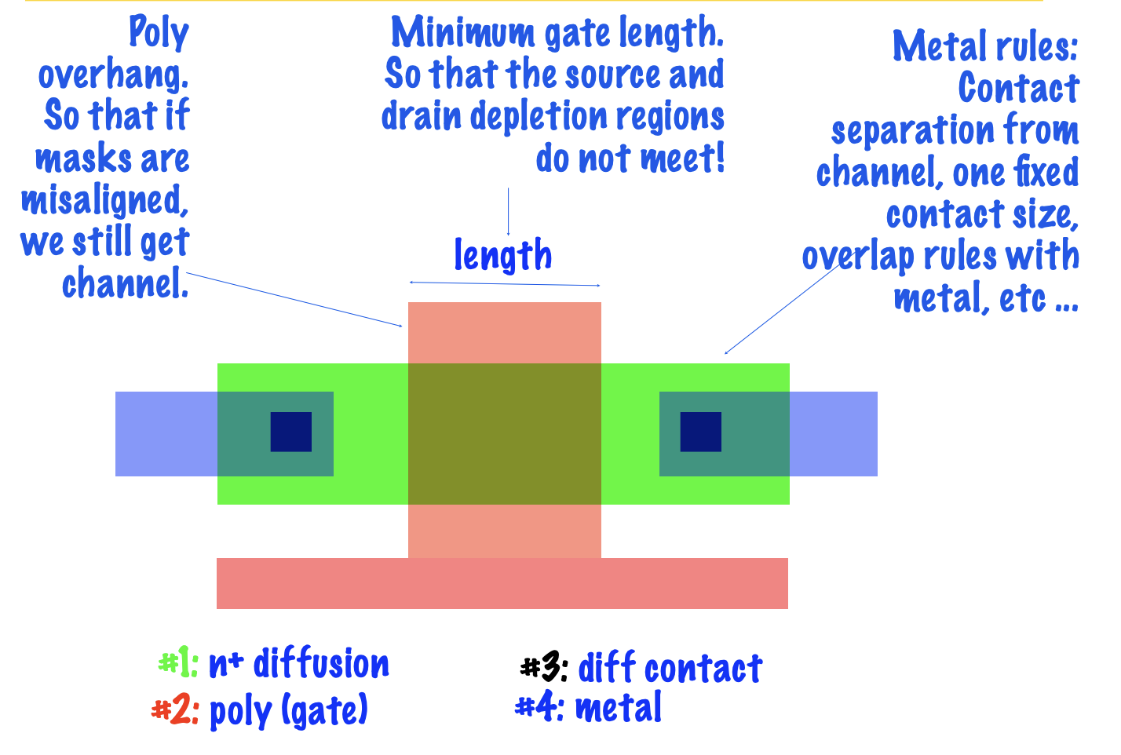
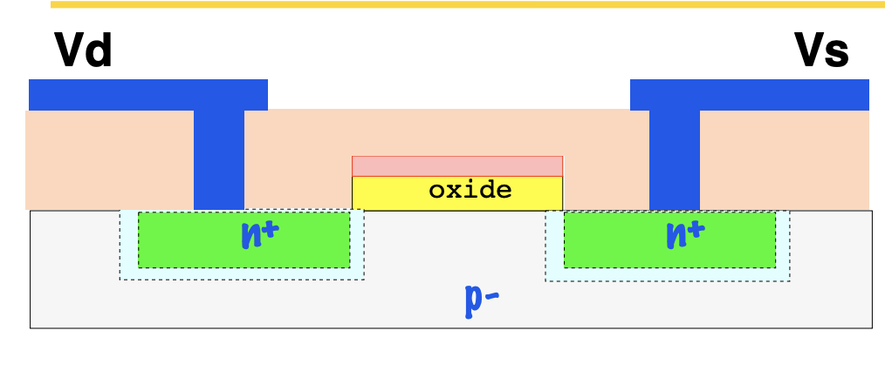
Circuit Layouts
A layout is a top-down view of a transistor. It is another perspective of transistor
Polysilicon represents the gate
Boxes with or without X represents via
Planar CMOS Transistor Cross Section:

Slide 5
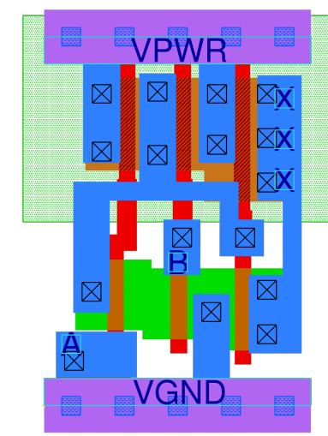
Circuit Layouts
This is a NAND gate
Steps:
Identify transistors
Separate PUN and PDN
Look at transistors connected to rails
Find shared diffusion regions and metal with via to discover inter-transistor connections

Slide 6
Static CMOS Circuits
PUN and PDN with single output
Transistors in series represents a logical AND
Transistor in parallel represents a logical OR
PUN and PDN are duals; Boolean expression is the negation of the other
Also simplify Boolean expression before drawing circuit

Slide 7
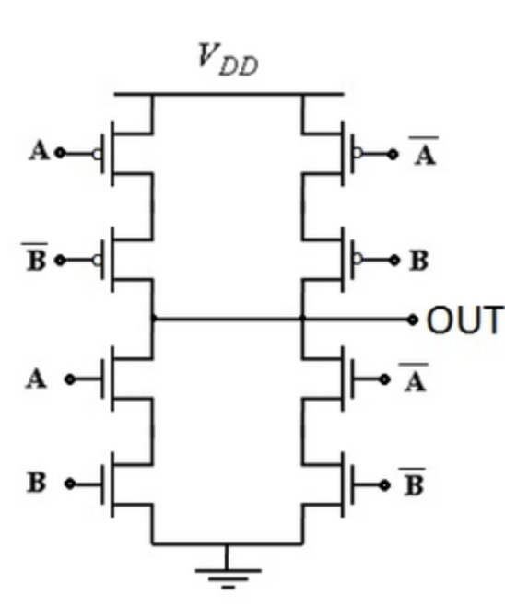
Static CMOS Circuits
Let’s write the Boolean expression for this circuit:
On your own, draw the circuit for an XNOR:

Slide 8
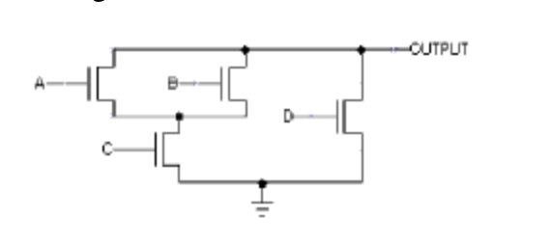
Static CMOS Circuits
What part of the static CMOS circuit is this?
Draw the other half of the CMOS circuit

Slide 9
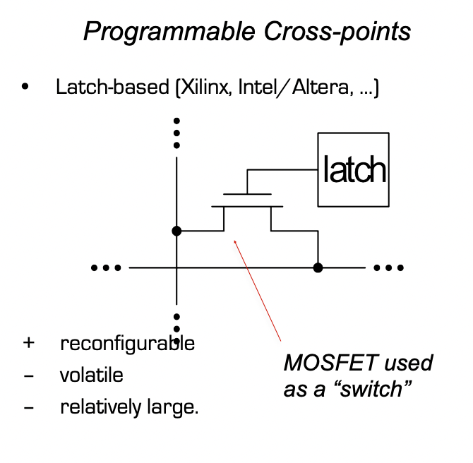
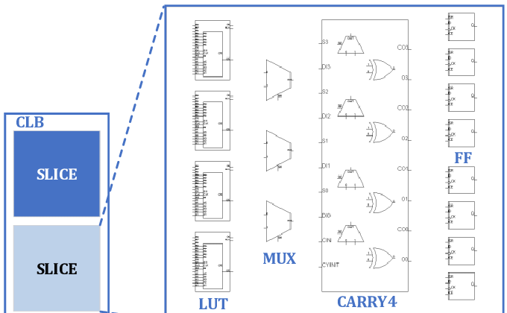
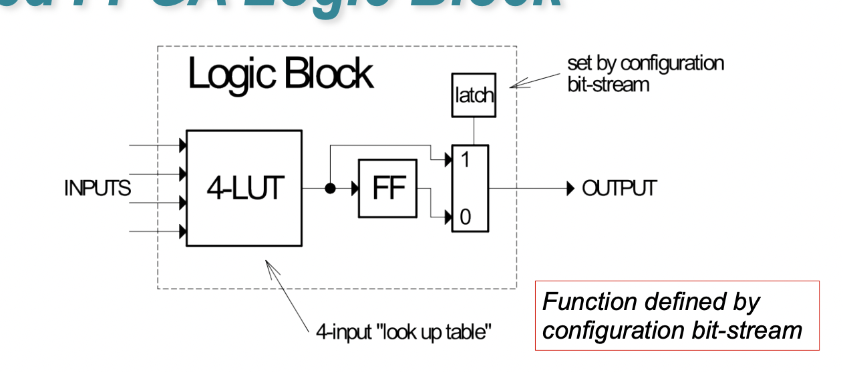
FPGA
FPGAs is a configurable HW platform (i.e. not fixed function)
The configurability comes from the interconnect and LUT
Xilinx Logic Element Hierarchy: LUTs -> Slice -> CLBs
Interconnect has latches to connect CLBs together
There are no gates in an FPGA
How many logical expressions can a LUT-X hold?
Simplified interconnect latch
Simplified LUT-4
Xilinx Series 7 CLB architecture

Slide 10
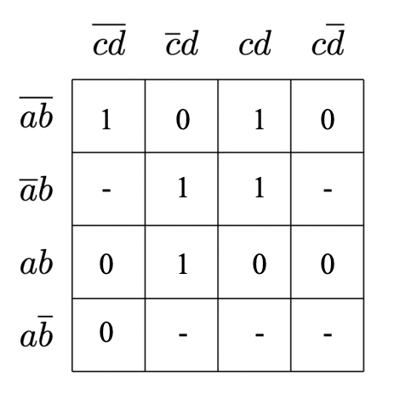
Karnaugh Map
Write the optimal SOP and POS:

Slide 11
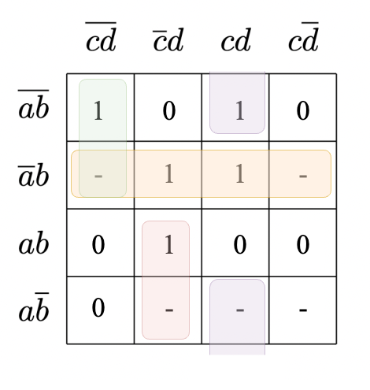
Karnaugh Map
All KMaps must be Gray coded
Write the optimal SOP and POS:
SOP:

Slide 12
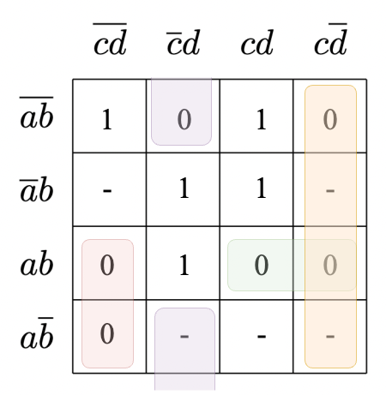
Karnaugh Map
All KMaps must be Gray coded
Write the optimal SOP and POS:
POS:

Slide 13
To-Know
Boolean Algebra
Cost Analysis (NRE and Recurring Cost)
NMOS and PMOS
CMOS Fabrication Process
CMOS Circuits for Common Logic Gates (NAND and INV)
FPGA vs ASIC
PMOS weak pull down, NMOS weak pull up
Timing diagram

Slide 14
Part 2: Verilog and Blocks
Positive-Edge FF
Finite State Machines
Verilog Basics
Verilog Advanced

Slide 15
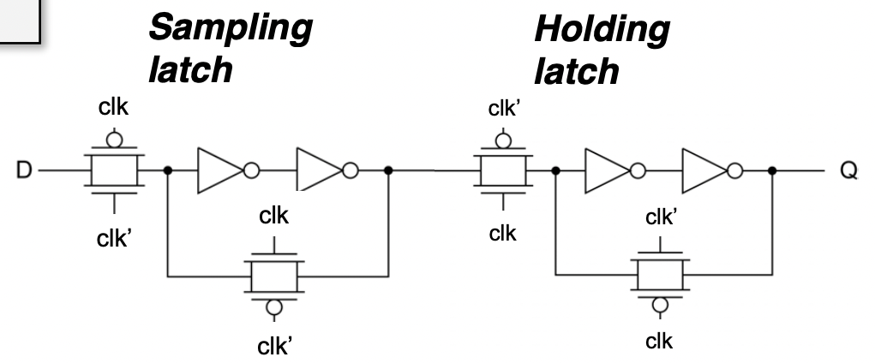
Positive Edge Flip-Flop
Flip-flop is composed of two latches
Transmission gates orchestrate exchange between latches

Slide 16
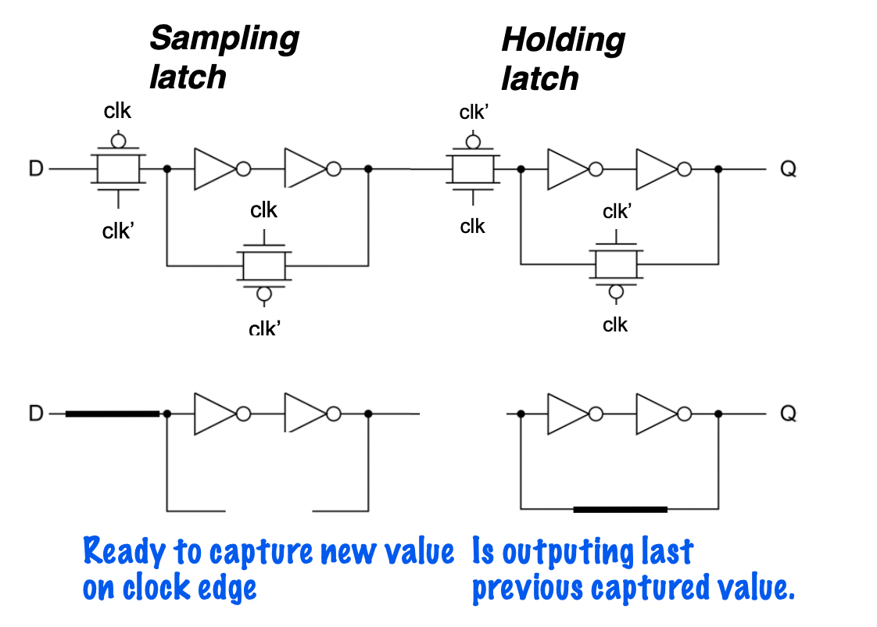
Positive Edge Flip-Flop
What is the clock state represented by the figure below?

Slide 17
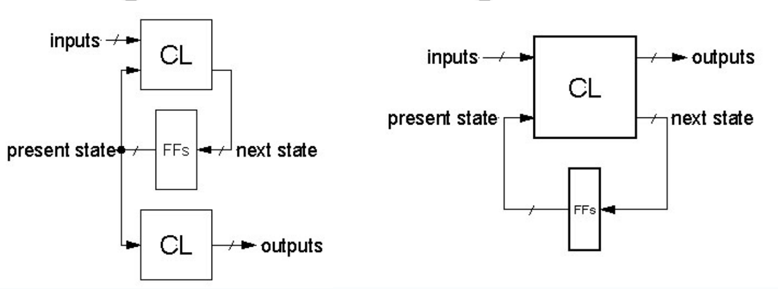
Finite State Machines
Mealy vs Moore
One-hot vs Binary vs BCD Encoding
BCD not really used for FSMs, but good to know the encoding
Gray Coding and Hamming Distance (for Binary and BCD only)
State Diagrams
Idle state
Transitions without conditions taken on following cycle always. Transitions with condition taken on cycle when condition is met
Outputs that change on transition are Mealy. Outputs that change within state are Moore. If outputs change on both, then it’s a mixture of both
Conceptual diagram of Mealy
Conceptual diagram of Moore

Slide 18
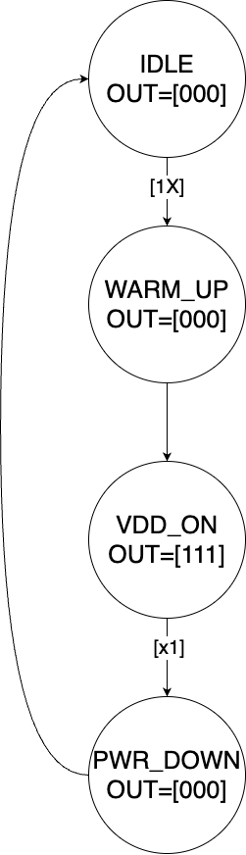
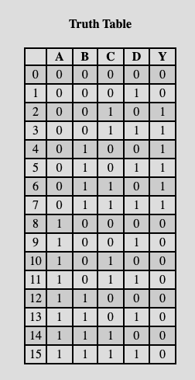

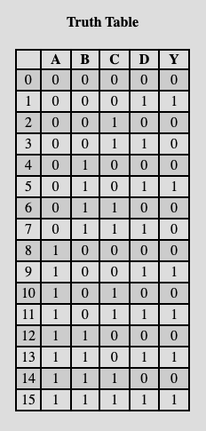

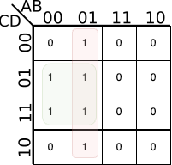
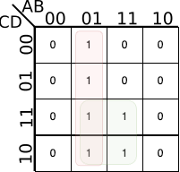
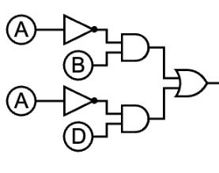
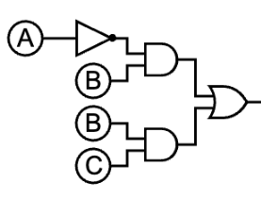
Finite State Machines
Verilog FSM from discussion 5
State LSb
State MSb
SOP:
SOP:

Slide 19
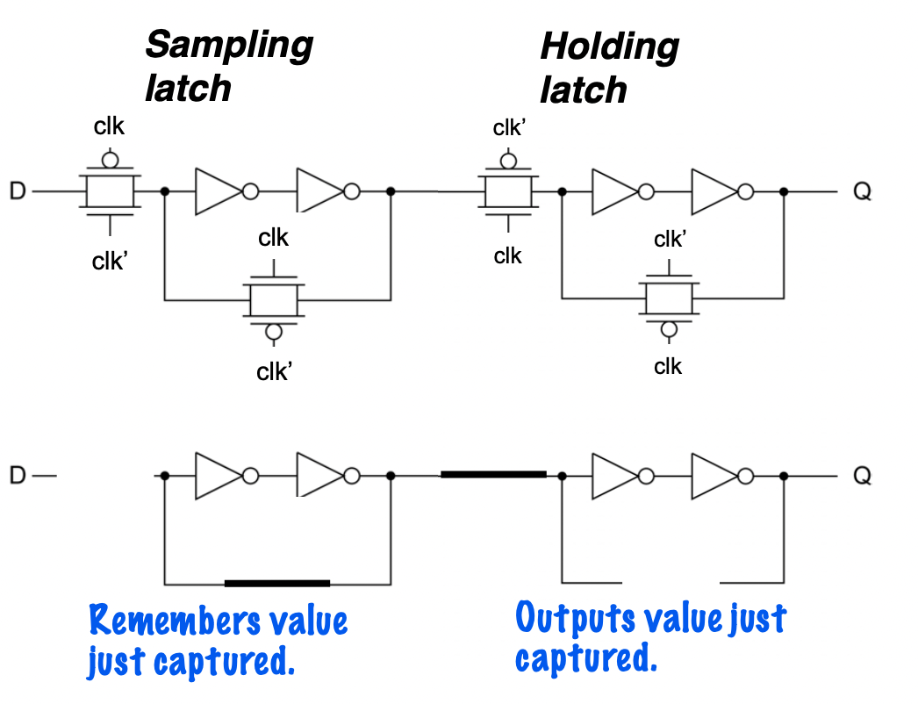
Positive Edge Flip-Flop
What is the clock state represented by the figure below?

Slide 20
Verilog Basics
No register inference!
wire used in continuous assignment
reg used in procedural assignment
case statement for FSMs
Use named ports for instantiation
Width matters!!
e.x. wire [1:0] tmp; assign tmp = 4;

Slide 21
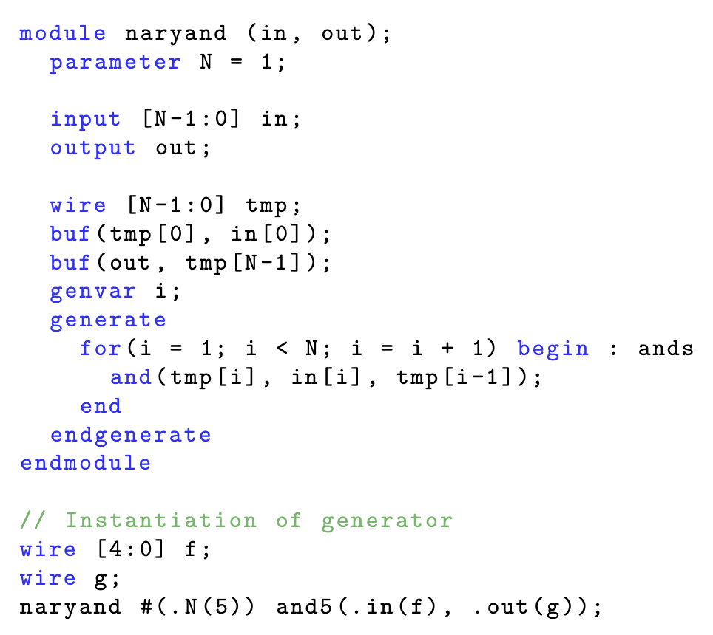
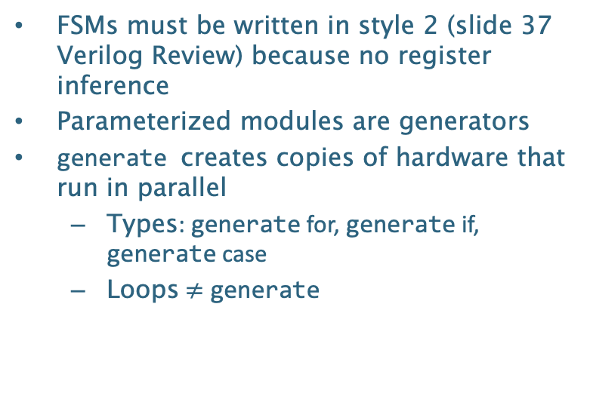
Verilog Advanced
FSMs must be written in style 2 (slide 37 Verilog Review) because no register inference
Parameterized modules are generators
generate creates copies of hardware that run in parallel
Types: generate for, generate if, generate case
Loops $≠$ generate
Example:

Slide 22
To-Know
Transmission Gates
Tri-state buffer vs Tri-state inverter
Create state diagram from word problem
Continuous Assignments and Procedural Assignments
Ternary Operator
Labelling state diagram
Shift Register in Verilog

