Slide 1
EECS 151/251 A Discussion 10
March 22, 2024

Slide 2
Content
Questions with common mistakes:
Q3
Q5
Q6
Q11

Slide 3
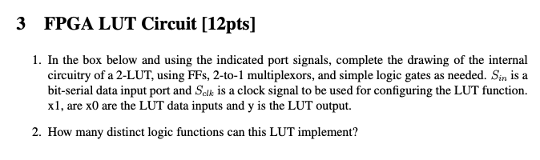
Question 3

Slide 4
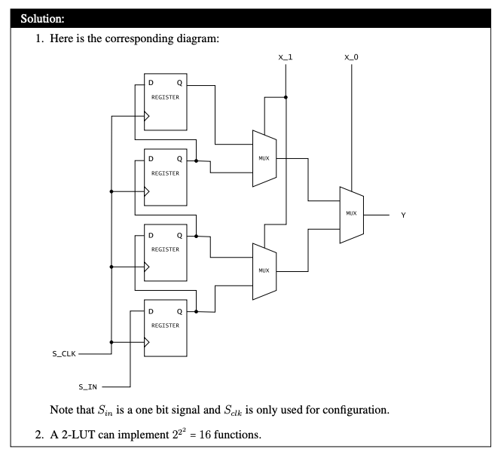
Question 3

Slide 5
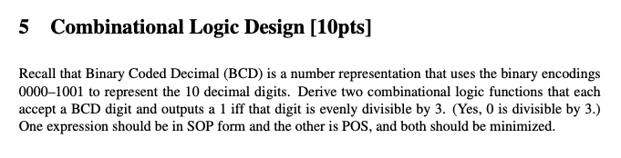
Question 5

Slide 6
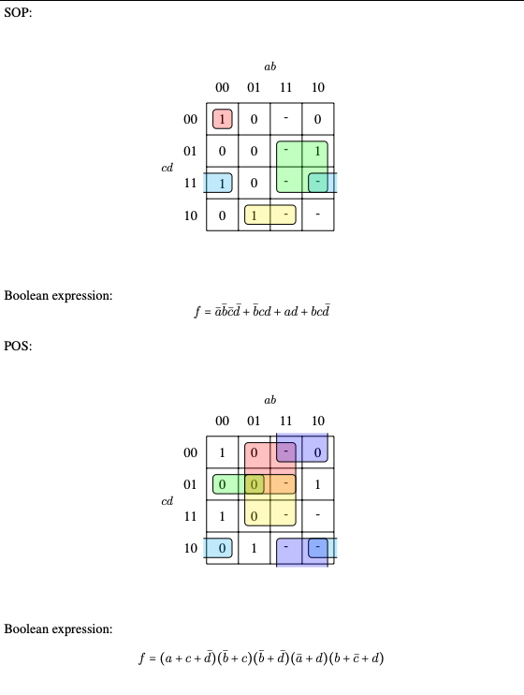
Question 5

Slide 7
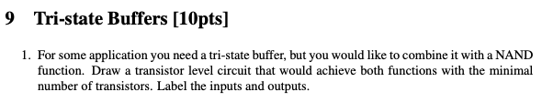
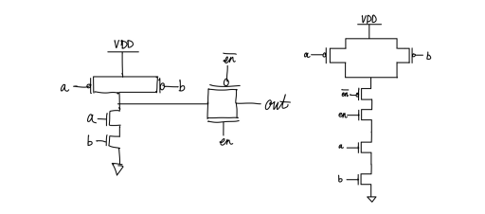
Question 9

Slide 8
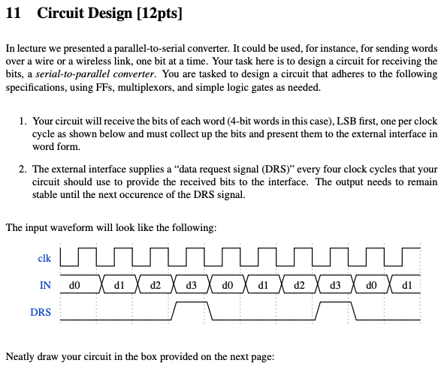
Question 11

Slide 9
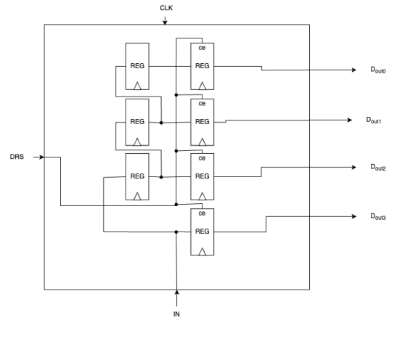
Question 11

Slide 10
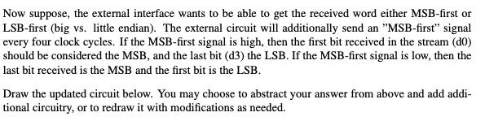
Question 11

Slide 11
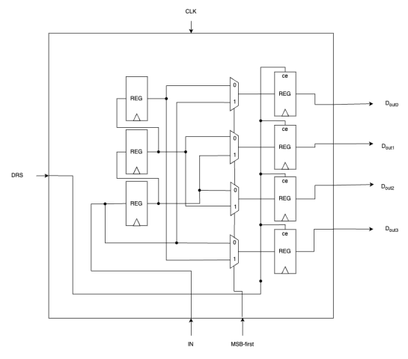
Question 11

